Slide 1

Graduation Project II
Evaluation of the Water Distribution System for the NW Pressure Zone in Nablus City
December 21, 2017
By :
Ahmad Alkateeb
Belal Abu Hani
Bilal Kababji
Hisham Saleh
Supervisor:
Dr.Hamees Tubeileh

Slide 2
Project Outline
Introduction.
Study area.
Existing situation.
Water Consumption Types.
Future water gap.
Analysis of water distribution network and modifying it to meet 2031 demand .
Alternative solutions to fill the gap.
Discussion and Recommendation.

Slide 3
Introduction
Project objectives
Significance of the work

Slide 4
Project objectives
To analyze and evaluate the existing water network and resources system.
Determine the water gap.
Estimate the consumption types
Developments in water resources and conveyance system will be estimated and analyzed for different design periods based on the future needs.
Study any alternative solutions to satisfy the water gap.

Slide 5
Significance of the work
After a visit to the water department in Nablus Municipality, the engineers pointed out some problems in the northern western pressure zone, as high water losses which reach about 30% and pressure problems in the high regions.

Slide 6
Study area.
  Geographical location
  Population
  Area
  Topography
  Background of water resources
  Pressure zones

Slide 7
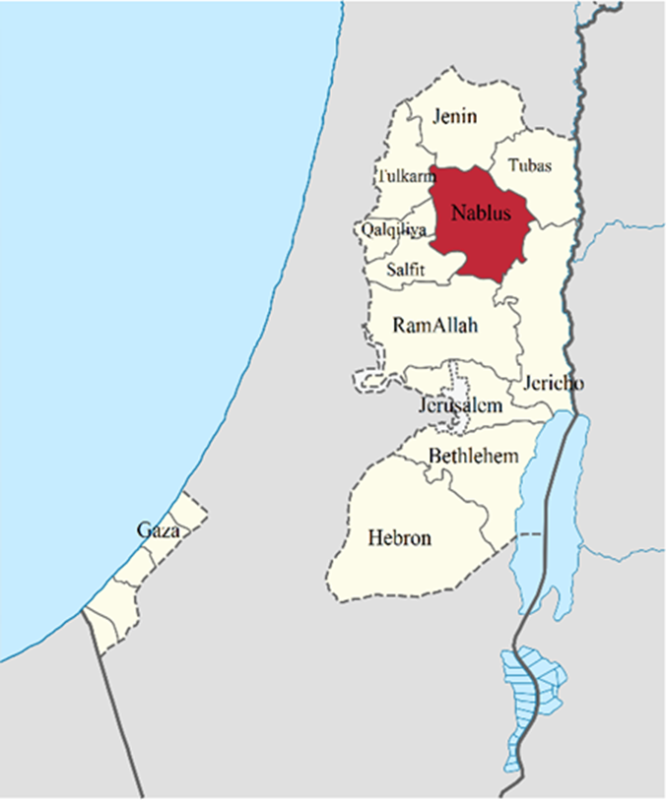
  Geographical location
Approximately 63 kilometers north of Jerusalem, 114 km away from the Jordanian capital Amman and 42 km away from the Mediterranean Sea.

Slide 8
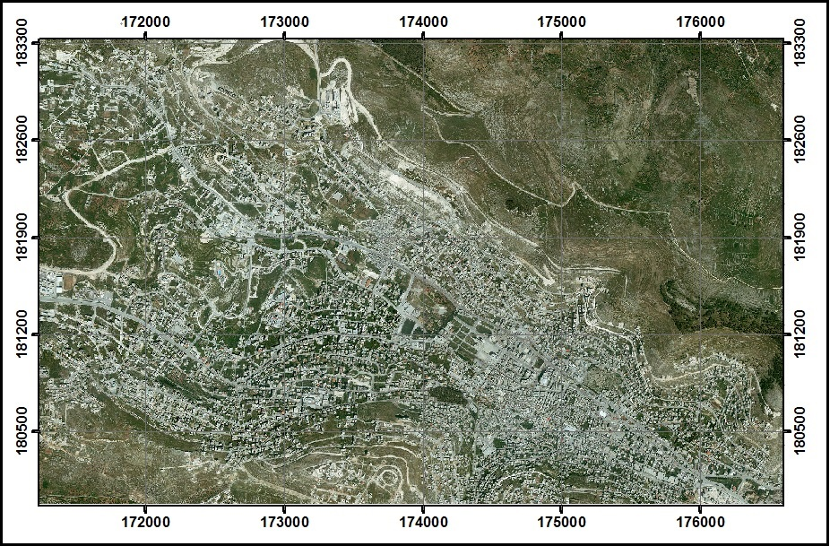
Location according to
Palestine 1923 Grid .
  Geographical location

Slide 9
Population
According to the recent estimates of the Palestinian Statistics, the total population of Nablus governorate is estimated at 348,023 inhabitants. While Nablus city population including
the refugee camps is 170,069.

Slide 10
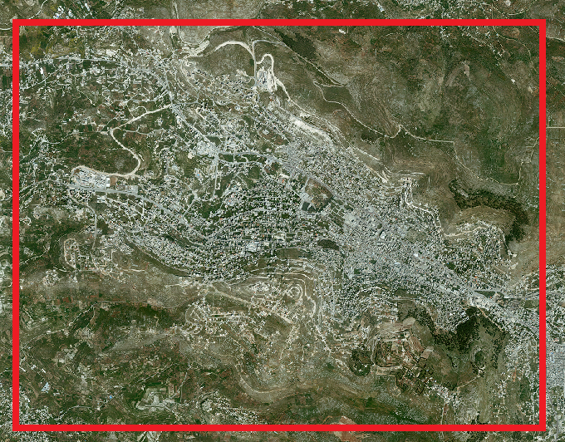
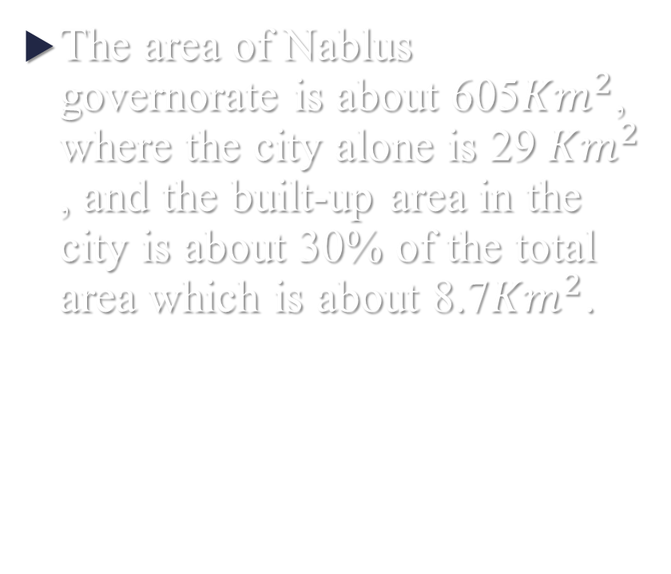
  Area
The area of Nablus governorate is about 605${Km}^{2}$, where the city alone is 29${Km}^{2}$ , and the built-up area in the city is about 30% of the total area which is about 8.7${Km}^{2}$.

Slide 11
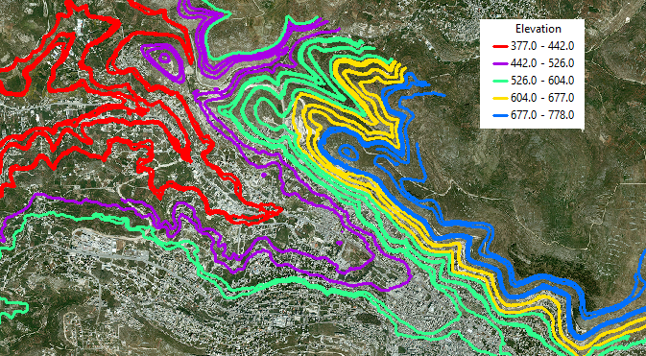
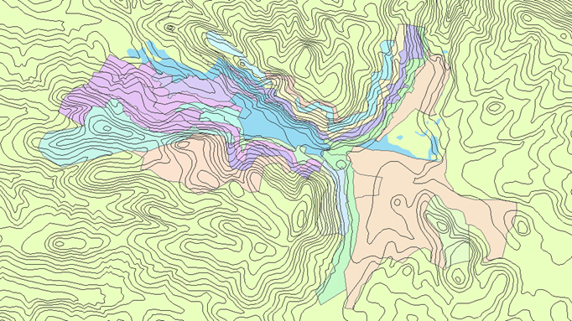
Topography
The highest point reaches 918m above sea level at Ebal Mountain.
The lowest elevation is 349m below sea level at the southeast corner of the district.

Slide 12
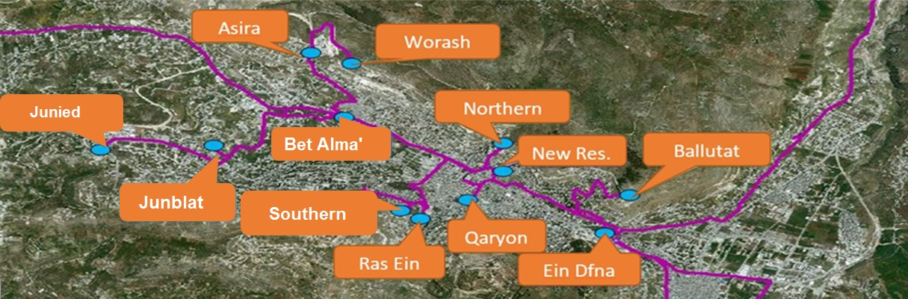
Background of water resources
There are two types of resources in Nablus, wells and springs, also 12 reservoir

Slide 13
Pressure zones
Nablus city is divided into six pressure zones due to:
The large area.
The mountainous topography.
High population of the city.
Easy to deal with.

Slide 14
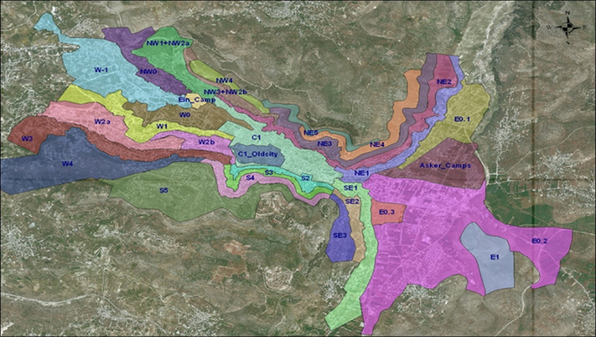

•Northeast pressure zone (NE)
•Northwest pressure zone (NW).
•Southern pressure zone (S).
•Central pressure zone (C).
•Eastern pressure zone (E).
•Western pressure zone (W).

Slide 15
Existing situation.
Reservoirs.
The Northwest pressure zone.

Slide 16
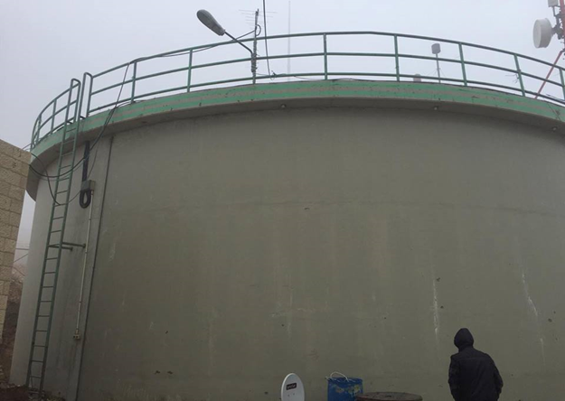
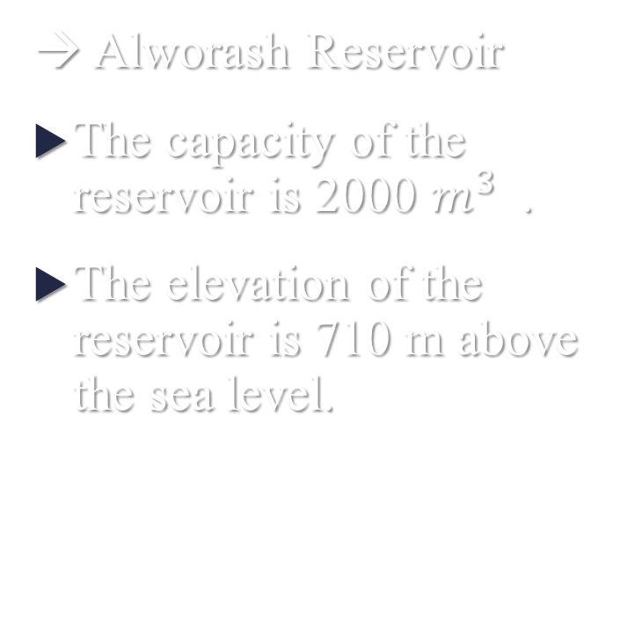
Reservoirs
→ Alworash Reservoir
The capacity of the reservoir is 2000 $m^{3}$.
The elevation of the reservoir is 710 m above the sea level.

Slide 17
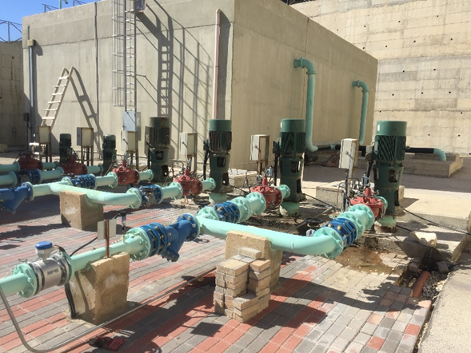

Reservoirs
→Asira Reservoir
The elevation of the reservoir is 570m AMSL.
It has a capacity of 750 $m^{3}$

Slide 18
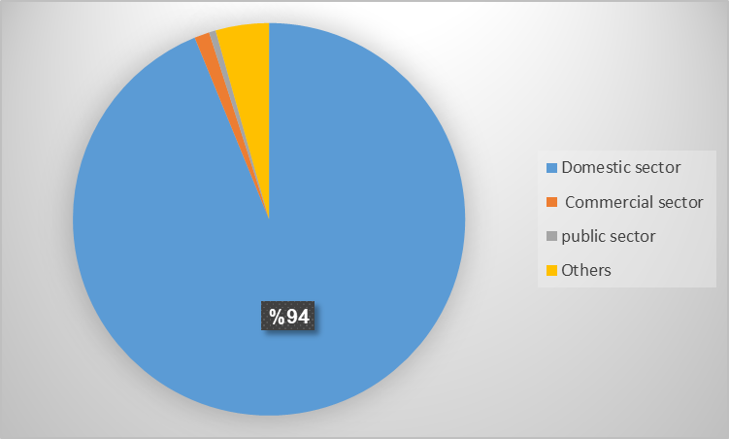
Water Consumption Types
First: Domestic sector
Second: Commercial sector
Third: Public sector
Forth: Others

Slide 19
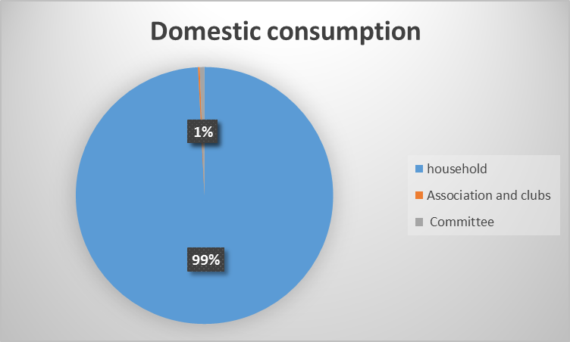
First: Domestic sector
Domestic Sector | # of meters
Household | 2973
Association and clubs | 17
Committee | 7
Total | 2997

Slide 20
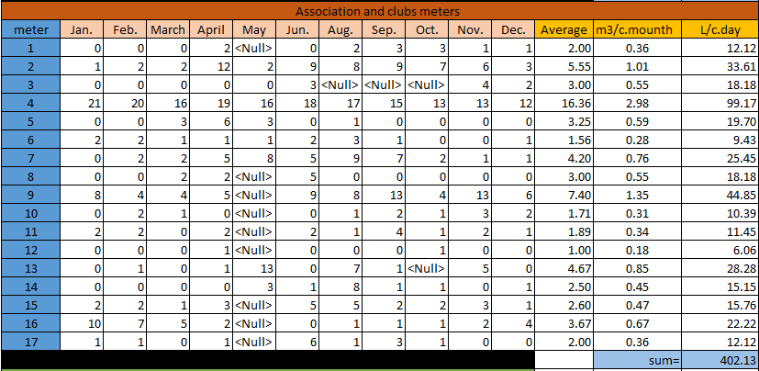

Slide 21

First: Domestic sector
The summation of all the meters reading = $211446.1078+546.2+402.12$
= 212394.427 L/c.day
The average of all the readings = $\frac{summation of all meter readings }{number of meters}$
Domestic water consumption = $\frac{212394.427}{2973+7+17}$ = 70.86 L/c.day
Water consumption = $\frac{70.86}{0.94}$ =
75.4 L/c.day

Slide 22
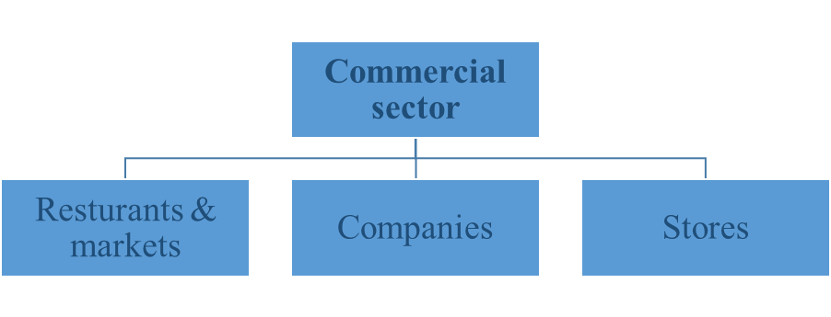
Second: Commercial sector
Commercial Sector | # of meters
Restaurants & markets | 18
Companies | 2
Stores | 16
Total | 36

Slide 23
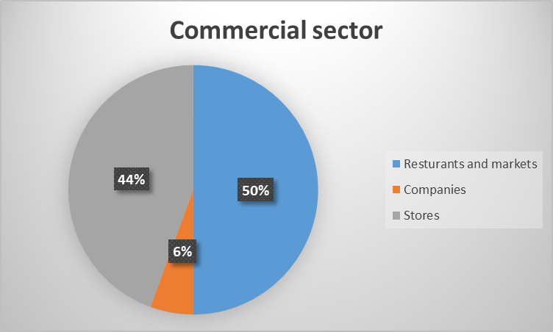
Second: Commercial sector
Each part of the commercial sector had a percentage as shown

Slide 24
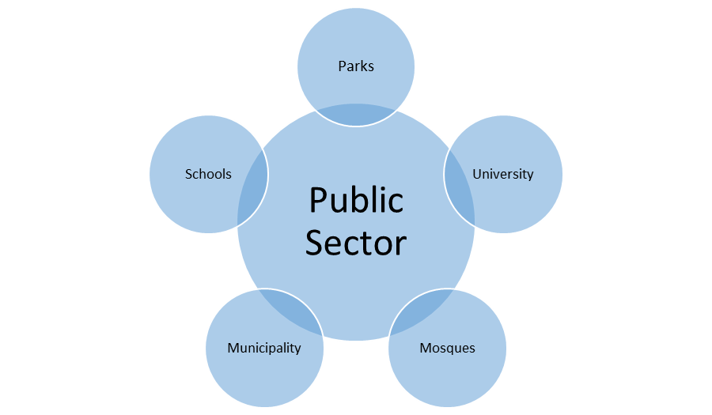
Third: Public sector

Slide 25
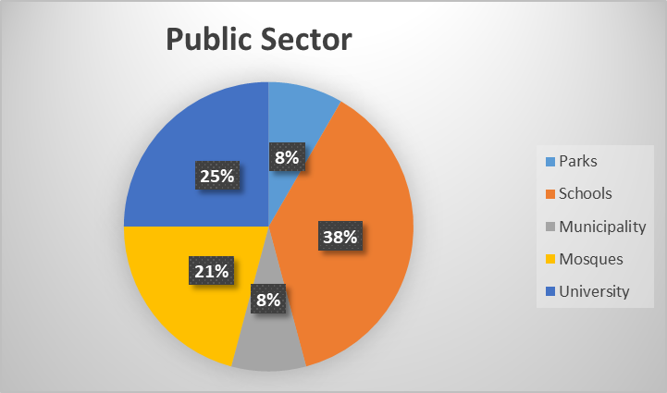
Third: Public sector
Public Sector | # of meters
Parks | 2
Schools | 9
Municipality | 2
Mosques | 5
University | 6
Total | 24

Slide 26
Forth: Others
There were almost 151 meters that didn’t have any reading during the whole year and this can be explained that these meters are new and there is no consumption in them.

Slide 27
The Northwest pressure zone (NW)
Distribution areas
Population
Water Loss
Demand
Water Gap

Slide 28
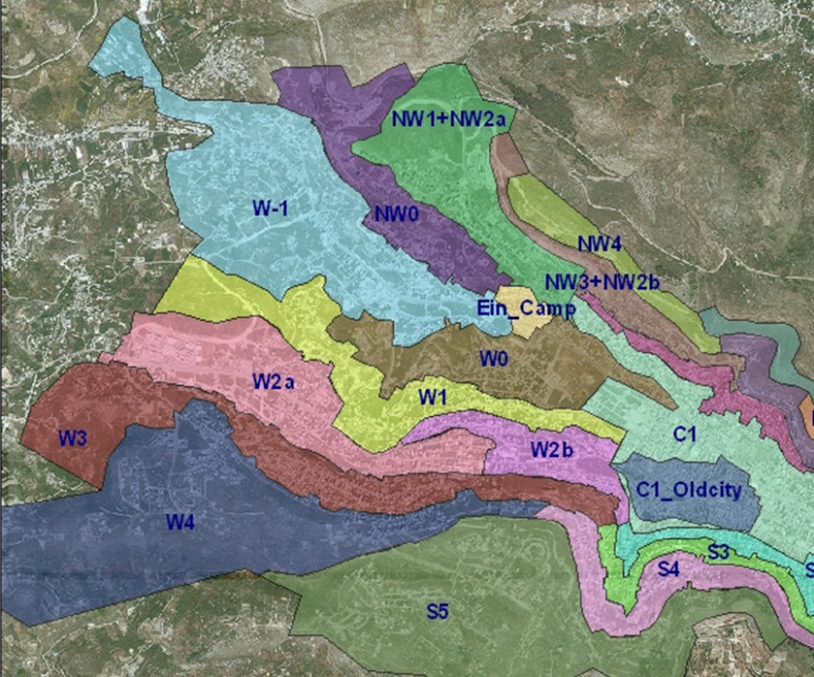
The Northwest pressure zone (NW)
Divided into the following distribution areas:
NW0
NW1
NW2
NW3

Slide 29
The Northwest pressure zone (NW)
 | Highest point | Lowest point | Pumping / gravity
NW0 | 548 | 440 | Gravity
NW1+NW2a | 630 | 477 | Pumping
NW3+NW2b | 697 | 545 | Gravity
Pressure zone | Service Area
NW0 | The region of al Ma'ajeen
NW1+NW2a | Asira Street
NW3+NW2b | Al-Ethad Street

Slide 30
The Northwest pressure zone (NW)
Population
Pressure Zone | Number of customers(meters) | Population 2016 | Forecasted Population in 2025 | Growth rate (%)
NW0 | 861 | 4736 | 6936 | 4.33
NW1+NW2a | 1685 | 9268 | 10852 | 1.77
NW3+NW2b | 678 | 3729 | 5445 | 4.3

Slide 31
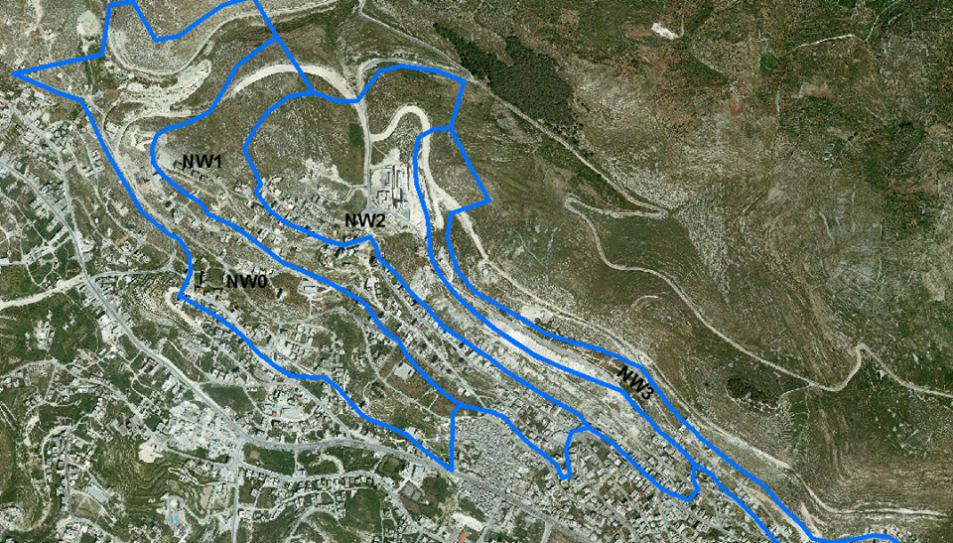

Slide 32

Population
The population for each zone can be calculated every three years as shown in Table :
 | 2016 | 2019 | 2022 | 2025 | 2028 | 2031
NW0 | 4736 | 5378 | 6108 | 6936 | 7876 | 8944
NW1+NW2a | 9268 | 9769 | 10297 | 10853 | 11440 | 12058
NW3+NW2b | 3729 | 4231 | 4801 | 5447 | 6180 | 7012
$${P future = Po (1+i )}^{n}$$

Slide 33
Water Loss
The water losses in the network is as shown in the table for each distribution area.
Pressure Zone | Supply m3/year | Consumed m3/year | Water Loss
NW0 | 140108 | 114593 | 18.2%
NW1+NW2a | 261630 | 186726 | 28.6%
NW3+NW2b | 140138 | 89728 | 36.0%
Total Zones | 541876 | 391047 | 27.8%

Slide 34
Demand
Municipal water demand
Pressure Zone | water consumption | 2016 | 2019 | 2022 | 2025 | 2028 | 2031
NW0 | 74 | 82.2 | 140 | 140 | 140 | 140 | 140
NW1 + NW2a | 74 | 82.2 | 140 | 140 | 140 | 140 | 140
NW3 + NW2b | 74 | 82.2 | 140 | 140 | 140 | 140 | 140

Slide 35
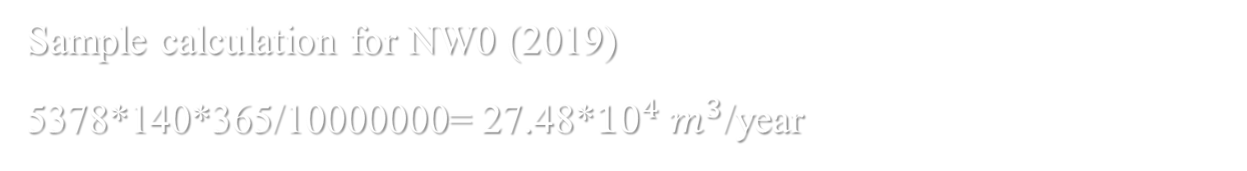

Demand
Total Demand (*${10}^{4}$) / year
Pressure Zone | 2019 | 2022 | 2025 | 2028 | 2031
NW0 | 27.48 | 31.21 | 35.44 | 40.25 | 45.71
NW1 + NW2a | 49.92 | 52.62 | 55.46 | 58.46 | 61.62
NW3 + NW2b | 21.62 | 24.53 | 27.83 | 31.58 | 35.83
Sample calculation for NW0 (2019)
5378*140*365/10000000= 27.48*${10}^{4}$ $m^{3}$/year

Slide 36
Water Gap
Area | Deficit (m³/year)
 | 2019 | 2022 | 2025 | 2028 | 2031
NW0 | 134,692.00 | 171,992.00 | 214,292.00 | 262,392.00 | 316,992.00
NW1+NW2 | 237,570.00 | 264,570.00 | 292,970 | 322,970 | 354,570
NW3+NW2b | 76,062 | 105,162 | 138,162 | 175,662 | 218,162
 |  |  |  | Sum= | 889724

Slide 37
Analysis of water distribution network
Required Information
Modeling

Slide 38
Required Information
Average daily consumption for each capita is 74 L/capita.day according to Nablus Municipality .
Hydraulic equation is Hazen- William equation .
This model was done according to the GIS shapefiles for
( Pipes , meters , contours ) .
Each sub-zone in the study area was modeled individually.

Slide 39
Modeling
Pressure zone | Pipes | Nodes
NW0 | 160 | 159
NW1 + NW2a | 133 | 127
NW3+NW2b | 134 | 134

Slide 40
Data Collected
Meters
Contour Map
Existing Network

Slide 41
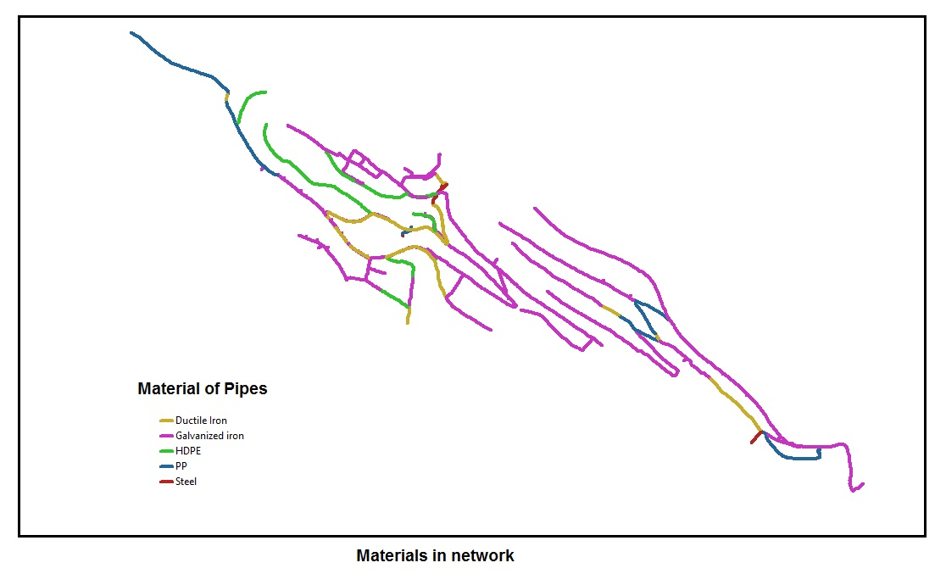
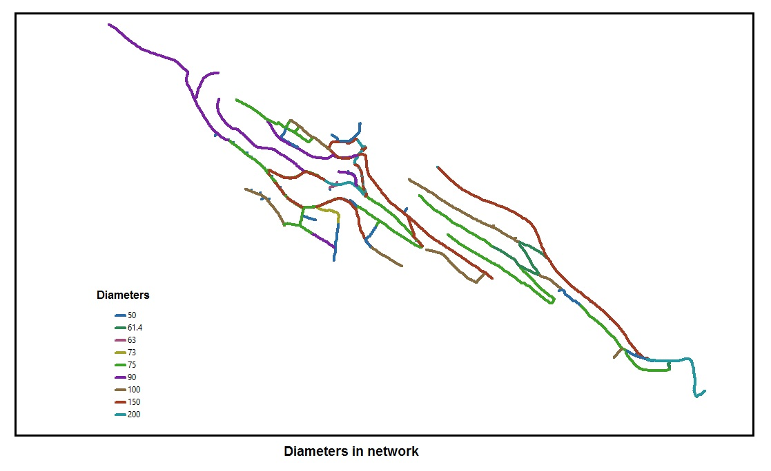
Data Collected
Existing Network (as shapefiles of pipes diameters and materials)

Slide 42
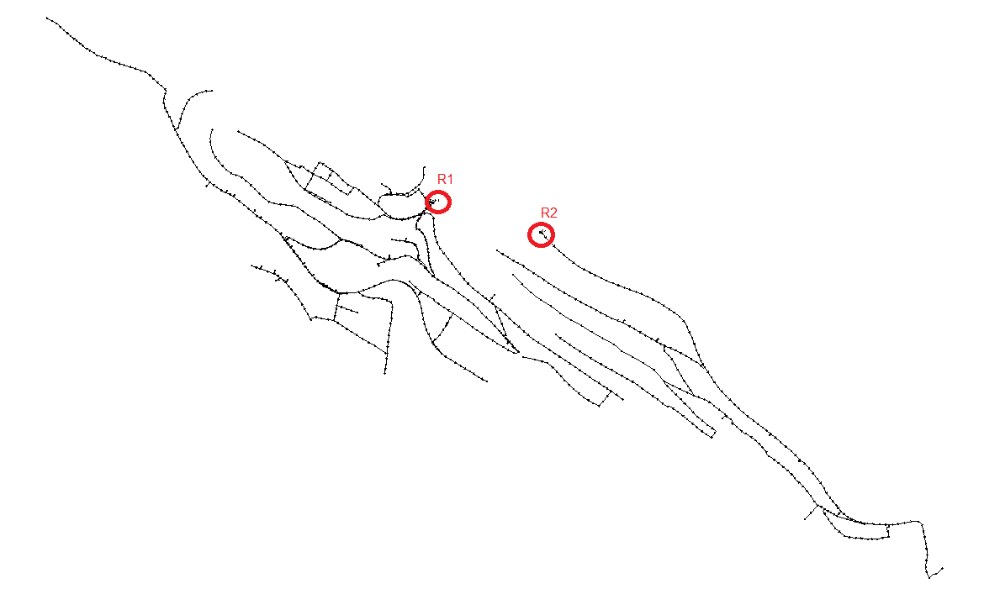
Watercad Modeling

Slide 43
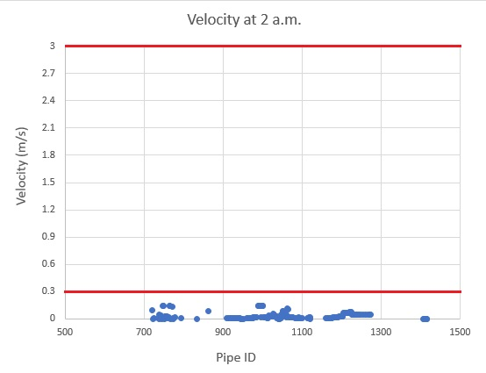
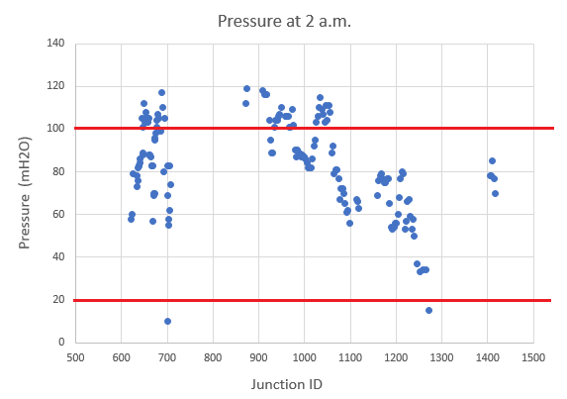
Watercad Results
For NW0 : at 2 a.m.

Slide 44
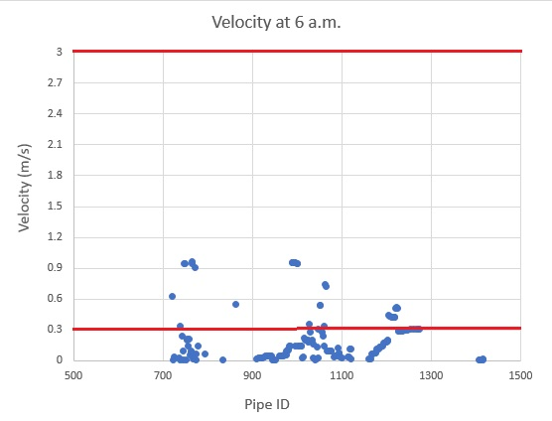
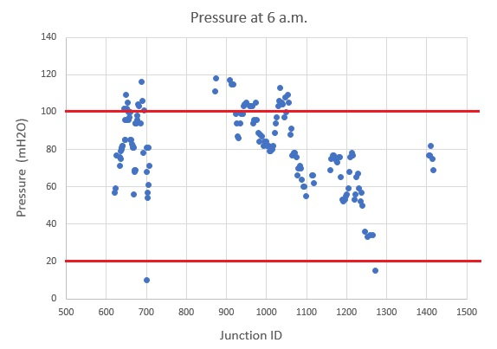
Watercad Results
For NW0 : at 6 a.m.

Slide 45
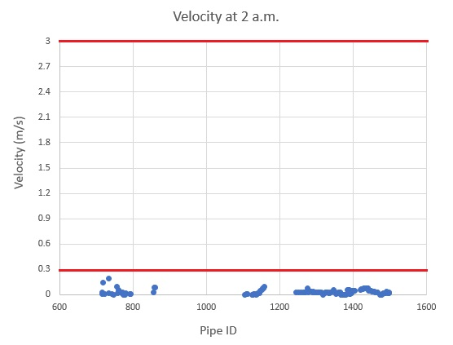
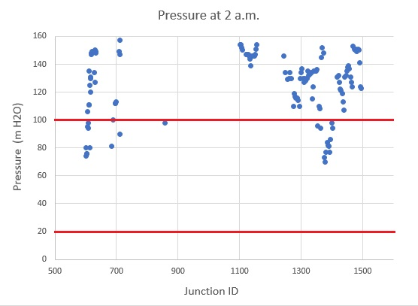
Watercad Results
For NW1+NW2a : at 2 a.m.

Slide 46
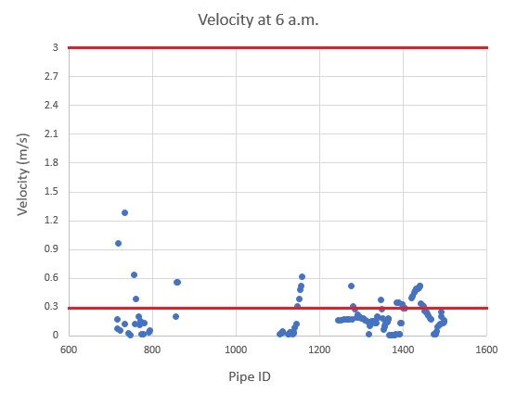
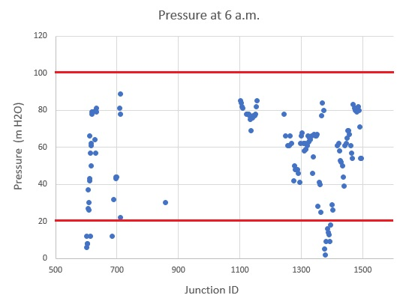
Watercad Results
For NW1+NW2a : at 6 a.m.

Slide 47
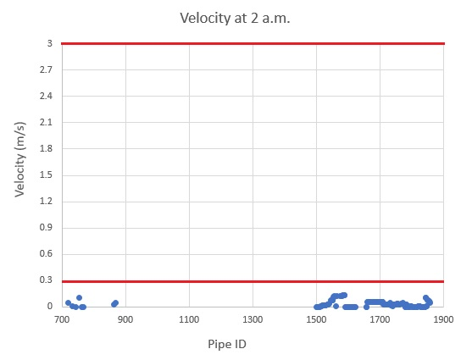
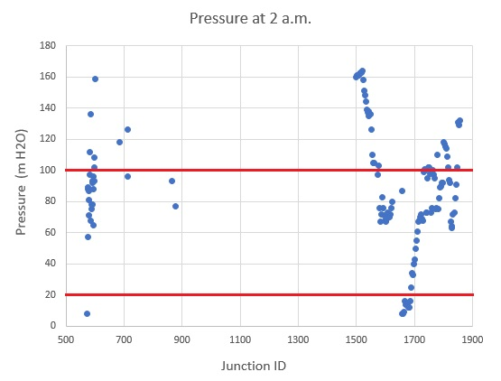
Watercad Results
For NW2b+NW3 : at 2 a.m.

Slide 48
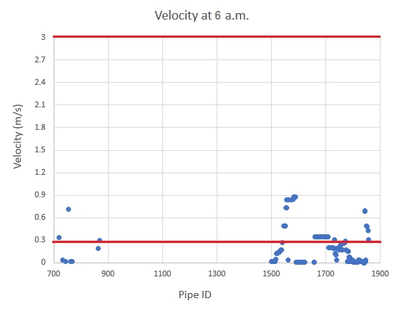
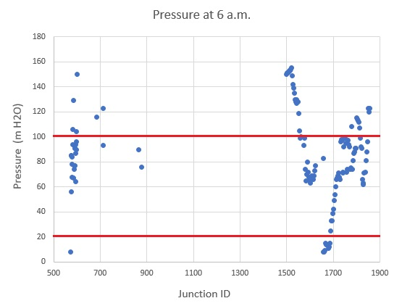
Watercad Results
For NW2b+NW3 : at 6 a.m.

Slide 49
Network Modification
Modifying Junctions Demand
We assumed a steady state pumping occurs once every 4 days , hourly and daily demand factors weren't considered due to the use of roof tanks .

Slide 50

Network Modification
Modifying Junctions Demand
This factor combines the increase
in population between 2016 and 3031,
the usage per capita from 74 to 140 L
and multiplied by 4 as explained .
Sample calculation: For NW0: Factor = ($\frac{8944}{4736}$) * ($\frac{140}{74}$) * 4 = 14.296
Pressure Zone | Modifying factor
NW0 | 14.296
NW1 + NW2a | 9.844
NW3 + NW2b | 14.228

Slide 51
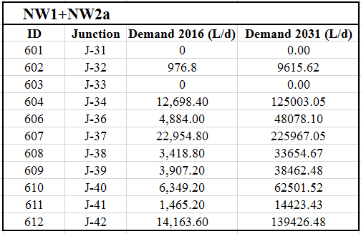
Network Modification
Modifying Junctions Demand
Using Excel sheet, the demand in each
junction was modified by factors shown .

Slide 52
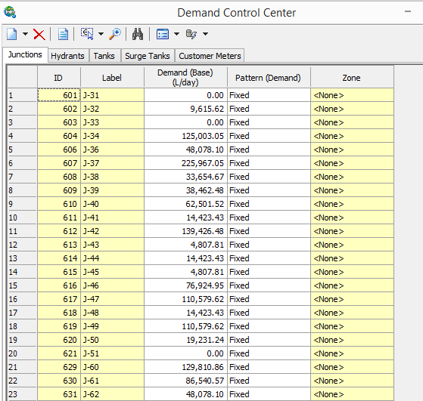
Network Modification
Modifying Junctions Consumption
Using Demand Control Center tool,
Junctions new demand was defined .

Slide 53
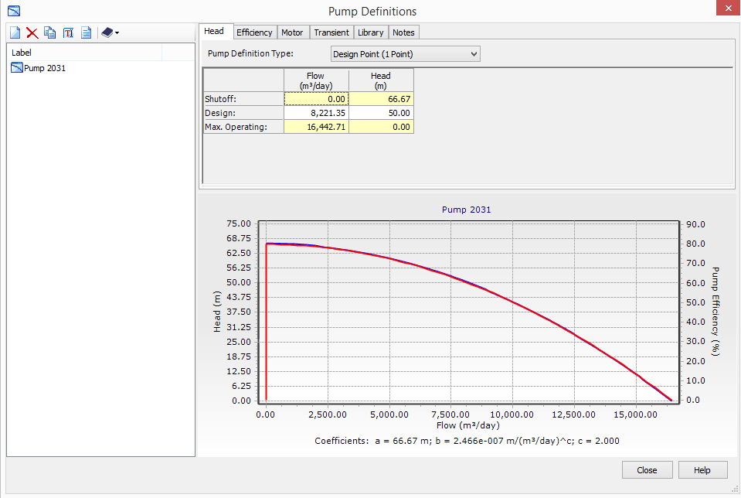
Network Modification
Pump Definition
A new pump was defied in
NW1+NW2a zone using
one design point . .

Slide 54
Network Modification
Preliminary Results
Due to the high increase in the flow values, some pipes velocities were over acceptable range , (some pipes reached 7 m/s) which affected the pressure values in junctions due to high headloss values .
. .

Slide 55
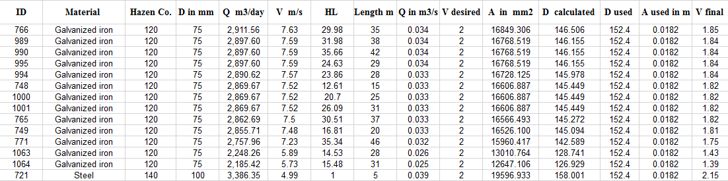
Network Modification
Preliminary Results
To fix this problem, we used Excel sheet to maintain the velocities by
changing pipes' diameters as shown :
. .

Slide 56
Network Modification
Replaced Diameters
NW0
D ( inch) | D ( mm ) | Replaced length | Pipe type
3 to 6 | 75 to 152.4 | 405 | Galvanized iron
4 to 6 | 100 to 152.4 | 5 | Steel
6 to 8 | 150 to 203.2 | 32 | Steel
6 to 8 | 150 to 203.2 | 368 | Ductile Iron
3 to 4 | 75 to 101.6 | 94 | Galvanized iron
2 to 3 | 50 to 76.2 | 97 | Galvanized iron
NW1+NW2a
D ( inch) | D ( mm ) | Replaced length | Pipe type
3.5 to 8 | 90 to 203.2 | 10 | HDPE
6 to 8 | 150 to 203.2 | 52 | Steel
3 to 4 | 75 to 101.6 | 142 | Galvanized iron
8 to 10 | 200 to 254 | 17 | Galvanized iron
NW2b + NW3
D ( inch) | D ( mm ) | Replaced length | Pipe type
2.4 to 4 | 61.4 to 101.6 | 485 | PP
2.4 to 4 | 61.4 to 101.6 | 42 | Ductile Iron
2 to 3 | 50 to 76.2 | 79 | Galvanized iron
3 to 4 | 75 to 101.6 | 330 | Galvanized iron
6 to 8 | 150 to 203.2 | 843 | Galvanized iron

Slide 57
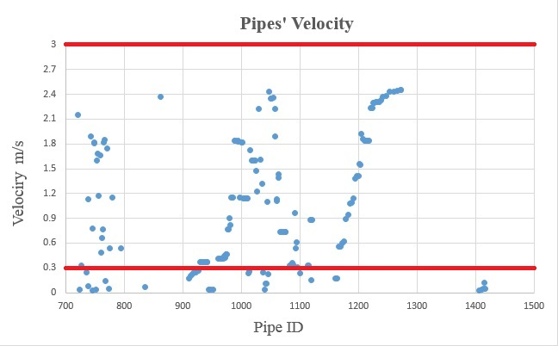
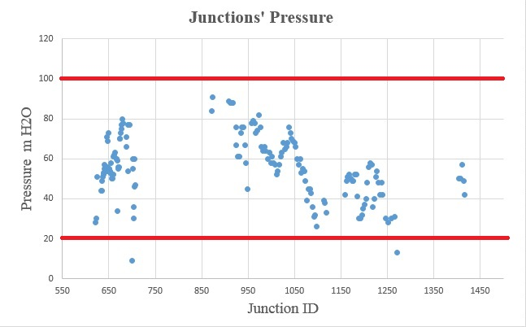
Final Results
For NW0 :

Slide 58
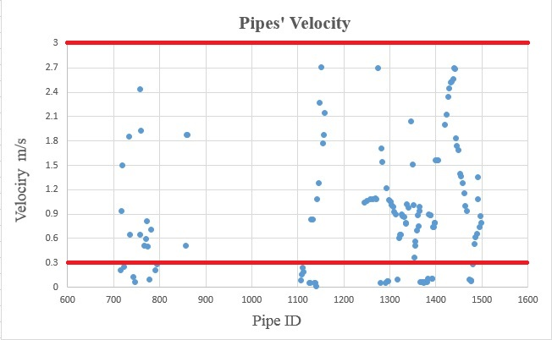
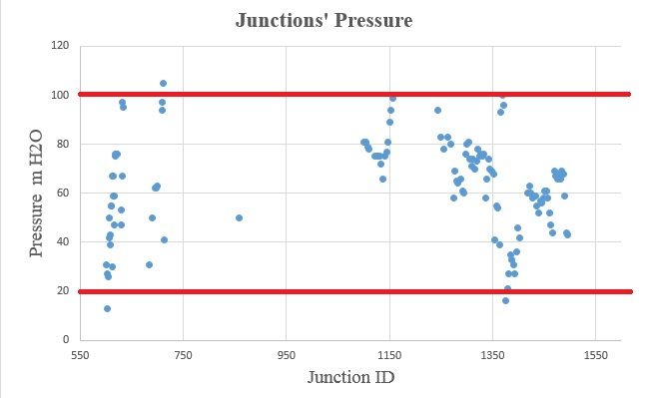
Final Results
For NW1+NW2a :

Slide 59
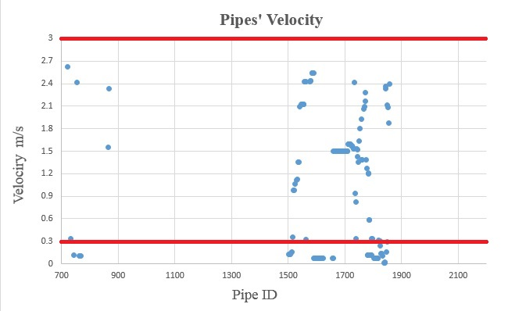
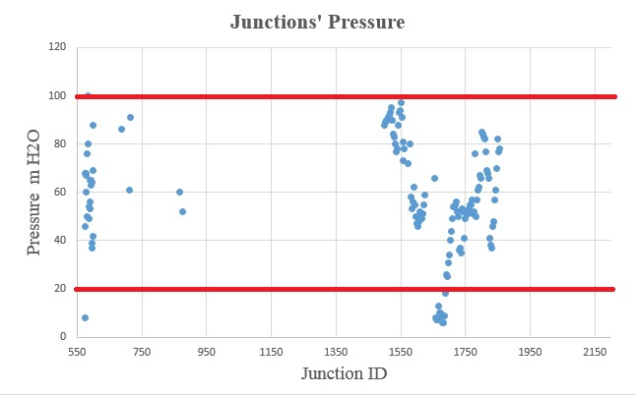
Final Results
For NW2b+NW3 :

Slide 60
ALTERNATIVE SOLUTIONS TO SATISFY THE WATER GAP
1- Individual / Personal Wells :
• Mamdouh Salahat Well – AL-Fara'a : With a productivity
rate of 100 m3/hour, it is useful in peak times .
This well is already used since 2016.
• Farah Al-Hmoud and Khaldon Al-Hmoud Wells – Sahl AL-Smait :
Each one of these two wells has a productivity rate of 100 m3/hour,
these wells used in the last water crisis in Nablus at 2017 summer .

Slide 61
ALTERNATIVE SOLUTIONS TO SATISFY THE WATER GAP
2- There is a proposed site of a new well to be established in the coming period in Al-Hesba area in the eastern region of Nablus, only waiting for permission from the occupation authorities.
3- " Sherian AL-Hayat " project , which aims to extend a new conveyance line with 20 inch diameter from Al-Bathan area to serve Nablus city from the external wells in Al-Bathan and Al-Fara’a.
4- Reducing losses in the network to 20% or less , the amount of water to be pumped in the network from resources will be less , and this difference can be used as to meet any shortage in needed areas .This can be done by updating the old pipes , replacing faulty meters and pursuing black losses

Slide 62
Discussion and Recommendation.
Intermittent water supply in Nablus city caused by unavailability of enough water recourses due to Israelis restrictions to use water resources .
A new alternatives appeared to solve the current shortage of resources in peak times and to solve the future expected demand values , most of these resource are under study till now.
In order to reduce the cost of providing water to the consumers, it is recommended to locate new reservoirs on the top of the mountains to achieve a water distribution network that can transfer the water to the costumers by gravity this will reduce the cost of transferring water to a high level.

Slide 63
Discussion and Recommendation.
The high losses in water which equal on average 27.8 % can be attributed to the old and weak pipes and connections beside the meter losses . Updating the old pipes , replacing faulty meters and pursuing black losses will help in loss reduction.
Domestic water consumption calculations shows that consumption in current time equals 75.4 L/capita.day which is nearly equal to 74 L/capita.day given from Nablus Municipality, that gives an indication of how results meet the real situation .

Slide 64

THANK YOU

