Slide 1
Graduation Project 2
Prepared by
Abdullah aghbar
Ameer Hendiya
Mahmoud Ziad
Supervisors: Dr. Osayd Abdul Fattah
The Effect of Adding Pyrolysis Carbon Black On Concrete At Different Particle Size

Slide 2
Agenda
- Objective.
- Introduction.
- Material.
- Experimental Work.
- Methodology.
- Conclusion.
- Recommendation.

Slide 3
Objective
We are continuing the work done by Ayman Nassar, under Dr. Osayd Abdul Fattah supervisor which is the effect on mechanical properties of concrete when pyrolysis carbon black is added but we focused on the adding of particle size.

Slide 4
Concrete:
Concrete is the most widely used in construction material in the world. It is obtained by mixing cementitious materials, water and aggregates in required proportions.
Introduction

Slide 5
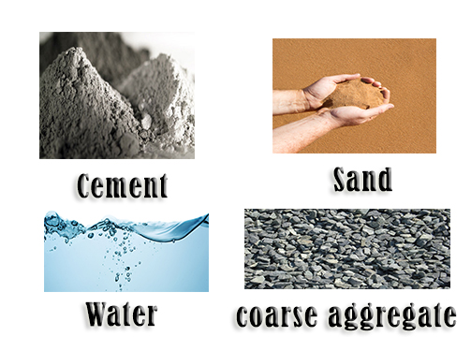
Concrete consists of

Slide 6
Concrete admixture
Additives are used in concrete for several purposes are (plasticizers, retarders, accelerators, Shrinkage-reducing and air entraining agents).

Slide 7
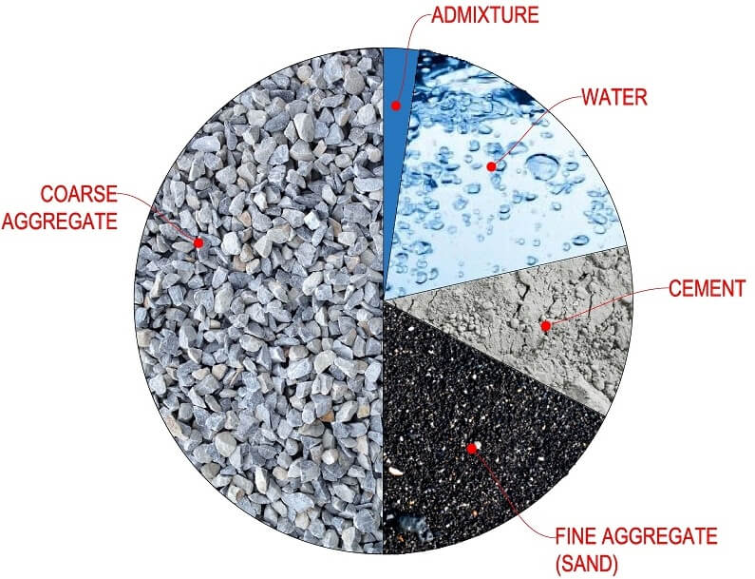
Concrete Additives

Slide 8
Advantage of concrete
1. Concrete components are easily available.
2. Concrete is free of defects unlike natural stones.
3. Concrete strength can be controlled with economy.
4. The durability of concrete is very high.
5. Easy to form concrete for the desired shape.

Slide 9
Dis advantage of concrete
1. The tensile strength of the concrete is low.
2. Concrete is high brittle.
3. Its weight is high compared to its strength.
4. Concrete contains soluble salts which affect their properties.
5. Concrete contains pores.

Slide 10
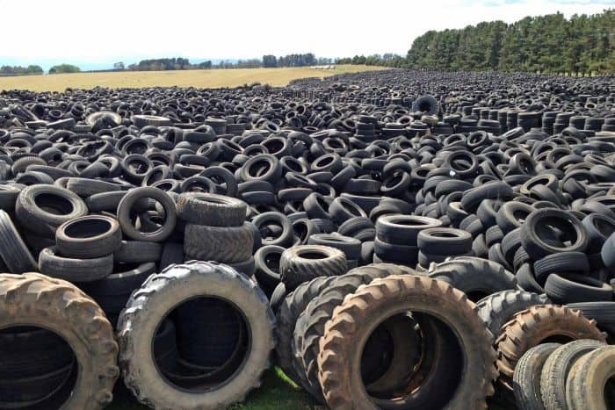
Pyrolysis carbon black:
Waste tire is one of the most important problems that face many countries in the world, especially with the growth of the auto-related industries.
Carbon black produce from waste tire by pyrolysis.

Slide 11
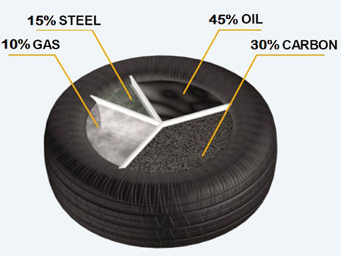
Pyrolysis is produce

Slide 12
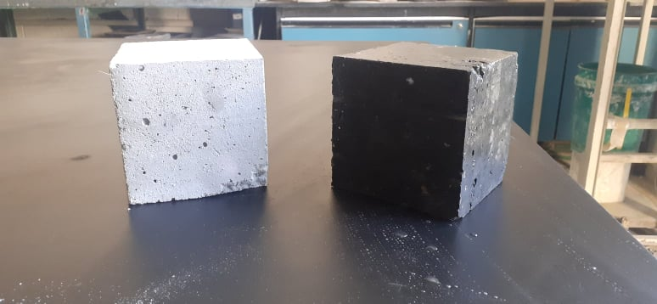

Slide 13

Experimental Work Program
Materials:
1.Cement: Cement acts mostly as a binding agent between coarse aggregate (gravel), fine aggregate (sand) and provides strength to concrete on setting and hardening

Slide 14
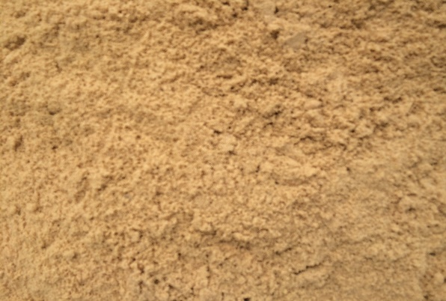
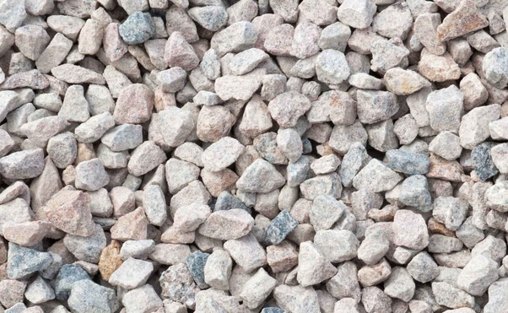
2. Sand: Is fine aggregate reduces shrinkage and cracking, fills voids present in coarse aggregates and helps in hardening of cement
3. Aggregate: Is coarse aggregates increases the crushing strength of concrete, makes concrete solid hard mass, reduce cost of concrete by occupying major volume in concrete.

Slide 15

4.Water: Its act as one of the component in concrete mix for reaction with cement which result in hard cement after drying, but increase water to cement ratio reduce concrete strength. Water to cement ratio is 50%
Note: High w/c ratio due to reduce strength of concrete.
5.Super G7: is a plasticizers substance which can be added to concrete to increase the workability of concrete when mixing concrete ingredients together
Super cement ratio is 2%

Slide 16
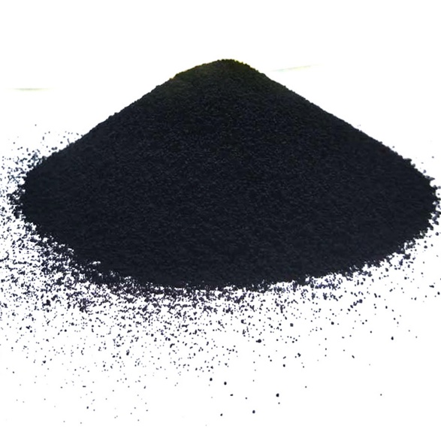
6. PCB

Slide 17
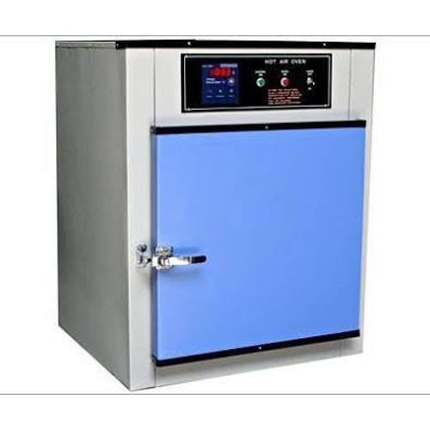
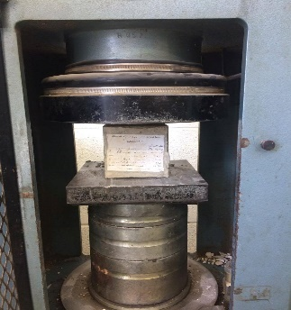
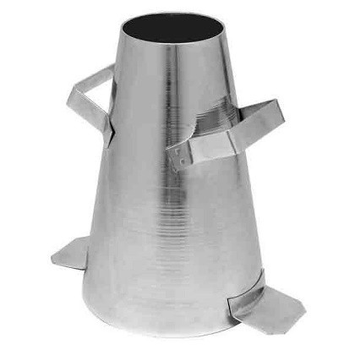
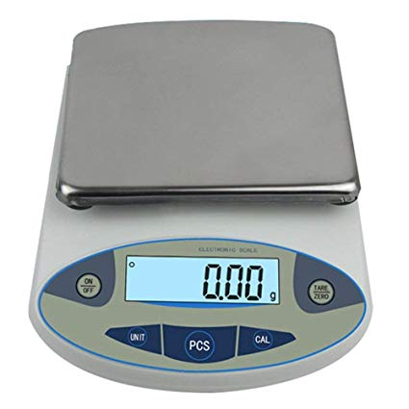
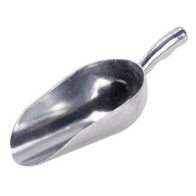
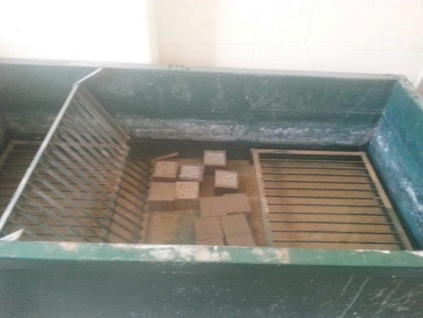
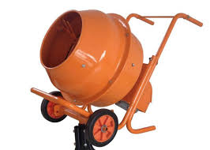
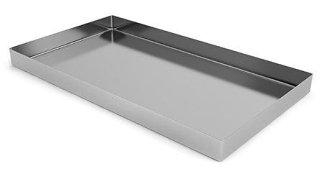
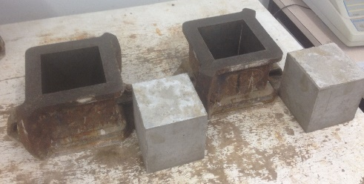
Instruments and characterizations

Slide 18
Methodology
In order for the concrete to be designed, the type has to be identified along with the properties, proportions involved in the preparation of the concrete and those things the typical standard normally used in buildings in the market of Palestine.
Mix 1Kg Cement, 2.3Kg Sand, 4.03Kg Aggregate
40g PCB and B300 type of concrete.
And we will have 3 type of tests :

Slide 19
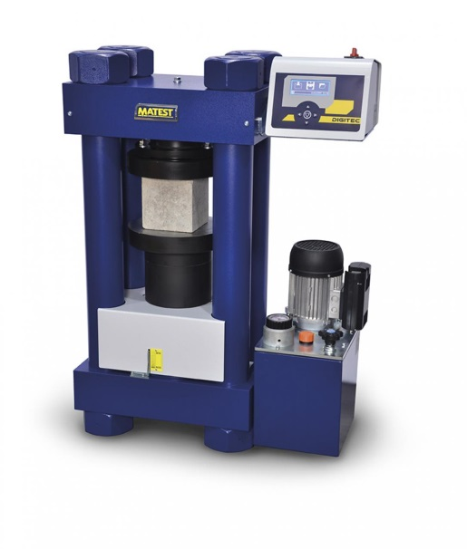
Compression Test

Slide 20
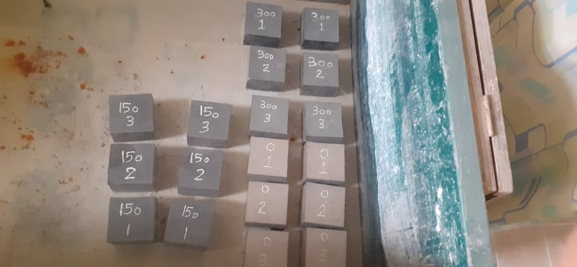

Water Adsorption Test

Slide 21
Slump Test

Slide 22
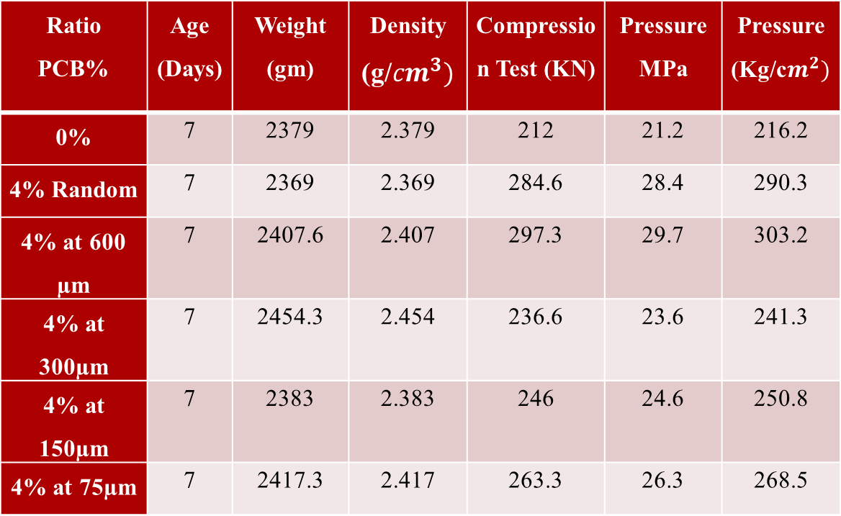
Results : 1- Compression Test
Compression Test at 7 days
Ratio PCB% | Age (Days) | Weight (gm) | Density (g/$cm^{3})$ | Compression Test (KN) | Pressure MPa | Pressure (Kg/c$m^{2})$
0% | 7 | 2379 | 2.379 | 212 | 21.2 | 216.2
4% Random | 7 | 2369 | 2.369 | 284.6 | 28.4 | 290.3
4% at 600 µm | 7 | 2407.6 | 2.407 | 297.3 | 29.7 | 303.2
4% at 300µm | 7 | 2454.3 | 2.454 | 236.6 | 23.6 | 241.3
4% at 150µm | 7 | 2383 | 2.383 | 246 | 24.6 | 250.8
4% at 75µm | 7 | 2417.3 | 2.417 | 263.3 | 26.3 | 268.5

Slide 23
Compression Test at 7 days Continue ..

Slide 24
Error for Compression Test at 7 days
Ratio PCB% | Error%
0% | ± 2.83
4% Random | ± 2.455
4% at 600 µm | ± 1.68
4% at 300µm | ± 2.535
4% at 150µm | ± 1.12
4% at 75µm | ± 3.795

Slide 25
Error for Compression Test at 7 days Continue ..

Slide 26
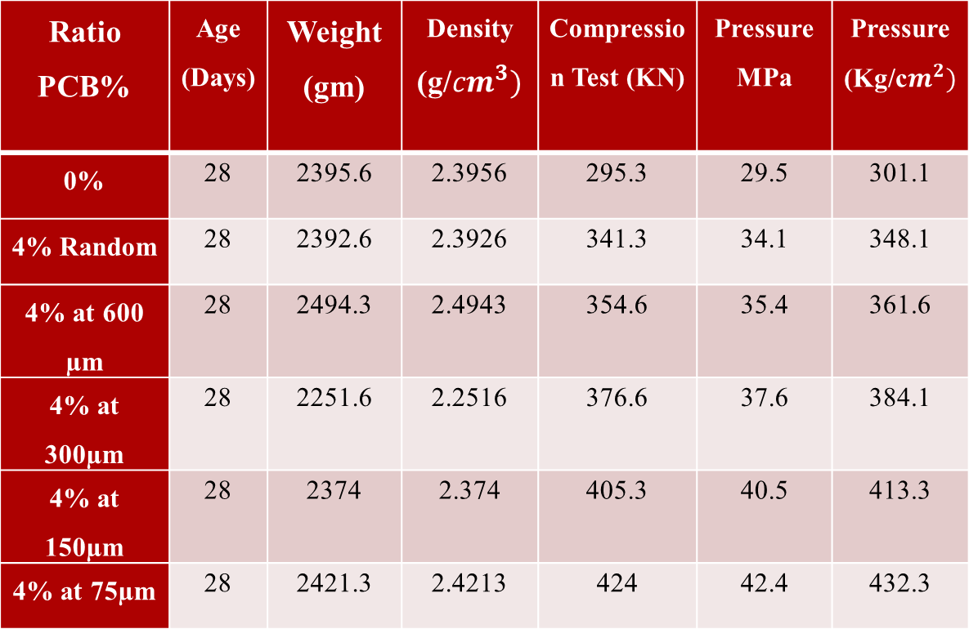
Compression Test at 28 days
Ratio PCB% | Age (Days) | Weight (gm) | Density (g/$cm^{3})$ | Compression Test (KN) | Pressure MPa | Pressure (Kg/c$m^{2})$
0% | 28 | 2395.6 | 2.3956 | 295.3 | 29.5 | 301.1
4% Random | 28 | 2392.6 | 2.3926 | 341.3 | 34.1 | 348.1
4% at 600 µm | 28 | 2494.3 | 2.4943 | 354.6 | 35.4 | 361.6
4% at 300µm | 28 | 2251.6 | 2.2516 | 376.6 | 37.6 | 384.1
4% at 150µm | 28 | 2374 | 2.374 | 405.3 | 40.5 | 413.3
4% at 75µm | 28 | 2421.3 | 2.4213 | 424 | 42.4 | 432.3

Slide 27
Compression Test at 28 days Continue ..

Slide 28
Error for Compression Test at 28 days
Ratio PCB % | Error %
0% | ± 3.385
4% Random | ± 1.755
4% at 600 µm | ± 1.97
4% at 300µm | ± 2.65
4% at 150µm | ± 1.97
4% at 75µm | ± 2.12

Slide 29
Error for Compression Test at 28 days Continue..

Slide 30
2- Water Adsorption Test
Water Adsorption (%) | Average Weight concrete Dry (gm) | Average Weight concrete Wet (gm) | Ratio PCB%
6.01 | 2251.221 | 2386.354 | 0
4.83 | 2326.333 | 2439.453 | 4% Random
4.89 | 2319.748 | 2433.765 | 4% at 600 µm
4.78 | 2179.519 | 2284.534 | 4% at 300µm
4.46 | 2256.983 | 2357.618 | 4% at 150µm
4.14 | 2262.158 | 2355.124 | 4% at 75µm

Slide 31
Water Adsorption test Continue ..

Slide 32
3- Slump Test
Slump (cm) | 4% PCB at different particle size
4.3 | 0
6.7 | 4% Random
5.1 | 75 µm
6.4 | 150 µm
7.3 | 300 µm
7.9 | 600 µm

Slide 33
Slump Test Continue ...

Slide 34
Slump Test Continue ...
Placing Conditions | Blinding concert; Shallow sections; Pavement using pavers | Mass concrete; Lightly reinforced Sections in slab, beams, walls, columns, floor | Heavily reinforced, sections in slab, beams, walls, columns; Slipform work; pumped concrete | Trench fill; in site piling | Termite concrete
Degree of workability | Very low | Low | Medium | high | Very high
Slump (mm) | <25 | 25 – 75 | 50 - 100 | 75 – 100 | 100 – 150

Slide 35
Conclusion
The PCB of waste automobile tires may be one of the most desirable techniques for the economic and environmental stand point.
Lastly, a PCB content of 4% of the weight of concrete mix will be recommended to use at 75 µm particle size to give desirable compressive strength after 28 days.

Slide 36
First of all adding water to concrete must be very careful so water amount that should be added must be studied and weighed carefully.
About dealing with cement it is not preferable to use cement from an opened left pocket.
Another recommendation which is dealing with pyrolysis carbon black should be in very careful way and this is due to the light weight of the PCB
Recommendation

Slide 37
Thank you ☺

