Slide 1





𝑴𝒐𝒓𝒆 𝒕𝒉𝒂𝒏 𝒋𝒖𝒔𝒕 𝒂 𝒄𝒖𝒔𝒕𝒐𝒎𝒆𝒓
Made by:
MohammadHajjaj
MusabAbuBshara
Supervisor:
Dr. Mahmoud Dwikat

Slide 2
Table of contents
01
02
03
Introduction
Components
Process
04
05
06
Difficulties
Future work
Conclusion

Slide 3
01
Introduction

Slide 4

Project Idea
Our project introduces a smart shopping assistant that combines two innovations:
Smart Product Scanner → detects if products are Halal, or Boycotted, and alerts the user with sound and screen display.
Smart Shopping Wheelchair → designed for people with disabilities, it moves in all directions and supports easier shopping while using the scanner.

Slide 5
Objectives & Motivation
Motivation
Support people with disabilities in shopping.
Enable ethical choices (Halal / Boycott check).
Combine mobility assistance with smart scanning.
Objectives
Build a smart wheelchair with lifting system.
Integrate scanner to detect product status.
Develop web interface for product management.
Provide clear audio & visual feedback.

Slide 6
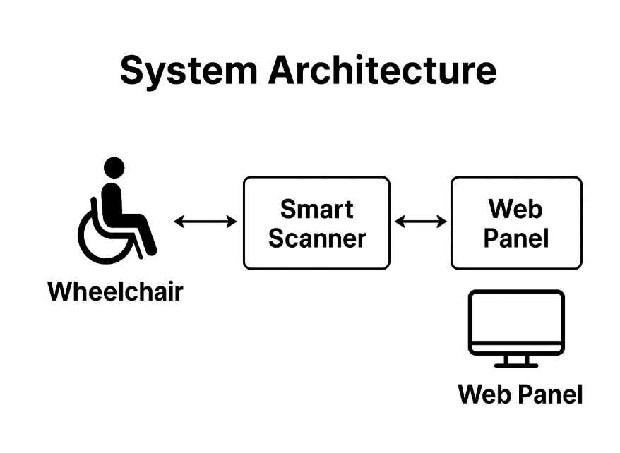


Slide 7
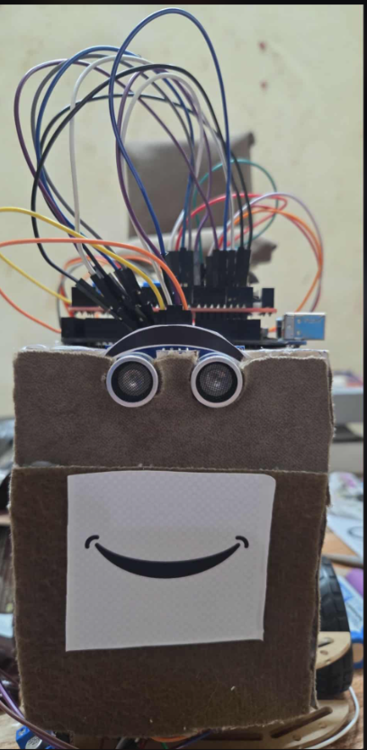
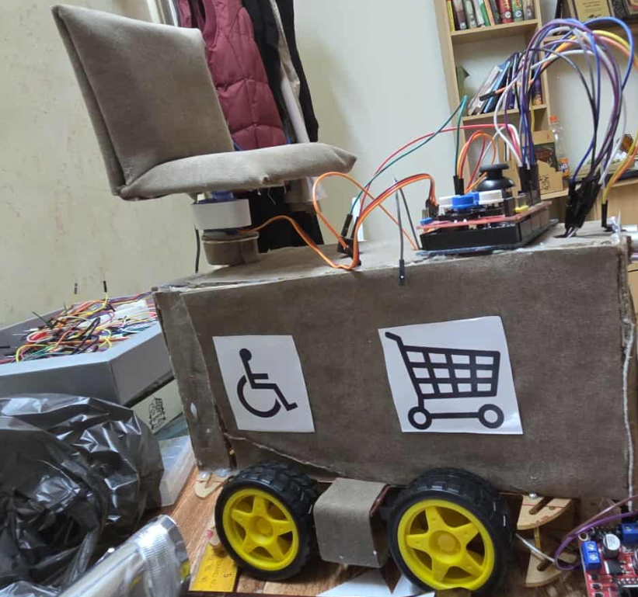
System Overview

Slide 8
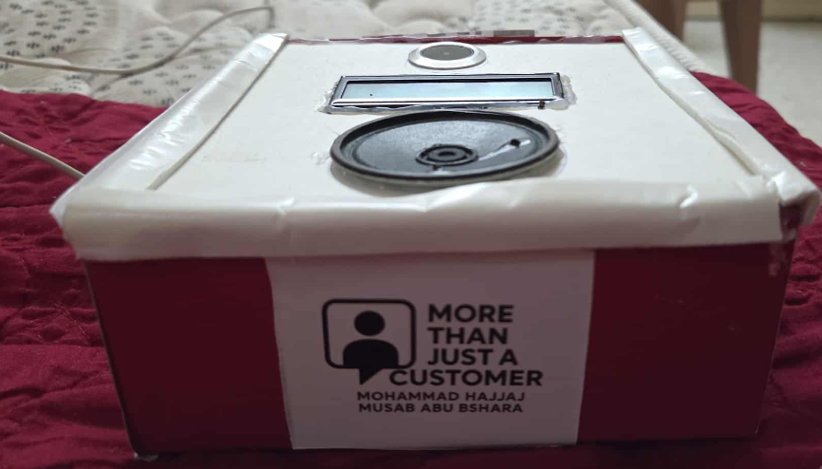
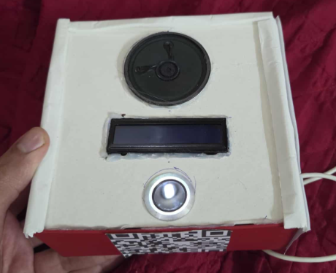
System Overview

Slide 9


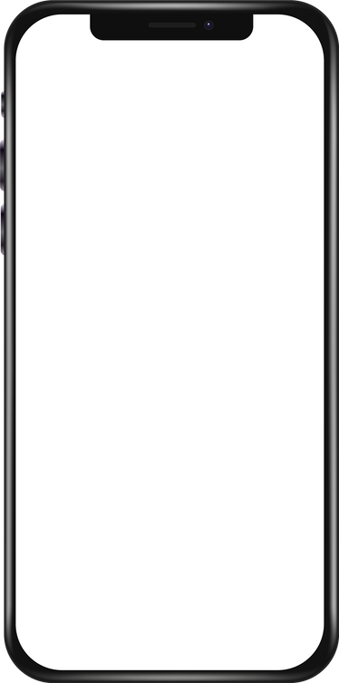


System Features
1
2
3
Wheelchair
Product Scanner
Web Panel (ESP)
Detects if items are Halal, or Boycotted.
Gives sound + screen alerts.
Helps users make quick decision
  Joystick for full-direction.
  Obstacle detection for safety.
  Designed for shopping support.
Add / Edit / Delete / Update products
Runs on ESP32 local web server
Syncs instantly with scanner

Slide 10
02
Components

Slide 11
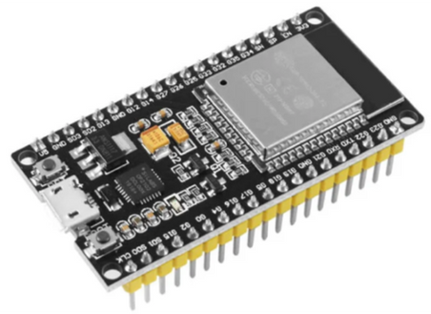
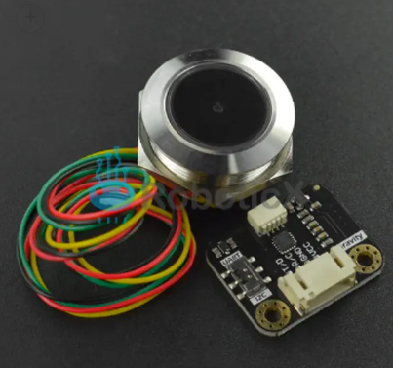
Hardware Components
ESP32
  ESP32 (Main Controller + Web Server)
  → controls scanner hardware, processes QR/Barcode data,
  → hosts a wireless web panel to add, edit, delete, update products
Gravity: Ring 2D QR Code Scanner – DFROBOT
Scanner / Barcode Reader
→ scans product codes to identify the item

Slide 12
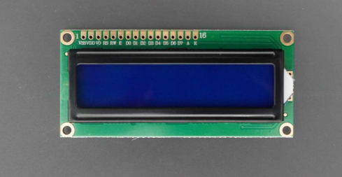
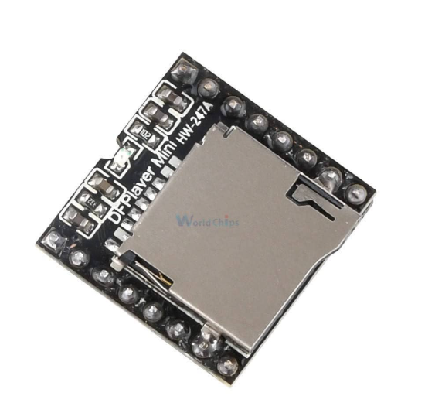
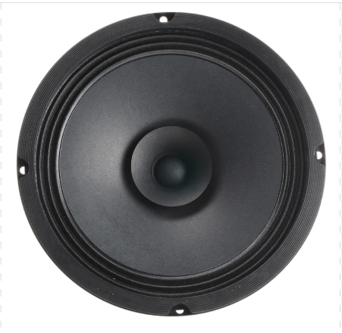
Hardware Components
LCD Display
  LCD Display
  → shows product status (Halal, Forbidden, Boycotted).
DFPlayer Mini
Speaker
DFPlayer Mini + SD Card
→ stores and plays audio messages for product status.
Speaker
→ outputs clear voice/audio feedback to the user.

Slide 13
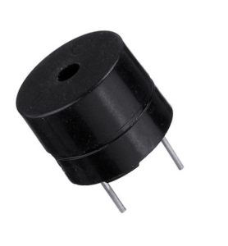
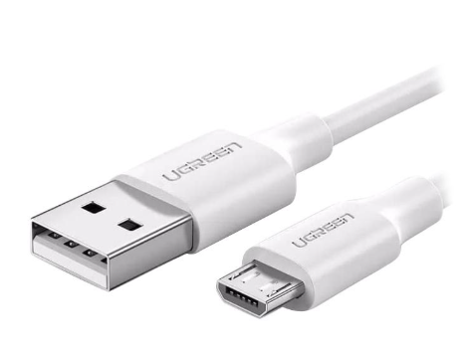
Hardware Components
buzzer
  Buzzer
  → gives quick alert tones (warning or confirmation).
Micro-usb
Power Supply (via Micro USB)
→ powers the ESP32 and all connected components safely.

Slide 14
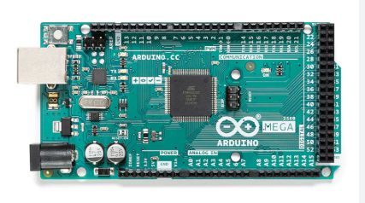
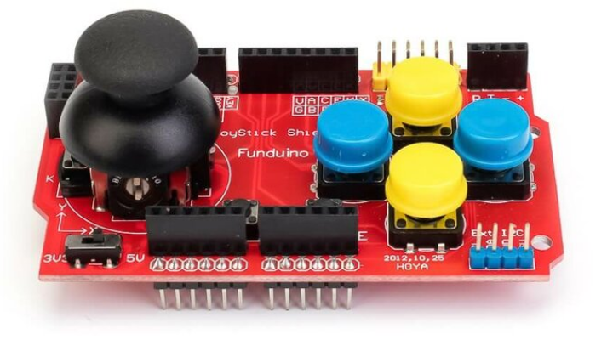
Hardware Components
Arduino mega
  Arduino Mega
  → main controller; reads joystick, sensors, and controls motors + actuator.
Joystick Shield V1.2 For Arduino
  Joystick Shield
  → user control for movement.

Slide 15
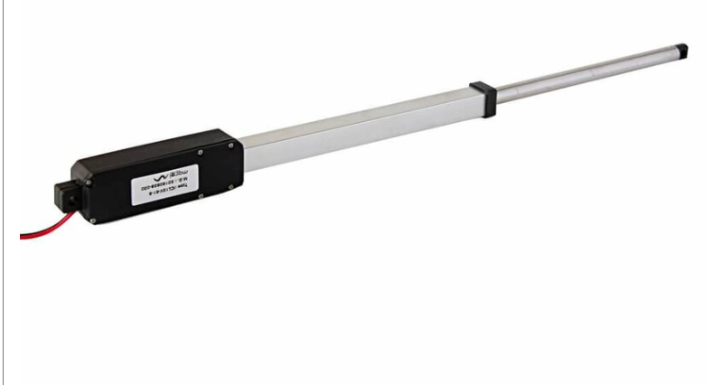
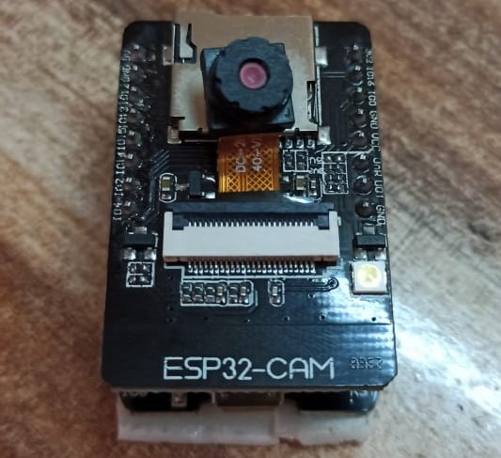
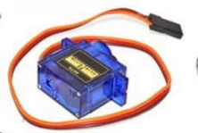
Hardware Components
12V DC Linear Actuator 100mm Stroke 8mm/s 60N Force LA-WR
  12V DC Linear Actuator
  → provides vertical lift (up/down)
  Stepper Motor
  → used for rotation (precise angle control).
ESP-32-CAM
  ESP-32-CAM
  → captures video to show user what’s behind wheelchair
  → built-in Wi-Fi
Stepper Motor

Slide 16
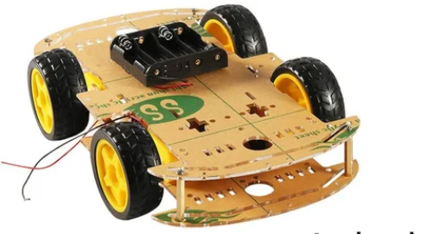
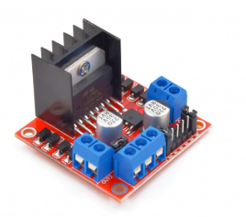
Hardware Components
Car Chassis
Car Chassis with DC Motors
→ base frame equipped with motors and wheels for movement.
L298N
L298N H-Bridge Driver
→ drives the DC motors for wheel movement: forward / backward / left / right.
→ also controls the linear actuator for seat lift (up / down).

Slide 17
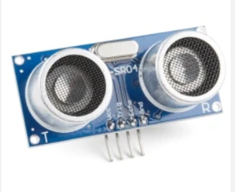
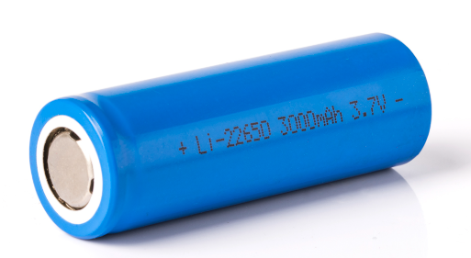
Hardware Components
HC-SR04
Ultrasonic Sensor (HC-SR04)
→ measures distance; detects obstacles ahead
Buzzer
→ alarm when obstacle is too close (safety warning).
buzzer
Lithium Batteries 3.7V
Power Supply (Lithium Batteries 3.7V)
→ multiple cells connected in series to provide required voltage (e.g., 3 × 3.7V ≈ 11.1V).
→ powers DC motors, actuator, and regulated down to 5V for Arduino & logic.

Slide 18
03
Process

Slide 19

Smart Scanner

Slide 20
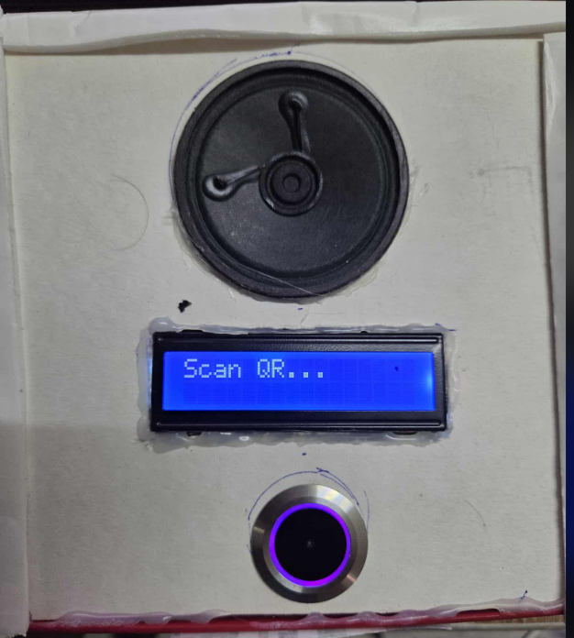
The smart scanner device is ready for use

Slide 21
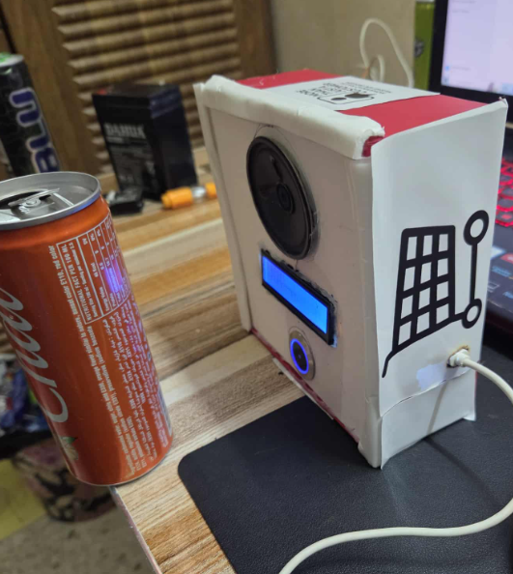
A product is placed in front of the scanner for checking.

Slide 22
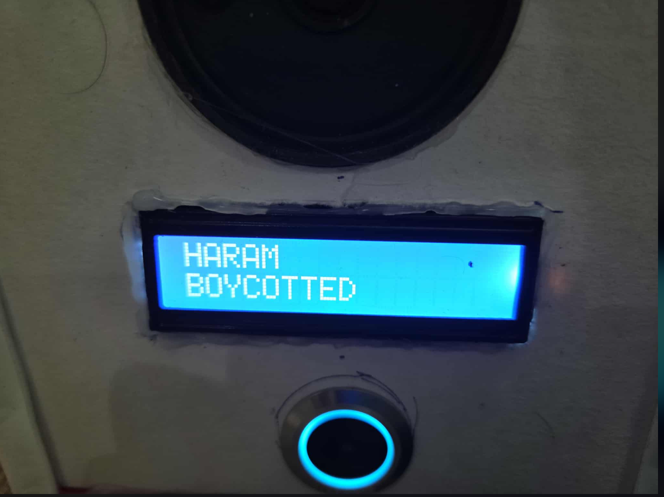
The LCD shows the result: product is haram and Boycotted.

Slide 23
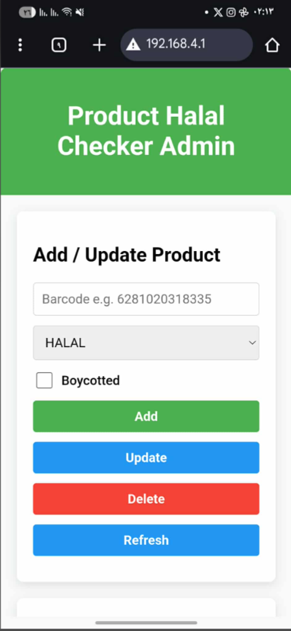
The ESP32 web panel is opened on the browser.

Slide 24
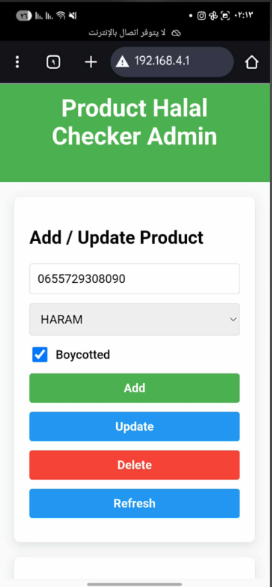
The user selects the product that needs to be edited.

Slide 25
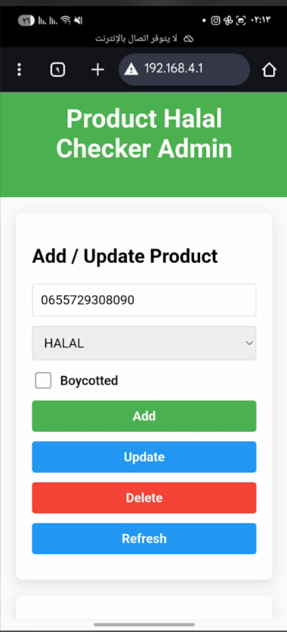
The product status is updated to Halal and Not Boycotted.

Slide 26
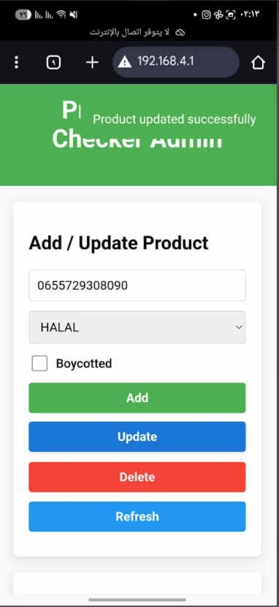
The system confirms: update completed successfully.

Slide 27
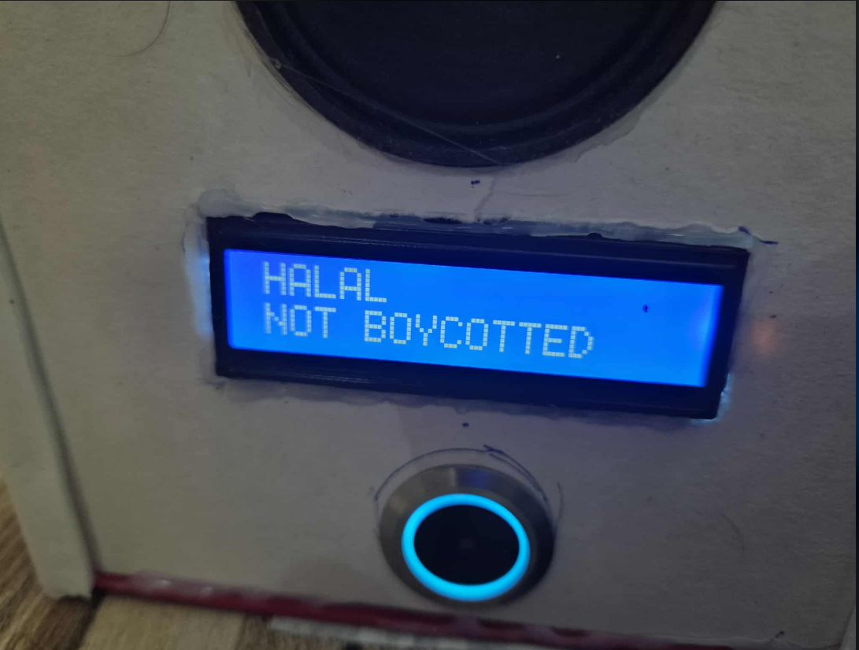
After re-scanning, the LCD shows the product is Halal and Allowed.
The system confirms: update completed successfully.

Slide 28
WheelChair

Slide 29
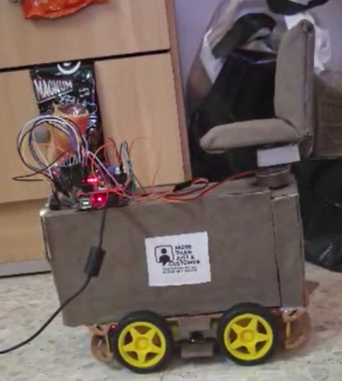
Smart wheelchair system is ready for use.

Slide 30
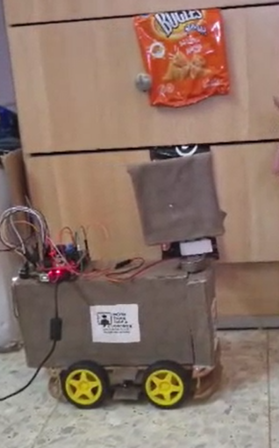
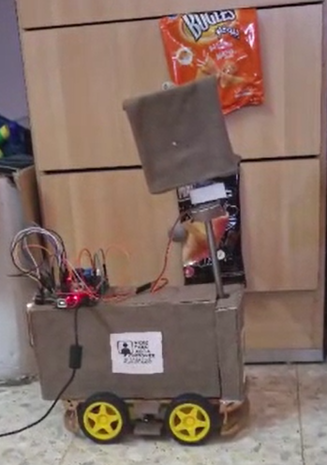

Joystick Up/Down: lifts the seat up and down using the linear actuator.

Slide 31
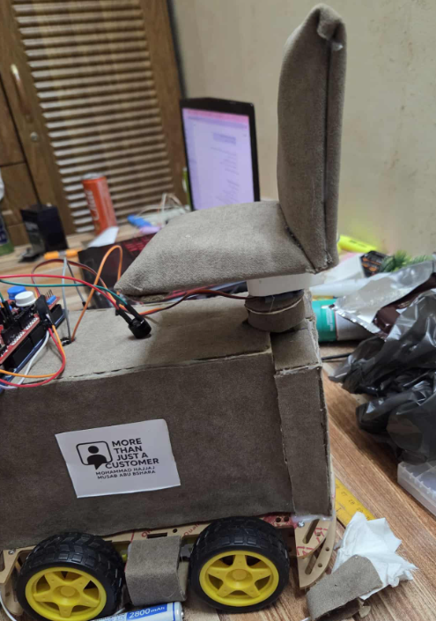
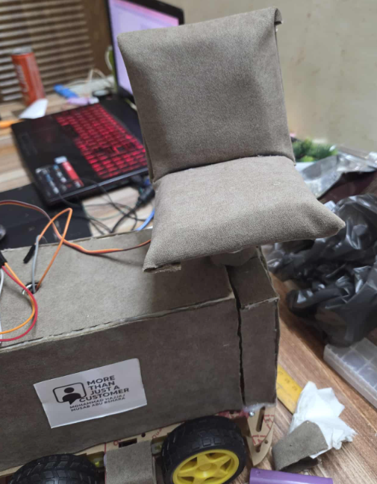
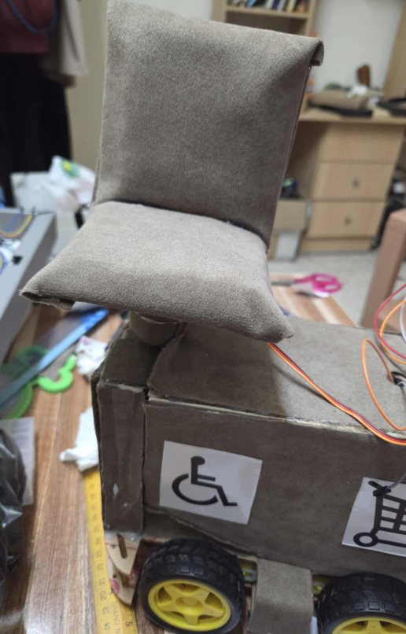
Joystick Left/Right: rotates the seat ±90°.

Slide 32
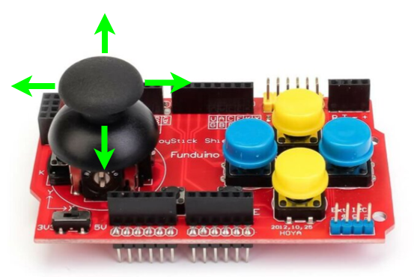
The wheels controlled by joystick: forward, backward, left, right.

Slide 33
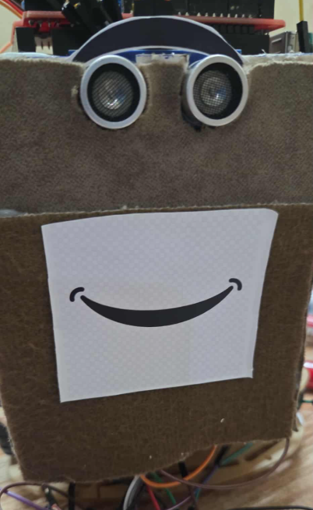
Ultrasonic sensor detects obstacles. Buzzer alerts when too close.

Slide 34
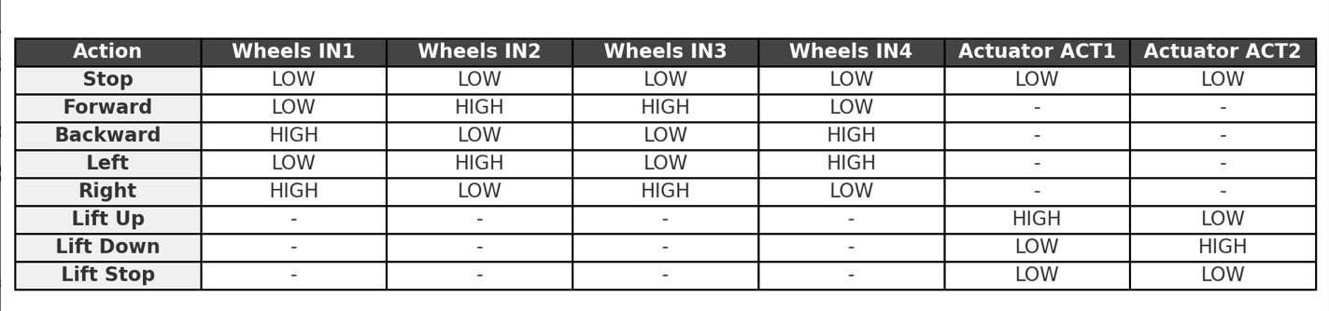
How did we control the motor?
This table shows how the two L298N drivers were used:
First L298N → controls the wheels (Forward, Backward, Left, Right).
Second L298N → controls the linear actuator (Lift Up / Down / Stop).

Slide 35
Web Interface (ESP32-hosted Web Application for Product Management)

Slide 36



Technologies

Slide 37
04
Difficulties

Slide 38
WheelChair

Slide 39
Limited budget/resources
Challenge: Couldn’t buy professional wheelchair parts.
Solution: Built a custom prototype using available materials.

Slide 40
Power Management and Drive System Optimization.
Challenge: High power consumption from 4 wheels.
Solution: Use only 2 wheels while maintaining full directional control.

Slide 41
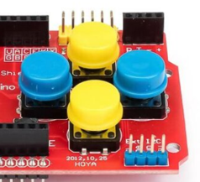
Control Interface Reliability.
Challenge: Corruption of two buttons.
Solution: Rely on the remaining two buttons so functionality is not affected.

Slide 42
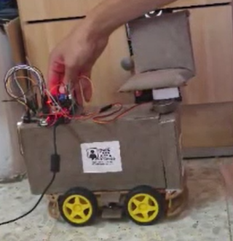
Mechanical Integration and Component Placement
Challenge: Mounting the control panel on the moving part of the chair .
Solution: Mounting the control panel on a fixed part of the wheelchair.

Slide 43
Smart Scanner

Slide 44
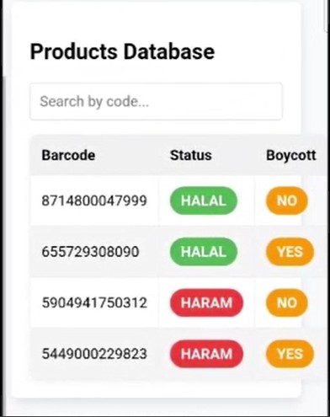
Product Compliance Database.
Challenge: No existing API provides a comprehensive, unified list of products that are both religiously non-compliant (Haram) and ethically boycotted.
Solution: Developed a custom, internal database that is manually researched, curated, and regularly updated to ensure accurate and holistic product filtering.

Slide 45
Barcode recognition accuracy
Challenge: Some barcodes were hard to scan.
Solution: Adjusted scanning angle and optimized software filtering.

Slide 46
05
Future Work

Slide 47
Future Work
01
Improve wheelchair design with a larger, stronger, and more ergonomic frame.
02
Develop a mobile app for easier control in addition to the web interface.
03
Implement AI-based recommendations (suggest alternatives if a product is boycotted/haram).
04
Optimize the battery system for longer runtime and faster charging.

Slide 48
06
Conclusion

Slide 49
Conclusion
We successfully combined mobility assistance with a smart product scanner.
The system helps users make independent and ethical shopping decisions.
The project demonstrates how hardware and software integration can solve real-life problems.
With future improvements, this solution can become a practical tool for everyday use.

Slide 50
Acknowledgment
We would like to express our sincere gratitude to Dr. Mahmoud Assad for his valuable guidance and support during this project.
We also thank our faculty and colleagues for their encouragement and assistance throughout the work.

Slide 51


Thanks!
Do you have any questions?

