Slide 1
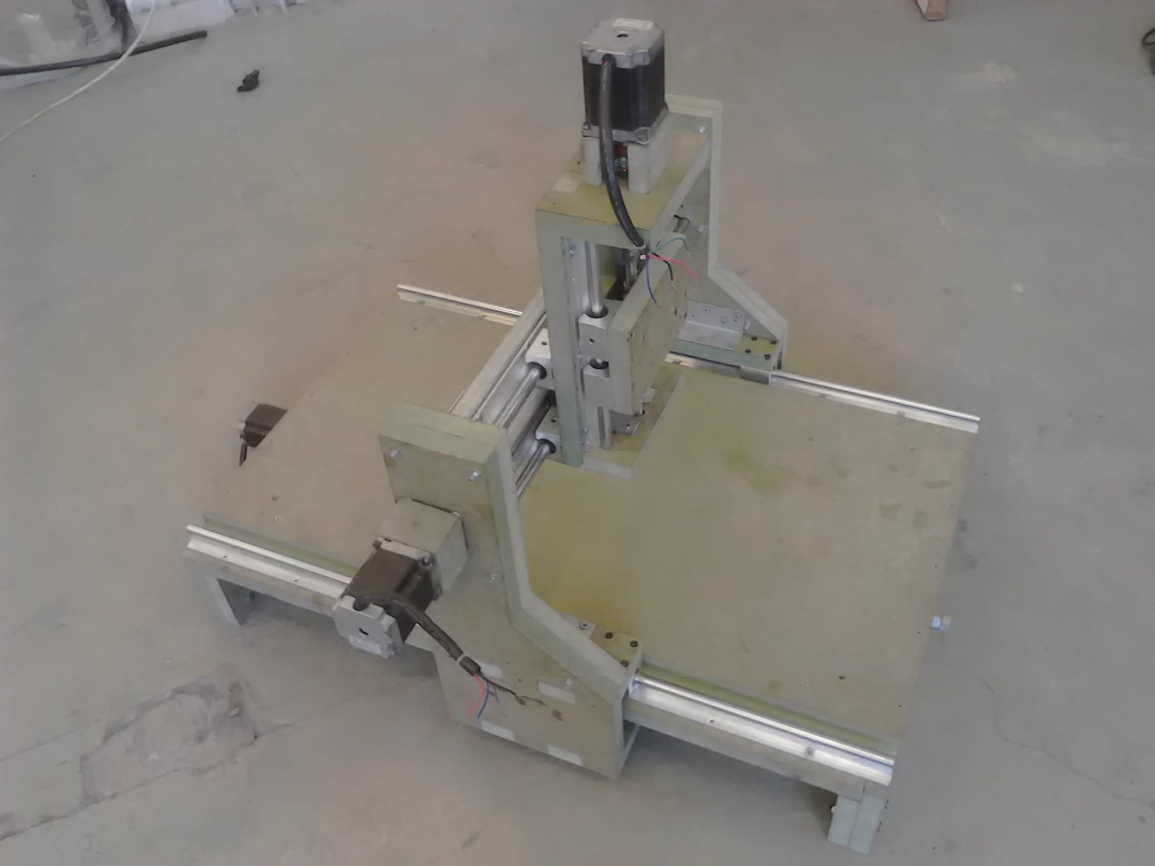
Graduation project ii:
3-axis cnc milling machine
Supervisor: Eng. Salameh Abdul Fattah.
Team: Enas Fouqha, Mahmoud Radwan, Rimal Zaareer
Wala’ Blebleh, and Zaid Hmaid

Slide 2
Presentation Layout
Introduction
Mechanical Part
Electrical Part
Control
Conclusion

Slide 3
Introduction

Slide 4
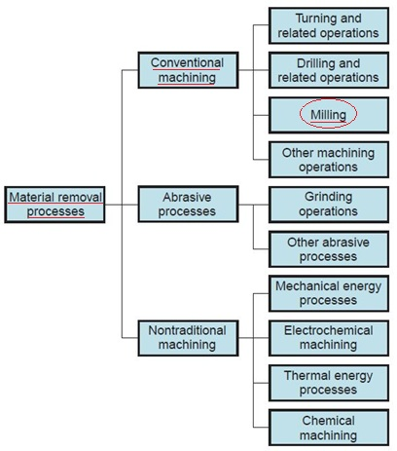
Machining and milling
One of the most important manufacturing processes.
Milling is an example of machining.
A rotating cylindrical tool removes parts of the work piece

Slide 5
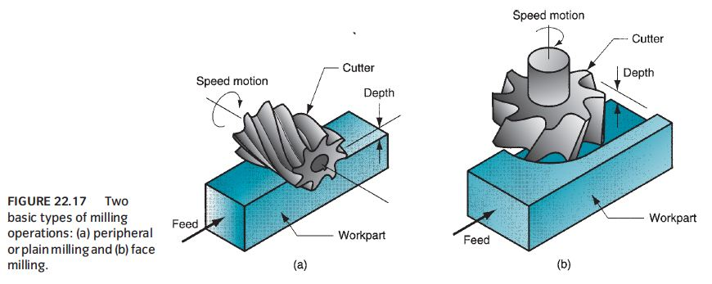
Types of milling operations

Slide 6
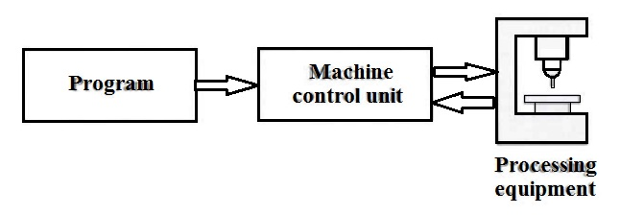
What is CNC ?
Computer Numerical Control
Complete integration between machine and computerized control

Slide 7
Mechanical part

Slide 8
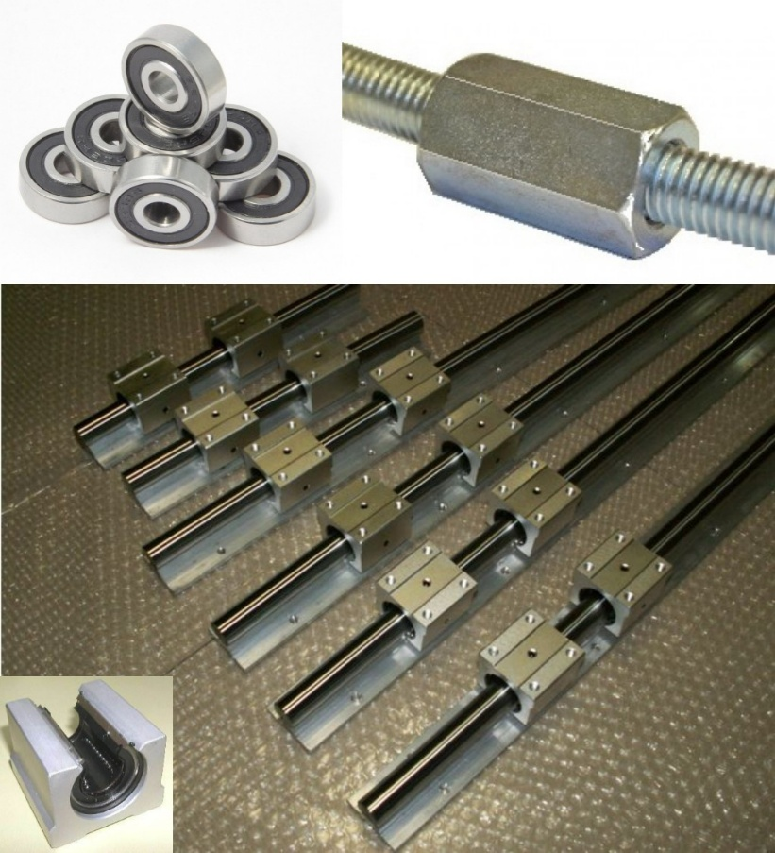
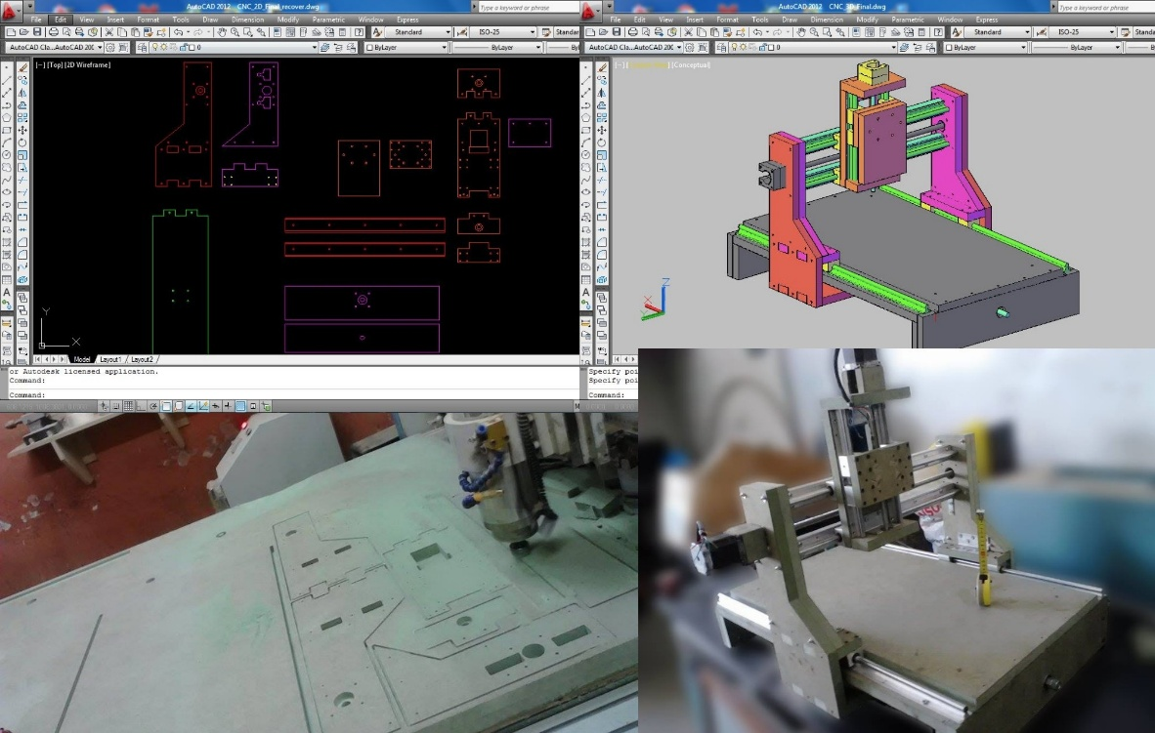
Mechanical design
Frame design
Transmission systems

Slide 9
Frame design
From CAD design to practice
Materials
Assembly

Slide 10
Frame design
Withstand effects of
- Static loads:
weight of machine parts
weight of work piece
- Dynamic loads
Vibrations due to spindle and motors
bending of axes and screws
Optimum in dimensions and materials

Slide 11
From CAD to practice
2D drawings
3D models
Practical models

Slide 12
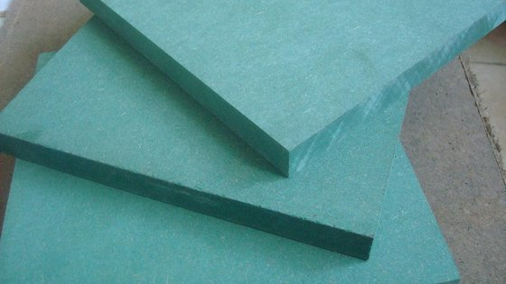
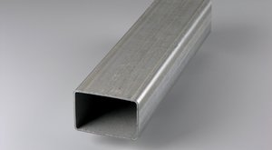
Materials
Green MDF (wood)
Galvanized steel

Slide 13
Assembly
Wood and metal screws
Bolts-and-nuts, and Ellen bolts
Welding

Slide 14
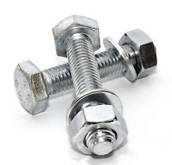
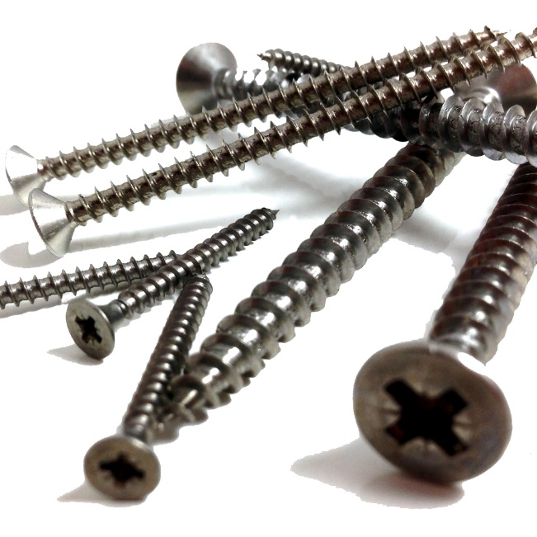
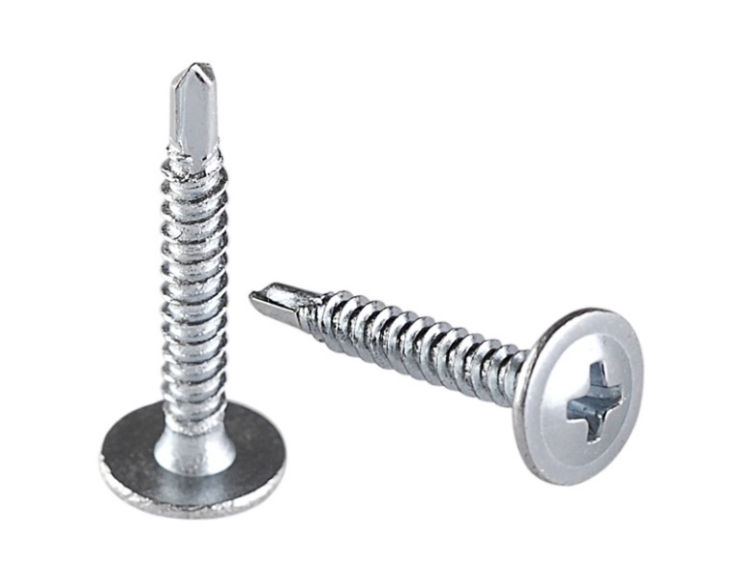
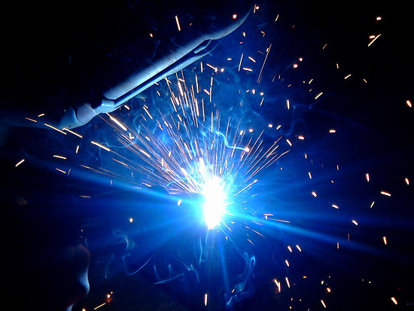
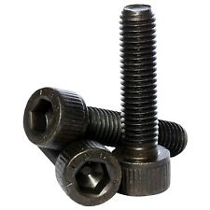

Slide 15
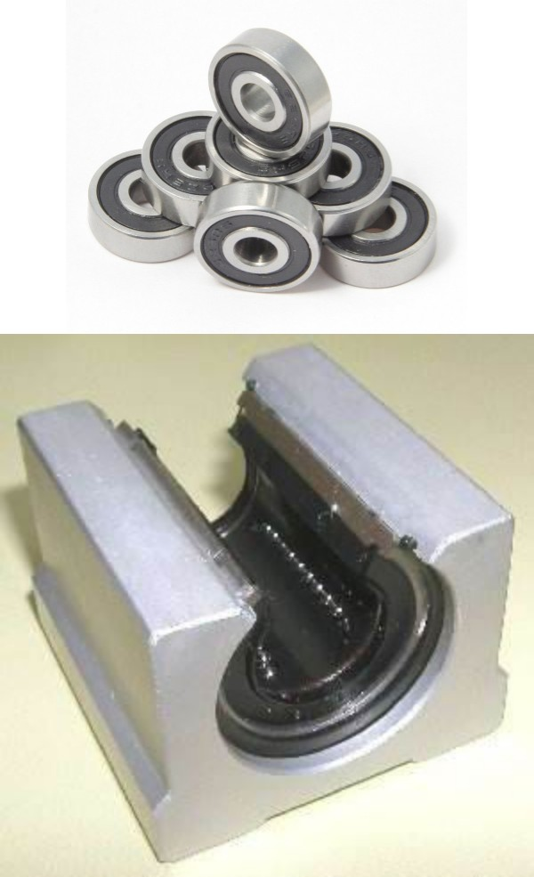
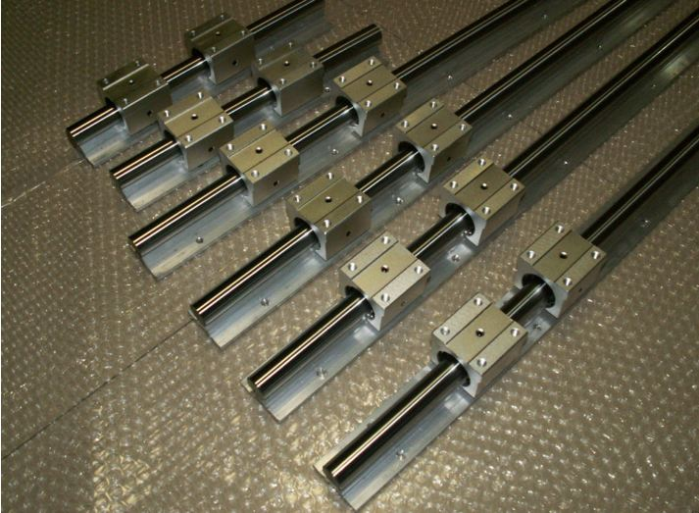
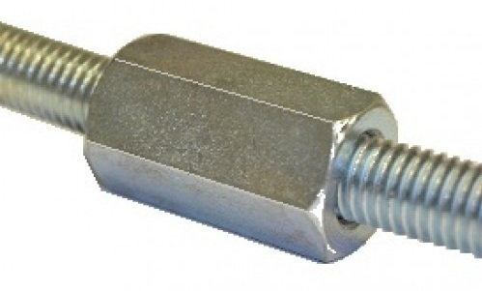
Transmission systems
Rails
Lead screw
Bearings

Slide 16
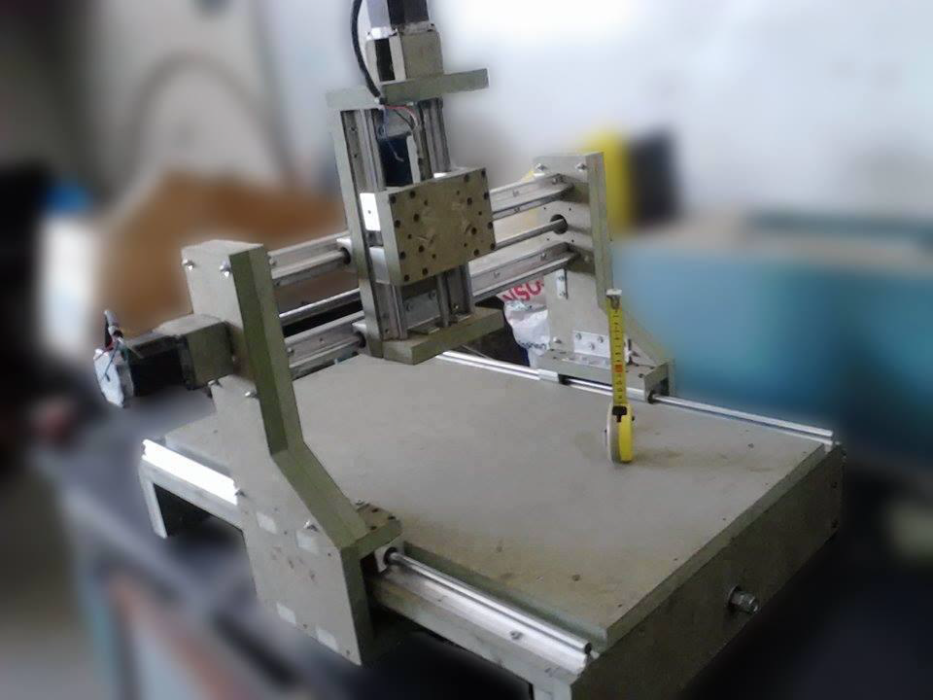
Rails
Y, Z & X rails

Slide 17
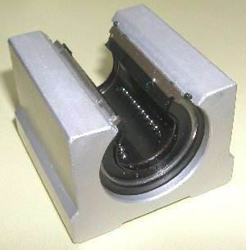
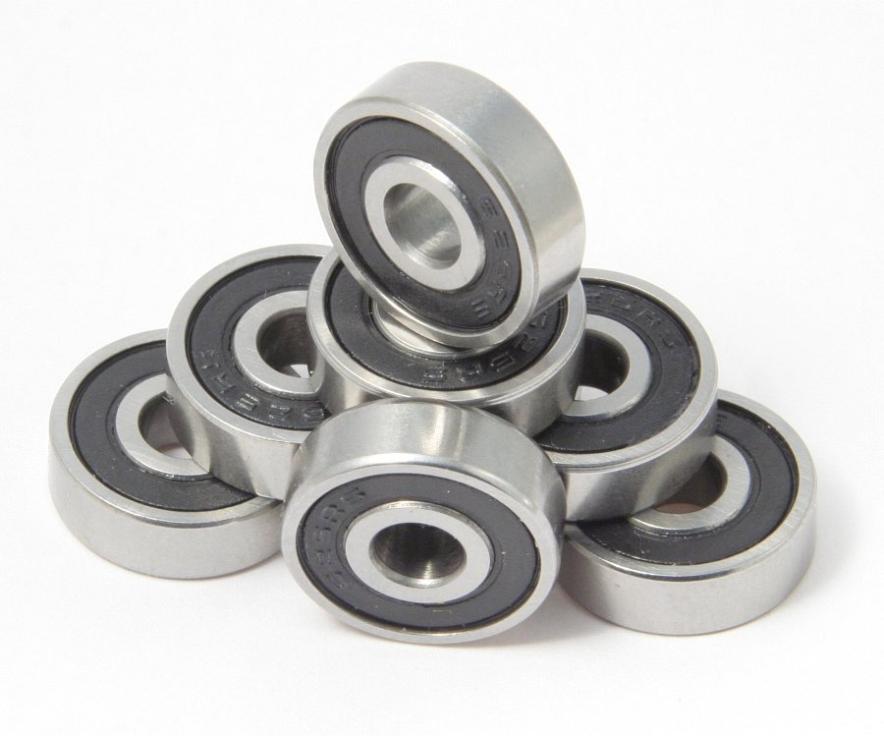
Bearings
Linear guide bearings
Shaft ball bearings

Slide 18
Rails
Rails used in each Axis :
Specifications | X-axis | Y-axis | Z-axis
Rail type | SBR12 | SBR12 | SBR12
Diameter | 12 mm | 12 mm | 12 mm
Length | 835mm X2 | 575mm X2 | 260mm X2

Slide 19
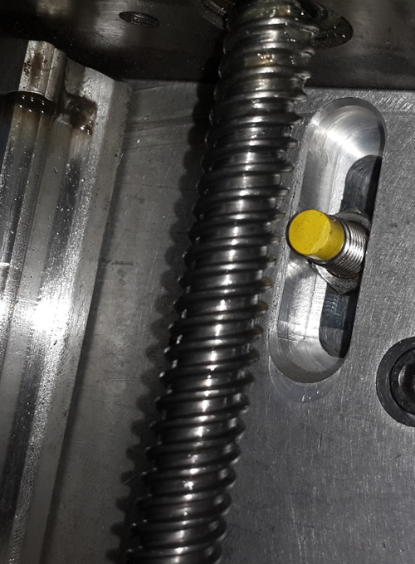
Lead screw

Slide 20

X, Y and Z Motor tuning (screw)
The screws that used in the project is single start that mean :
For X and Y axes :-
Lead ($\frac{Distance moved}{number of revolution}$) = Pitch = 1.75 mm/rev
steps per millimeter = $\frac{400 steps}{rev}×\frac{1}{1.75}\frac{rev}{mm}$= 228.57 Steps/mm

Slide 21

X, Y and Z Motor tuning (screw)
The screws that used in the project is single start that mean :
For Z axis :-
Lead ($\frac{Distance moved}{number of revolution}$) = Pitch = 1.5 mm/rev
steps per millimeter = $\frac{400 steps}{rev}×\frac{1}{1.5}\frac{rev}{mm}$= 266.67 Steps/mm

Slide 22
Electrical part

Slide 23

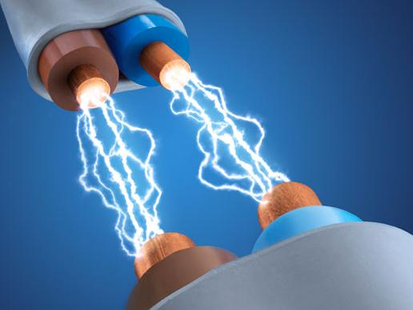
Electrical Part
Power
Control

Slide 24
Power
Power supply units
Electrical protections
Motors

Slide 25
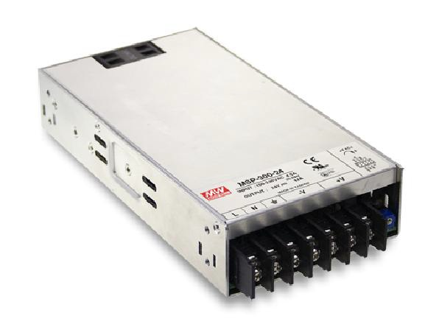
Power supply units
Switching power supply for stepper motor drivers.

Slide 26
Electrical protections
Guard against over current
Fuses : Used to prevent over current from destroying the electrical devices.
In this project, fuses provide protection for the drivers and the power supply.
Isolate inputs/outputs from controller
Opto-couplers : The main function of opto-couplers is to isolate the microcontrollers from the I/O signals

Slide 27
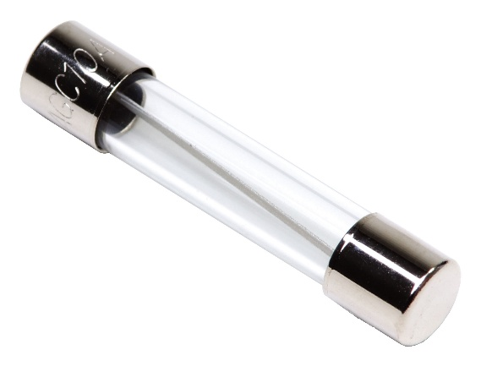
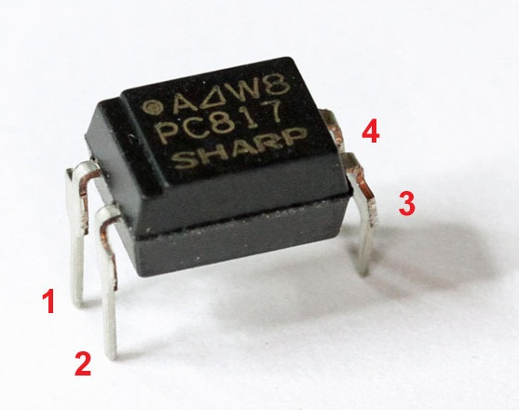
Electrical protections
Fuses
Opto-isolators

Slide 28
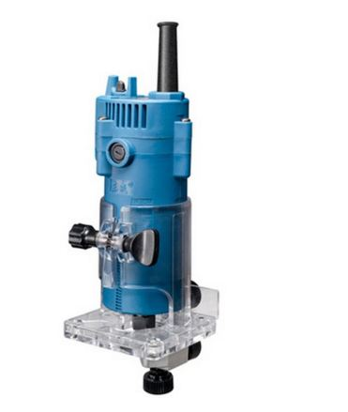
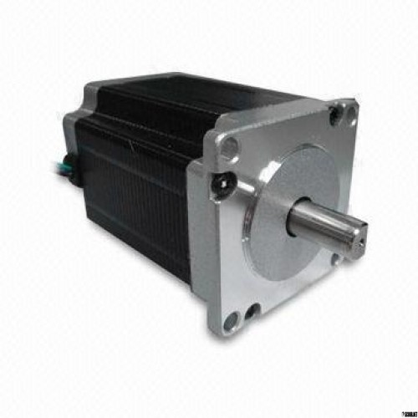
Motors
AC spindle
Stepper motors

Slide 29
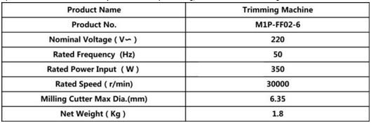
Spindle specifications

Slide 30
Stepper motors
What are stepper motors good for?
Good position control : Since steppers move in repeatable steps,
Speed control : allow for excellent control of rotational speed for process automation and robotics, by sending a pulses with different frequency.
Low-speed torque : A Stepper motor has maximum torque at low speeds, so they are a good choice for applications requiring low speed.

Slide 31
Stepper motor specifications
NEMA 23 stepper motors
2-phase
Bipolar connection
Rated current = 2A
Maximum torque = 3N.m
Step angle = 0.9 degrees/step

Slide 32
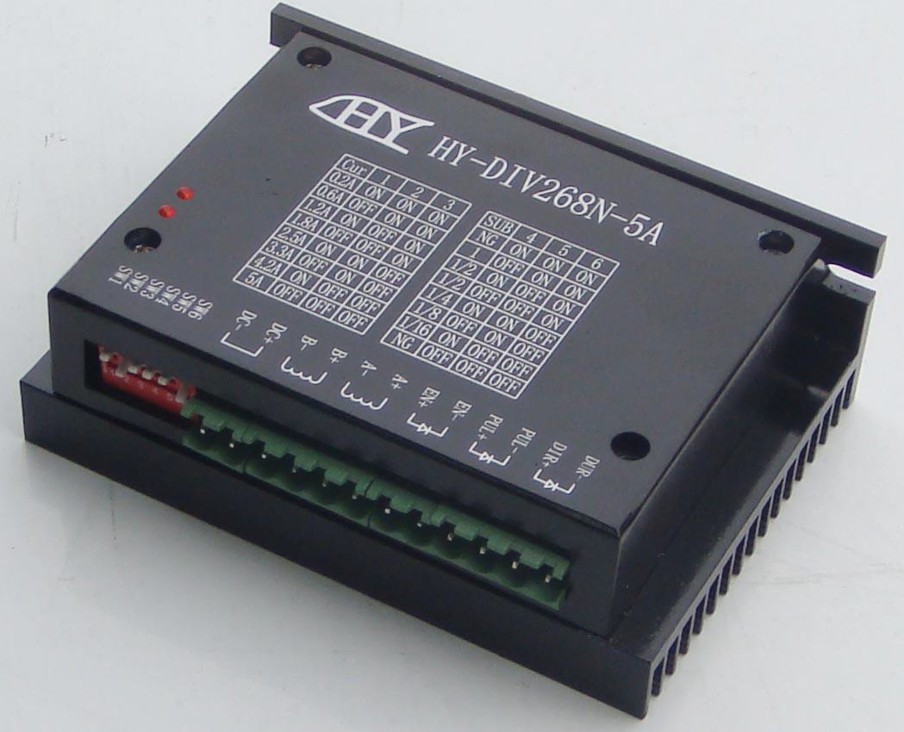
Stepper motor drivers

Slide 33
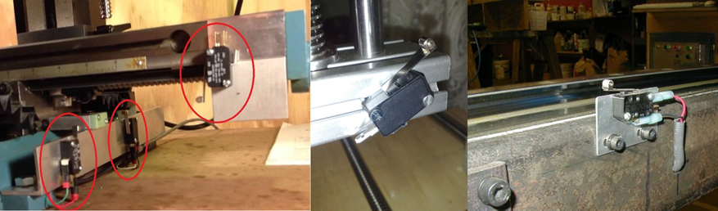
Hardware control
Limit and home switches

Slide 34
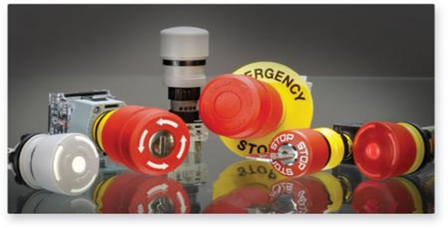
Hardware control
Emergency switch

Slide 35
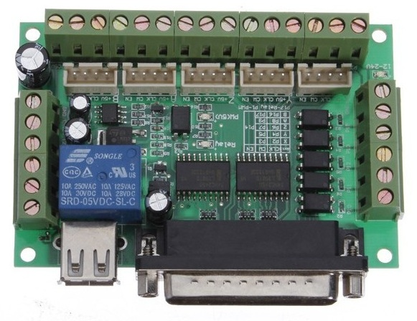
Hardware control
Breakout board

Slide 36
Software

Slide 37
CAD Drawing Software
Computer Aided Drawing
It draws the part as a vector image
Saved as DWG

Slide 38
CAD Software
Computer Aided Manufacturing
It converts the DWG to machine instruction language G-Code
Parameters needed to be optimized is
  Offset
  Speeds

Slide 39
Control software
It converts the G-Code into Pulse signals through the parallel port

Slide 40
MACH 3
Flexible
Customizable
Provides Adjustable Acceleration
Can handle with several inputs and feedback

Slide 41
Conclusion

