Slide 1

AIEN
artificial intelligence electronic nose

Slide 2
Introduction
Smell is one of our five senses and is linked by the olfactory bulb to the limbic system that controls behavior, emotion, and even memory also it could save humans' life by detecting dangerous odors but unfortunately humans can’t detect some dangerous odors like certain gasses and in general human can smell different odors but our brains couldn't recognize it and because there is some material are dangerous for humans to smell or touch
From this point we creat AIEN

Slide 3
WHAT IS AIEN
AIEN is modified electronic nose can detect odors using an array of sensors that sent all information to microcontroller and create database that have several odor and for sure can detect gas liquid and solid materials using AI software to analyze and determine different odor's and display it on external screen.

Slide 4

AIEN consist of
1- Plastic bottle
9- DC 12V fan
10- 220V fan
11- Funnel
12- Power Supplies
2- Arduino mega
3- Arduino uno
4- Nextion Resistive Touch Screen
5-Compressor nebulizer
And MQ sensors
6-Out-side case
7- Double relay
8- DHT22 Sensor

Slide 5

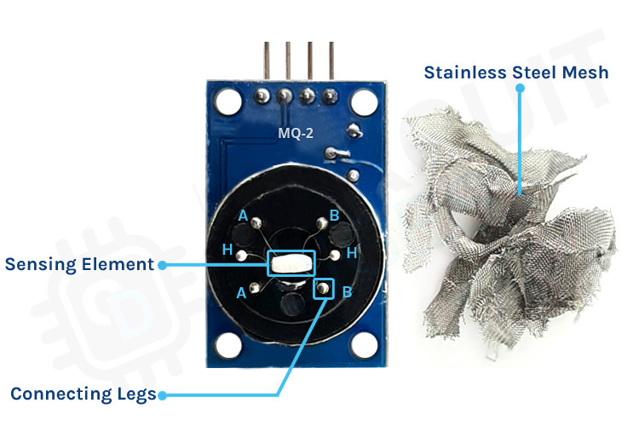
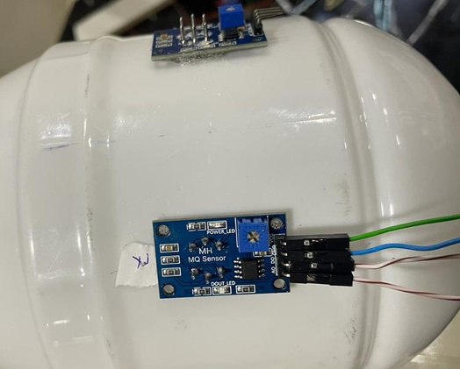
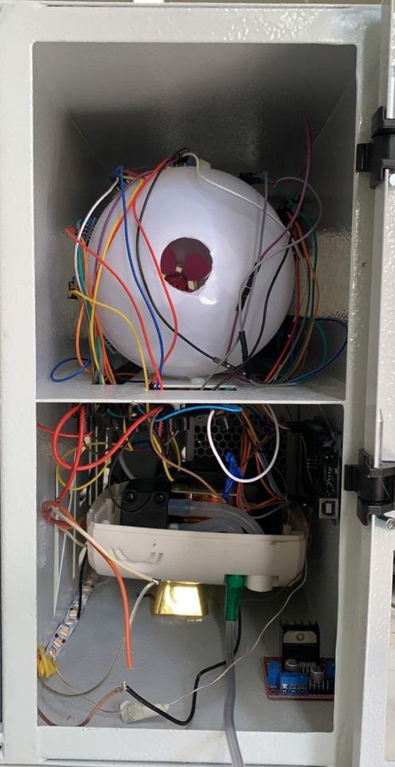
MQ Sensors
MQ-2 | Methane, Smoke
MQ-3 | Alcohol, Ethanol
MQ-4 | Methane, CNG gas
MQ-5 | Natural gas
MQ-6 | Butane gas
MQ-9 | Propane
MQ-135 | Ammonia, Air quality

Slide 6

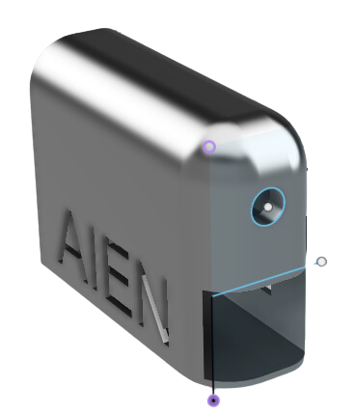
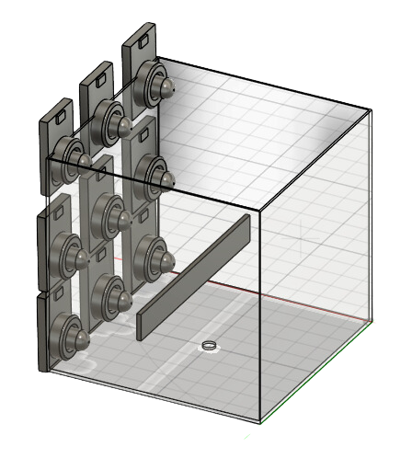
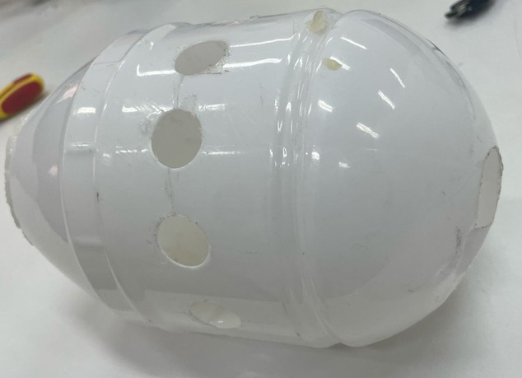

what changed?
"we have implemented significant changes in our project, encompassing a comprehensive transformation of both its internal structure and the operational processes. This overhaul extends to the control system, external facets, and the integration of an advanced Artificial Intelligence system. These modifications have been strategically undertaken to enhance the overall efficiency and functionality of the project."

Slide 7
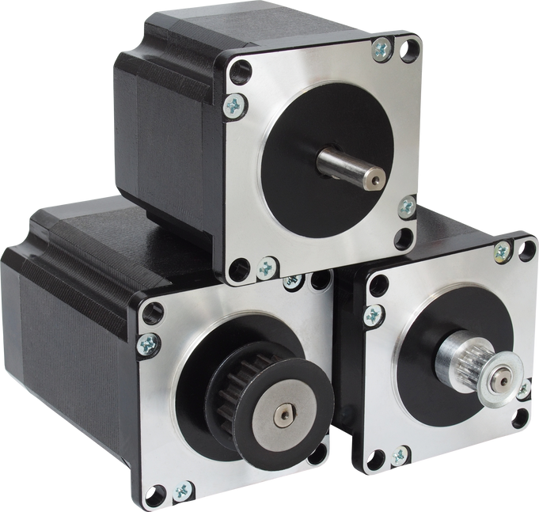

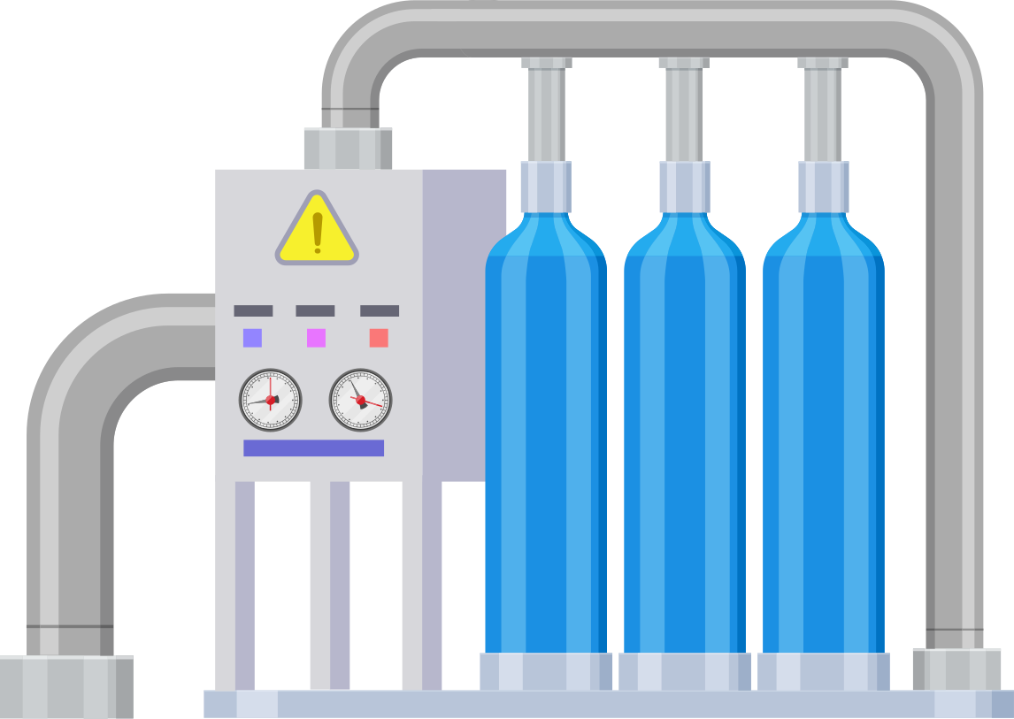
How AIEN works ?
control system
AI system
filteration system

Slide 8


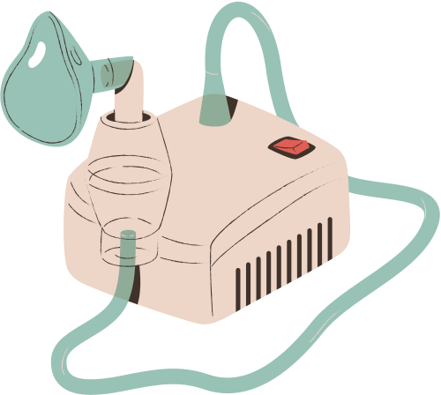
Control System:
The Control System stands as the master conductor of AIEN's operations. This elegant system is responsible for overseeing the seamless coordination of various components, and its efficiency lies in its simplicity.
Through a user-friendly touch screen and intuitive switches, the Control System allows effortless interaction with AIEN. , and even customize the filtration process.With the precision of a virtuoso, the Control System commands the motors that drive AIEN's internal mechanisms. These motors enable smooth movements, ensuring the most accurate and efficient odor sampling.

Slide 9

Filtration System:
The Filtration System serves as the guardian of AIEN's olfactory purity, purging any lingering odors that might interfere with the accuracy of subsequent samples.
Its primary role is to cleanse AIEN's environment between samples, eliminating any residual scents that might linger from previous detections.
This diligent system ensures that every sample is taken in a pristine, uncontaminated environment, guaranteeing the utmost accuracy in odor detection.

Slide 10
AI system
The AI System is the true genius behind AIEN's extraordinary capabilities, transforming raw data into invaluable insights.
Armed with advanced algorithms and machine learning, the AI System collects and analyzes vast amounts of data from AIEN's array of sensors.
With a stroke of artistry, the AI System draws intricate plots, revealing complex patterns and relationships in odor profiles.
This cognitive powerhouse possesses the ability to calibrate and correct sensor values, ensuring unmatched accuracy in identifying and differentiating odors.

Slide 11
z score
A Z-score is a statistical measure that quantifies the relationship of a data point to the mean of a group of data points. It is expressed in terms of standard deviations from the mean. The Z-score is particularly useful for comparing individual data points to a standard normal distribution, which has a mean of 0 and a standard deviation of 1.
The formula for calculating the Z-score of a data point (X) in a distribution with mean (μ) and standard deviation (σ) is:

Slide 12
Neural network

Slide 13

input
hidden layers
output
Weight

Slide 14
Activation function
Activation functions are used in neural networks to introduce non-linearities into the network. The inclusion of non-linear activation functions is crucial for enabling neural networks to learn and approximate complex relationships in data. Without activation functions, a neural network would essentially reduce to a linear model, no matter how many layers it has.

Slide 15
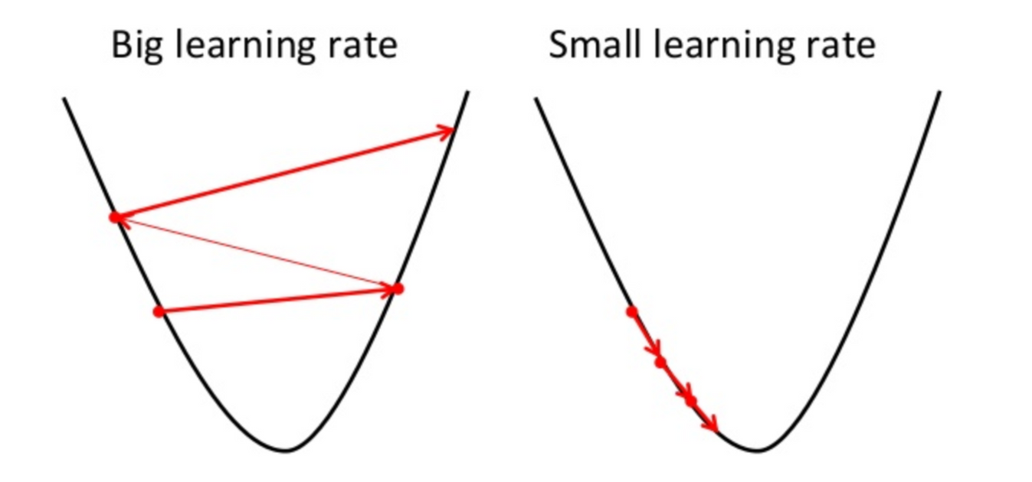
gradient decent
Gradient descent is a fundamental optimization algorithm used in training neural networks. Neural networks consist of interconnected layers of nodes (neurons), and during training, the network learns to adjust its parameters (weights and biases) to minimize a given cost or loss function. Gradient descent is employed to find the optimal set of parameters that minimize this cost function.

Slide 16







Goals
plots
data collection
data analysis
data correction

Slide 17
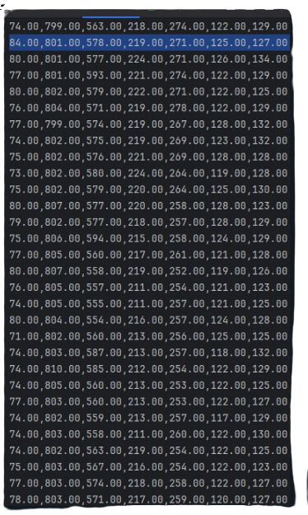


Serial monitor
The Serial Monitor allows you to communicate with a microcontroller or Arduino board through a serial connection (usually over USB). It's often used for debugging and monitoring the behavior of the program running on the microcontroller in real-time.

Slide 18
temperature

Slide 19
stage one
perfumes

Slide 20
stage two
Alcoholic and non-alcoholic drinks

Slide 21
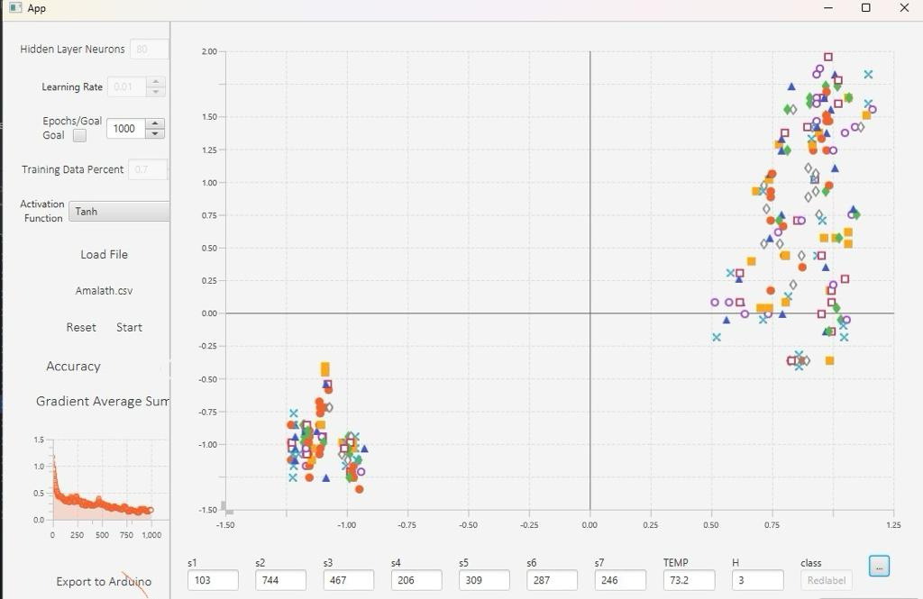
83.04%

Slide 22

stage 3
DRUGS

Slide 23

Conclusion
In conclusion, electronic noses, or e-noses, represent a groundbreaking technological advancement with far-reaching implications across various industries. These devices, inspired by the human olfactory system, are designed to detect and identify odors and volatile compounds. Through sensor arrays and advanced data analysis, e-noses offer the ability to 'smell' the invisible, enabling applications that range from quality control in food and beverages to environmental monitoring, healthcare, and beyond.

Slide 24

Thanks for your listening
FEEL FREE TO ASK ABOUT ANY THING
with respect

