Slide 1
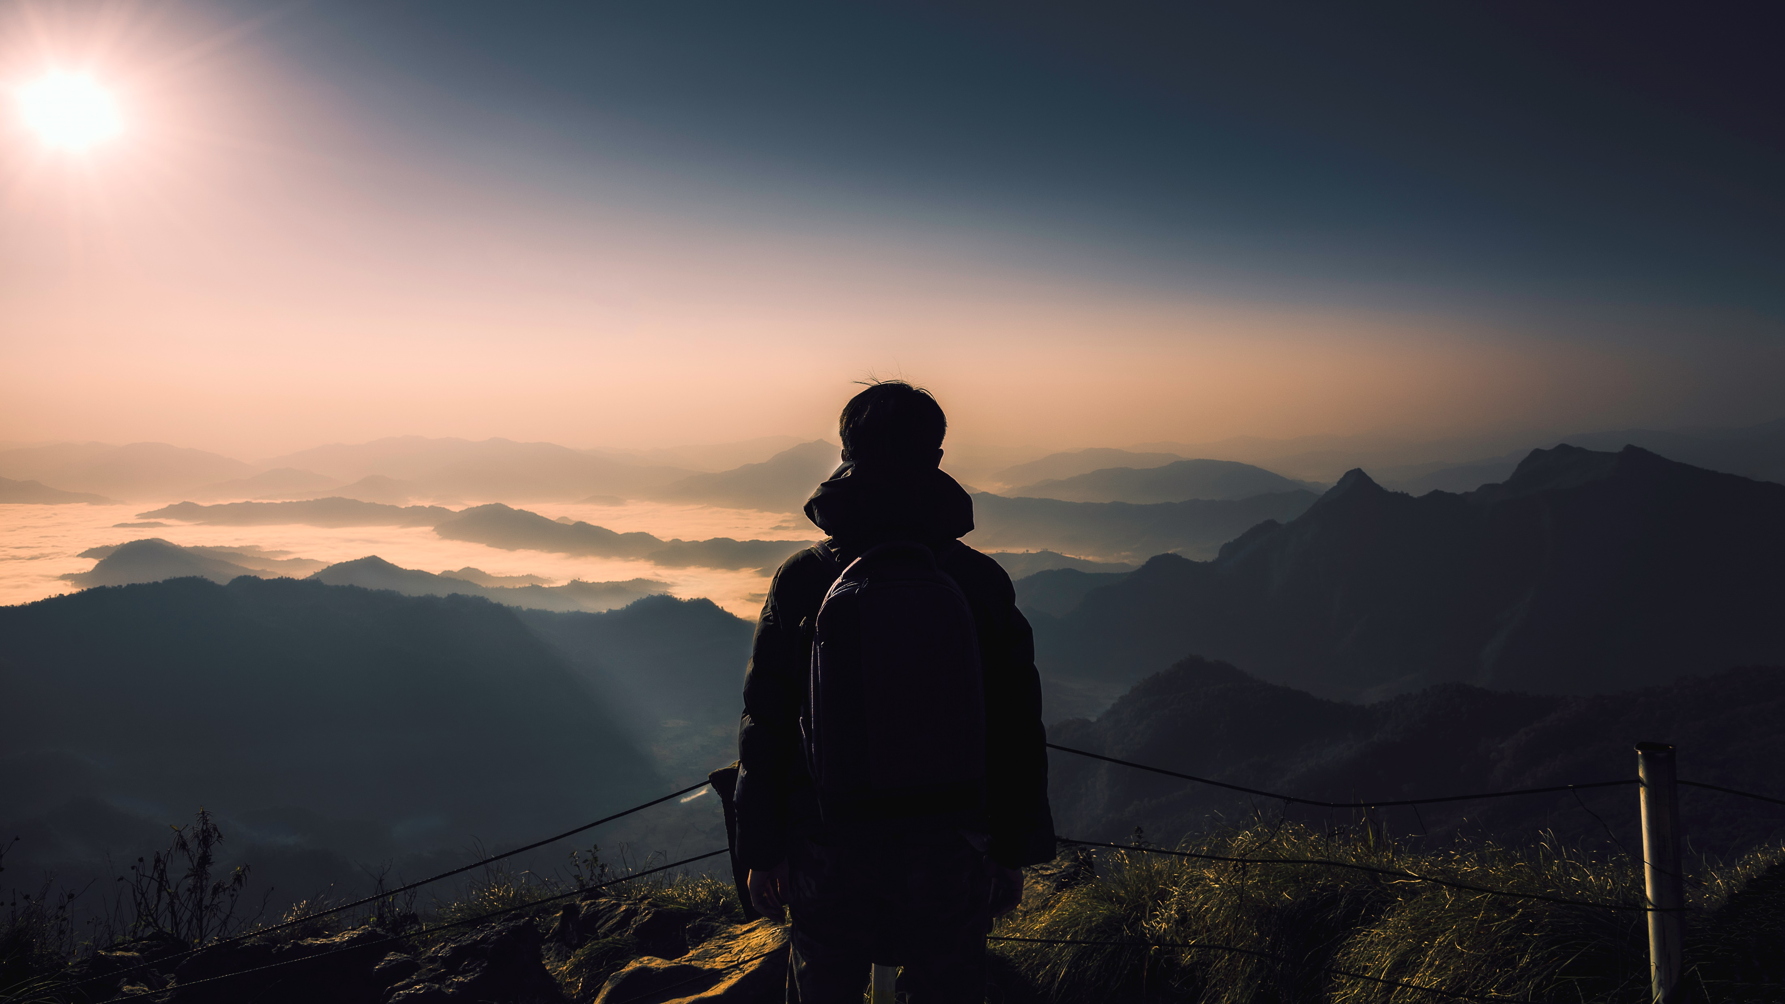
masaar
Enhancing Internal Tourism in the West Bank

Slide 2

Author:
- Jehad Abu Raed
- Osaid Jabaji
Supervisor:
Dr. Anas Toma
        Faculty of Engineering
Computer Engineering Department
Graduation Project

Slide 3
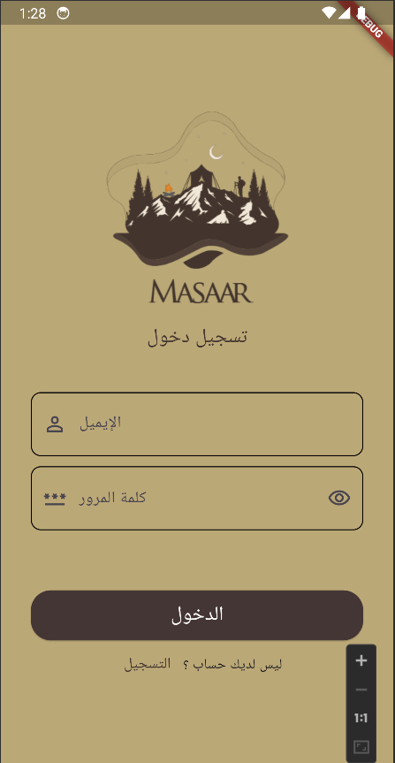
Introduction
“Masaar” is an application for booking tourist trips, camping, and climbing trips designated for Palestinians.
It can also be used as a tour guide to go on your own trip.
For the younger generation and visitors, exploring the West Bank through tourism can be highly educational. It offers an immersive way to learn about the area's history, culture, and current socio-political context.

Slide 4
Problem
Domestic tourism in Palestine in general and in the West Bank in particular suffers from a lack of resources and organization.
There is no similar application in Palestine, although it has existed for years in some Western countries.
The occupation's continuous efforts to falsify heritage and archaeological monuments and erase history.

Slide 5
Solution - Masaar
From here came the idea to design an application that enables the user to search through several suggestions for going on a trip that suits his free time, his place of residence, and his physical and financial ability.
If the trip to the place he wants is not available at the time that suits him, he can go alone or with his friends with the help of our application as a tourist guide.

Slide 6
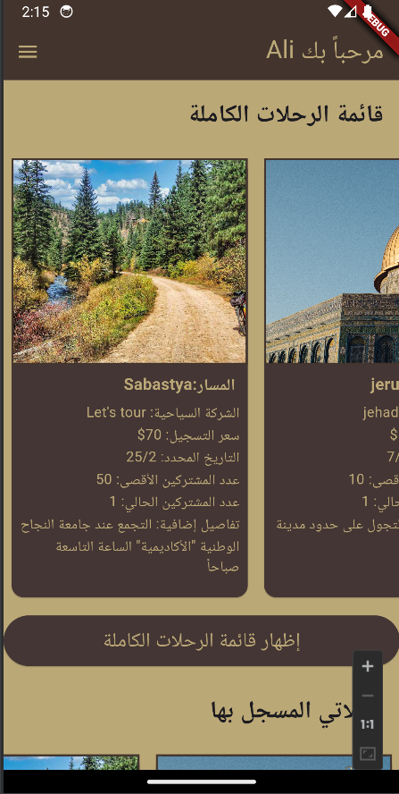
Features
1.(CRUD)
Adding a Trip :done by tourism companies or a tourist guide (company account) .
Registering for a Trip: normal users can register for trips.
Trip Management: pages dedicated to showing all trips, trips that the user has already registered for, or those created by a specific company and another.
Search ability : if the user wants to search for a specific trip or company.

Slide 7
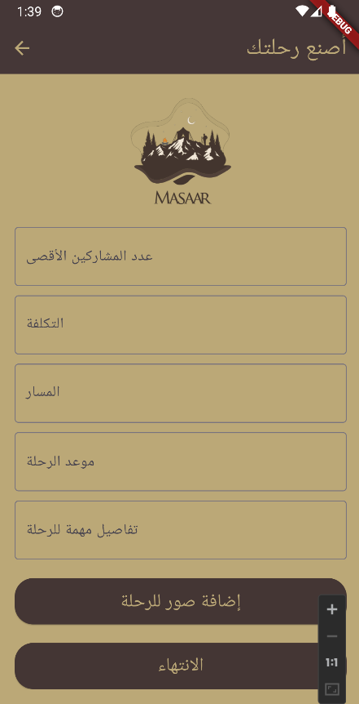
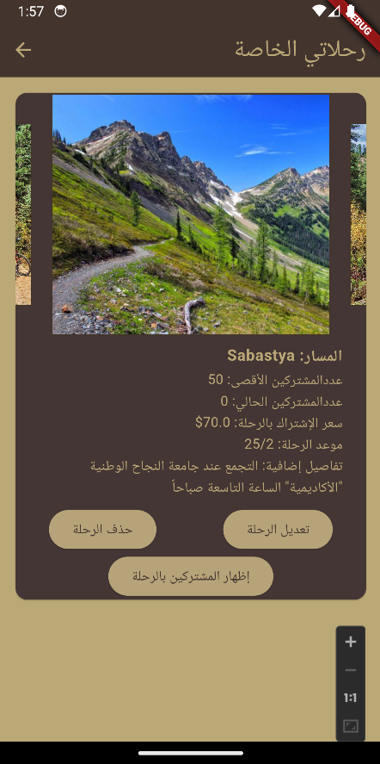
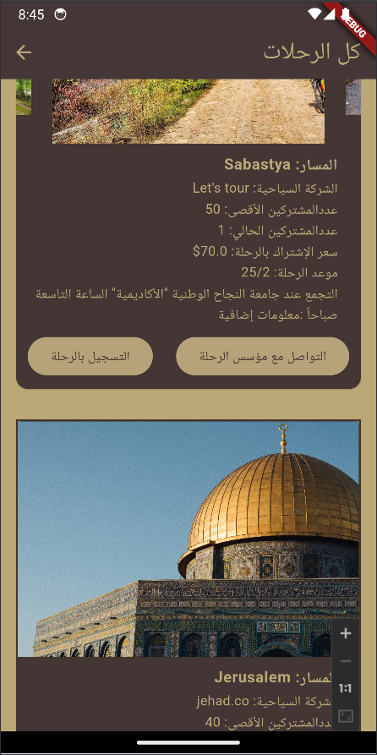
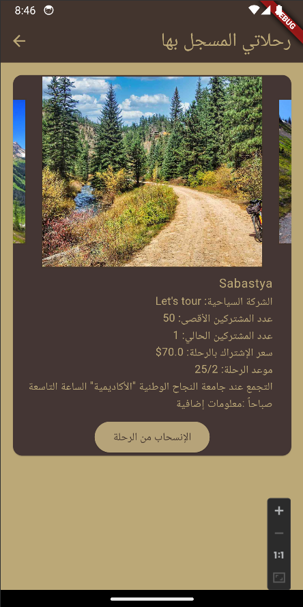
Trip Management

Slide 8
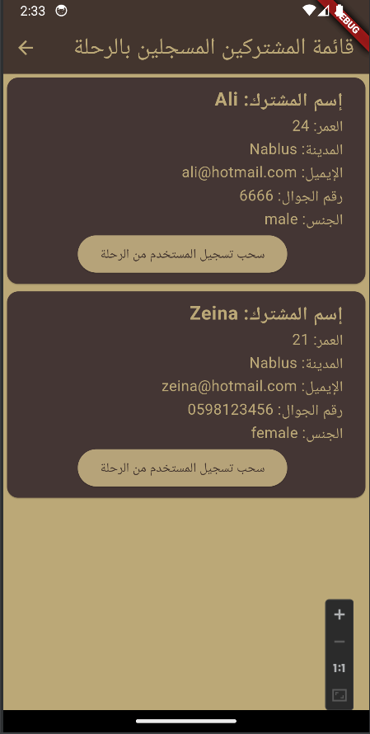
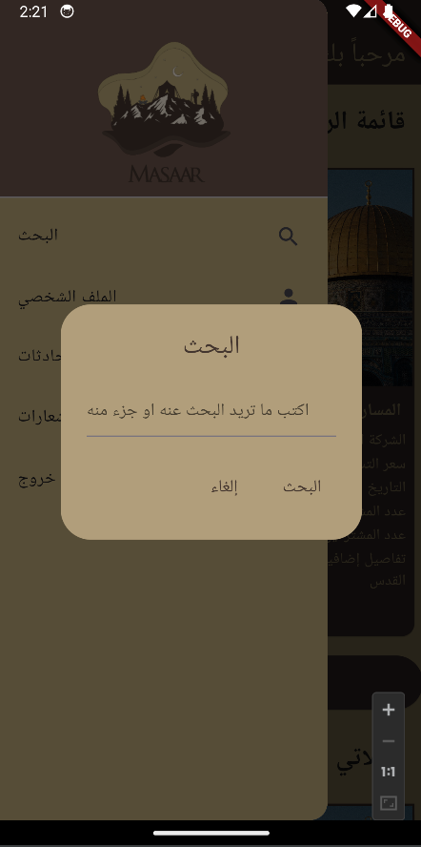
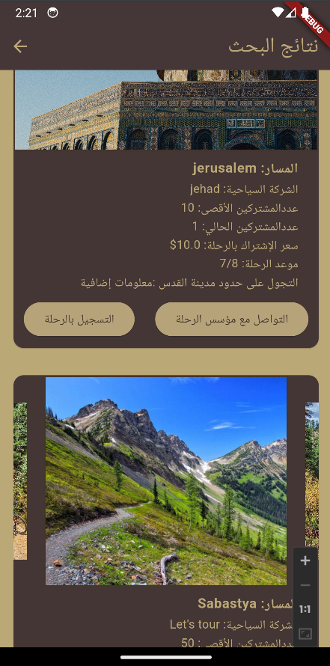
Participant info & Search Bar

Slide 9
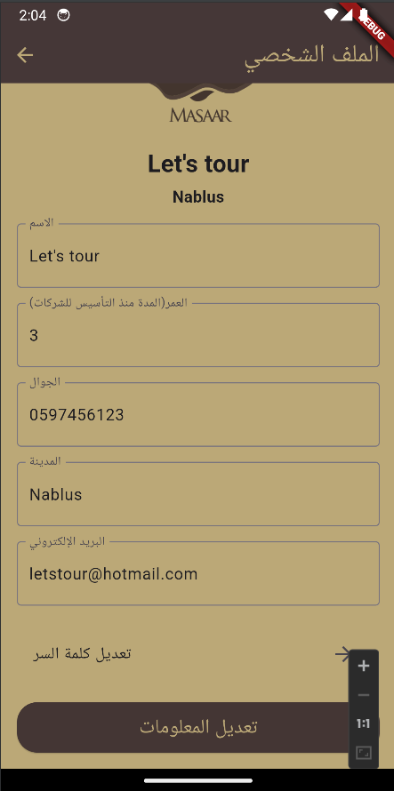
Features
2.(CRUD)
Company review : Users can rate companies (out of five stars).
The company has complete control over its tours : The company can view the participants in its trip and can delete any of them.
Suggestions for the most popular tours: which the user can review to choose the tour that suits him.

Slide 10
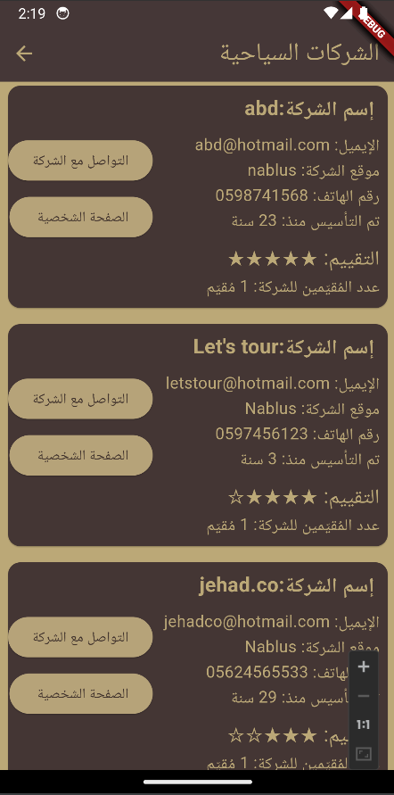
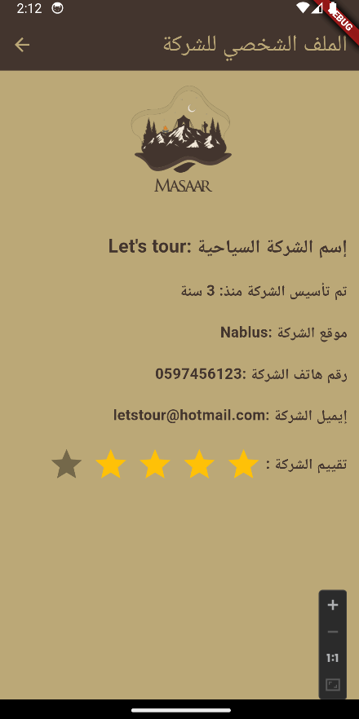
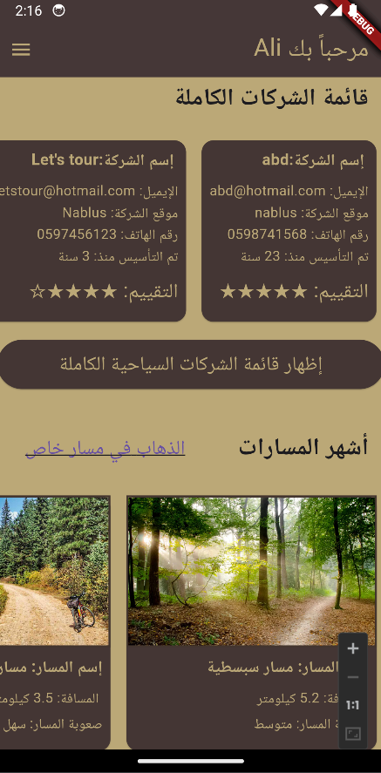
Company info & Solo Adventure

Slide 11
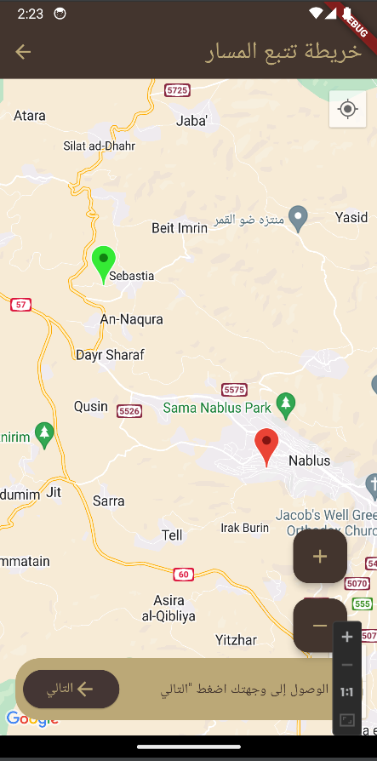
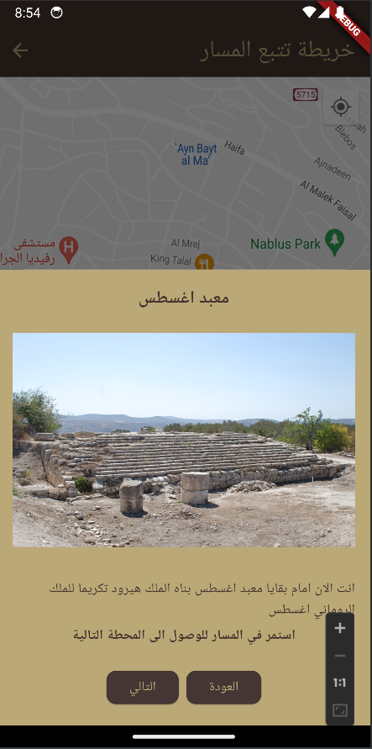
Features
3. MAP & GUIDE
When you choose to go on a private tour, and select one of the tours provided by the application, a map will be displayed showing your current location and the start location of the tour.
When you arrive at the beginning of the tour, the tour guide will provide you with information about the area and help you with directions until you complete your tour

Slide 12
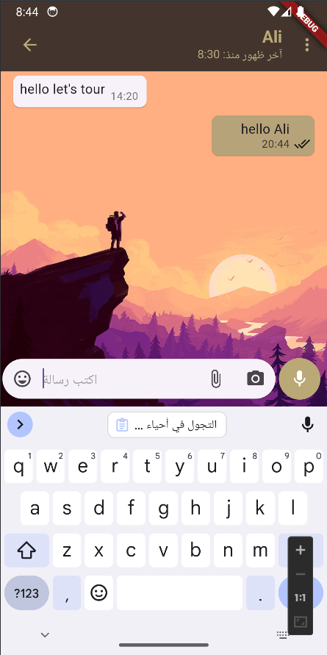
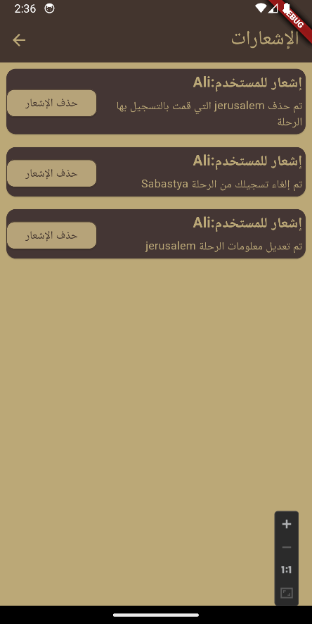
Features
4. CHAT & NOTIFICATOINS
The application provides the ability to chat between a company and a user if one of them needs to provide the other with more details.
The application also provides a notification system, and works to alert the user and the company if anything new occurs, such as modifying a tour date or if a company deletes one of the registered users, etc.

Slide 13






Technology Used
Front-End : Flutter (.dart)
Back-End : NodeJS (js)
Database : MongoDB

Slide 14
  Constraints and Limitations
1- fixed budget for development and implementation.
2- platform constraints : we test and build our project on Android devices due to the lack of resources for IOS Devices.
3- using the Arabic language in the GUI of our app which caused some display issues.

Slide 15
Conclusion
The anticipated impact of "Masaar" on the West Bank’s tourism landscape is significant. By facilitating easier access to tourism information and providing a platform for users to share experiences.
The app is expected to boost local tourism, support the economy, and promote the region's rich cultural heritage. This project has not only been about developing an application but also about contributing to the community and the local tourism industry.

Slide 16
Future Work
In envisioning the future trajectory of the "Masaar" app, our team is dedicated to exploring a range of enhancements and expansions that promise to elevate the platform's capabilities and user experience. A significant focus will be on the development of advanced personalization features, utilizing sophisticated algorithms to tailor tour and activity recommendations to individual user preferences and past behavior.
Augmented Reality (AR) integration is another exciting prospect, offering an immersive layer of digital interactivity to the exploration of historical sites and landscapes. Recognizing the diversity of our user base, expanding the language options within the app is a key objective, aimed at broadening accessibility and inclusivity.

Slide 17

Thanks

Slide 18
Q&A

