Slide 1

Home Automation System
Hardware project to control and monitor our smart home module remotely using a flutter mobile application.
Notes:
<a href="https://www.freepik.com/free-photos-vectors/background">Background vector created by freepik - www.freepik.com</a>

Slide 2
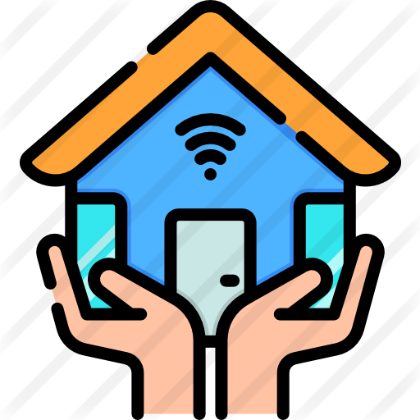
Motivation
The goal of the Smart Home is to facilitate the process of managing, monitoring and securing.
Luxury, convenience, energy management, security and connectivity.
Notes:
Photo by sergio souza on Unsplash
<a href="https://www.freepik.com/free-photos-vectors/business">Business vector created by katemangostar - www.freepik.com</a>

Slide 3
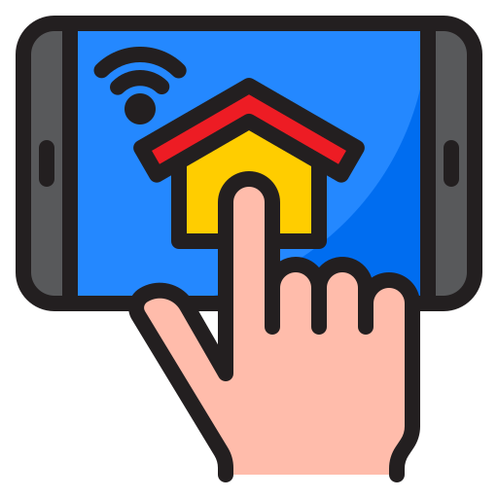
Smart Home
We had the opportunity to work on building such system.
Applying the IoT concept.
Notes:
<a href="https://www.freepik.com/free-photos-vectors/car">Car vector created by macrovector - www.freepik.com</a>

Slide 4

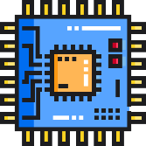
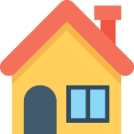
Work Steps
Idea
.
Electronic parts
Design
Mobile App

Slide 5
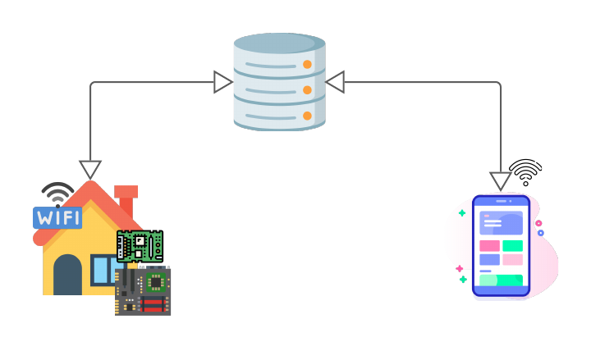
Project Architecture
Firebase Real-time Database
House model
Mobile Application

Slide 6
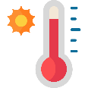




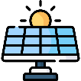

Features Implemented
Temperature & Humidity Monitoring
Water Tank Level
Fire & Gas Detection
Lighting System
Fan Control
Solar Panel
Security System
Notes:
<a href="https://www.freepik.com/free-photos-vectors/background">Background vector created by rawpixel.com - www.freepik.com</a>

Slide 7

Security System
Password
Face Recognition
.
Microphone

Slide 8
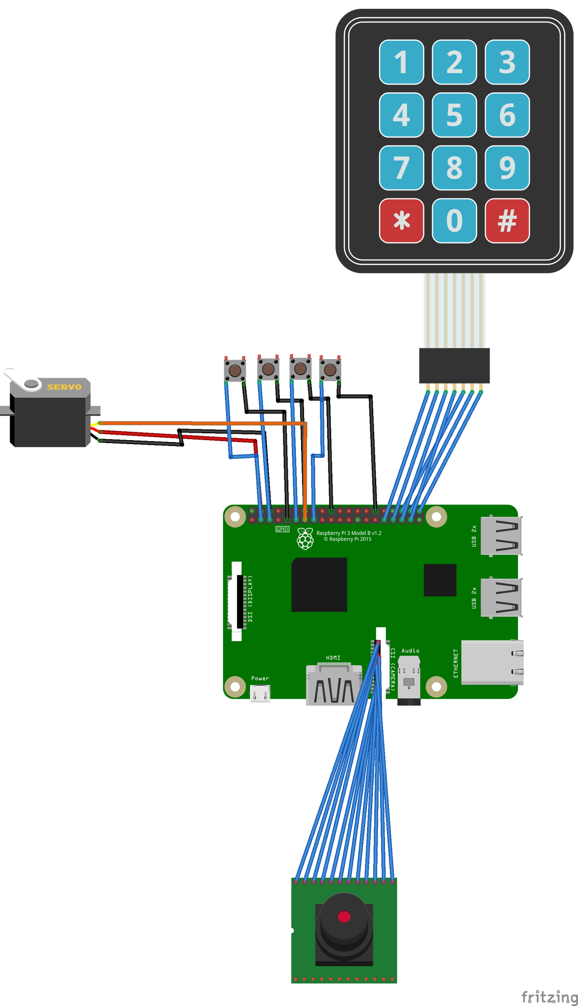
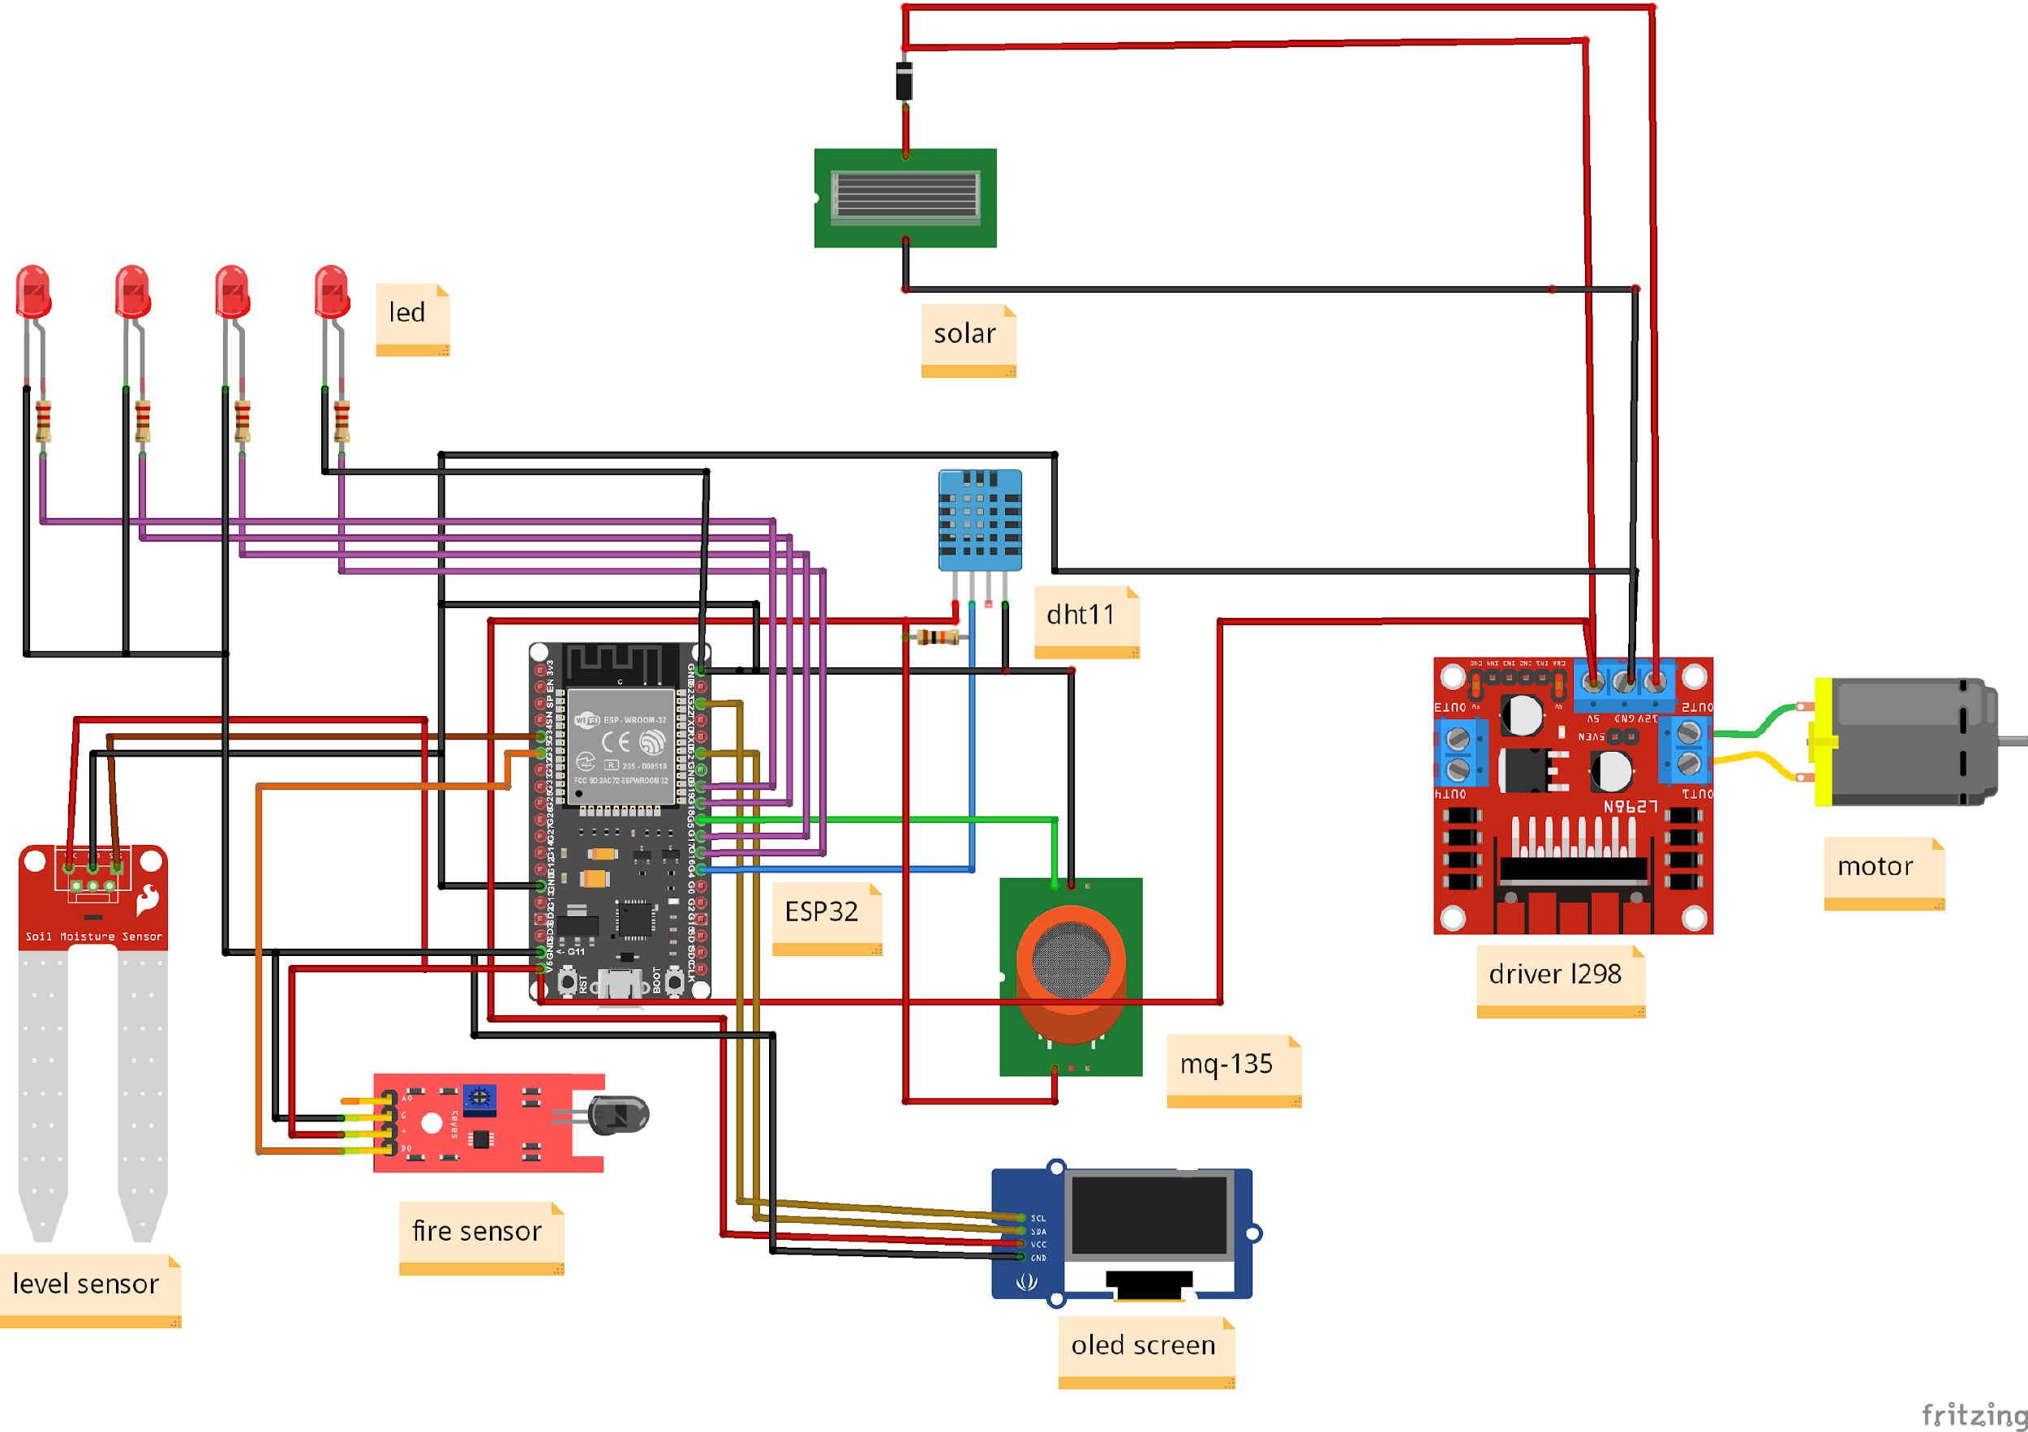
Schematics
ESP32 Circuit
Raspberry Pi Circuit

Slide 9
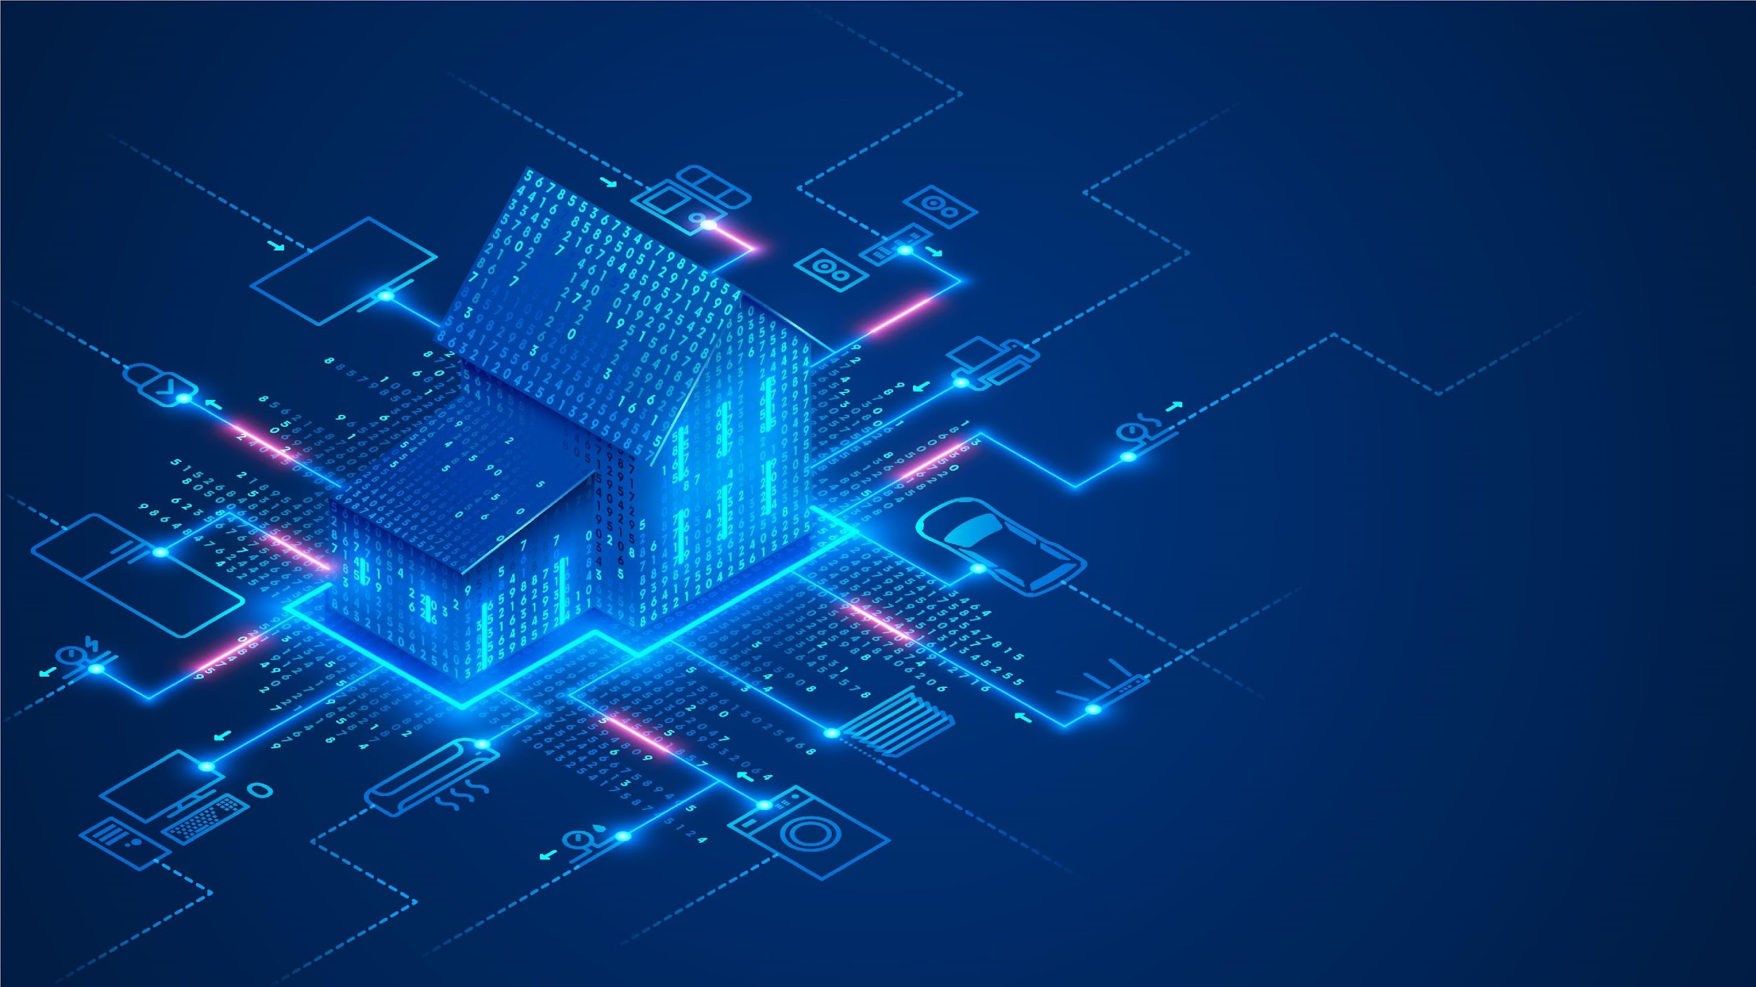

Conclusion and Future Work

Slide 10
THANK
YOU
Manar Shaar & Shahd Nassar
Supervisor: Dr. Sufyan Samara
Notes:
<a href="https://www.freepik.com/free-photos-vectors/background">Background vector created by freepik - www.freepik.com</a>

