Slide 1
Graduation Project 2
Assessment and Potential of using
Passivated Emitter and rear cell (PERC) in Palestine
Supervisor: Eng. Ramez Khaldi
Students:
* Belal Bazzari * Abdallh Shawhnee

Slide 2
Content:
Introduction
Energy types
PERC Cell and Advantages
Efficiency and Market Share
Methodology
Data Sheet
Devices
Experimental Data
Challenges
Recommendations
Conclusion

Slide 3
Introduction
The importance of energy.
Palestine is 100% dependent on neighboring countries for fuel, and 90% for electricity.
The percentage of renewable energy from the energy consumed in Palestine is 11.7% .
The percentage of families using solar heaters reached 56% in Palestine.

Slide 4
Energy types:
Non-renewable sources
Renewable resources
Fossil fuels
Natural Gas
Coal
Nuclear energy
Solar energy
Wind energy
Water energy
Geothermal

Slide 5
PERC Cell and Advantages
PERC stands for (Passive Emitter and Back Cell) and it is basically a process that adds an extra layer on the back of the solar cell to reflect some of the light photons that manage to pass through the cell back into the cell, thus increasing the overall efficiency. This method takes a standard solar cell and adds an extra layer to the backside. The passivation layer acts as a mirror that reflects the light that has already passed through the plate. This gives the light a second chance to be absorbed by the solar cell, resulting in increased absorption of solar radiation.

Slide 6
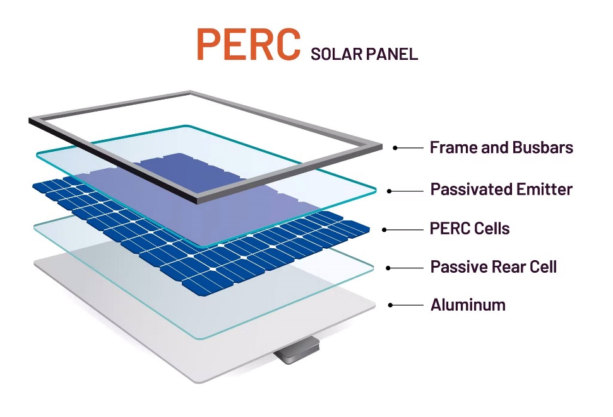
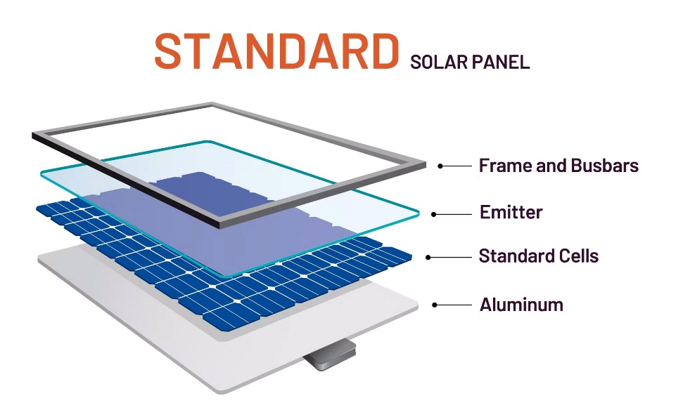

Slide 7
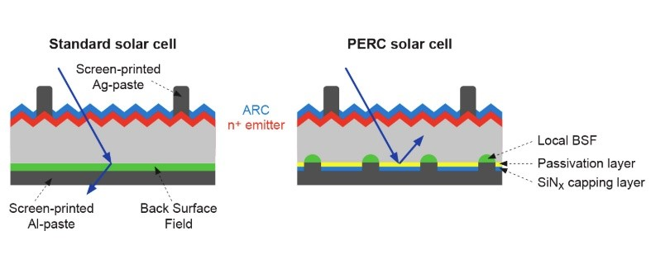

Slide 8
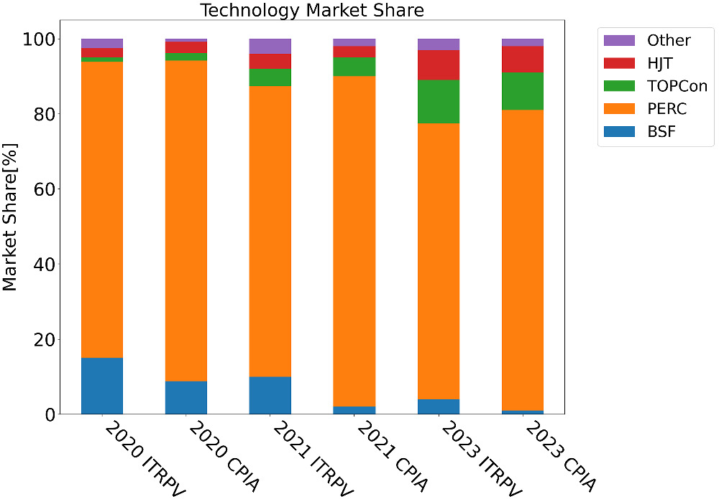
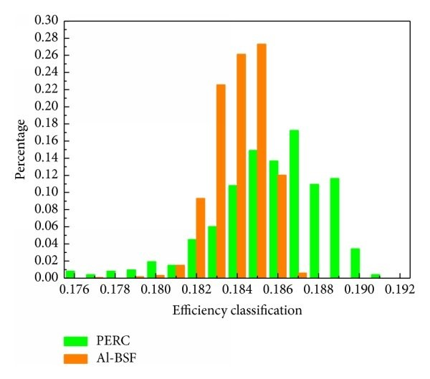
Efficiency and Market Share

Slide 9
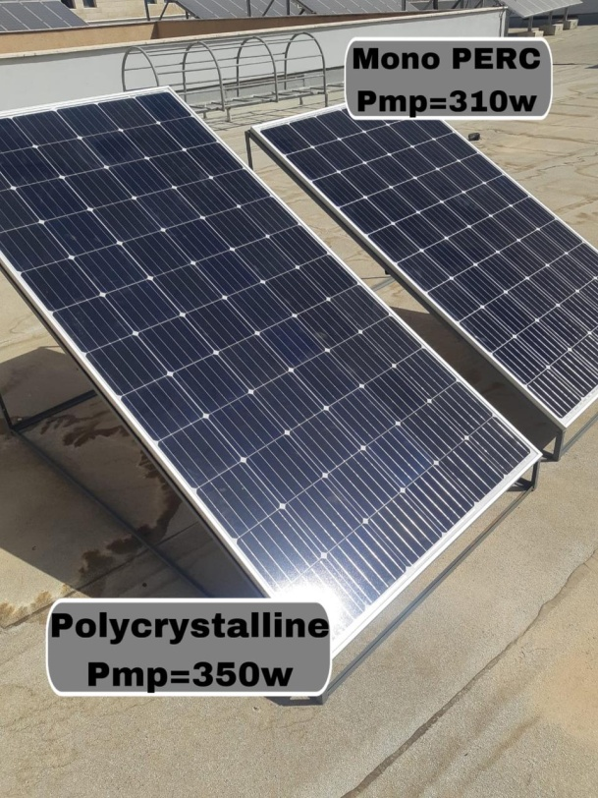
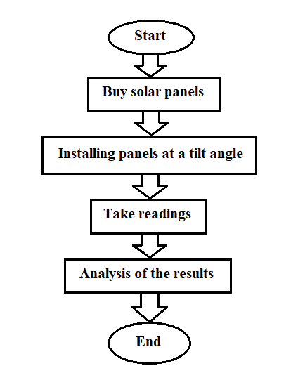
Methodology
The work plan

Slide 10
Data Sheet
Technology | Model | V_{OC} (V) | I_{SC} (A) | P_{mp} (W) | η (%)
PERC | TP660M-310 | 40.1V | 9.69 A | 310 | 18..9
AL-BSF | SR 350-72M | 47.24V | 9.56 | 350 | 18.03

Slide 11
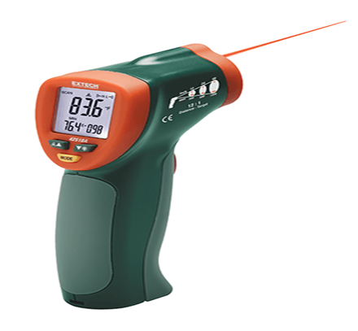
Devices
•Temperature Measurement by Using a thermometer

Slide 12
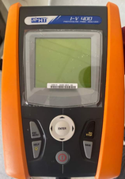
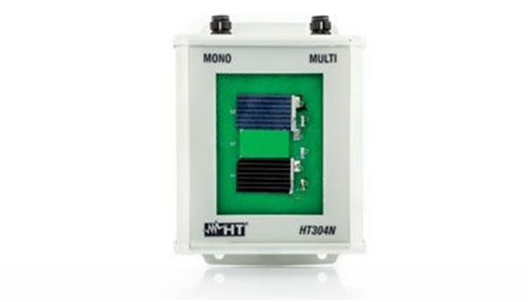
Devices
Irradiance & Power Measurements by Using IV-400.

Slide 13
Experimental Data
Power perc(w/m^2) | Power poly(w/m^2) | Irr perc poly(w/m^2) | Irr poly(w/m^2) | Temp perc(c°) | Temp poly(c°) | Hour | Date
72.70283 | 68.54426 | 360 | 390 | 33.1 | 34.1 | 9 | 2-Oct
114.2473 | 106.6817 | 605 | 587 | 39.9 | 41.1 | 10
141.129 | 130.3887 | 792 | 751 | 56.6 | 57.7 | 11
153.9589 | 140.6961 | 882 | 826 | 50.2 | 51.1 | 12
0 | 0 | 0 | 0 | 0 | 0 | 1
148.4604 | 125.235 | 858 | 758 | 48.5 | 49 | 2

Slide 14
Temperature Measurement Result

Slide 15
Irradiance Measurement Results

Slide 16
Power Measurement Results

Slide 17
  Efficiency Measurement Results :

Slide 18
  Challenges
The IV-400 is not able to give readings for panels with a short-circuit current (Isc) higher than 9.99A, so we had to search for panels with an Isc (short-circuit current), and it was also difficult to find two panels with the same capacity and area, and after a lot of searches we got two plates and we couldn't get the same capacity and area, because of that we compared the power per unit area (w/m^2)

Slide 19
Conclusion:
Economic analysis proves that this technology has dominated the photovoltaic market for the past four years, and PERC technology has reached its theoretical limit of 24.5% cell efficiency. The results of the experimental study in Palestine (the hot Middle East and North Africa region) proved that this technology adds more energy and efficiency. By studying the factors affecting the efficiency of the photovoltaic cell and analyzing the results that we studied in this project.

Slide 20
Recommendations
Through the results that appeared in our experience, we recommend the use of PERC panels, due to their efficiency and high energy productivity in the climate of Palestine, and we recommend those who are about to install solar energy panels to make sure that the panels that will be installed are of high efficiency.

Slide 21
Thanks

