Slide 1
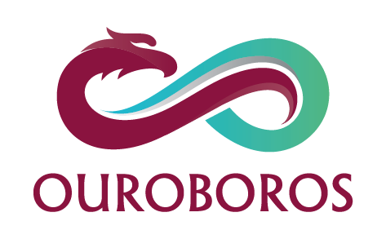
Presented by: Ban Afanah & Rema’ Bdair
Supervised by: Dr. Samer Arandi

Slide 2

Outline
App’s idea.
Users’ segment.
Process.
Features.
Challenges.
Future work.

Slide 3
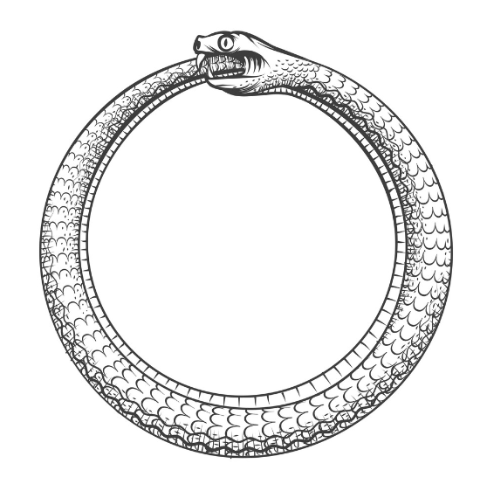
What does Ouroboros mean?
Greek word meaning “tail devourer”.
A snake or a dragon eating its tail.
Symbolizes infinity and rebirth.

Slide 4
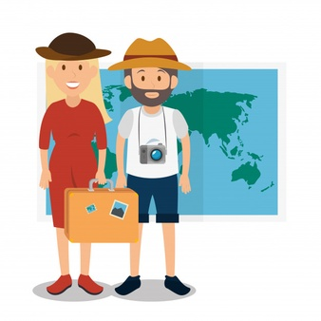
What is Ouroboros?
Android App.
Dedicated for tourism.
Shows previous statuses of places using AR.
Extended to the web.

Slide 5




What is Ouroboros?

Slide 6



Process
Data collection
Development
Testing

Slide 7
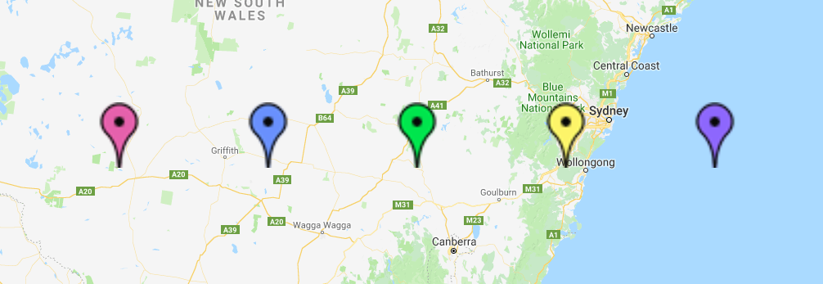

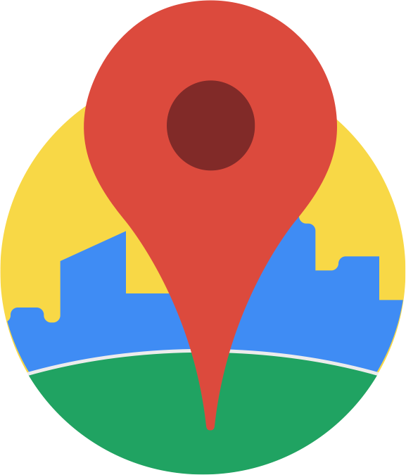
Features: Touring
current location

Slide 8




Features: Touring

Slide 9

Features: Users’ Community
Post - comment feed.
Ability to add images.
Tagged places.

Slide 10
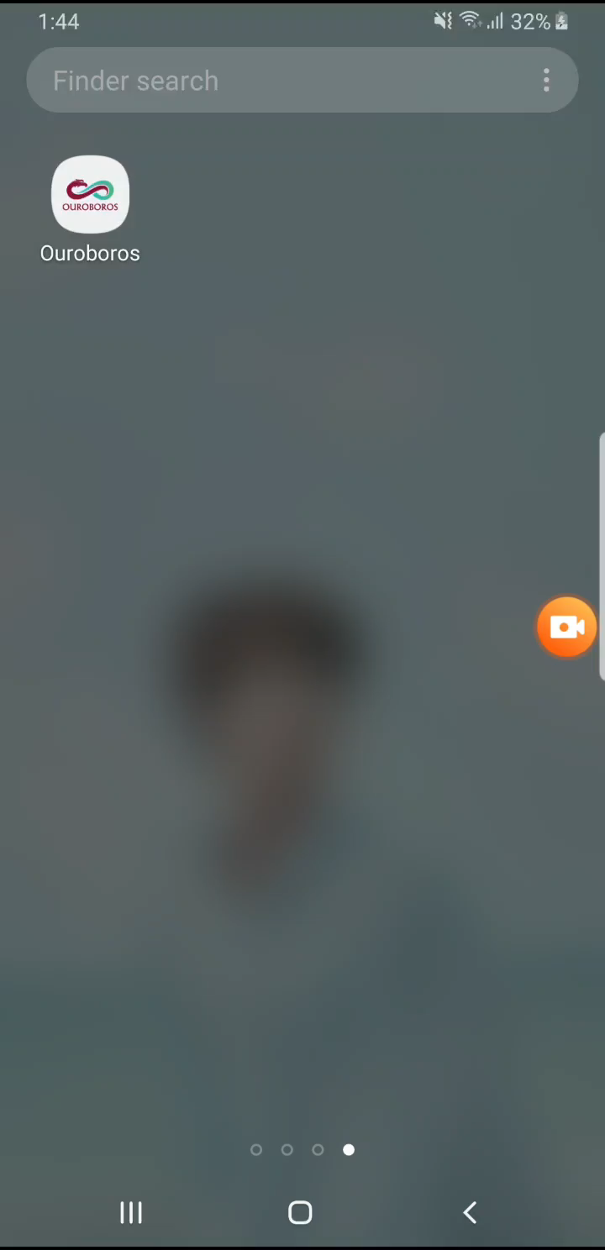

Slide 11
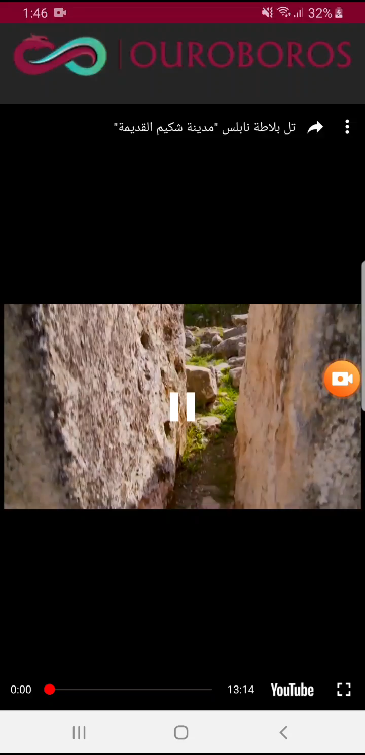

Slide 12
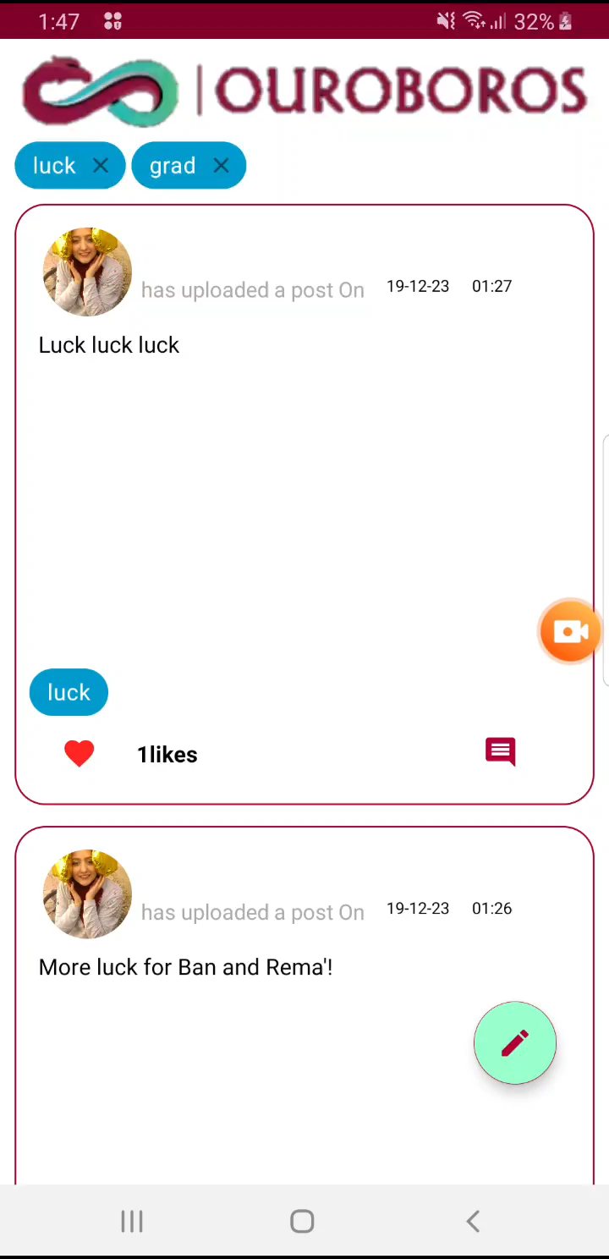

Slide 13
Features: AR
ARCore, Unity Engine.
Internal database of place’s photos.
Scan current views.
Match scanned view with the database.
Show 3D model.

Slide 14
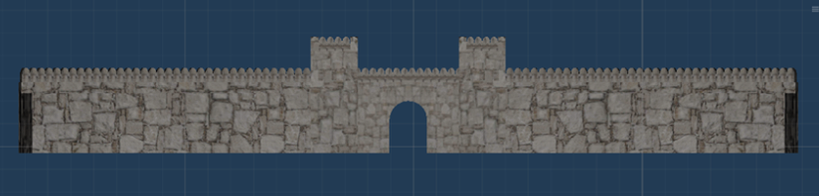
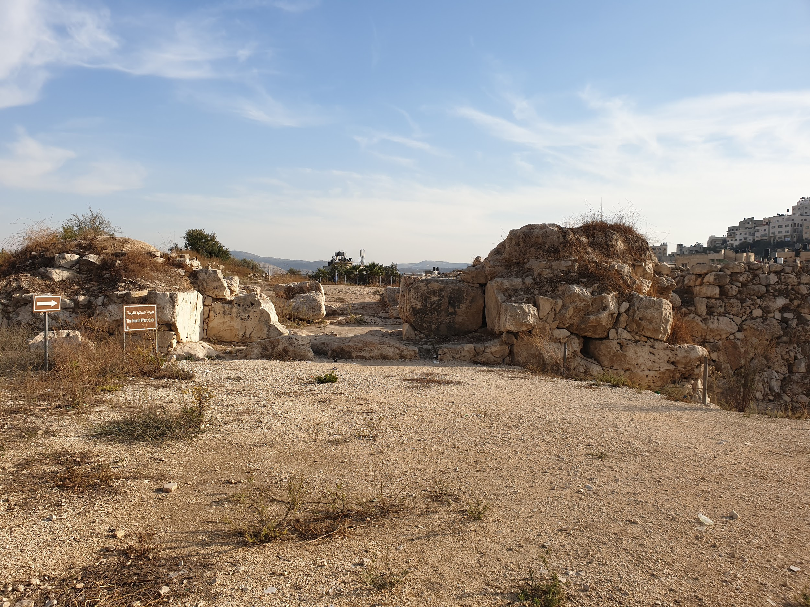
Tell- Balata

Slide 17

Features: Users’ Stories
Track user’s steps when in a tour.
View user’s trip and activities.
Allow user to edit activities.
Share stories with other users.

Slide 19
Challenges
3D modelling.
Testing in-sight.
Hardware capabilities.

Slide 20
Future Work
Image processing.
Location-based AR.
Expand to more places.

Slide 21
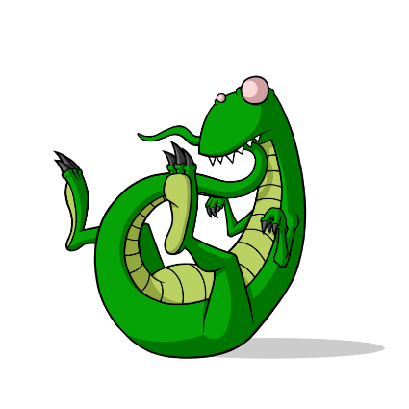
Thank you!

