Slide 1



GIS-Based Airport Sites Suitability (ASS) Mapping in the
West Bank, Palestine
By:
Yousef Mohammed Odeh – 12028892
Mohammed Ahed Nafee – 12010072
Supervisor: Prof. Sameer Shadeed
Geomatics Engineering Program, An-Najah National University

Slide 2



BACKGROUND
The importance of airport management:

Slide 3


IMPORTANCE AND OBJECTIVES
The ultimate goal of this project is to develop an airport site selection suitability map in the West Bank, Palestine.
  Develop a GIS-based MCDA model to integrate various factors (environmental, social, economic, and operational) and create a comprehensive airport site suitability (ASS) map.
  To integrate the developed ASS map with some other layers, such as governorates, Oslo, and Land use.

Slide 4
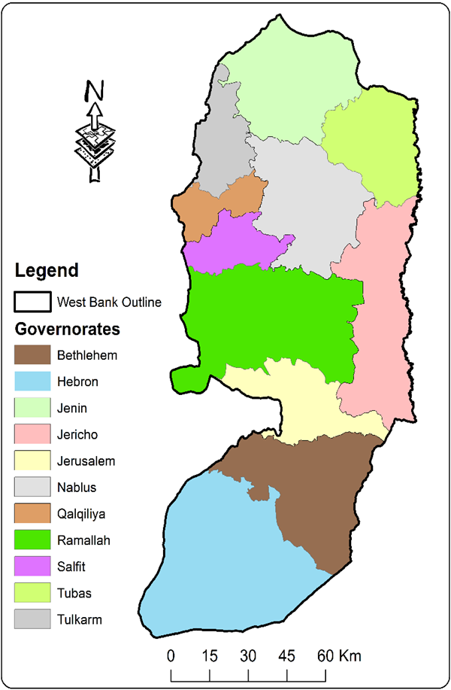
Study Area
  Area of about 5,624 km2​
  Population of around 3.26 m
  It consists of 11 Governorates

Slide 5


DATA COLLECTION
  Geomolg platform

Slide 6
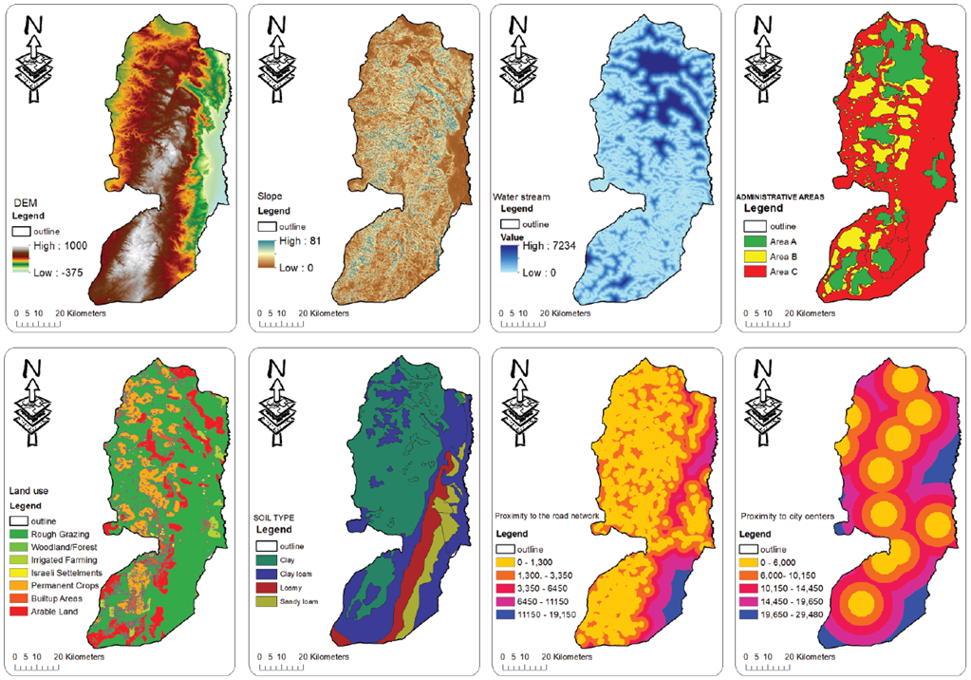
ASS CRITERIA

Slide 7
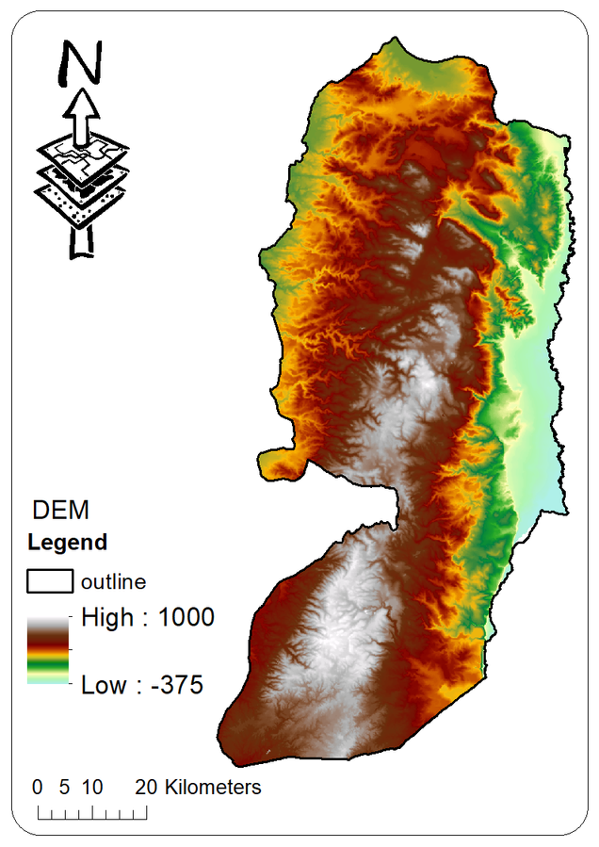
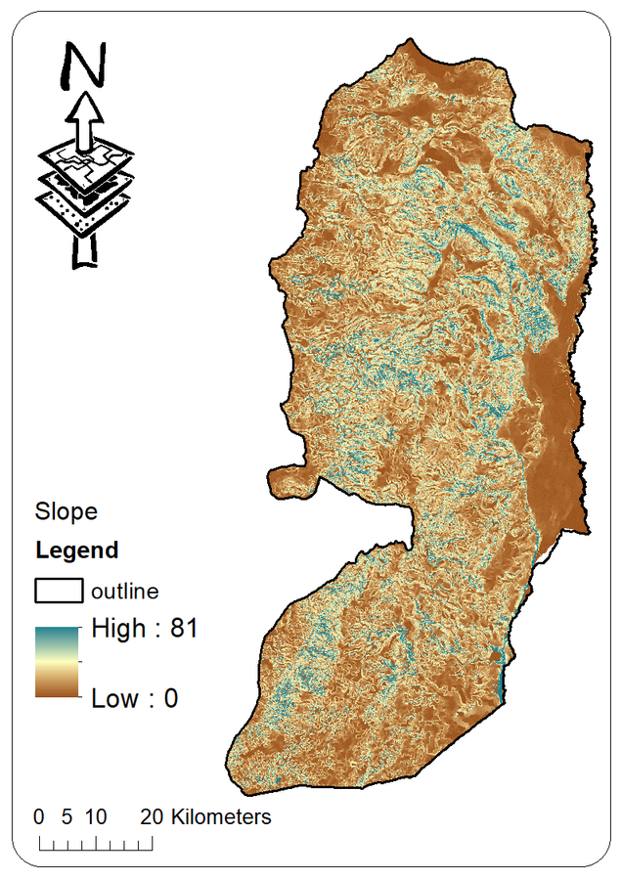
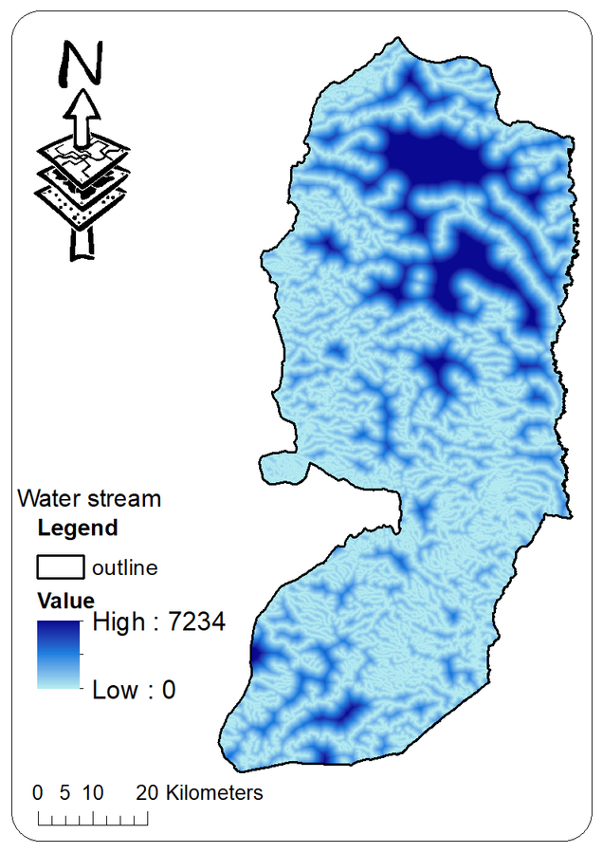
ASS CRITERIA
DEM
Slope (S)
Water stream (WS)

Slide 8
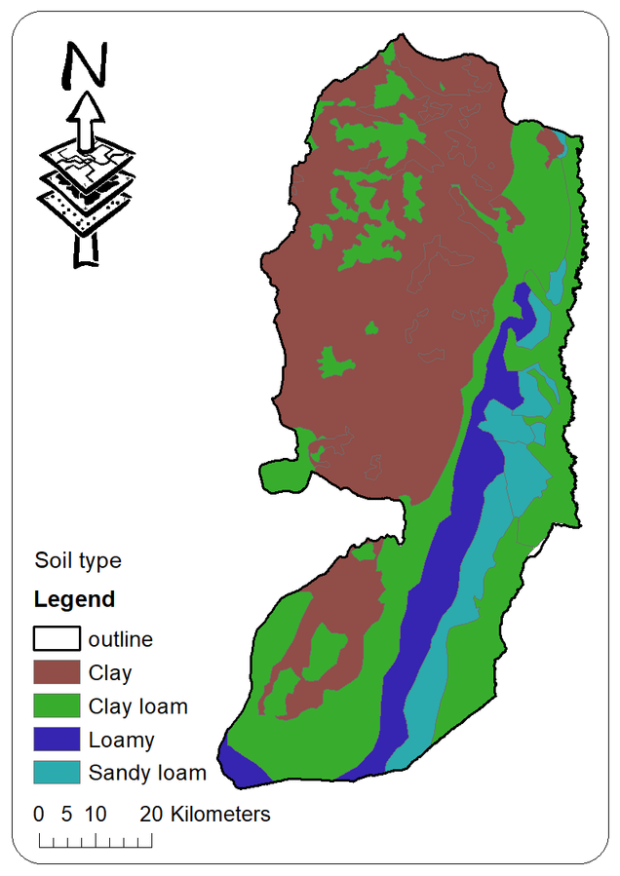
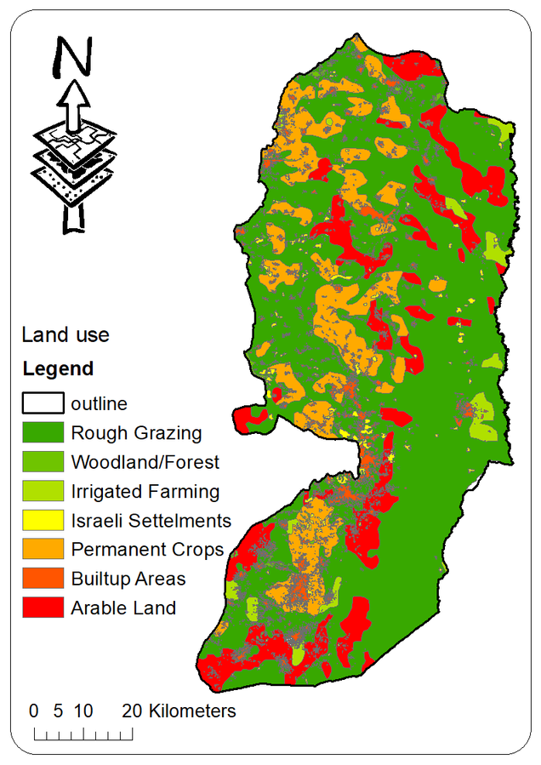
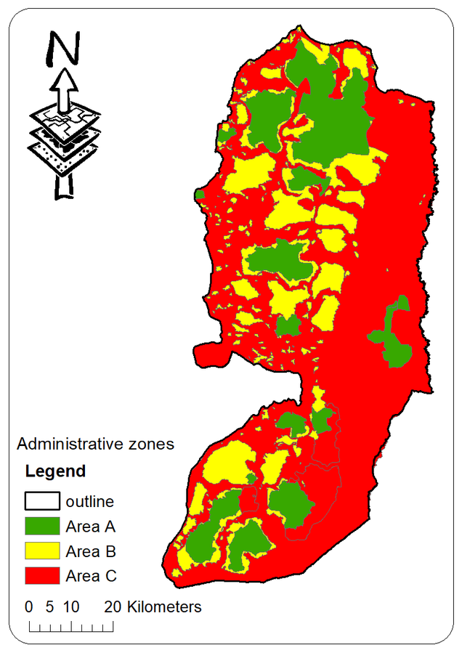
ASS CRITERIA
Soil type (ST)
Land use (LU)
Administrative zones (ABC)

Slide 9
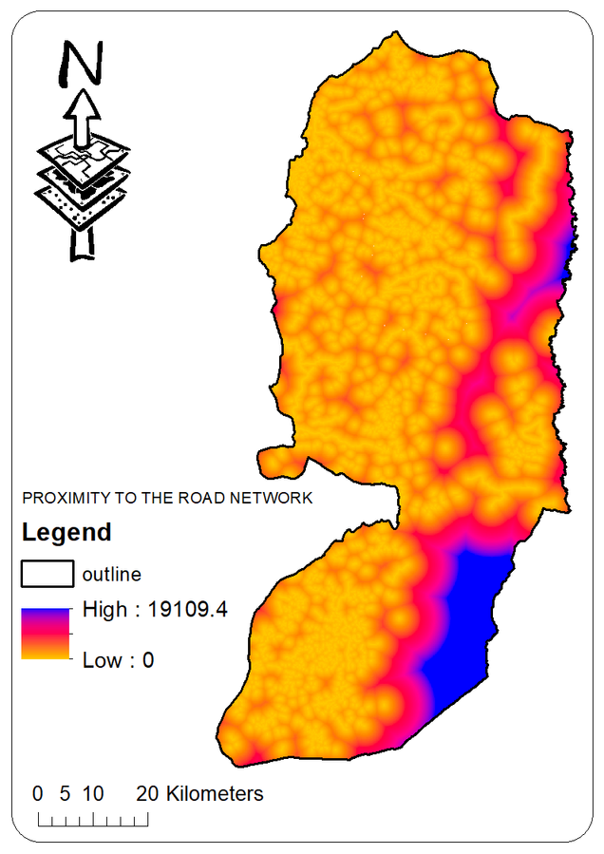
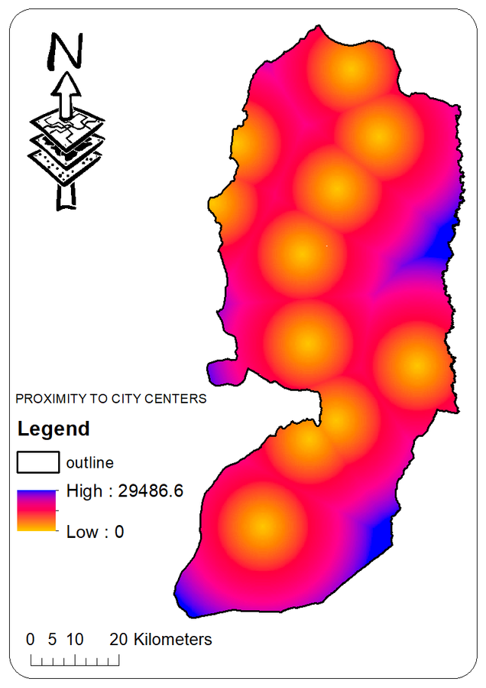
ASS CRITERIA
Distance from the road network (R)
Distance from city center (CC)

Slide 10
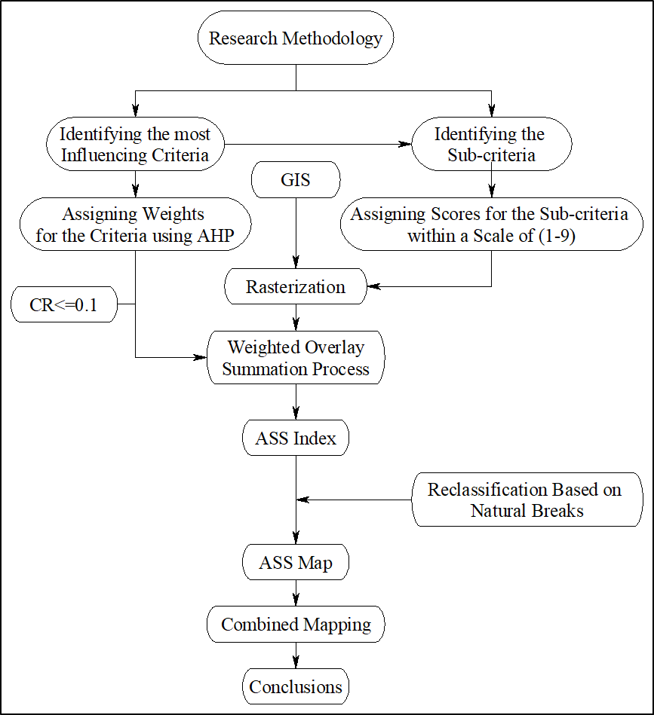
METHODOLOGY APPROACH

Slide 11
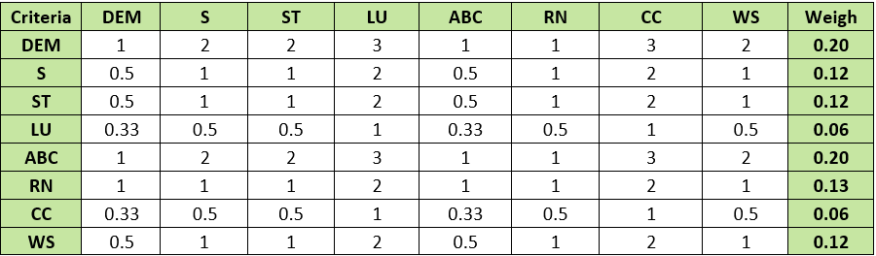
METHODOLOGY APPROACH

Slide 12
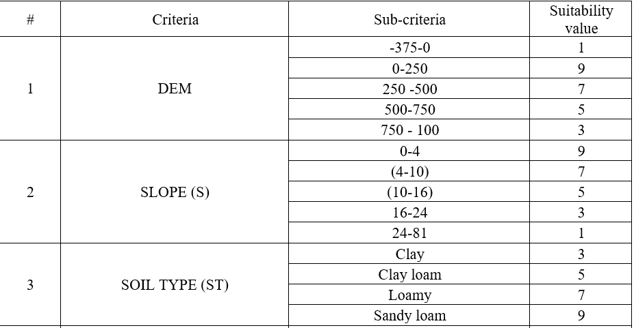
METHODOLOGY APPROACH

Slide 13
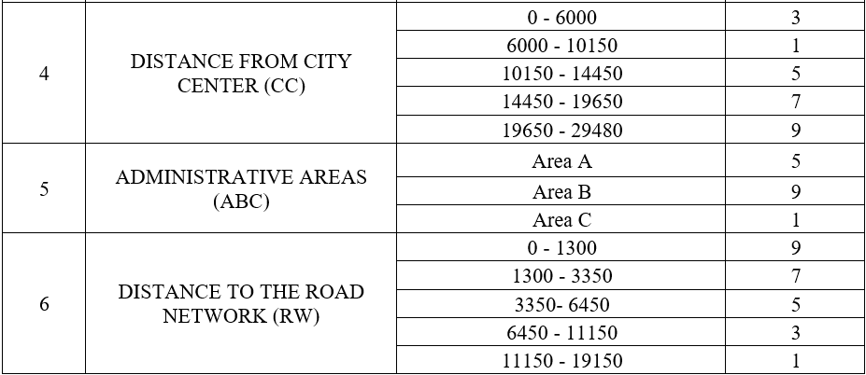
METHODOLOGY APPROACH

Slide 14
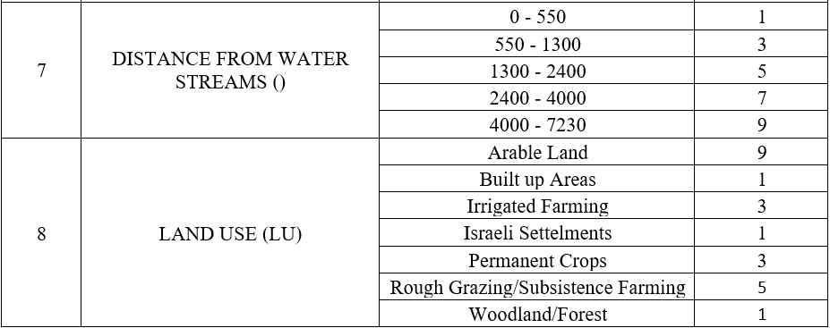
METHODOLOGY APPROACH

Slide 15
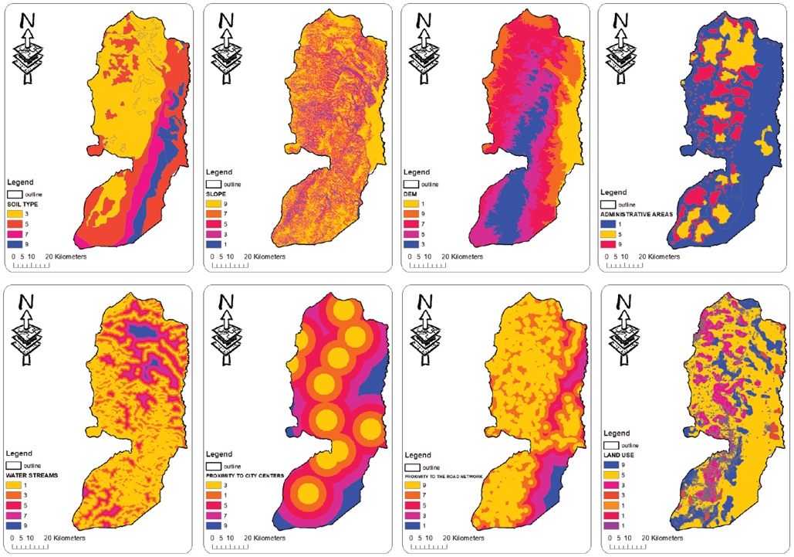
CLASSIFIED CRITERIA

Slide 16
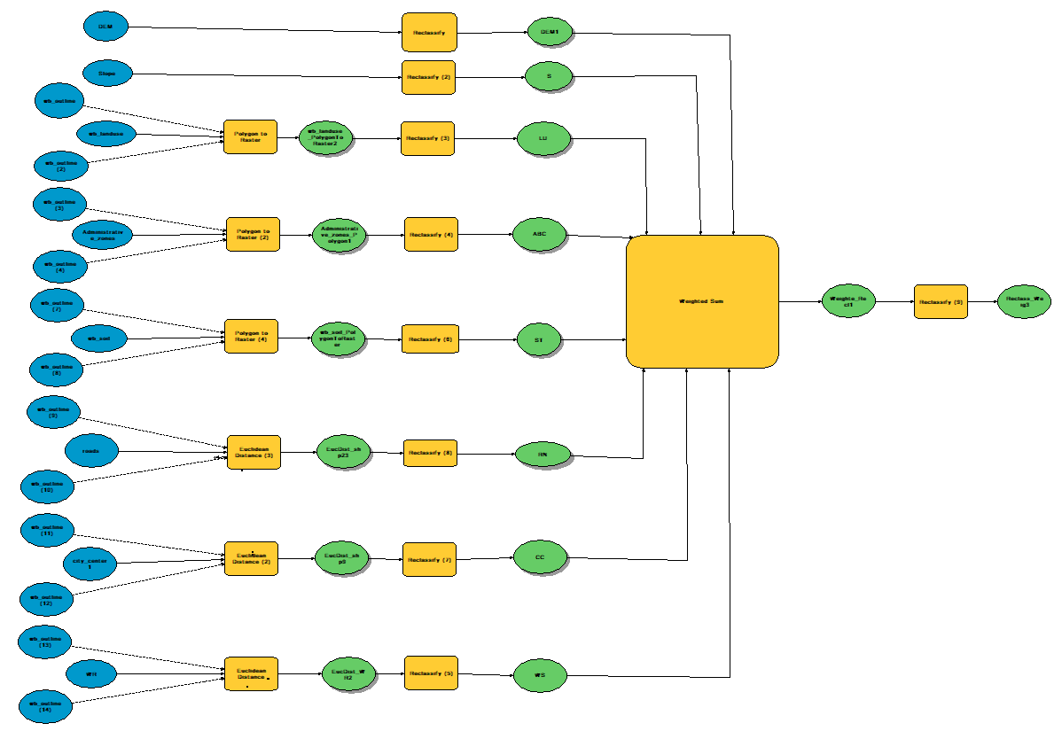
MODELING

Slide 17

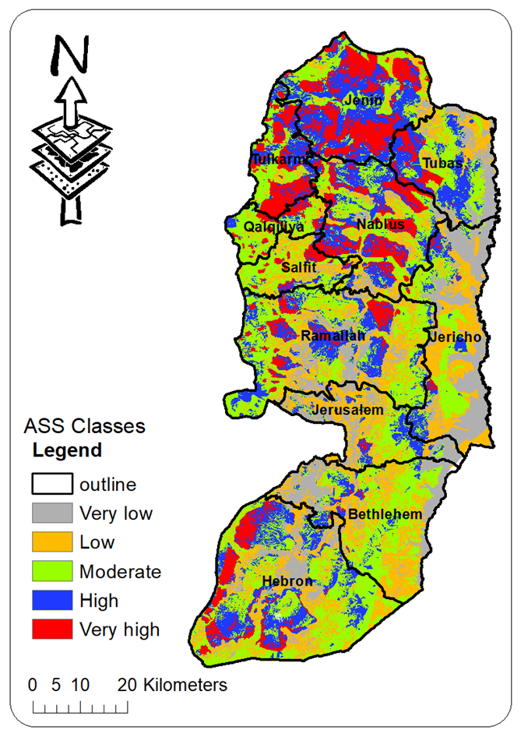
RESULTS – ASS MAP

Slide 18
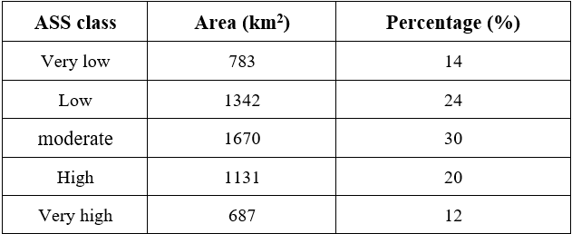
RESULTS – ASS MAP

Slide 19
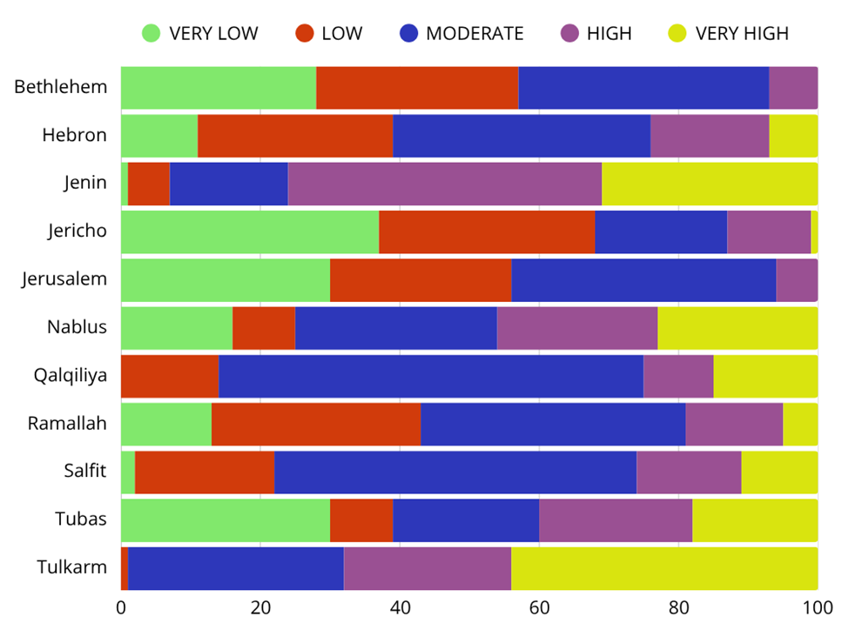
ASS MAP - GOVERNORATES

Slide 20
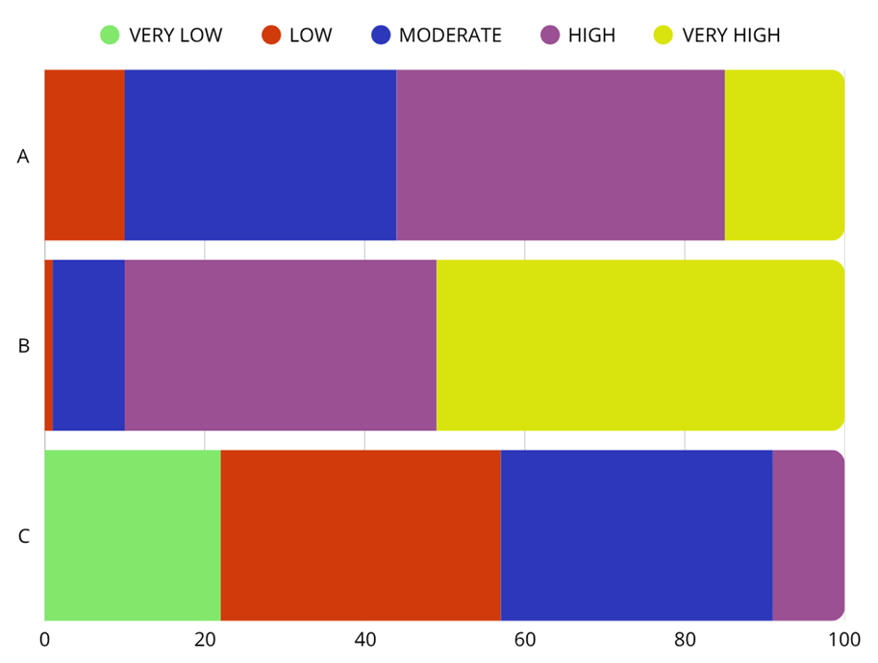
ASS MAP - OSLO

Slide 21
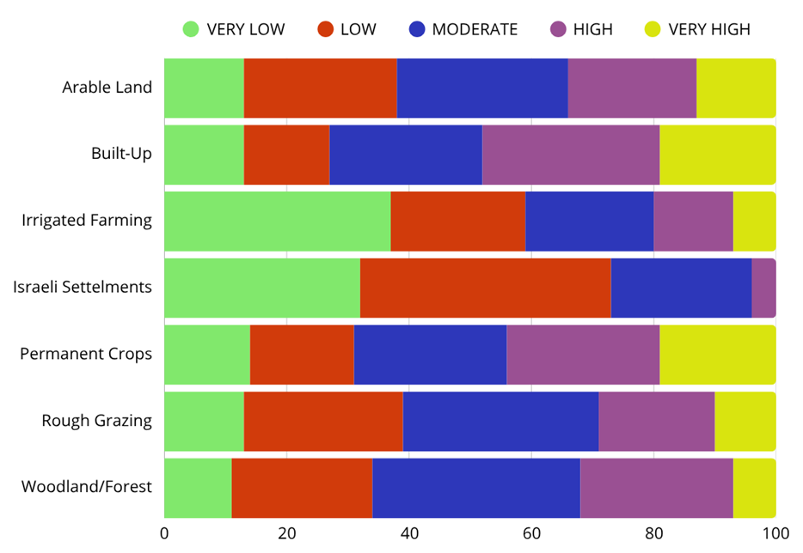
ASS MAP - LAND USES

Slide 22

RECOMMENDATIONS
Adopting results to identify optimal Airport sites in West Bank governorates.
Updating the developed ASS map given the dynamic spatial changes

Slide 23
THANK YOU

