Slide 1
Evaluation and Re-Design of the Transportation System Around the New Campus of An-Najah National University
2012/2013
Graduation Project

Slide 2
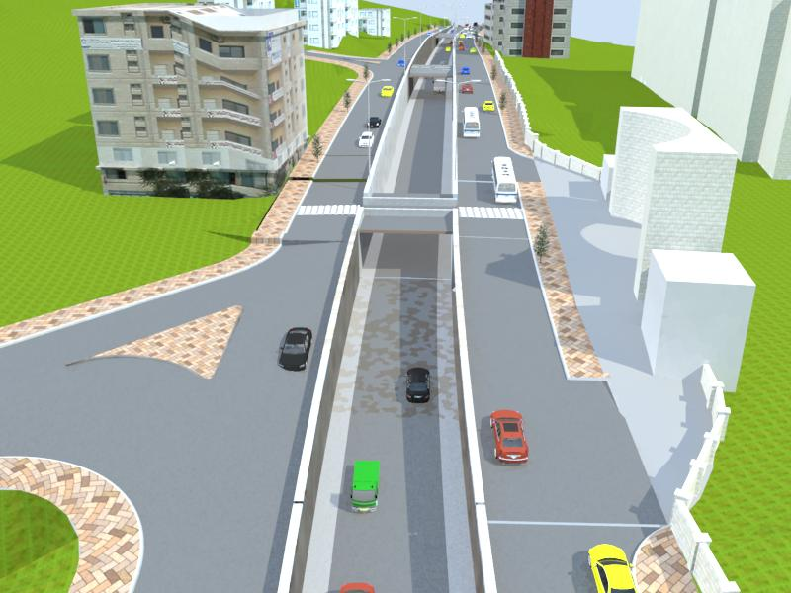
By: Maen Itaer
Morad Shoman
Huthaifa Issam
Supervisor: Prof. Sameer Abu-Eisheh

Slide 3
PRESENTATION OUTLINE
Graduation Project I
Design Concept
Geometric Design
Intersection Design
Public Transportation
Bill Quantity
Conclusion & Recomomndation

Slide 4
Graduation Project I
Traffic Studies
  Pedestrian
  Through Traffic (42%)

Slide 5
Design Concept
Main Objective: separate Traffic Type
  Through
  Pedestrian
  Local
Start & End of the Underpass (530 m)
Bridges
  Front of the main Gate
  Al-Amriya Intersection
  Al-Maktoom Intersection
Puplic Transportation (50%)
Parking

Slide 6
Geometric Design
Horizontal Alignment
Profile

Slide 7
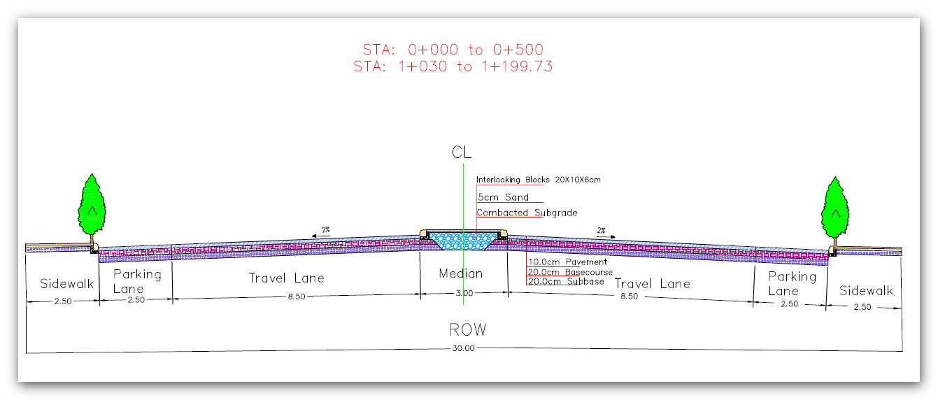
Cross Section

Slide 8
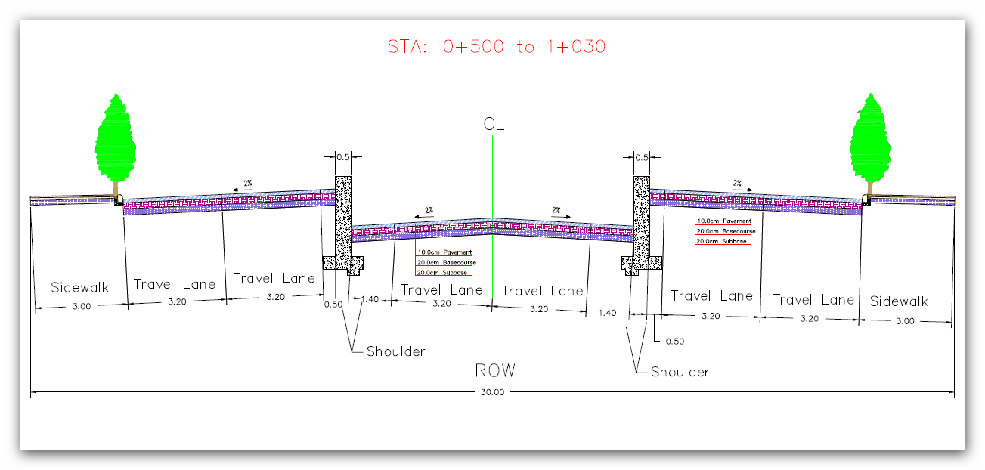
Cross Section

Slide 9
Intersections
Geometric Design
Traffic Evaluation
Parking

Slide 10
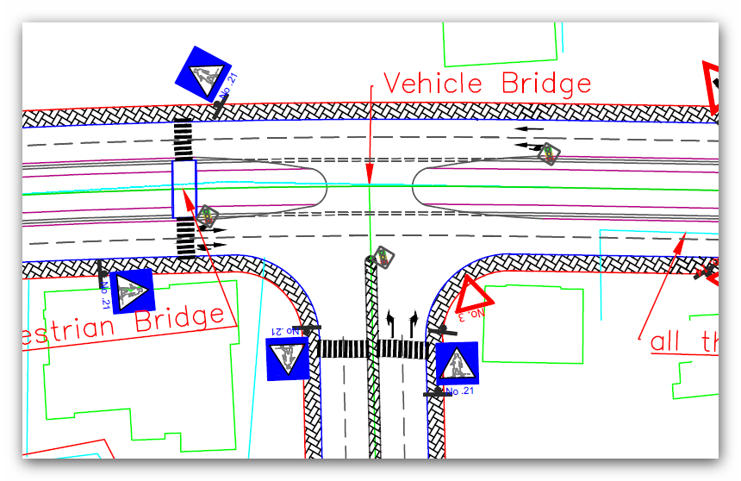
Al-Maktoom Intersection

Slide 11
Public Transportation
Parking Load
Taxi & Buses to City center through Ring Road
Taxi to the old campus

Slide 12
Bill of Quantities
No. | Item | Quantity | Unit | Unit Cost ($) | Total Cost ($)
1 | Cut | 29725 | m³ | 5 | 148,625
2 | Fill | 0 | m³ | 9 | 0
3 | Asphalt | 1527 | m³ | 14 | 21,378
4 | Base course | 975 | m³ | 8 | 7,800
5 | Sub Base | 975 | m³ | 8 | 7,800
 | Signs | 31 | No. | 100 | 3,100
6 | Markings | 2075 | m³ | 12 | 24,900
7 | Concrete (Wall) | 4373 | m³ | 95 | 415,435
 | Total |  |  |  | 629,038

Slide 13
Conclusion
Reduce the Conflicts and Congestion
Safety for pedestrian
LOS
Management Actions

Slide 14
Recommendation
Traffic Studies for Ring Road
Parking-allow in University
Pedestrian & Car Bridges
Enforcement
Nablus Municipality
Markings & Signs

Slide 15
THANK YOU
Our Parents
Prof. Sameer
Eng. Ibraheem
Eng. Fady
Eng. Ahmed
All Our Friends

