Slide 1
Movable Roof Controlled Remotely using Microcontrollers
By:
Ala’ Atabeh
Ramy Tubaileh
Under supervision of Dr. Moin Omar.

Slide 2
Contents
Overview
Problem statement
Proposed solution
Flowchart
Parts & Components
Block Diagram
Overall Circuit
Conclusion

Slide 3
Overview
There has been a dramatic growth in the use of smart things and technologies that are equipped with sensors, simple and effective software algorithms, proximity and remote sensing technologies, and wired\wireless connectivity. This has aroused great enthusiasm among individuals and institutions to benefit from these services. Therefore, that allowed the emergence of the phenomenon of communication and communication via the Internet between devices, and this is what is required.
Similarly, “Smart Home” was one of the hottest topics in modern society. The development of the internet of things and embedded technologies provided the basis for the rise of the smart home. With the transformation of the consumption concept and development of the industry, the smart home market is rapidly gaining momentum. More and more companies and organizations are devoted to the research and development of the smart home.

Slide 4
Problem Statement
Some facilities is abandoned in winter or in bad climatic conditions. For example: swimming pools, squares or home gardens, especially in villas. The Jordan Valley is a real example in our country where chalets have been recently built in enormous numbers. Also, as we mentioned before, sports facilities and Olympic stadiums have always searched for a solution to this problem. From this point, we have started out searching for a solution to this problem.

Slide 5
Proposed Solution
First, we thought with the idea of a movable roof as an alternative for conventional roofs.
We designed the roof to consist of two parts, the upper one is from fiberglass panels that can extend vertically, so fresh air can easily pass through it. The lower part is made from fabrics and plastic fibers, which will provide a shade from sun when opened.
Arduino Uno and WeMo's d1 were used as microcontrollers.
Electrical antenna was used to work as a lift for the panels of the roof.
Stepper motor was used to move the shadier back and forth.
With the aid of other electrical and electronic components our movable roof was completed.

Slide 6
Flowchart

Slide 7
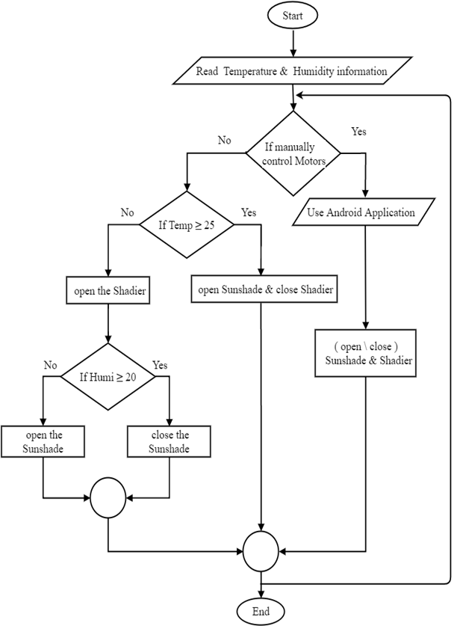

Slide 8
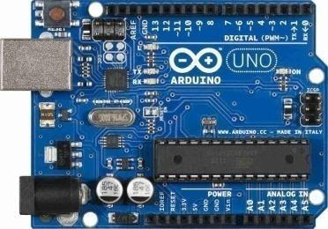
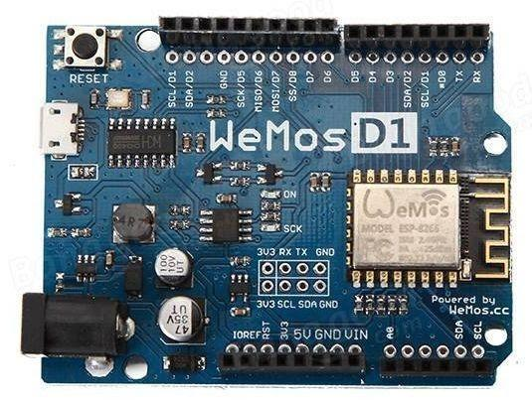

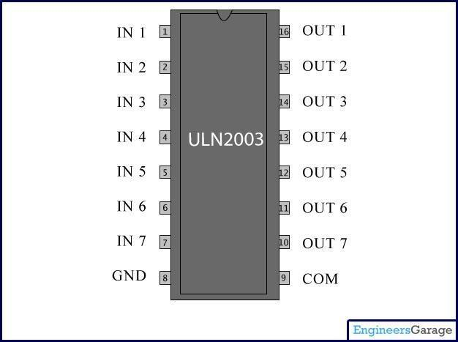
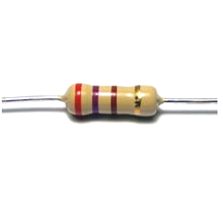
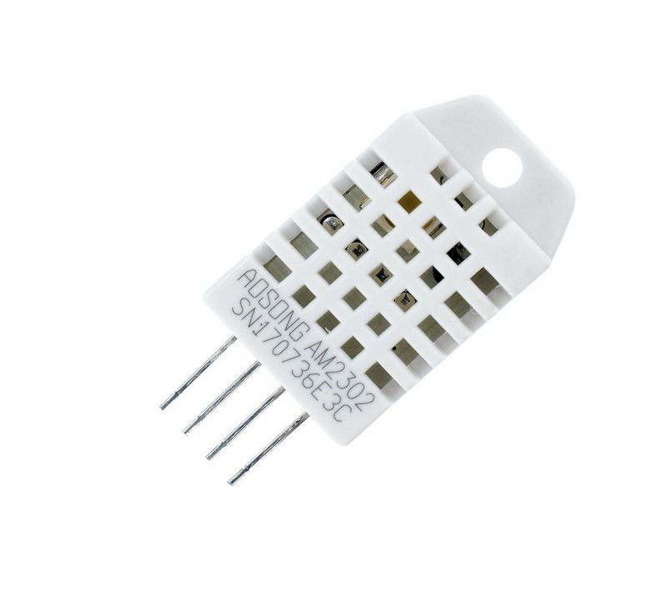

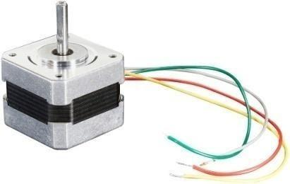
Parts & Components
Arduino UNO
WeMo’s D1
PCB
Uln2003 IC
Resistor
DHT 22
ln298
Stepper Motor

Slide 9
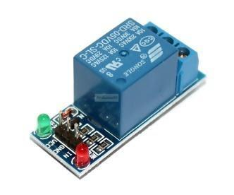
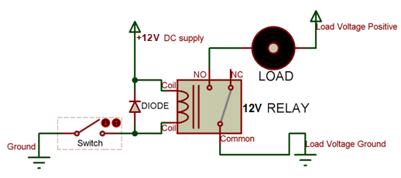
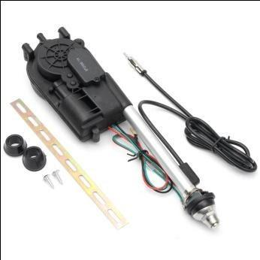
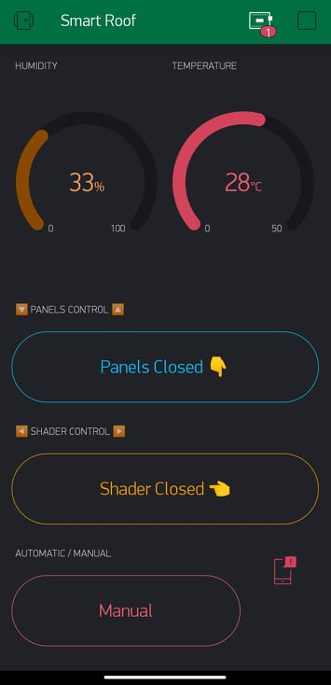
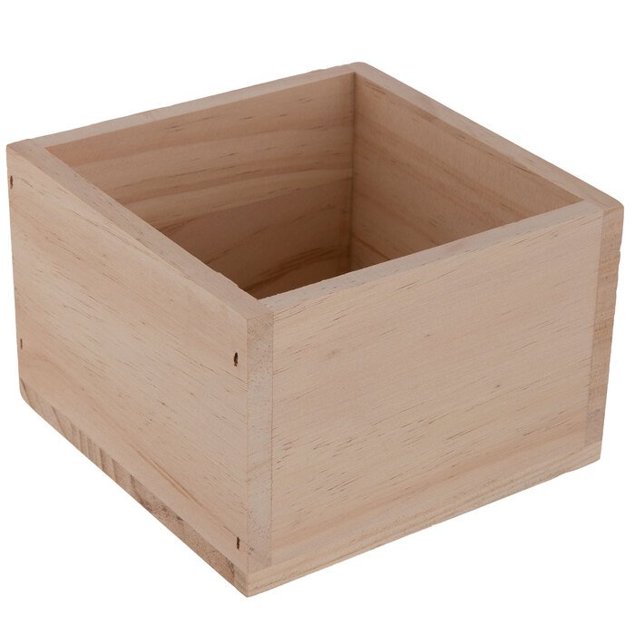
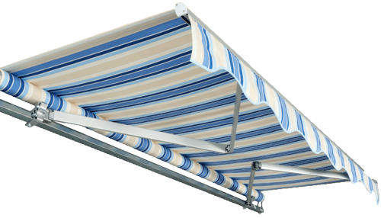
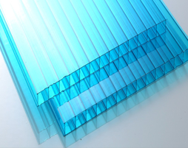
Relay 5V Module
12V relay
Linear Actuator
Android Application
Wooden Box
Shadier
Fiberglass

Slide 10
Block Diagram

Slide 11
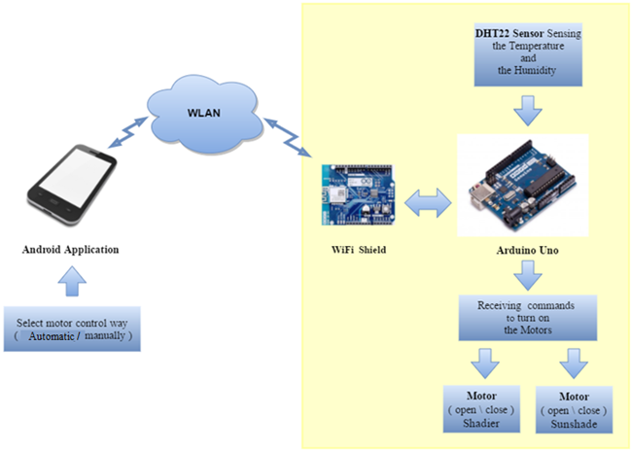

Slide 12
Overall Circuit

Slide 13
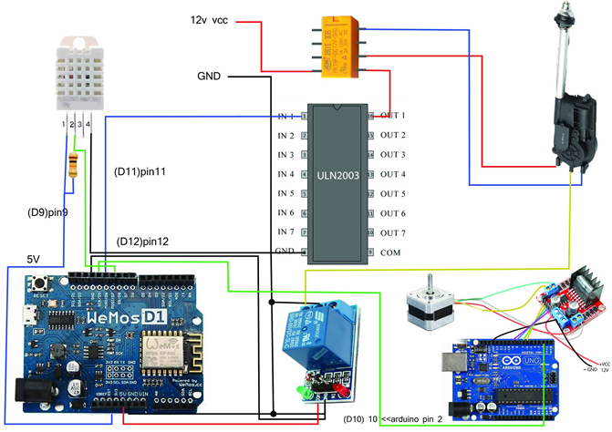

Slide 14
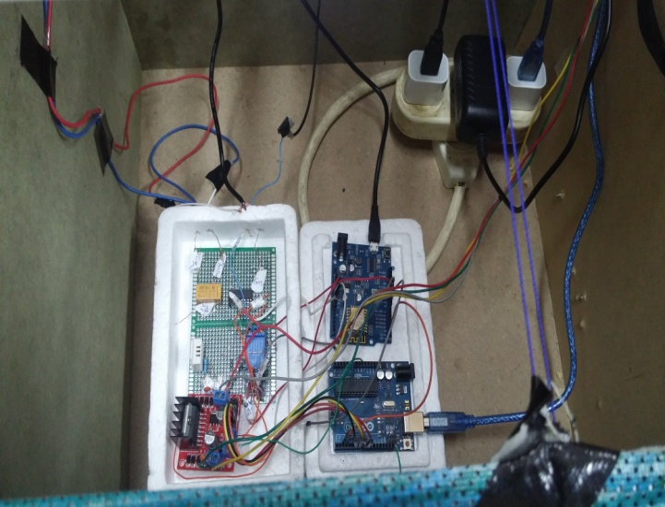

Slide 15
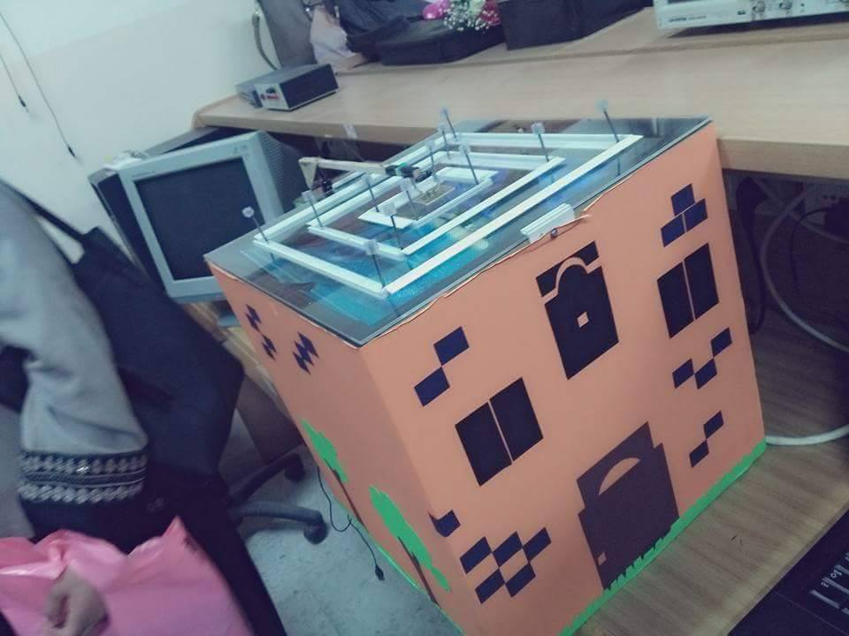
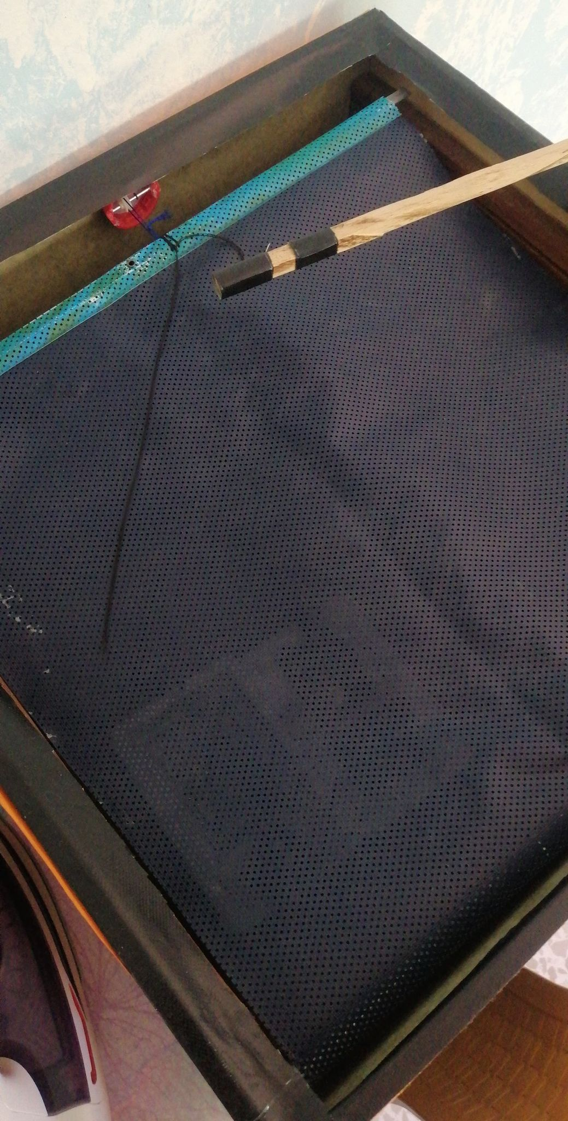

Slide 16
Application Interface

Slide 17
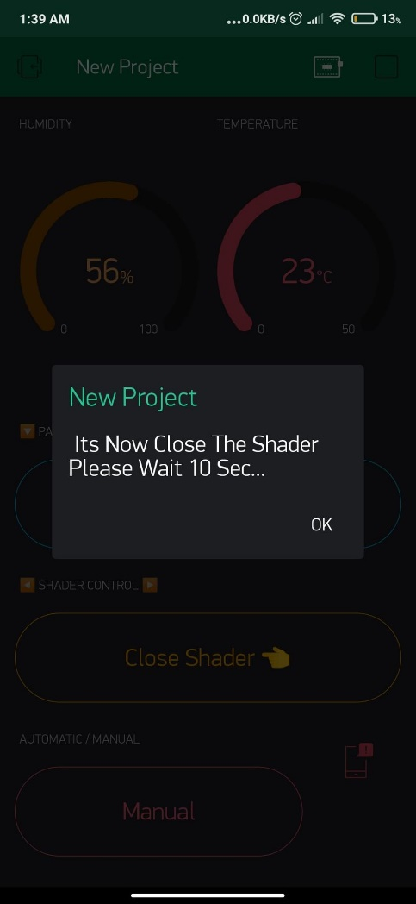
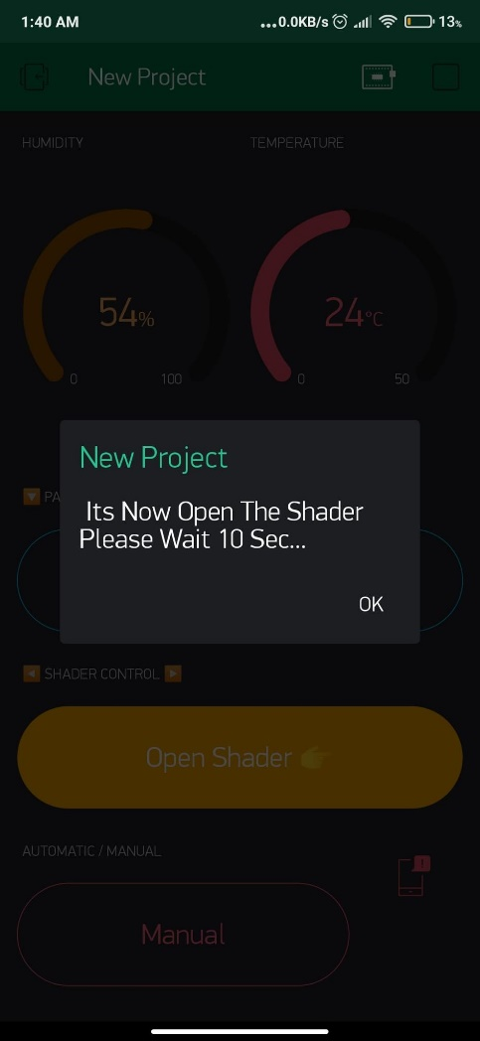

Slide 18
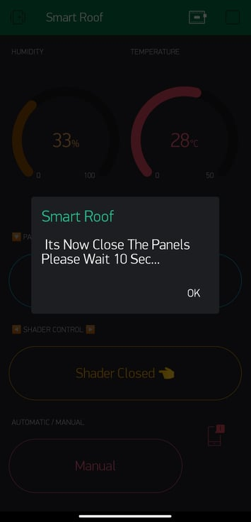
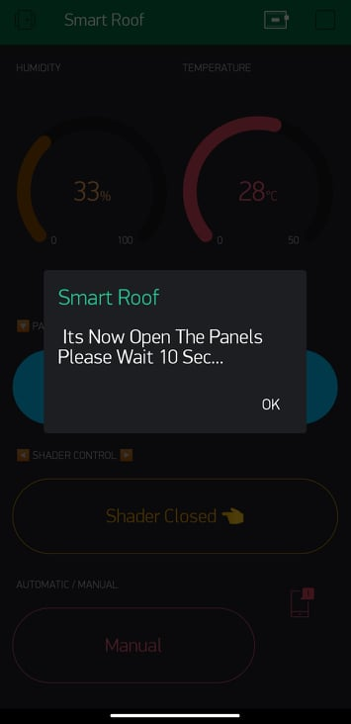

Slide 19
Conclusion

Slide 20
However, our project may have some good side effects that would make it more popular and sought after by some engineers as a solution to their problems, such as, energy saving.
As our roof is adaptive and flexible, it allows the building to be naturally ventilated by fresh air from outside, or to be warmed by sunshine in cold days. Moreover, direct sunlight would help considerably cutting off the electrical bill of the building by optimizing natural light. In general, this savings would take place considerably in huge constructions and projects like stadiums and opera houses.
As a result, our project is a proposed idea which can be considered by engineers either as an architectural design or an engineering solution for some problems including environmental ones.

Slide 21
The End

