Slide 1

AN-NAJAH NATIONAL UNIVERSITY
Bright Path to Learning
Reem Abd Al Raheem Hasan & Farah Faisal Ahmad
Supervised by: Dr. Shareef Yaseen

Slide 2

Table of Contents:
1
2
3
4
5
Main Idea
Technology
Features & Roles
Constraints
Future work

Slide 3
Main Idea
Bright Path to Learning is an AI-powered online learning institute that provides structured courses, interactive lessons, and personalized learning experiences through web and mobile platforms. The system supports students, teachers, and administrators with dedicated dashboards, real-time communication, and intelligent content transformation tools. By integrating modern technologies and artificial intelligence, the platform delivers a flexible, scalable, and engaging digital learning environment.

Slide 4




Technology
Frontend-Web :React.js
Frontend-APP: React Native + Expo
Back-End :Node.js
Database :MySQL
Real-Time Services: Firebase
Payments: Stripe

Slide 5
Roles :
Student
Teacher
Admin

Slide 6

<<Start page>>
The Welcome Screen greets users with an animated logo and welcoming messages, providing two main actions: "Start Now" to navigate to login, and "Learn More" to explore the app.

Slide 7
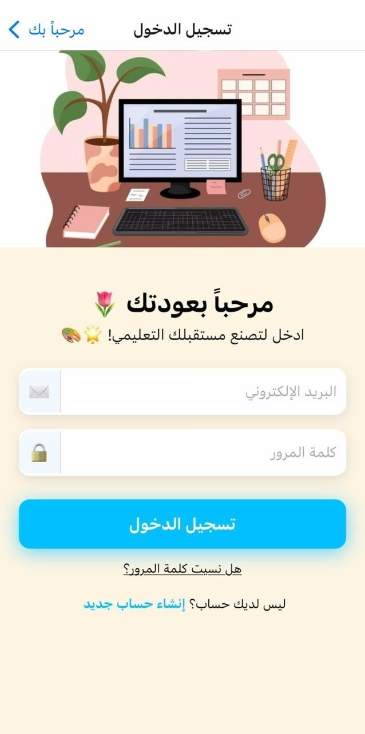
<< Login page >>
Users log in using email and password. The backend verifies credentials and returns a JWT token for secure API access. Students are directed to courses, and teachers to their dashboard.

Slide 8
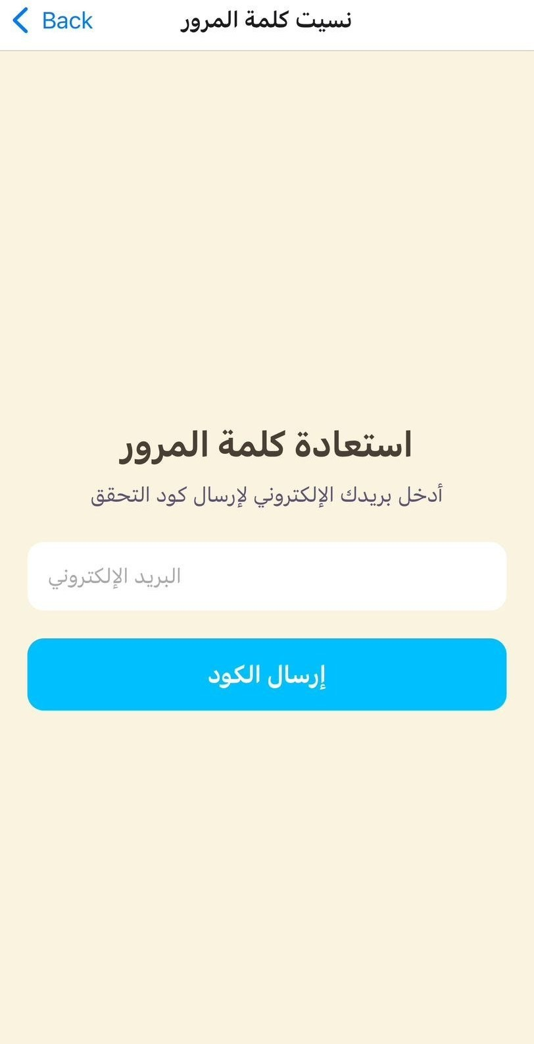
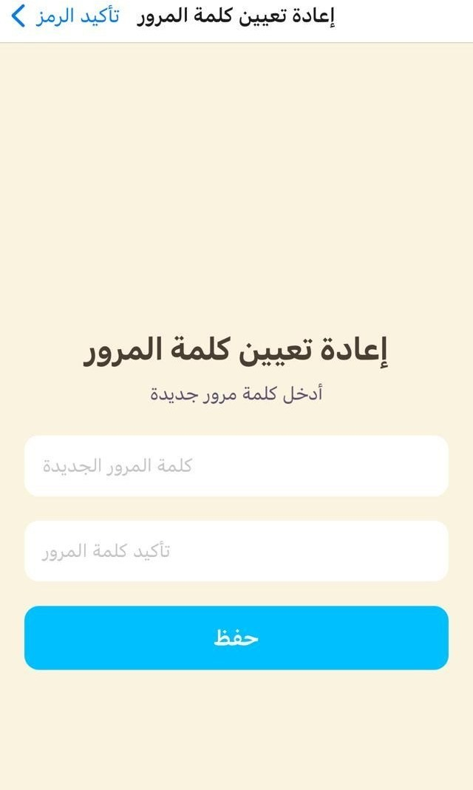

<< Resete Password >>
The Forgot Password screen sends a time-limited verification code to the user’s email.The Reset Password screen allows entering a new password with confirmation.

Slide 9
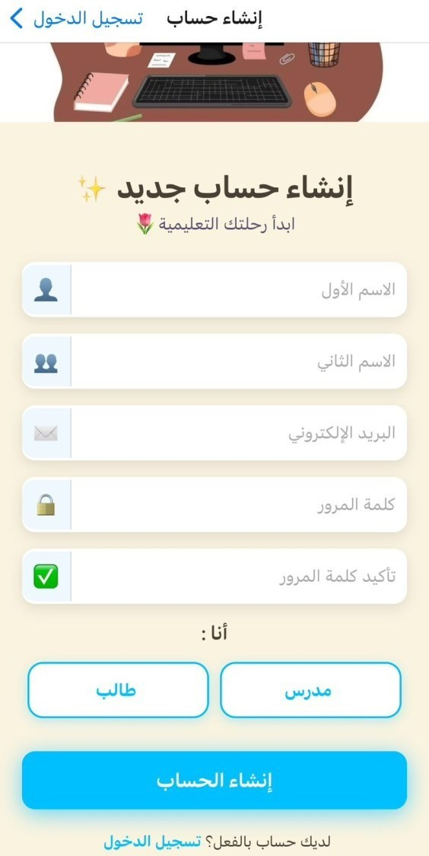
<< Sign Up page >>
Users can sign up as Students or Teachers by selecting their role and providing basic info (name, email, password). Input is validated on both client and server sides. Admin accounts are managed only via the Admin Dashboard.

Slide 10
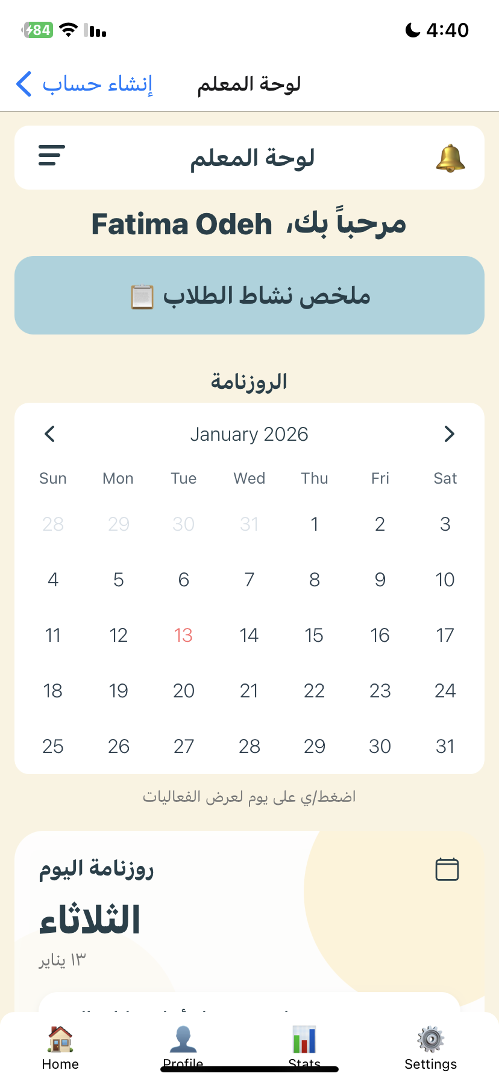
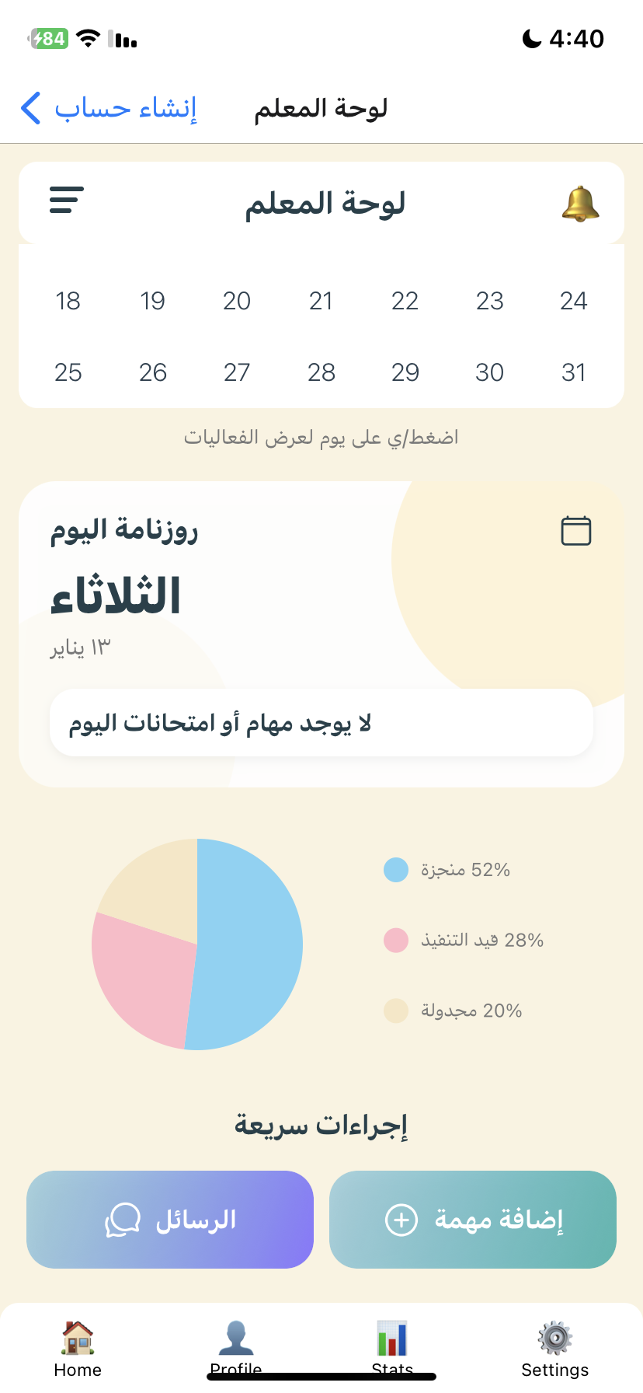
Teacher Dashboard and Management Features
Main Dashboard
The main dashboard shows a quick overview of the teacher’s activity, including assigned courses, enrolled students, and recent notifications. It also provides quick access to common actions.

Slide 11
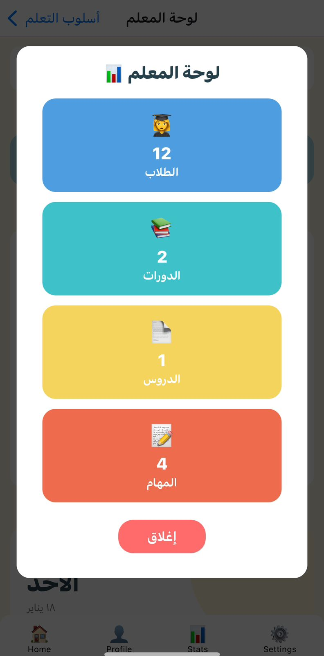
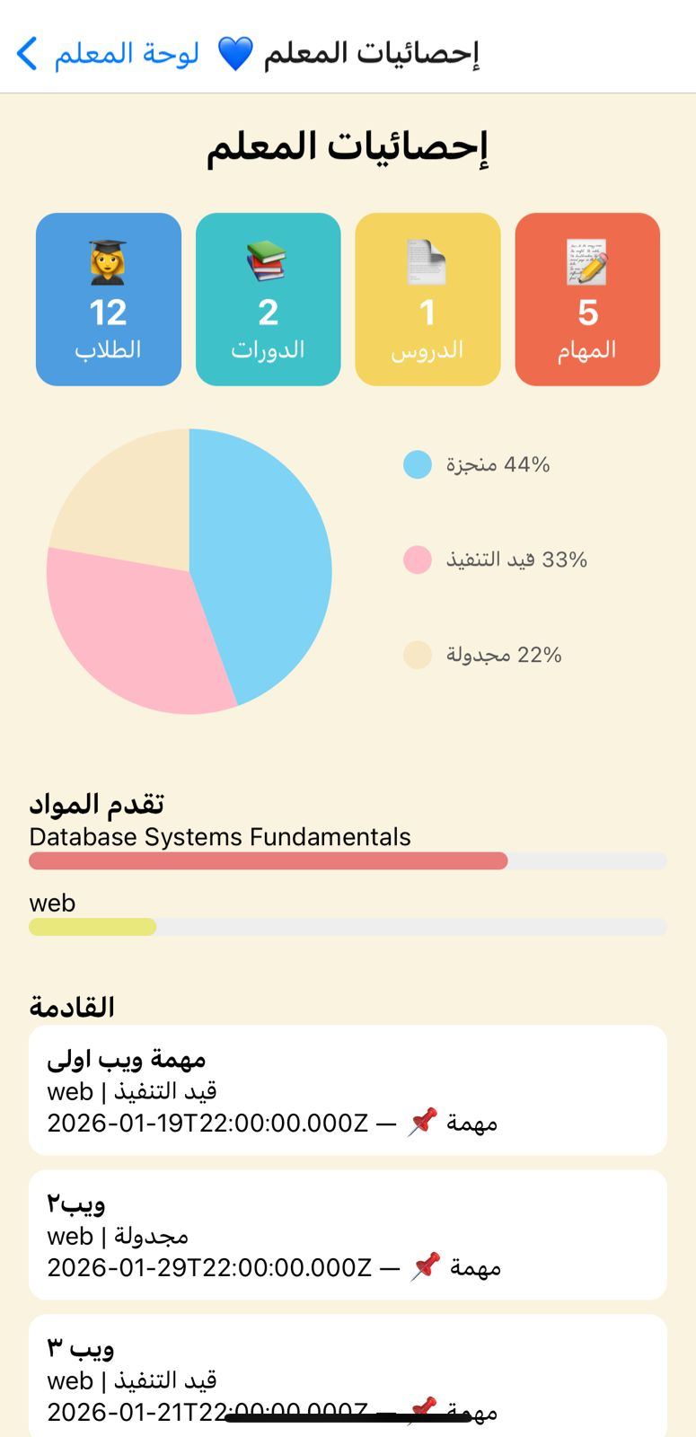
Teacher Statistics Screen
This screen provides teachers with a comprehensive overview of their academic activities and performance. It displays key statistics such as the number of students, approved courses, lessons, and assignments. Visual analytics include a pie chart showing the status of tasks and tests (completed, in progress, and scheduled), progress bars that reflect course completion based on assignments and tests, and a list of upcoming tasks and exams with their status and deadlines.

Slide 12
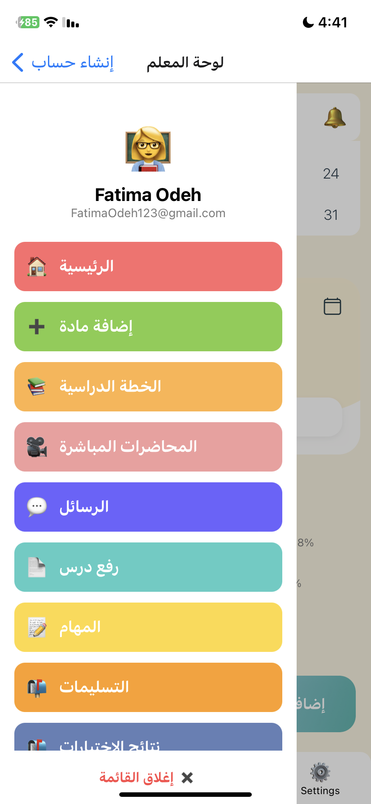
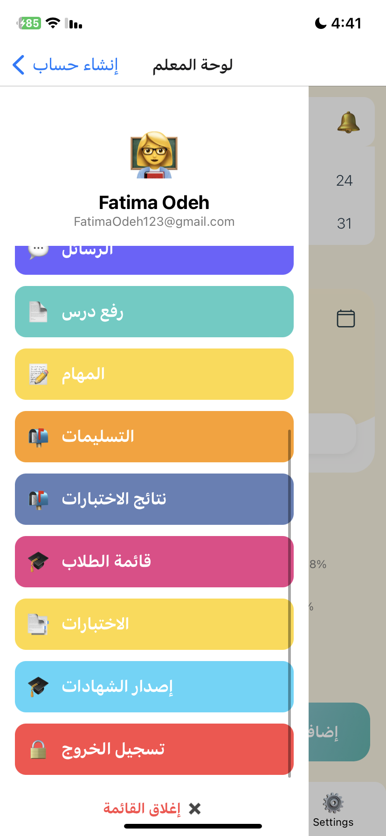
Teacher Dashboard and Management Features
Side Menu
The side menu allows easy navigation between sections such as courses, students, messages, and settings to manage content and account options.

Slide 13
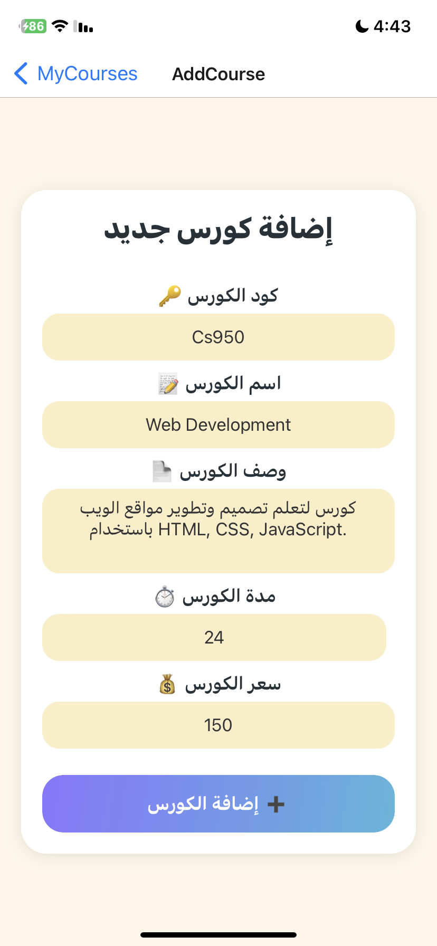
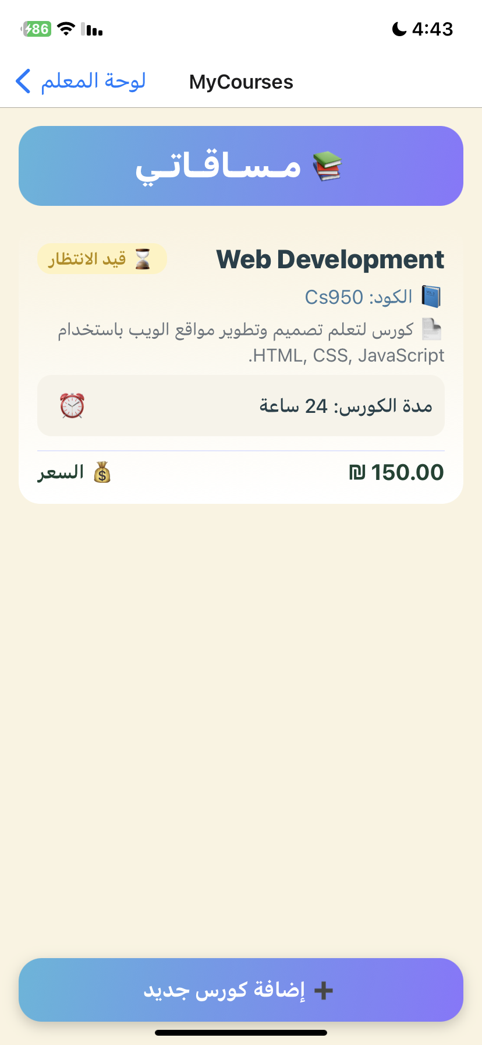
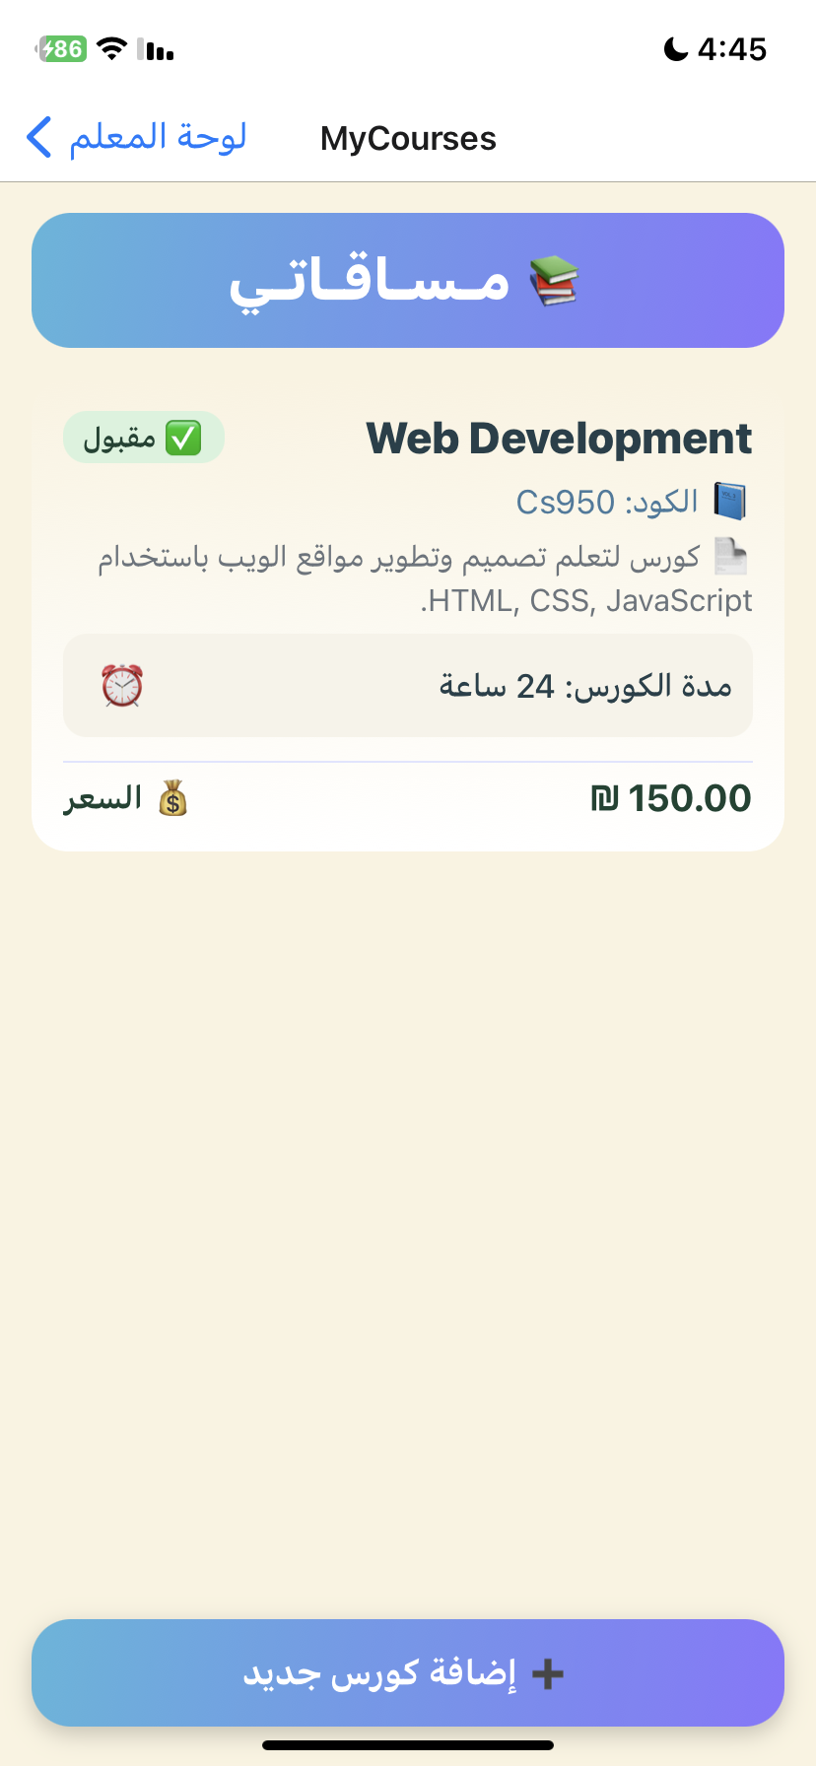
This screen displays all courses created by the teacher, showing key details such as course name, code, duration, price.Teachers can also quickly add a new course using the add button.
The Add Course screen allows teachers to create new courses by filling in basic course information. Required fields are validated before submission, and the course remains pending until approved by the admin.

Slide 14

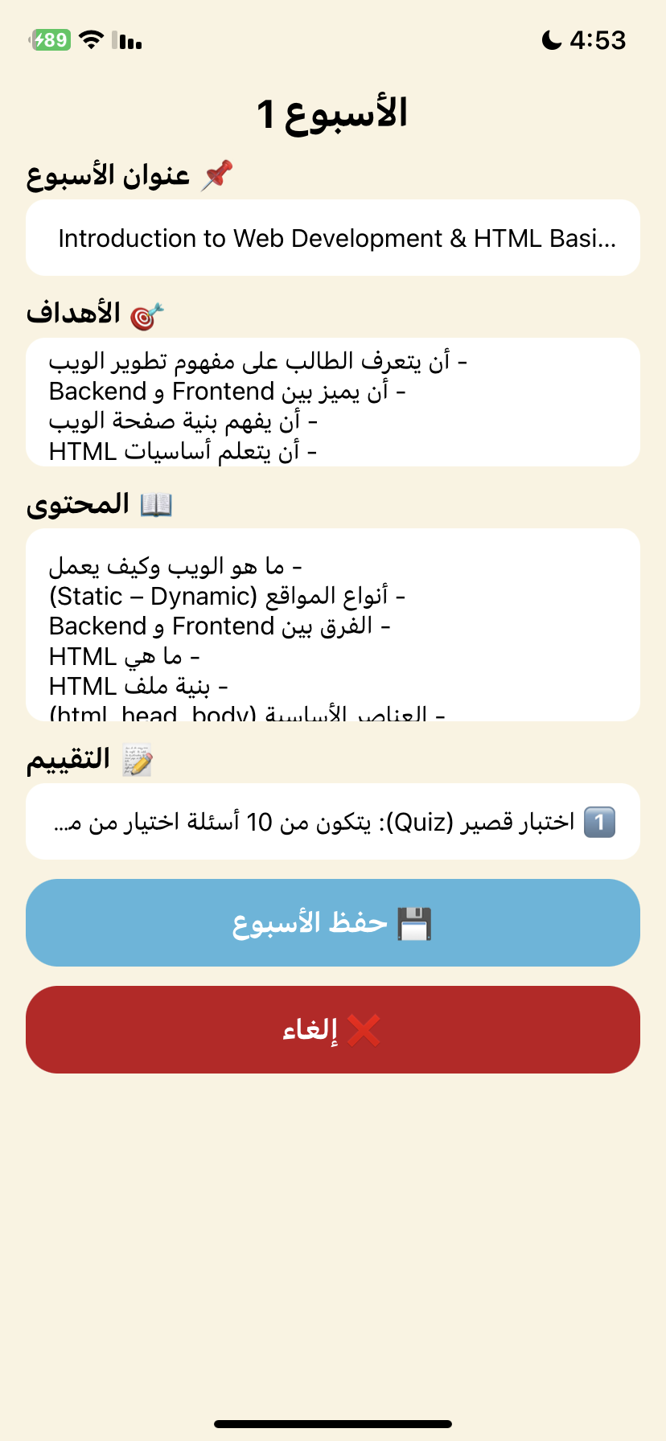
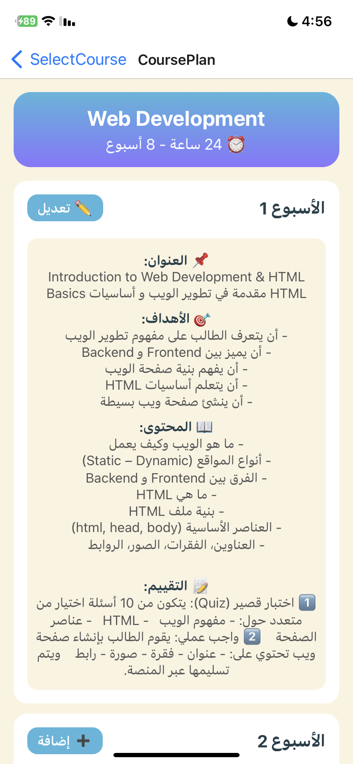
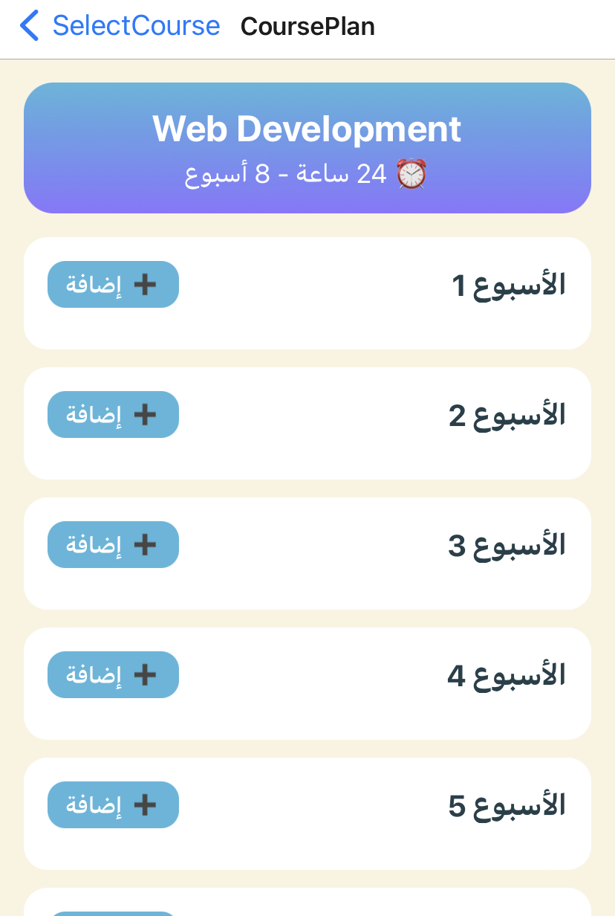
The Course Plan screen allows teachers to plan and organize their courses on a weekly basis, with the number of weeks automatically calculated from the course duration. Each week includes a title, objectives, content, and evaluation, which can be easily added or edited and saved instantly, providing a clear overview and effective tracking of course progress.

Slide 15
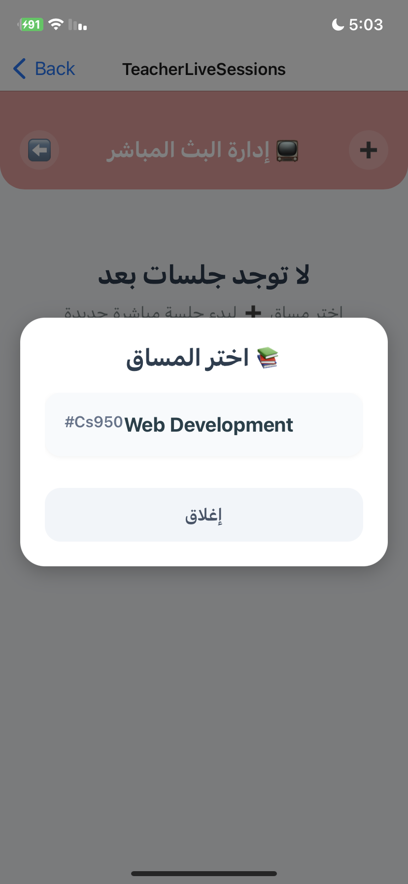
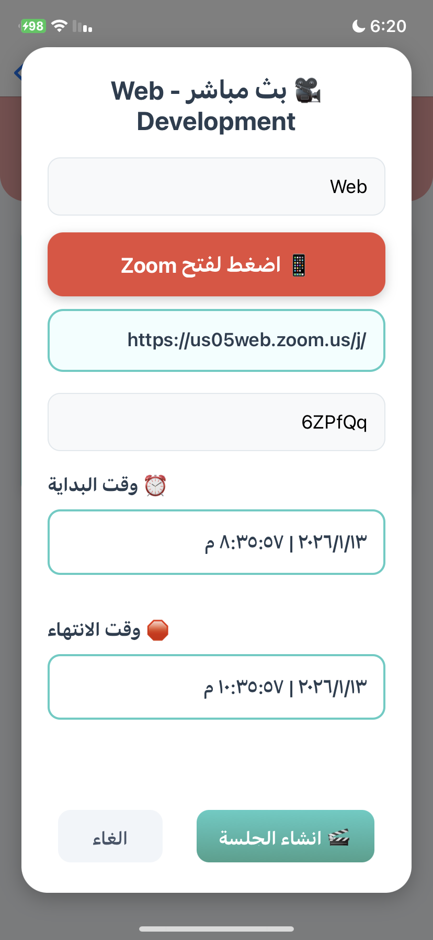
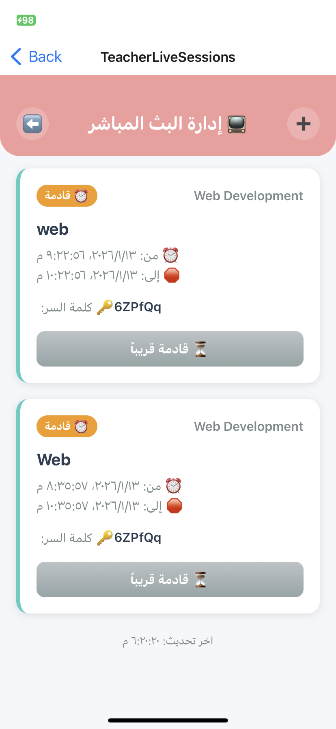
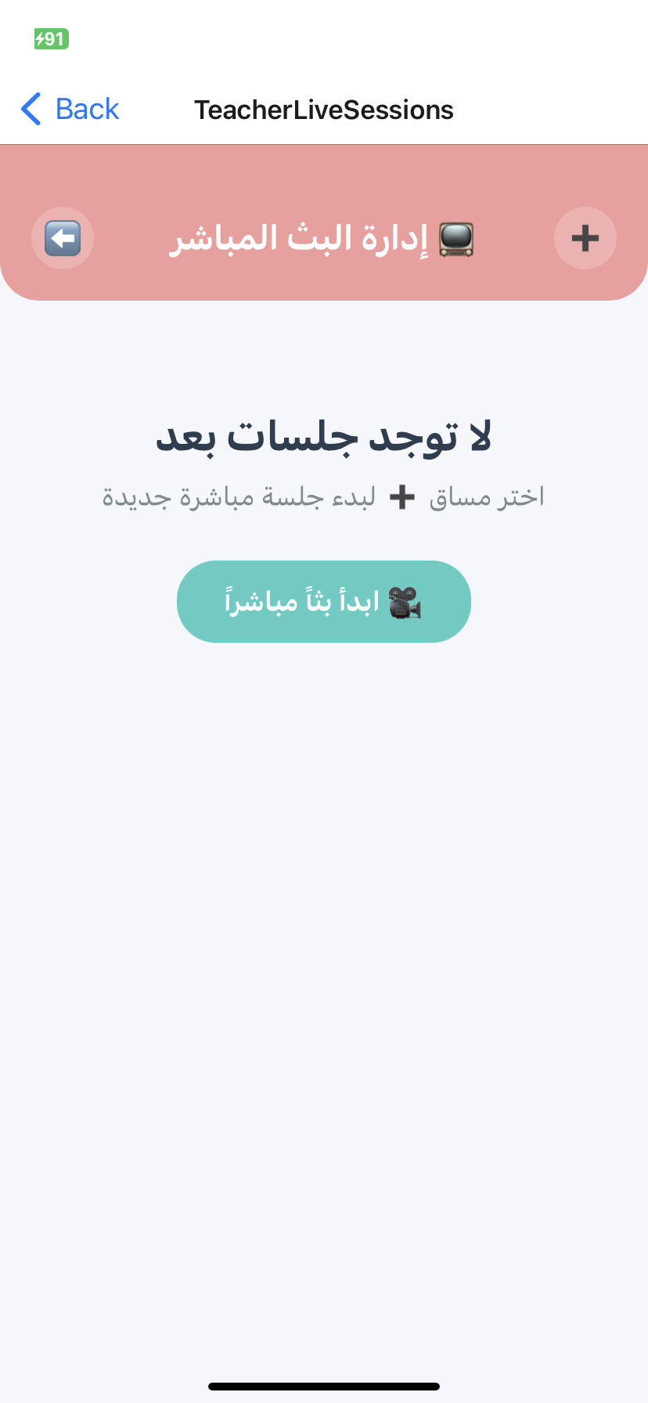
Live Sessions Screen
Teachers schedule Zoom lectures by setting the link and time. Students see lectures as Upcoming, Live, or Past based on the lecture status.

Slide 16

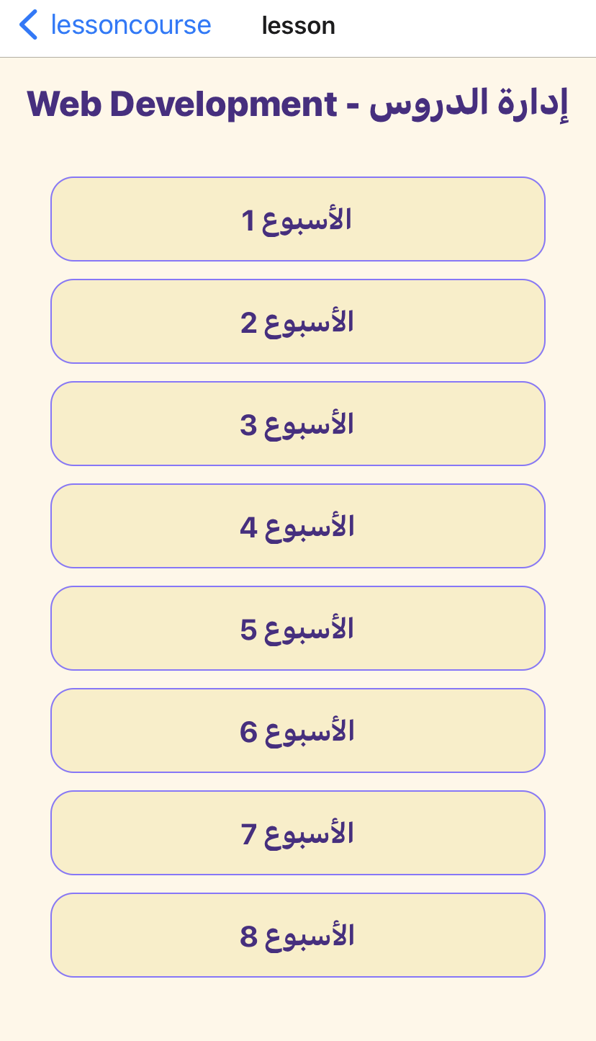
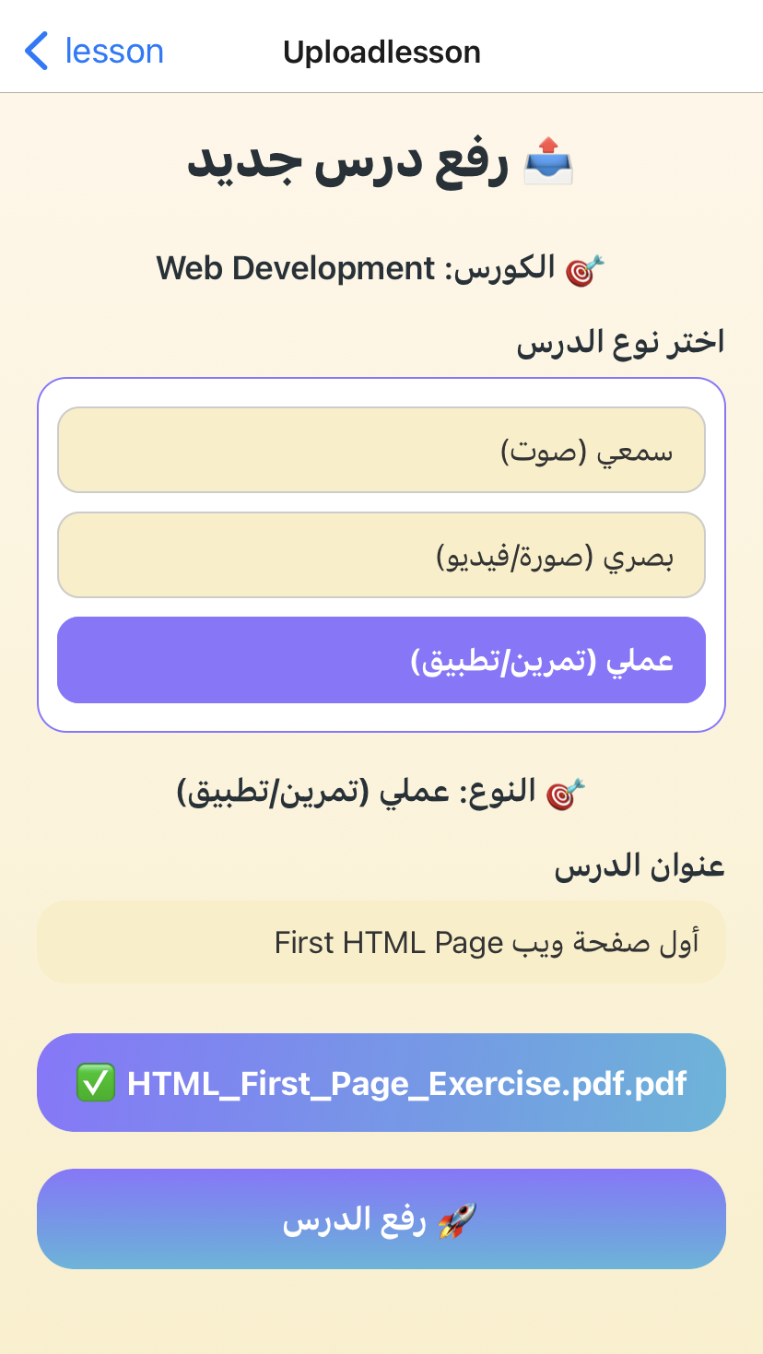
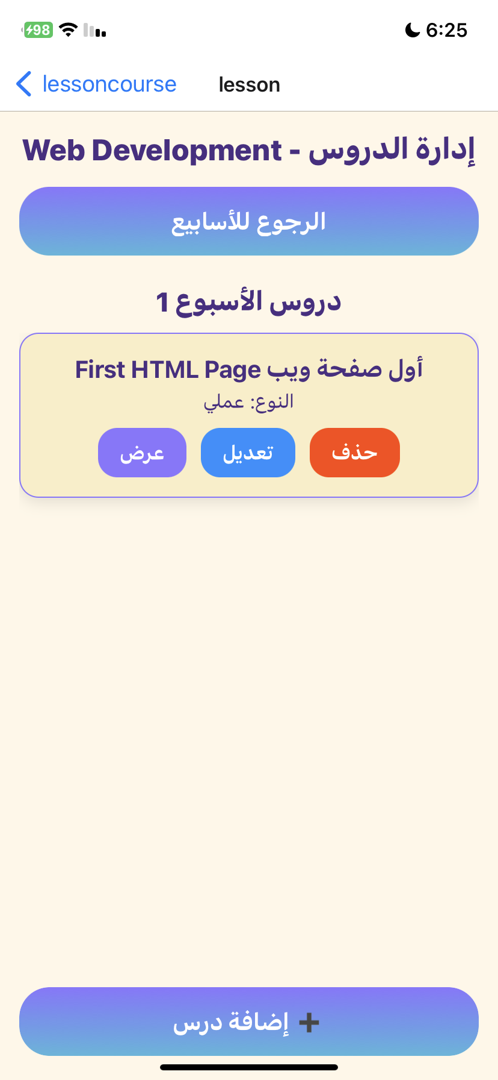
Teachers upload lessons by selecting the course, week, and lesson type (visual, auditory, or practical). Students view lessons based on their chosen learning style, with the option to change it at any time.

Slide 17
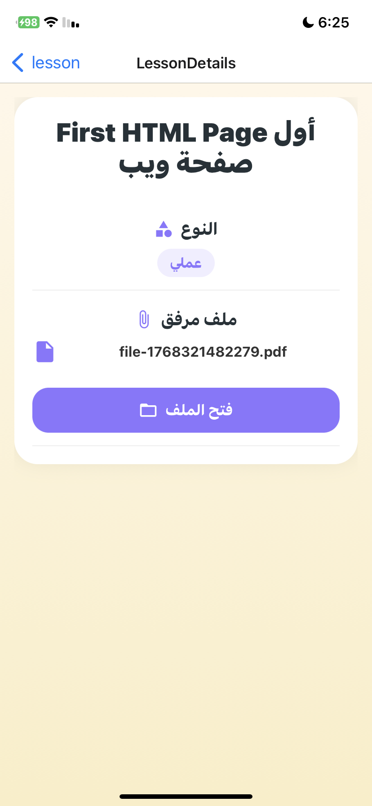
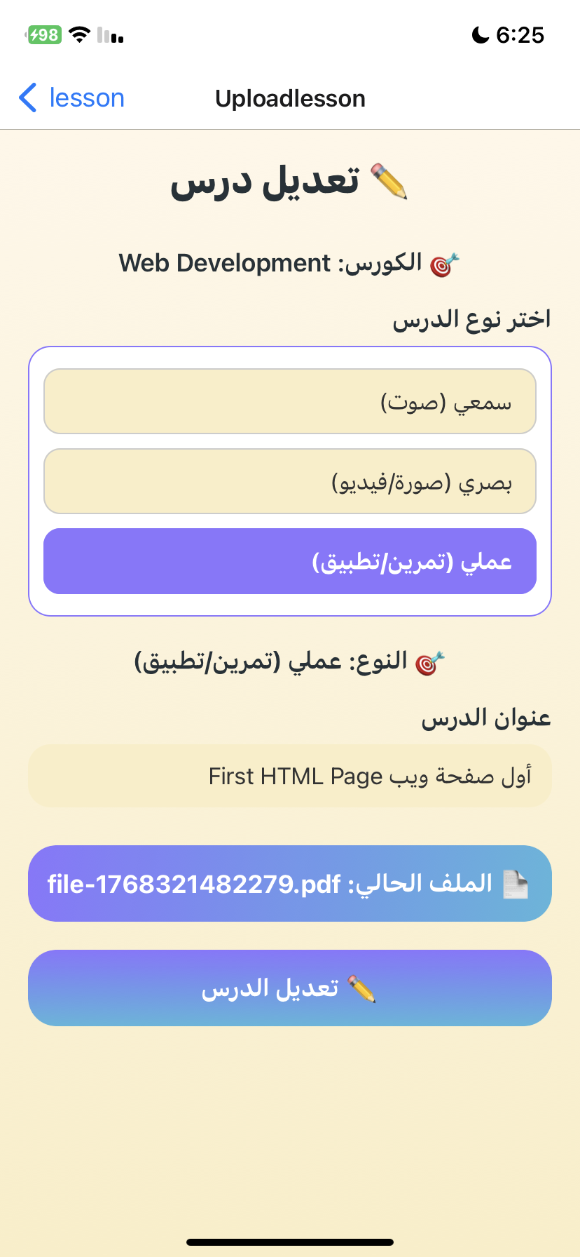
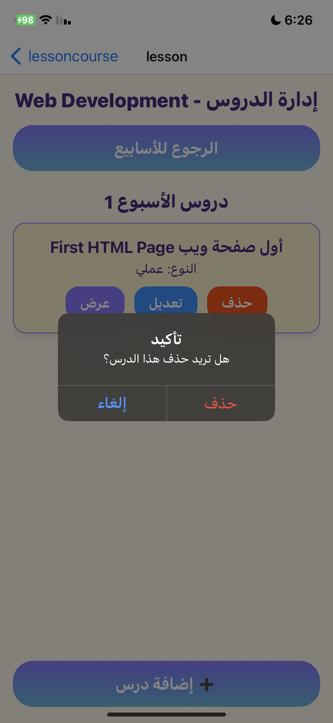
Teachers can view, edit, or delete lessons after publishing, ensuring content accuracy and flexibility.

Slide 18

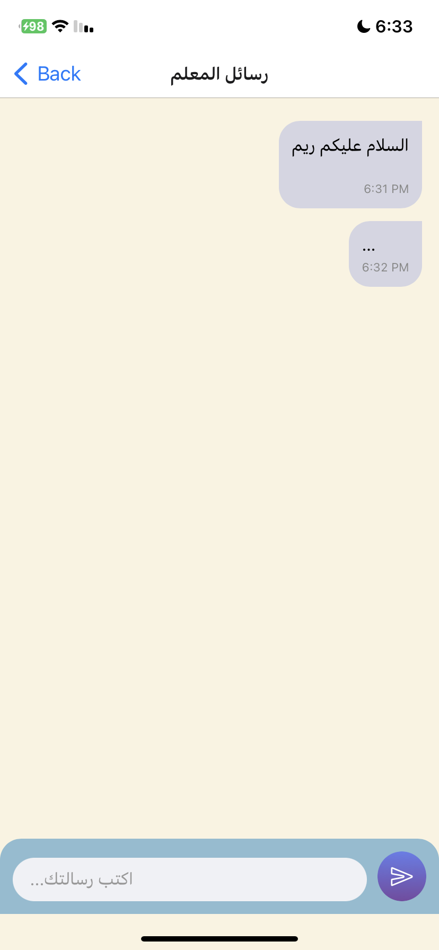
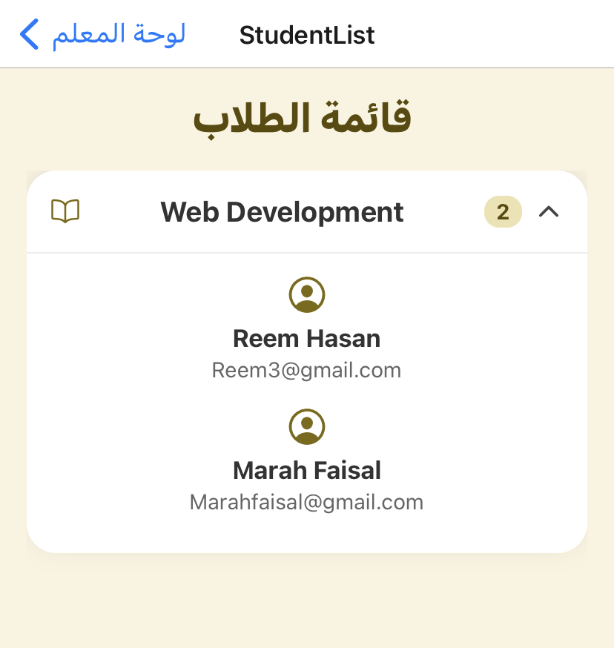
Built-in messaging enables direct student–teacher communication, and teachers can view enrolled student lists for each course.

Slide 19

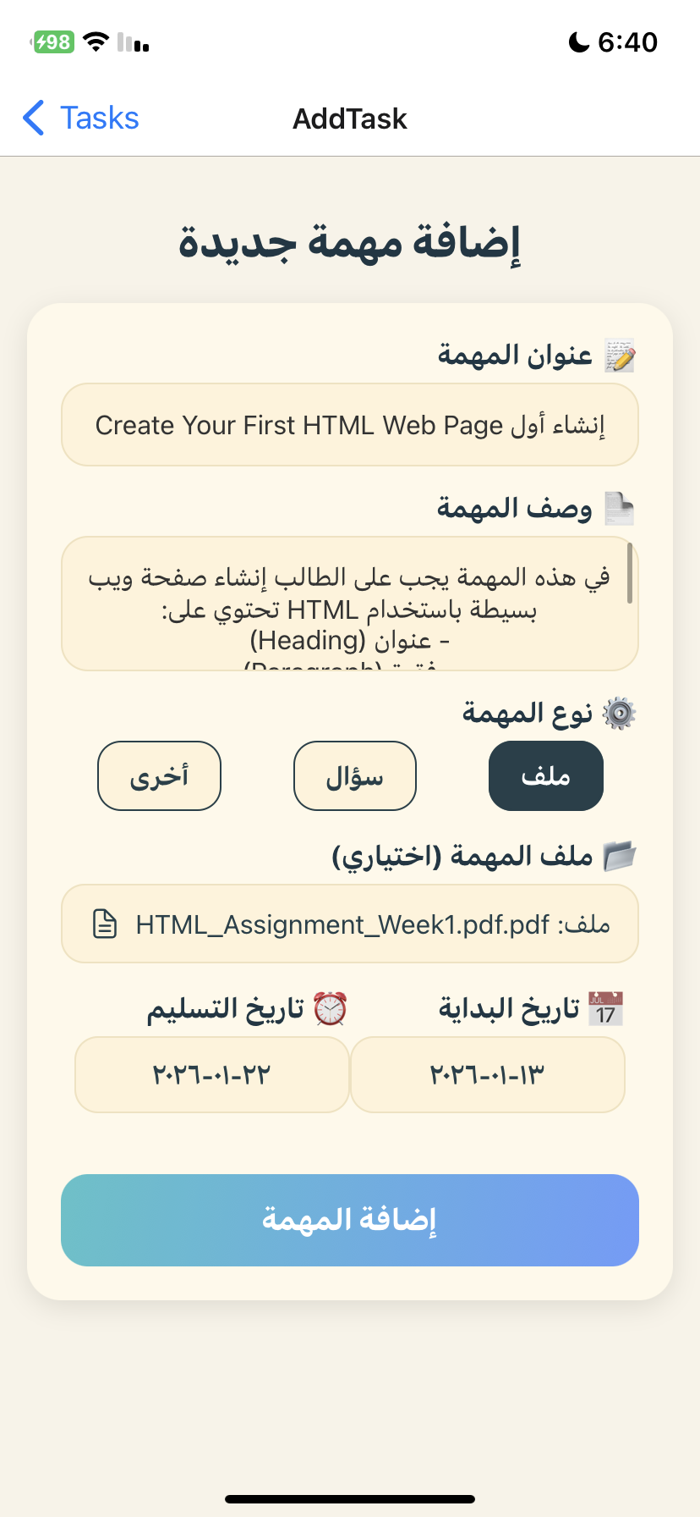
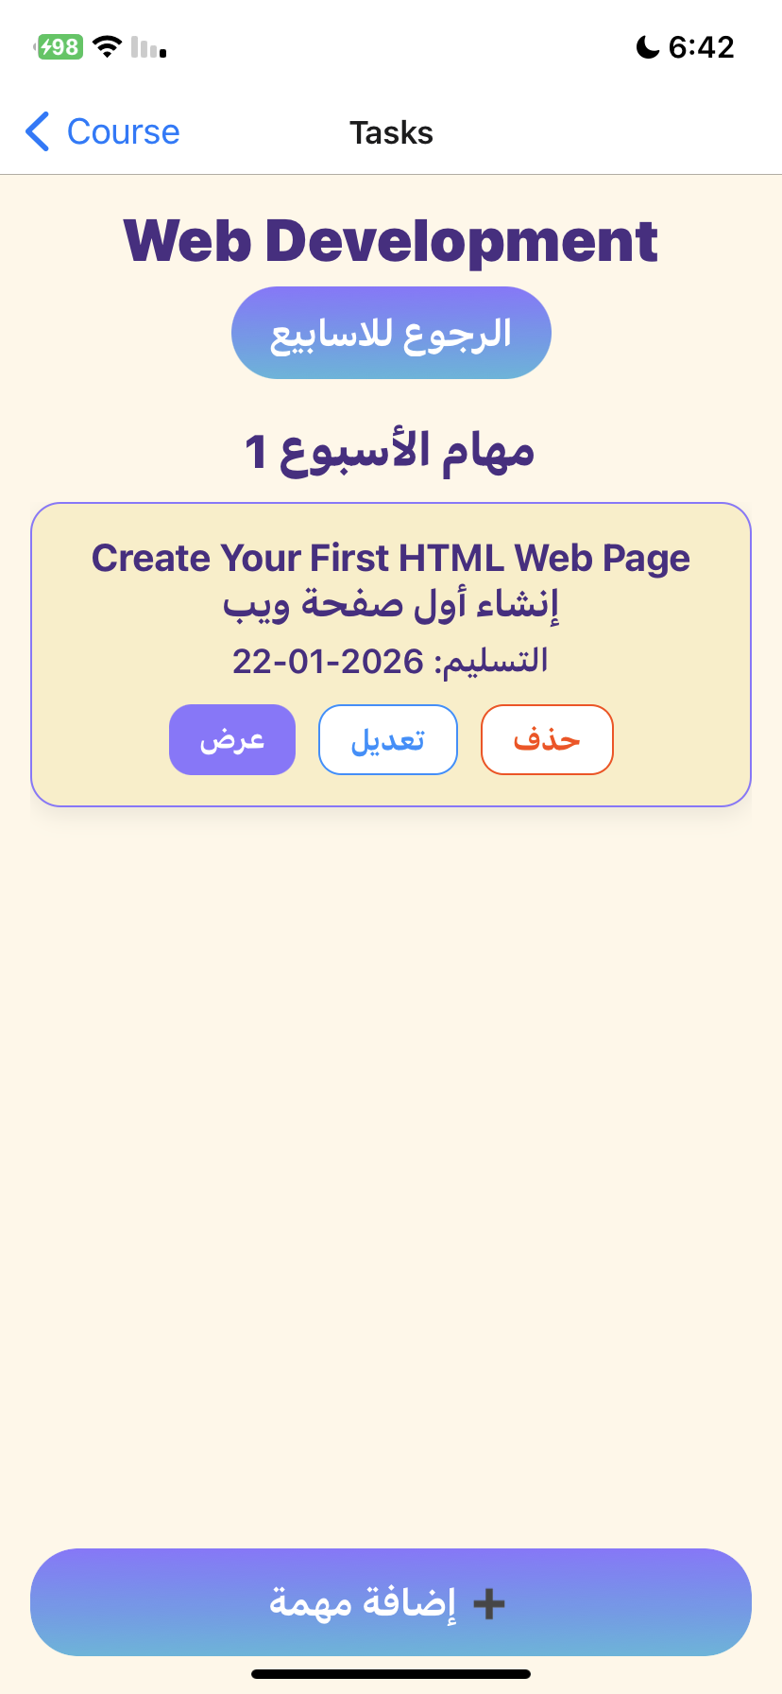
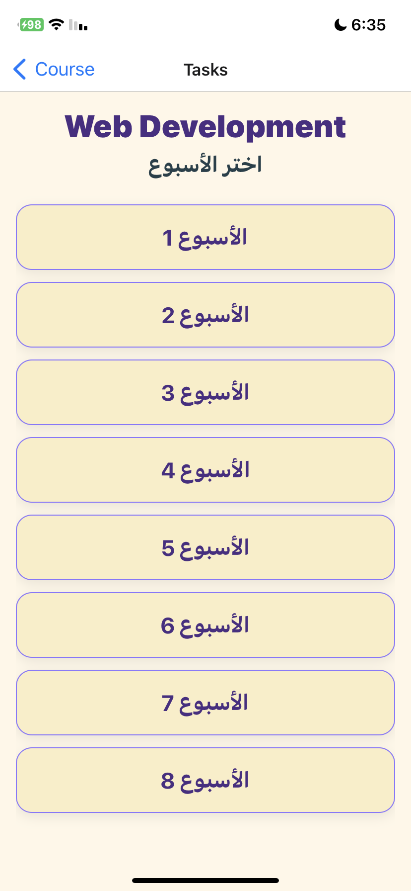
Teachers can create assignments by selecting the course, week, assignment type, and availability period. Assignments are automatically displayed to students during the scheduled time.

Slide 20
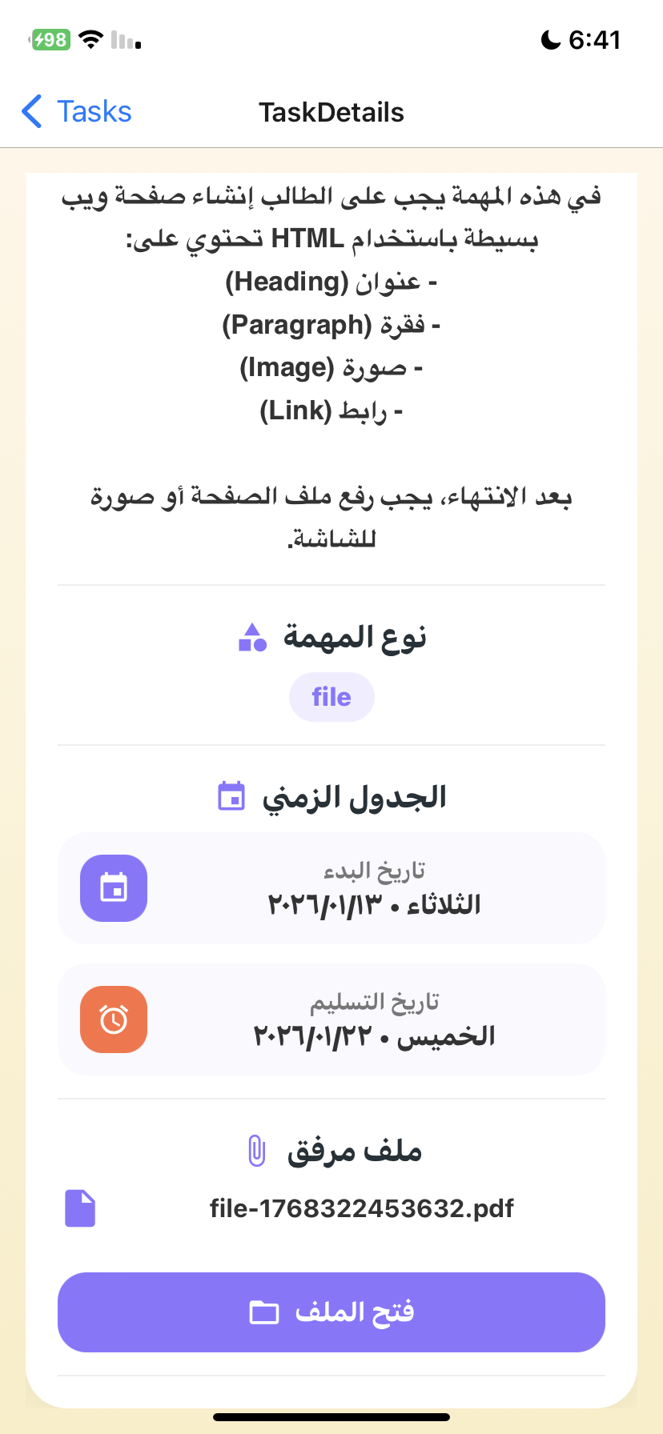

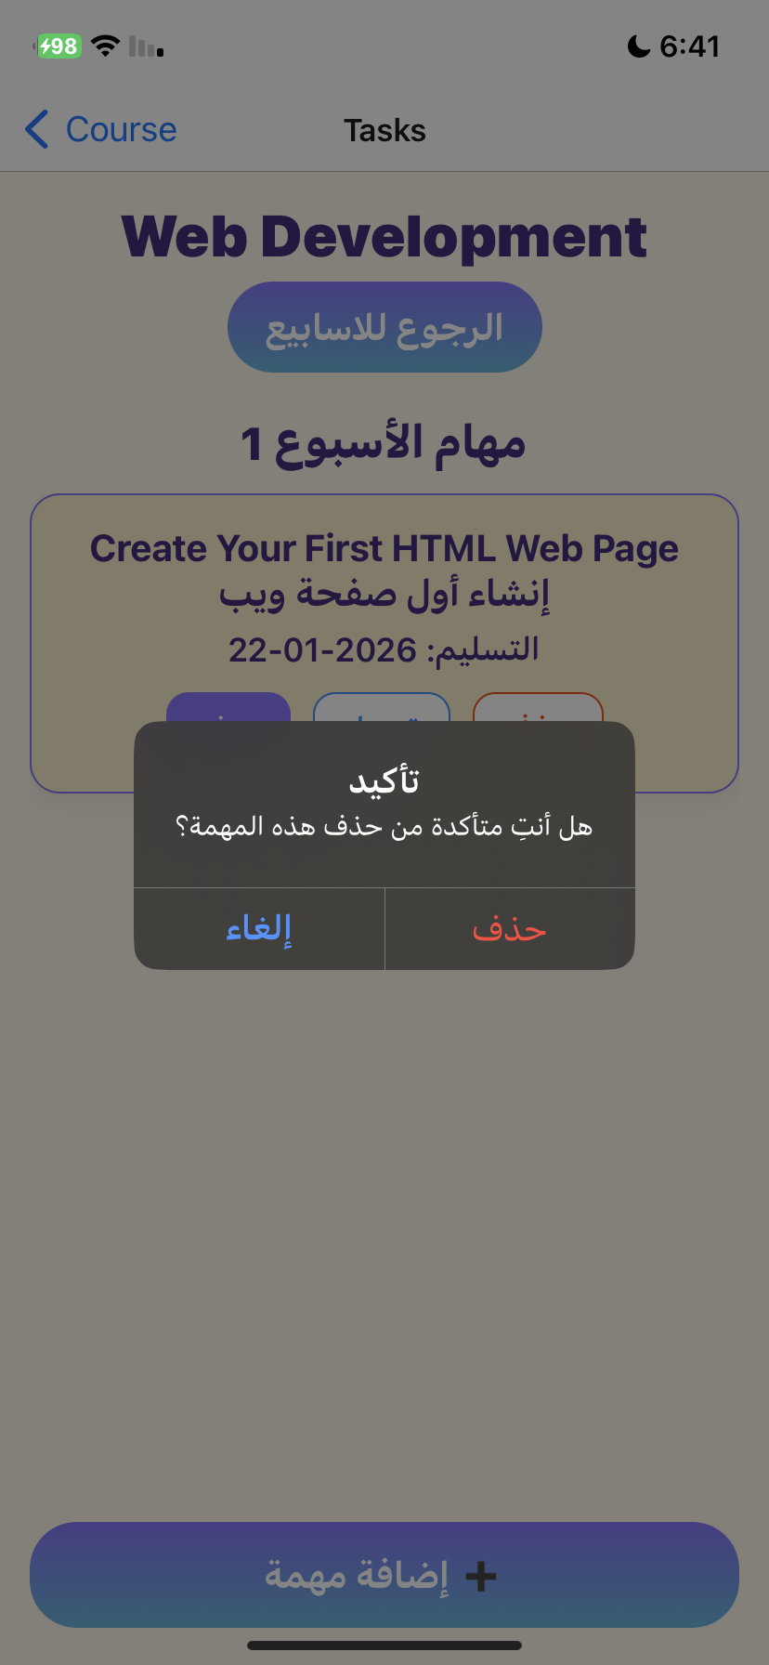
Teachers can view uploaded assignment files, edit task details, or delete tasks when needed directly from the task management screens, ensuring full control over assignment content and organization.

Slide 21
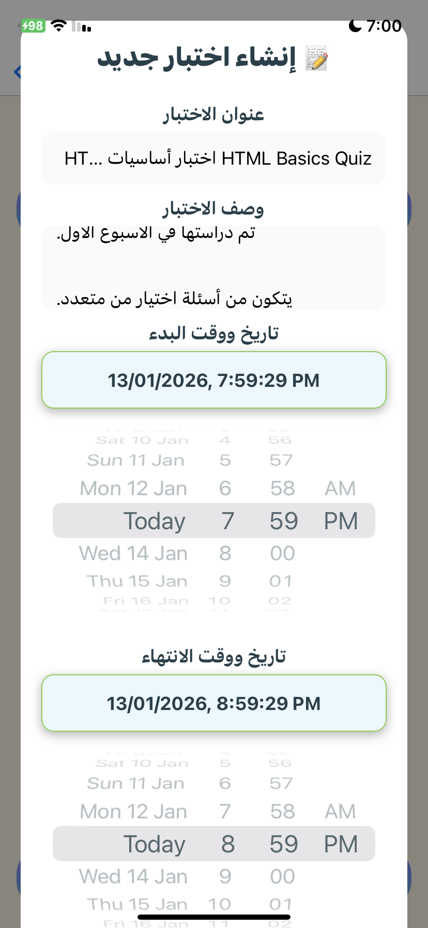
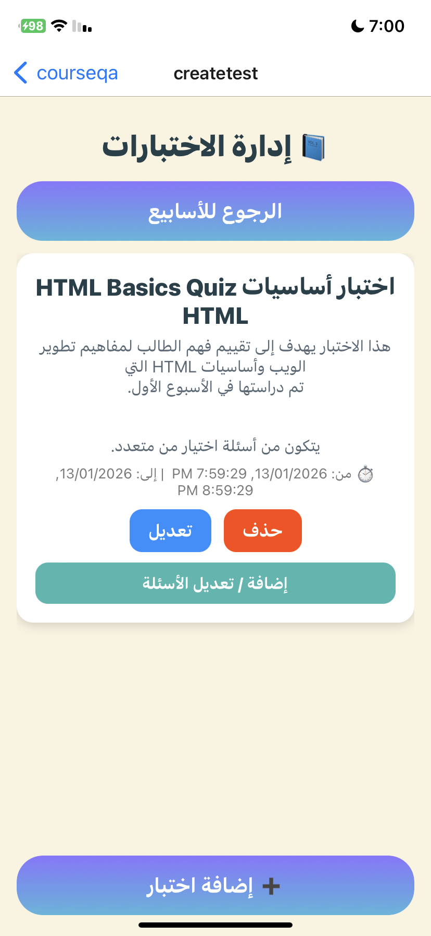

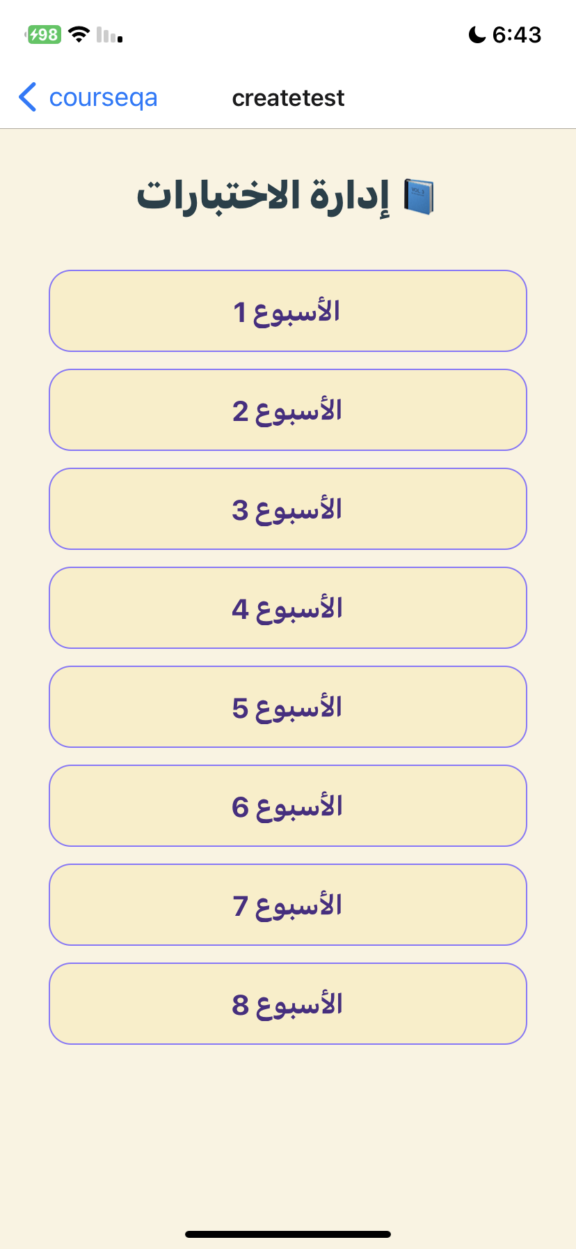
This module allows teachers to create and manage course tests organized by weeks. Teachers can add, edit, or delete tests, set schedules, and automatically notify students.

Slide 22
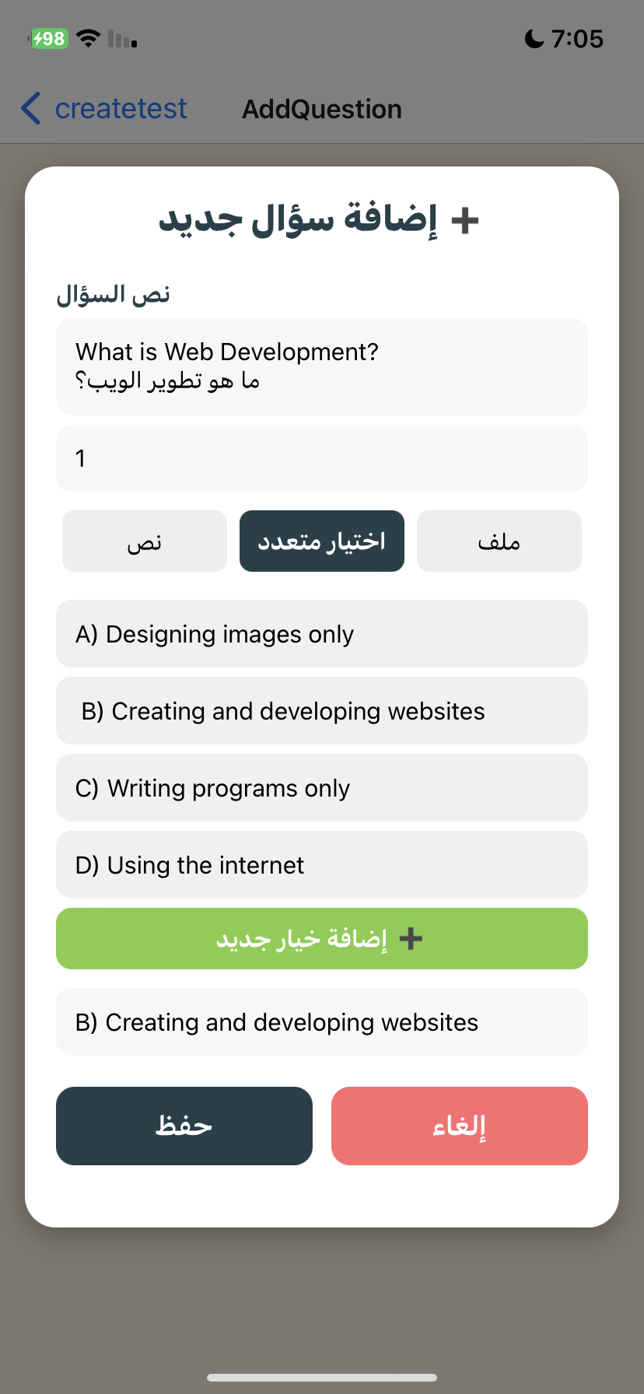

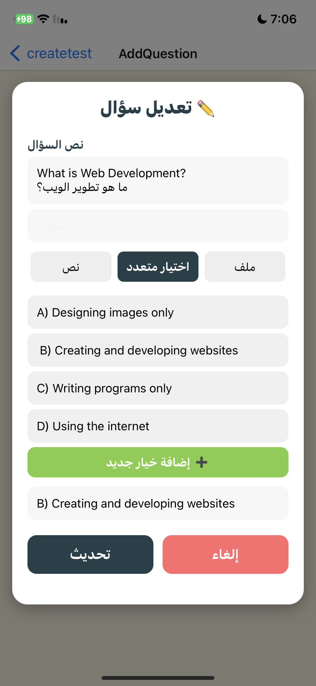
The system adapts based on test status, enabling question management during active tests and result viewing after completion.

Slide 23
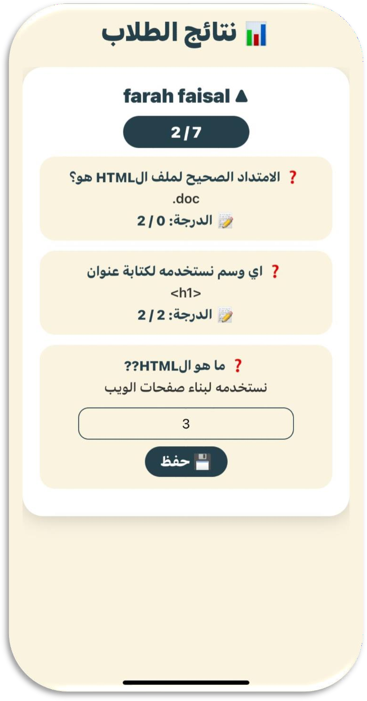
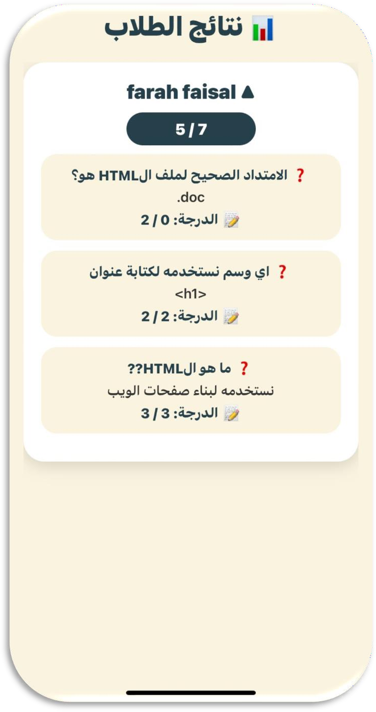
Teachers can review student quiz and test submissions, view all answers, assign grades where needed, and see final scores compared to the total marks. Uploaded files can be opened directly for evaluation.

Slide 24
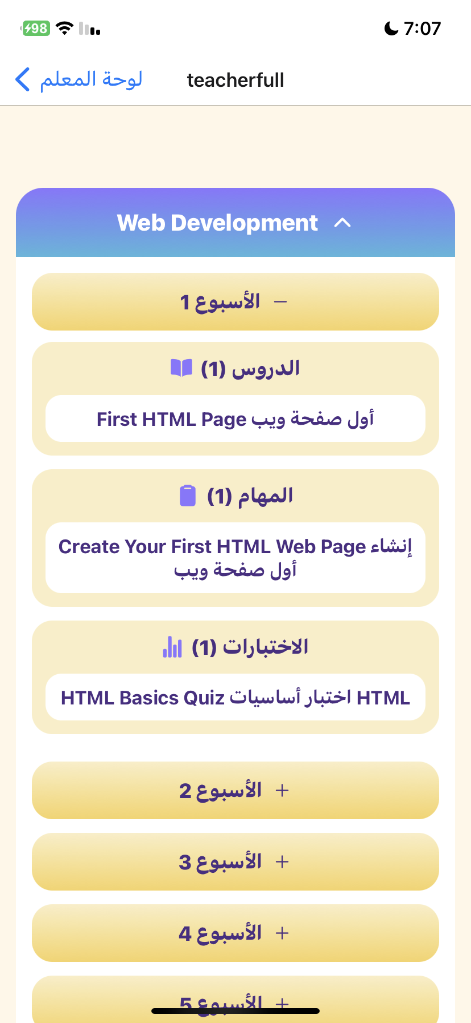
The Course Content Overview screen provides teachers with a clear and organized view of all approved courses and their weekly content.
Courses are displayed as expandable cards, showing lessons, tasks, and tests for each week, helping teachers easily track course structure, content distribution, and overall academic progress.

Slide 25
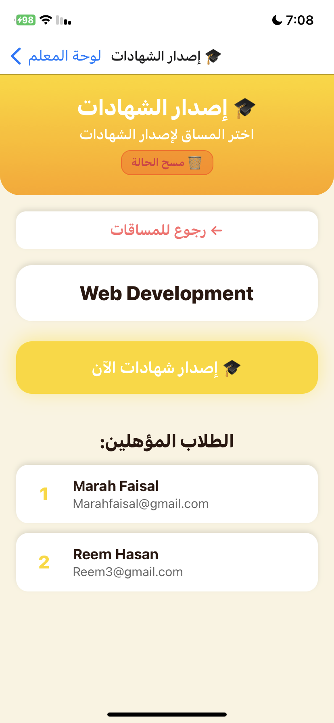
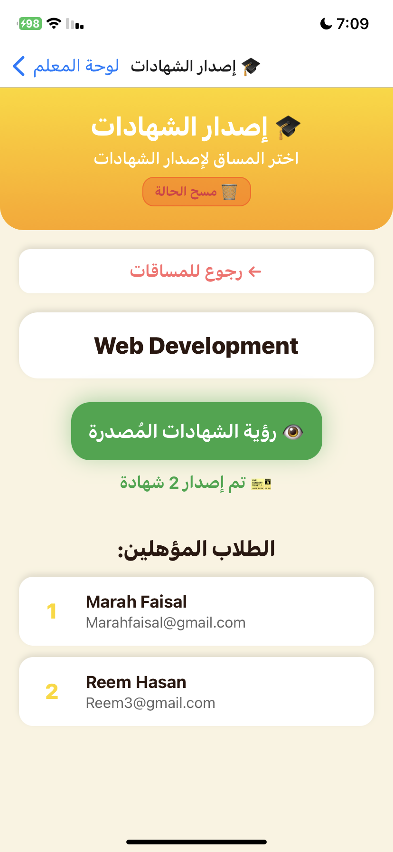

The Certificates Management screen allows teachers to manage the issuance of course certificates. Teachers can view approved courses, check which certificates have been issued, and generate certificates for eligible students. Once issued, certificates are tracked to prevent duplicates, and students receive real-time notifications about their certificates.

Slide 26
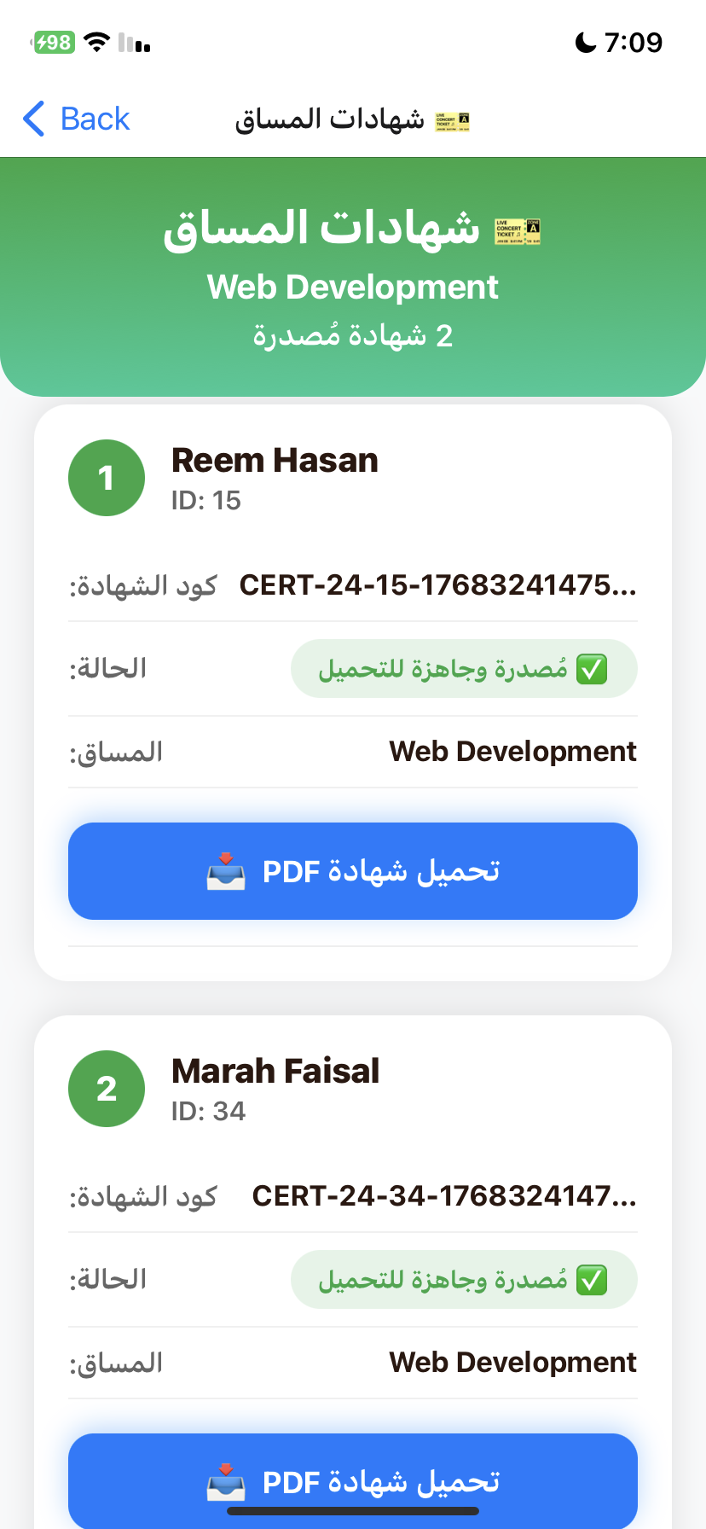
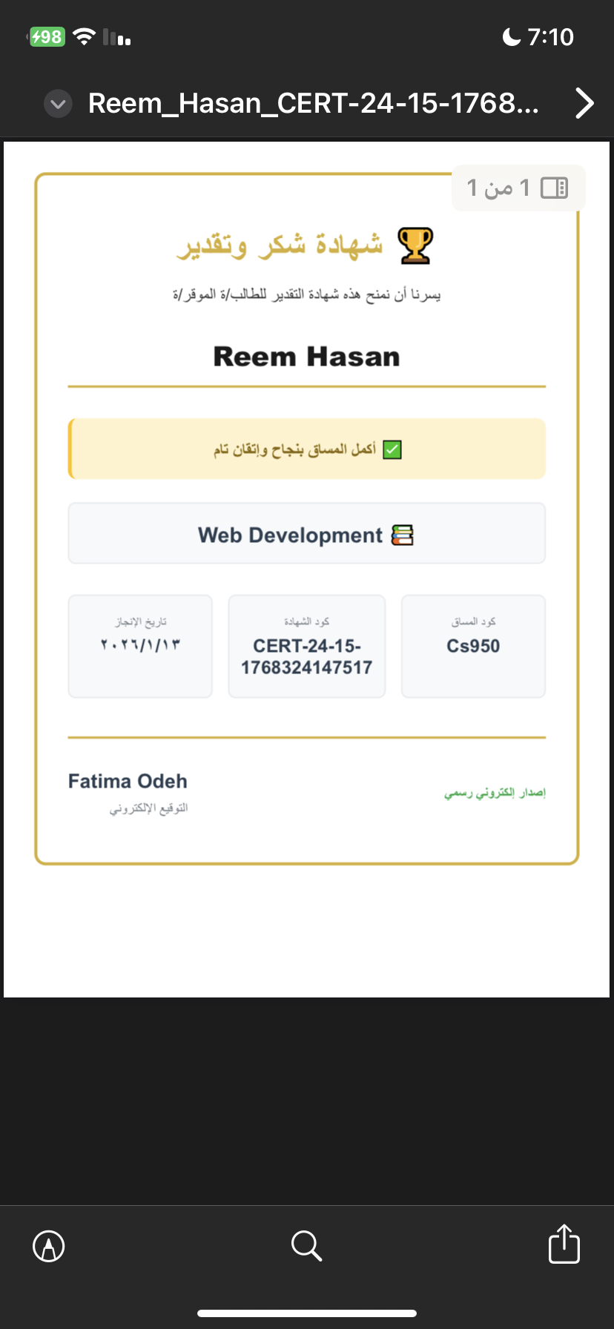
The Course Certificates screen displays all issued certificates for a course, showing student information, certificate codes, and status. Teachers can download certificates as PDFs, share them immediately, and monitor various download states with clear feedback, providing a smooth and organized workflow.

Slide 27
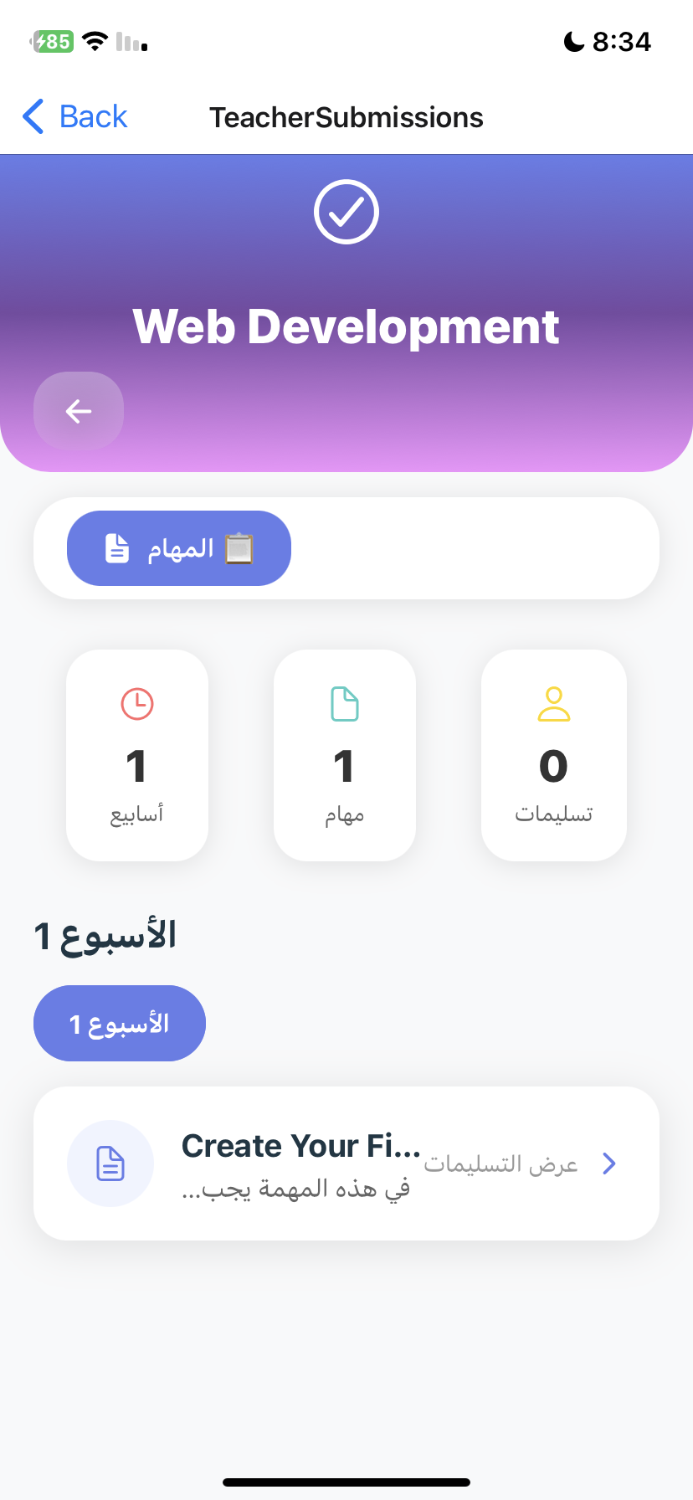
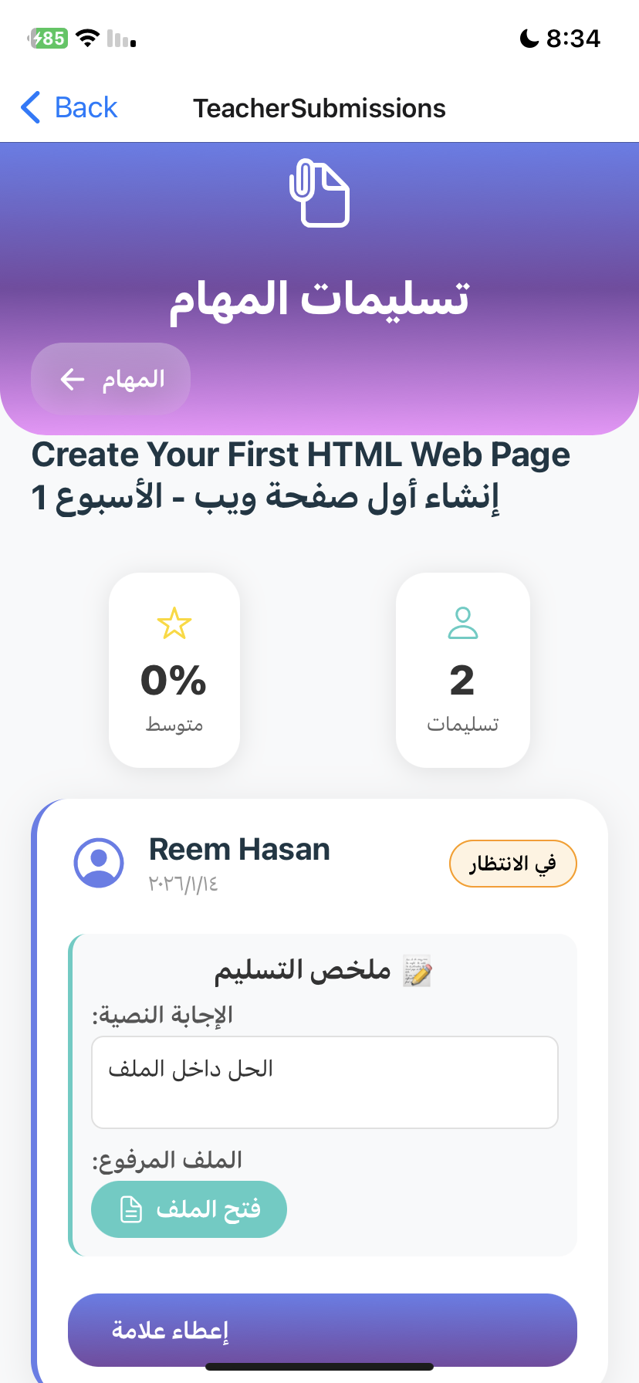
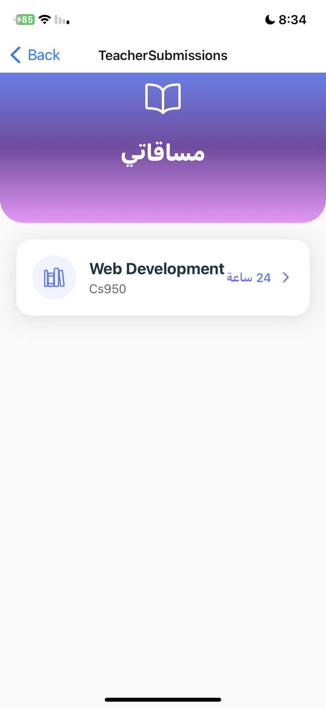
Assignment Evaluation & Class Performance
Teachers can view all student assignment submissions for a course, grade each submission, and provide feedback or comments. They also see the overall scores and percentages for all students, giving a clear view of class performance.

Slide 28
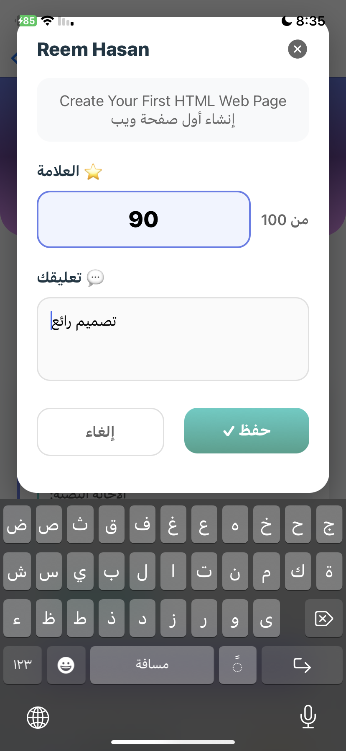
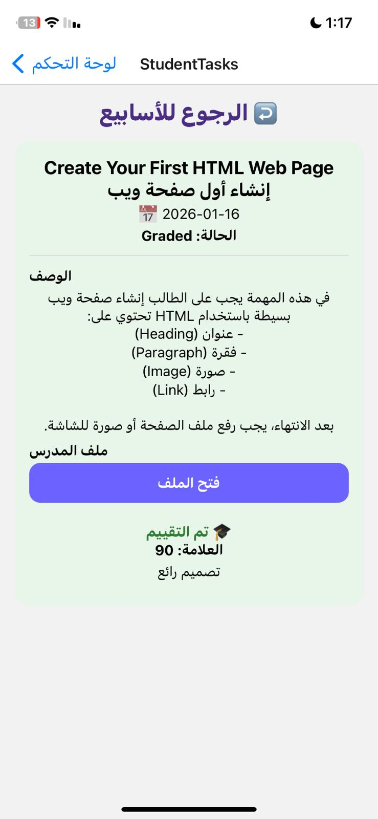
"Teacher grading the assignment, giving a score and feedback."
"Student receives the grade and feedback for the submitted assignment."

Slide 29



<< Notifications & Profile Page >>
Teachers receive real-time notifications whenever students submit assignments, ask questions, or interact with course content, allowing them to stay updated and respond promptly.

Slide 30


<< Student Course Enrollment >>
Students can browse available courses, complete secure payments via Stripe, and select their preferred learning style to personalize their learning experience.

Slide 31


<< Learning Style Selection >>
After enrollment, students choose their preferred learning style—Visual, Auditory, or Kinesthetic—to tailor their learning experience. They can switch styles at any time to best suit their study needs and maximize understanding.

Slide 32



After selecting a learning style, students access their personalized dashboard. The main interface adapts to their chosen style, while the side menu remains consistent across all learning styles, providing easy navigation and access to core features.

Slide 33


Course Selection & Overview
The Choose Course and Courses Overview screens allow students to view available and enrolled courses, check payment status, access course content, and select a learning style to personalize their experience, helping them manage and organize their learning in a clear and user-friendly way.

Slide 34


Student Course Plan Screen
Displays the course study plan in a weekly structure, including objectives, content, and assessment methods, helping students understand course requirements and track their progress.

Slide 35


Weekly Lessons Tailored by Learning Style
Students can also view weekly lessons for each enrolled course, which are organized by the teacher according to learning style.
For example, if a student chooses the (Practical) style, only lessons designed for that style will appear in their dashboard.

Slide 36




Students can view, complete, and submit assignments uploaded by the teacher. They can edit or delete their work before the deadline, but once the submission period ends, the assignment is marked as closed and no further submissions are allowed.

Slide 37


"Live Online Lectures"
"Course Completion Certificates"
Students can access all live online lectures through their dashboard. Ongoing sessions are displayed as live, upcoming sessions show scheduled times with Zoom links, and completed lectures are marked as finished.
After completing a course, students receive a certificate of completion in their dashboard, which they can download as a PDF.

Slide 38



Students can see all upcoming quizzes with their schedule and visibility status. Upon taking a quiz, answers are automatically graded based on the teacher’s correct responses, and students receive their scores immediately.

Slide 39


"Personal Study Plans & Progress Tracking"
Students can create daily and weekly study plans, adding tasks for each day. A progress page shows which tasks are completed and which are pending, including totals, helping students track their productivity.

Slide 40


Visual
Auditory
Practical

Slide 41


Visual Learning Style:
The Visual Learning features include the YouTube Learning Screen, where students can search and watch educational videos directly within the app, and the Mind Map Fun Screen, which allows creating interactive mind maps with drawing, shapes, and text.

Slide 42


Auditory
Learning Style:
The Auditory Learning features include the Listen Screen, where AI generates text explanations that can be converted to speech for listening, and the Repeat Screen, which allows users to record and playback their own voice, reinforcing learning through repetition, memorization, and pronunciation.

Slide 43



Practical
Learning Style:
The Practical Learning AI Screen generates hands-on activities using AI, providing a title, materials, step-by-step instructions, challenges, and estimated completion time, helping learners apply concepts through real-world practice and enhancing engagement and understanding.

Slide 44


"AI Chatbot Support"
"AI Text Summarization"
Students can interact with the AI chatbot, asking any questions in real-time and receiving instant answers, guidance, or explanations to support their learning.
Students can upload Word or text files, and the system automatically summarizes the content in either Arabic or English.

Slide 45



Dynamic Quiz Screen
Uses AI to generate interactive multiple-choice quizzes based on a selected topic. Students receive instant evaluation, final scores, and feedback, supporting active learning and self-assessment.

Slide 46


"Direct Teacher Communication"
Students can also communicate directly with their teacher through the dashboard, sending messages and receiving real-time responses.

Slide 47


"Real-Time Notifications & Management"
The student dashboard also shows real-time notifications whenever a teacher uploads a lesson, assigns a task, sets a quiz, issues a certificate, or sends a message. Students can view and manage these notifications, including deleting them when no longer needed.

Slide 48


<< Profile Page >>
The Student Profile screen lets students view and edit their name, email, and avatar, change their password, and log out securely.

Slide 49

Admin Dashboard and Management Features
The Admin Dashboard serves as the central control hub of the platform, allowing administrators to manage users, courses, payments, and monitor overall system activity. It provides a clear overview of key statistics and quick access to important actions through a responsive and user-friendly interface.

Slide 50

This screen allows the admin to manage all courses in the system. The admin can view course details, change teachers, update course status, delete courses, and add new courses. It also shows statistics about total courses, approved courses, and enrolled students.

Slide 51


The admin can easily manage course assignments by selecting a new teacher for a course through a searchable modal and can also update the course status, approving or rejecting it with a single tap.

Slide 52


This screen allows administrators to review newly submitted courses by teachers before publication. Admins can approve or reject courses to ensure content quality and platform standards before they become visible to students.

Slide 53


This screen allows administrators to view, add, and delete teachers while managing their basic information in a clear card-based layout. It provides quick access to teacher details, secure deletion with confirmation, and an easy-to-use form for adding new teachers to the system.

Slide 54


This screen enables administrators to view, add, search, and delete student accounts from the platform. It ensures clean data management by automatically removing related enrollments when a student is deleted.

Slide 55

Admins can quickly enroll any student into any approved course using a simple modal with dropdowns, instantly updating enrollments and platform statistics.

Slide 56

Admins can view and manage all student payments, see total revenue, filter transactions, and handle pending or rejected payments efficiently.

Slide 57


The admin can filter revenue by date range and see total revenue for that period. A line chart shows overall revenue trends including total, daily, and monthly figures.

Slide 58


The top 5 teachers are displayed with enrollment numbers, alongside total and today’s enrollments. Enrollment statistics show total and today’s registrations.

Slide 59


Course status is shown in a bar chart as approved, pending, or rejected. KPI cards provide quick access to key metrics for students, teachers, courses, and enrollments.

Slide 60

Admin Settings
The admin can view and update personal information and change their password directly from the settings screen. The system validates inputs, ensures password confirmation matches.

Slide 61

Constraints
Limited budget: used free/open-source tools efficiently.
Tech challenges: seamless web/mobile performance, real-time messaging, AI features.
Scalable & sustainable: flexible architecture for future features

Slide 62
FUTURE WORK :
Native mobile app with offline access.
Integration with school or regional systems for centralized data.
Virtual support tools for guidance and learning assistance.
Enhanced collaboration for group projects and peer interaction.

Slide 63


