Slide 1


Num
Hoor Qadri
Nisreen Al-Saleh

Slide 2
Idea
I
D
E
A

Slide 3
Solved Problems
Find the number quickly.
Heuristic.
Real-time.

Slide 4
Our Aim
Find the numbers quickly

Slide 5
Target Market
Students
Researchers
Business Companies
Journalists

Slide 6
Project Timeline
Software Engineering
Backend process
Frontend process
Sep | Oct | Nov | Dec | Jan | Feb | Mar | Apr | May
Analysis & documenting
Crawling
NLP
Indexing
Interface

Slide 7
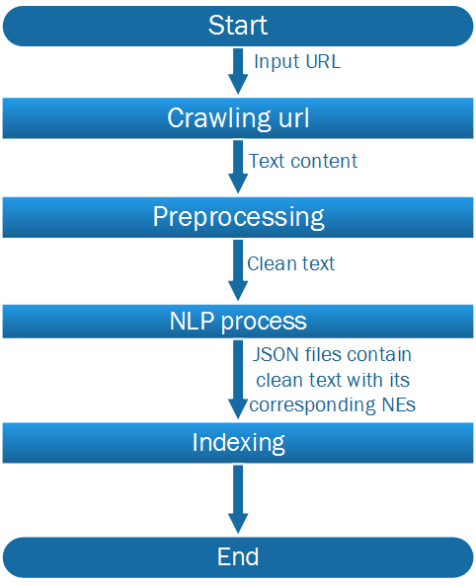
Project flowchart

Slide 8
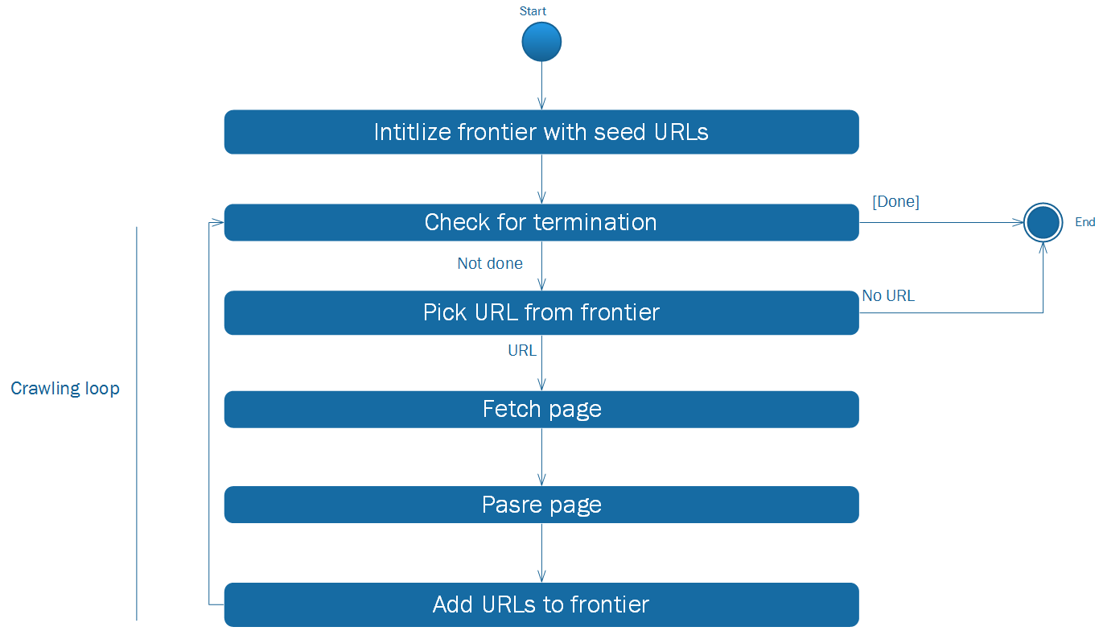
Crawling
Study of Web Crawler and its Different Types [1]

Slide 9
Preprocessing
Text data
Clean Text

Slide 10

Name Entity Recognition(Gate)
Advantages:
Supports Arabic Language
Disadvantages:
Lack of resources
Not easy to learn
Gate tool[2]

Slide 11

Name Entity Recognition(Stanford)
Advantages:
Extract entities (Location , Person ,Organization and numbers).
Disadvantages:
Hard to recognize the chunks of the data.
Example:
Text : An-Najah National University
Results : An-Najah: Org , National: Org , University: Org
Stanford[3]

Slide 12

Name Entity Recognition(AYLIEN)
Advantages:
Extract entities (Location , Person ,Organization, Phone,Emails,URLs,Percentages,Product,Money and Keywords).
Can recognize the chunks of the data.
Disadvantages:
Can’t make more than 60 request per minute.
Can’t make more than 1000 call per day.

Slide 13
Name Entity Recognition tools Combination
LOC
NUM
Keywords
NER
Aylien
Stanford
PER
ORG

Slide 14
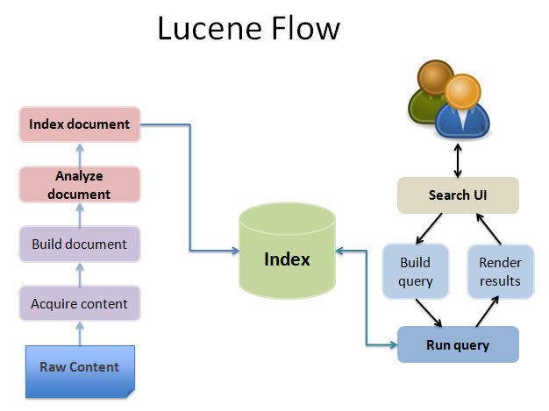
IRS
Lucene flow[4]

Slide 15
Challenges
1
Choose appropriate crawling library
2
Page structures
3
Choose appropriate NLP tool

Slide 16

Acknowledgment
Dr.Abed Razzaq Natsheh
Dr.Hamed Abdelhaq
Mr.Omar Rayyan

Slide 17
References
[1] Trupti V. Udapure , Ravindra D. Kale , Rajesh C. Dharmik, “Study of Web Crawler and its Different Types”, IOSR Journal of Computer Engineering (IOSR-JCE), Volume 16, Issue 1, Ver. VI (Feb. 2014).
[2] Gate general architecture for text engineering , https://gate.ac.uk/
[3] The Stanford Natural Language Processing Group, https://nlp.stanford.edu/software/
[4]Lucene flow, http://gopaldas.org/wp-content/uploads/2015/10/lucence-flow.png

Slide 18
?
ANY QUESTIONS
?
?

