Slide 1
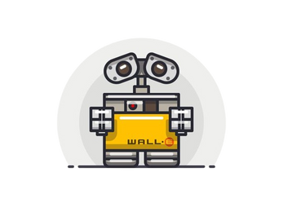
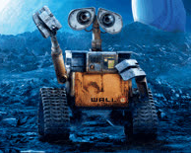
WALL-E SAVIOR ROBOT
PRESENTED BY:
MARAH HANINI
AHMAD HUSSIEN
SUPERVISED BY:
DR. MUHANNAD AL-JABI

Slide 2
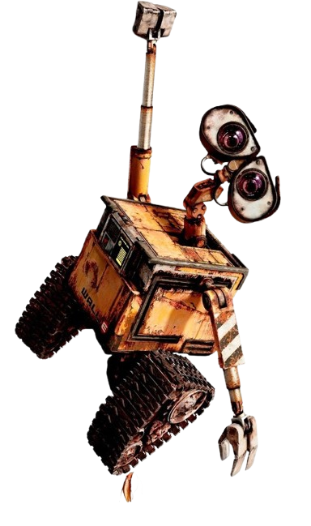
CONTENTS
Introduction
Features
Hardware Components
Future work
Demo

Slide 3
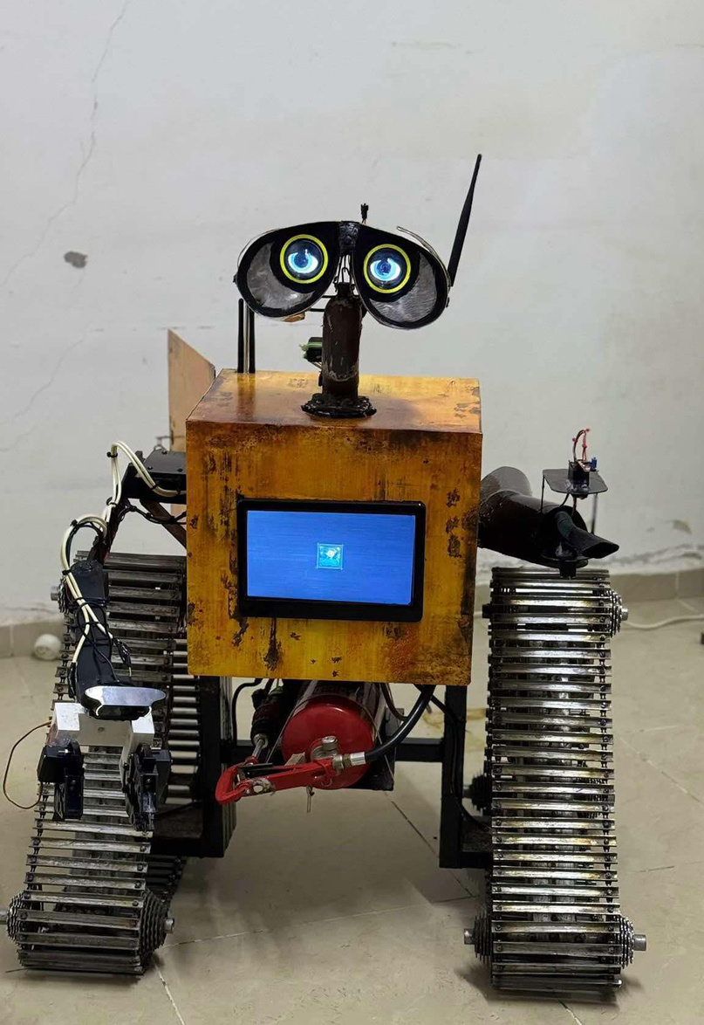
INTRODUCTION
In various high-risk environments, such as high-pressure areas and hazardous zones, performing tasks like cutting or connecting wires presents significant challenges and risks to human safety. Traditional approaches often require manual intervention, which can be dangerous and inefficient. Technological advancements in robotics and digital image processing provide innovative solutions to mitigate these risks and enhance operational efficiency.

Slide 4
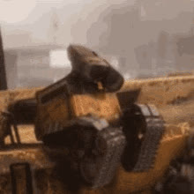
ball bearing problem
Constraints
Unavailability and High Cost of Components
Battery Specifications
Insufficient Motor Power
Relay Noise Interference
insufficient Current Handling of the Motor Drivers:

Slide 5
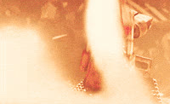
FEATURES
Image processing
works under hard conditions
Wireless Control
Efficient Power Management
friendly appearnce

Slide 6
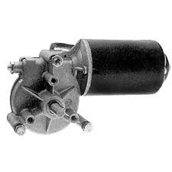
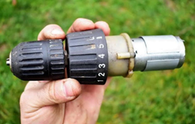
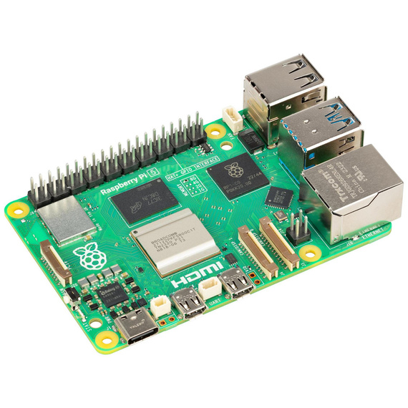
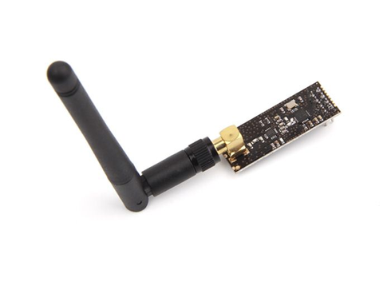
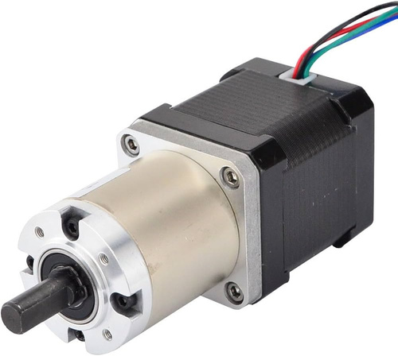
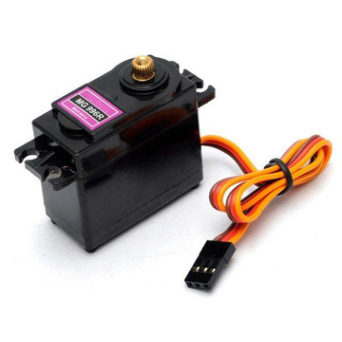
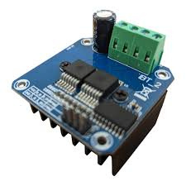
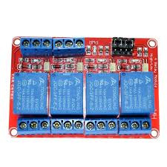
HARDWARE COMPONENTS:
WIPER MOTOR
DRILL MOTOR
RASPBERRY PI 5
NRF24
STEPPER MOTOR
SERVO MOTOR
4 CHANNEL
RELAY
DC DRIVER

Slide 7
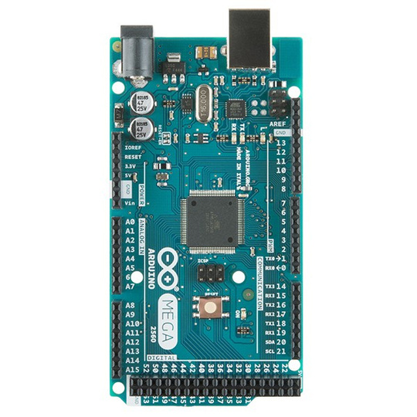
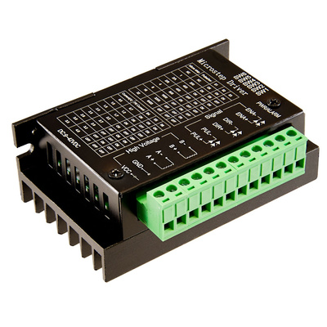
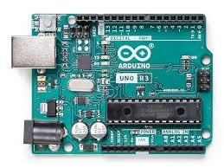
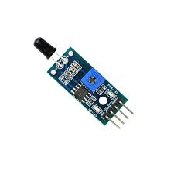
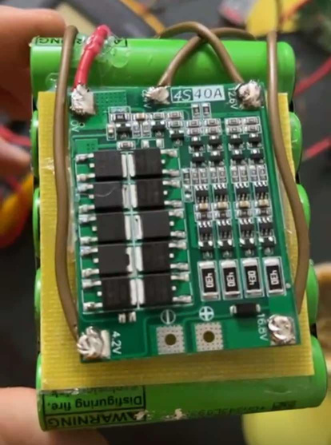
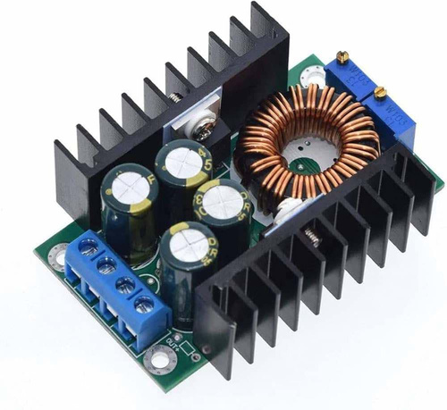
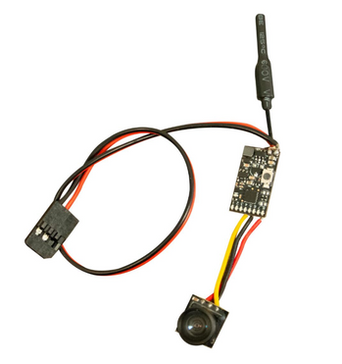
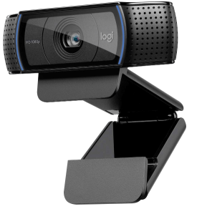
HARDWARE COMPONENTS:
ARDUINO UNO
ARDUINO MEGA
FIRE SENSOR
STEPPER DRIVER
LITHUIM BATTARY
AND PMS
BUCK CONVERTOR
WEB CAM
FBV CAMERA

Slide 8
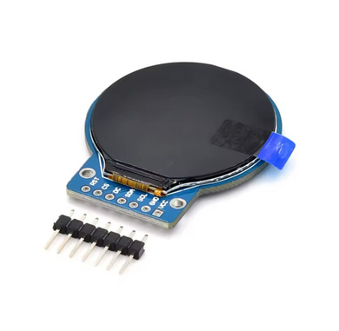
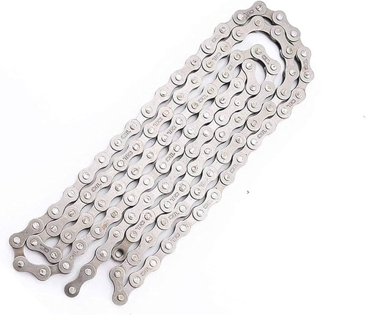
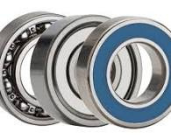
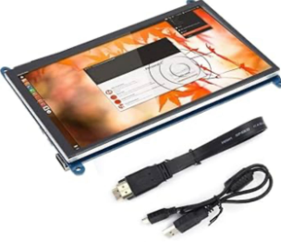
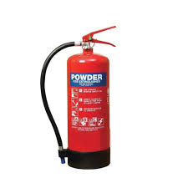
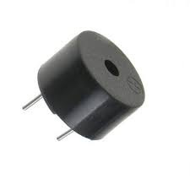
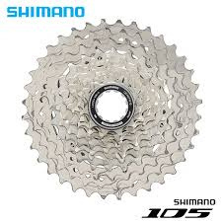
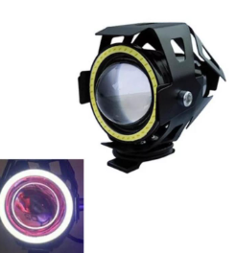
HARDWARE COMPONENTS:
ARDUINO UNO
ARDUINO MEGA
BICYCLE CHAIN
BALL BEARINGS
BICYCLE COGS
CAR LIGHT
FIRE
EXTINGUISHER
BUZZER

Slide 9
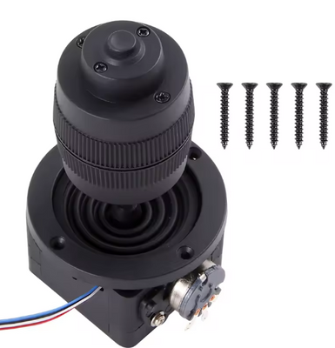
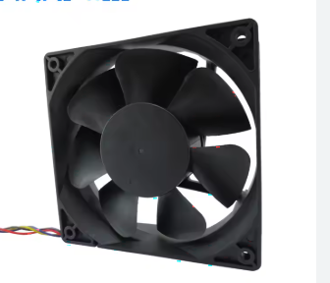
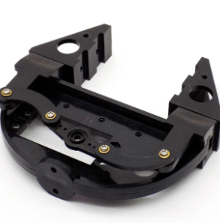
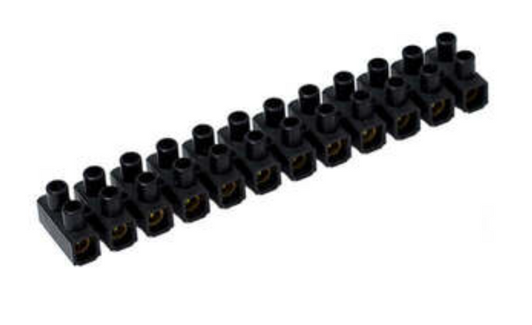
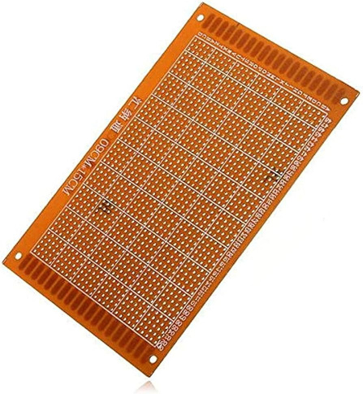
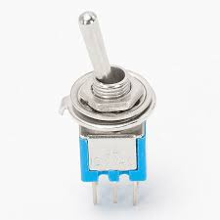
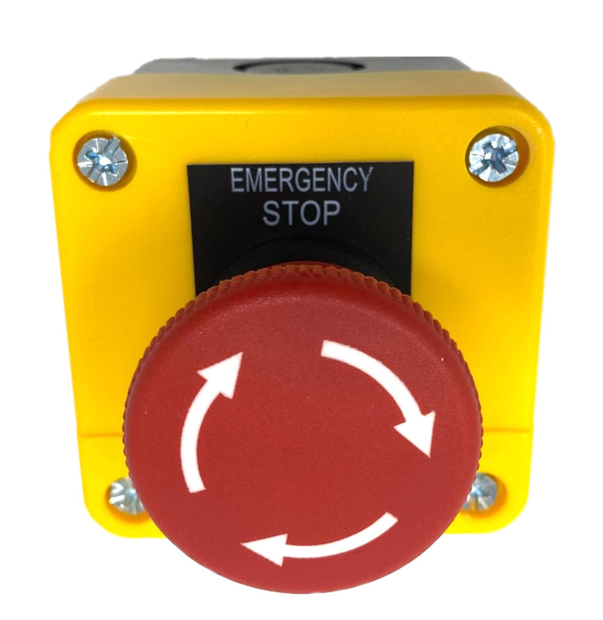
HARDWARE COMPONENTS:
JOISTIKS
COOLING FAN
CLAMP
CONNECTORS
EMERGENCY
BUTTON
COPPER PLATE
TOGGLE SWITCH

Slide 10
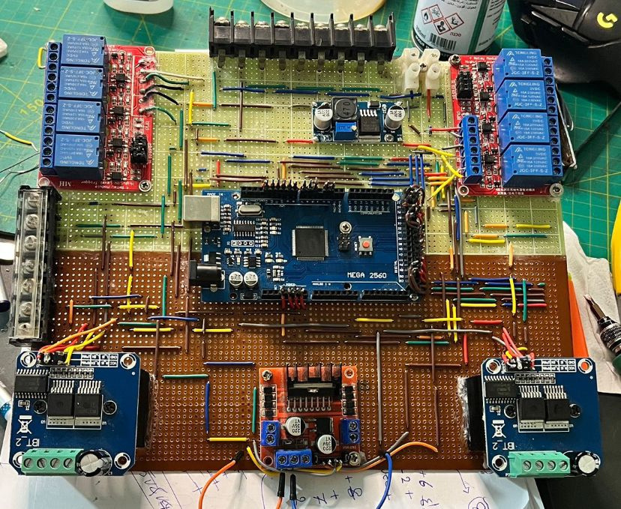
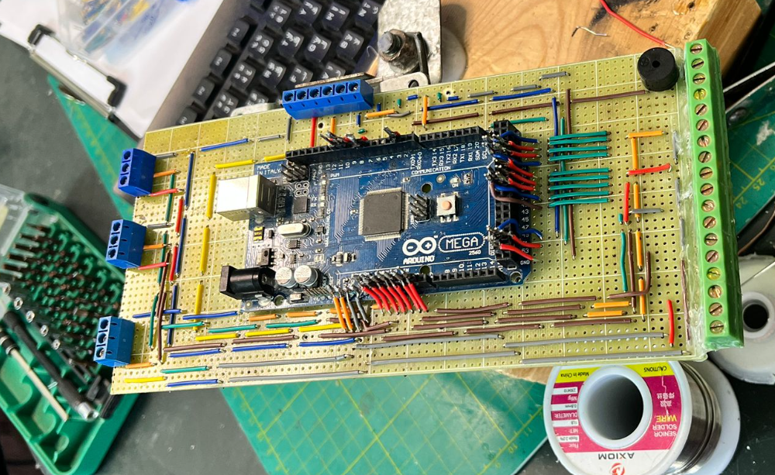
THE MOTHER BOARD CIRCUIT
THE REMOTE CONTROL CIRCUIT

Slide 11
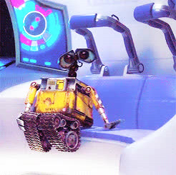
FUTURE WORK :
Integration of a 360-Degree Camera
Integration of LiDAR Sensor
Thermal Sensor Integration
Enhanced Camera Functionality
Enhanced Fire Suppression System
AI and Machine Learning Integration
Microphone for Real-Time Communication

Slide 12
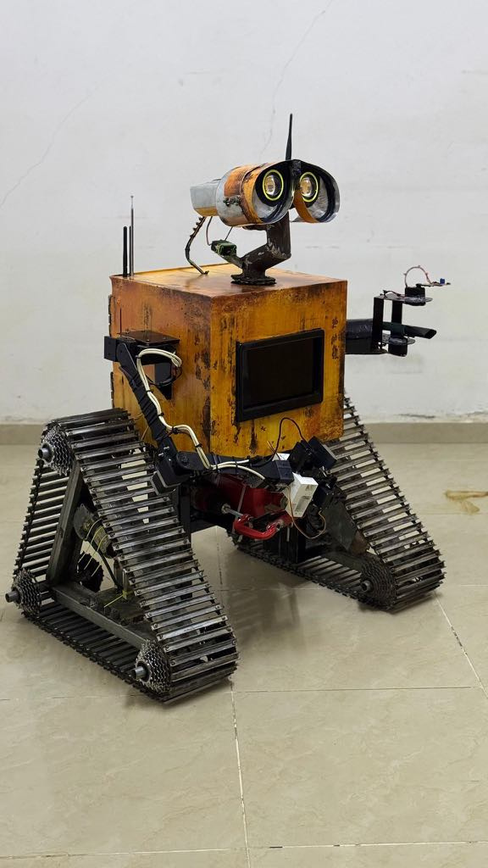

CONCLUSION
THE WALL-E SAVIOR ROBOT SHOWCASES THE POWER OF ROBOTICS IN ENHANCING SAFETY AND EFFICIENCY IN HAZARDOUS ENVIRONMENTS. IT INTEGRATES FIRE DETECTION AND SUPPRESSION, PRECISION WIRE HANDLING, AND WIRELESS REMOTE CONTROL, REDUCING HUMAN EXPOSURE TO DANGER. RECHARGEABLE BATTERIES ENSURE EXTENDED OPERATION, WHILE IMAGE PROCESSING ENHANCES TASK ACCURACY. THIS PROJECT DEMONSTRATES HOW ROBOTICS CAN REVOLUTIONIZE FIREFIGHTING, BOMB DISPOSAL, AND OTHER HIGH-RISK APPLICATIONS, PUSHING INNOVATION TO PROTECT LIVES AND IMPROVE OPERATIONAL EFFECTIVENESS.

Slide 13
Demo

Slide 14
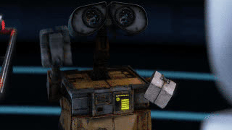

ANY QUESTIONS?

