Slide 1
Single Phase Active Power Filter Using H-Bridge
Prepared by : Aysar Daraghmeh
Osama Daraghmeh
Diya Kharouf
Supervised by: Dr. Kamel Saleh

Slide 2
content:
General Idea about the project
Sources of harmonics and its effects
Solution of the harmonic problem
Passive filter
Active filter
Ordinary methods of APF
D-Q Transformation method and its advantages
Methodology and MATLAB Simulation of APF
Results
Future Work

Slide 3
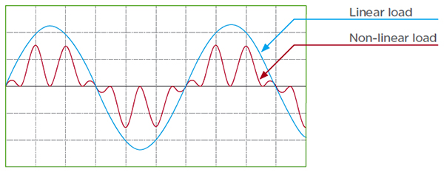


• General Idea about the project
Non-linear Loads:
Which is a Load with more than one frequency such as Power electronic devices (rectifier), Florescent lamps.
Non-linear loads have fundamental freq and other frequencies (harmonic freq) which causes non-pure Sinusoidal current .

Slide 4
• Sources of harmonics and its effects
Harmonics comes from non-linear load .
the increased amount of harmonics that pollute the distribution systems. These harmonics will affect the system by:
increase losses(decrease the efficiency)
cause male-function of protection
interfere with Telecommunications
Decreases the voltage
Cause THD penalty
Increase the installation cost

Slide 5
• Solution of the harmonic problem
Passive Filter :
are based on combinations of resistors, inductors and capacitors . they do not depend upon an external power supply.
Active Filter :
The active filter use voltage source inverter to eliminate the harmonic.

Slide 6

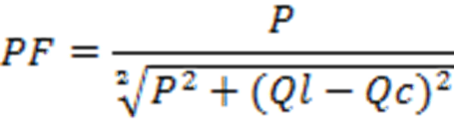
• Passive Filter :
Passive filters are based on combinations of resistors, inductors and capacitors . they do not depend upon an external power supply. Inductors block high-frequency signals and conduct low-frequency signals, while capacitors do the reverse.
Passive filter not stable
If the system frequency is changed will not be valid
The passive filters are more expensive for power system

Slide 7
Active Filter :
The active filter use voltage source inverter to eliminate the harmonic ,and it can control reactive power and voltage stability at transmission levels .
small size.
no requirement for tuning
stable operation
Cheap for power system

Slide 8
• Ordinary methods of APF
These common methods which are used for solving harmonic problem, which are:
Multiplication with sine function :
This method not require the voltage transformation for computation except for the sine wave generation (synchronization). The algorithm can provide a response time of half cycle (one cycle) for load current containing odd (odd and even) harmonic only.

Slide 9
• Ordinary methods of APF
pq theory :
This method is the fastest of all algorithm presented with a response time of T/4 time period. But the source current generated by pq theory deviate from sinusoidal shape when the supply voltage is distorted.
Fourier transfer :
This method can generate the reference source current even under the distorted source voltage. also, the method can provide a good transient response of half cycle for load current contains odd harmonic and one cycle for load current contains even harmonics.

Slide 10
• Ordinary methods of APF
dq transformation :
In case of compensation using this method, the source supplies the power corresponds to the fundamental component of supply voltage and load current. But in case distorted supply voltage, the load requires more power corresponds to the harmonic component of voltage and current.
and this method was applied to this project

Slide 11
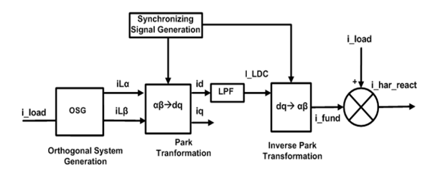
•D-Q Transformation method and its advantages

Slide 12
• D-Q Transformation method and its advantages
* result of the power factor obtained after closed loop control :

Slide 13
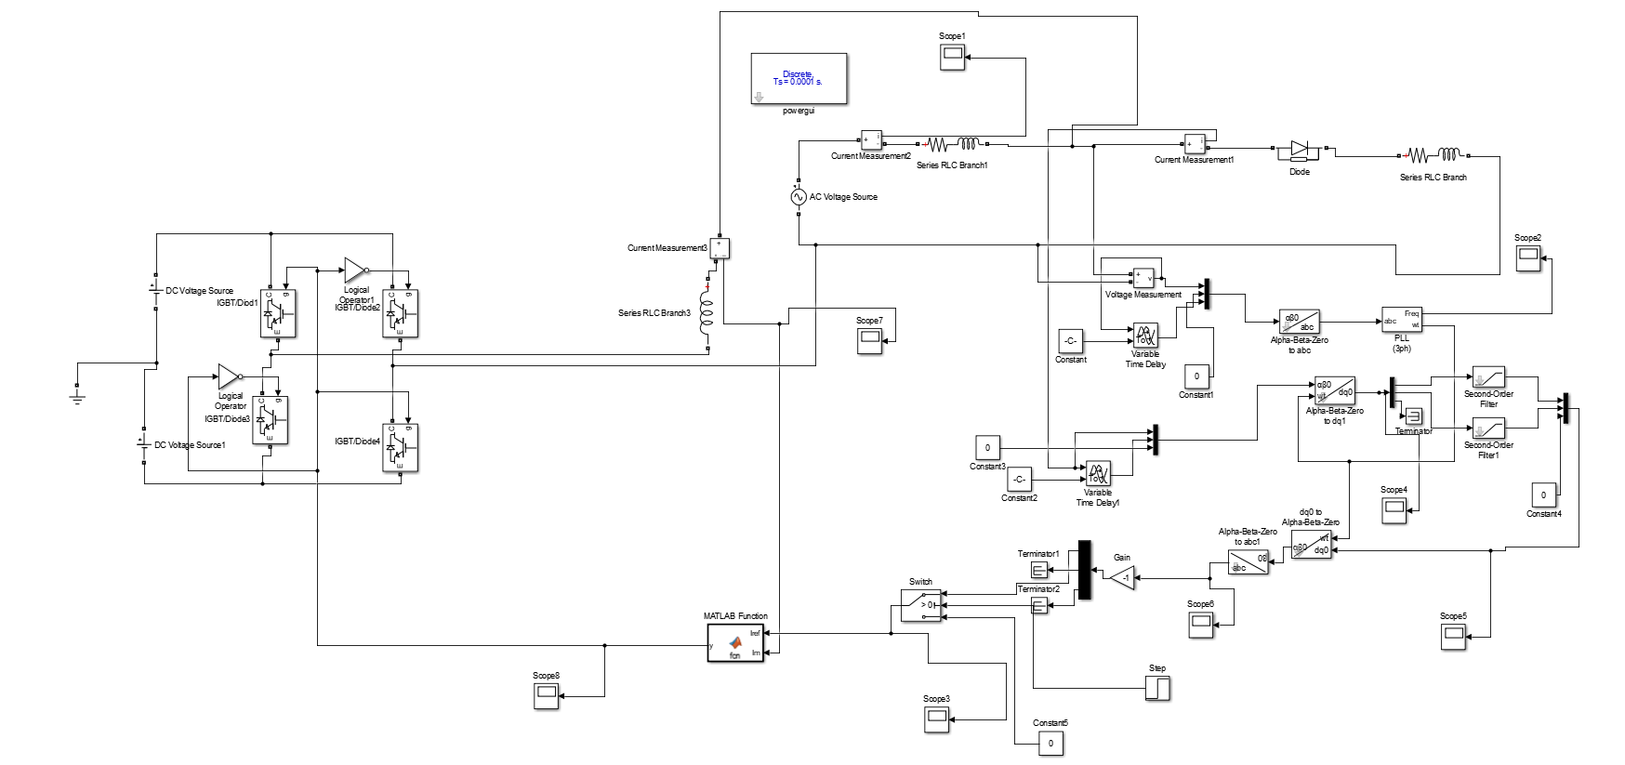
• Methodology and MATLAB Simulation of APF

Slide 14
Results

Slide 15
• Results

Slide 18
Future Work

Slide 19


