Slide 1
Standalone Inverter
Prepared by :
Mohammad Harb
Malek Abu Madi
Naser Abu Madi
Instructor : Jamal Khroushe

Slide 2
Introduction
In this modern society, electricity has great control over the most daily activities for instance in domestic and industrial utilization of electric power for operations. Electricity can be generated from public supply to consumers in different ways including the use of water, wind or steam energy to drive the turbine as well as more recently the use of gas. Generators, solar energy and nuclear energy are also source of electricity

Slide 3
Construction Details
According to our design in the first section of our graduation project we have done the inverter's desgin in order to achieve high performance using multipile components.
The most important components in our desgin were the 555 timer and the MOSFET transistors.
However, the multi-vibrator as in the timer was used to inject 50Hz frequency that used to drive the transistors ( the gate section ) , in the other hand the most applicable frequency that can be used in our country is 50Hz.
Although, the other component is the MOSFET , we can name it as the switcher, other information about it will be shown in the next chapters.
The other design components will be discussed in the next section .

Slide 4
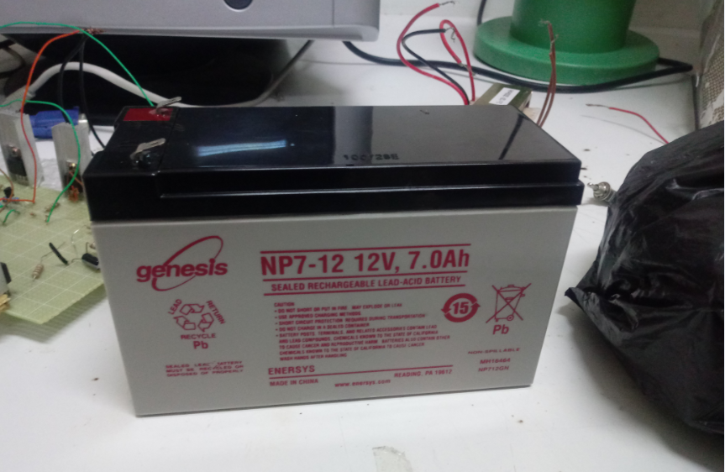
System Architectures
Selection of The Storge Elements (Battery)

Slide 5
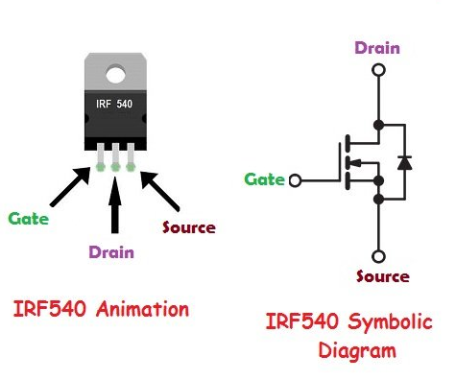
Selection of The MOSFETs

Slide 6
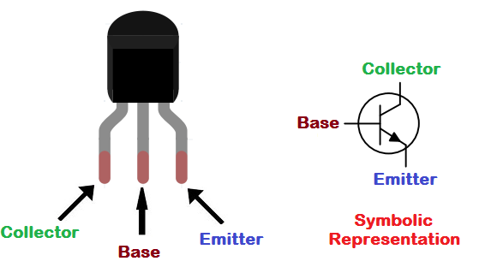
Selection of The Transistors:

Slide 7
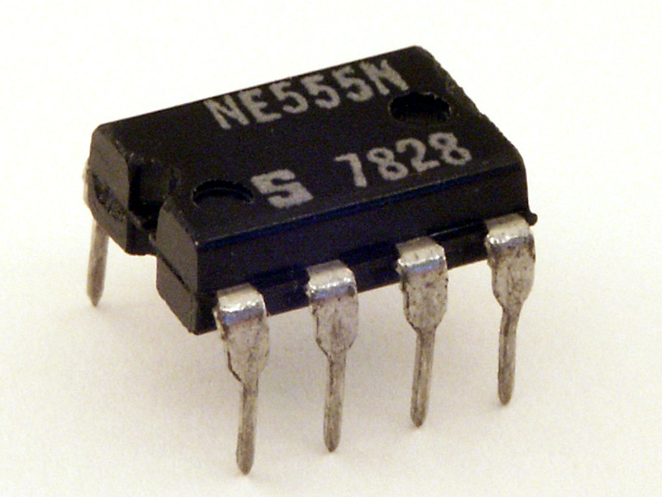
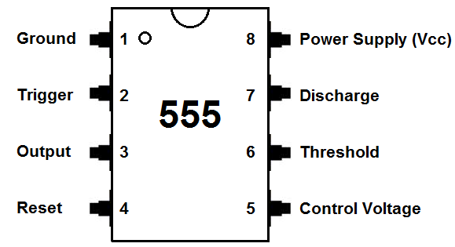
Selection of The 555 Timer

Slide 8
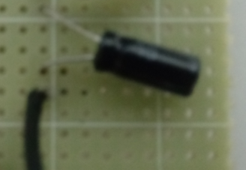
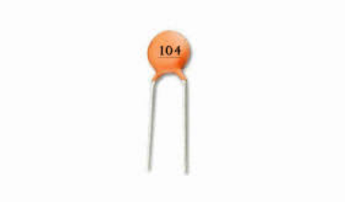
Selection of The Capacitors

Slide 9
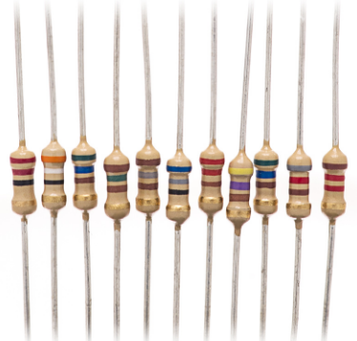
Selection of The Resistors

Slide 10
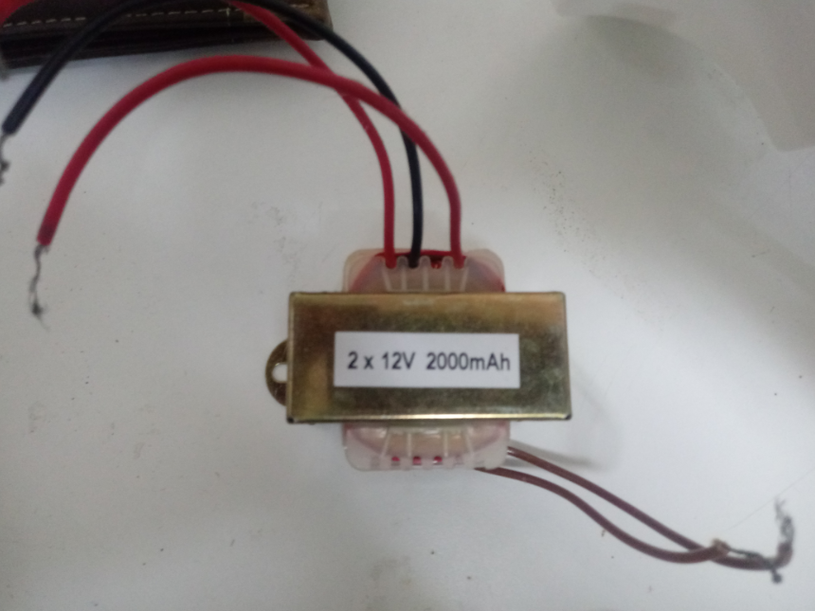
The Selection of The Transformer

Slide 11
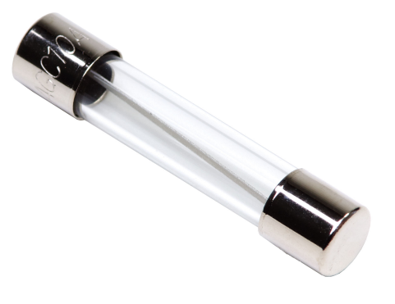
protection devices

Slide 12
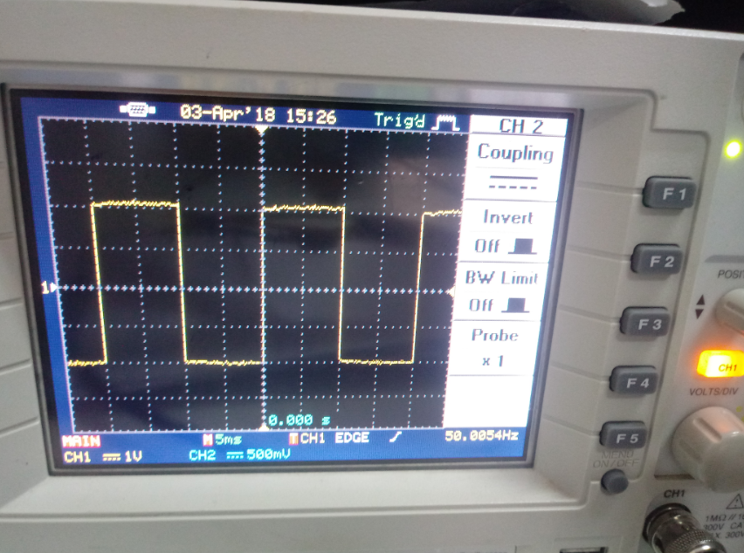
Methodology
The first step was testing the timer and its wiring select, using oscilloscope we obtained the desired signle as the following picture

Slide 13
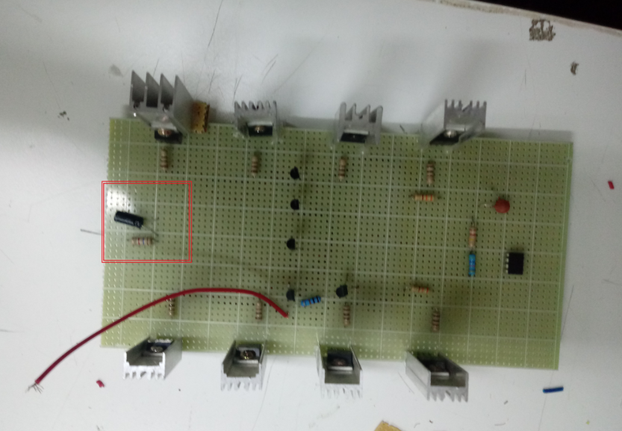
Adding the T-section filter

Slide 14
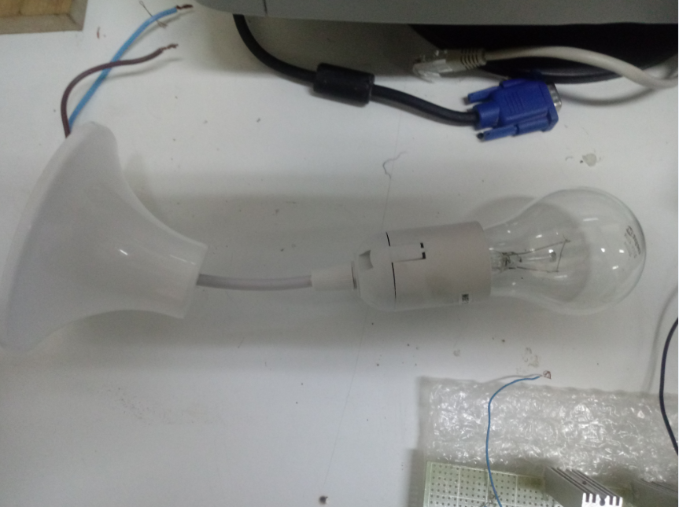
Choosing the load

Slide 15
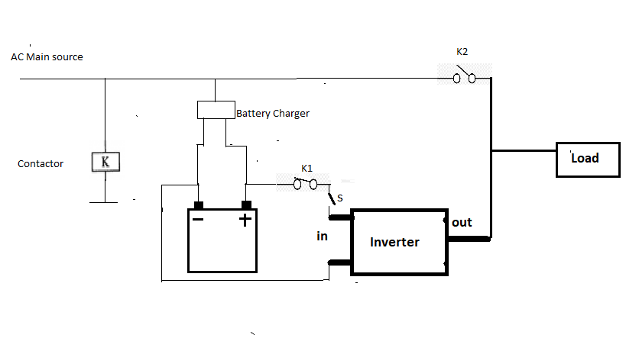
the wiring diagram of the further elements

