Slide 1
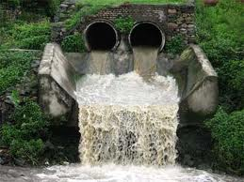
THE EFFECT OF TEMPRETURE AND pH ON SETTLE ABILITY OF ACTIVATED SLUDGE
Prepared by :
Sabren Yahya
Sahar Khalid
Sondos Saleh
Submitted to :
Dr. Ola Sawalha

Slide 2
Out line:
Introduction.
Objectives.
Process of activated sludge.
Main tests.
Results.
Conclusion.

Slide 3
Introduction
Wastewater includes substances such as human waste, food scraps, oils, soaps and chemicals.
The major aim of wastewater treatment is to:
remove as much of the suspended solids .
reduce impurities to acceptable level to produce water that is safe for human use at reasonable cost.

Slide 4
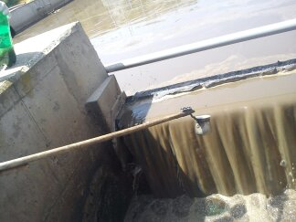
Our case study:
Domestic waste water.
Al-Beirah waste water treatment plant.
We used the activated sludge in secondary treatment.

Slide 5
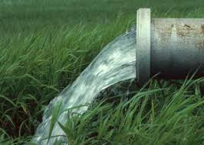
Objective:
The main objective of this research is to study the effect of temperature and pH on settle ability of activated sludge.
In this project we focus on temperature and pH because these two factor mostly affected on activated sludge.

Slide 6
Other factors that affect the performance of an activated sludge treatment system. These include:
amount of oxygen available.
amount of organic matter available.
aeration time.

Slide 7
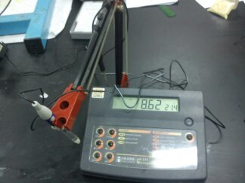
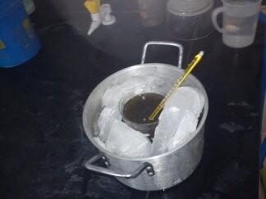
The studied ranges of pH were (5 to 9) with increments of one unit, according to literature review domestic waste water pH is (5-9).
Temperature from (5-35ͦ C) in general this the temperature range in Palestine .

Slide 8
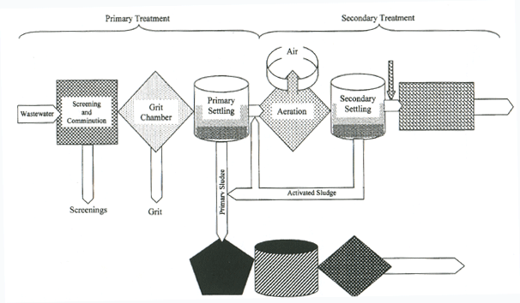
Process of activated sludge

Slide 9
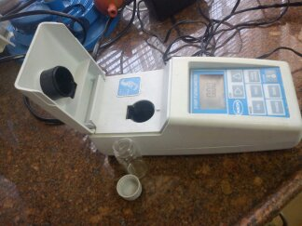
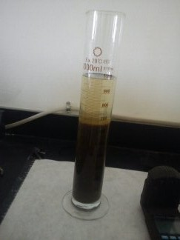
Main Tests:
Turbidity.
Sludge volume index (SVI).

Slide 10
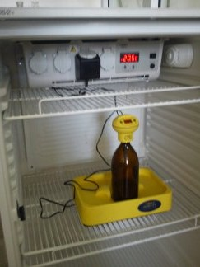
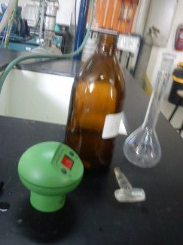

Biological Oxygen Demand (BOD).
Dewater ability (Capillary Suction Time CST ) .

Slide 11
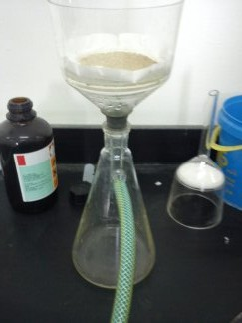
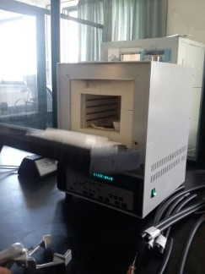
Total Suspended Solid (TSS).
Total Solid (TS).

Slide 12
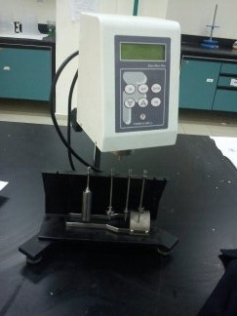
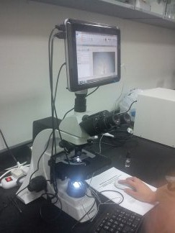
Viscosity.
Floc structure .

Slide 13

Results

Slide 14
Effect of pH
Test ∕pH | SVI (ml/g) | CST (sec) | Turbidity (NTU) | BOD (mg/L) | Viscosity (mPa.s)
5 | 706 | 15 | 8.58 | 180 | 6.7
6 | 453 | 10 | 6.59 | 90 | 5.4
7 | 603 | 20 | 8.53 | 270 | 8.3
8 | 767 | 50 | 8.73 | 270 | 8.3
9 | 776 | 38 | 9.5 | 360 | 8.3

Slide 15
This figure shows the relationship between SVI and pH .

Slide 16
This figure shows the relationship between CST and pH.

Slide 17
This figure shows the relationship between turbidity and pH .

Slide 18
This figure shows the relationship between BOD and pH .

Slide 19
This figure shows the relationship between viscosity and pH .

Slide 20
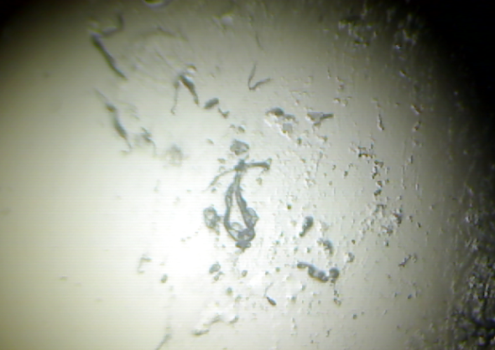
Those figure show the relationship between floc structure and pH .
At pH=5 At pH=6

Slide 21
At pH=7
At pH=8
At pH=9

Slide 22
Effect of temperature
Test/Temp | SVI (ml/g) | CST (sec) | Turbidity (NTU) | BOD (mg/L) | Viscosity (mPa.s)
5 | 689.6 | 49 | 22.4 | 270 | 7.2
10 | 646.5 | 43 | 18.19 | 90 | 7.1
20 | 603.4 | 20 | 15.21 | 270 | 6.9
35 | 293.1 | 10 | 2.47 | 90 | 5.6

Slide 23
This figure shows the relationship between SVI and temperature.

Slide 24
This figure shows the relationship between CST and temperature.

Slide 25
This figure shows the relationship between turbidity and temperature.

Slide 26
This figure shows the relationship between BOD and temperature.

Slide 27
This figure shows the relationship between viscosity and temperature.

Slide 28
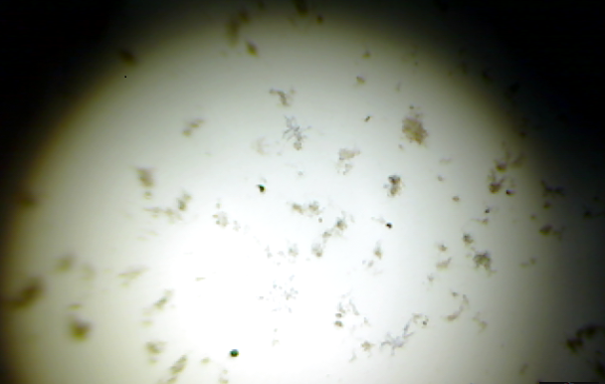
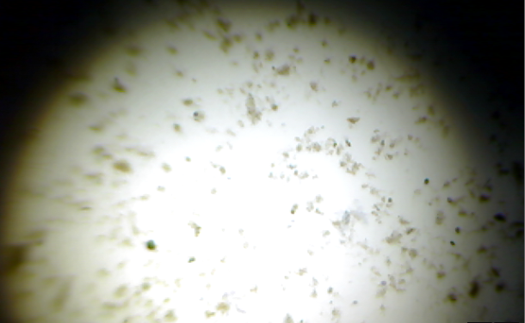
This figure show the relationship between pH and floc structure.
At temp=5◦C At temp=10◦C

Slide 29
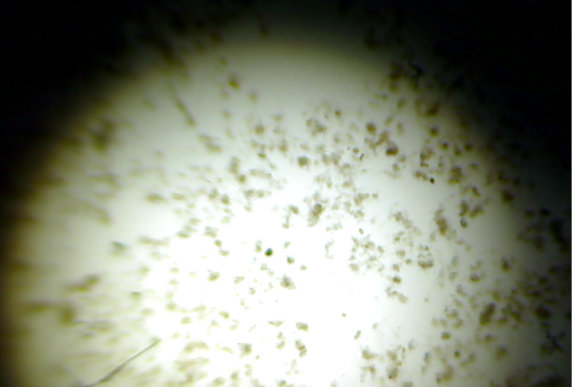
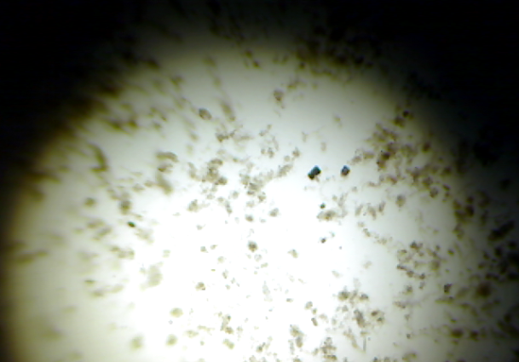
At temp=20◦C At temp=35◦C

Slide 30
:Conclusions
The relationship between SVI and T was described by a linear regression with very high coefficient of determination R²⁼0.91.
The relationship between pH and SVI was tested and found to be a perfect fit of cupic curve with R² =0.99. A prediction equation was derived and it was
SVI = 16,992 - 7,170X + 1014.9X² - 46 X³

Slide 31
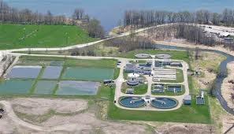
(SVI) was in its lowest value at (T=35̊ C and pH=7) , and ( pH=6 and T=22 ̊ C ).

Slide 32

Thanks For Listening……

