Slide 1

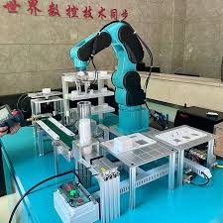
An-Najah National University
Faculty of Engineering and Information Technology
Electrical and Telecommunication Department
Graduation Project 2
7-Axis Robotic Arm
Hashem Alshami 11926161
Baraah abualreesh 11822790
Supervisor : Dr. Omar Tamimi

Slide 2
Introduction

Slide 3
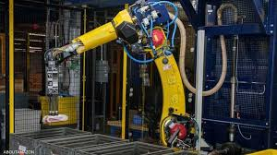
1-Literature Review
Robots have their verifiable past however they came into presences just in 1961 when Unimation Inc, USA presented the principal servo-controlled new robots. Early advancement tracing back to 500B

Slide 4
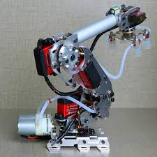
Overview
7-DOF Robotic Arms
A 7-degree-of-freedom (DOF) robotic arm refers to a robotic arm with seven independent movements or axes of rotation. These degrees of freedom allow the arm to achieve a high level of dexterity and flexibility, mimicking the range of motion of a human arm

Slide 5
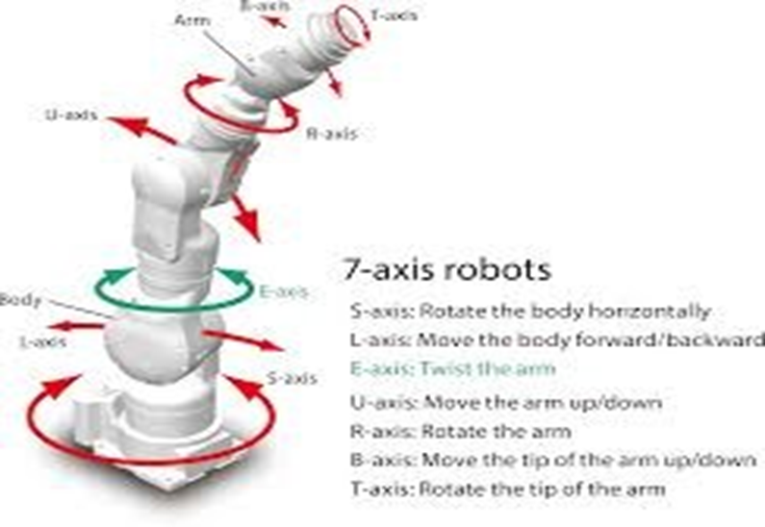
PROPOSED METHODOLOGY

Slide 6
Current situation on the Market
The current status of 6-DOF (degrees of freedom) robotic arms in the market shows significant advancements in their design, functionality, and applications The UFACTORY xArm 7 is available for purchase at around $10,000 to $11,500, depending on the specific configuration and optional add-ons like grippers or vacuum systems. It comes with support options such as free training, a one-year warranty, and local support in some regions​ ​.

Slide 7
Control using matlab
INTRODUCTION
For the control simulation of a robotic arm, most studies focus on the implementation of a single axis. In other words, the control method is simulated based on the dynamics of one axis, ignoring the coupling effect from other axes and the timevariant of parameters.To improve performance and correctness of control simulation of the multi-axis system, this paper uses MATLAB robotics toolbox to simulate control of 7-DOF manipulator based on sliding model control. The Robotics Toolbox is a software package that allows a MATLAB user to readily create and manipulate datatypes fundamental to robotics such as homogeneous transformations, quaternions and trajectories. Functions provided, for arbitrary serial-link manipulators, include forward and inverse kinematics, Jacobians, and forward and inverse dynamics

Slide 8
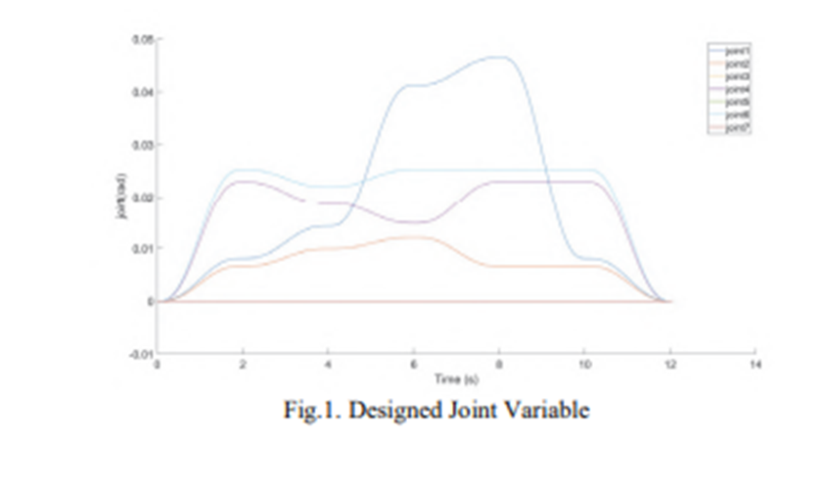
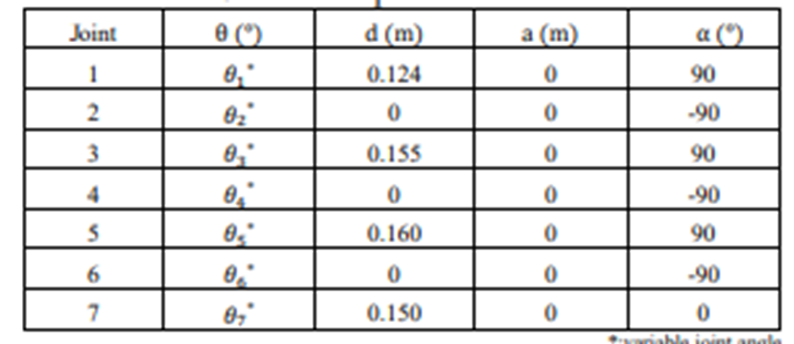
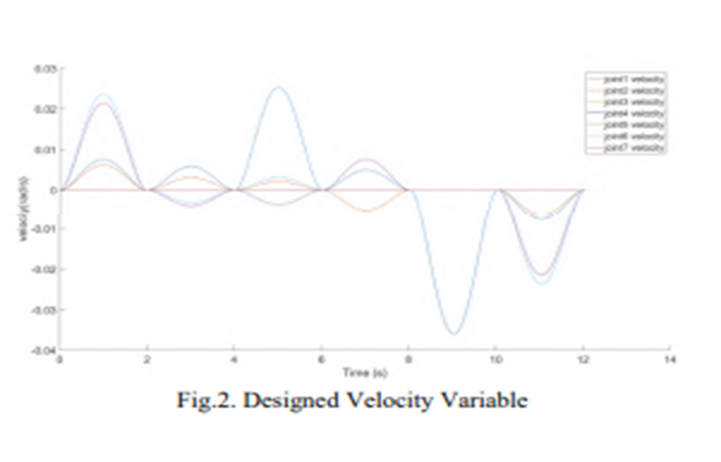
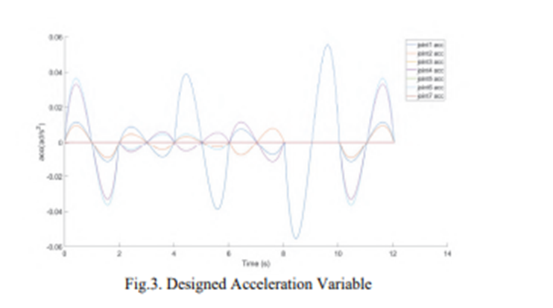
METHOD

Slide 9
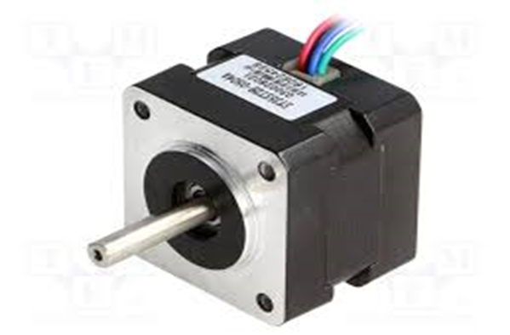
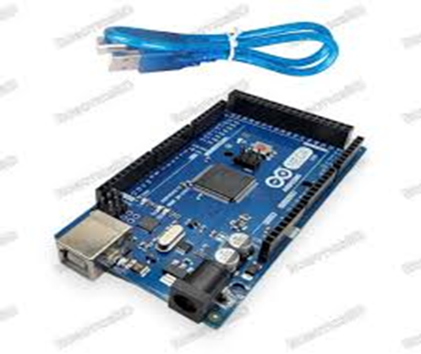
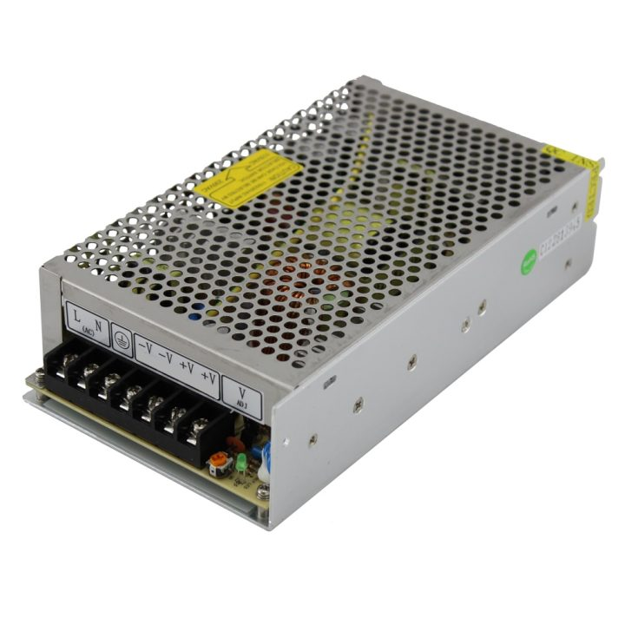
Component and Programming
1 Fabrication of Robotic Arm
stepper motor
Arduino mega 2560
power supply

Slide 10
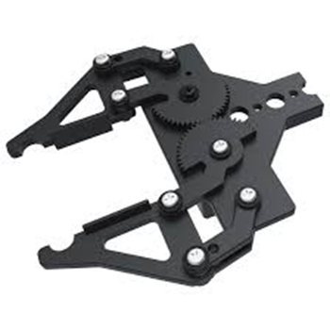
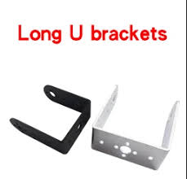
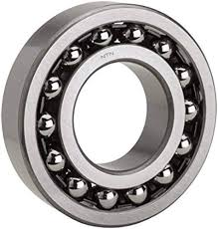
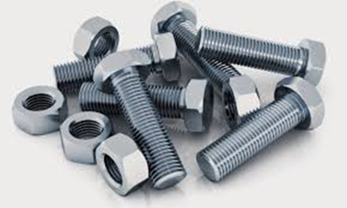
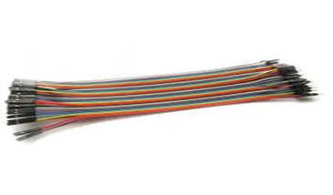
Mechanical Claw
Brackets
Bearing
Screws & Nuts
Mechanical Claw
Brackets
Bearing
Headers and Jumper wires:

Slide 11
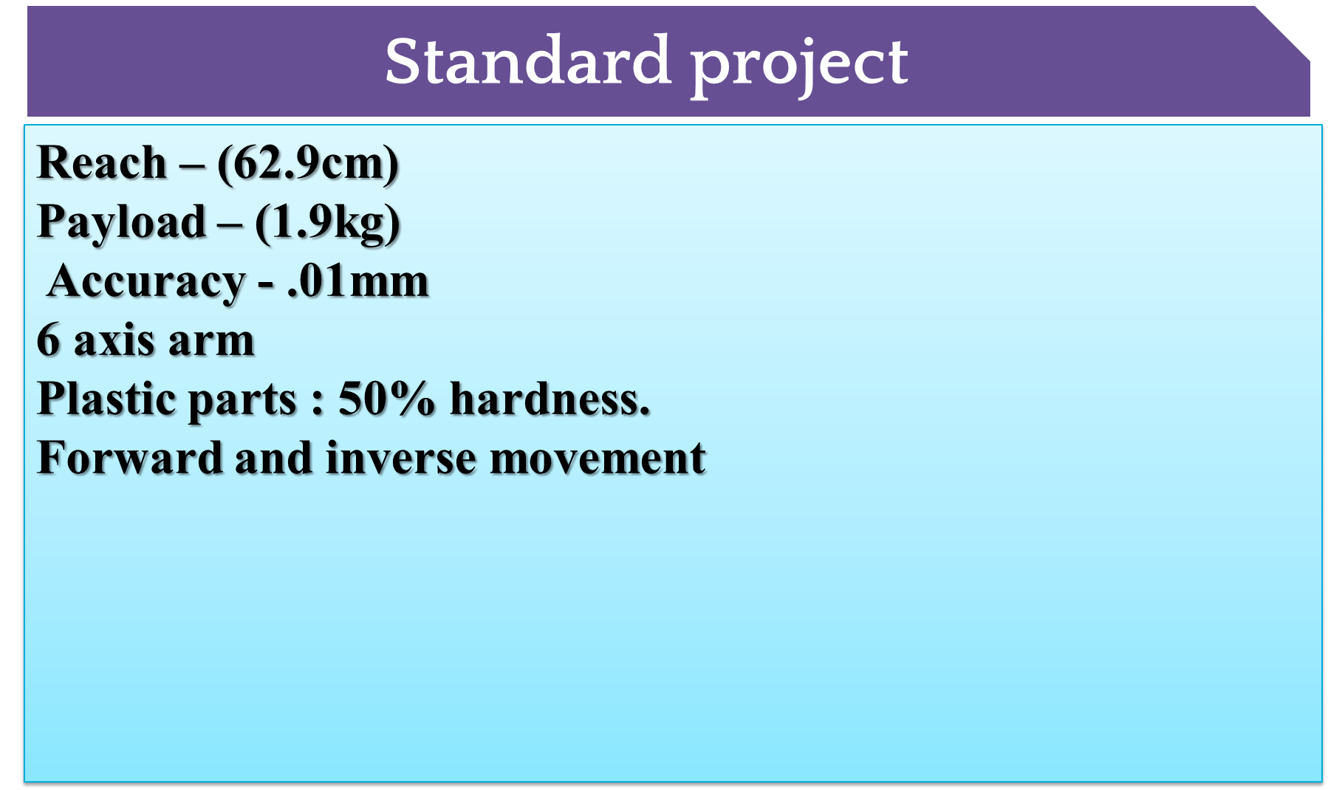
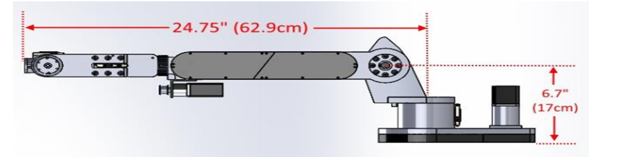

Slide 12
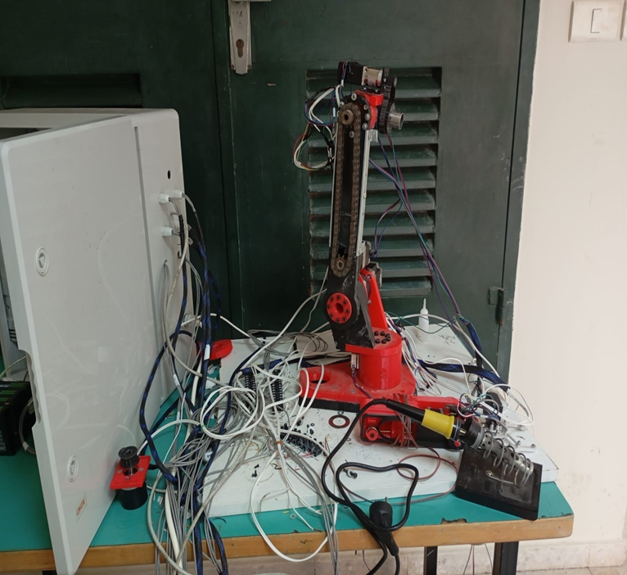
The structure of the robotics system

Slide 13
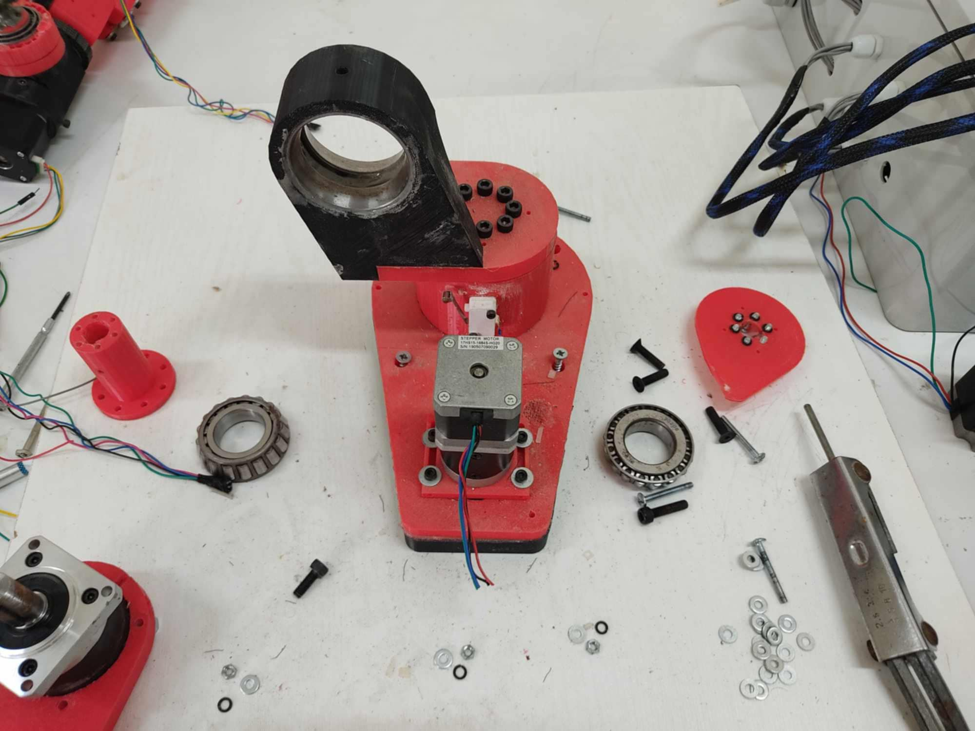
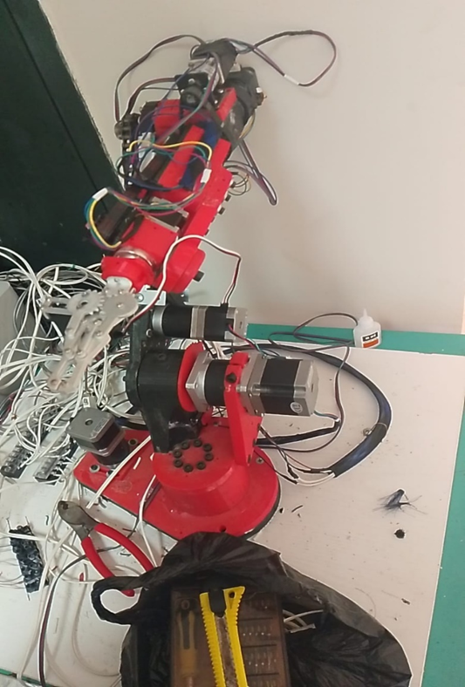

Slide 14
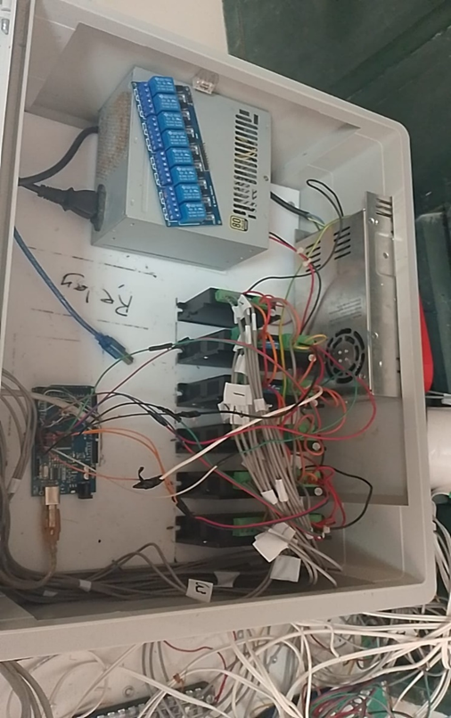
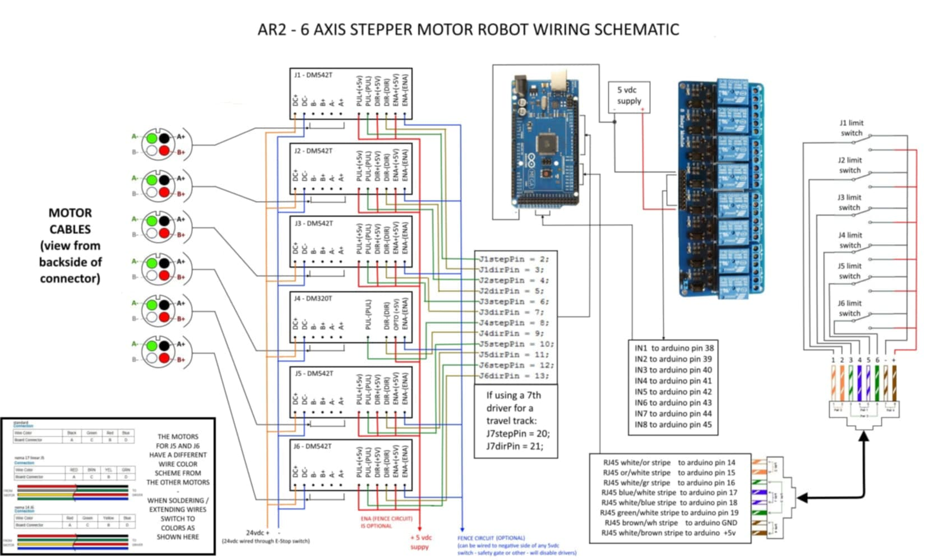

Slide 15

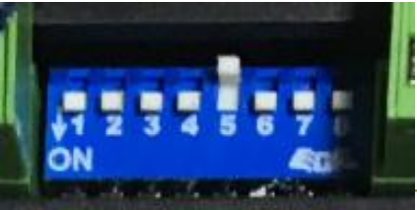
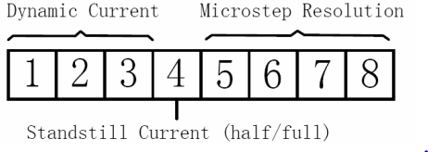
15 selectable microstep resolutions including
Soft-start when powered on
8 selectable peak current
optically isolated input
Support PUL/DIR and CW/CCW modes
Over-voltage, over-current protections

Slide 17
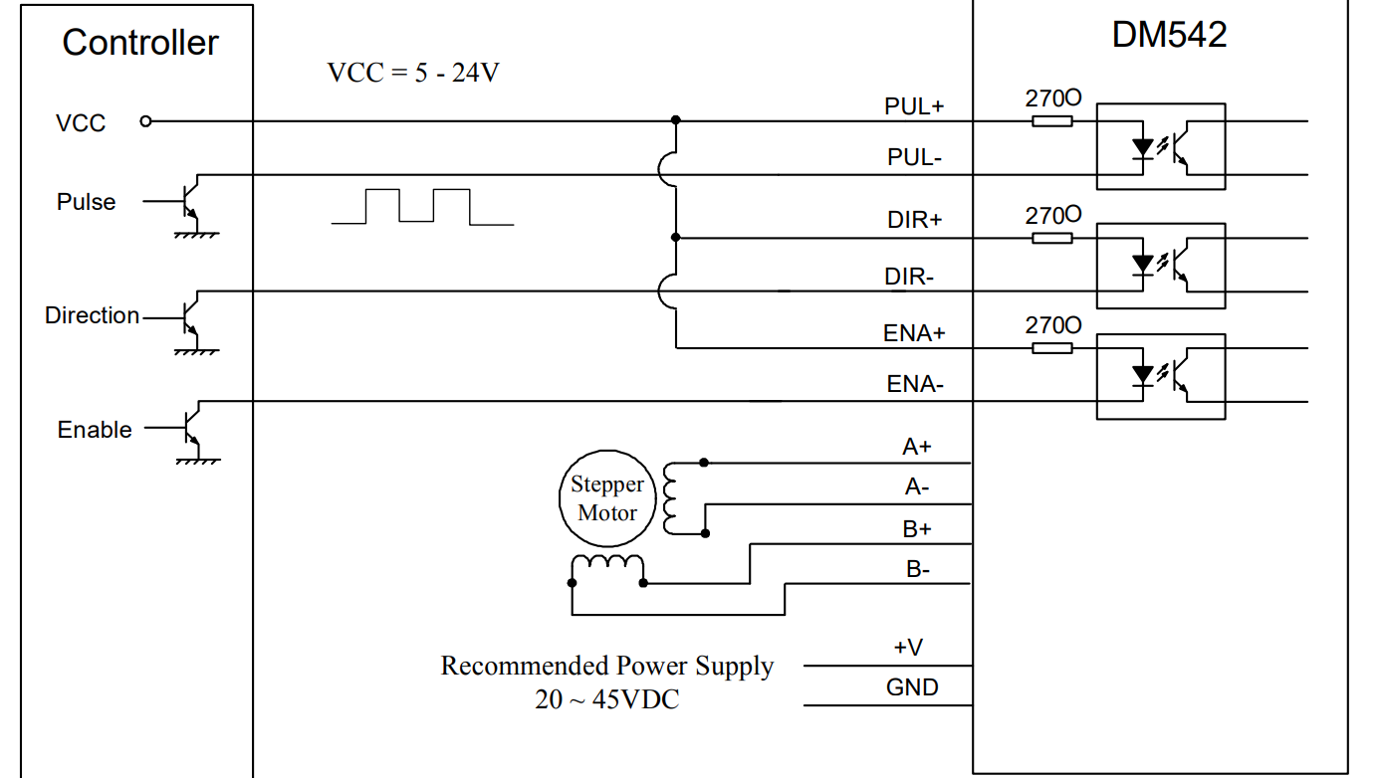
Open collecter (common anode)

Slide 18
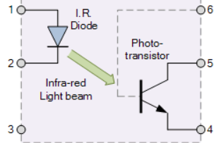
Protection Driver
Over Voltage
Over Current
Opto-isolator

Slide 19
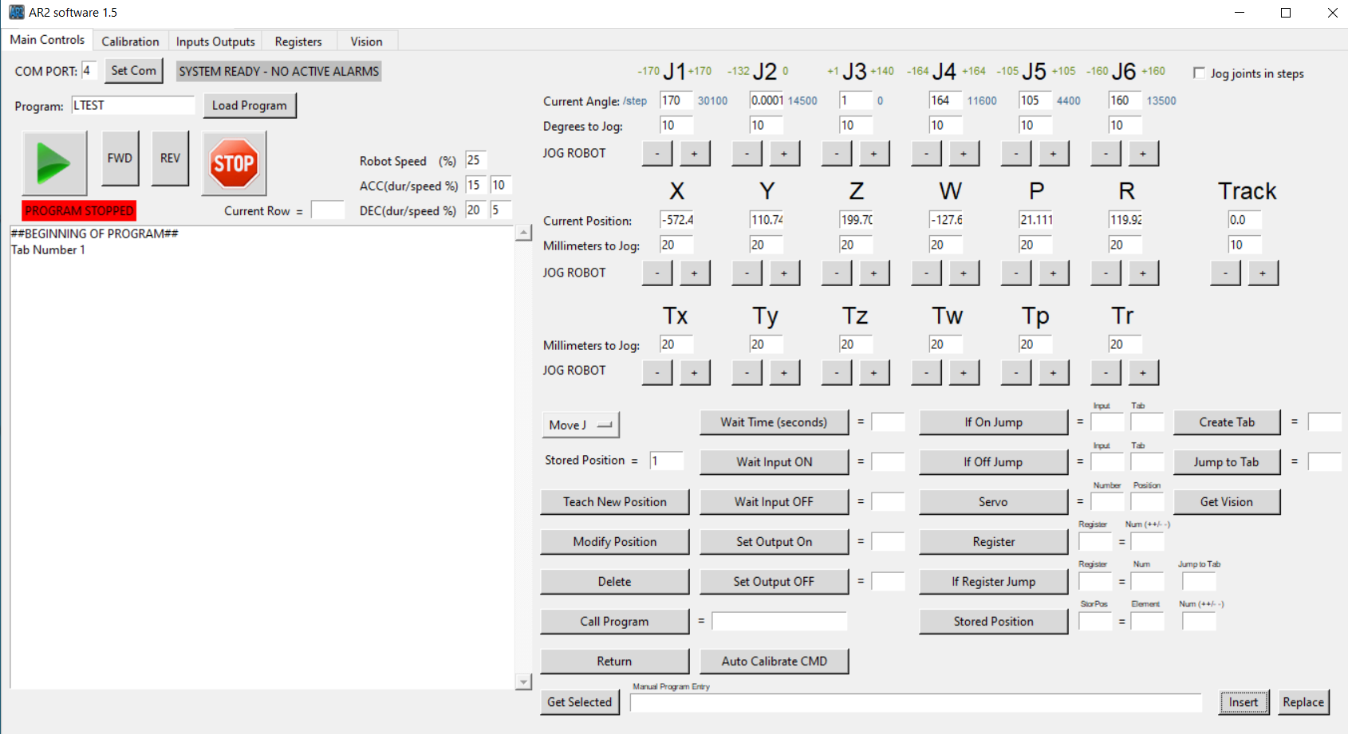
User interference ( Control Software)

Slide 20
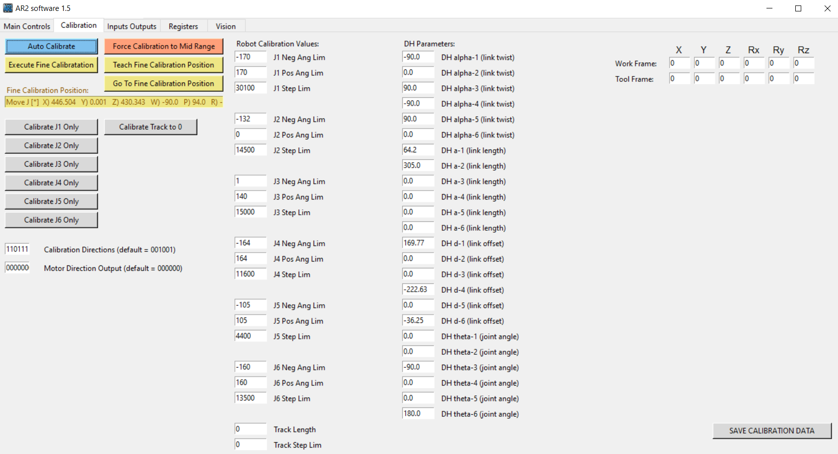

Slide 21
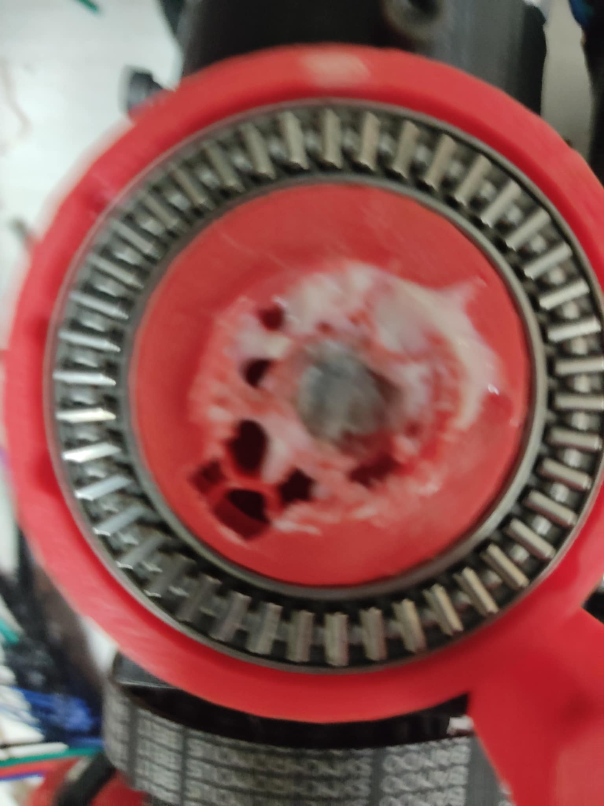
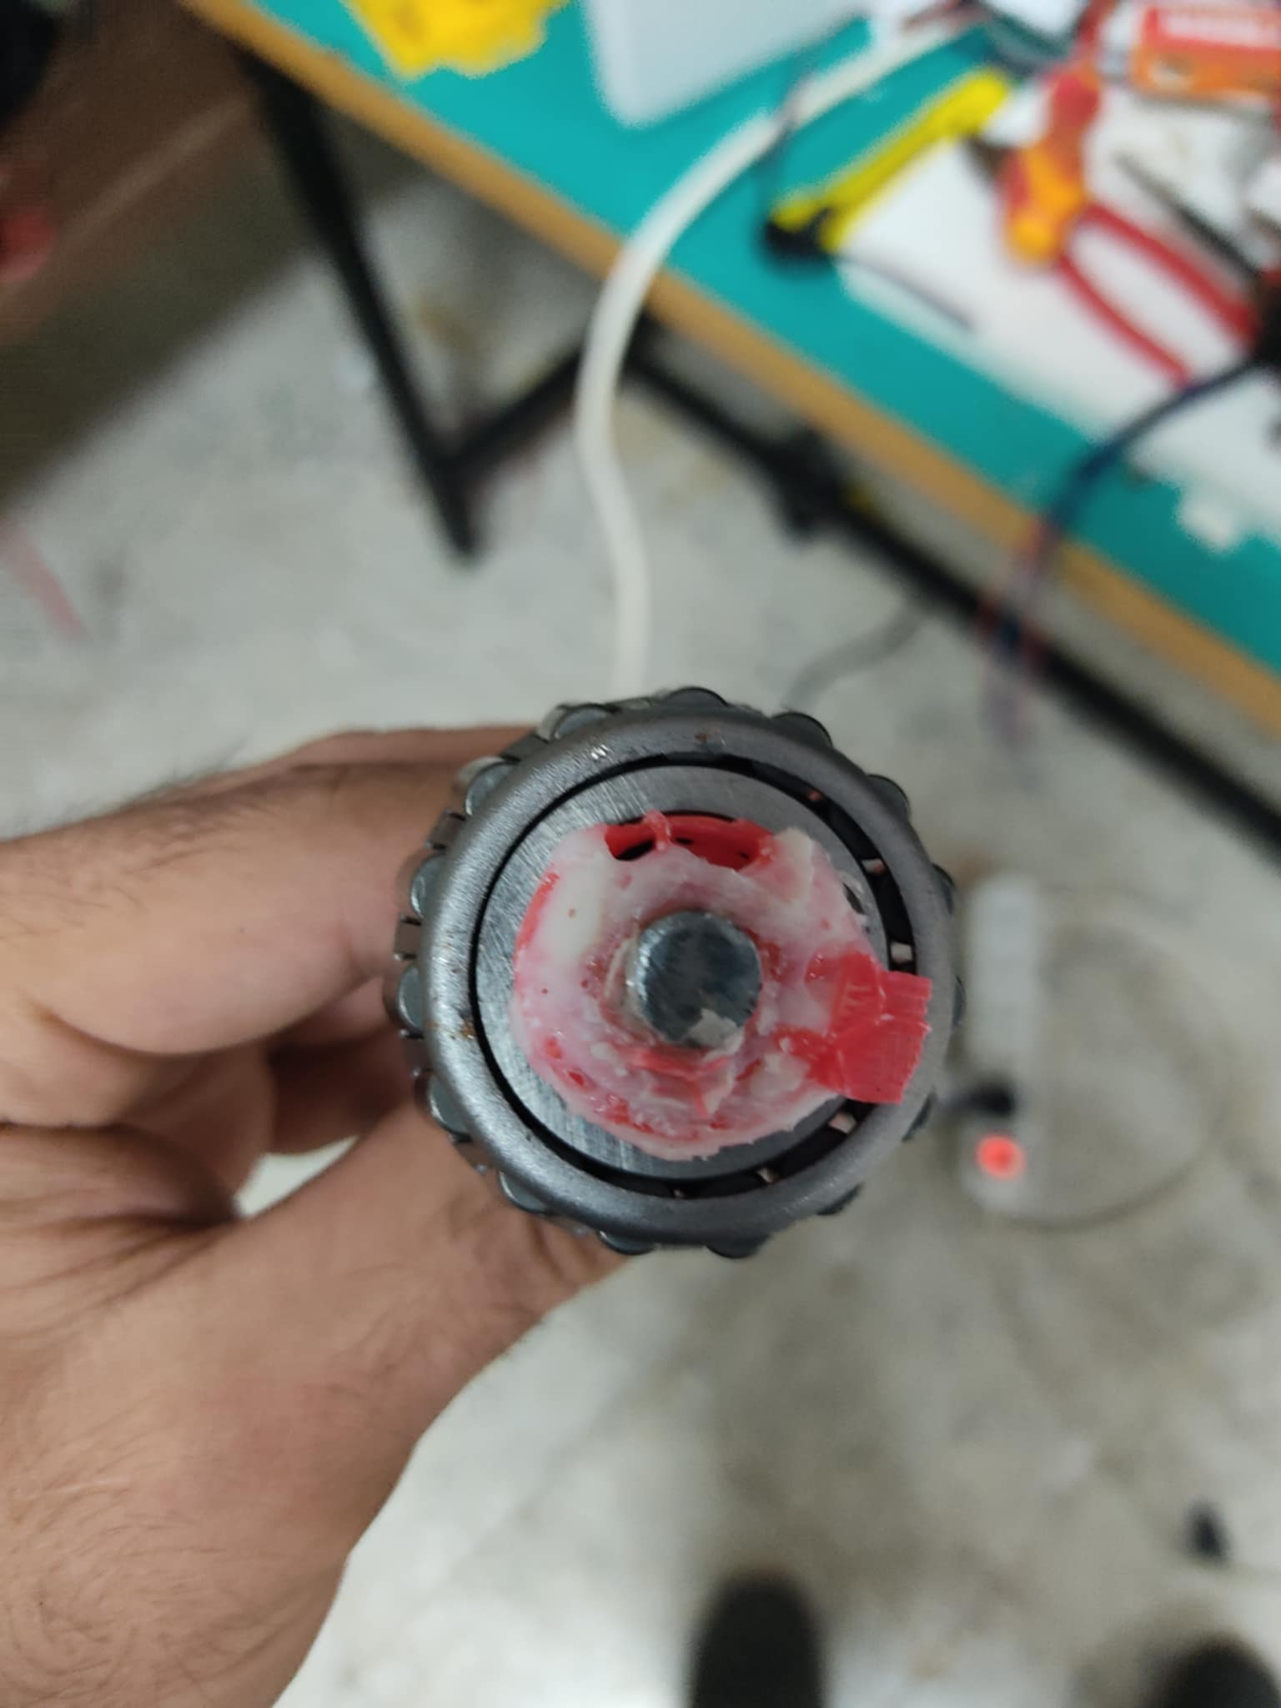
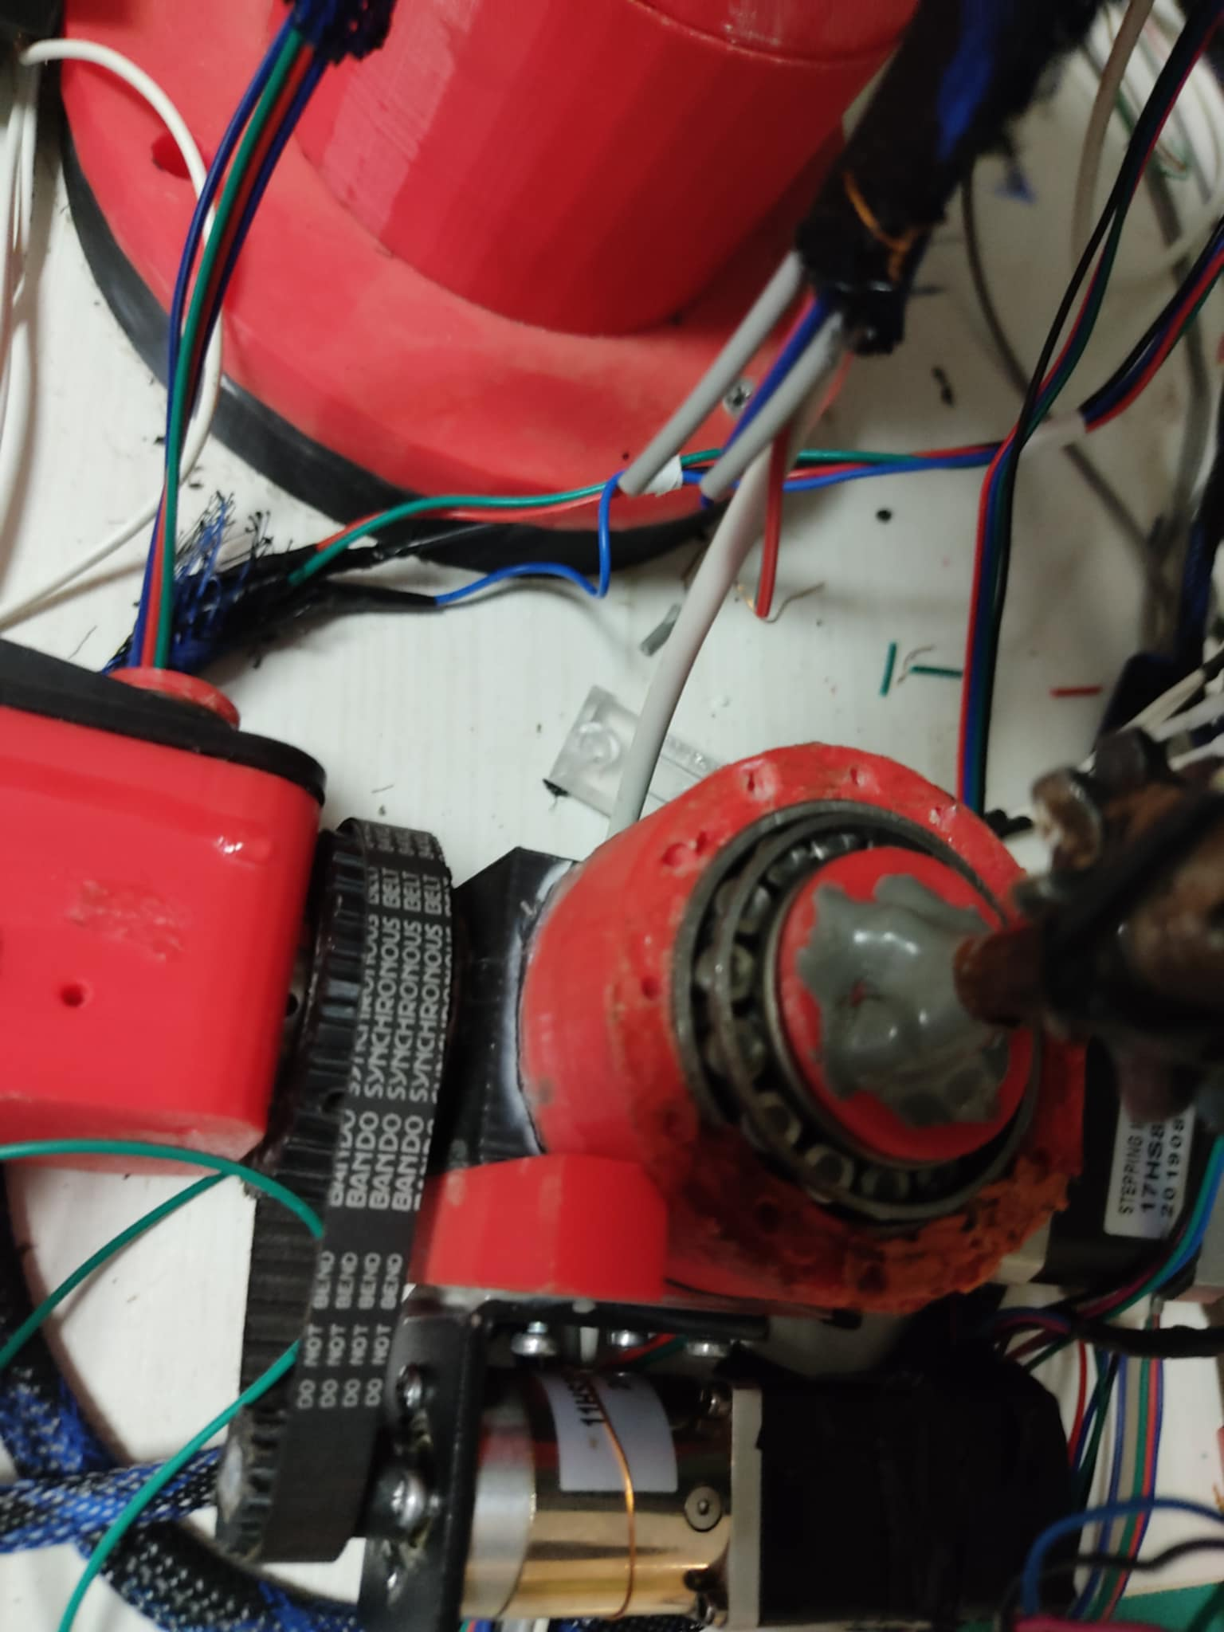
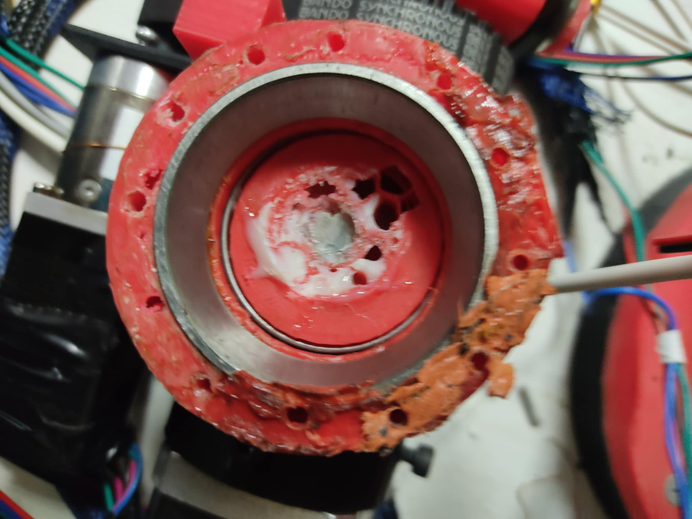
Issuse
عدم توافر القطع مثل ستيبر موتور

Slide 22
Conclusion
Throughout the project, various challenges were encountered, including issues with component compatibility, signal interference, and precise control of the arm's movements. These challenges were addressed through iterative testing, debugging, and refinement of both hardware and software
In conclusion, the project has successfully demonstrated the design, implementation, and wireless control of a 7-axis robotic arm, highlighting the potential for advanced robotic systems in various applications. The lessons learned and the technologies developed can serve as a foundation for further advancements in robotic manipulation and control

