Slide 1
Transportation Management Plan of Haifa, Jaffa, and Tunis streets area
By
Tamer Sami Isawi
Amr Shaker Bitar
Amjad Amir Amir
Mohammed Kamel Abdul-Hadi
Under supervision of : Dr. Khalid Al-Sahili

Slide 2
Outline
Introduction
General Background
Study Area Description
Objectives
Methodology
Analysis and results
Conclusion

Slide 3
General background

Slide 4
Study area Description

Slide 5
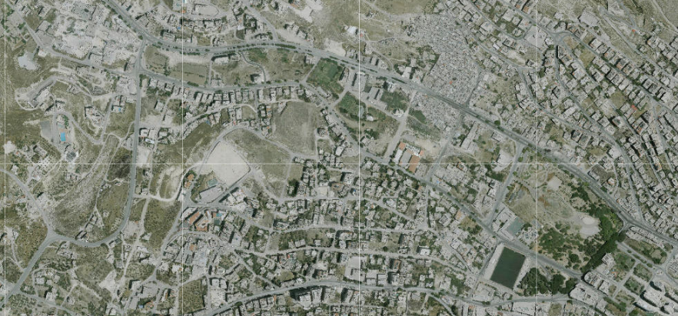

Slide 6
Objectives
A few existing problems will be mentioned, but the concentration will be in the future problems and working out possible solutions for them.
Our study will include these aspects:
Traffic Operating Conditions
Pavement Performance
Geometric Design of the streets in the area

Slide 7
Methodology
Traffic Counts
Road Inventory Studies
Geometric Plans Analysis
Level Of Service

Slide 8
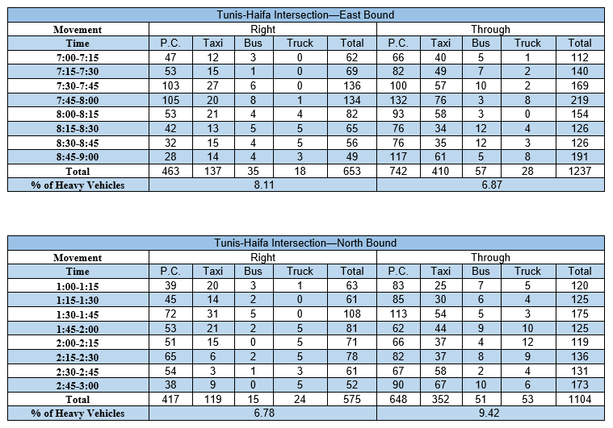

Slide 9
Analysis and Results

Slide 10
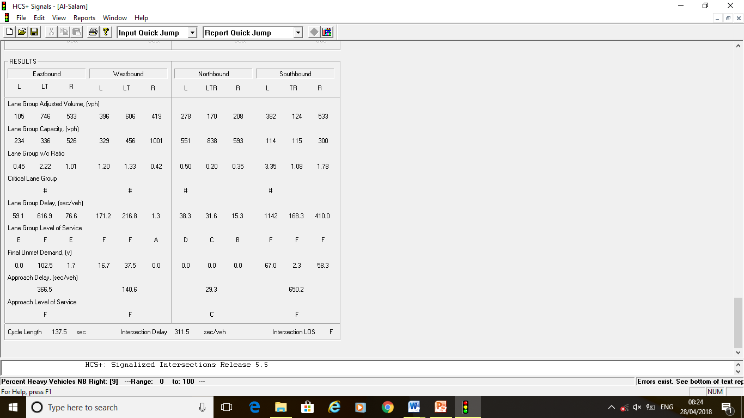
Traffic Analysis
Haifa – Jamal Abdel-Nasser Intersection
(Al-Salam Intersection)

Slide 11
Geometric Analysis
Vertical Alignment
Drainage
Roundabout
Horizontal Alignment
Stopping, Passing, and Headlight Sight Distances

Slide 12
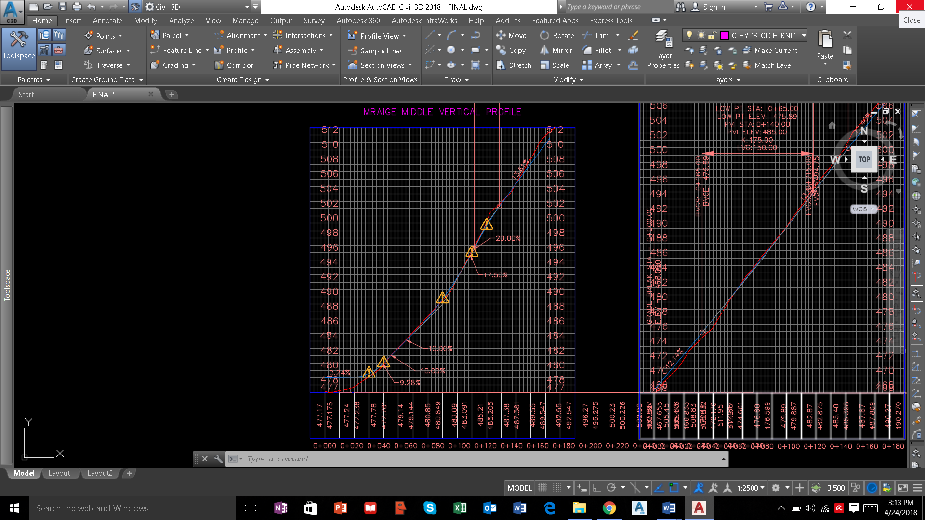
Vertical Alignment
CHECK: VIOLATED
LOCAL ROAD
20%>15%

Slide 13
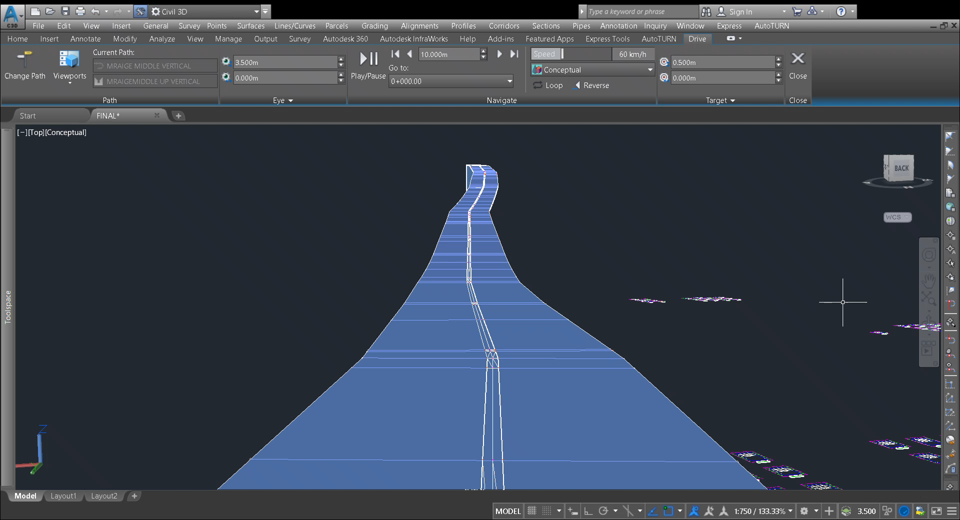
Real driving problem on Al-Mraij Middle Street

Slide 14
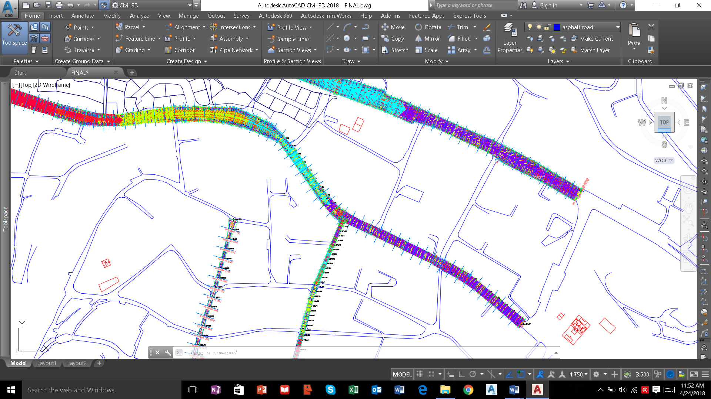
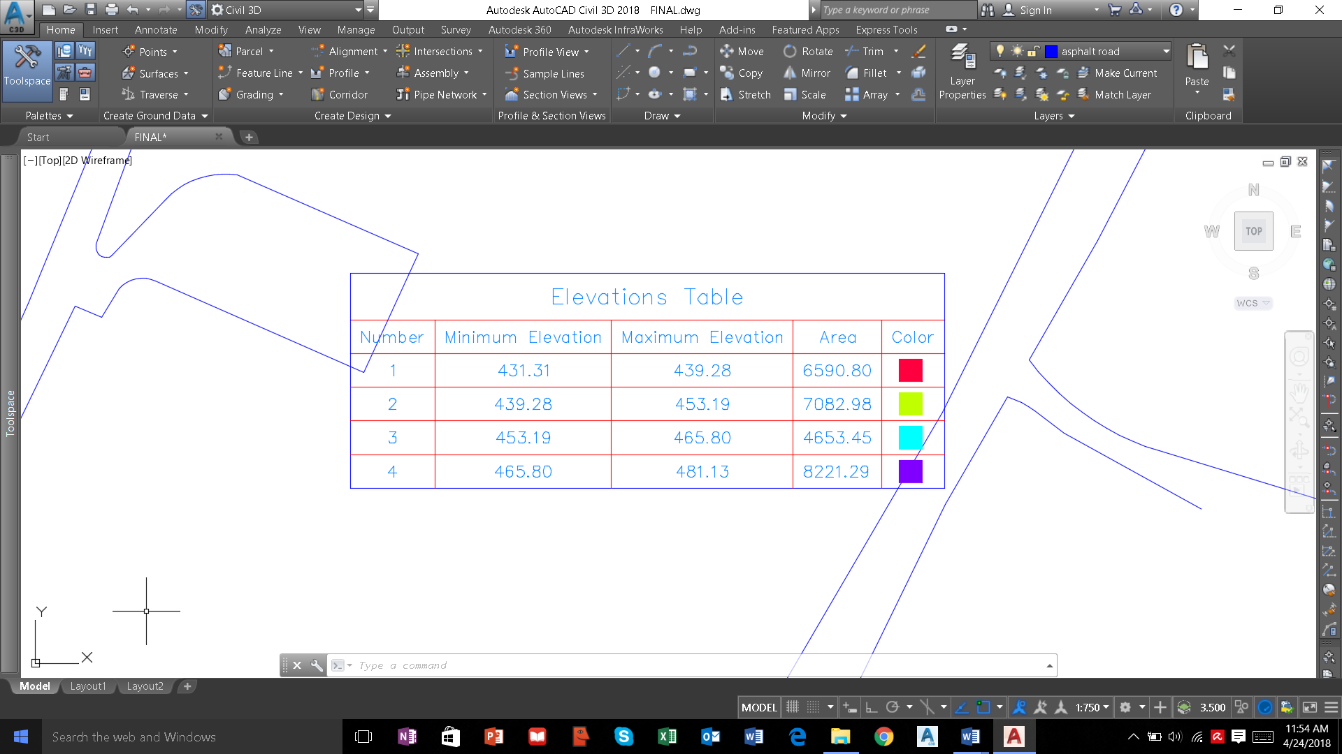
Drainage
Jaffa St

Slide 15
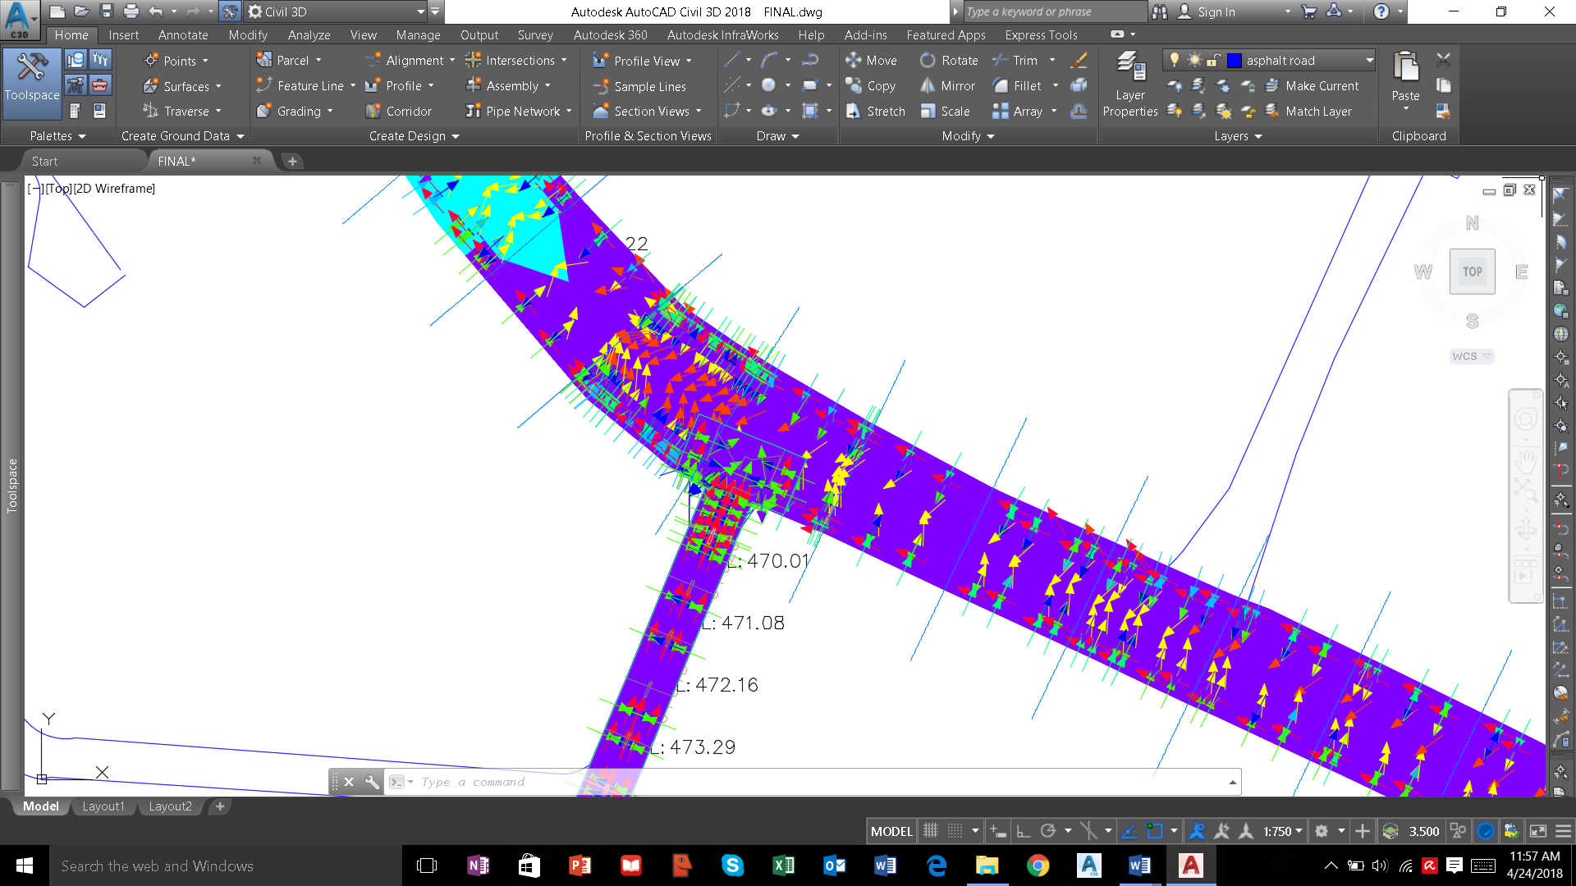

Slide 16
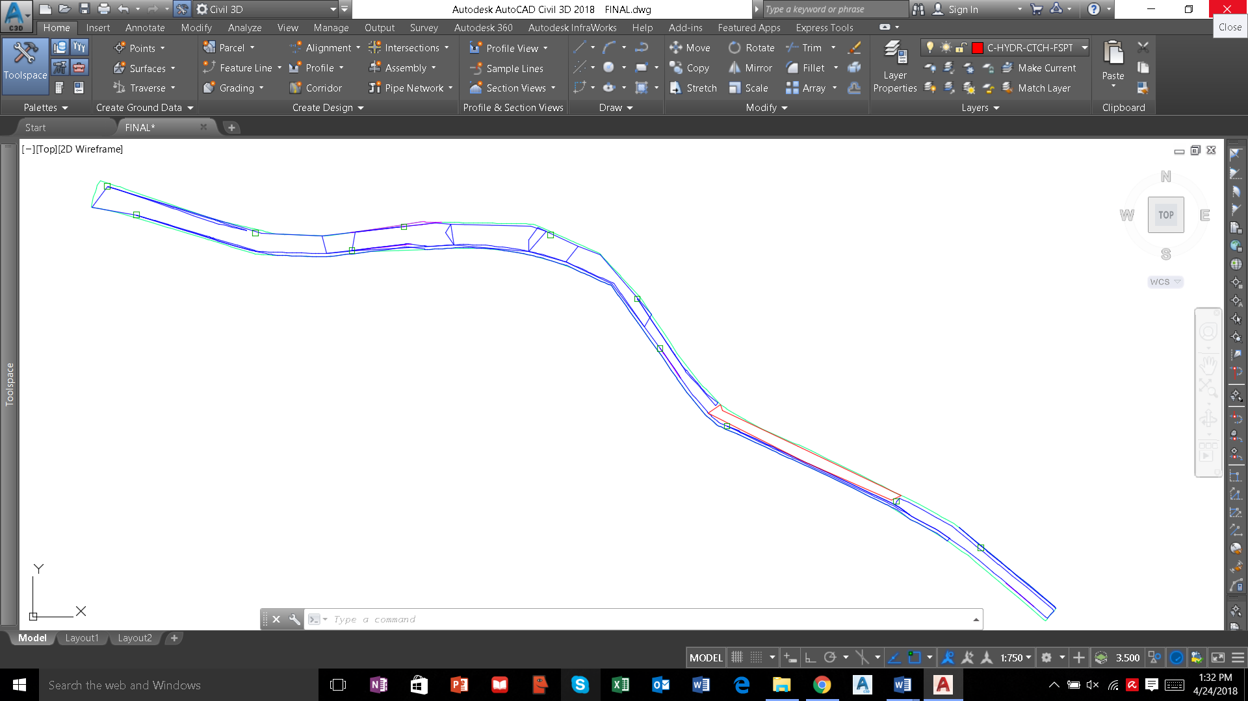
BLUE : COVERED AREA OF WATER FROM CATCH BASIN
RED : UNCOVERED AREA OF WATER FROM CATCH BASIN
GREEN : CATCH BASIN

Slide 17
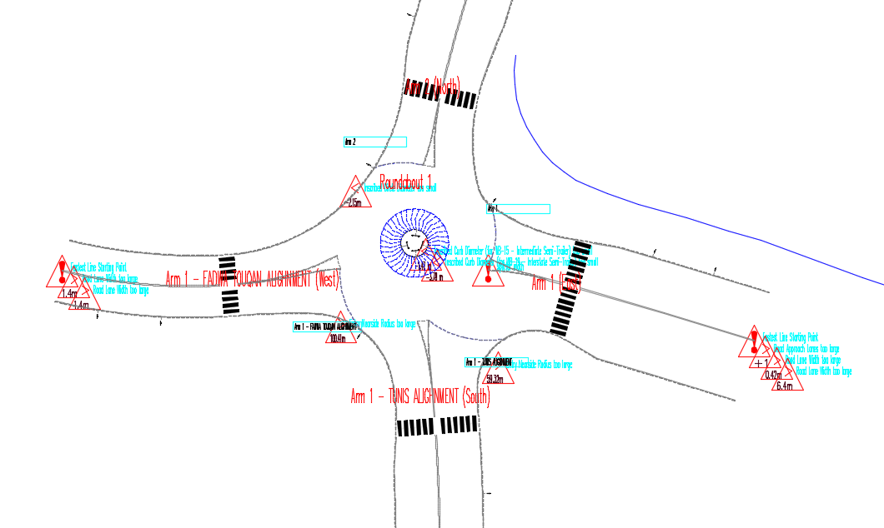
Roundabout

Slide 18
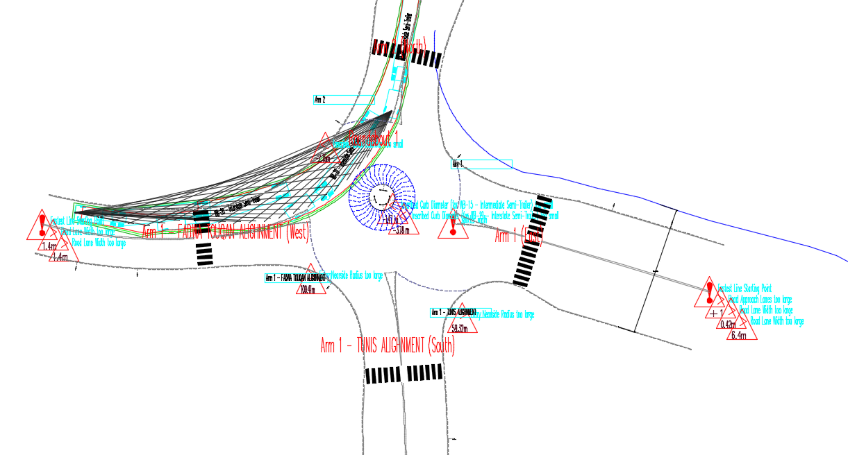
Driver sight line on this roundabout

Slide 19
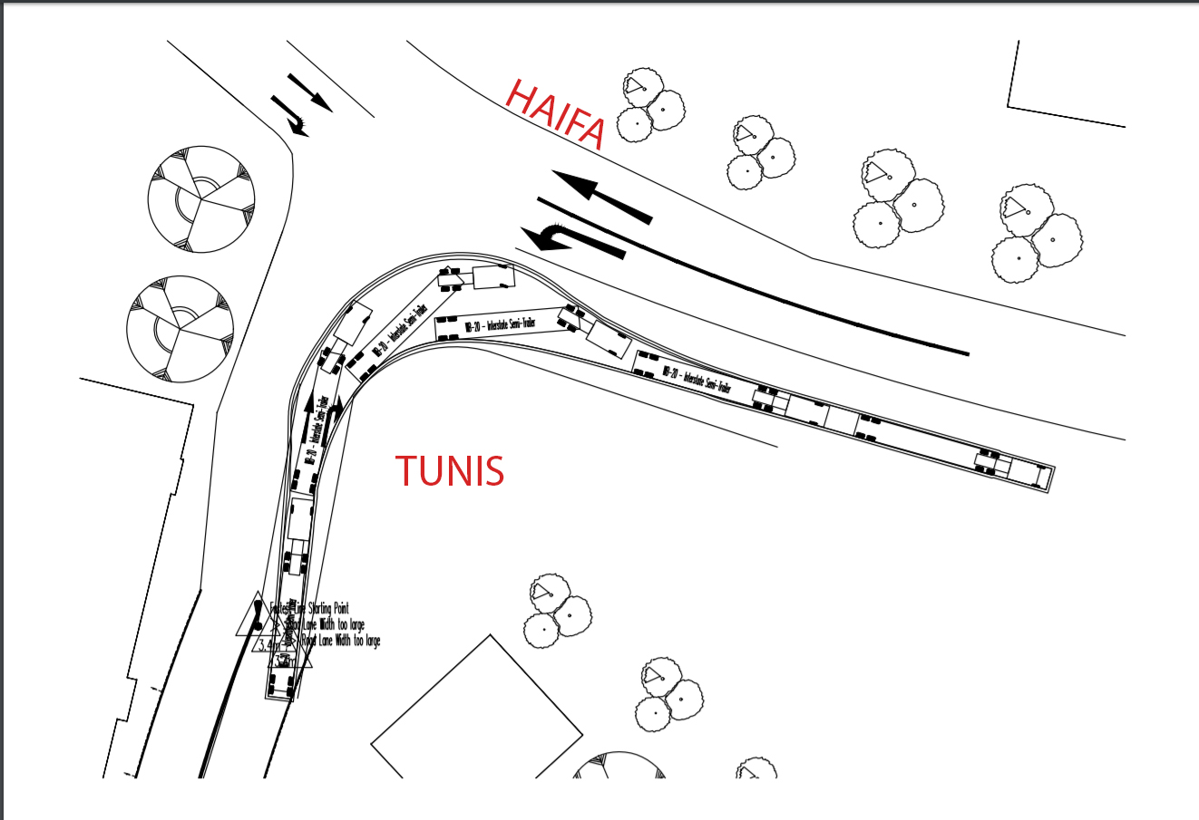
movement of truck on the turning path

Slide 20
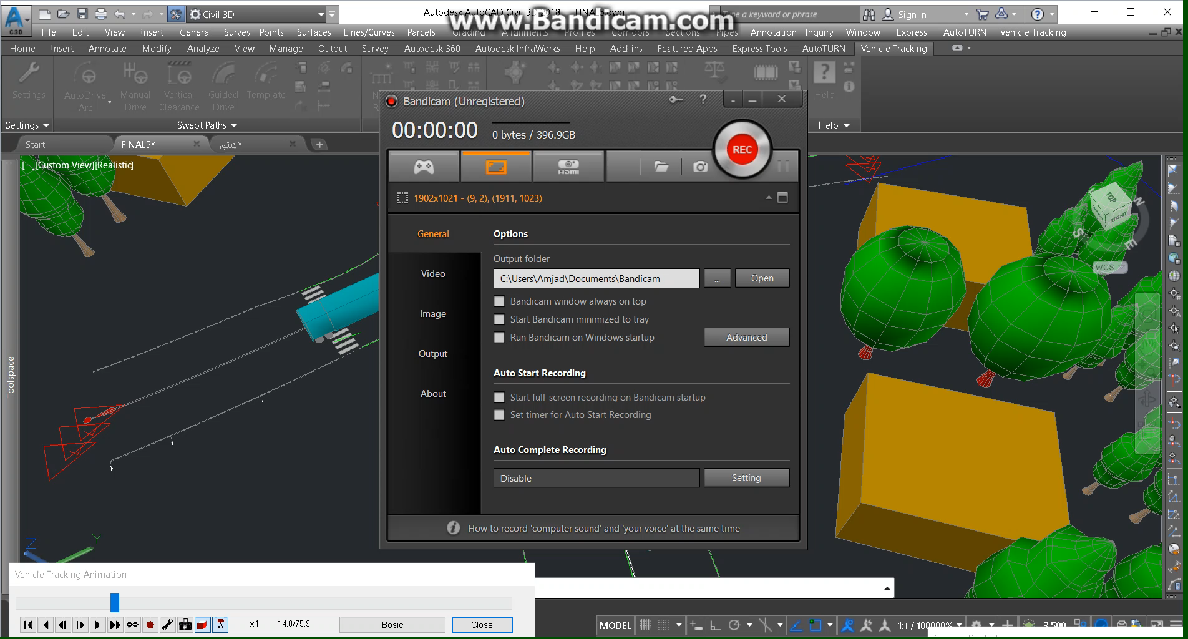
Videos

Slide 21
CHECK DESIGN HORIZONTAL CURVES :
4 Circular Curve
 | Start Station: | 0+415.55
 | End Station: | 0+438.67
 | Radius: | 165.789m
 | Design Speed: | 70
 | Design Criteria:
 | Minimum Radius: | 203.00
 | Design Checks: | VIOLATED
8 Circular Curve
Start Station: | 0+617.03
End Station: | 0+836.46
Radius: | 287.780m
Design Speed: | 70
Design Criteria:
Minimum Radius: | 203.00
Design Checks: | CLEARED

Slide 22
7 Tangent
 | Start Station: | 0+601.78
 | End Station: | 0+617.03
 | Length: | 15.257m
 | Design Speed: | 70
 | Design Checks: | VIOLATED

Slide 23
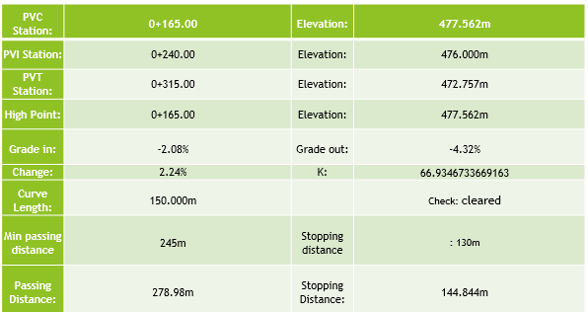
Checking Stopping, Passing, and Headlight distances in Jaffa Street :

Slide 24
PVC Station: | 0+925.00 | Elevation: | 440.911m
PVI Station: | 1+000.00 | Elevation: | 436.527m
PVT Station: | 1+075.00 | Elevation: | 434.632m
Low Point: | 1+075.00 | Elevation: | 434.632m
Grade in: | -5.85% | Grade out: | -2.53%
Change: | 3.32% | K: | 45.1939241897209
Curve Length: | 150.000m
Headlight Distance: | 171.312m | Check : cleared

Slide 25
Pavement Analysis

Slide 26
Fadwa Touqan Street

Slide 27
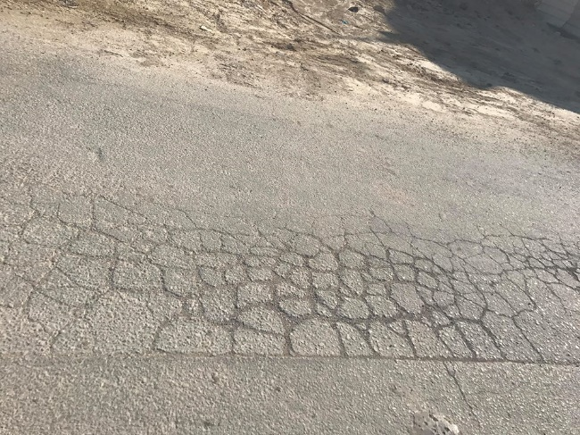
Alligator Cracking

Slide 28
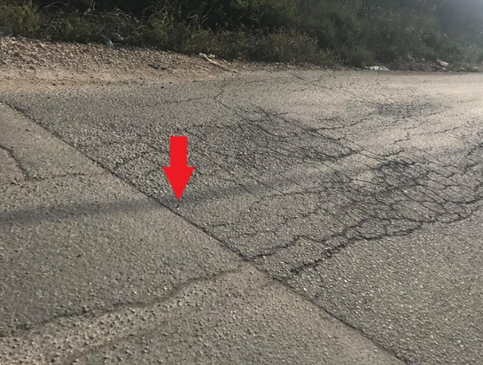
Transverse Cracking

Slide 29
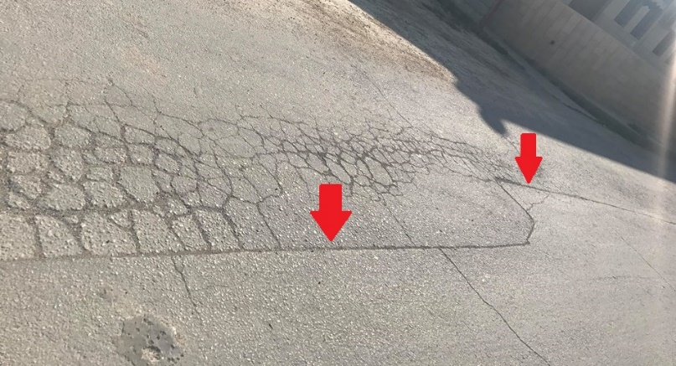
Longitudinal Cracking

Slide 30
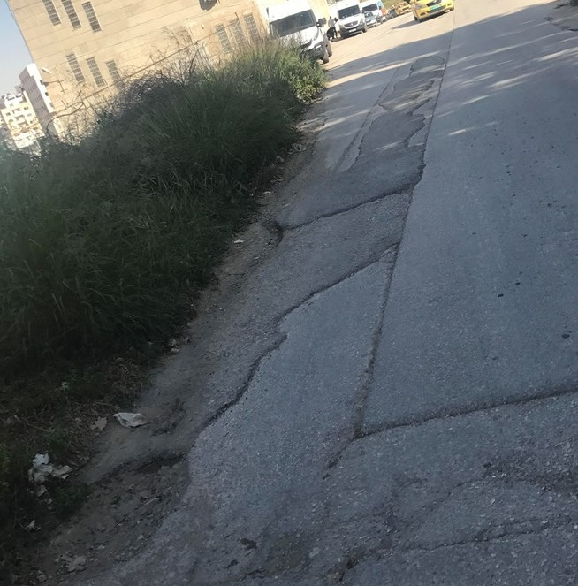
Potholes and Patching

Slide 31
Conclusion

Slide 32

Thanks

