Slide 1
Online Ordering and GPS Delivery Management System
Delivery.PS
Students:
Anas M. N. Khraim
Mahmoud A. M. Sharaf
Supervisors:
Dr. Raed Al-Qadi
Dr. Ashraf Armoosh
Fall 2011

Slide 2
Motivation
A huge difficulty in answering the large number of orders simultaneously on telephone.
Restaurant management.
Manage Orders
Manage Employees
Manage Meals
Manage Customers

Slide 3
Facilitate customer ordering process.
likes and dislike
Reviews
Ranking
Order tracking service.

Slide 4
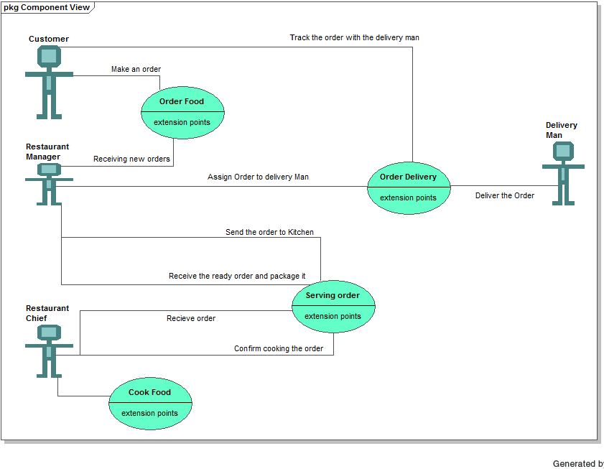

Slide 5
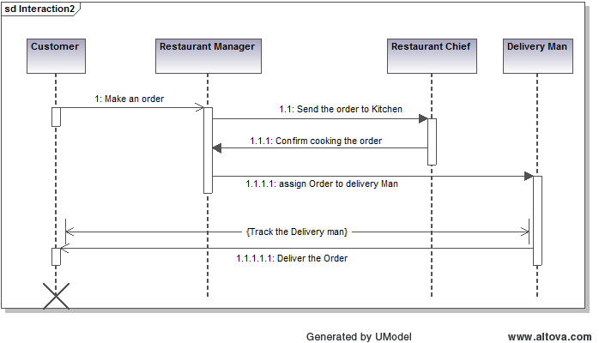

Slide 6
Our system is a distributed system that consists of website + mobile.
Website
A suitable way for customers to order.
A suitable way for customers to track the orders.
A good advertisement for Restaurants.
Mobile:
A suitable way for Delivery Man to receive new assigned orders.
A suitable way for the tracking process.

Slide 7
The Smart Mobile Phone
What
Google Android O.S
Samsung Galaxy S Device

Slide 8
Why ?
GPS sensor.
Wi-Fi receiver.
Mobile computer based device.
Telephone communication.

Slide 9
System’s features
distinguish our system from the competition.
attractive solution empowering users to conduct business in a modern, advance approach.
control a large share of the market

Slide 10
Now we move to see the Demo..

