Slide 1
Coffee Machine
Presented by:
Aroub Na’eem & Sondus Abu Ghdaib
Supervisor: Dr. Hanal Abuzant
May 22,2018

Slide 2

Outline
Introduction
Project Tools and Resources
Software Part
Constraints and Problems
Future Work
Demo
Conclusion

Slide 3
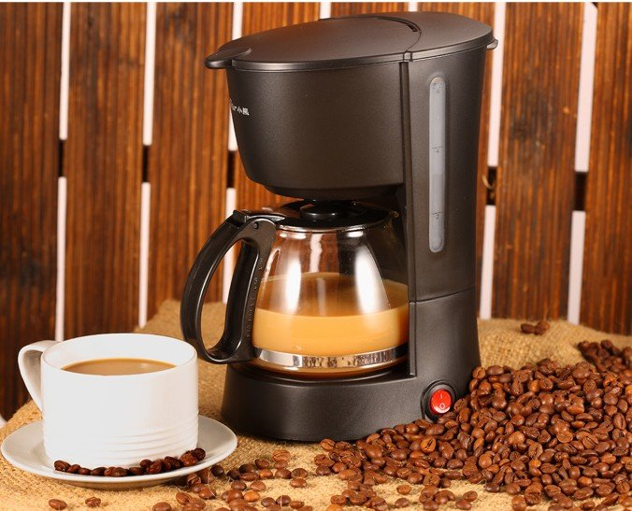
Introduction

Slide 4
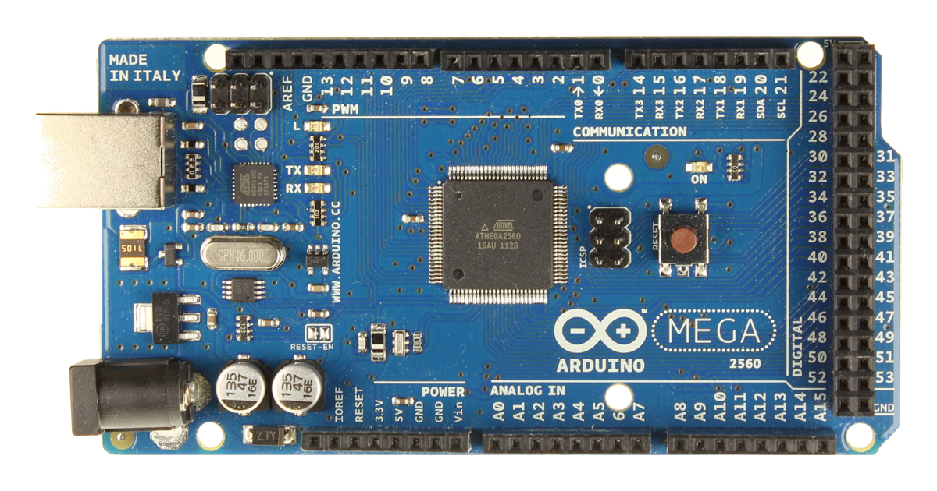
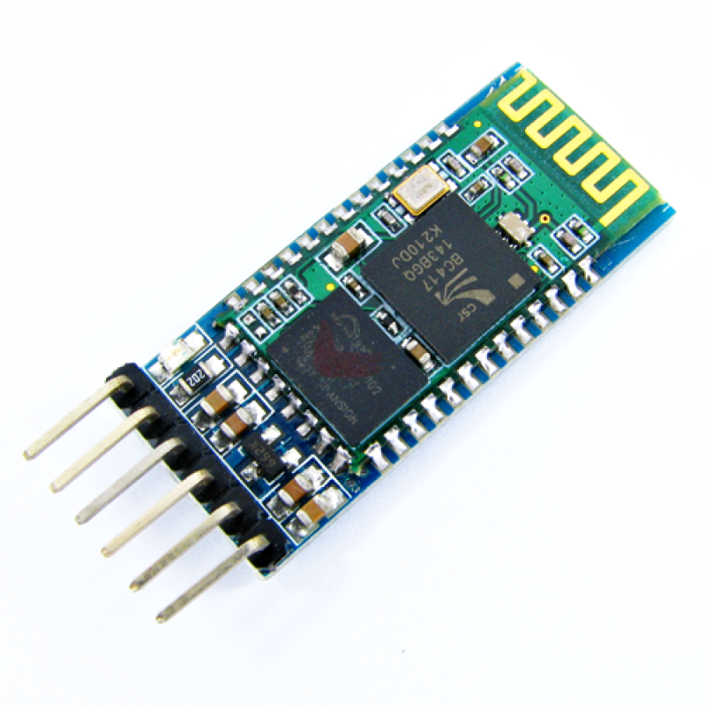
Project Tools
Arduino Mega
Bluetooth Module HC-05

Slide 5
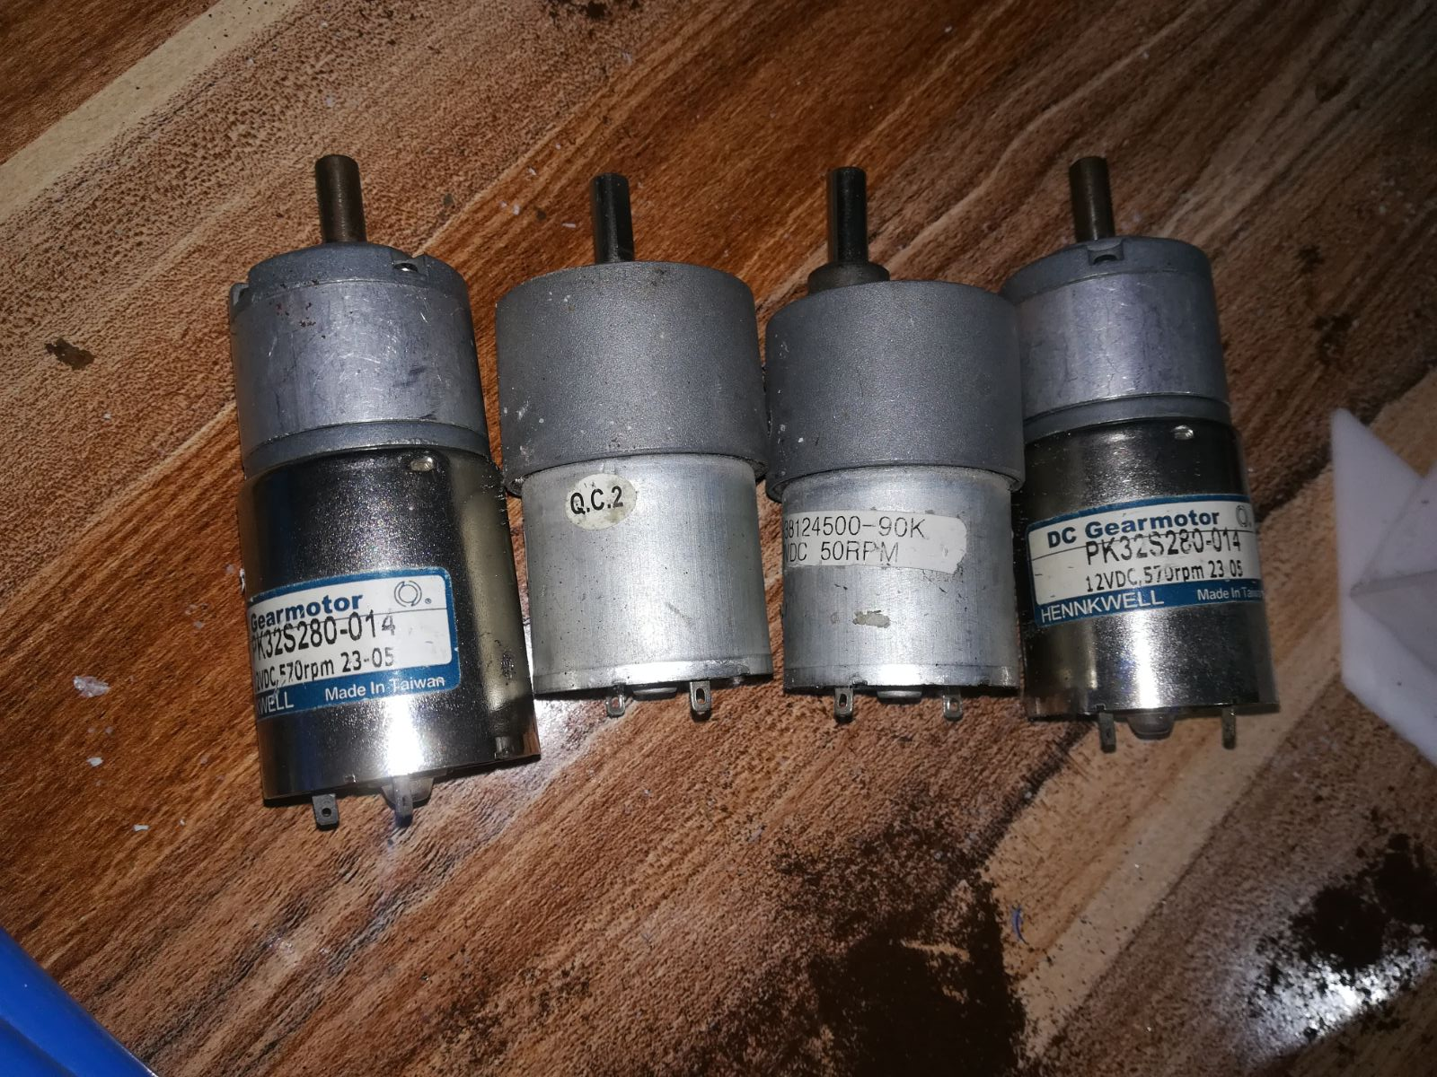
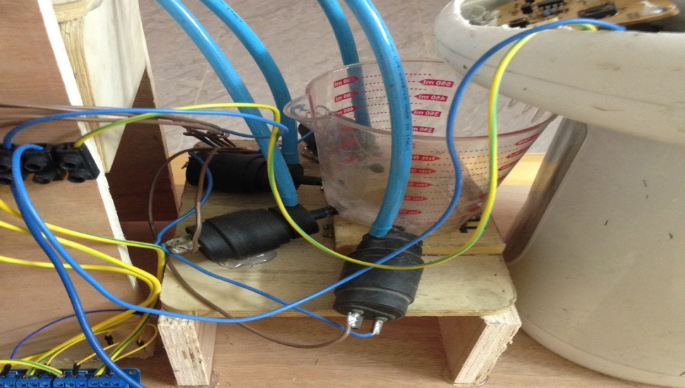
Four DC-Motors
Four Water Pumps

Slide 6
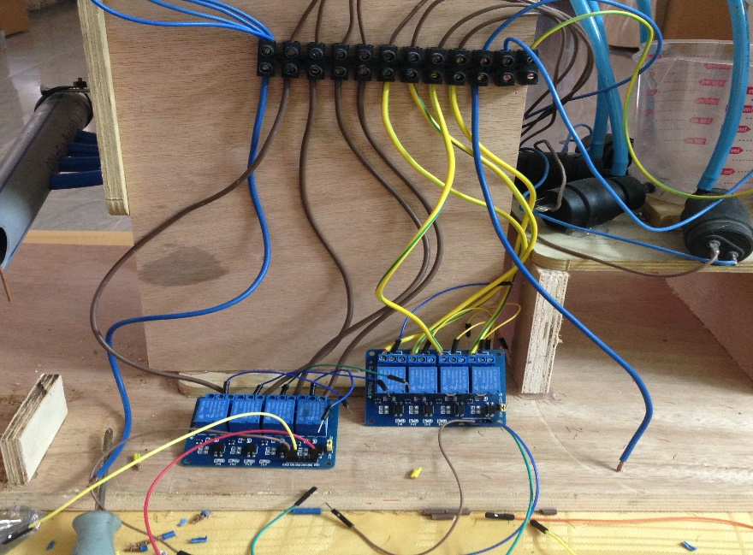
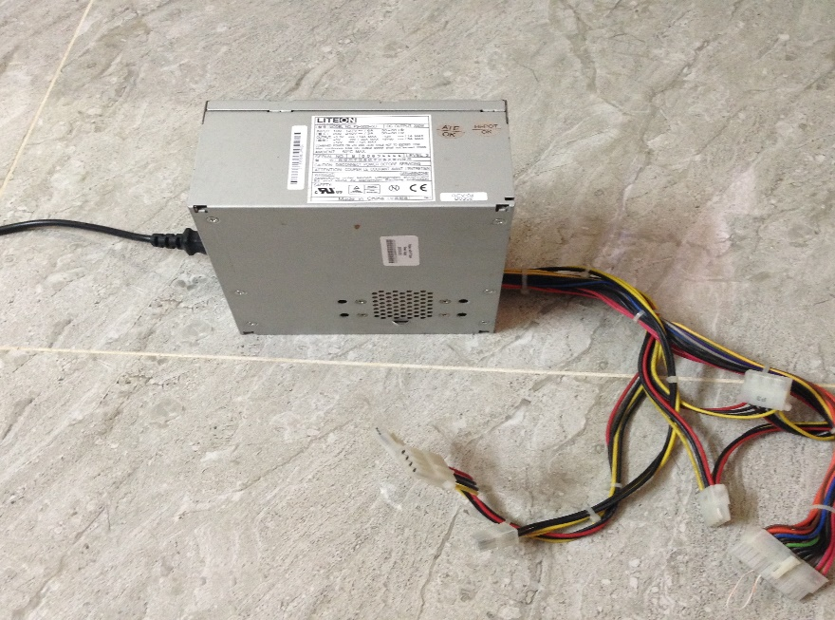
13 Relays
Power Supply

Slide 7
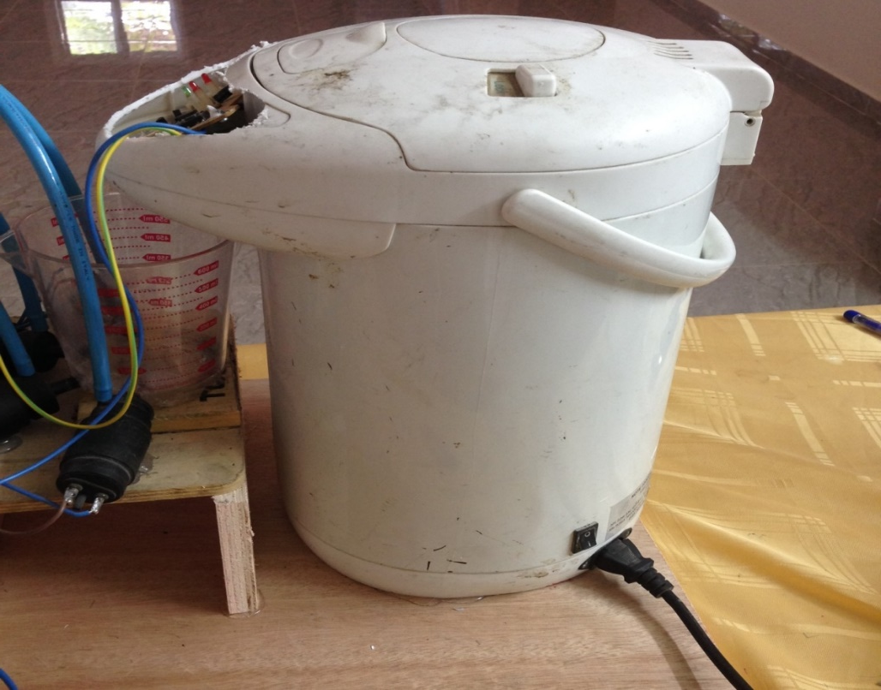
Water Heater

Slide 8
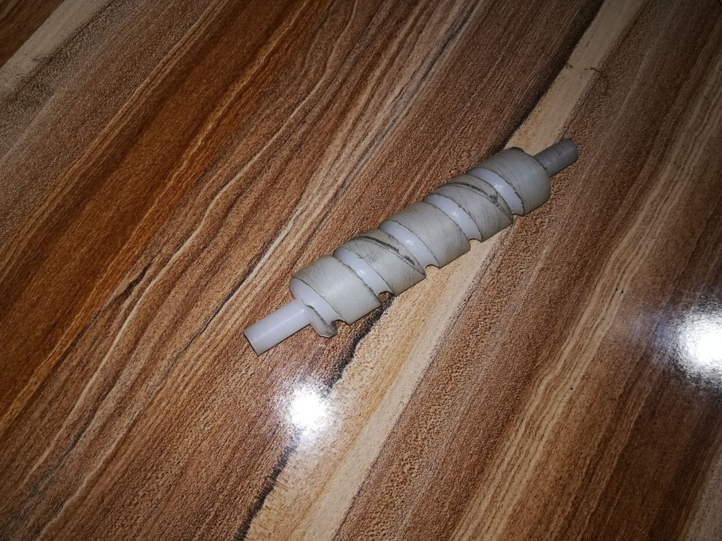
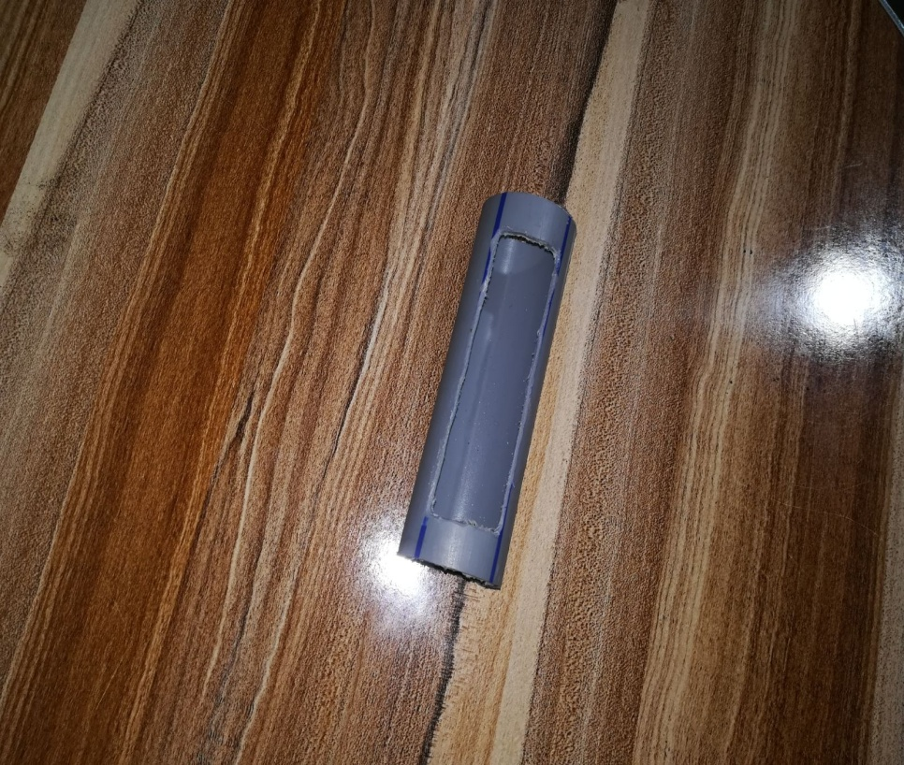
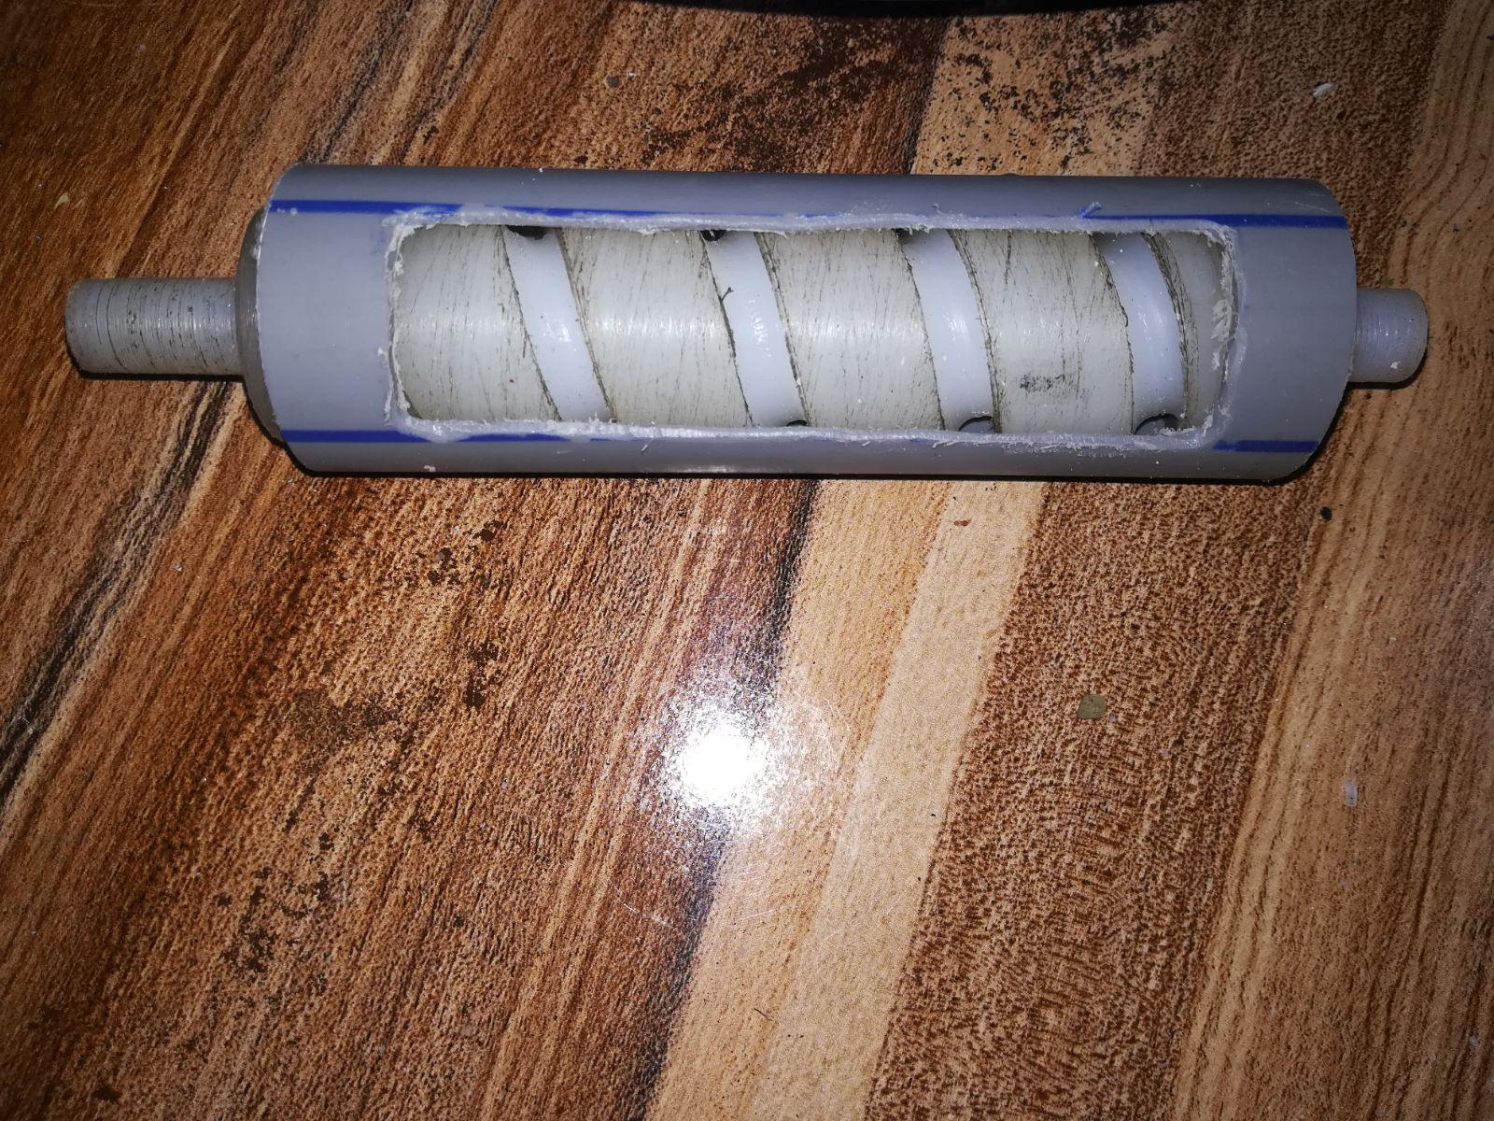
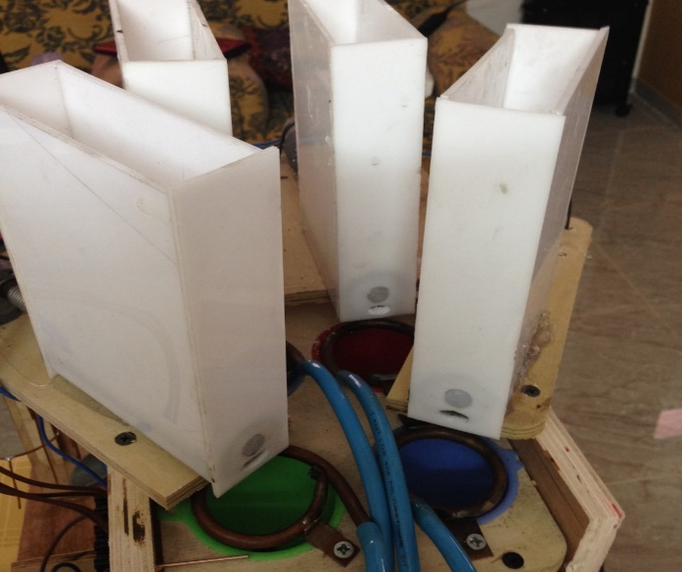
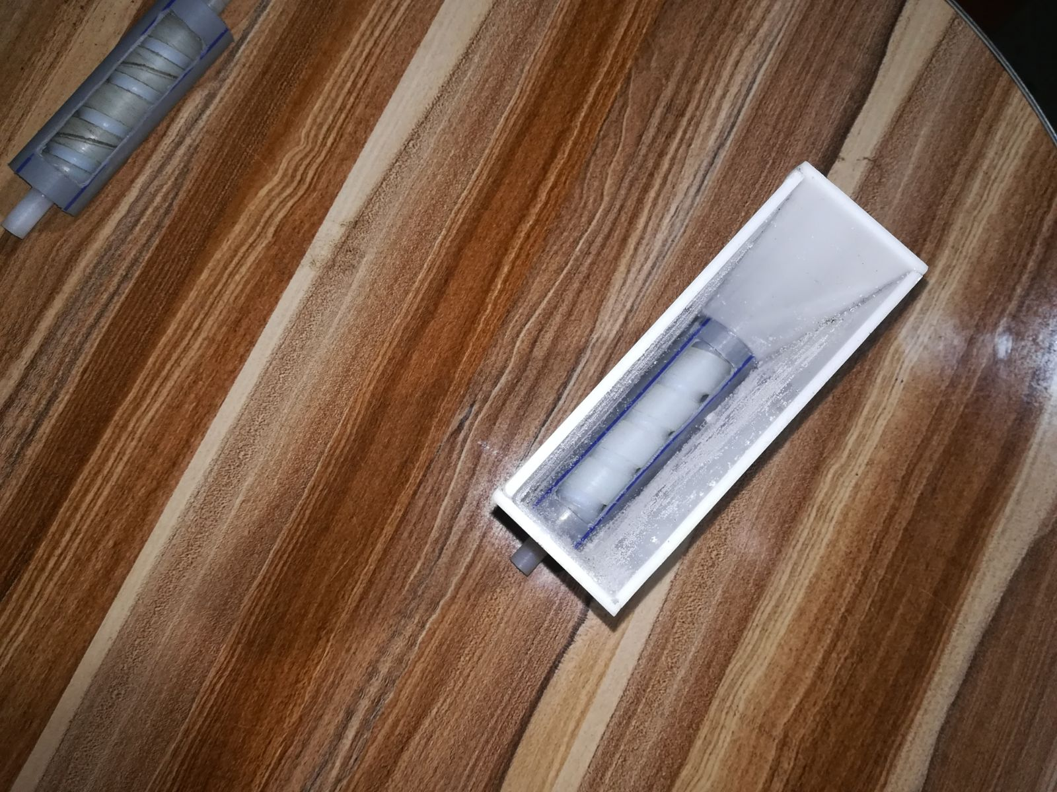
Materials Containers

Slide 9
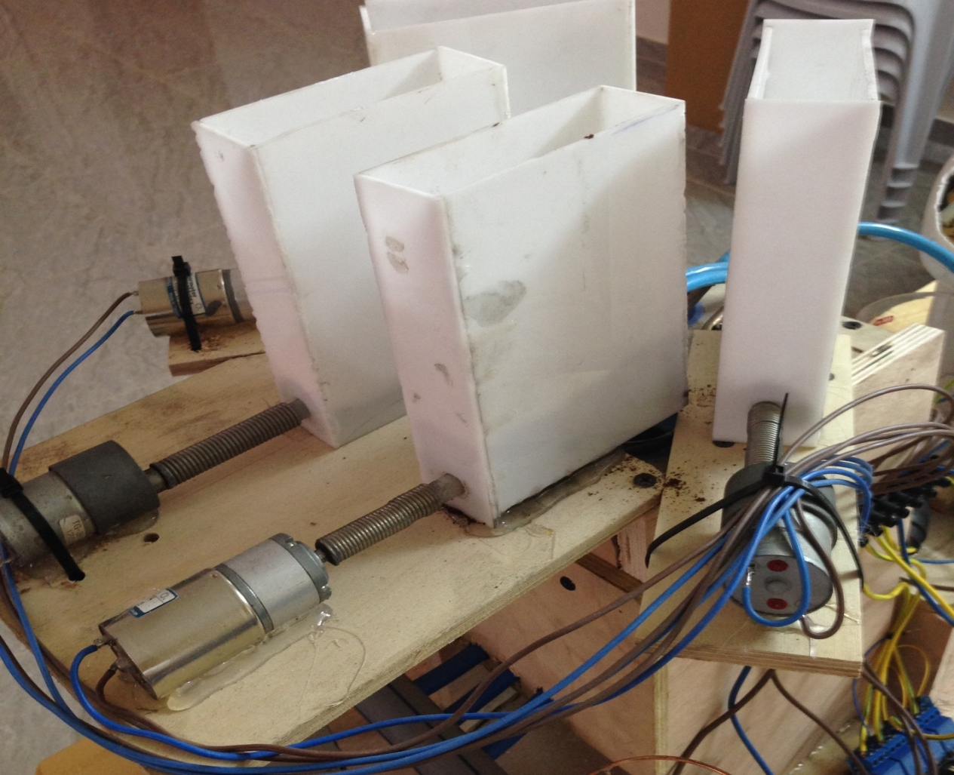
Motors Connected to containers

Slide 10
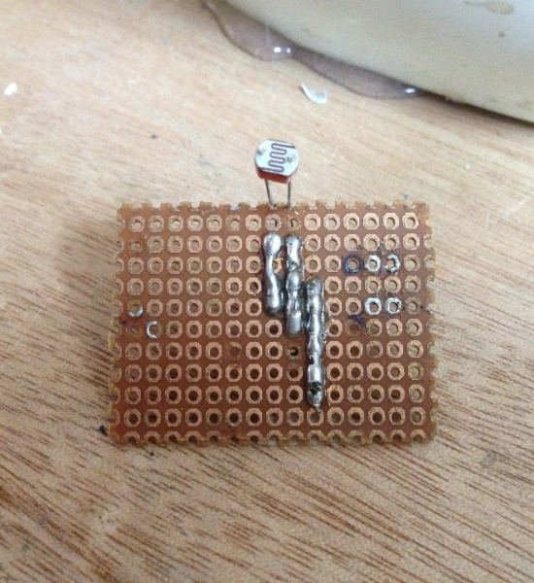
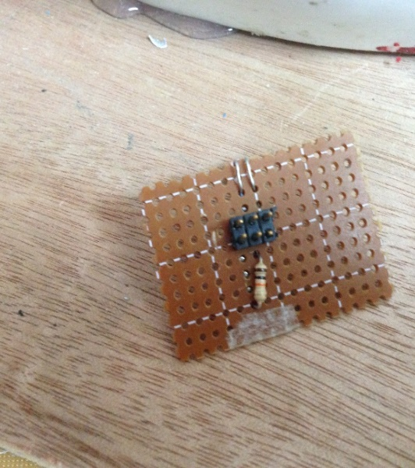
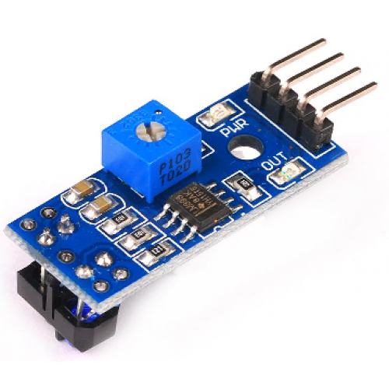
4 LDR Circuits
IR Sensor

Slide 11
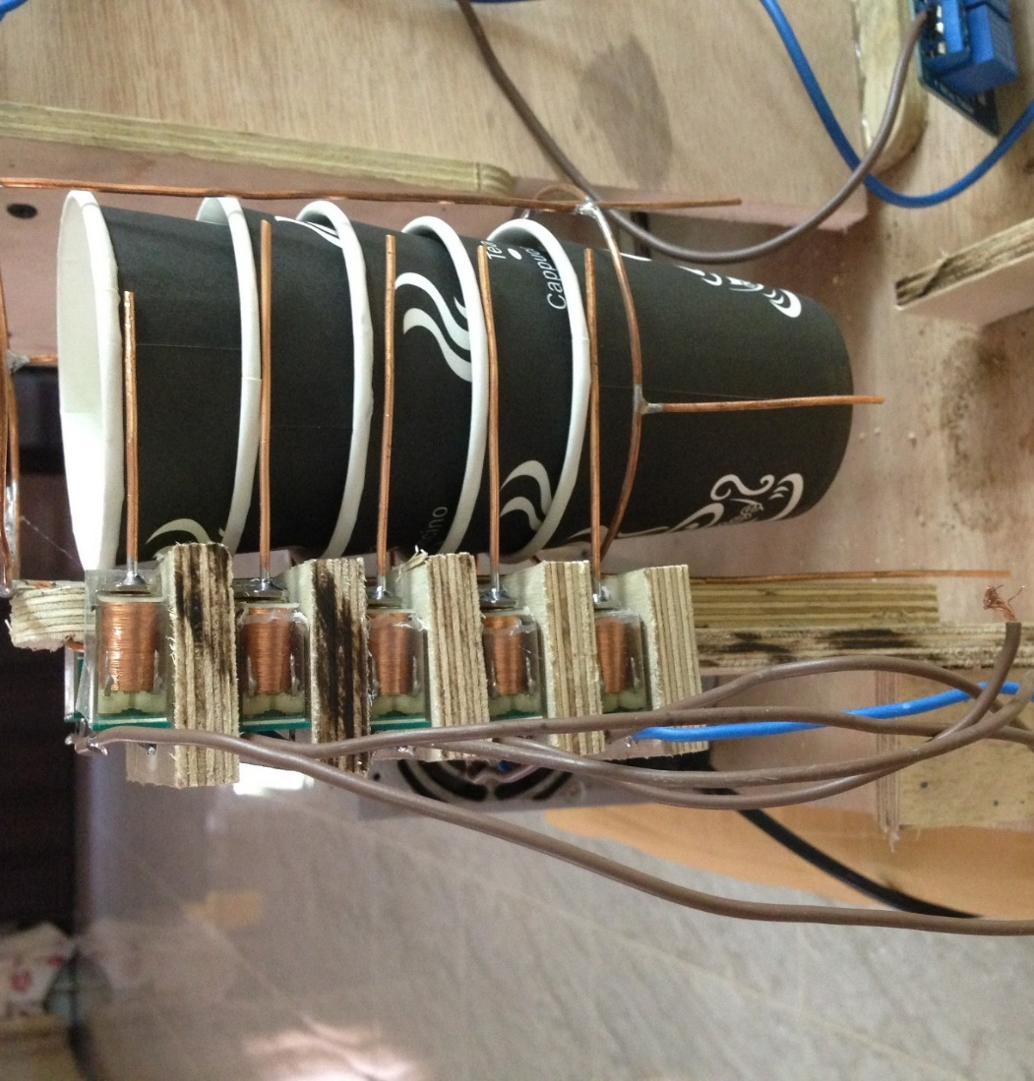
Features
Placing the cup automatically

Slide 12
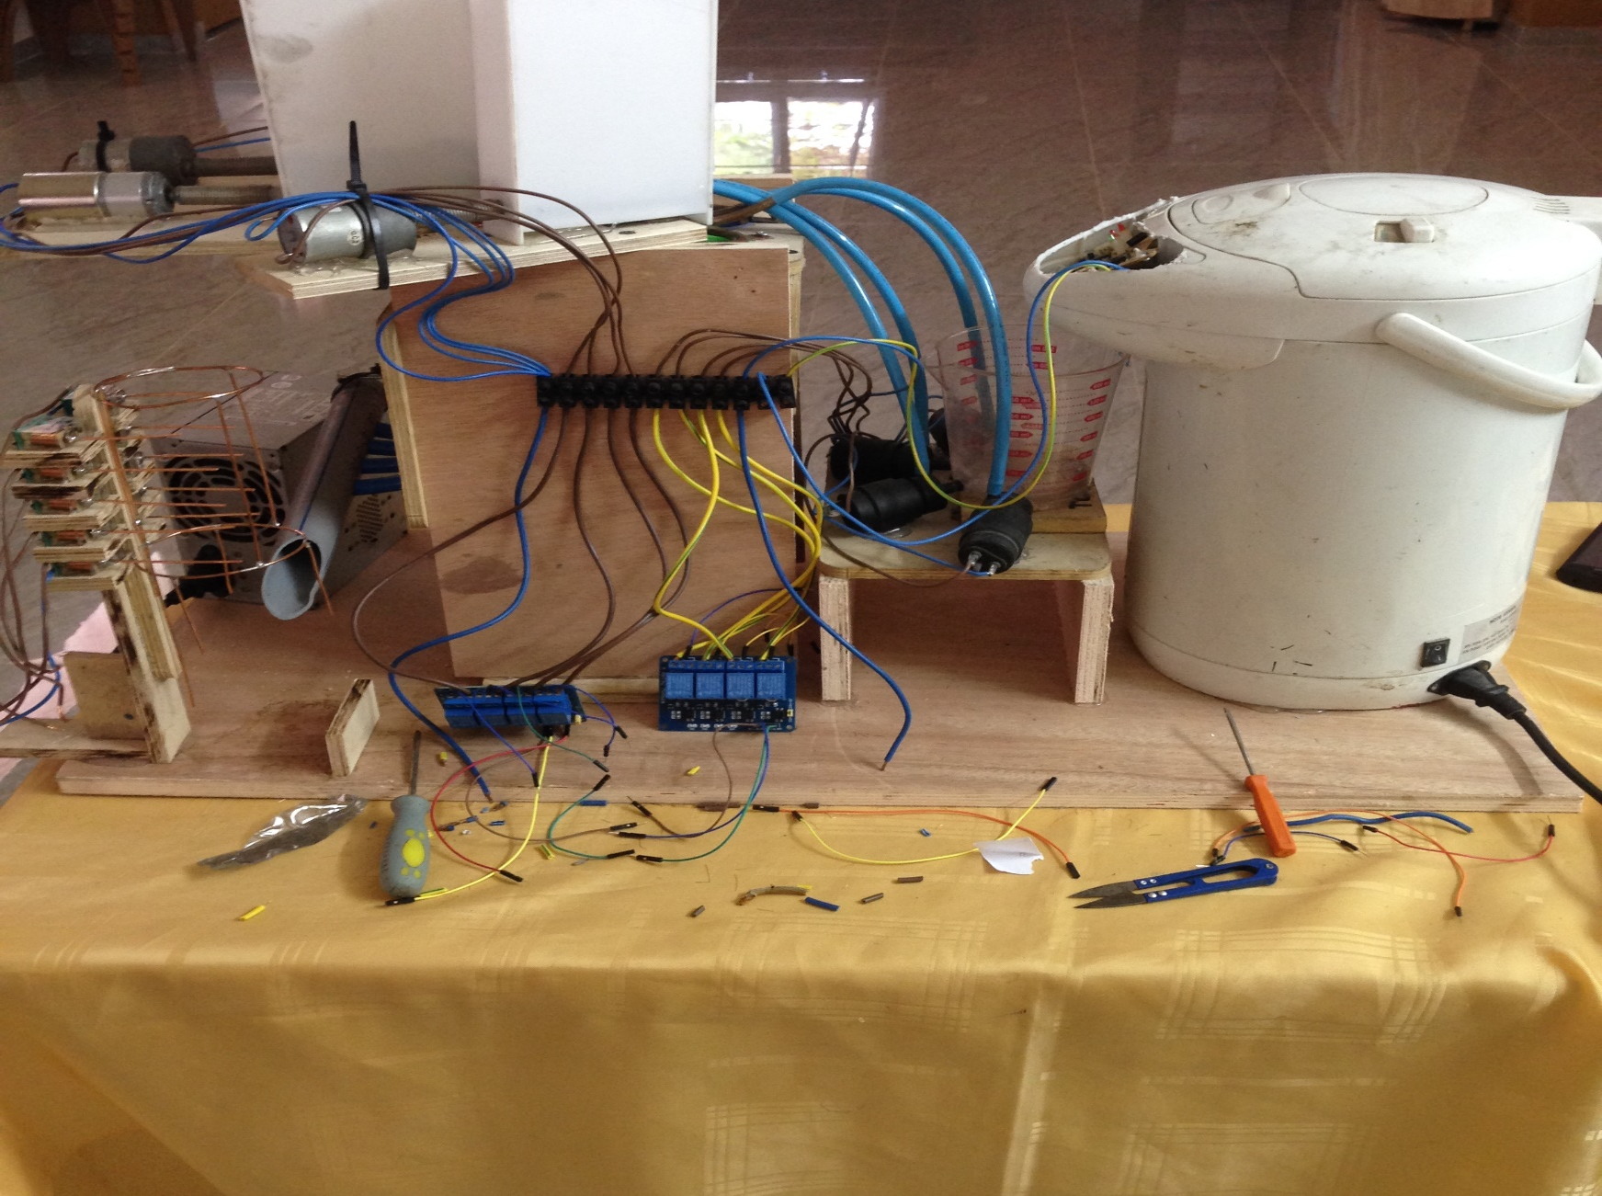
The Whole Machine

Slide 13
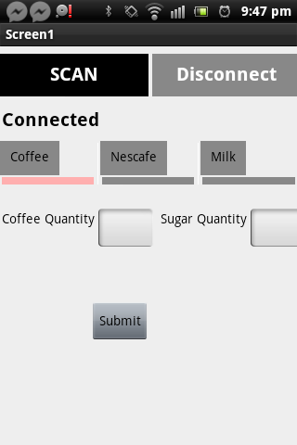
Software Part
Android Application

Slide 14
Constraints and Problems
Mechanical Part
The Project is Costly
Time

Slide 15
Future Work
Add Mixture Tool.
Heating untaken cup for a while.
Add alarm to the machine.
Add LCD and Keypad.

Slide 16
Demo

Slide 17
Conclusion

