Slide 1


Energy generation using palm waste for Heating applications, case study for Palestine
An-Najah National University
Faculty of Engineering and Information Technology
Mechanical Engineering Department
Prepared by:
Ahmad Abu Arra
Dirar Hara
Firas Mansour
Supervisour: Eng.Luqman Herzallah
Wednesday,7 February 2024

Slide 2
Agenda
I
II
III
Introduction
Literature Review
Methodology
V
VI
Feasibility study
Conclusions
VII
Recommendations
IV
Results

Slide 3
I
Introduction

Slide 4

Introduction
1
Phoenix dactylifera
2
Tropical and subtropical tree
3
Jericho and Jordan Valley regions and the Gaza Strip
4
What is the city that is dubbed the "City of Palms"?

Slide 5
Palm Tree Parts
Leaf
Fruit
Length 3-6 m
Lifespan 3-6 yrs
Produce 20kg/yr from the dry leaf
Length 3-7 cm
Contain sugar, proteins, calcium, phosphorus, iron, and vitamins of the B and A group
Female inflorescence
Male inflorescence
Essential for the production of dates
Requires pollination from male trees
The male date palm yields flowers that produce the pollen
Stem
Root
Kernel
The main structural part of the tree that supports the branches and leaves
Absorb water and nutrients from the soil
Represent 10% of palm fruit waste
Used in cosmetics, as it reduces the visible signs of aging

Slide 6

Problem Statement
PROBLEM
SOLUTION
Environmental
Emergence of the red date palm weevil.
Large quantities of date palm waste can be converted into :
Fertilizer
Animal food
Energy
Heating applications

Slide 7
II
Literature review

Slide 8


Applications
Insulation
Biofuels and Biogas
Animal food
Thermal conductivity of 0.083 (W/m.K)
Energy production
Lightweight wood
Fertilizer

Slide 9
III
Methodology

Slide 10
Methodology
Literature review
Laboratory Analysis
Evaluation
Step I
Step II
Step III
Step IV
Step V
Data collection
Data Analysis

Slide 11
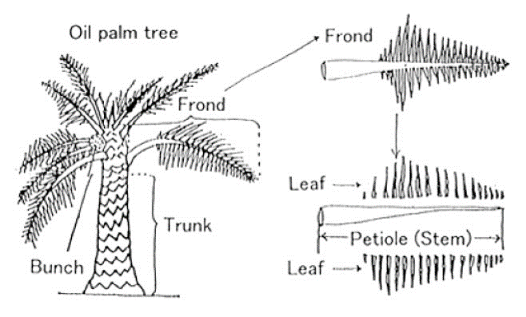
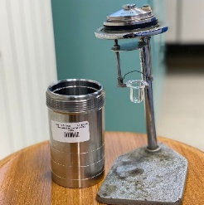




Experiments Methods
Approximating Analysis
Moisture (M)
Ash (A)
Volatile matter
(VM)
Fixed carbon
(FC)
Experiments Methods
Weight 1 g
Weight 1 g
Weight 1 g
Crucible lid loosely closes
Crucible lid opened
Crucible lid tightly sealed
Furnace at 105 C
Furnace at 600 C
Furnace at 950 C
$$FC= 100−(\%M+\%A+\%VM)$$
Time 1 hour
Time 2 hours
Time 7 minutes
Cooling inside desiccator
Cooling inside desiccator
Cooling inside desiccator
$\%M=\frac{W_{before}−W_{after}}{W_{before}}×100\%$
$$\%A=\frac{W_{after}}{W_{before}}×100\%$$
$\%VM=\frac{W_{before}−W_{after}}{W_{before}}×100\%$
Higher Heating Value (HHV)
Weigh 0.5 grams of benzoic acid
Place the Decomposition vessel inside calorimeter.
Take out Decomposition vessel from calorimeter, empty it of oxygen
Put the crucible inside the Decomposition vessel
Add water to the calorimeter.
Repeat the same steps for the three samples (Date Kernel, palm leaf, and Palm frond petiole).
Fill the Decomposition vessel with oxygen gas.
Wait for the complete combustion

Slide 12
IV
Results and Analysis

Slide 13
Results and Analysis

Slide 14
Results and Analysis

Slide 15
Results and Analysis

Slide 16
Results and Analysis
Sinokrot Factory
Al-Qawasme Factory
  Amount of waste
  130 tons during the past year
  will increase to approximately 180 tons this year.
  Amount of waste
  54 tons of date seeds
  6 tons of damaged dates
  No information about the quantity of date paste
  Type of waste for date paste
  date seed
  damaged dates
  date paste (a mixture of date pulp and date seeds).
  Waste disposal methods
  in Garbage
  cooperation with the Ministry of Agriculture, which uses it as animal feed
  Challenges
  financial and environmental
  occupying large spaces
  negatively affecting the final product

Slide 17
V
Feasibility Study

Slide 18
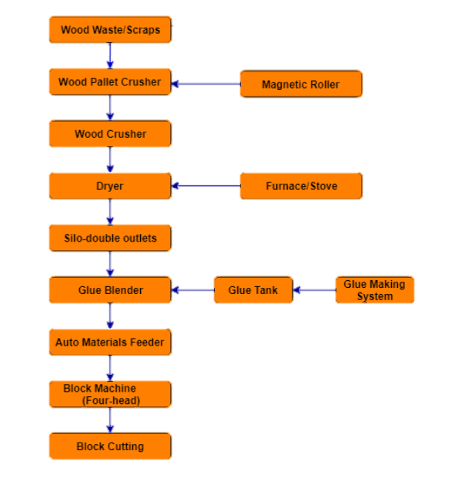
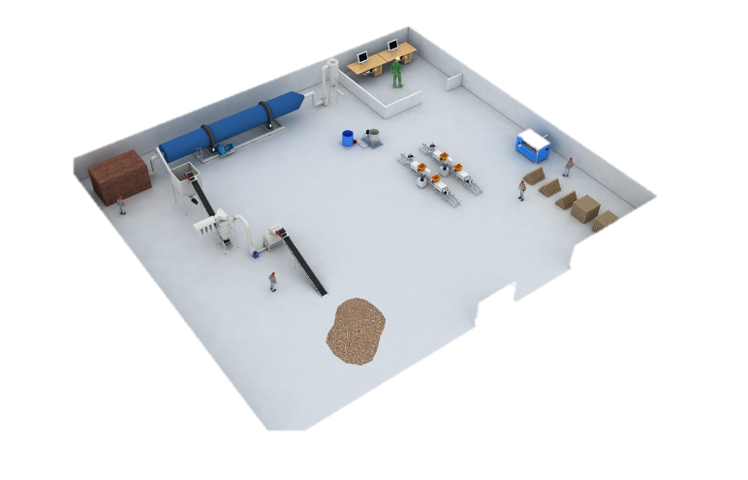
production line
Remove Nails
Hot air
NOTE: https://www.youtube.com/watch?v=f0OTbmMtwNY&t=3s

Slide 19
Economical data
Operational Costs / Day
Investment cost
  Electricity Consumption=158 NIS
  Investment Costs=414000NIS
Glue Consumption=431 NIS
Production Details
Worker Salaries(3workers)=300 NIS
Engineer Salary=200 NIS
  Blocks Produced Per Day=1670 blocks
Transportation Cost= 100 NIS
Cost per block= 0.72
Total operational Cost= 1190 NIS
Market Price per Block=1 NIS

Slide 20
Economical data
SPP
863 days
Annual Profit
ROI
150240 NIS/year
36.3%

Slide 21
VI
Conclusions

Slide 22
Conclusions
Determine the Higher Heating Value (HHV)
Conducting approximate analysis experiments
Comparing the results
Transforming palm waste into wooden blocks
Conducting an economic feasibility study

Slide 23
VII
Recommendations

Slide 24

Recommendation
Comprehensive Feasibility Study for the Market
1
Local Manufacturing
3
2
New Applications and Product Diversification
4
Government Intervention and Support

Slide 25
Thanks

Slide 26
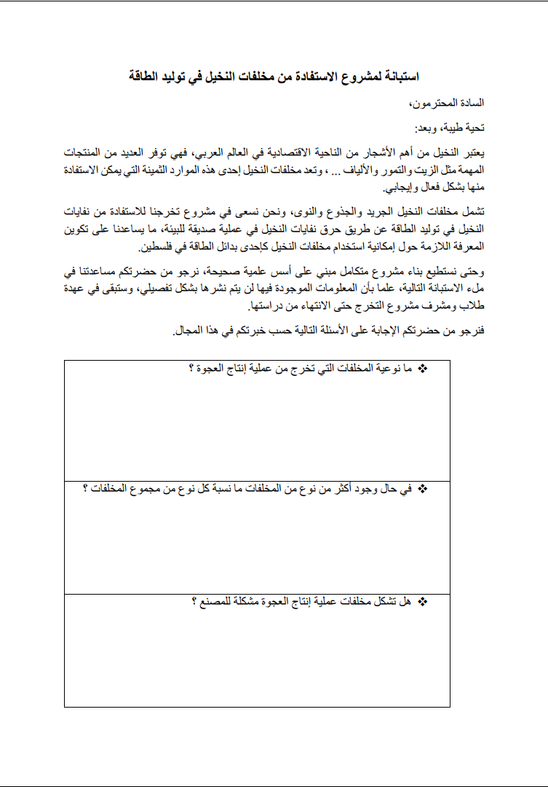
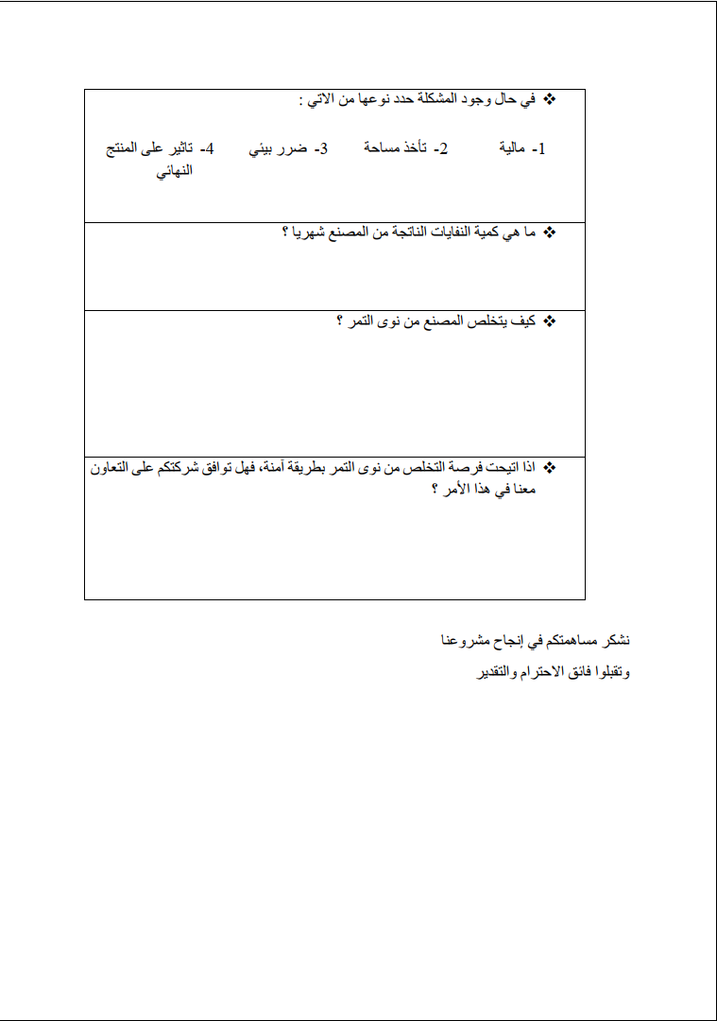
Questionnaire

