Slide 1
Let’s Share
Q&A Website
Presented by: Bassam A Yaseen
Amjad Dardouk
Supervisor: Dr.Haya Sammaneh

Slide 2
Contents
Introduction
How does it work
Technologies
Constraints
Future work & recommendation

Slide 3
Introduction
Let’s Share is : A website that is reachable any where and available for every one to ask their questions and get an answer for it in an easy and simple way.

Slide 4
Introduction
Problems :
getting a reliable answer for your question has never been so easy .
Q&A websites are hard to use for some people.

Slide 5
How does it work ?
Register & login to the website.
The website will navigate the user to the home page , where he/she has many options.
if user want to add a new question all what he/she need to do is write the question and the website will give all the related questions for that question .
if the user is not satisfied with the related question or there is no related questions the question will be classified to its correct category and added to the website to get an answer for it.
users can ask questions or answer others question or rate the answers

Slide 6





Technologies

Slide 7
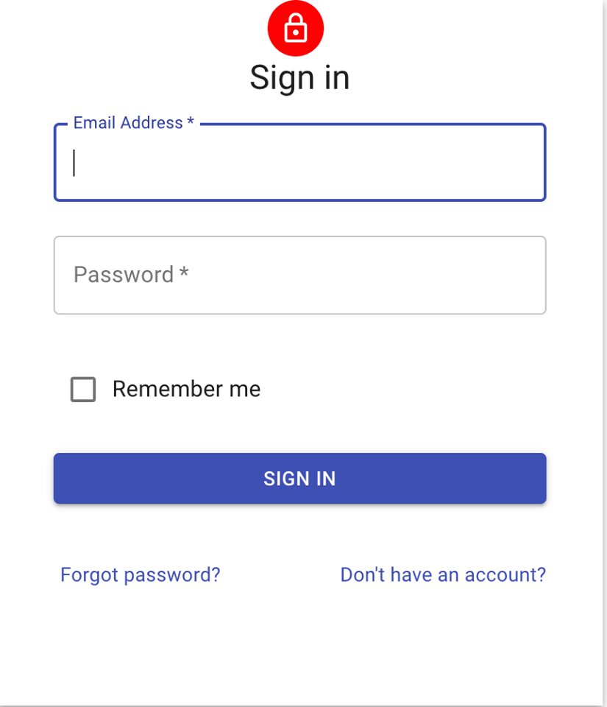
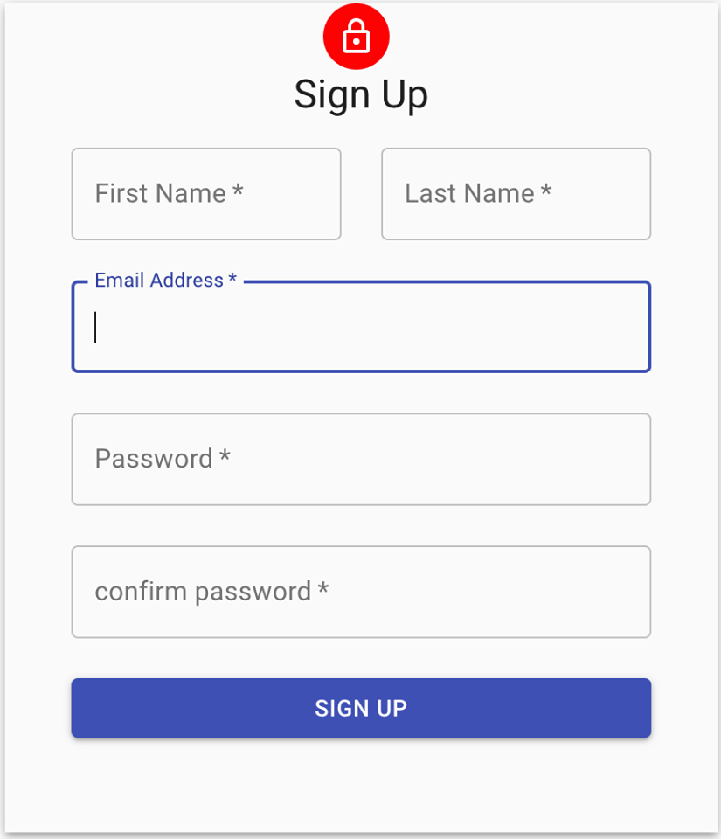

Slide 8
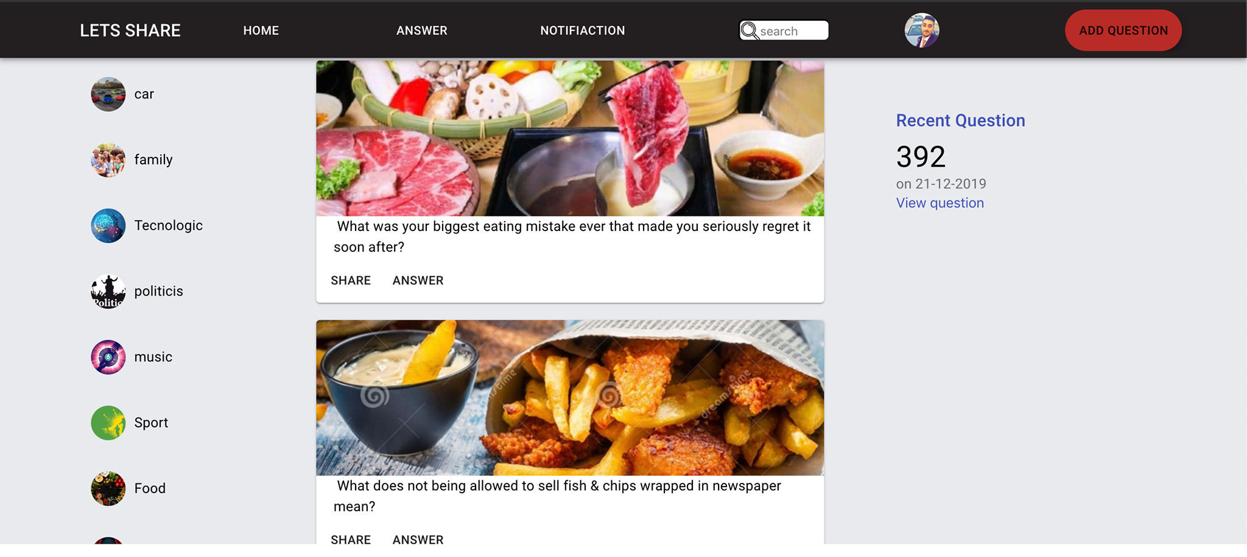

Slide 9
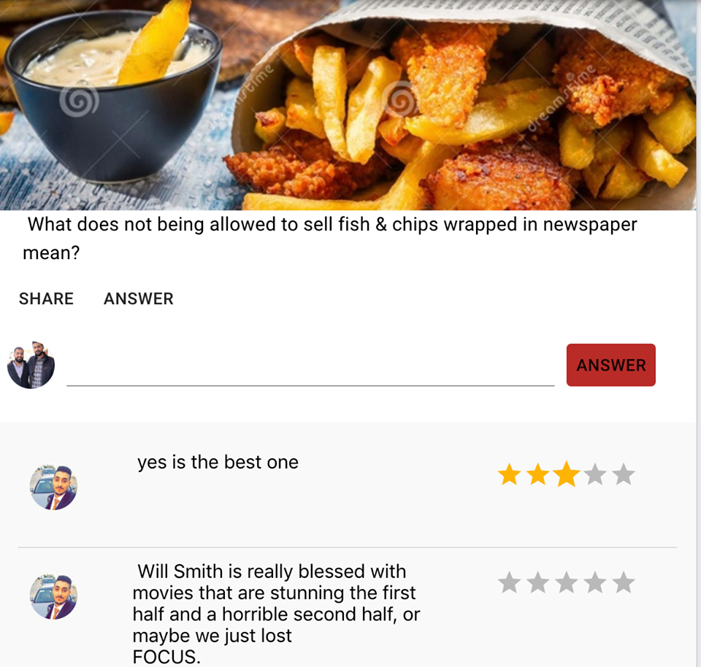
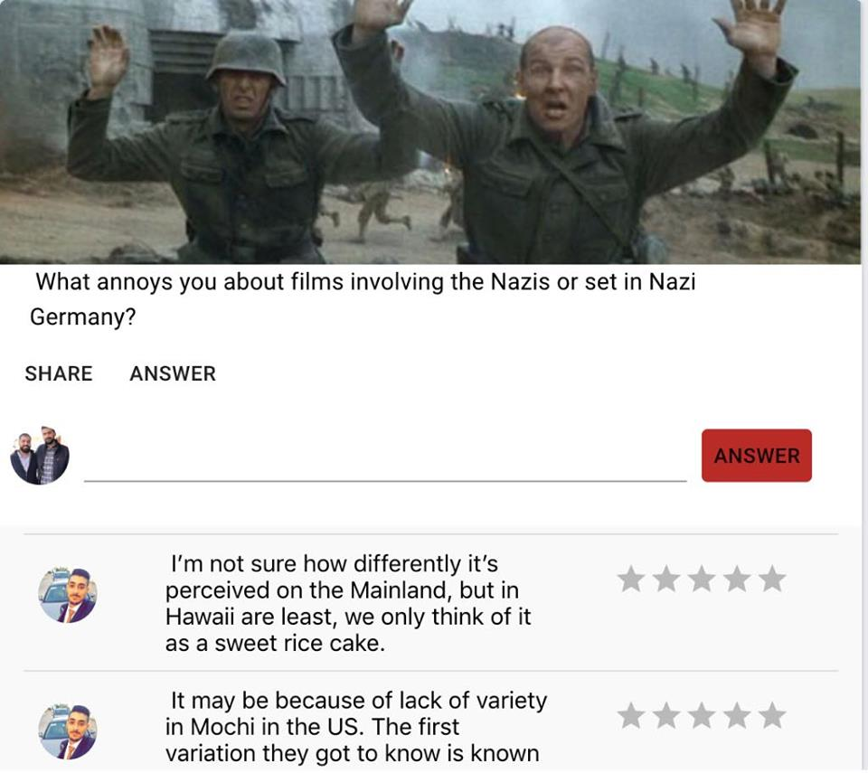

Slide 10
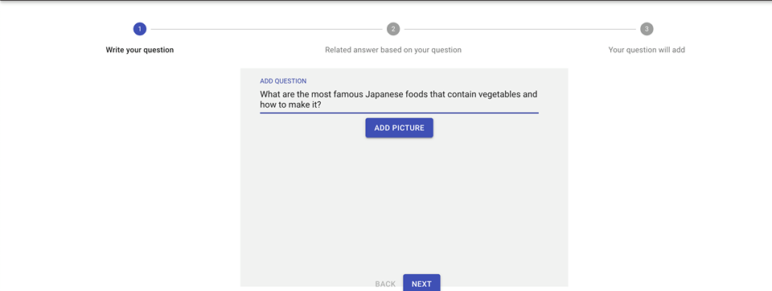

Slide 11
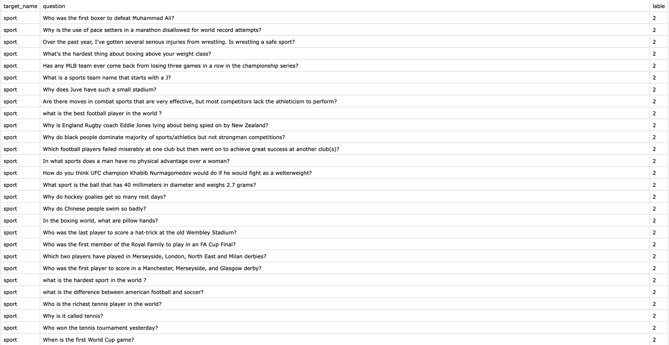

Slide 12
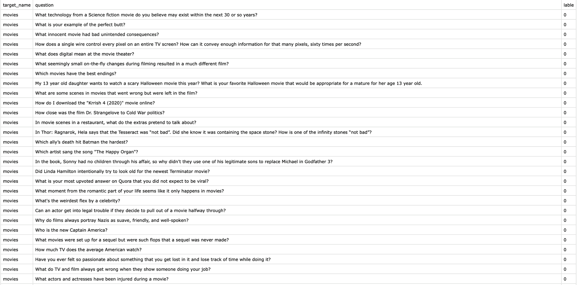

Slide 13
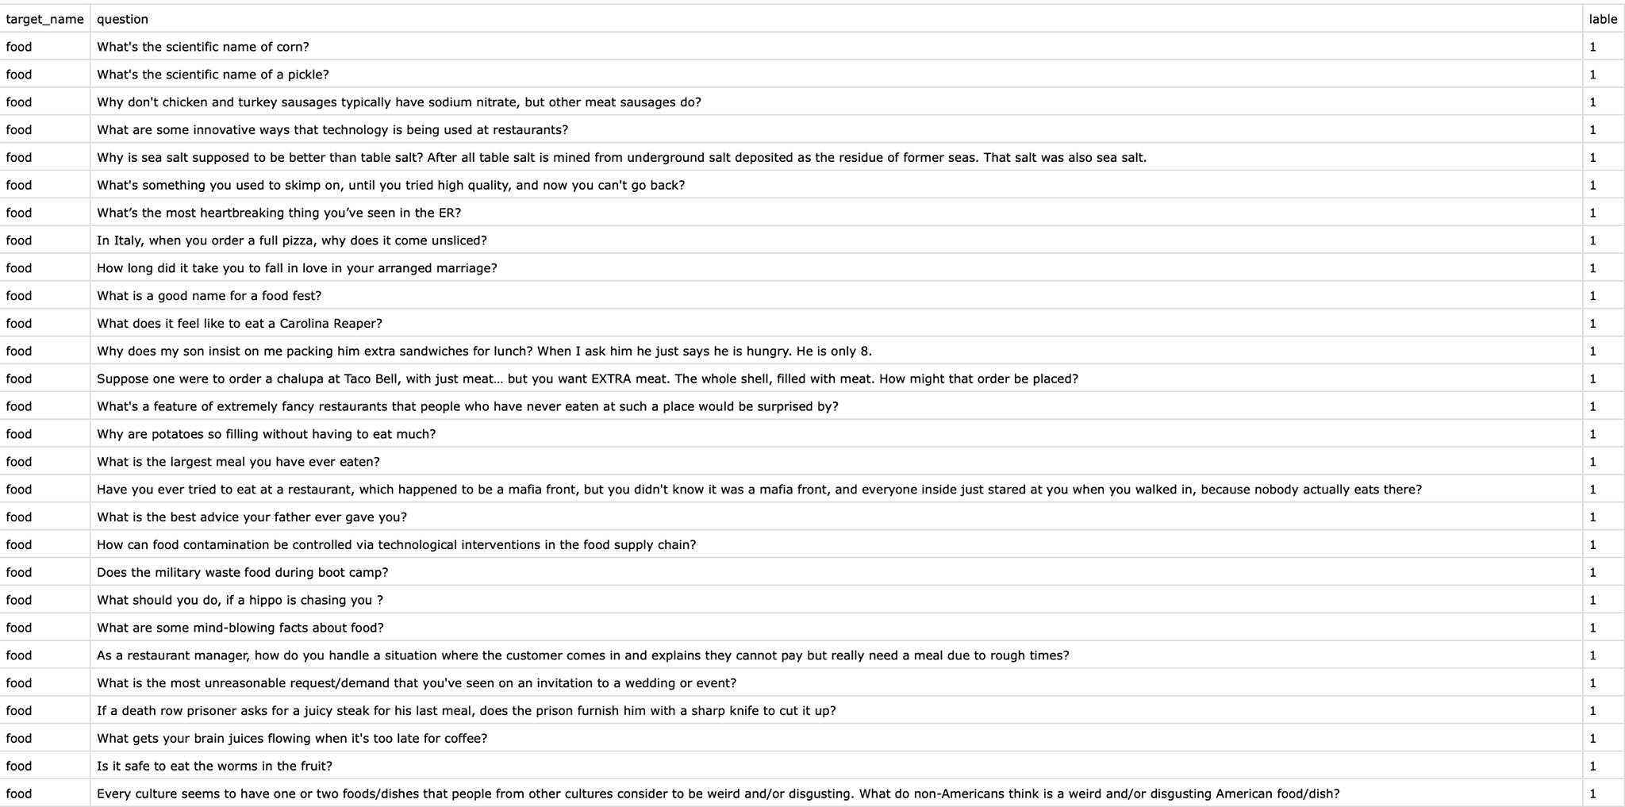

Slide 14
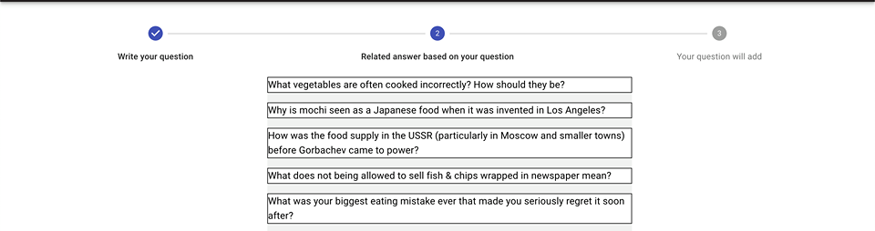

Slide 15
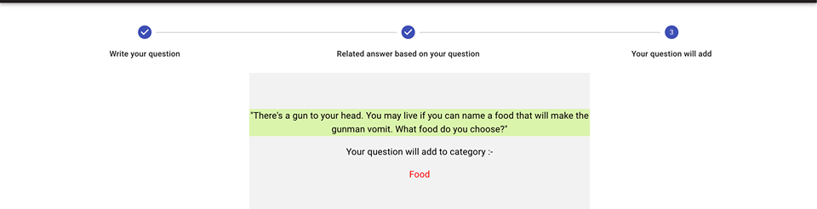

Slide 16
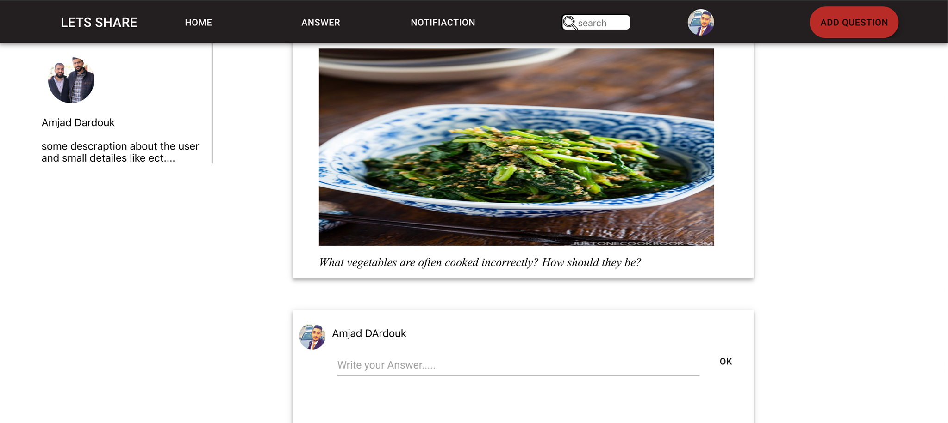

Slide 17
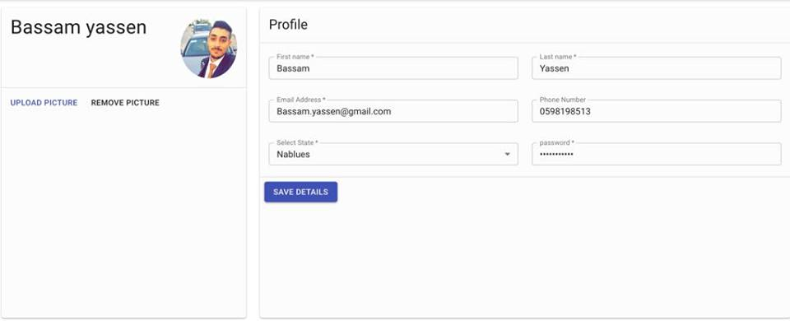

Slide 18
Constrains
New frameworks and languages.
Collecting data for the AI.
Filtering data to train the AI.

Slide 19
Future work
Classify Arabic and other languages.
get related from different sites not just from ours to get more data.
The site will be fully automated after providing it with sufficient amount of data.
Provide the site with analysis tools to help researchers to get results from real life data.
Not just test classification also photo recognition.
Make the site able to create new Categories.

