Slide 1


AN-NAJAH NATIONAL UNIVERSITY
Evaluating Manufacturing Systems with Machine Learning Techniques
Graduation Project
By:
FIRAS MABROUKEH
BASEL AL-SAHILI
Supervisor:
Dr. RAMIZ ASSAF

Slide 2




Outline
1
2
3
4
5
Introduction
Key Terms
Methodology
Results
Conclusion
1

Slide 3

  Introduction
1.1 Overveiw
  Industrial Revolution
  Development of AI and ML applications
  Domination of mass production systems
  High variability in predicting output parameters
  Evaluate manufacturing systems
    Simulation-integrated machine-learning technique
2

Slide 4

  Introduction
1.2 Problem statment
  Challenges in Manufacturing
Opportunities with Machine Learning
Solution: Synthetic Data and ML Integration
3

Slide 5





  Introduction
1.3 Research Questions
  How effective is simulation-generated synthetic data for training machine learning models?
  How do models trained on theoretical equations compare to those trained on simulation synthetic data?
  How does increasing production line complexity impact model performance?
  Can machine learning accurately evalute production lines with varying constraints?
4

Slide 6
  Introduction
1.4 Research Phases
phases
1. Queuing system
M/M/s
2. Serial Production Line
5

Slide 7


2. key Terms
2.1 Simulation
simulation:
Simulation is the practice of imitating a real-world process or system to study its behavior and predict potential outcomes
- Oxford Dictionary
The benefits of simulation :
01
02
03
  Flexibility
  Scalability
  Replicability
6

Slide 8
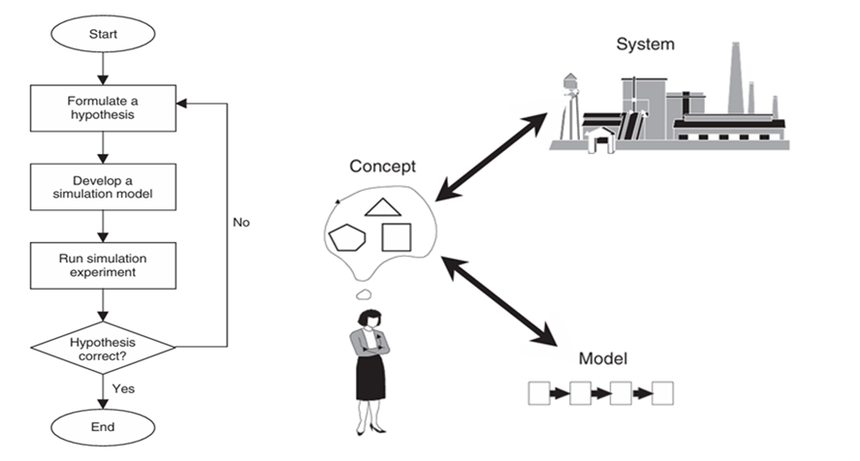
2. key Terms
2.1 Simulation
7

Slide 9
2. key Terms
2.2 Machine Learning
Machine Learning:
Extracting knowledge from data and using algorithms to enable AI to imitate the way that humans learn
- IBM
ML Learning process :
01
02
03
Decision Process
Error Function
Optimization Process
8

Slide 10
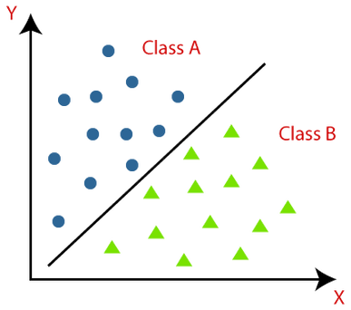
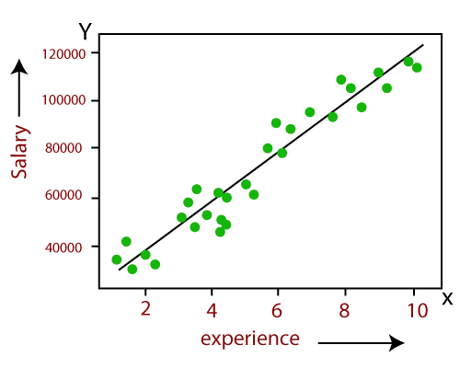
2. key Terms
2.2 Machine Learning
Type of Machine Learning
Supervised ML
Unsupervised ML
Reinforcement Learning
Classification
Regression
9

Slide 11
2. key Terms
2.3 Queuing system
The M/M/s/GD/∞/∞ Queuing System :
A system where customers/parts arrive for service at a facility, forming a queue when the service facility is busy.
Customers are served based on preassigned rules
- OR A P P L I C AT I O N S AN D A L G O R I T H M S 4th
μ
1
ρ
2
λ
S
10

Slide 12
2. key Terms
2.4 Serial Production Lines
synchronous serial buffered production lines machine systems :
  Operating at the same time
  Sequential machine connection
  Temporary item storage (WIP)
m
b
m
b
b
m
1
1
2
2
M-1
M
(e , P )
N
(e , P )
N
N
(e , P )
1
1
1
2
2
2
M-1
M
M
11

Slide 13





3. Methodology
1
2
3
4
5
Data Generation
Data Splitting
Algorithms Training
Optimize Algorithms
Evaluate the Algorithms
12

Slide 14

3. Methodology
3.1 Data Generation
Inputs:
  S = [ 1 - 10 ]
  ρ = [ 0.1 - 0.9 ]
  mean interarrival time = [ 1 - 60 ]
  mean service time = Traffic intensity x mean interarrival time
M/M/S
EQUATIONS
DATA SET
M/M/S
SIMULATION
DATA SET
Outputs:
  Average number in the system (L)
  Average number in the queue (Lq)
  Average waiting time in the system (W)
  Average waiting time in the queue (Wq)
13

Slide 15
3. Methodology
3.1 Data Generation
Inputs:
  E = [ 0.65 - 0.99 ]
  N = [2 - 50]
  Probability of Repair = [0.1 - 0.4]
  Probability of No Repair = 1 - Probability of Repair
  Probability of failure = ( R / E ) - R
  Probability of NO failure = 1 - Probability of failure
2 MACHINE
DATA SET
3 MACHINE
DATA SET
4 MACHINE
DATA SET
Outputs:
  Average Throughput
  Throughput standard deviation
  Average Buffer Level for each Buffer
14

Slide 16
3. Methodology
3.2 Data Splitting
%80
TRANING
(X)
TRANING
(Y)
DATA
SET
X
Y
%20
TEST
(X)
TEST
(Y)
15

Slide 17
3. Methodology
3.3 Training Algorithms
Machine Learning Algorithm
phase one
(popular ML Algorithm)
phase two
(Tree-based ML Algorithm)
Linear Regression
Random Forest Regression
Decision Trees Regression
Extra Trees Regression
Random Forest Regression
Gradient Boosting Regression
MLP Regression
Xgboost Regression
K-Neighbors Regression
Lightgbm Regression
16

Slide 18
3. Methodology
3.4 Optimization
Algorithms
Random Search
Bayesian Optimization
17

Slide 19

3. Methodology
3.5 Evaluation
Algorithms
MAE
2
R
Error Metric
MSE
MAPE
18

Slide 20
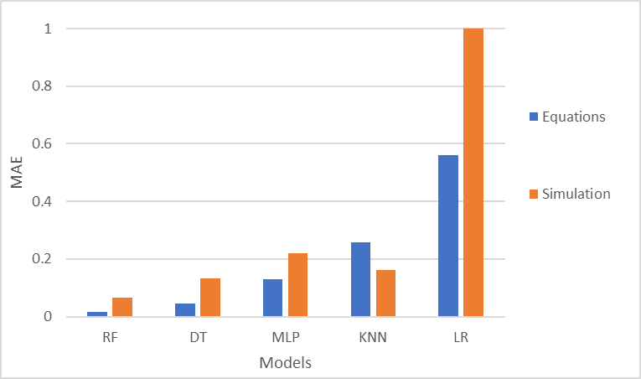
4. Result
4.1 PHASE ONE RESULTS
M/M/S Algorithms Comparison
19

Slide 21
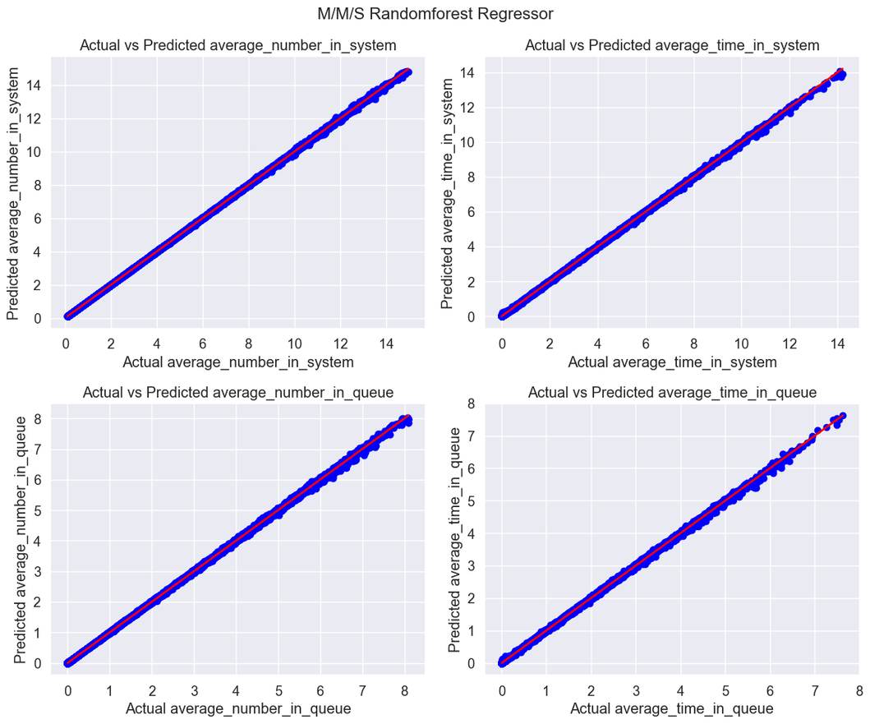
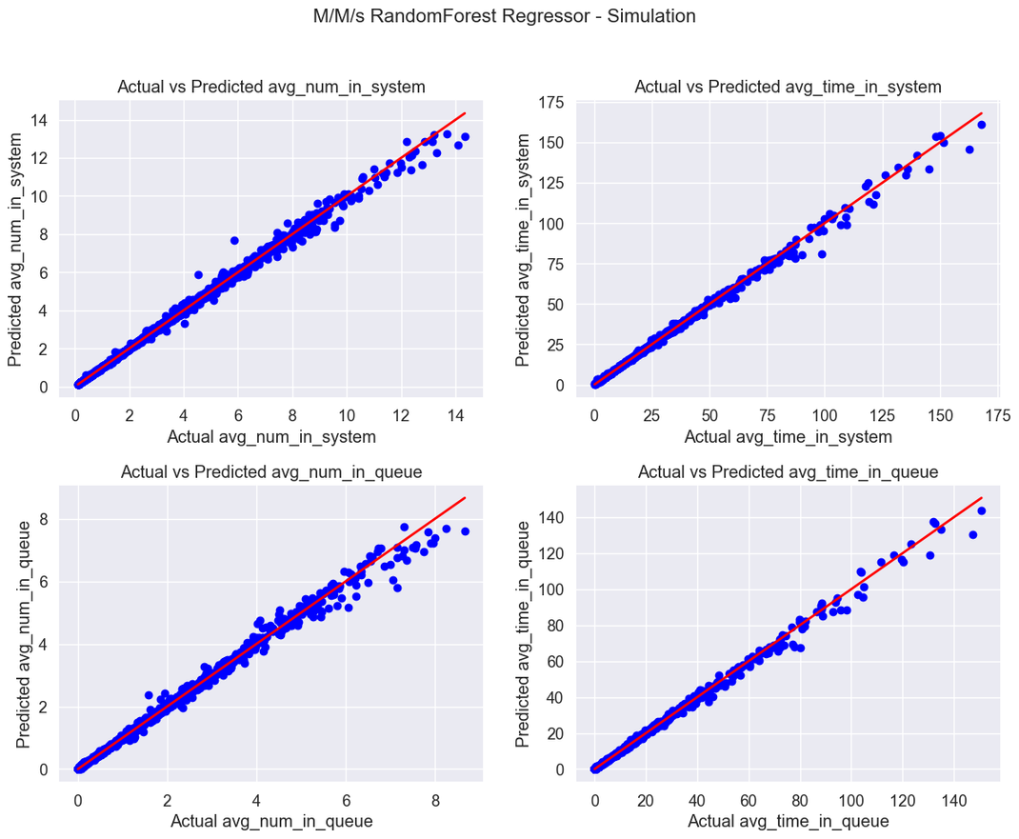
4. Result
4.1 PHASE ONE RESULT
M/M/S Random-forest Models
Equation RF Model
Simulation RF Model
20

Slide 22
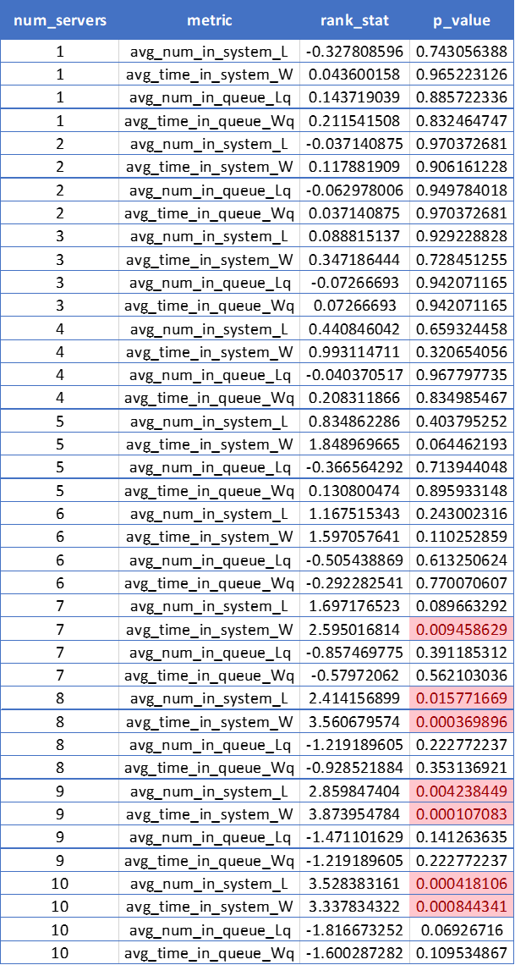
4. Result
4.1 PHASE ONE RESULTS
  M/M/S Models comparison
Wilcoxon Test
21

Slide 23
4. Result
4.2 PHASE ONE
Main findings
1
  Machine learning models can accurately predict queuing system behaviors, as demonstrated in our project.
2
  Simulation provides reliable data, especially in scenarios where theoretical equations are unavailable or impractical.
3
  Tree-based algorithms are the most accurate models in predicting Manufacturing systems
22

Slide 24
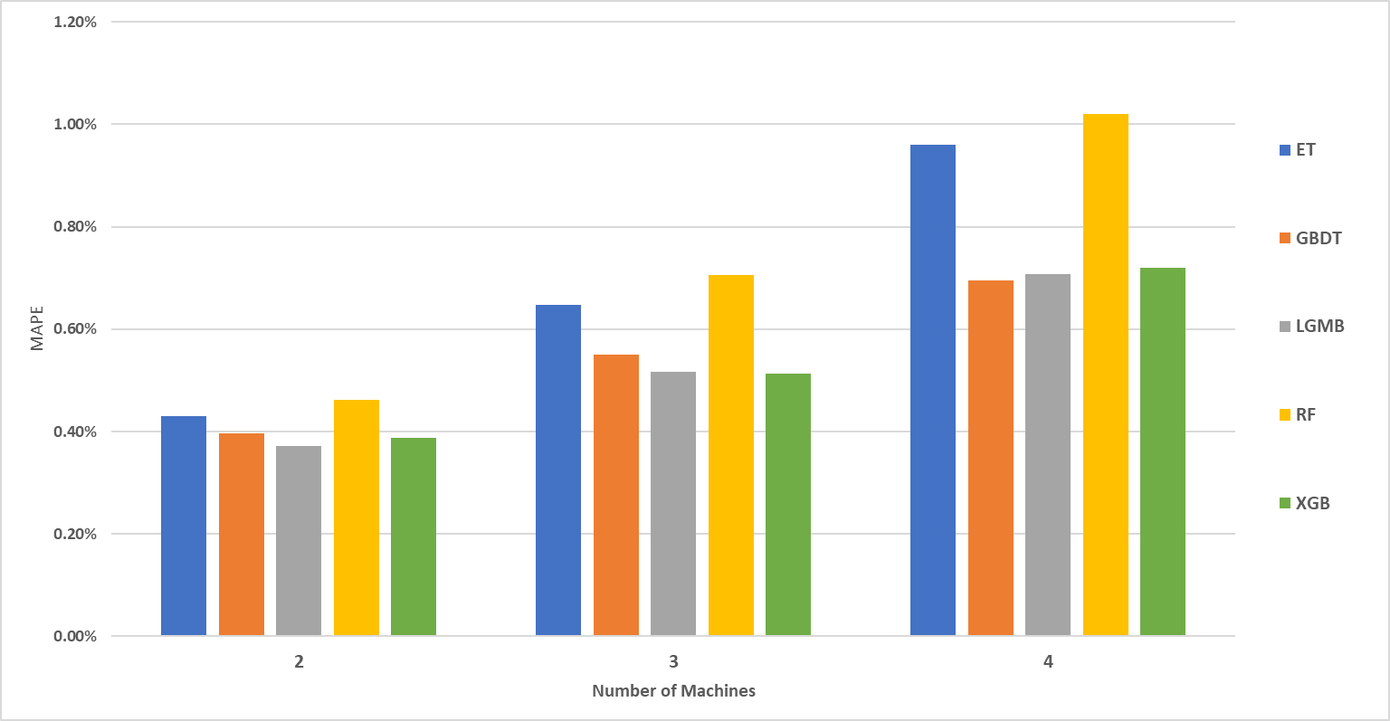
4. Result
4.3 PHASE TWO RESULTS
Avg_Throughput results
23

Slide 25
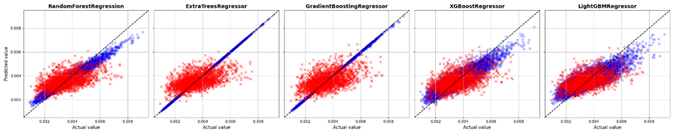
4. Result
4.3 PHASE TWO RESULTS
Throughput_Std results
24

Slide 26
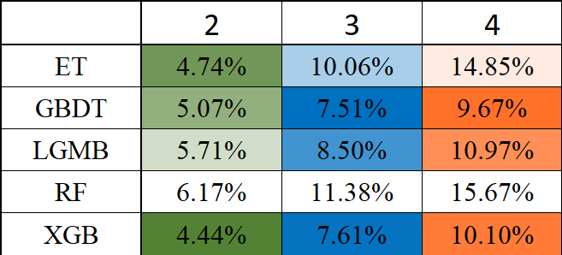
4. Result
4.3 PHASE TWO RESULTS
Avg_Buffer level results
M
Algorithm
25

Slide 27
4. Result
4.4 PHASE TWO
Main findings
1
Developed a framework for evaluating serial production lines
2
Gradient Boosting, XGBoost, and LightGBM performed well in predict avg_throughput and buffer levels.
3
Identified the need for better methods to predict variability metrics
26

Slide 28
5. Conclusion
5.1 Strengths and
Limitations
Strengths
Limitations
Development of a robust framework for evaluating Manufacturing systems
Limited Throughput_Std. prediction capability for tree-based models
Establishing a methodology that can be extended to evaluate production lines with varying configurations and parameters
Representation of low variability systems only (exponantially distributed).
The integration of simulation and machine learning
inattention to deep learning models
27

Slide 29

Acknowledgement

Slide 30
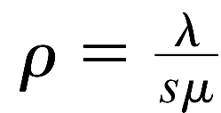
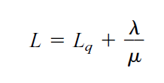
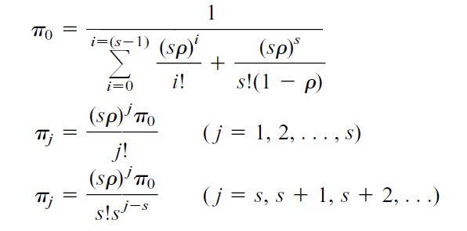




m/m/s

Slide 31
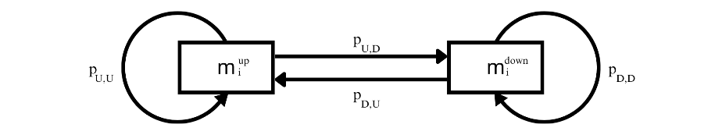

markov chain model
$$P= \left[\begin{matrix}p_{U,U} & p_{U,D} \\ p_{D,U} & p_{D,D}\end{matrix}\right]$$

Slide 32
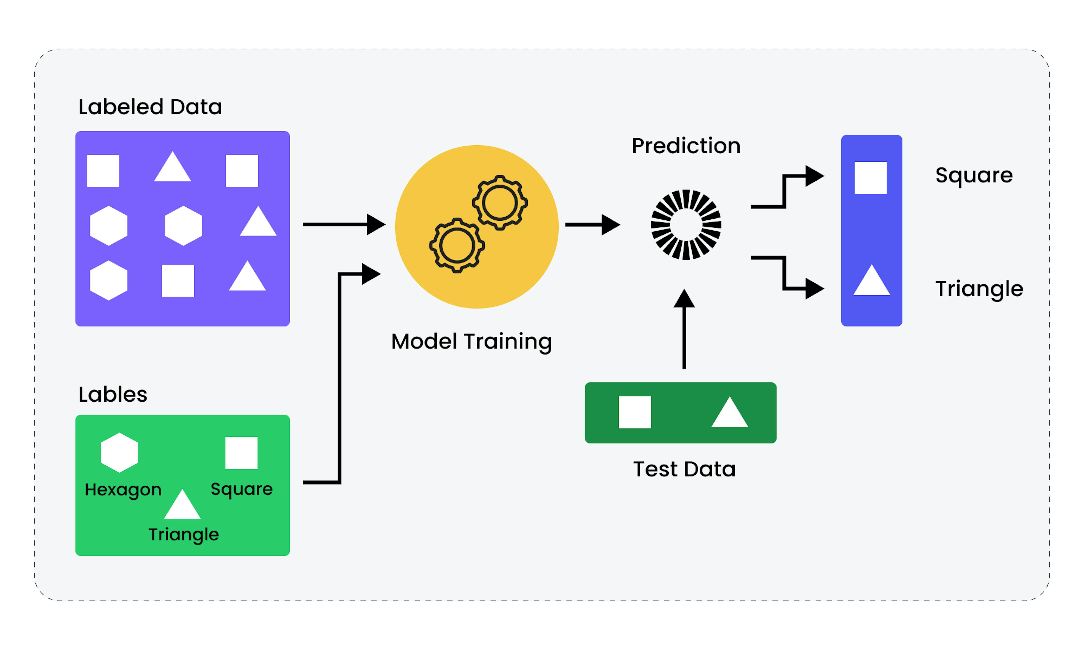
Supervised Learning

Slide 33
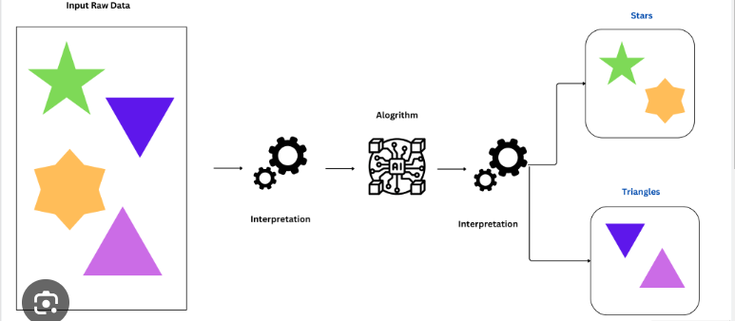
unsupervised Learning

Slide 34




Error metric

Slide 35
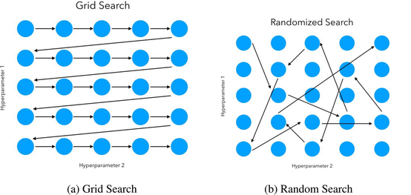
Hyperparameter Tuning

Slide 36
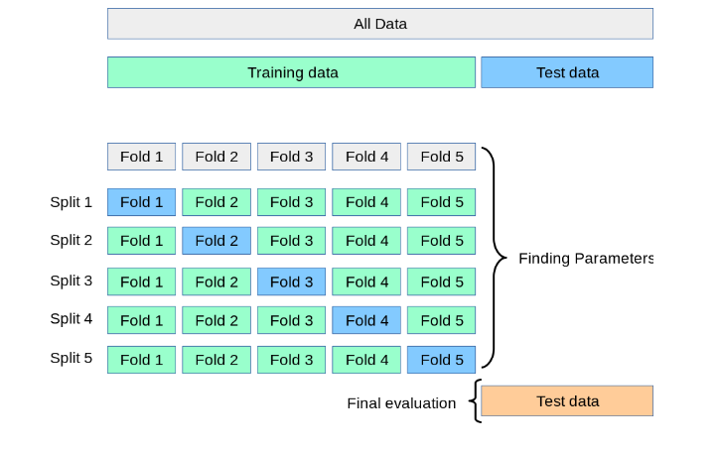
Cross validation

Slide 37
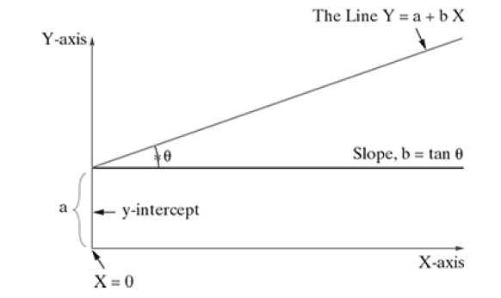
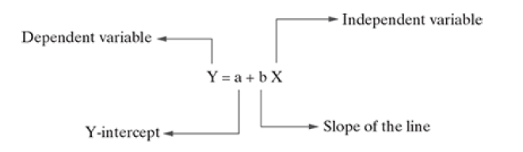
Linear regression

Slide 38
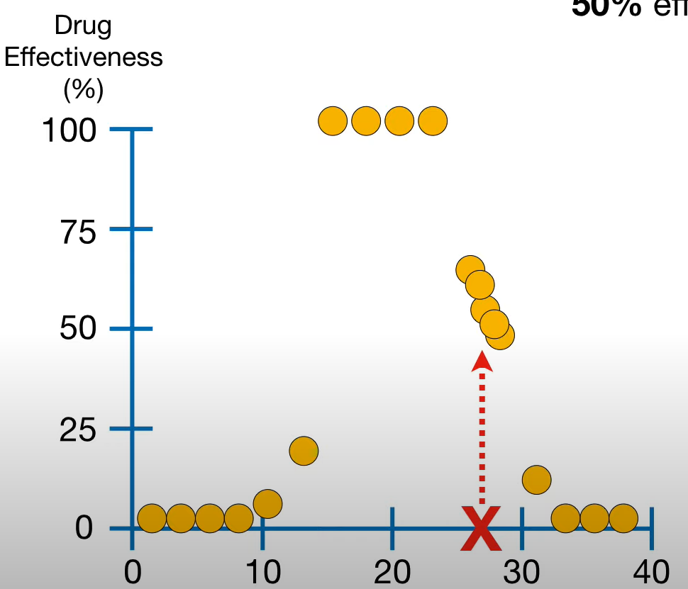
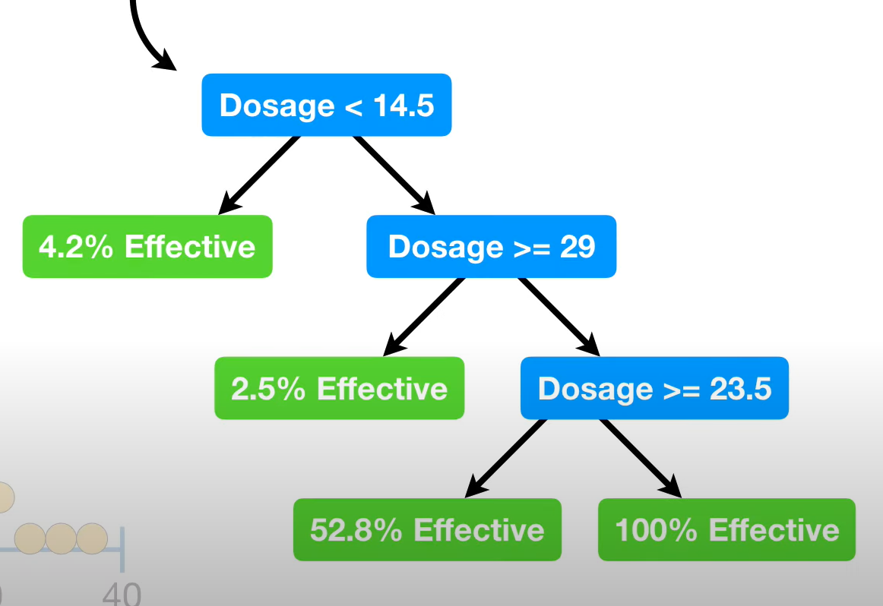
Decision tree regression

Slide 39
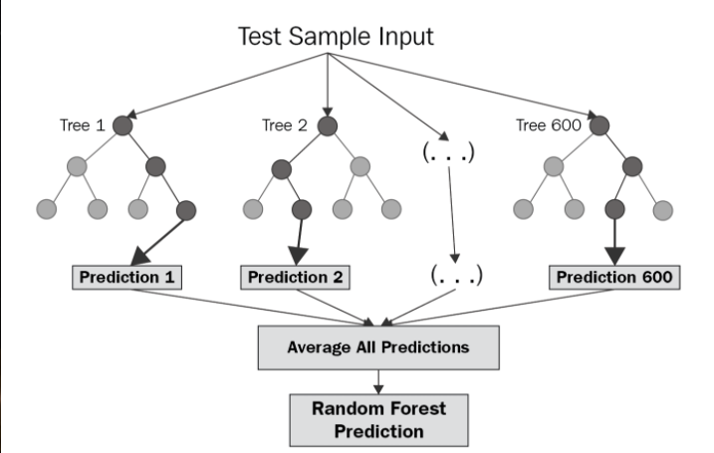
Random forest

Slide 40
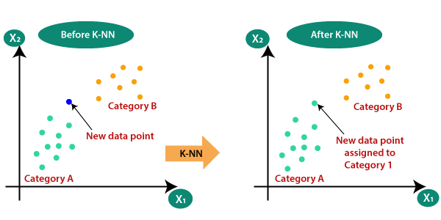
K-nearest neighbors (KNN)

Slide 41
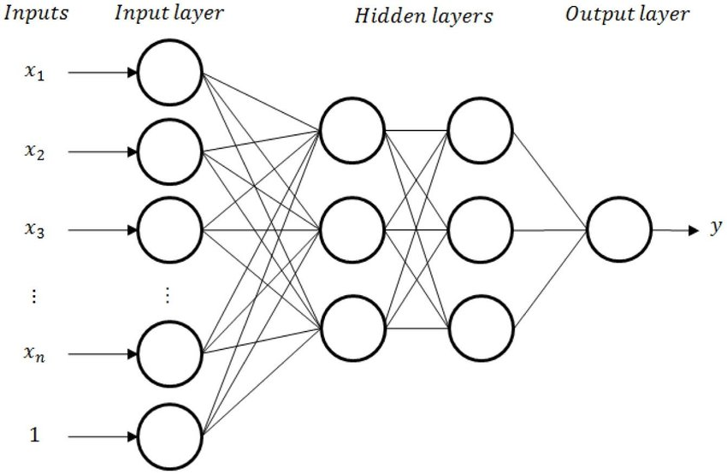
MLP Regressor

Slide 42
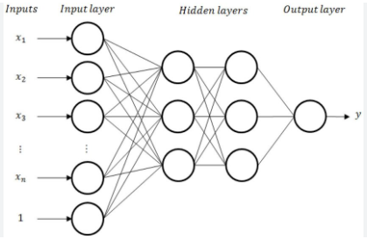
MLP Regressor

Slide 43
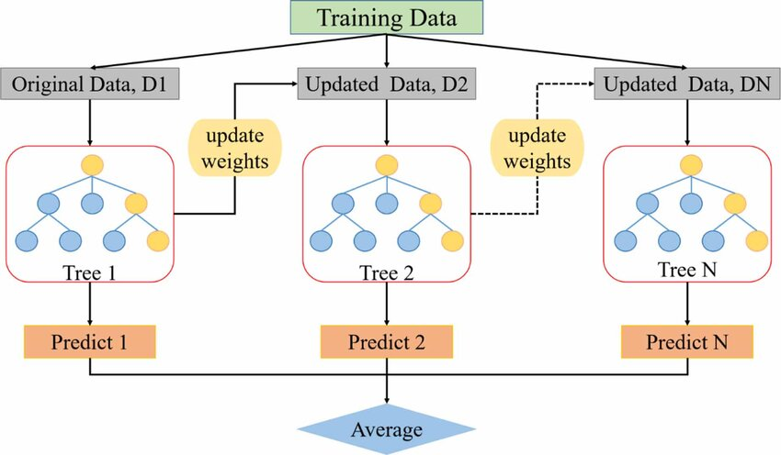
Gradient boosting decision tree

Slide 44
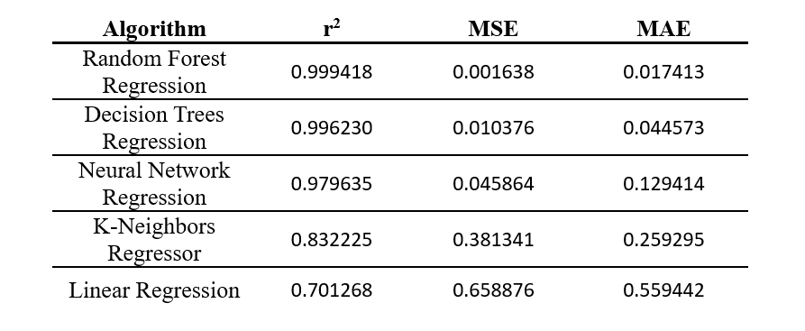
m/m/s Algorithms comparison
Equations

Slide 45
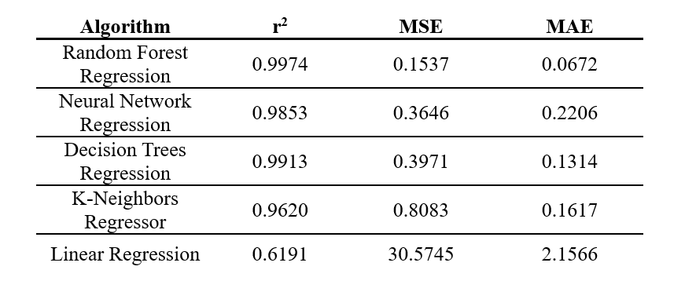
m/m/s Algorithms comparison
simulation

Slide 46
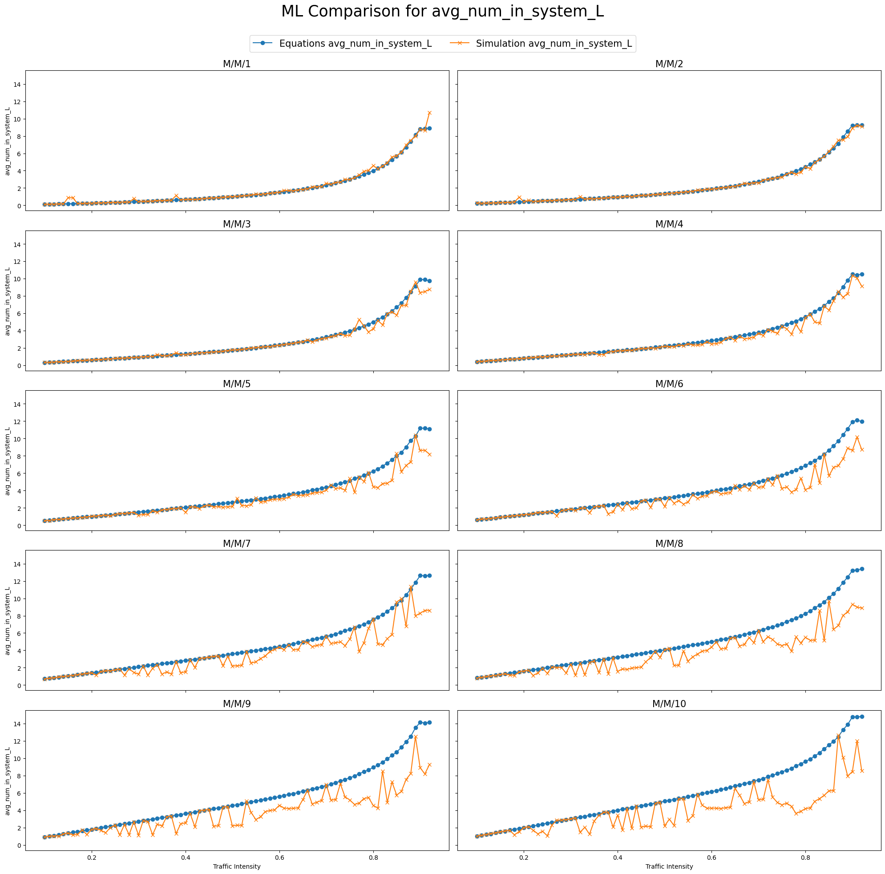
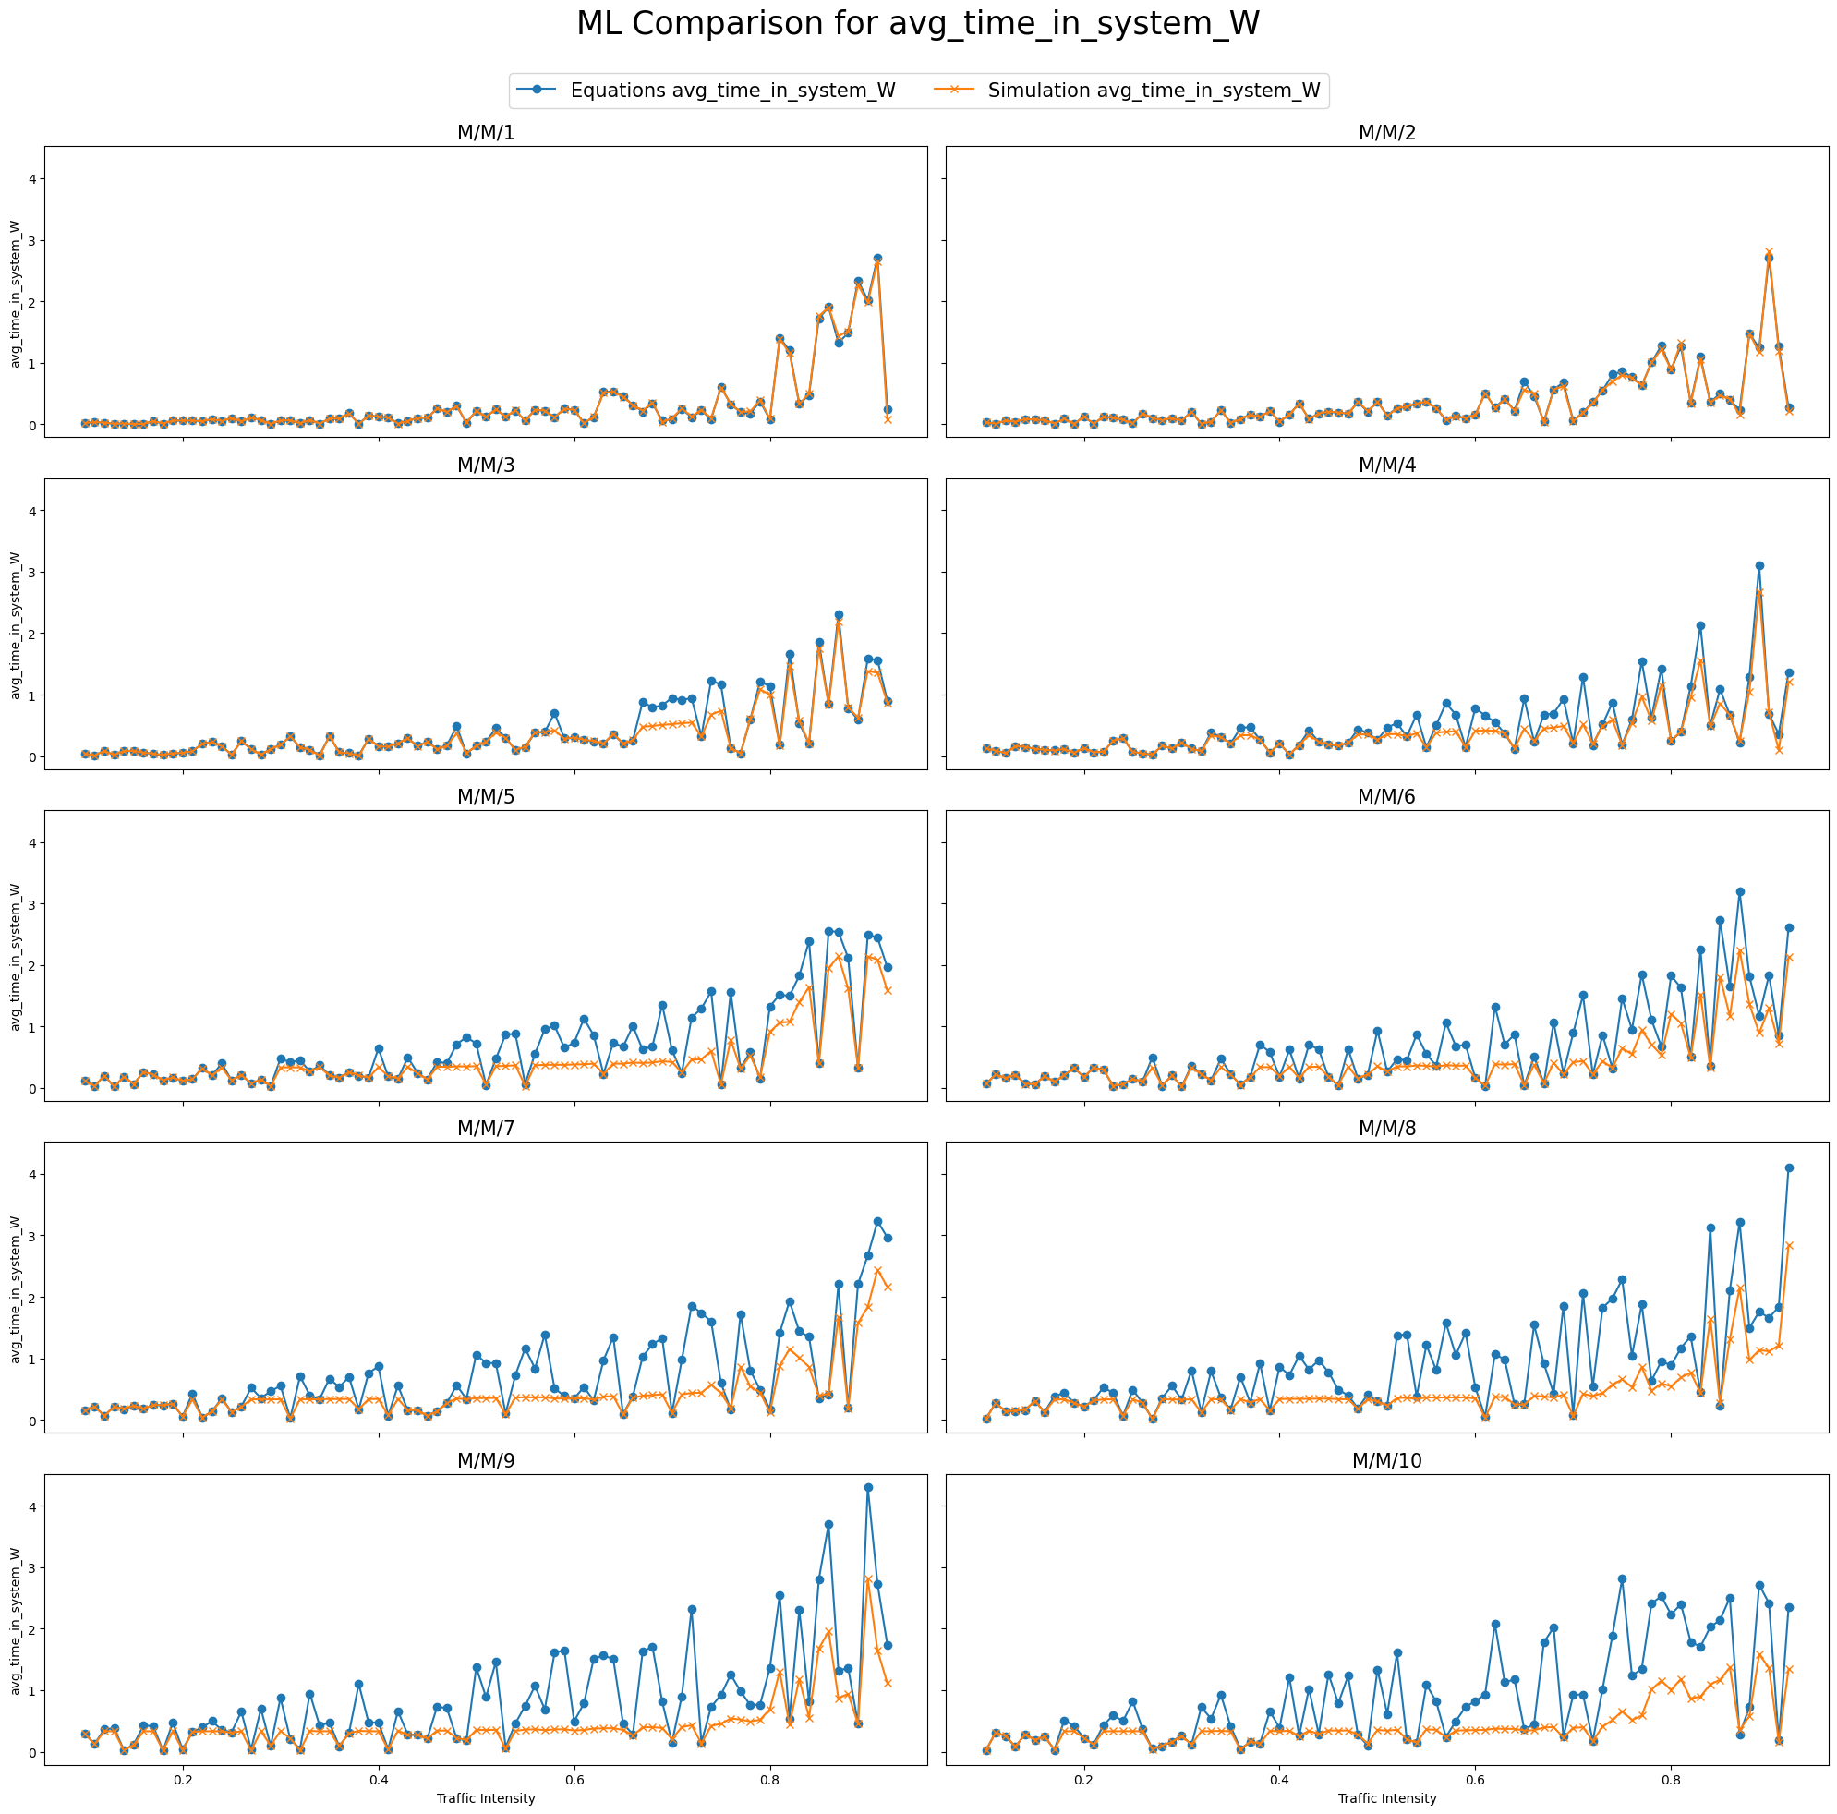
m/m/s models comparison

Slide 47
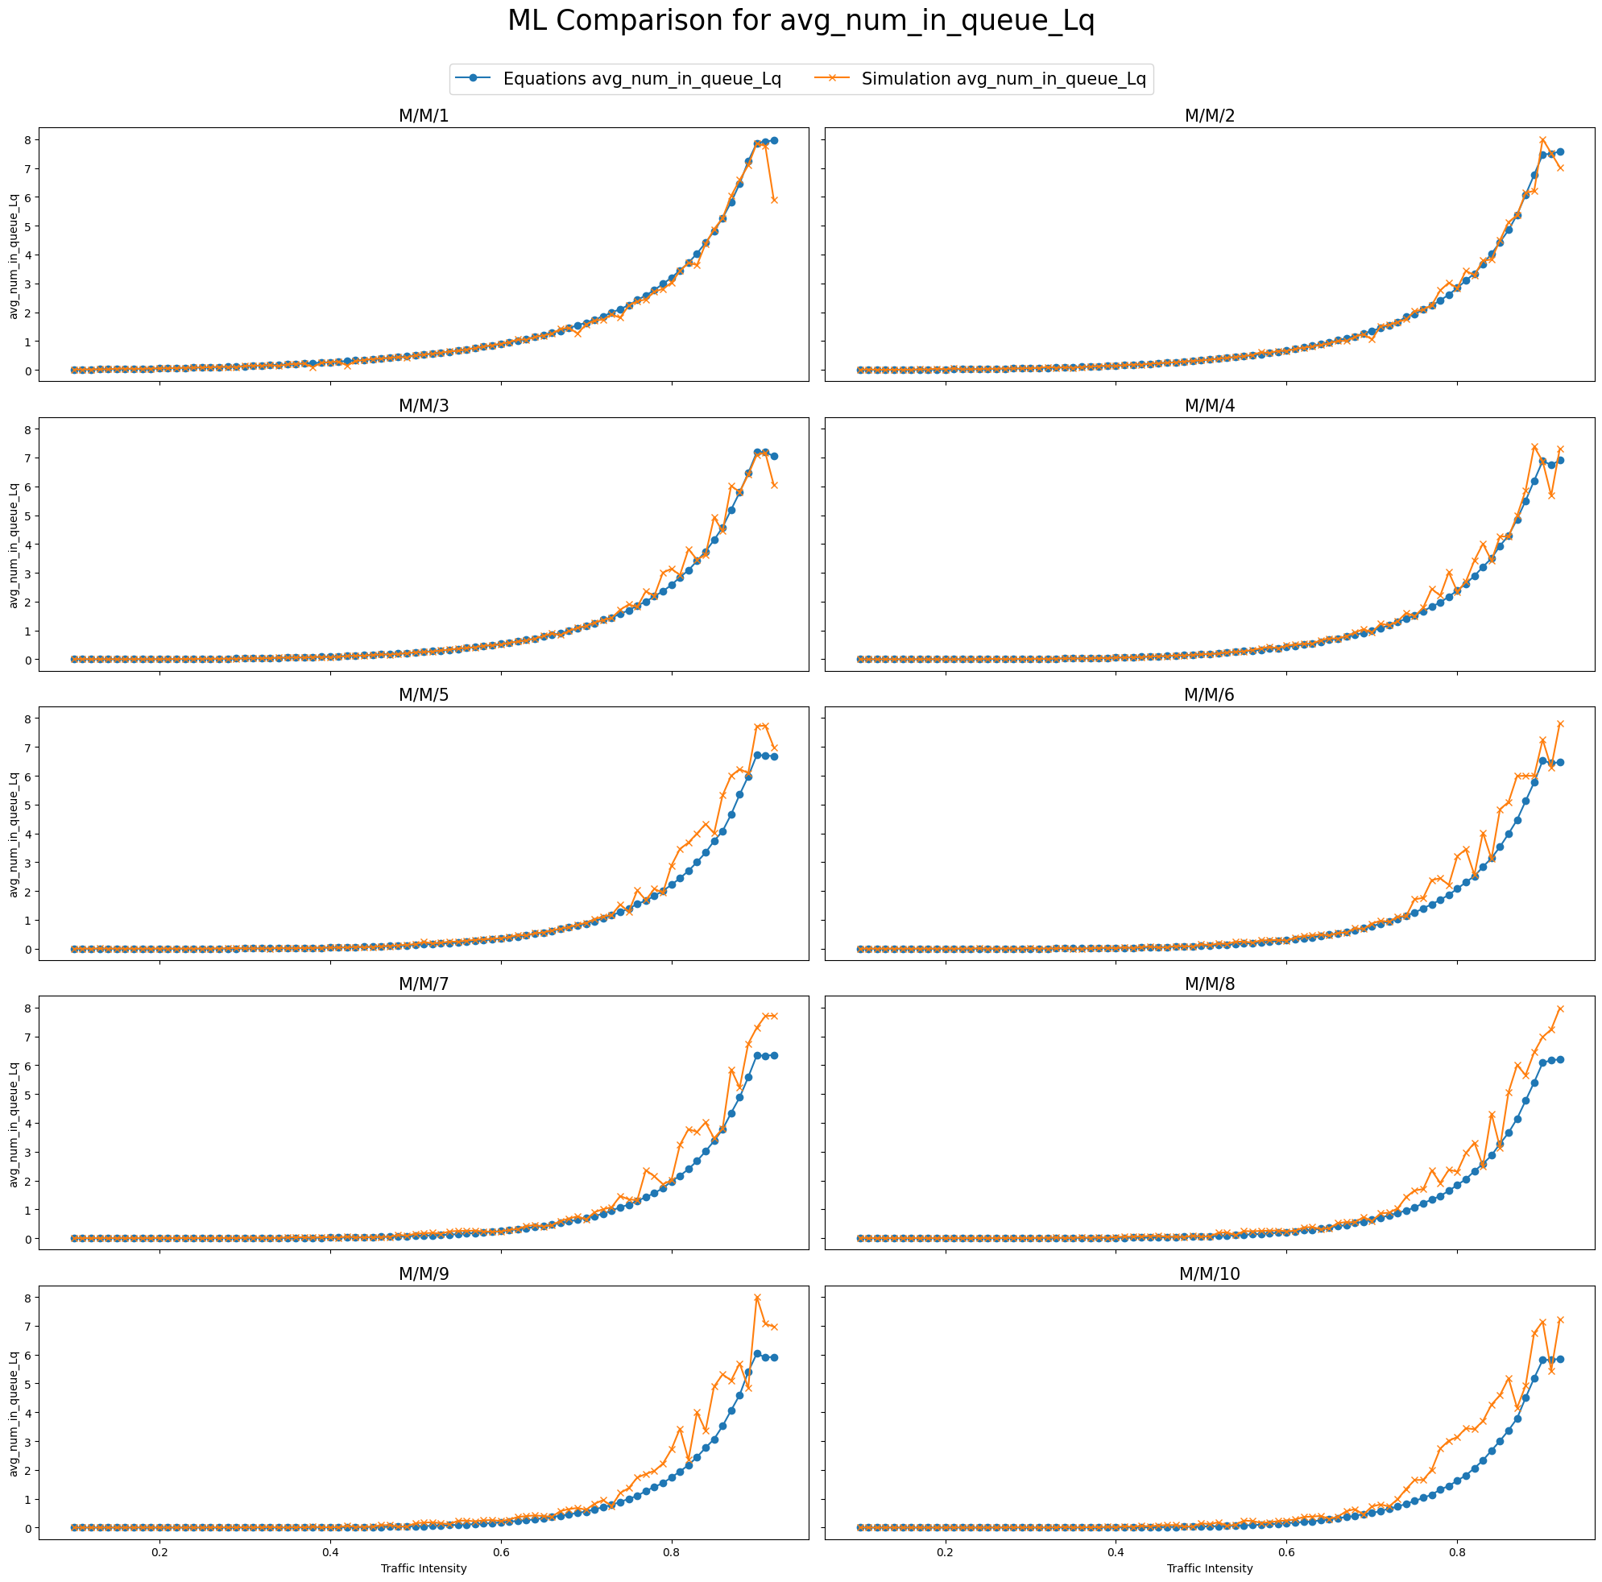
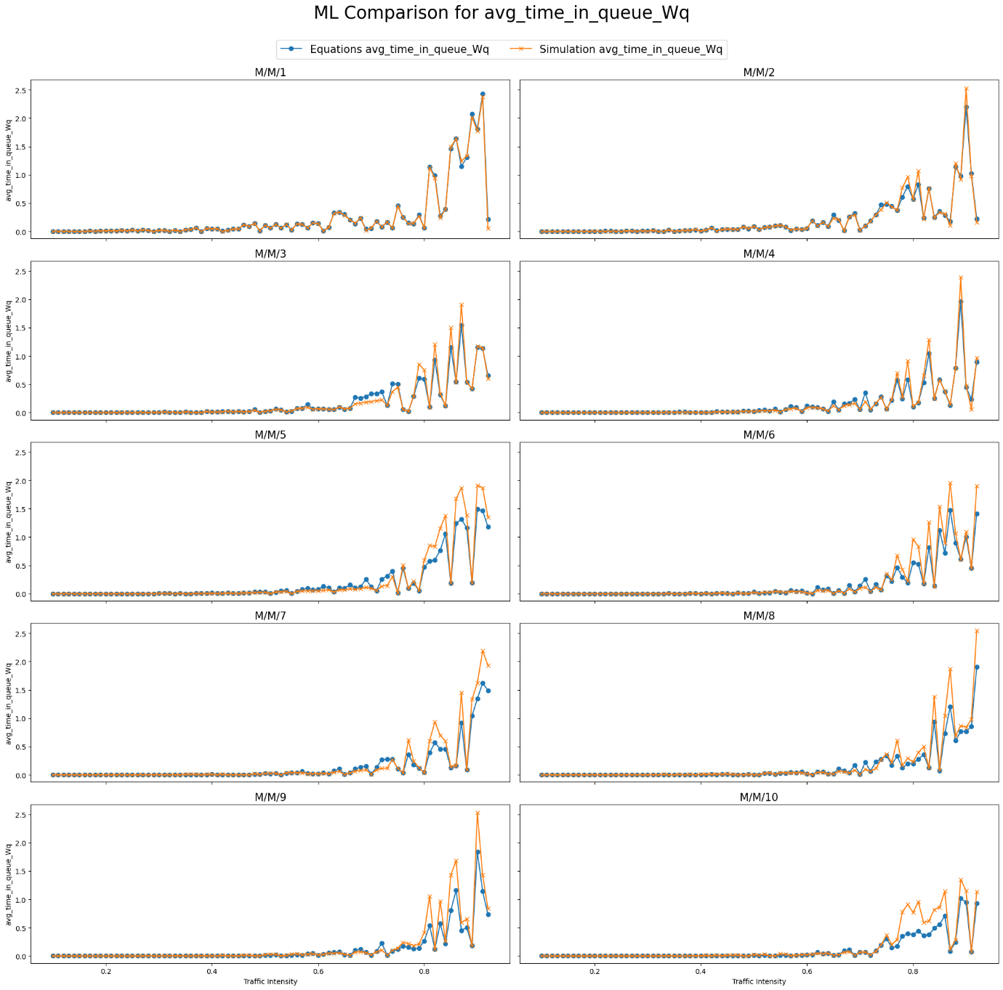
m/m/s models comparison

Slide 48
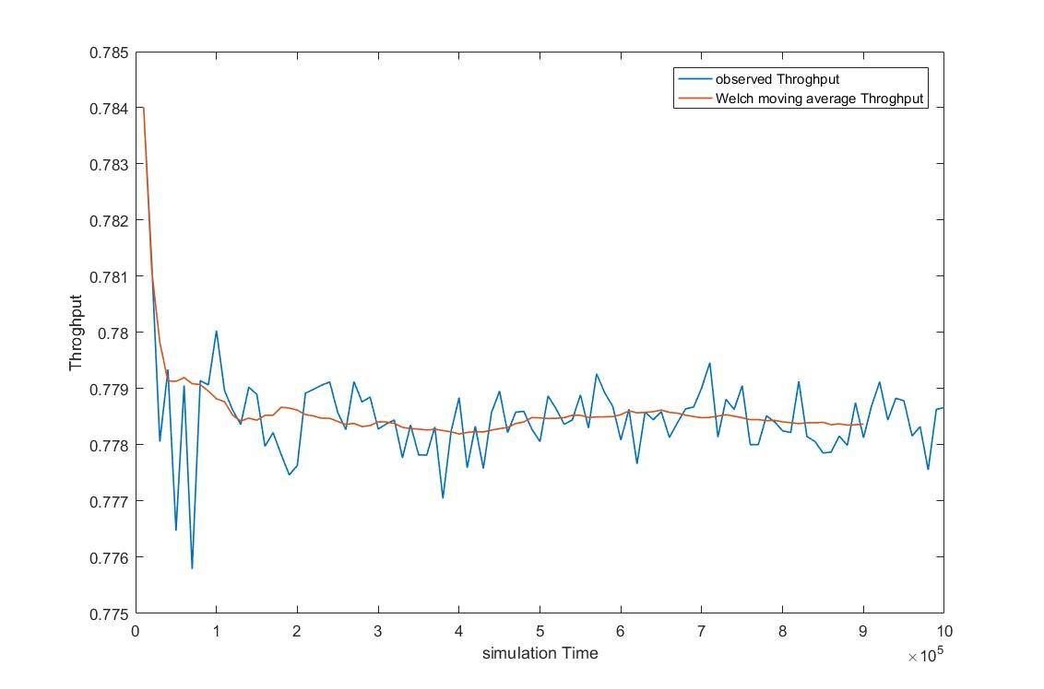
Simulation warm up time

Slide 49
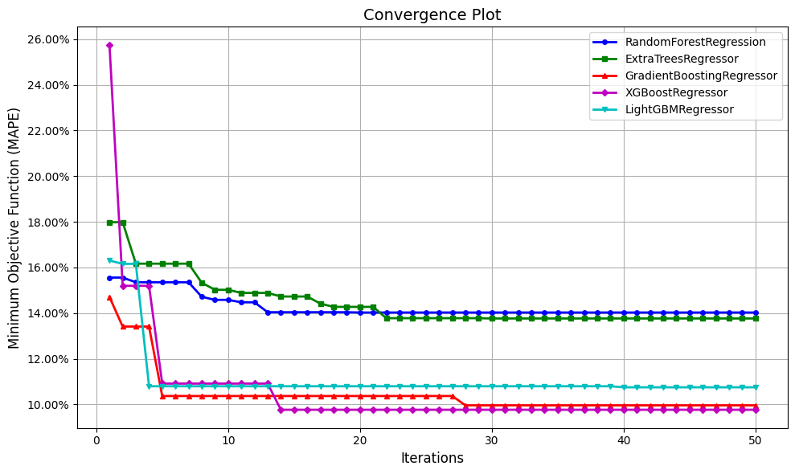
Hyperparameters tuning plot

Slide 50
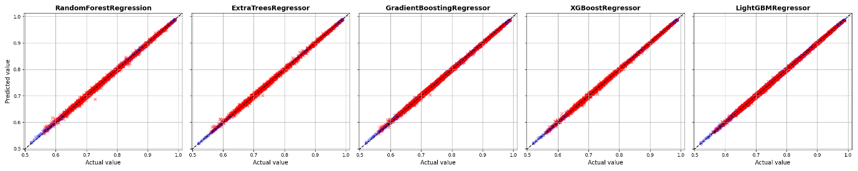
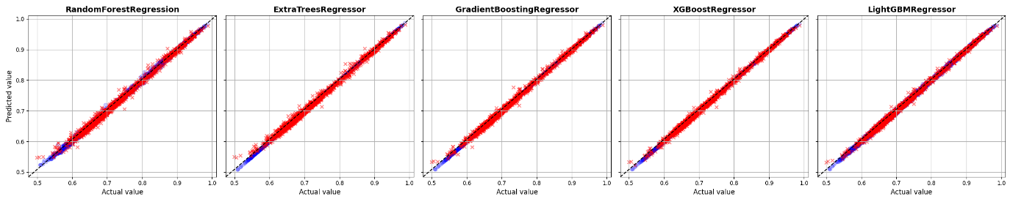
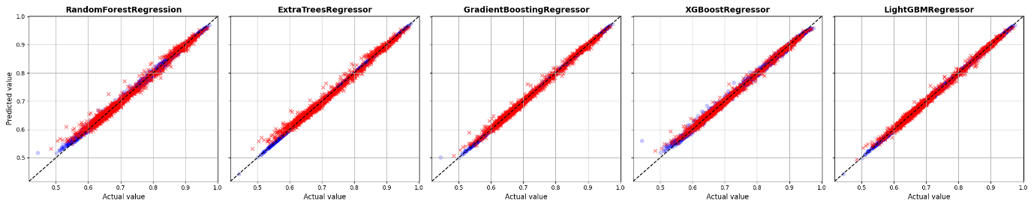
Hyperparameters tuning plot

Slide 51
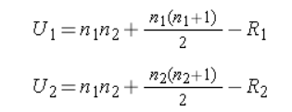
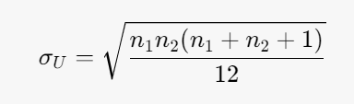


1. Parameter of Interest
The parameter of interest is the difference in the central tendency (median or general location) between the two independent samples.
2. Null Hypothesis
H0: The distributions of the two populations are identical, which implies that their central tendencies are equal.
3. Alternative Hypothesis
H1: The distributions of the two populations are not identical, which implies that their central tendencies are different (two-sided).
4. Test Statistic
The test statistic for the Wilcoxon rank-sum test is based on the ranks of the combined data from both samples. The Mann-Whitney U statistic is commonly used, which is calculated as follows:
1) Combine the data from both samples and rank the combined data.
2) Calculate the sum of ranks for each sample.
3) Compute the U statistic using the formula:
where R1, R2 are the sums of the ranks for samples 1 and 2. the smaller of U1 and U2 is used as the test statistic of U
5. Reject H0 if the sample size is large, the U statistic can be approximated by a normal distribution. So, we reject H0 if Z is greater than the critical value from the standard normal distribution for a two-sided test or if or if the p-value is less than 0.05.

