Slide 1

Middleware
Prepared by
Mazen Alkoa’ & Ahmad Nabulsi
Submitted to
Dr. Sufyan Samara
A documentation report of graduation project (66581/3)
Computer Engineering Department
Faculty of Engineering
An-Najah National University

Slide 2
Introduction
In our project we have developed a middleware that can be used from other applications to interact with each other.
It provides a higher-level building block for programmers than Application Programming Interfaces (APIs) such as sockets that are provided by the operating system.
This middleware hides more complex work from the programmers and reduces the responsibility of synchronization between different machines.

Slide 3
Our project isn’t the first project that develop a middleware, many different similar projects have done before, but in different sides and different types of middleware, some use message passing interface for communications ,others use remote procedure calls and different types of middleware.
We have used message passing interface for the communication due to different reasons that are related to the nature of the project .

Slide 4
In our project the main objective of the middleware is to provide the developers of games the ability of making their applications to be run onto different machines and the interaction between their games will be done through our middleware.
We have searched for the requirements of games and we found that the most perfect way for communication is message passing interface ,because sending pictures and movies may increase the overhead on the application.

Slide 5
Objectives
To make the communication between two mobile phones easy.
To make flexible middleware that can be used for different applications.
-> And in our project we will make a test game that runs on different machines and the middleware will take care of the communication.

Slide 6
Methodology
We have divided the work into two main parts , the first part is a middleware in distributed system and second is in centralized system.
Now we will take about the first part and later we will take about the second part.
In the first part we have used mobiles with android operating system.

Slide 7
We divided the work into different stages. In the first stage we have developed an application that can be used for sending messages between two mobiles.
Our application is divided into three modules, the first module is for scanning for devices and inform the user about the paired devices.
The user can select previous paired devices or can scan for other devices

Slide 8
The second module is for establishing the connection and transfer this connection to the third module that takes
this connection to apply the interaction between devices.
As a result of this stage we have a good implemented application that takes care of communication and sends messages between different devices.

Slide 9
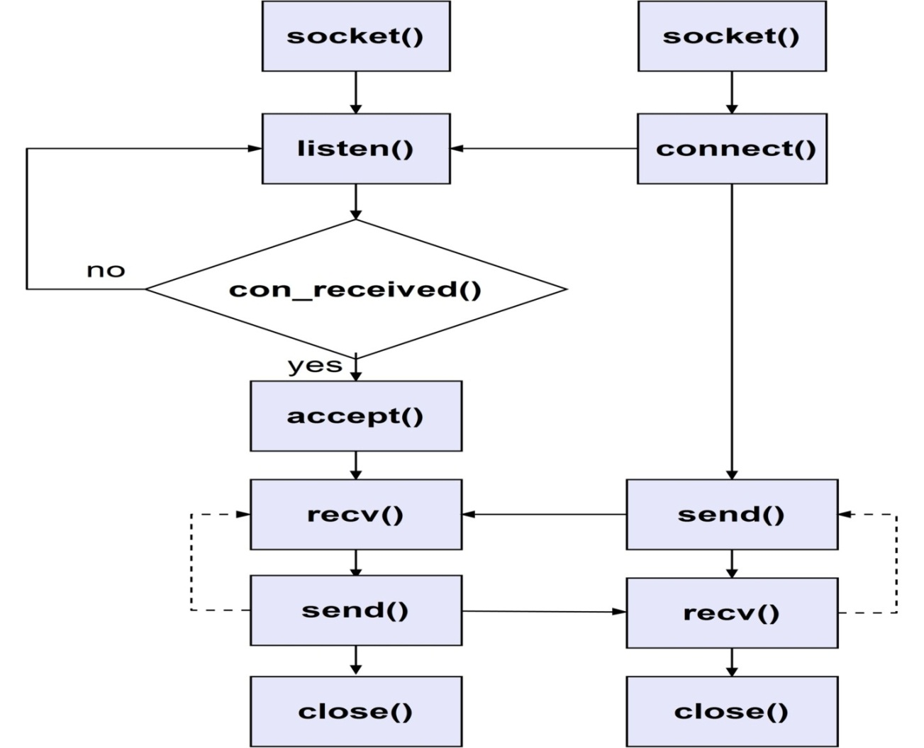
Here is the flowchart that illustrates the communication activities

Slide 10
In the second stage we tried to find a game that is implemented in a single machine but can be played in different machines and we tried to analysis the game to find the control units that control the flow of the game.
In the third stage we have added the communication to the game.

Slide 11
Middleware work
In this stage we have made only one module to be access from the user to send and receive messages.
Other modules are hidden from the user and he don’t have to know how they work
The work for the user is easy only one function from the main module launches other modules and takes care of all interactions
Other modules provide good synchronization.
This is the longest stage and it is the most difficult one.

Slide 12
Packaging
After we have finished the communication and the playing parts, we began putting our application into one package to be used later from other applications.
We have used .jar format to make the user hidden from the implementation by putting only the classes in this jar file.
In this stage we have encountered many problems and difficulties related to android environment, but finally we solved these problems.

Slide 13
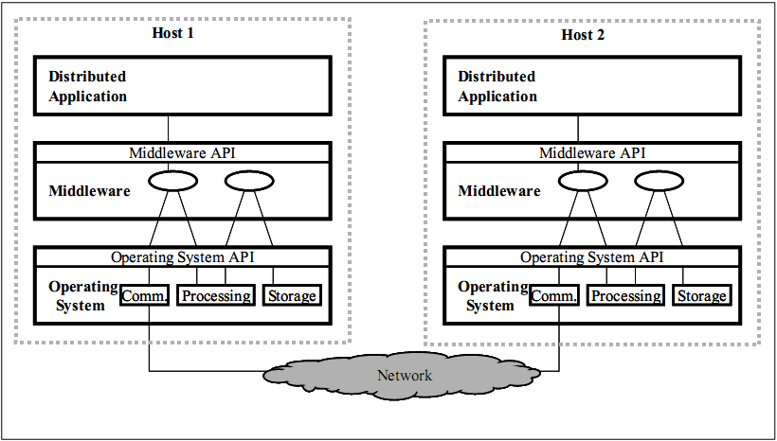
Finally we have a good middleware that are used with no coordinator that appears as the following figure:

Slide 14
Now we will talk about the second part of the project which is middleware using TCP communication that acts in centralized system with a computer (server) as the coordinator.

