Slide 1


Presented By:
Manar Haji
Sama’ Hajeer
Supervised By:
Dr. Emad Enatsheh

Slide 2
Outline
General Overview
Features
Motivation
ObjectiveTools and Technologies
Challenges
Futurere Work
Conclusion

Slide 3
General Overview
Steps is a mobile application, which use android in order to improve Sign language understanding.
could be used to help poor hearing children learn basic ABC's and numbers and making it more interactive .

Slide 4
Motivation
Mobile apps allows the student to participate in the story, develop empathy to experience outside their current realm of understanding.

Slide 5
Motivation ... cont
Deaf and hard of hearing children's difficulty in learning alphabet is sometimes related to the limited resources and the ways that schools and teachers traditionally had to represent and teach this subject.

Slide 6
Objectives
The main goal of our app is to improve education in more powerful learning experience by:
Offering students an easy way to link the letter with its sign.
Providing the first step to begin the education journey.

Slide 7



Tools and Technologies

Slide 8

Features
Includes two parts, one for Child and the other for Parent

Slide 9
For Child
1
Daily Adventure
2
Free Choice

Slide 10
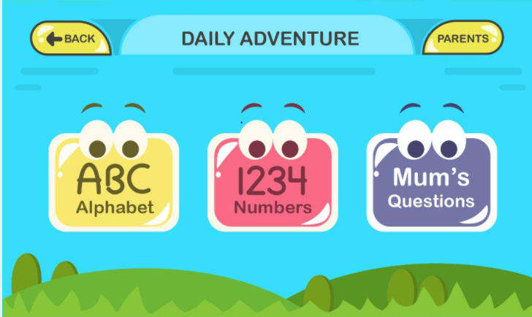
Child
Daily Adventure
1
Alphabet
2
Numbers
3
Parent Questions

Slide 11
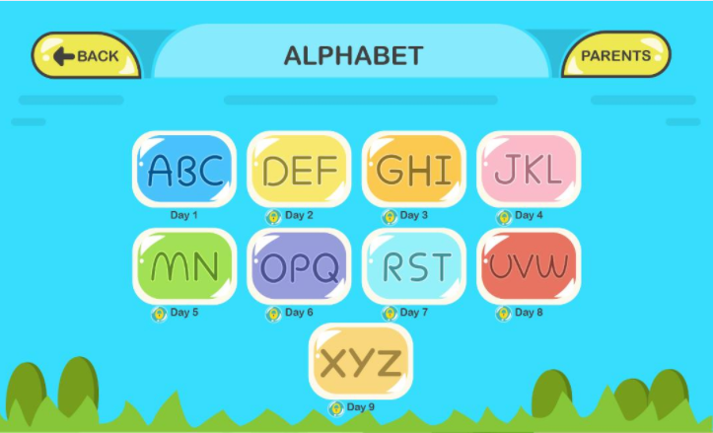
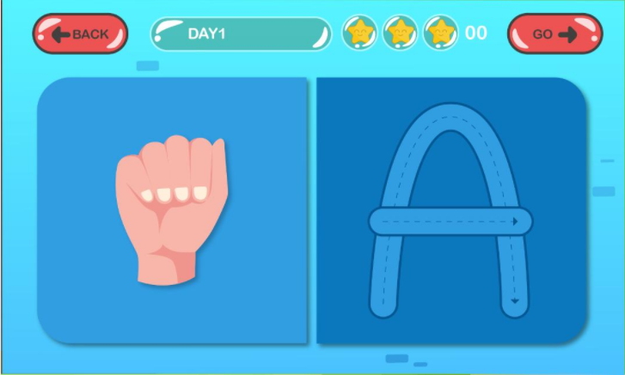
Child
Daily Adventure
    Alphabet /Numbers
The child can learn everyday 3 alphabet .
Tracing

Slide 12
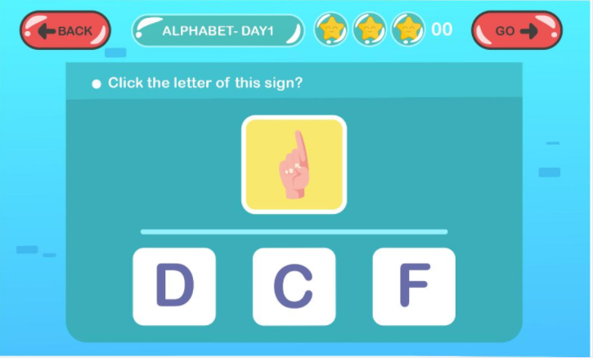
Child
Daily Adventure
    Alphabet /Numbers
The child can learn everyday 3 alphabet .
2. Find my letter game

Slide 13
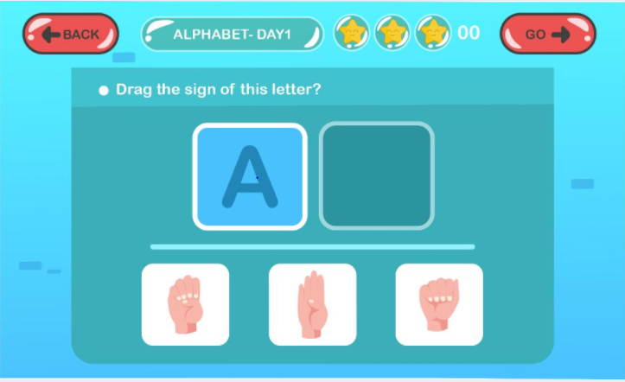
Child
Daily Adventure
    Alphabet /Numbers
The child can learn everyday 3 alphabet
3. Drag my sign

Slide 14
Child
Daily Adventure
    Alphabet /Numbers
After each day there is a Quiz
منار هون انت اشرحي

Slide 15
Child
Daily Adventure
    Parent Questions
The child can learn by playing games that has been designed by his parent.

Slide 16
Child
Free Choices
The child can practice by playing our whole games at anytime he want.
A -to- Z
1 -to- 20

Slide 17
For Parent
1
Add new child
2
Update information
3
Child performance
4
Create new game

Slide 18
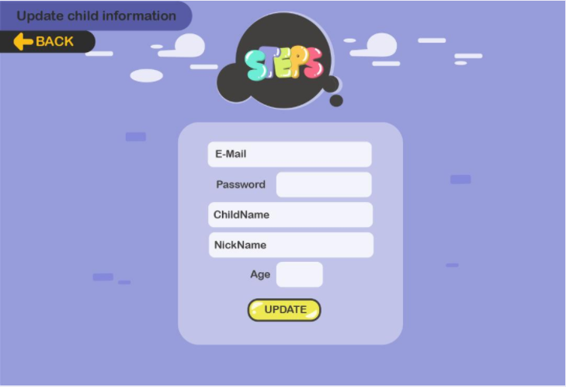
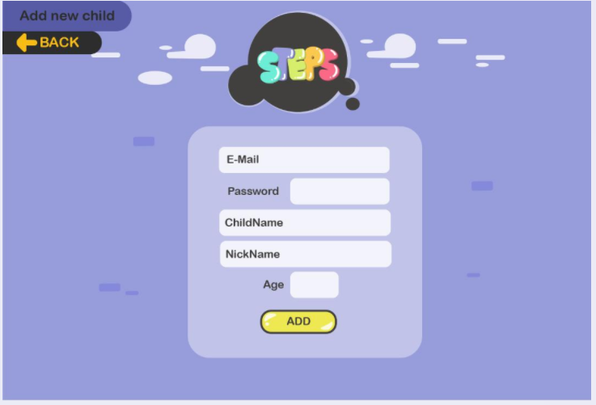
Parent
Add new Child and Update

Slide 19
Parent
Show Child Performance
The parent can follow up child improvement
(accomplished levels(dais)and his weakness letters)

Slide 20
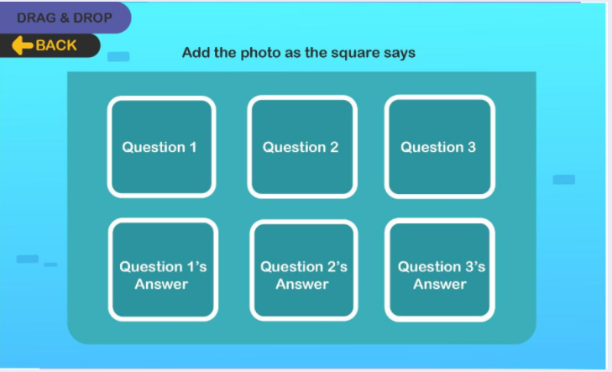
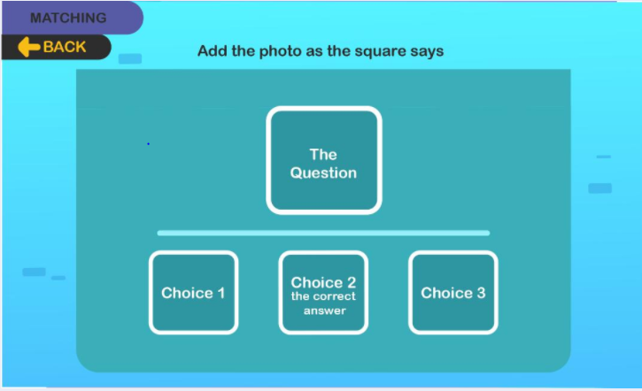
Parent
Design new game
The parent can design games for their child at any topic they want

Slide 21

C allenges\منار هون كمان اكتبي
1
Time
2
Database

Slide 22

Futhre Work
Improve the performance of our app.
Include additional subjects like everyday vocabulary , mathematic or another language that could help students in different classes.
Include image processing to detect the signs dynamically and at the time.

Slide 23
Conclusion
Finally, we hope that Steps will help any poor hearing child to learn their language in a way that is easy and simple .

Slide 24

Thank you

