Slide 1
Planify
Structured Learning, Reimagined
👤 Salahaldeen Tanbour
👤 Mohammad Ahmad
Supervisor: Dr. Aladdin Masri

Slide 2
Why Roadmaps Matter?
🧠 Too much resources, overwhelming
👥 Rely on structured content:
Videos 🎥
Articles 📚
Mentors 🧑‍🏫

Slide 3
Guided Sequence of Steps 🗺️
1️⃣➡️2️⃣➡️3️⃣

Slide 4
The Solution
Planify
Makes that structure:
🕹️ User-driven
🧏‍♂️ Accessible.

Slide 5
Planify: Platform for Building🛠️, Sharing📤 Roadmaps

Slide 6
Users Can:
Create
& Customize
🎨
Enroll 📝
Share📤

Slide 7

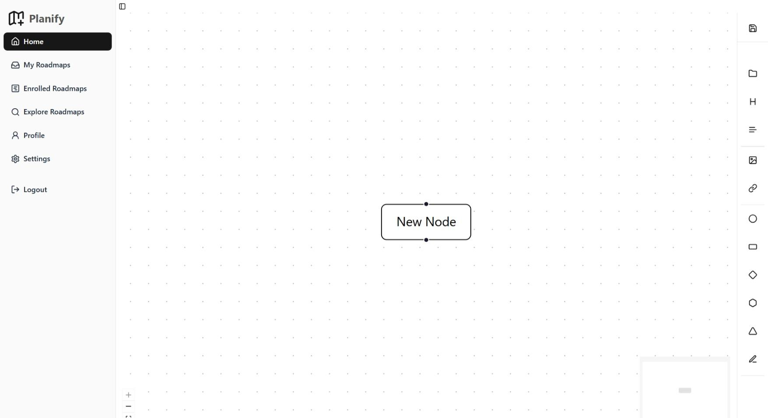
Drag & Drop

Slide 8
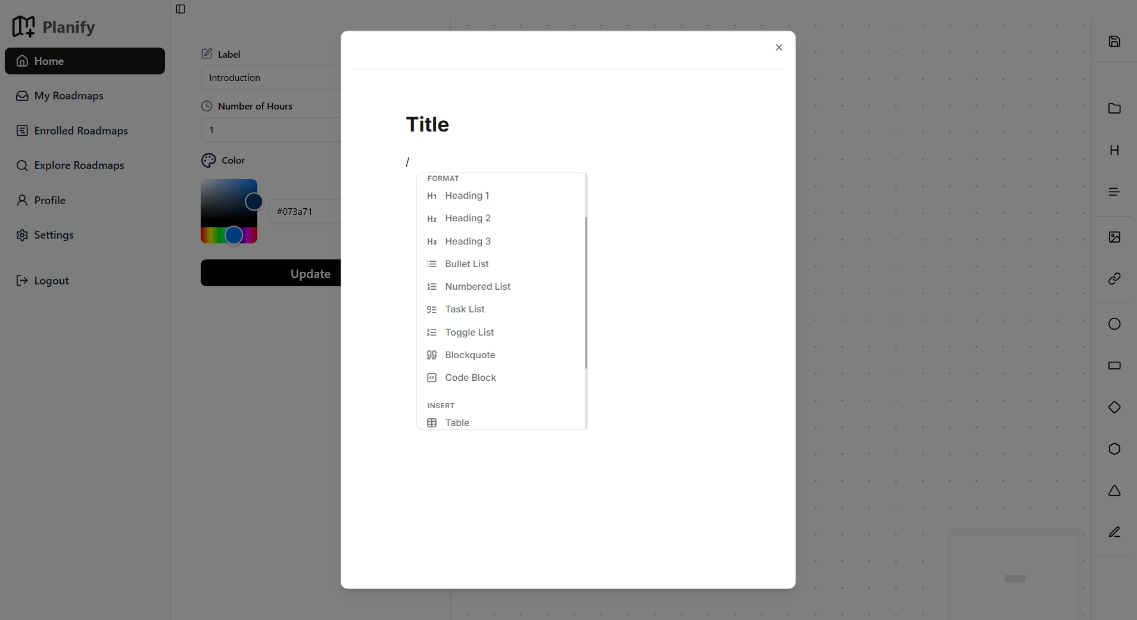
Nodes Hold Content

Slide 9
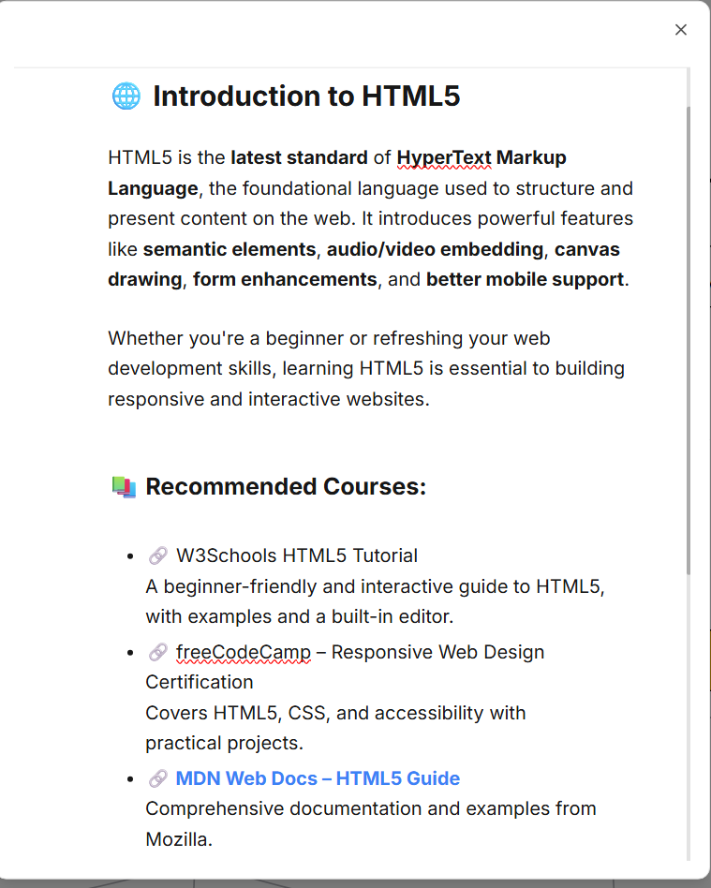
Markdown Text editor

Slide 10
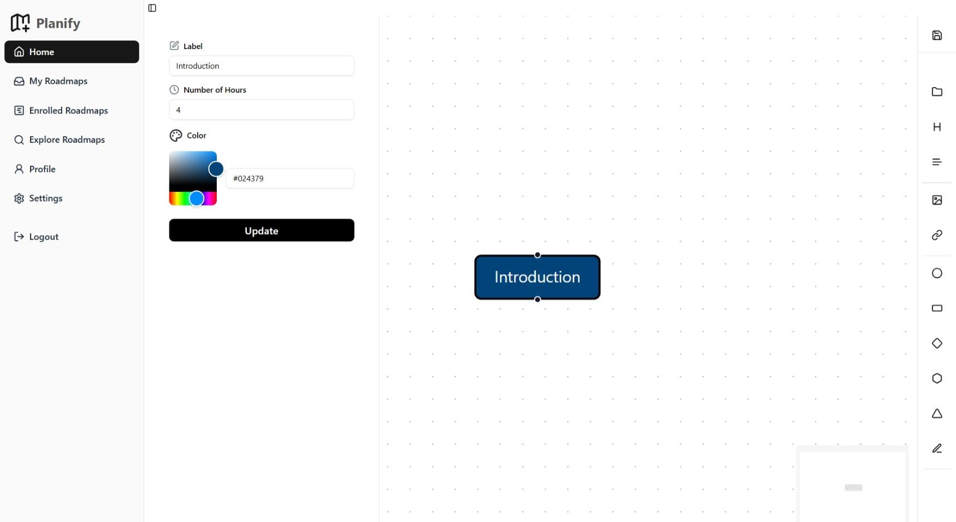
Customize

Slide 11
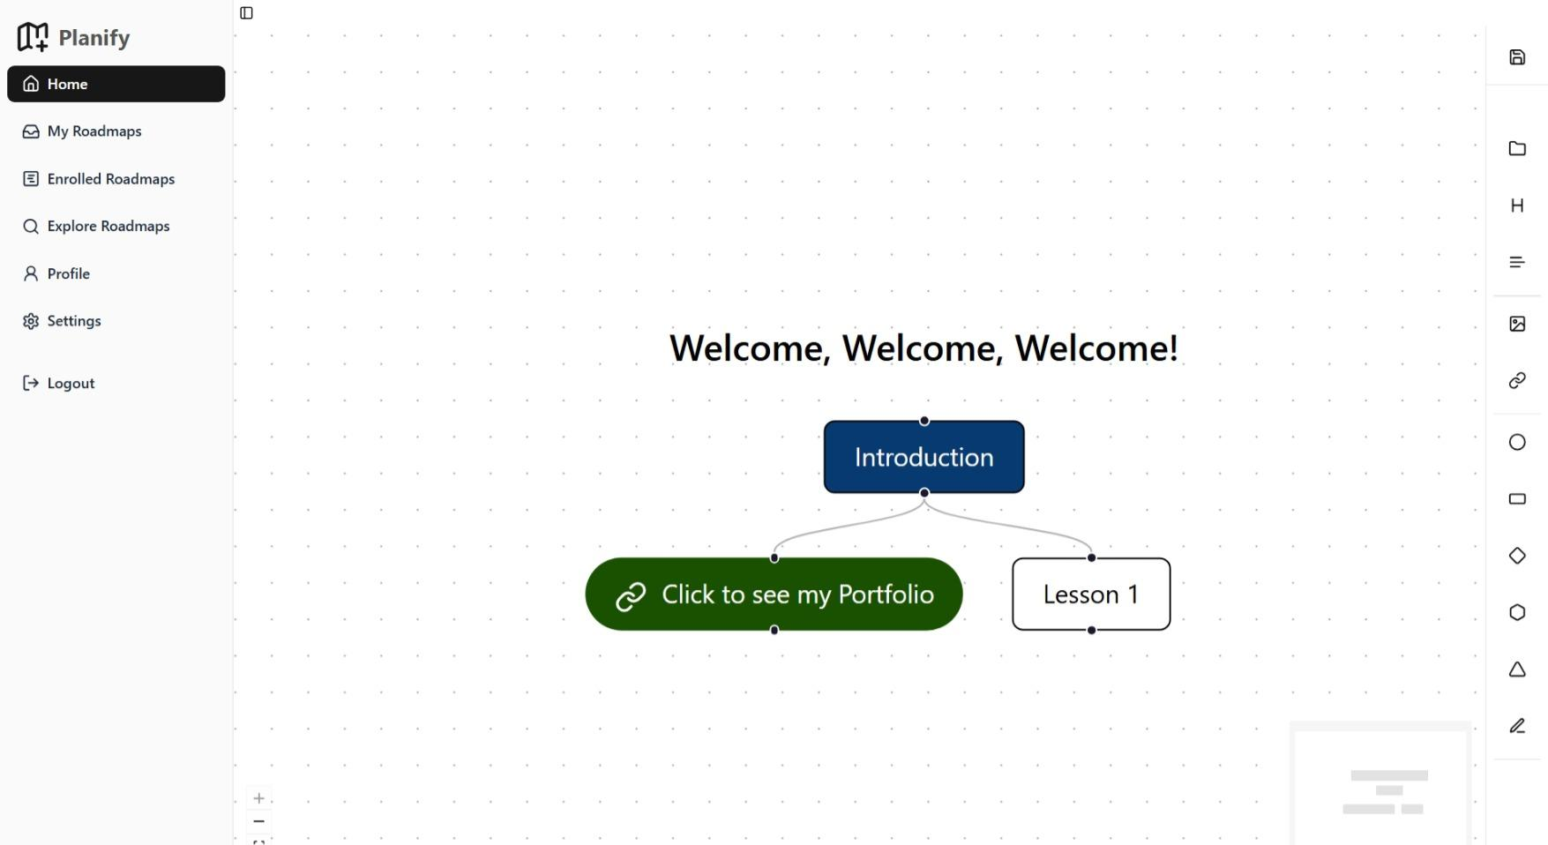
Connect Nodes

Slide 12
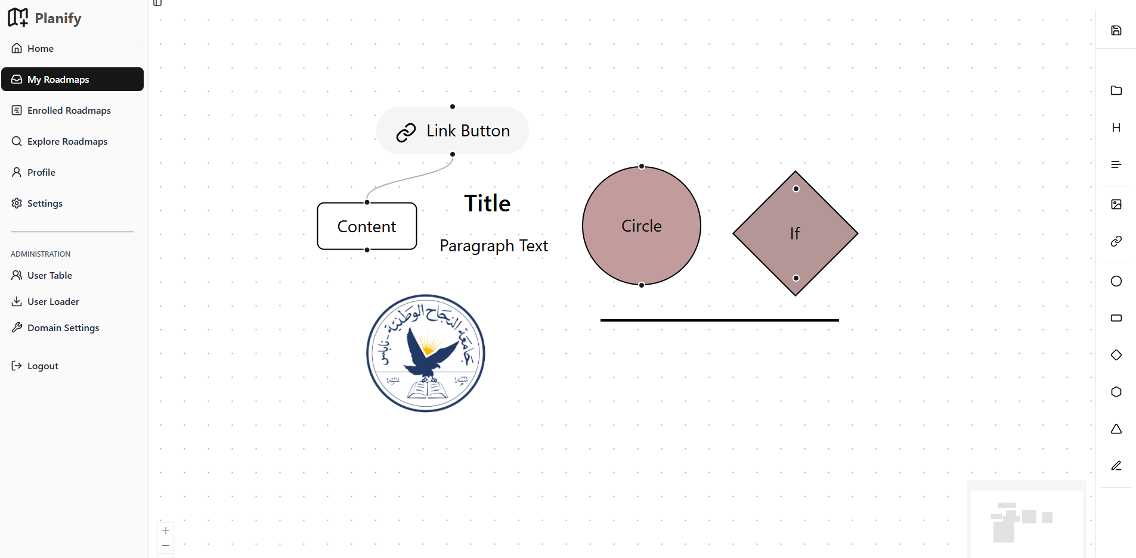
Many Elements

Slide 13
Roadmaps
are NOT Static
Users can enroll in roadmaps
🖱️Interactive
🤝Collaborative

Slide 14
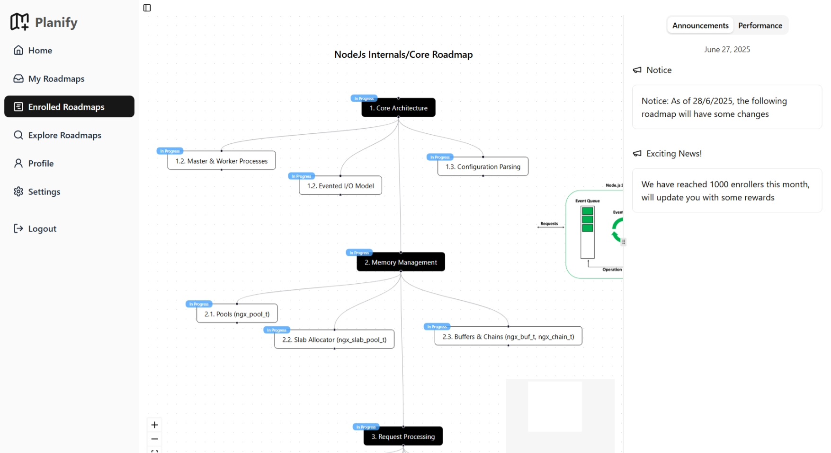
Enrollment Page

Slide 15
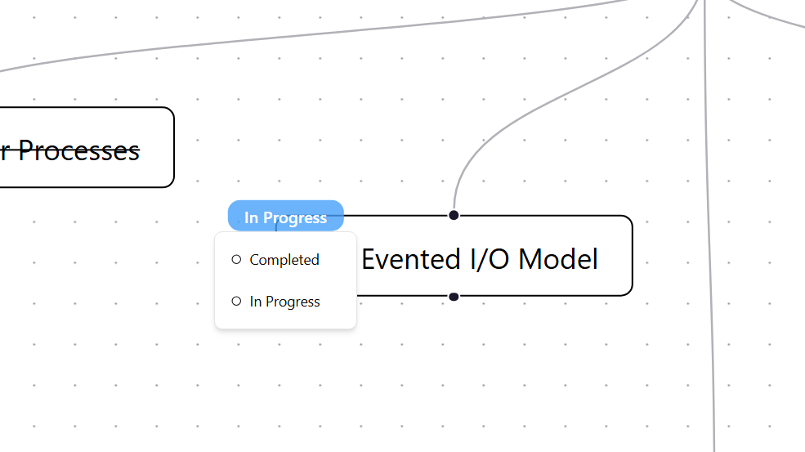
Complete Topics

Slide 16
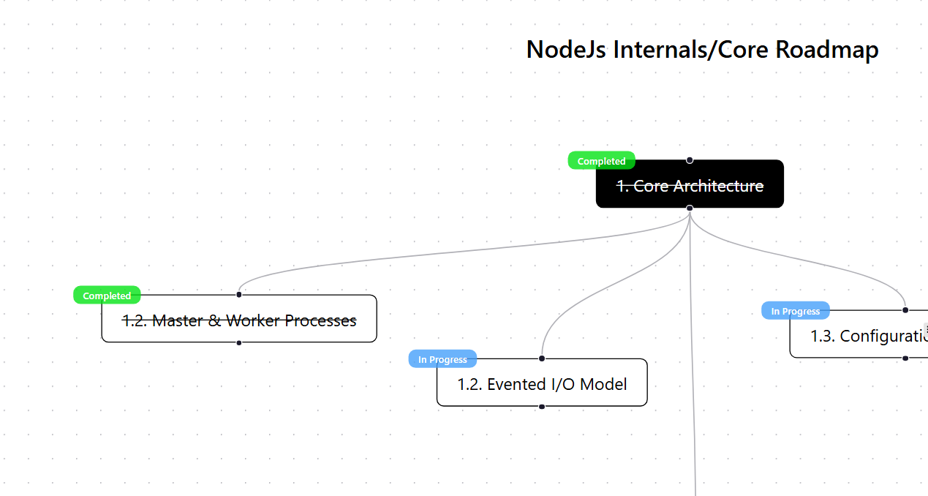
Track Progress

Slide 17
Enrollers Can:
Announcements 📣
Performance 📊
Chat 💬

Slide 18
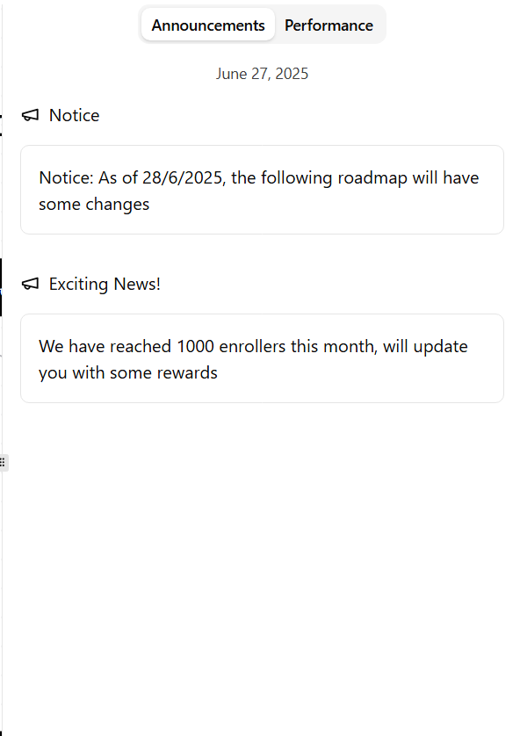
Announcements

Slide 19
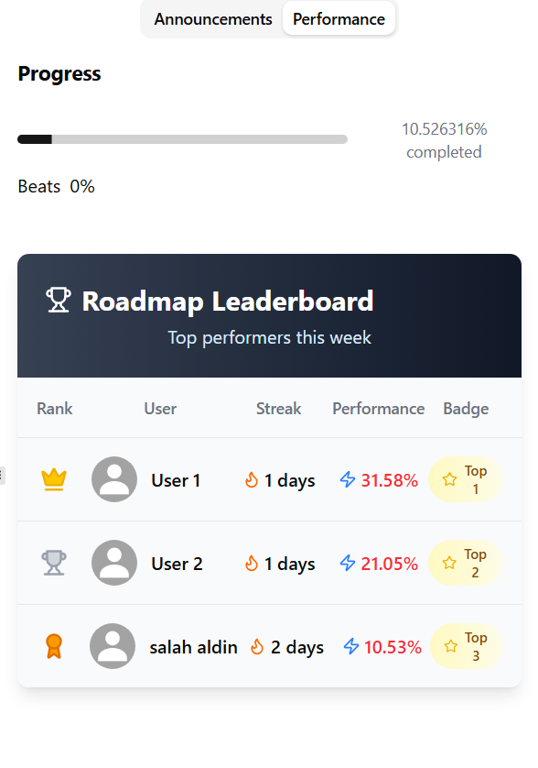
Performance & Metrics
Leaderboard
Progress Bar

Slide 20
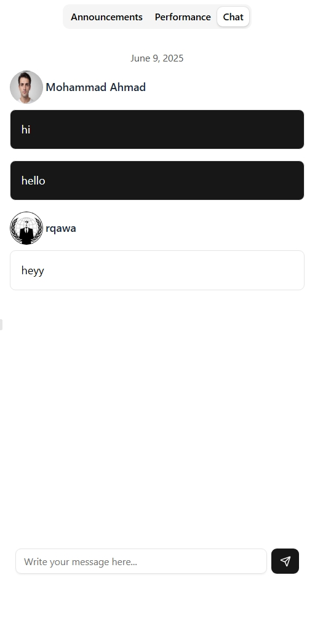
Chat with Peers

Slide 21
Explore Personalized Roadmaps 🔍
Users can explore roadmaps created by other users
🎯Personalized
🌐Community-driven

Slide 22
Recommendation Engine🤖
🧠 Planify uses NLP for recommendations
❤️ Based on user’s interests
spaCy's en_core_web_md
Size: ~50MB
Understands meaning, not just string matching

Slide 23
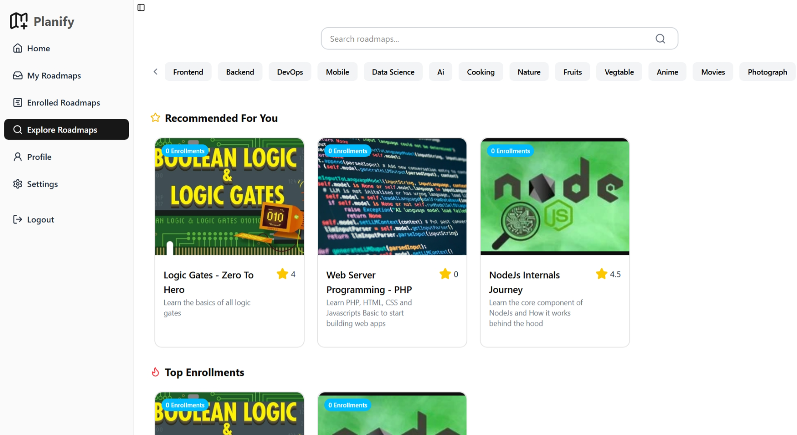
Explore Page

Slide 24
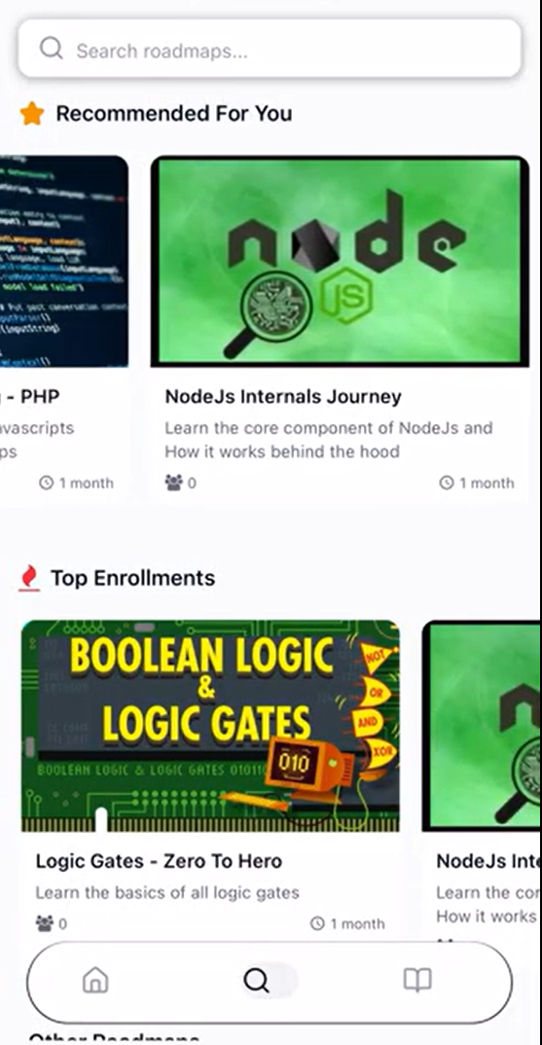
Explore Page

Slide 25
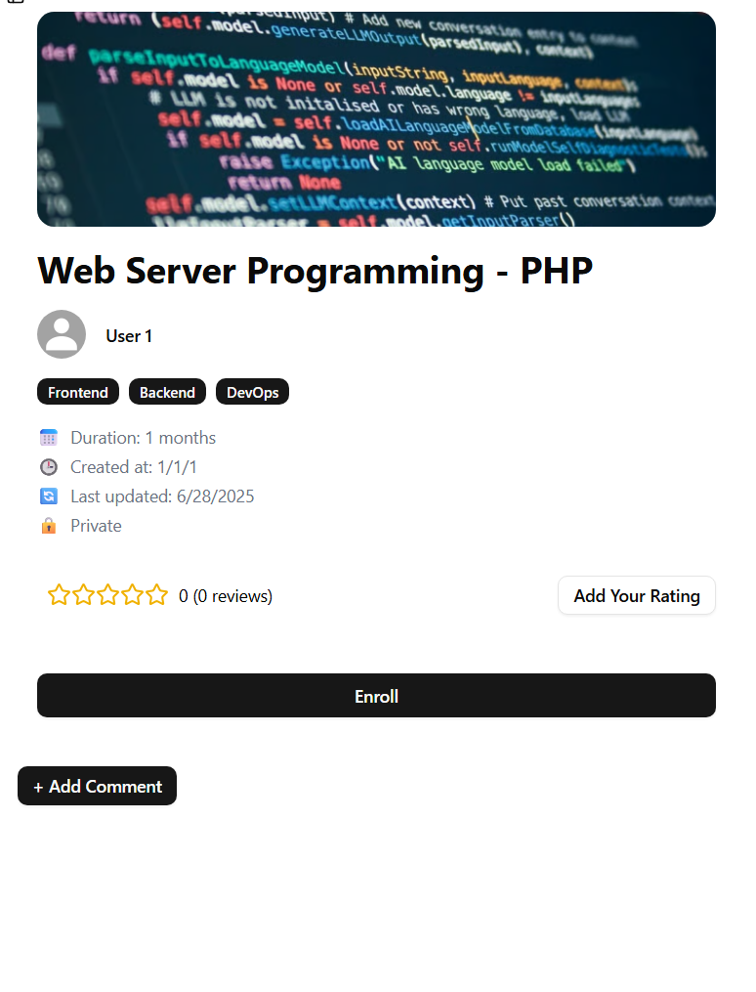
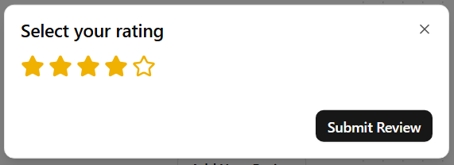
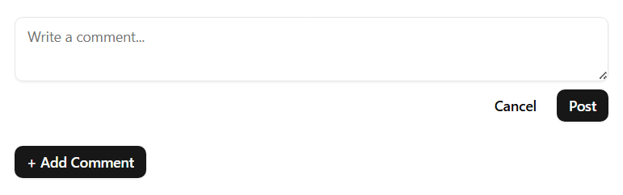
Roadmap Details

Slide 26
Planify Addresses Companies Too 🏢
🔐📁Private resources

Slide 27
Multi-Tenant Architecture
Each customer has a sub-domain
🔒Isolated, Private spaces
Example:
najah.planify.ink
foothill.planify.ink

Slide 28
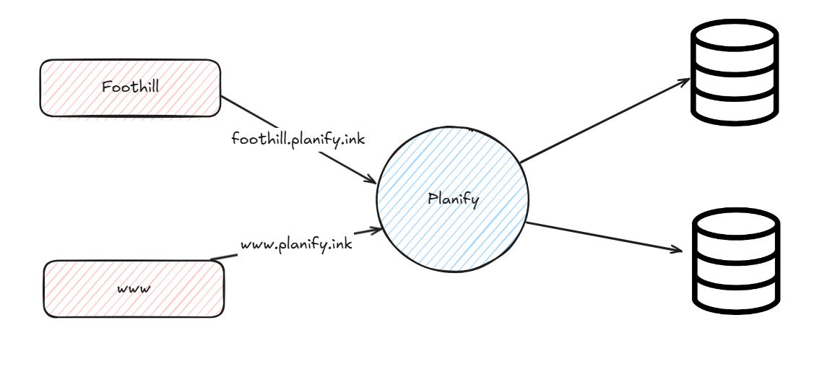

Slide 29
Support companies on-boarding
📤Import user accounts
🧾CSV file

Slide 30
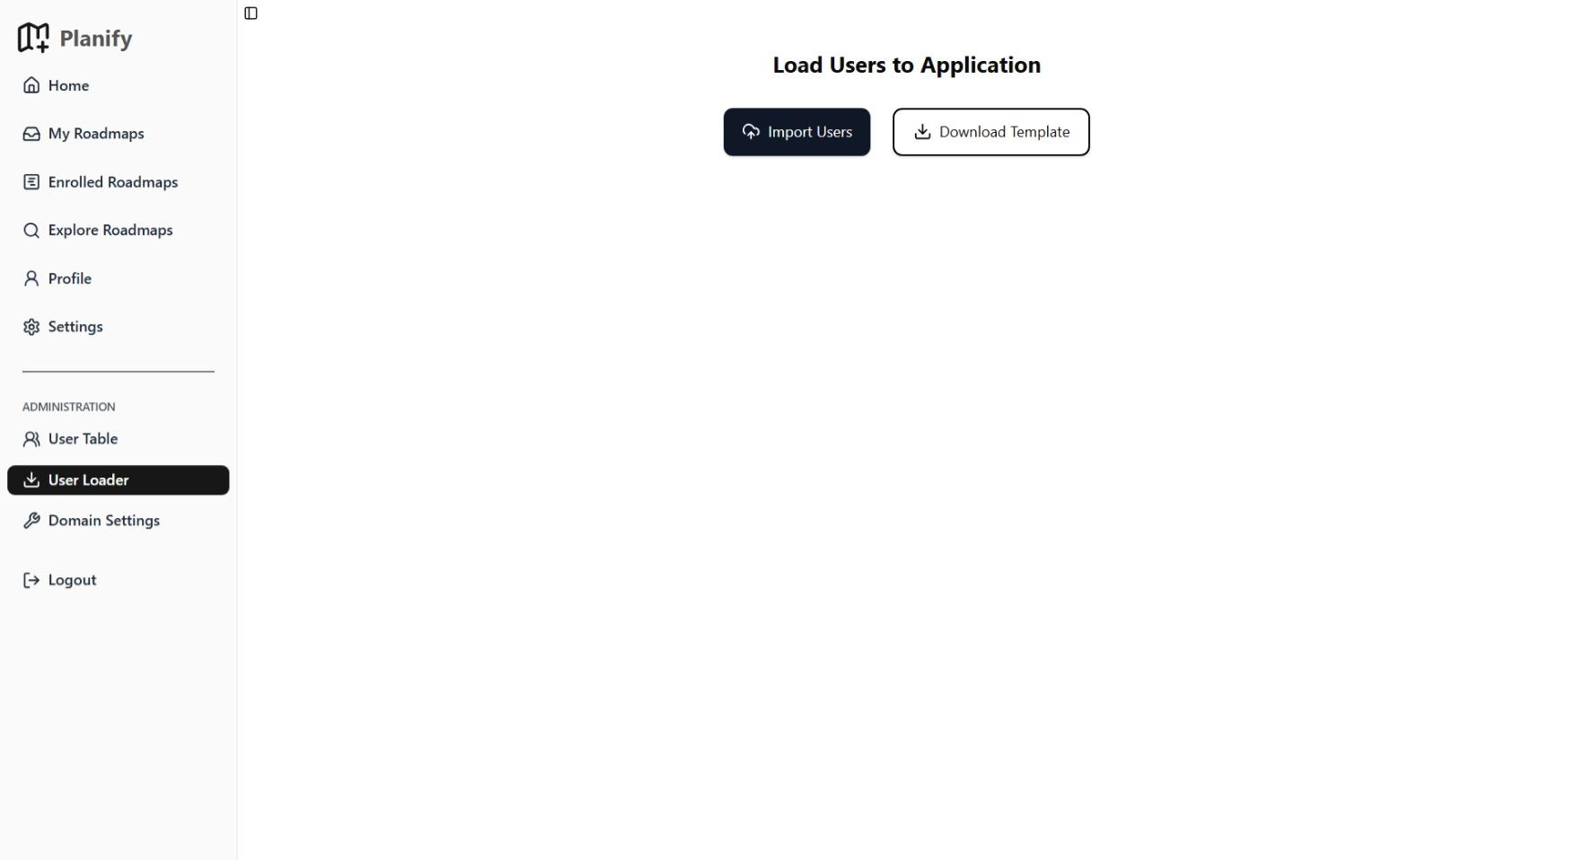
User Import Page

Slide 31
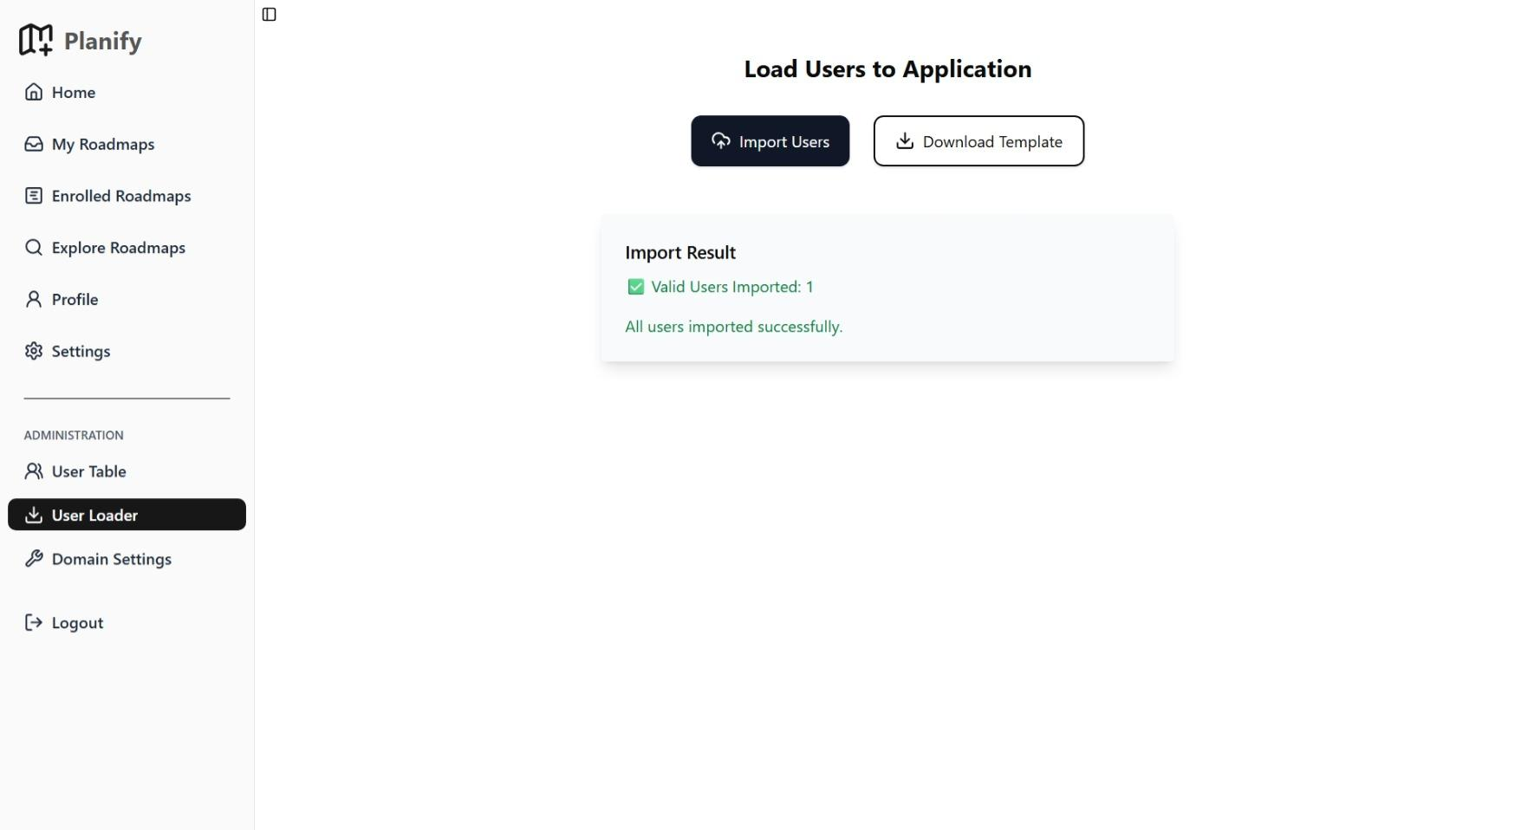
Import Sucessfully

Slide 32
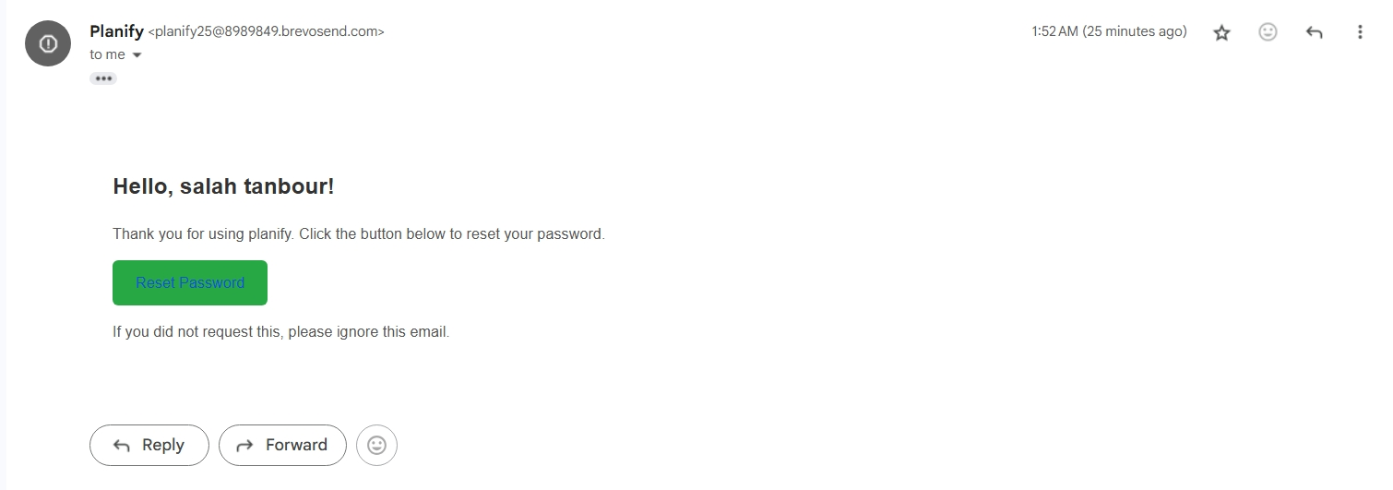
Reset Password Email

Slide 33
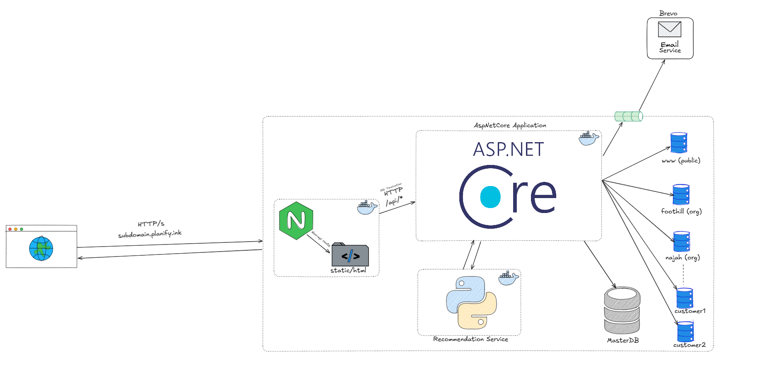
Request Life Cycle

Slide 34
Deployment
⚙️CI/CD Pipeline using GitHub Actions
📜Secure connection with certificate
🖥️Nginx web server

Slide 35
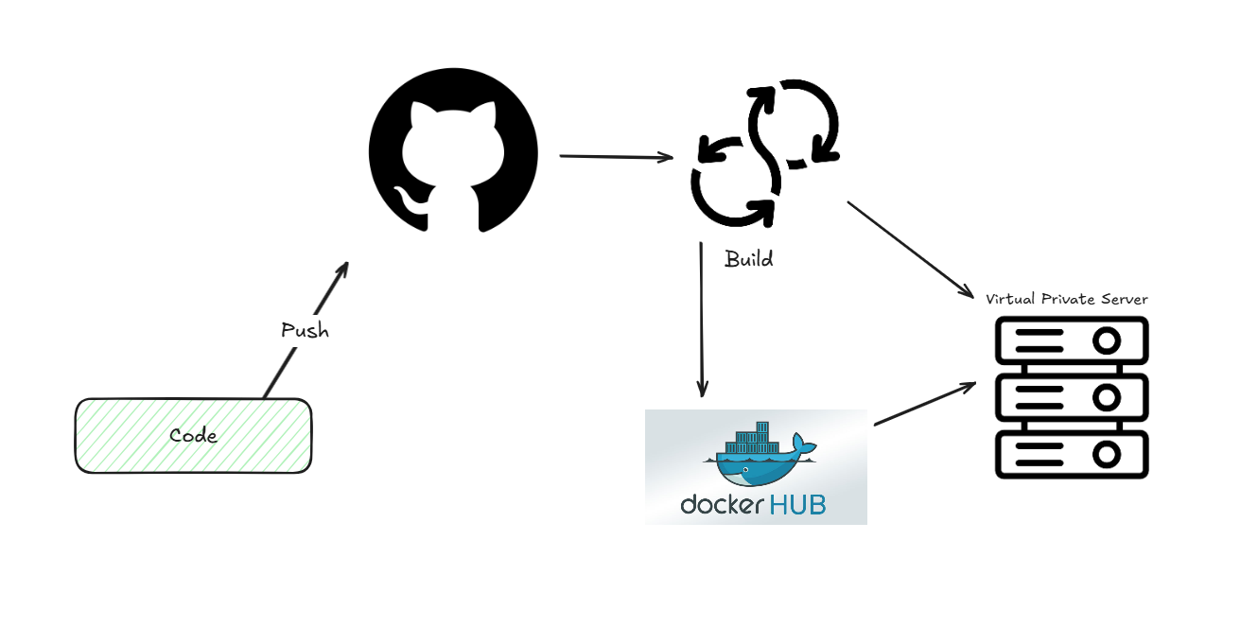
Deployment

Slide 36
Challenges
⚙️SSL Certificate: Need wildcard support
🛡️Separate shared and private data
🧾Roadmap JSON representations

Slide 37
Future Work
💳Payments and self onboarding
🗄️Auto-create tenant DB
🧰More customization/tools in Builder

Slide 38
Thank You – Questions?

