Slide 1
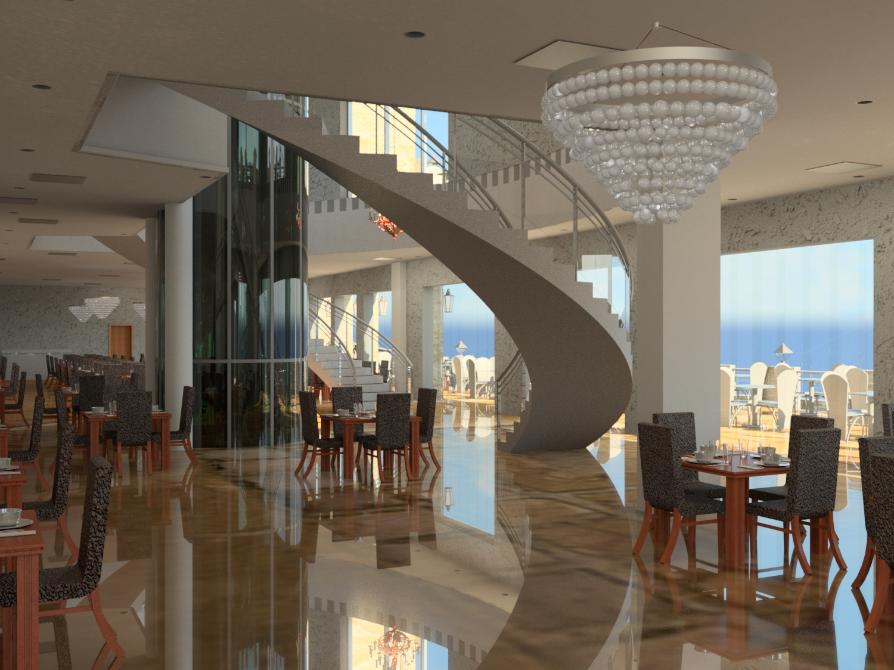
Design of a Restaurant
Graduation Project 2
Prepared by:
Ameed Faidi
Khaled Halawa
Loay Abuodeh
Sa’ad Abdulhaq
Produced to: Eng Abdulhakeem Al-Jawhari

Slide 2
Outline:
Introduction
Structural Design
Quantity Surveying and Cost Estimation
Environmental Design
Mechanical Design
Electrical Design
Architectural Design
Safety Design

Slide 3
Introduction:

Slide 4
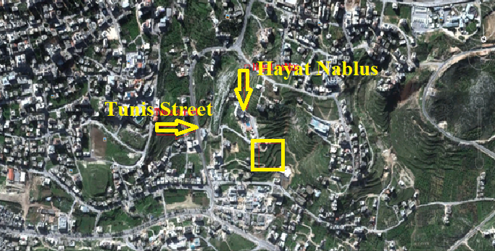
Site location:
Location: Nablus ,Tunis street to the north of Hayat Nablus

Slide 5
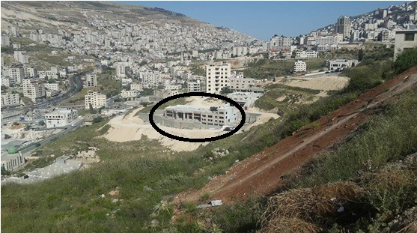
Site location:

Slide 6
Site advantages:
The slop of land can be handled.
Away from traffic rush.
Has a quiet surrounding environment.
Very close to Hayat Nablus resort that may increase coming of customers.

Slide 7
Architectural Re-Design

Slide 8
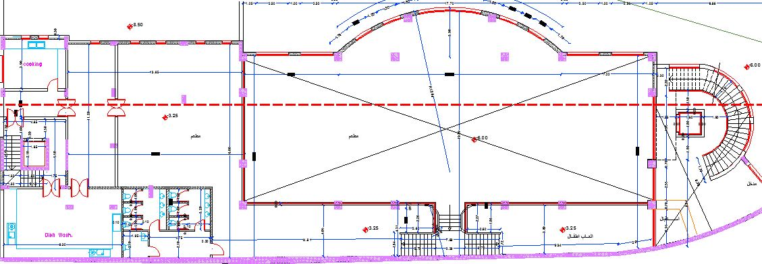
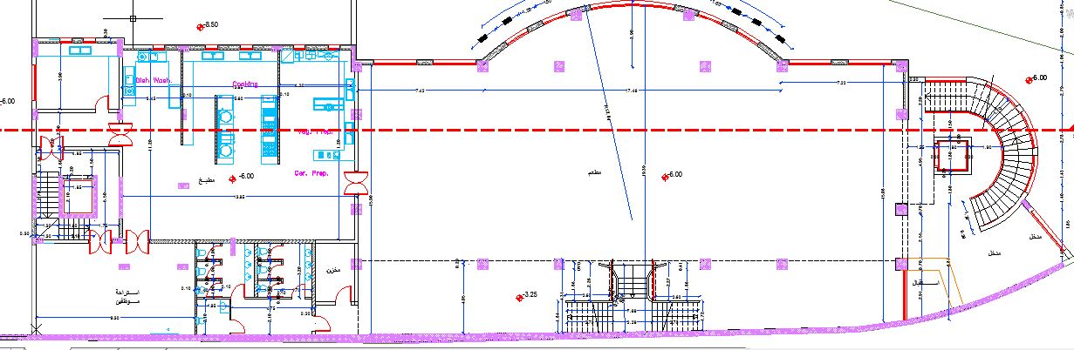
Architectural Redesign:
Old design layout:

Slide 9
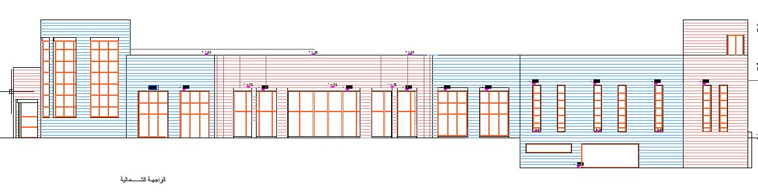
Architectural Redesign:
Old design elevation:

Slide 10
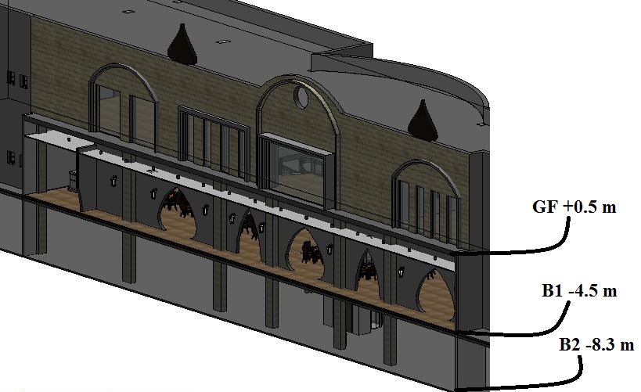
Architectural Redesign:
Modifications:
An extra floor were constructed because the parking area were very small and located on the roof, now it can contain 35 cars in basement 2.
The height of the floor were enlarged.

Slide 11
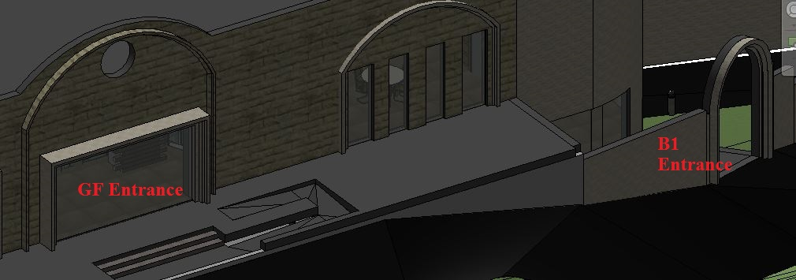
Architectural Redesign:
Modifications:
Entrances were modified and connected to the main street.

Slide 12
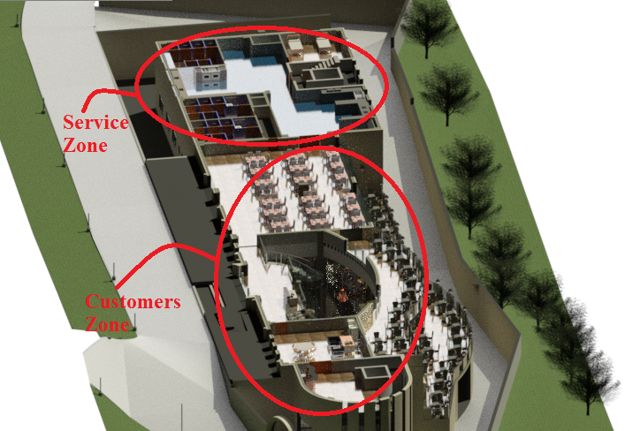
Architectural Redesign:
Modifications:
The layout is divided into two main
zones:
- Service Zone
-Guests & customers zone.

Slide 13
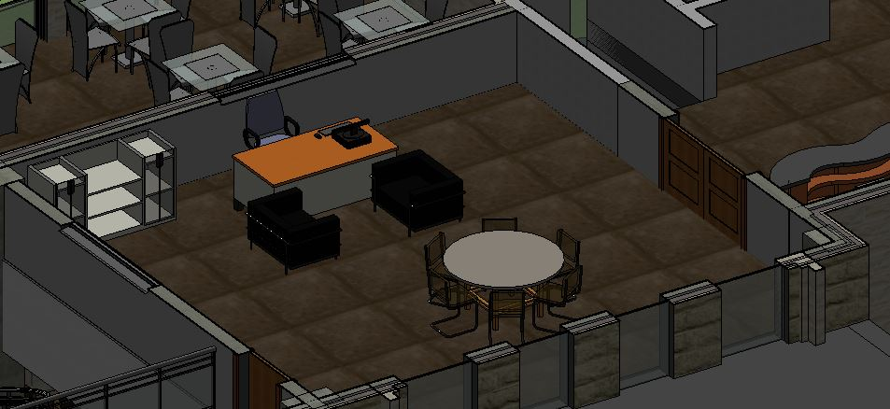
Architectural Redesign:
Modifications:
The manger and administration area was not existed

Slide 14
Architectural Redesign:
Modifications:
Handicap utilities and circulation were studied well.

Slide 15
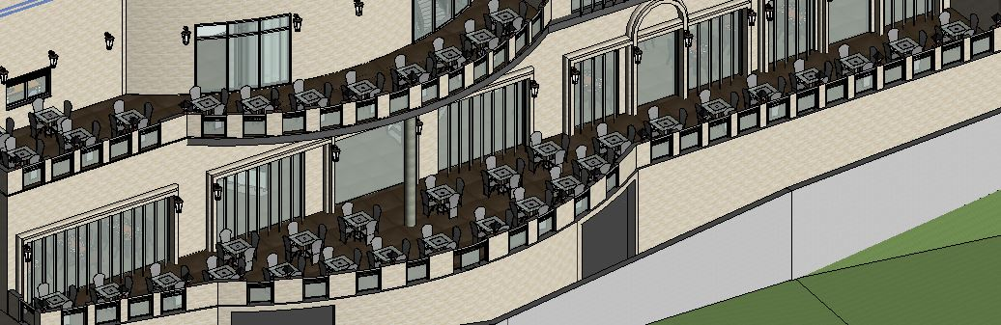
Architectural Redesign:
Modifications:
Terraces now are bigger and for two floors.

Slide 16
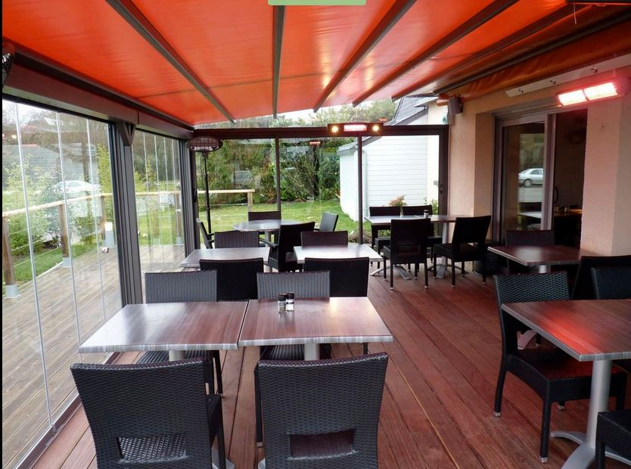
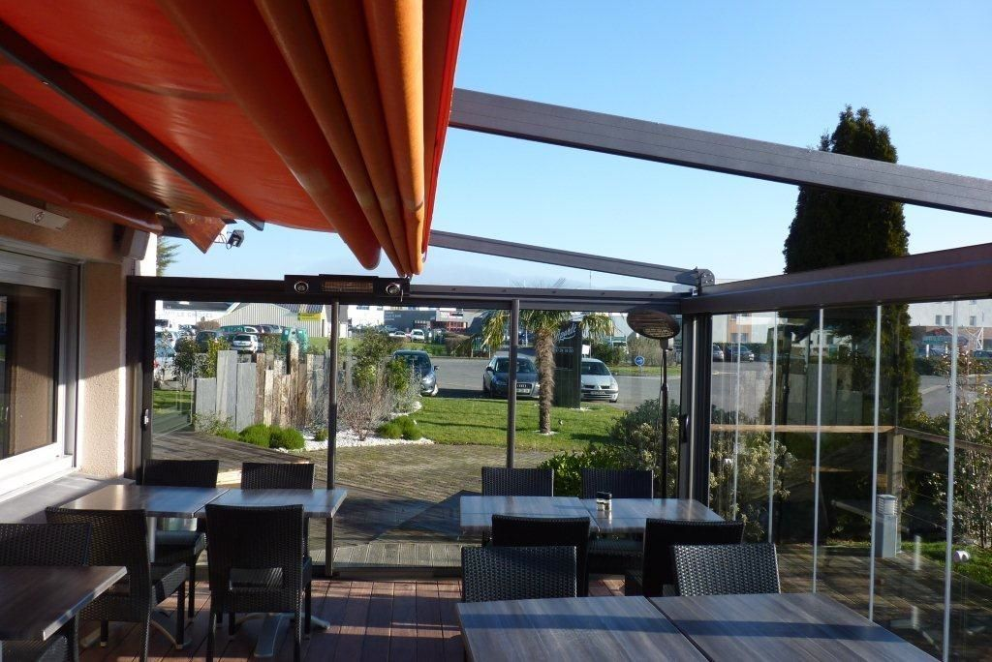
Architectural Redesign:
Modifications:
Terraces will be coved in winter days with light plastic materials.

Slide 17
Architectural Redesign:
Modifications:
Labor restrooms and sleeping areas were not existed.

Slide 18
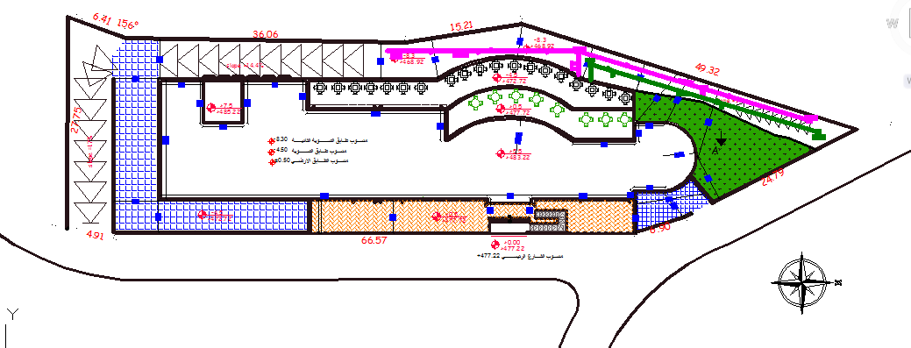
Architectural Redesign:
Site plan:

Slide 19
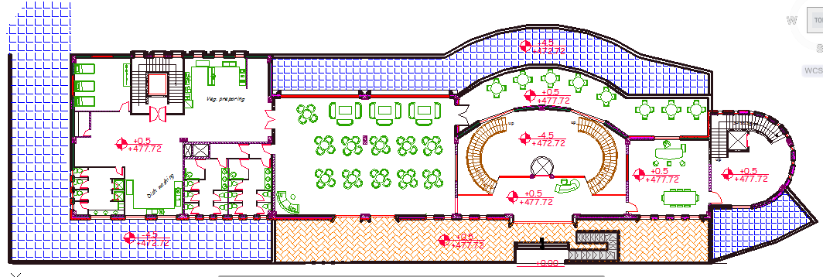
Architectural Redesign:
Final Areas:
Ground Floor ( Dining ) Area = 855 m².

Slide 20
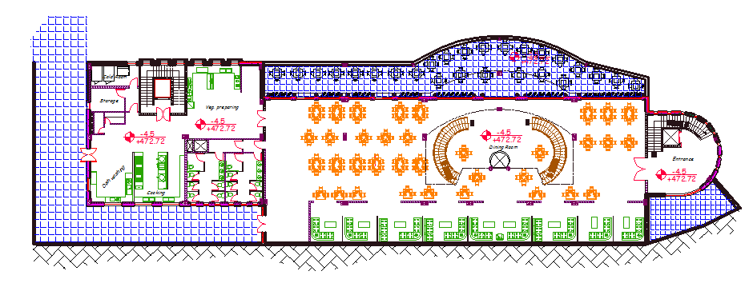
Architectural Redesign:
Final Areas:
Basement One ( dinning ) Area = 1198 m².

Slide 21
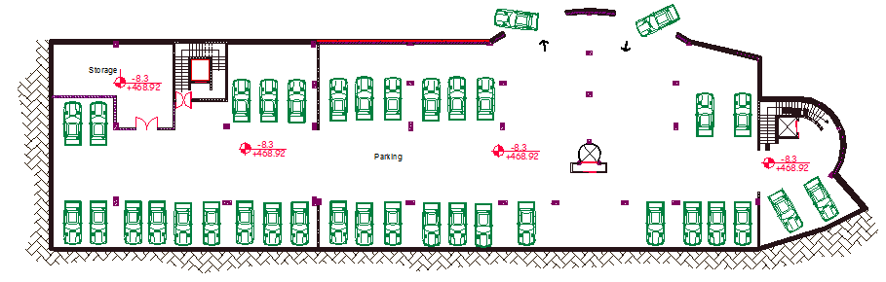
Architectural Redesign:
Final Areas:
Basement Two (parking) Area= 1438 m².

Slide 22
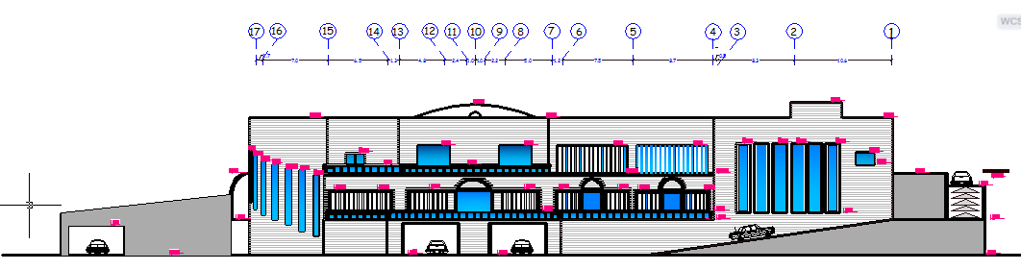
Architectural Redesign:
Elevation:
West Elev.

Slide 23
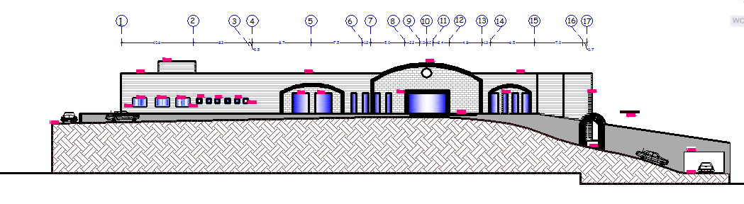
Architectural Redesign:
Elevations:
East Elev.

Slide 24
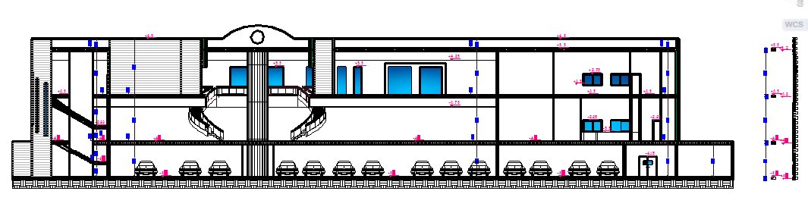
Architectural Redesign:
Section:

Slide 25
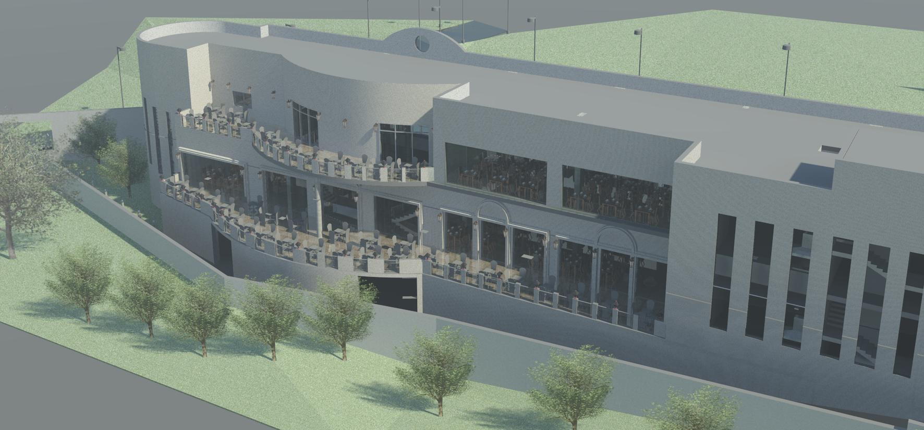
Architectural Redesign:
Final design photos:

Slide 26
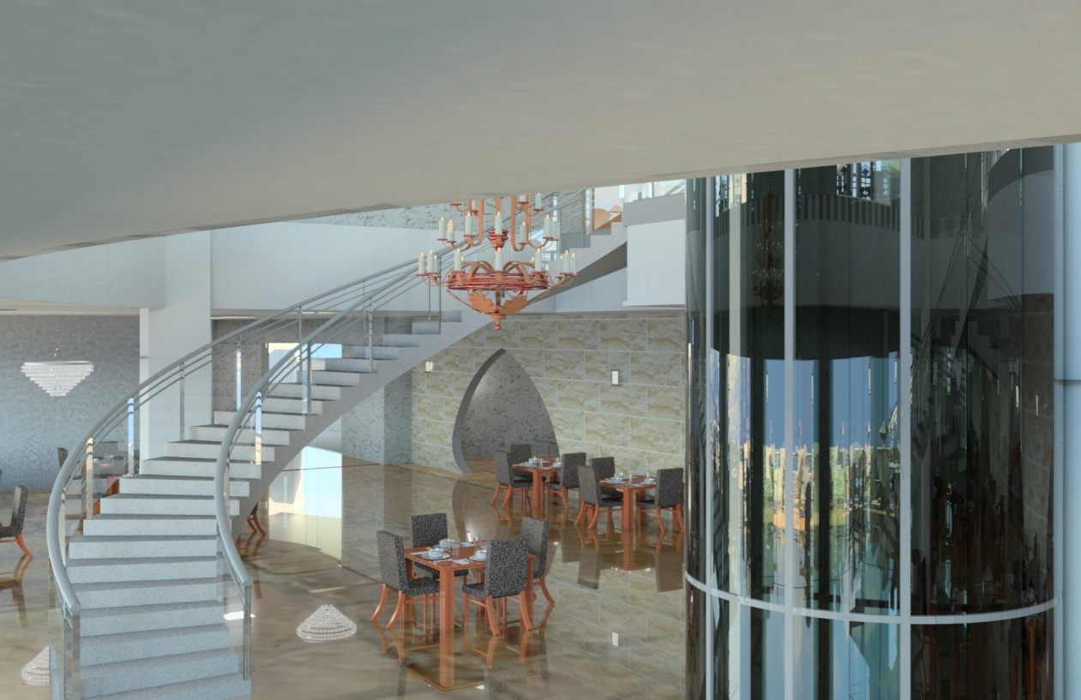
Architectural Redesign:
Final design photos:

Slide 27

Architectural Redesign:
Final design photos:

Slide 28
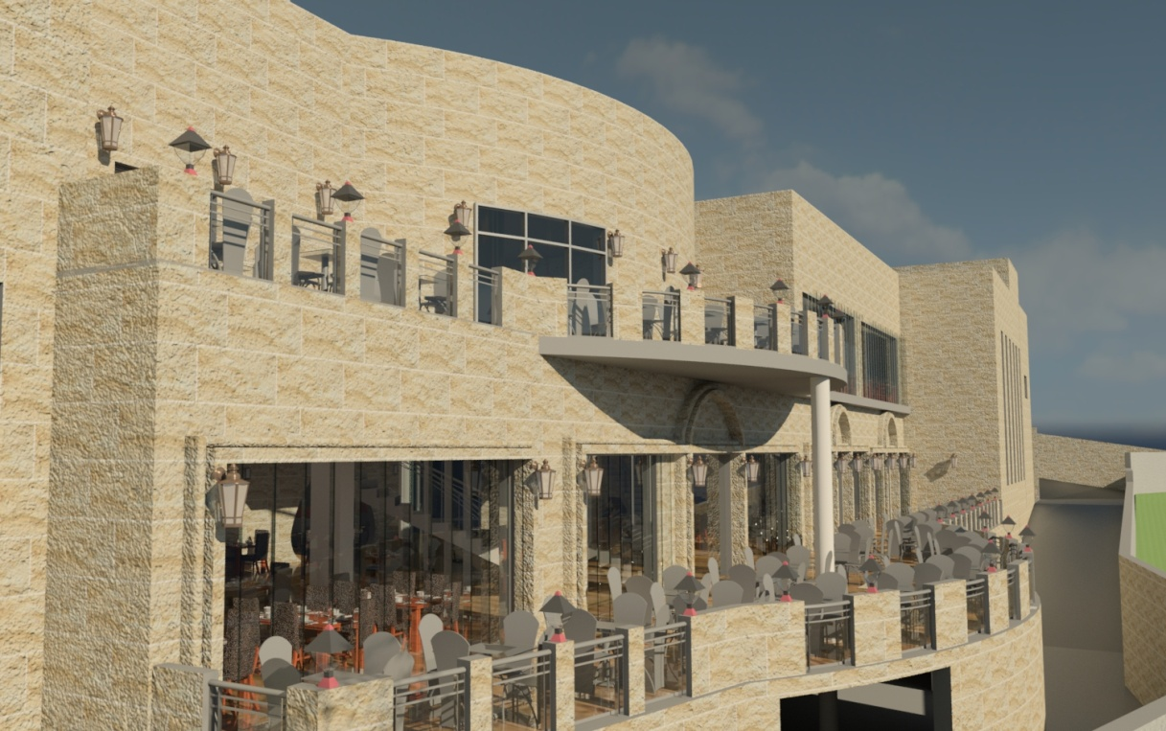
Architectural Redesign:
Final design photos:

Slide 29
Architectural Redesign:
Video:

Slide 30
Structural Design

Slide 31
Structural Design:
Design Codes:
ACI -318-08 (American Concrete Institution) for reinforced concrete structural design.
UBC-97 (Uniform Building Code) for earthquake load computations.
ASCE (American Society Of Civil Engineers) for design loads.

Slide 32
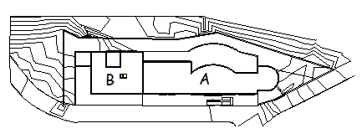
Structural Design:
Building Description:

Slide 33
Structural Design:
Materials:
Material | Density KN/m³
Reinforced concrete | 25
Concrete Hollow Block | 12
Masonry stones | 27
Polystyrene | 0.3
Mortar | 2.3
Glass | 26

Slide 34
Structural Design:
Types of loads:
Type of load | Load KN/m²
Live load | 4 KN/m²
Super imposed dead load | 3.5 KN/m²
Exterior walls | 25 KN/m
Combined Glazed walls with stone | 7 KN/m
20 cm block wall, 5m height | 12 KN/m
10 cm block wall, 5m height | 6 KN/m

Slide 35
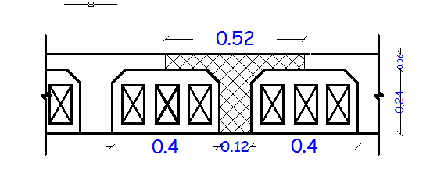
Structural Design:
Structural System:
Beam girder system.
The system of the slab is one way ribbed slab(30 cm thickness) with Drop beams.

Slide 36
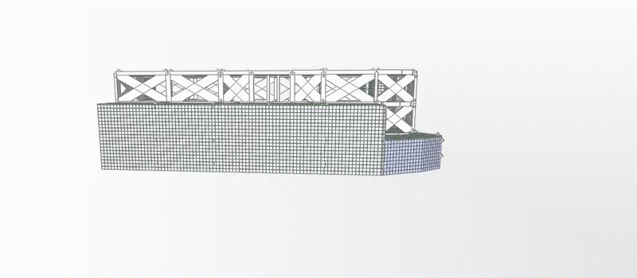
Structural Design:
Sap model:

Slide 37
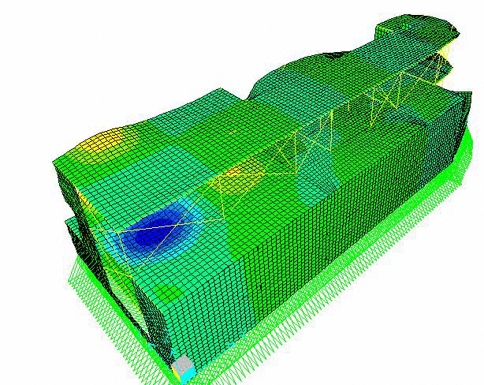
Structural Design:
Model validation:
Compatibility check

Slide 38
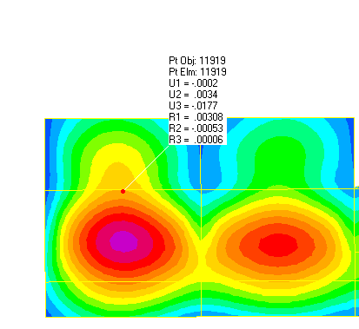
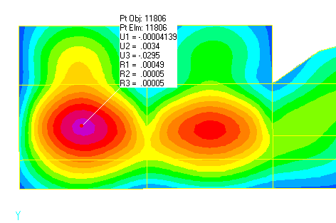
Structural Design:
Deflection check:

Slide 39
Structural Design:
Equilibrium check:
Load | Manual | Sap | Error
Dead load | 24631 KN | 25869.1 KN | 4.7 %
Live load | 8286 KN | 8271.3 KN | 0.17 %
Super imposed | 11766.25 KN | 11769.6 KN | 0.02 %

Slide 40
Structural Design:
Internal forces check
Element | Manual | Sap | Error
Slab | 17 KN.m/m | 16.3 KN.m/m | 4.11 %
Beam | 321 KN.m | 324.15 KN.m | 0.95 %
Column | 1324 KN | 1393 KN | 5%
Column 2 | 526.1 KN | 621 KN | 15 %

Slide 41
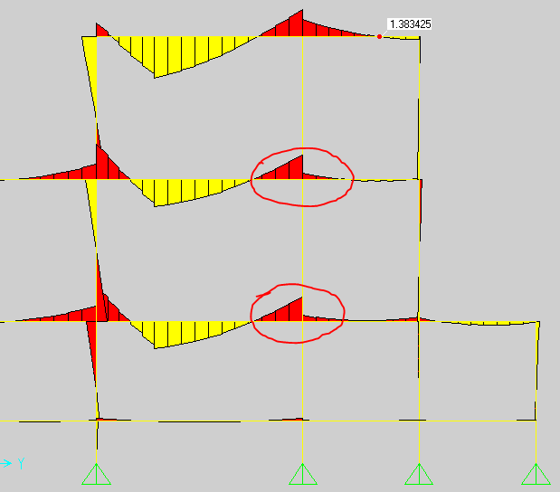
Structural Design:

Slide 42
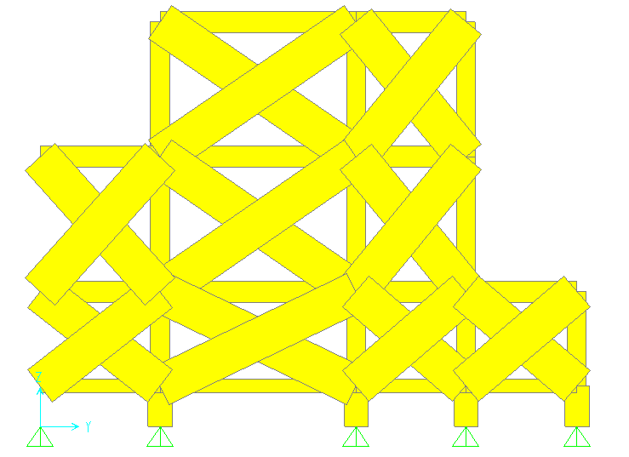
Structural Design:
Dynamic Analysis

Slide 43
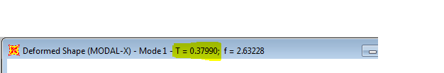
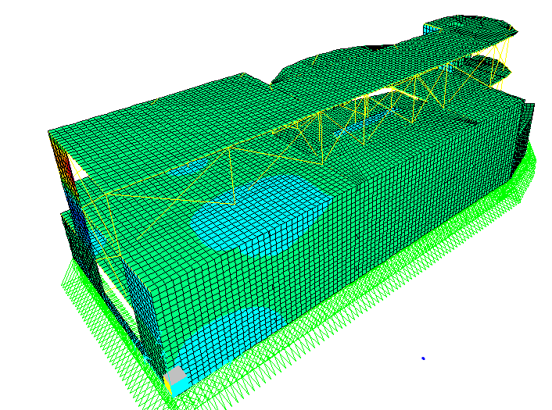
Structural Design:
Dynamic Analysis
Tb = 0.343

Slide 44
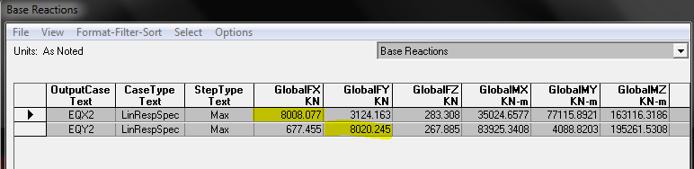
Structural Design:
Dynamic Analysis
Manual Base shear (V) = (𝐶𝑣∗𝐼/𝑅∗𝑇)* weight
= 0.4∗1 5.5∗0.37∗39880 = 8056.56 KN.

Slide 45
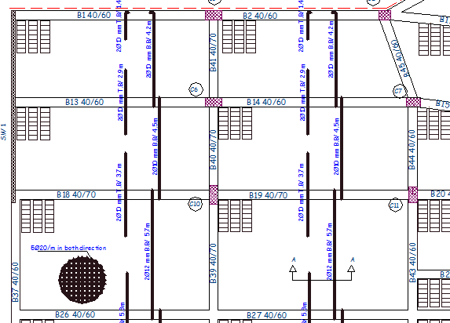
Structural Design:
Slab reinforcement

Slide 46
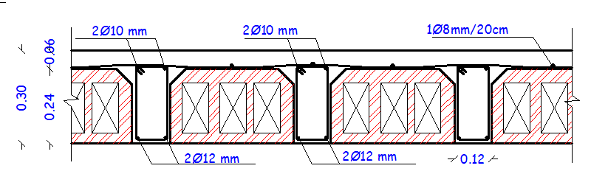
Structural Design:
Slab reinforcement

Slide 47
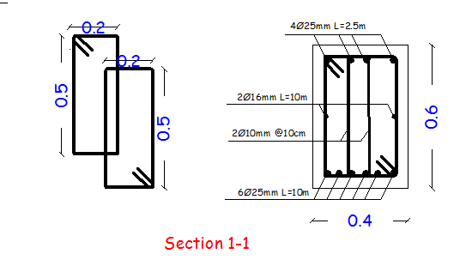
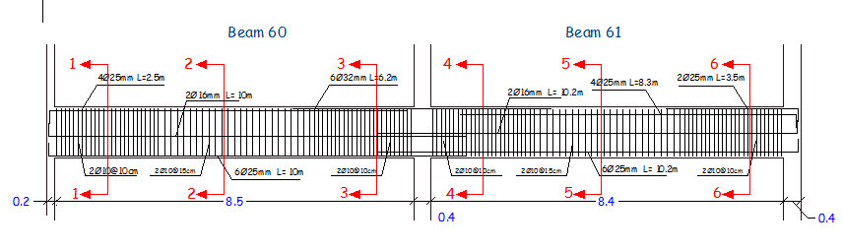
Structural Design:
Beam reinforcement

Slide 48
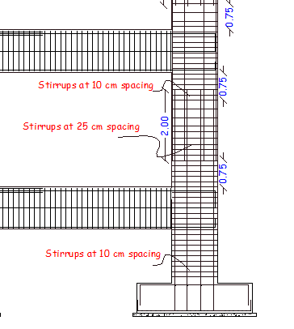
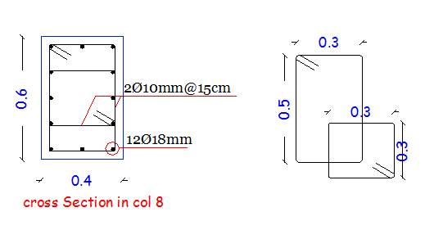
Structural Design:
Column reinforcement

Slide 49
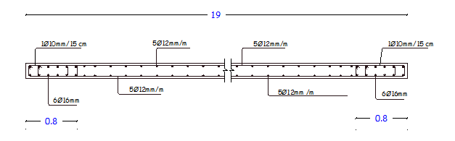
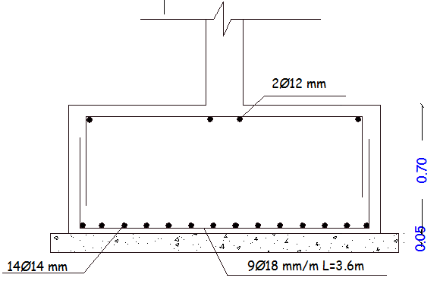
Structural Design:
shear wall reinforcement

Slide 50
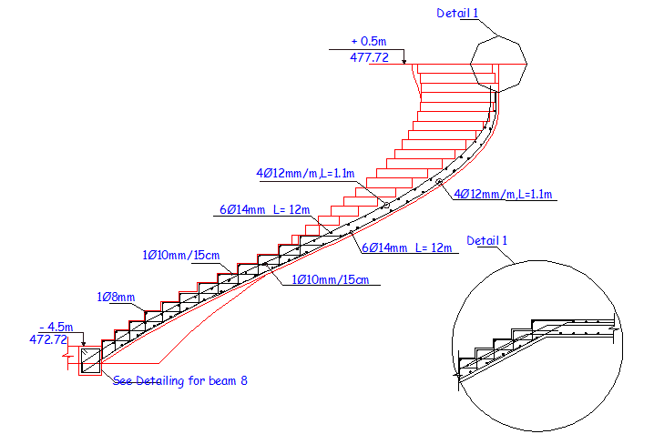
Structural Design:
Stairs reinforcement

Slide 51
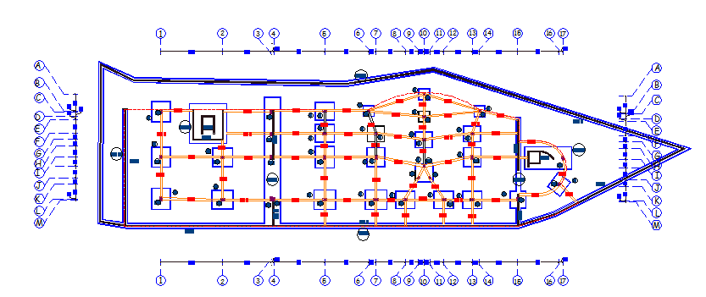
Structural Design:
Footing layout

Slide 52
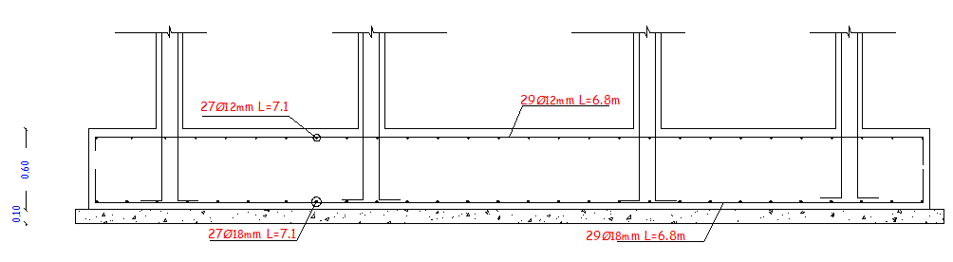
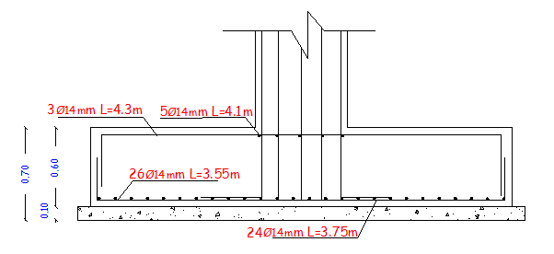
Structural Design:
Footing reinforcement

Slide 53
Environmental Design

Slide 54
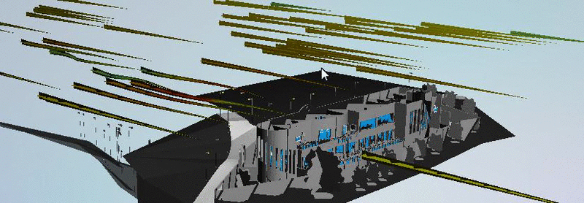
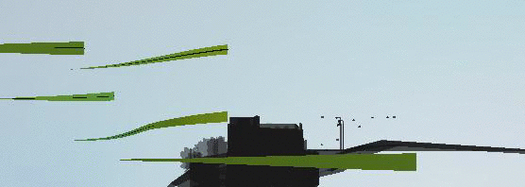
Environmental Design:
Wind analysis:

Slide 55
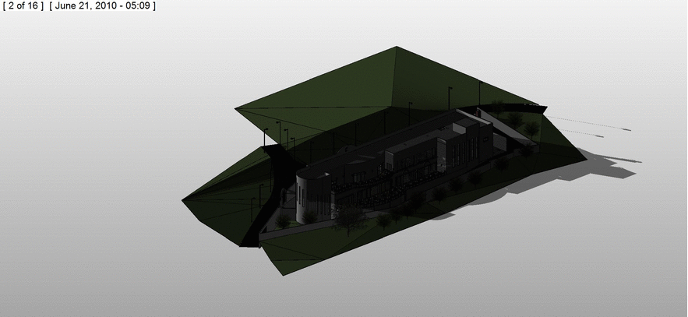
Environmental Design:
Solar Analysis:
Summer day

Slide 56
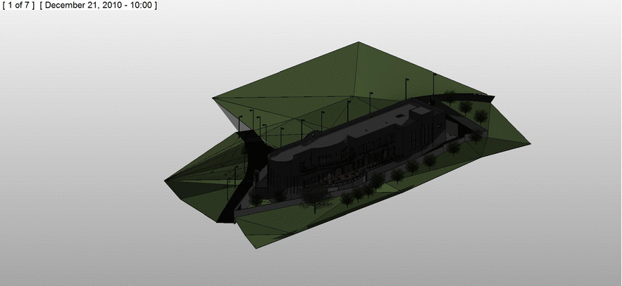
Environmental Design:
Solar Analysis:
Winter day

Slide 57

Environmental Design:
Solar Shading:
The west elevation is considered to be the most critical one because it is fully exposed to solar gain with very large glazing areas.

Slide 58


Environmental Design:
Solar Shading:
As shown in the figure above, the sun is concentrated on the west elevation at the afternoon hours where is the peak of customers’ service, so the heating gain is huge.
Solution:
Using vertical louvers to block sun exposure, in order to reduce heat gain.
Used material:
Low transparence glass louvers covered with micro-perforated panels.

Slide 59

Environmental Design:
Solar Shading:

Slide 60
Environmental Design:
Thermal Insulation:
The goal: The achieved thermal coefficient U for all new and air-conditioned buildings should be not more than the U-value of the specified code
 | highest value for U | Outer structural elements of the building |  | Number
 | 0.5 | The External wall |  | 1
 | 0.39 | Exposed horizontal roof |  | 2
 | 0.39 | Exposed leaning roof |  | 3

Slide 61

Environmental Design:
Thermal Insulation:
Exterior wall
 |  | R | K | thickness(m) | material name
 |  | 0.31 |  |  | Inside
 |  | 0.019 | 2.6 | 0.05 | Stone (jama'en)
 |  | 0.054 | 1.85 | 0.1 | concrete
 |  | 2.27 | 0.022 | 0.05 | insulation
 |  | 0.24 |  | 0.1 | Block
 |  | 0.014 | 1.4 | 0.02 | Plaster
 |  | 0.05 |  |  | External
 |  | 2.957 | Total
U = .33 < .5

Slide 62

Environmental Design:
Thermal Insulation:
Ceiling
U = .38 < .39

Slide 63

Environmental Design:
Acoustical Design:
One goal of acoustical engineering can be the reduction of unwanted noise, which is referred to as noise control.
According to specifications of restaurants the required RT60 is ( 0.8 – 1.2 ) s
RT60=3.7 s
After modification
RT60=0.83 s

Slide 64

Environmental Design:
Acoustical Design:
STC Calculations:
For inner wall ( between the kitchen and dining hall ):
required STC 50-52
50.4

Slide 65

Environmental Design:
Acoustical Design:
For western glazed wall
Required STC level (50-55)
STC = 52.55

Slide 66

Environmental Design:
Acoustical Design:
Speakers:
Sound system calculations for the restaurant were only made for the dining halls, and were calculated by Yamaha's application Cissca.

Slide 67

Environmental Design:
Acoustical Design:
Speakers:
Density: Minimum Overlap

Slide 68

Environmental Design:
Heating and cooling:
Dining cooling capacity= 84 KW

Slide 69

Environmental Design:
Heating and cooling:
Dining
Heating capacity = 41.72 kw

Slide 70

Environmental Design:
Daylight factor:
DF = 5. 5

Slide 71


Environmental Design:
Waste disposal:

Slide 72
Mechanical Design

Slide 73

Mechanical design
H-Vac system
water to air system
Air flow (L/S) | Design capacity Cooling (Kw) | Design capacity Heating (Kw) | Floor
3640 | 84 | 41 | B1

Slide 74

Mechanical design
H-Vac system
Duct sizing

Slide 75

Mechanical design
Water supply

Slide 76

Mechanical design
Water supply

Slide 77

Mechanical design
Water drainage

Slide 78


Mechanical design
Drainage system

Slide 79

Mechanical design
Drainage system

Slide 80

Mechanical design
Water usage

Slide 81

Mechanical design
Roof Slope:

Slide 82
Electrical Design

Slide 83



Electrical design:
Artificial lighting for dining
Dextra Pro Tec TC-DE 26w C84 Power: 2*26 watt Luminous flux: 3600 lm Number of units: 56
Zumtobel TC-DSE
Power: 11 watt Luminous flux: 360 lm Number of units: 10 `

Slide 84



Electrical design:
Artificial lighting for dining
Disano Janes power led 3000k Power: 6.2 watt Luminous flux: 448 lm Number of units: 30
Electro Scndanafi with Philips PL-C/2P
Power: 34 watt Luminous flux: 1800 lm Number of units: 7

Slide 85

Electrical design:
Artificial lighting for dining

Slide 86

Electrical design:
Artificial lighting for dining

Slide 87



Electrical design:
Artificial lighting for dining

Slide 88


Electrical design:
Artificial lighting for Manager room
OSRAM Siteco louvre T16

Slide 89


Electrical design:
Artificial lighting for cooking
OSRAM Europlex T26

Slide 90


Electrical design:
Artificial lighting for Veg.prep
OSRAM Europlex T26

Slide 91
Safety Design

Slide 92

Safety design:
Fire system
Sprinkler system

Slide 93

Safety design:
Fire system
suppression system

Slide 94


Safety design:
Fire system

Slide 95


Safety design:
Fire system

Slide 96

Safety design:
Evcauation

Slide 97

Safety design:
Evcauation

Slide 98
Quantity surveying and cost estimation:
The total cost of concrete & steel work is 2.9 million shekel.
The total cost of the Mechanical work is 377 thousand shekel.
The total cost of the Electrical work is 71 thousand shekel.
The total cost of the restaurant is about 7.68 million shekel.
The total cost per meter square for the restaurant is about 421 JOD/m².

Slide 99


