Slide 1

Graduation Project
CarHub
Authors : Ezz Mletat | Obada Jaber
Supervised by Dr. Haya Samanaa

Slide 2
LIST OF CONTENTS
01 CARHUB ?
02 TECHNOLOGIES
03 FEATURES
04 CONSTRAINS & LIMITATIONS
04 FUTURE WORK

Slide 3
Introduction
“CarHub” is an application designed specifically for the Palestinian people, created to help and streamline the process of finding car services. Whether you need to locate garages, car dealerships, car rental offices, or auto parts shops, CarHub is here to simplify your search and enhance your automotive experience.

Slide 4






TECHNOLOGIES
Front-End : Flutter (.dart)
Back-End : NodeJS (js)
Database : MongoDB

Slide 5
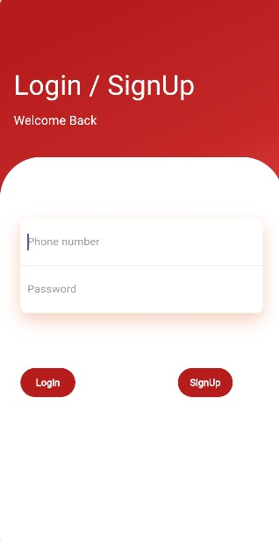
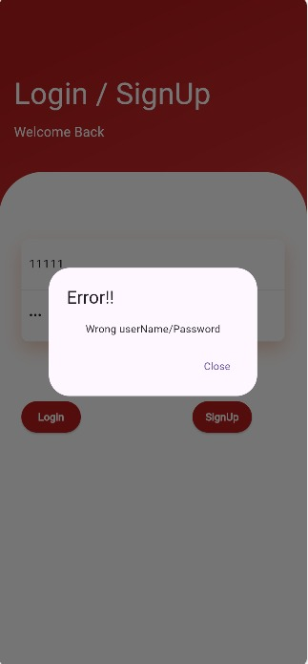
FEATURES
App User (Client):
The Client Can enter the Login/Sign up page
or create an account , it can see all
merchants (service providers)
and look for the service he is searching for ,
through search and filtering
or through touring around the application .

Slide 6

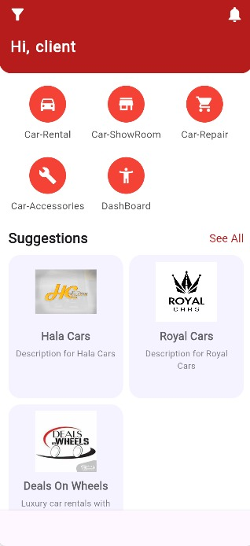
Client Features
Welcome Screen
Home Page
In the home page
the client can see
suggestions randomly
of many service
providers

Slide 7
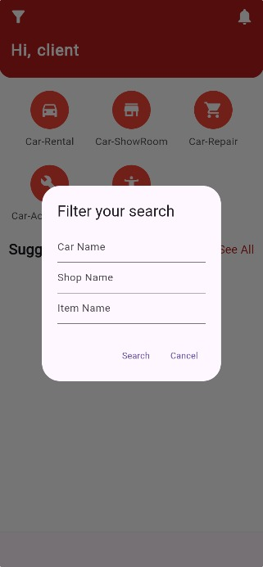
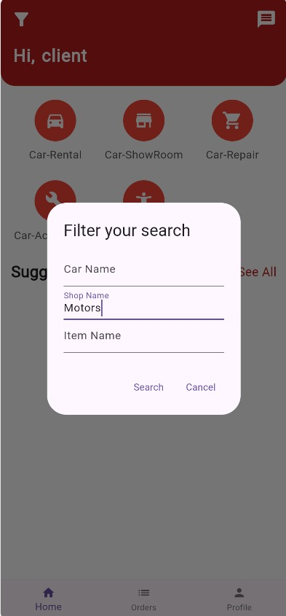
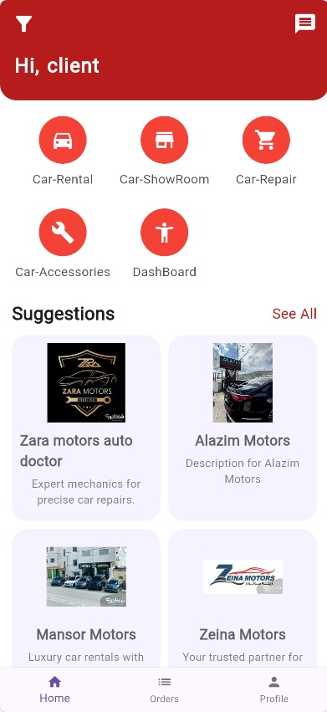
Client Features
Search & Filtering to specific standards and needs of a service or an item.

Slide 8
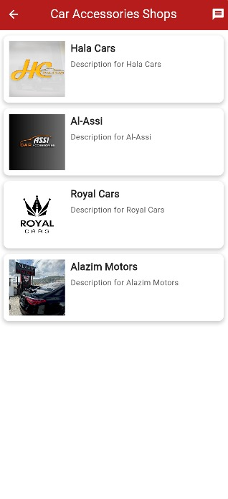
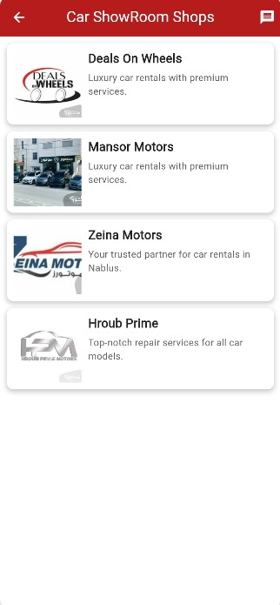
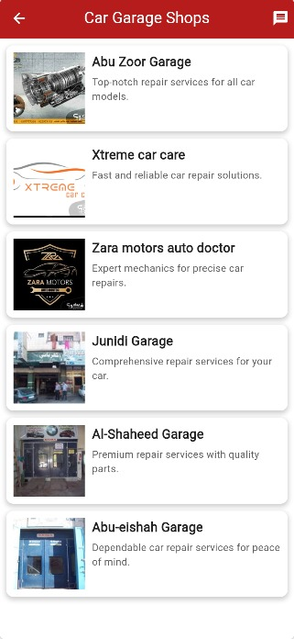
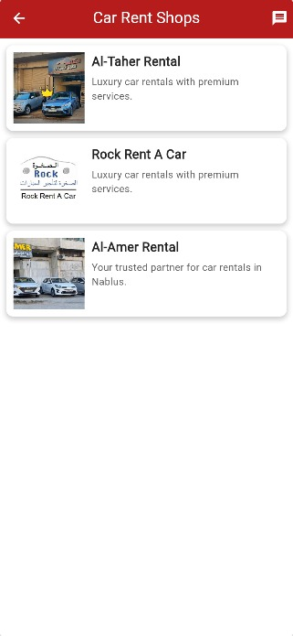
Client Features
  The client can look through pages to see available service providers , their information , rate them , contact them , or send a message .

Slide 9
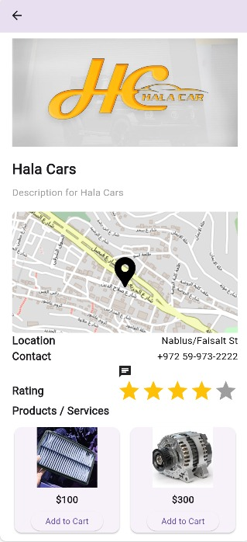
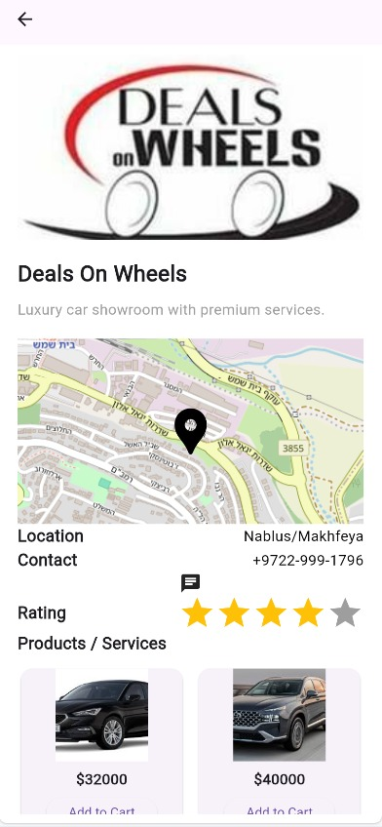
Client Features

Slide 10
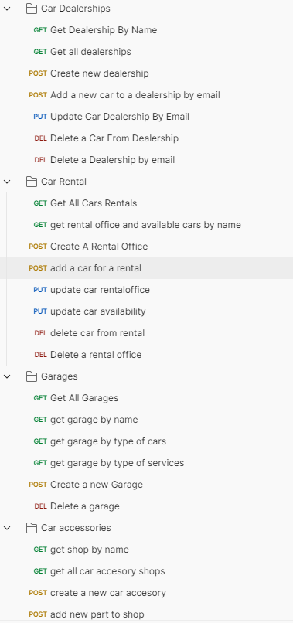
Merchant Features
Merchants -Service Provider- have almost the same interface and features of the client but as web interfaces, the difference is Merchants can edit their profiles , and do CRUD operations on the services and data he has .

Slide 11

Merchant Features
Merchant Mobile App Interface , where it has a small type of editing on its profile .

Slide 12
Merchant Features
We will take Hala car Merchant as an example !

Slide 13
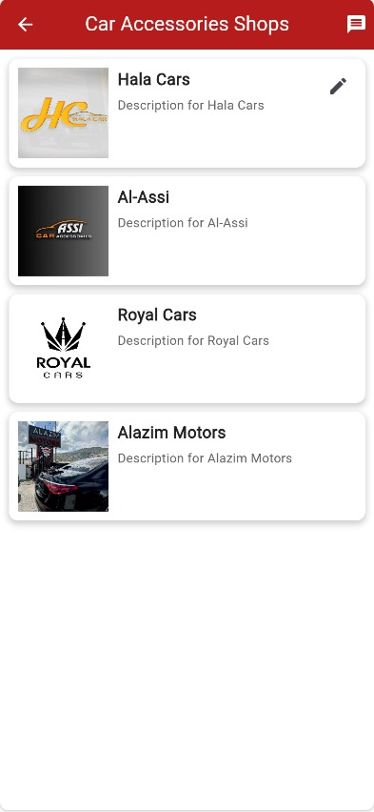
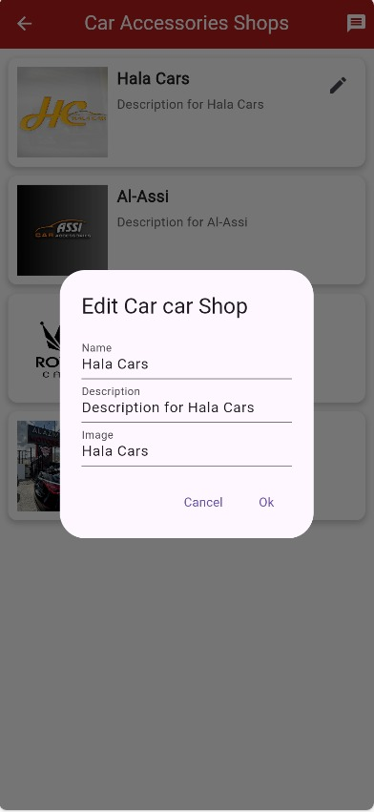
Merchant Features
We can see Hala Car
Merchant can see other
service provider and only edit his data

Slide 14
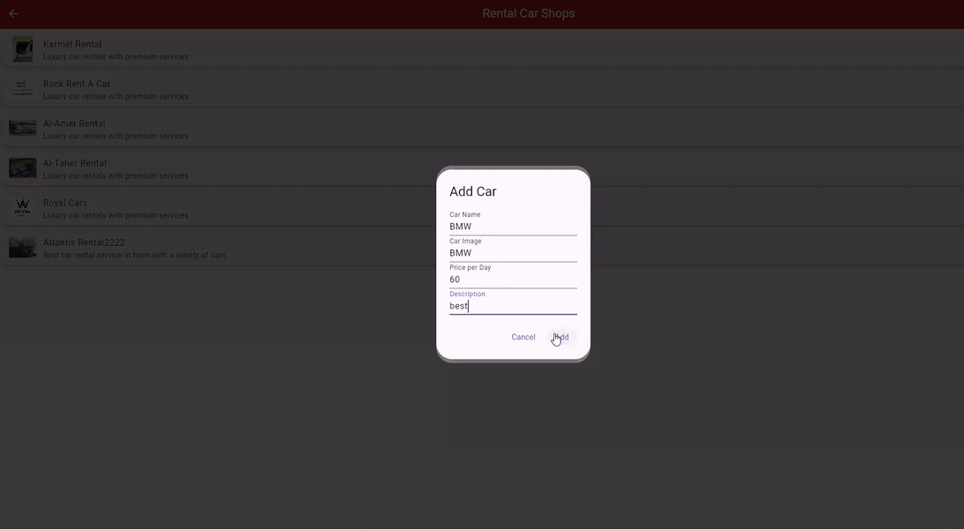
Merchant
We can see a rental car office
adding a car for the office to be
inserted and shown for the clients

Slide 15
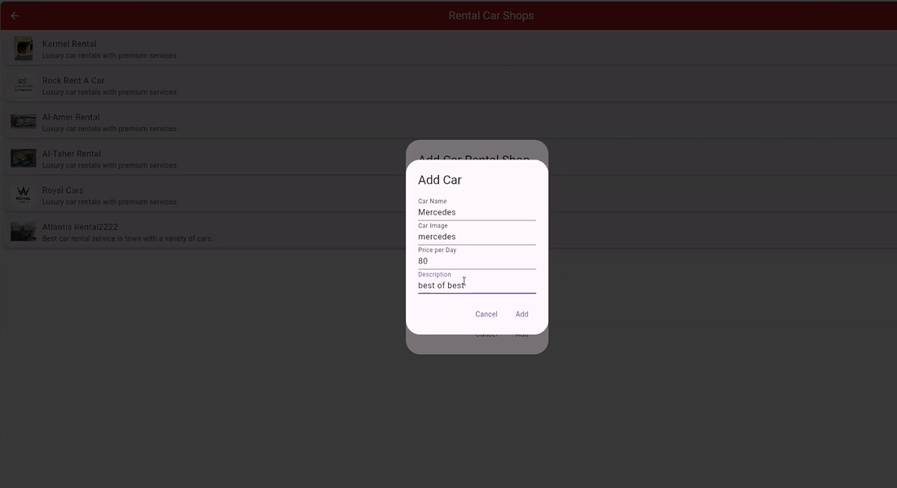
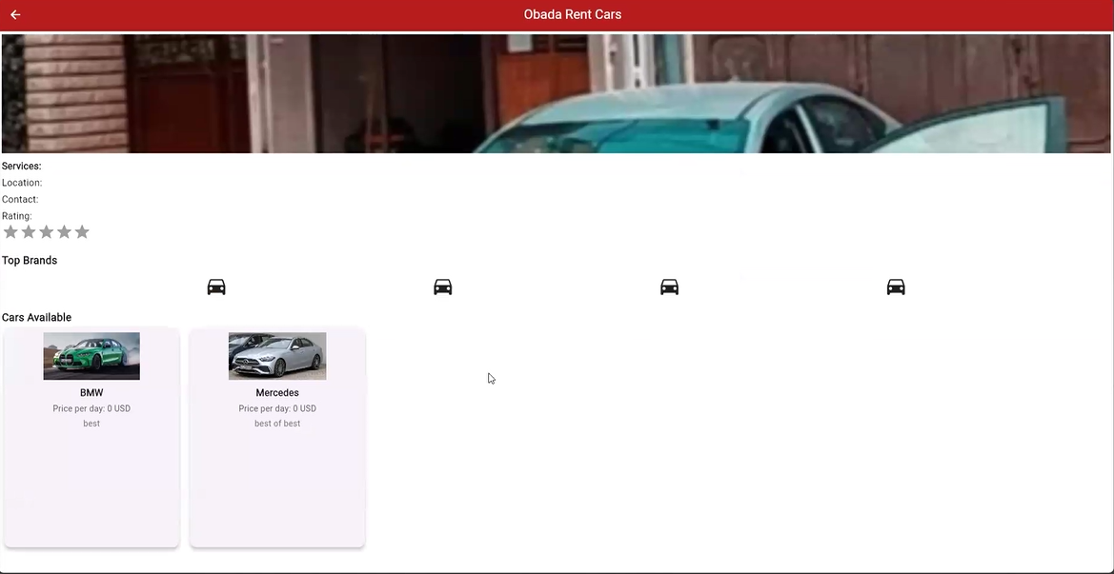
Merchant

Slide 16
Admin
The Admin role in our Project focus on the Reliability of the users, and Can Make CRUD operations on all type of users and their services and watch everything happening around the project !

Slide 17
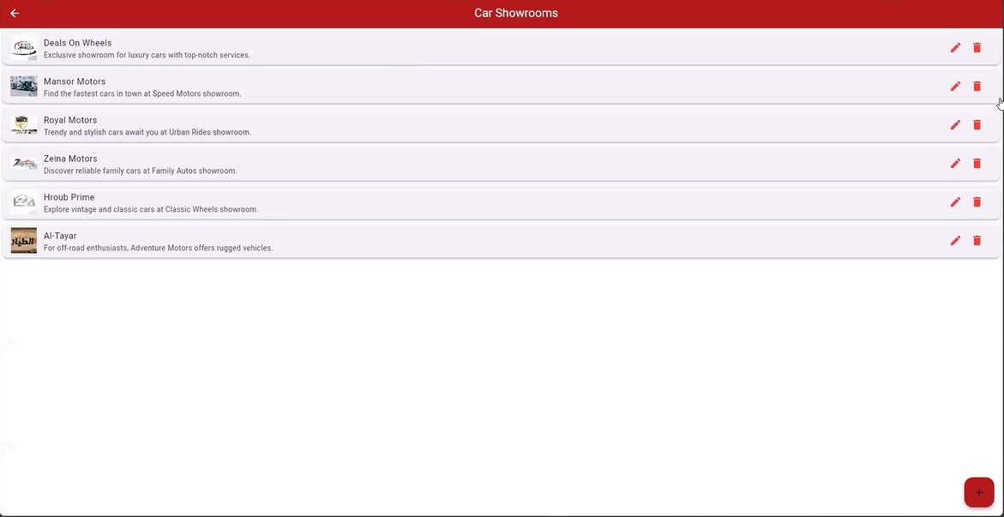
Admin(CRUD)

Slide 18
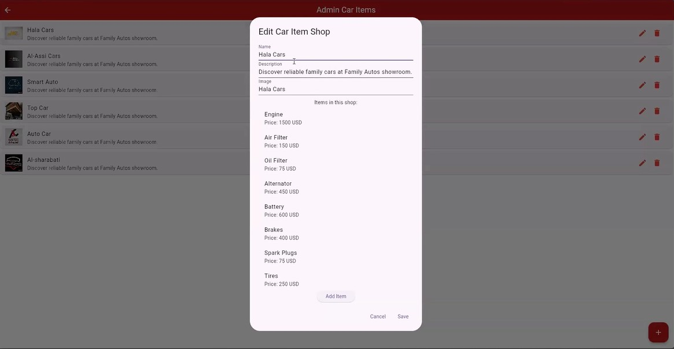
Admin(CRUD)

Slide 19
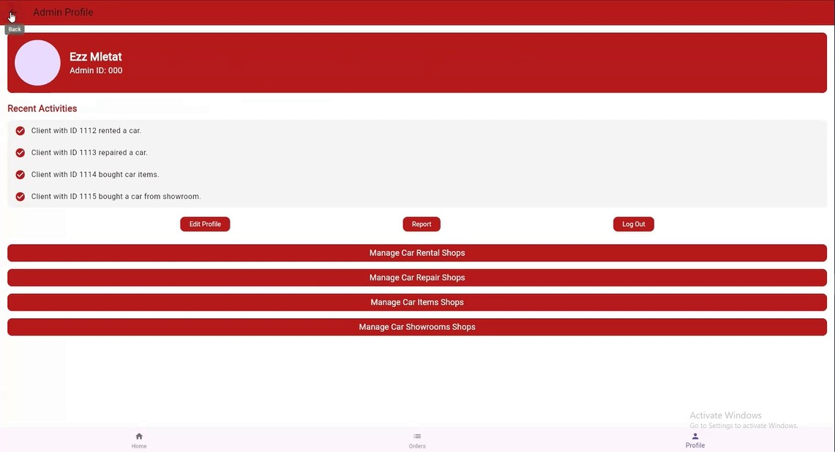
Admin profile

Slide 20
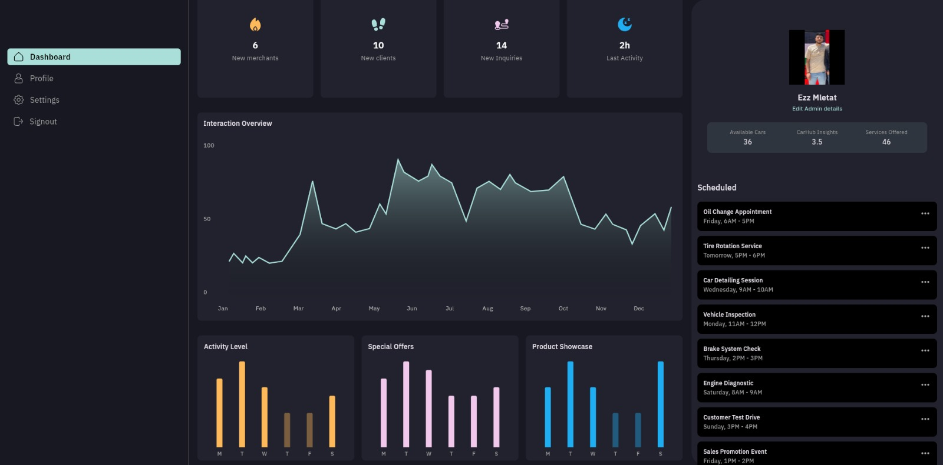
Admin
Admin
Dashboard and
Application data
We can see here
The activities of the
Users on statistics
And charts

Slide 21
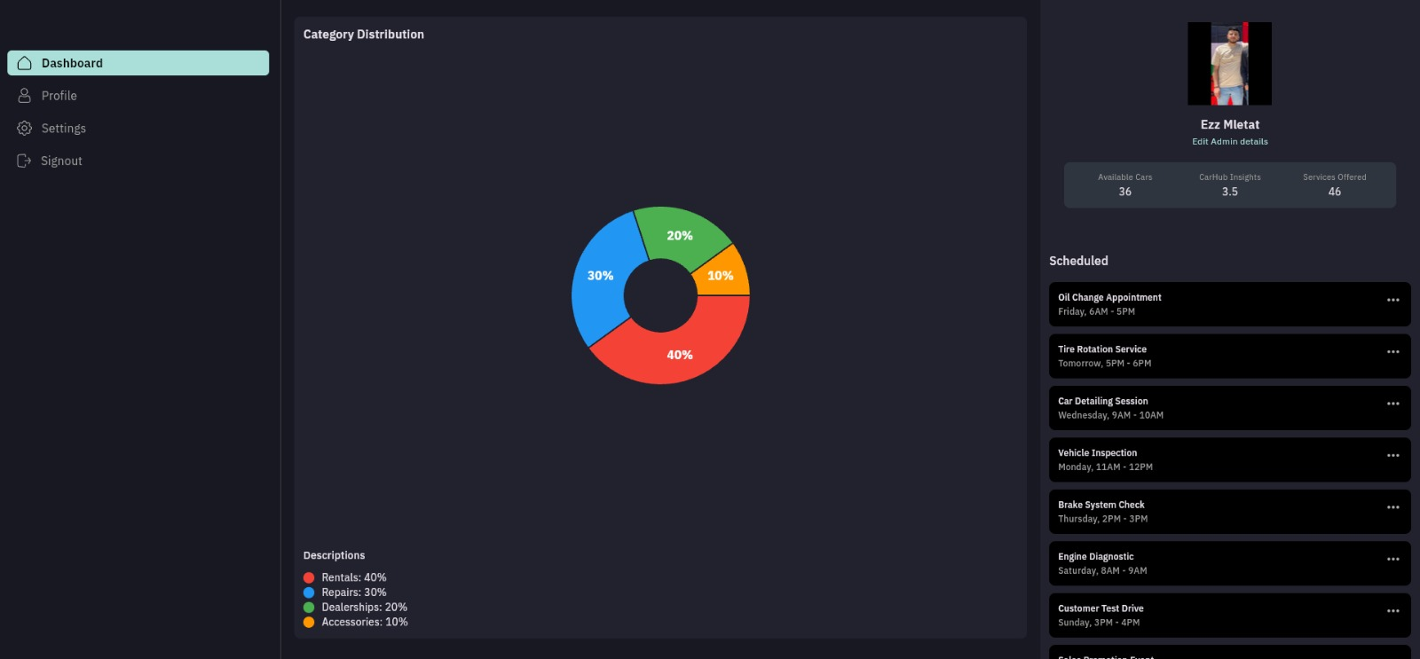
Admin
This chart
shows number
of merchants
,their type and
Their percentage

Slide 22
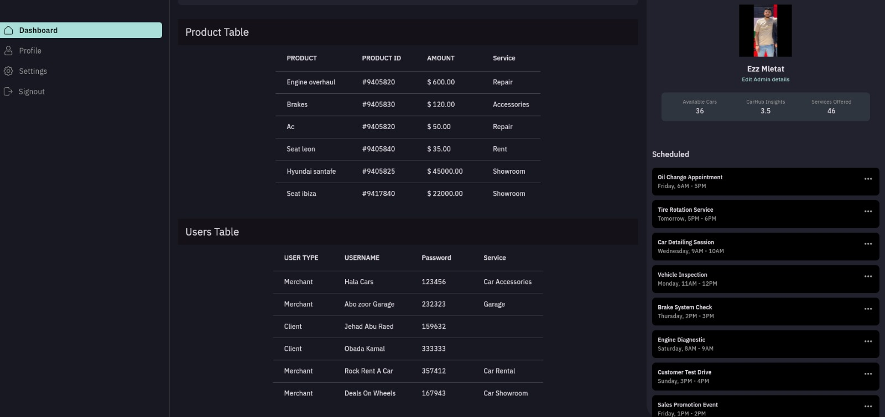
Admin
Admin can also see and track tables of the database running the application

Slide 23
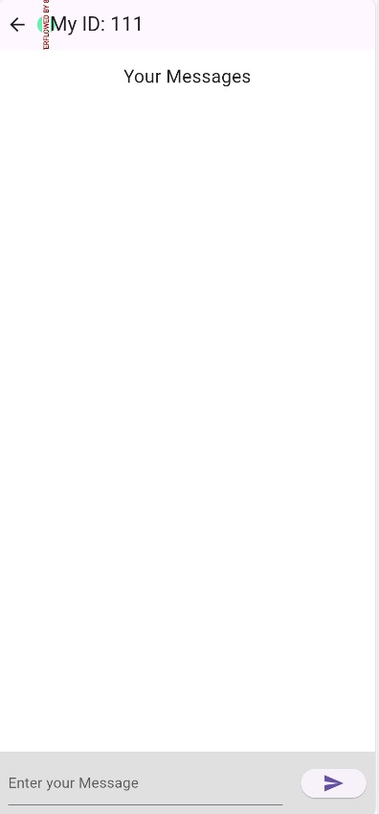
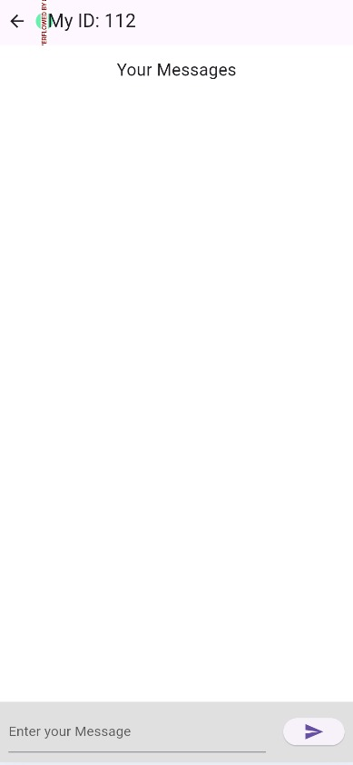
CHATTING !
We designed a chatting system between all types of users using websocket io , for a better experience in the application .

Slide 24
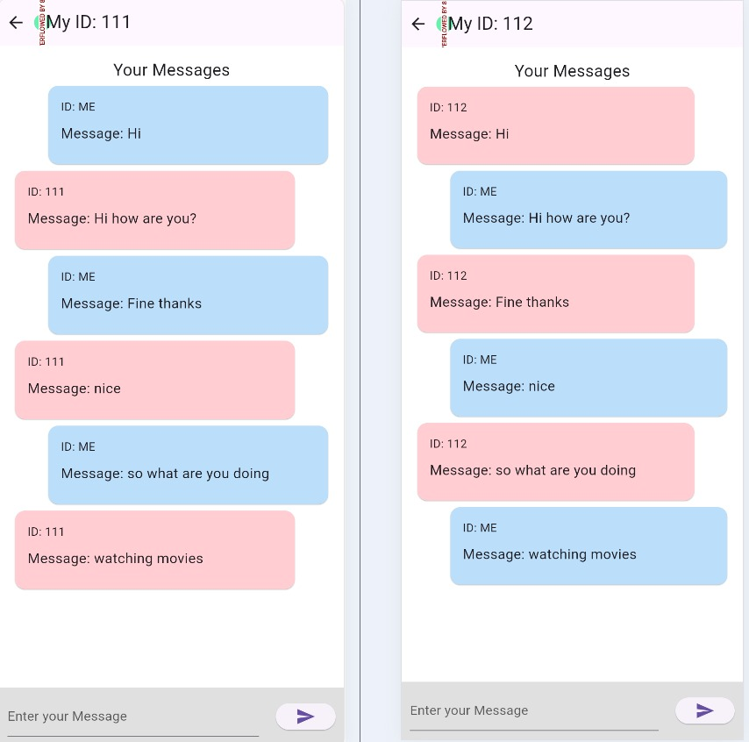
CHATTING !

Slide 25
Constrains & limitations
1- fixed budget for development and implementation.
2- platform constraints : we test and build our project on Android devices due to the lack of resources for IOS Devices.
3- Lack of Resources and idea’s From service providers

Slide 26
FUTURE WORK
Multi-language Support: Expand the app's usability by adding support for multiple languages, catering to a broader audience.
Advanced Search and Filtering: Implement more sophisticated search and filtering options, such as filtering by location, price range, or service type, to enhance the user experience.
Expansion of Services: Continuously expand the range of services offered on CarHub, such as car insurance , car washes , and etc .

Slide 27
Q&A
Thanks for Listening ,
Any Questions ?

