Slide 1
Waste Tires Pyrolysis
Nablus as a case study

Slide 2
Objectives
Discuss the effectiveness of waste tires pyrolysis in Nablus

Slide 3
Significant Problems in Palestine
Waste accumulation
Lack of natural resources
Not all renewable energy types are applicable in Palestine
Instability of political conditions
Pollution due to rapid growth of population and industries
Unemployment
Direct combustion of waste
Energy security
High cost of fossil fuels

Slide 4
Facts about Palestine
Palestine depends on other countries for 100% of its fossil fuels imports.
In 2014 , the amount of waste tires in palestine was 5550 tons/ year .
According to Palestinian Central bureau of statistics in March 2020 , the unemployment rate in Gaza Strip was 46% compared with 14% in West Bank.
According to the Palestinian Central Bureau of Statistics, Palestinians Consumed more than 30 to 40 thousand barrels per day of petroleum in 2017
In 2017 ,The amount of Carbon dioxide emissions in Palestine obtained from three sectors: energy , waste and agricultural was about 477.2 thousand tons . With an increase of 45% over the year 2010.

Slide 5
Waste tires pyrolysis in Nablus
Presence of specialists
Availability of raw material used.
Availability of land , workers ,equipments and waste tires.
Determine the places where waste tire gathering
Ability to create a plan to organize the arrival of waste tires from disposal sites to pyrolysis plant .
Initial cost.
Characteristics of pyrolysis fuel
Feed back : study the Effective of pyrolysis process : less emissions , reduce cost, waste management .
Enhancements on the system.

Slide 6
Project cost
To estimate the cost an existing project in An-Najah National university was taken as an example, all the data taken from previous project that designed the pilot scale plant and estimate the cost.
Many factors determine the cost of the project : design , type of materials used , scale of the project , reactor type and enhancements added.

Slide 7
Main components of the pilot scale plant
Reactor :material used is steel 1030 , dimensions are thickness 1 cm, a diameter of 46 cm, and Height of 70 cm. Main function is place where pyrolysis process happens.
Heating system : burner system and recycling the pyrolysis gas provides heat to the system.
Controller to control the pressure and temperature.
Pressure and heat sensor.
Supporting base , wheels , pipes , two layers of steel with air gap for isolation and motor with sprocket for rotational speed.
Cost for design: 8435 Nis.

Slide 8
Cost of conventional fuel vs cost of pyrolysis fuel
Due to previous experimental study in Palestine, this results taken from an industrial scale project located in Jenin , West Bank.
It has been found that the heavy fuel oil price in Palestine was around 0.5 $/liter. However, the production cost of the tire pyrolysis oil (TPO) is around 0.15 $/liter.
three pyrolysis plants, such as the one in the present study with a capacity of 330 (tons/month), were found, they would be able to get rid of the waste tires generated yearly in Palestine (3800 metric tons).

Slide 9
Transportation and Communications Statistics in Palestine
In 2019 , The total number of licensed vehicles in the West Bank was 269,550. private cars 84.0%, 9.3% was of trucks and commercial cars, w taxis 3.6% , agricultural tractors was 0.2%, while the remaining vehicles formed 2.9%.
total number of licensed vehicles in Nablus 38538 , the number of private cars 32812, trucks and commercial cars 2457 , taxies 1921. So the most resources of waste tires in Nablus from private cars, trucks and commercial and taxies.
The relative distribution for vehicles according to fuel type in West Bank showed that 46.3% use gasoline fuels , 52.3% use diesel fuel and 1.4% use non-classified fuel.

Slide 10
Transportation and Communications Statistics in Palestine
Total number of vehicles using diesel fuel in Nablus city is 18383 that’s mean that 47.7% of vehicles in Nablus use diesel fuel so pyrolysis oil is a good , friendly and cheap alternative.
In Nablus city total number of different stores is 596, number of repair stores is 354 , repair stores has a percentage of 59.3% ,spare parts stores has a percentage of 24.1% , these stores are one of the sources of waste tires.
Nablus has the highest number of stores in West Bank ,the third number of licensed vehicles in West Bank after Hebron and Ramallah and 47.7% of its licensed vehicles use diesel fuel so these statics give the indication that waste tires pyrolysis is an effective alternative fuel .

Slide 11
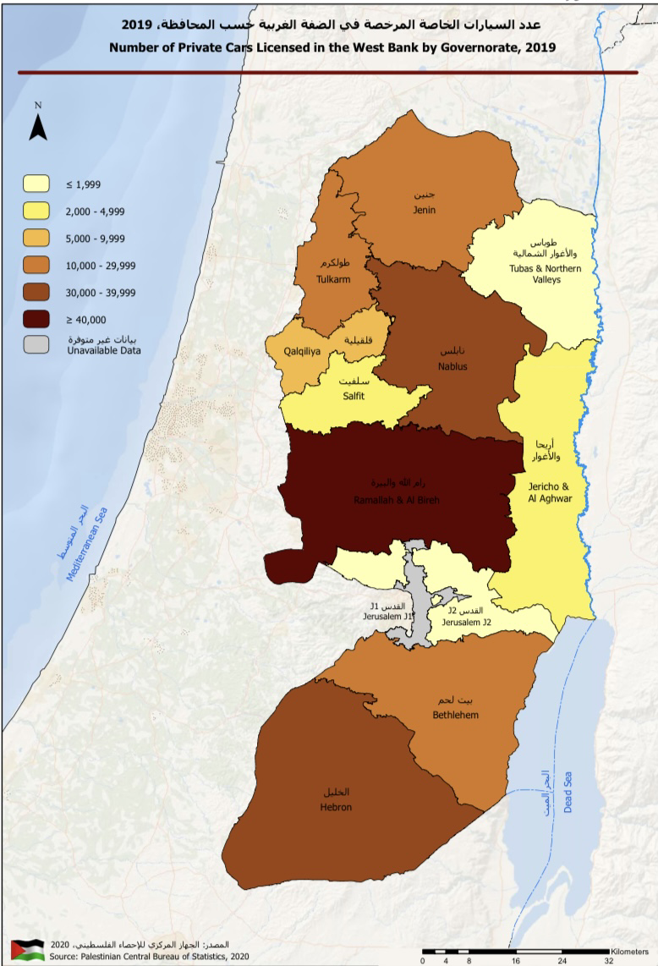
Number of private cars licensed in West Bank by governorate in 2019

Slide 12
pollution reduction
Pyrolysis process in Palestine is very important to focus on to solve critical problems like : energy security , finding new job opportunities , finding alternative fuel source with lower cost and less emissions , waste accumulation and pollution problem.
According to previous experimental studies in Palestine it has been found that There was a present of Sulfur and chlorine in pyrolysis black carbon , this presence is due to the waste tire composition, most of chlorine was present in pyrolysis black carbon. Pyrolysis oil had a presence of hydrogen sulfide so it must be cleaned before using to avoid acidic rain.

Slide 13
Energy sector in Palestine
Energy sector in Palestine is critical for several reasons: the natural energy resources are not available like fuel and coal, political conditions is changing always so it is not stable , pollution, no waste management, no finding to concentrate on new energy sources, dependence on other countries for electricity and fuels .
Palestine depends on other countries for 100% of its fossil fuel imports and for 87% of its electricity imports .

Slide 14
Yields of pyrolysis process
The yields of the pyrolysis products obtained from waste tires were Char , oil , steel wires and pyrolysis gas , the weigh in Kg of each product was : pyrolysis oil 2249.2 Kg , Char 1708.4 Kg , steel 547.3 Kg and pyrolysis gas 494.3 Kg.
Solid product: black carbon, presence of sulfur and chlorine, high heating value 36 MJ/kg .
this value compared to petroleum high heating value which has a range of values from 39.5 to 45 MJ/kg . Heating value of black carbon gives the indication that it can be used as solid fuel.

Slide 15
Pyrolysis Oil
The most significant characters must be considered : viscosity , colour and smell , density , flash temperature and PH value.
Color is dark brown , smell is bad and sticky.
Viscosity is low , indicates that the fuel easy to handle and transport.
Flash point is 30 to 33 ºC , low , low flash point for any fuel means that the fuel is not safe and easy to fire while using or while storage.
Flash point of diesel fuel is 55 ºC .
pH value has a range of 4.27 to 4.37 , this value gives the indication of the fuel will has a specific way to handle and storage.

Slide 16
Pyrolysis Oil and pyrolysis Gas
there are two common ways to use pyrolysis oil as a fuel : treatment and flirted of pyrolysis oil or blend with conventional fuels.
the pyrolysis gas. The heating value of pyrolysis gas has a range of (38–41 MJ/m3).
Heating value is very close to heating value of natural gas.
The most common use of pyrolysis gas is an external source of energy in the pyrolysis plants
There is a presence of hydrogen sulﬁde
the main disadvantages of hydrogen sulfide is the damage of equipment.

Slide 17
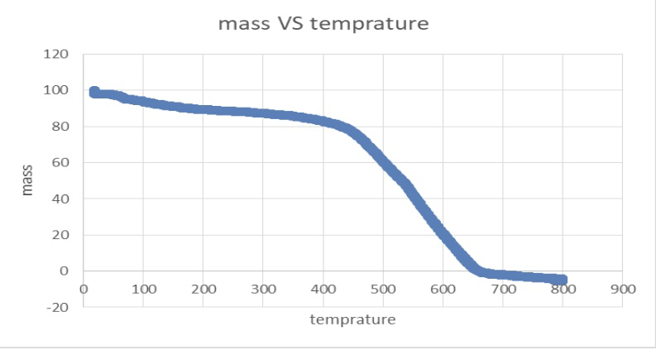
TGA test results for char at a temperature of 800 ºC and flow rate 10 ºC /min.

Slide 18
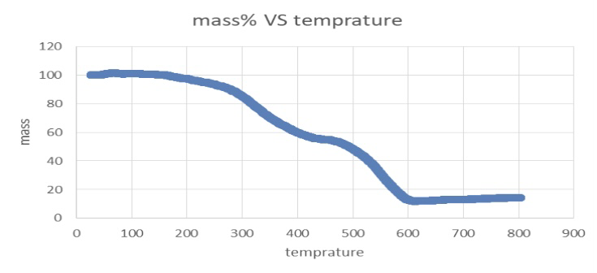
TGA test results for wheel at a temperature of 800 ºC and flow rate 10 ºC /min.

Slide 19
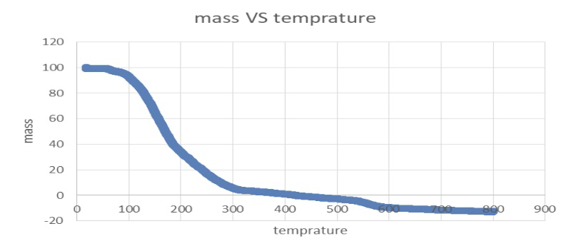
TGA test results for oil at a temperature of 800 ºC and flow rate 10 ºC /min

Slide 20
Conclusion

