Slide 1
SAFE
(Smart Agency For Entities)
Hardware Graduation Project
Prepared by:
Ansam Soliman.
Yasmeen Shqair.
Supervised by:
Dr. Ashraf Armoush.
Dr. Manar Qamhieh.
Eng. Haya Samaaneh.

Slide 2
Outline
Problem.
Solution.
What is SAFE project.
Introduction.
Objectives.
Tools and components.
Constraints.
Future work.
Conclusion.

Slide 3
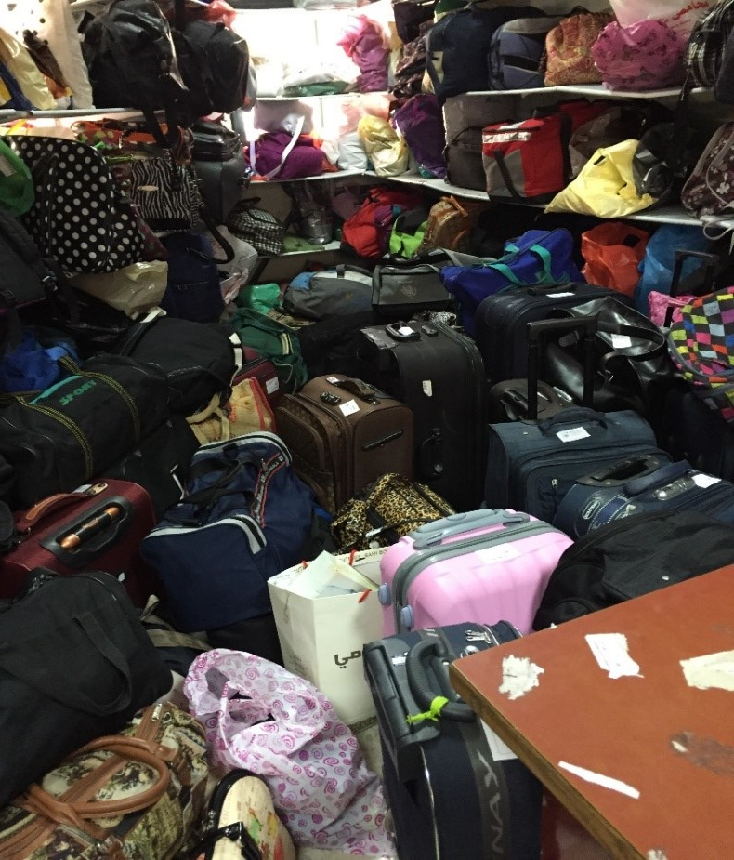
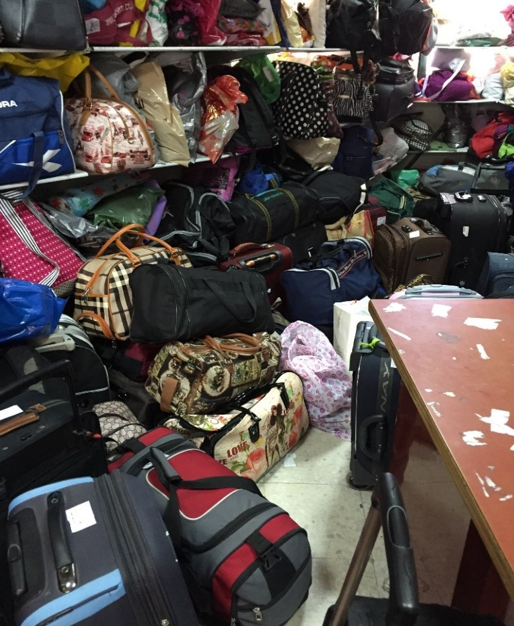
Problem
Untidy and unorganized method that used to save packages.
This lost a lot of time and effort.

Slide 4
Solution
Smart System For Smart Packaging
Like
Our SAFE Project

Slide 5

So what SAFE Project is?

Slide 6
What is SAFE project?
SAFE (Smart Agency For Entities), is a model that includes two sections to save packages depending on their sizes(small or large) by using different mechanisms ( Phone Number or Barcode).

Slide 7
Introduction
Existence of the Problem ( At university …)
Recommended Solution
SAFE Project easy to deal with it.
SAFE Project need to be investigated in our country.
SAFE Project can be improved in many sides to be one of the important projects

Slide 8
Objectives
Organizing and saving packages in several sizes.
Reduce time and effort.
Increase the utilization of space.
Reduce mistakes.

Slide 9
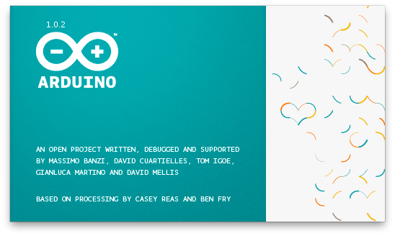
Tools and components
Arduino C SW used for programming based on C language.

Slide 10
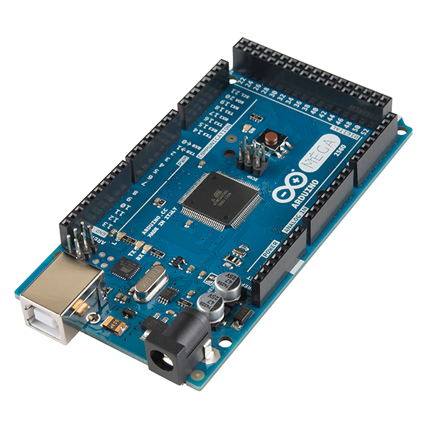
Tools and components
Arduino Mega

Slide 11
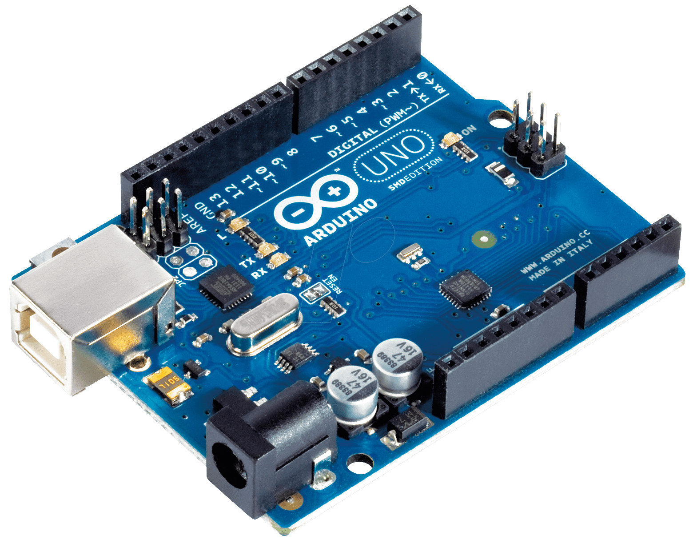
Tools and components
Arduino Uno

Slide 12
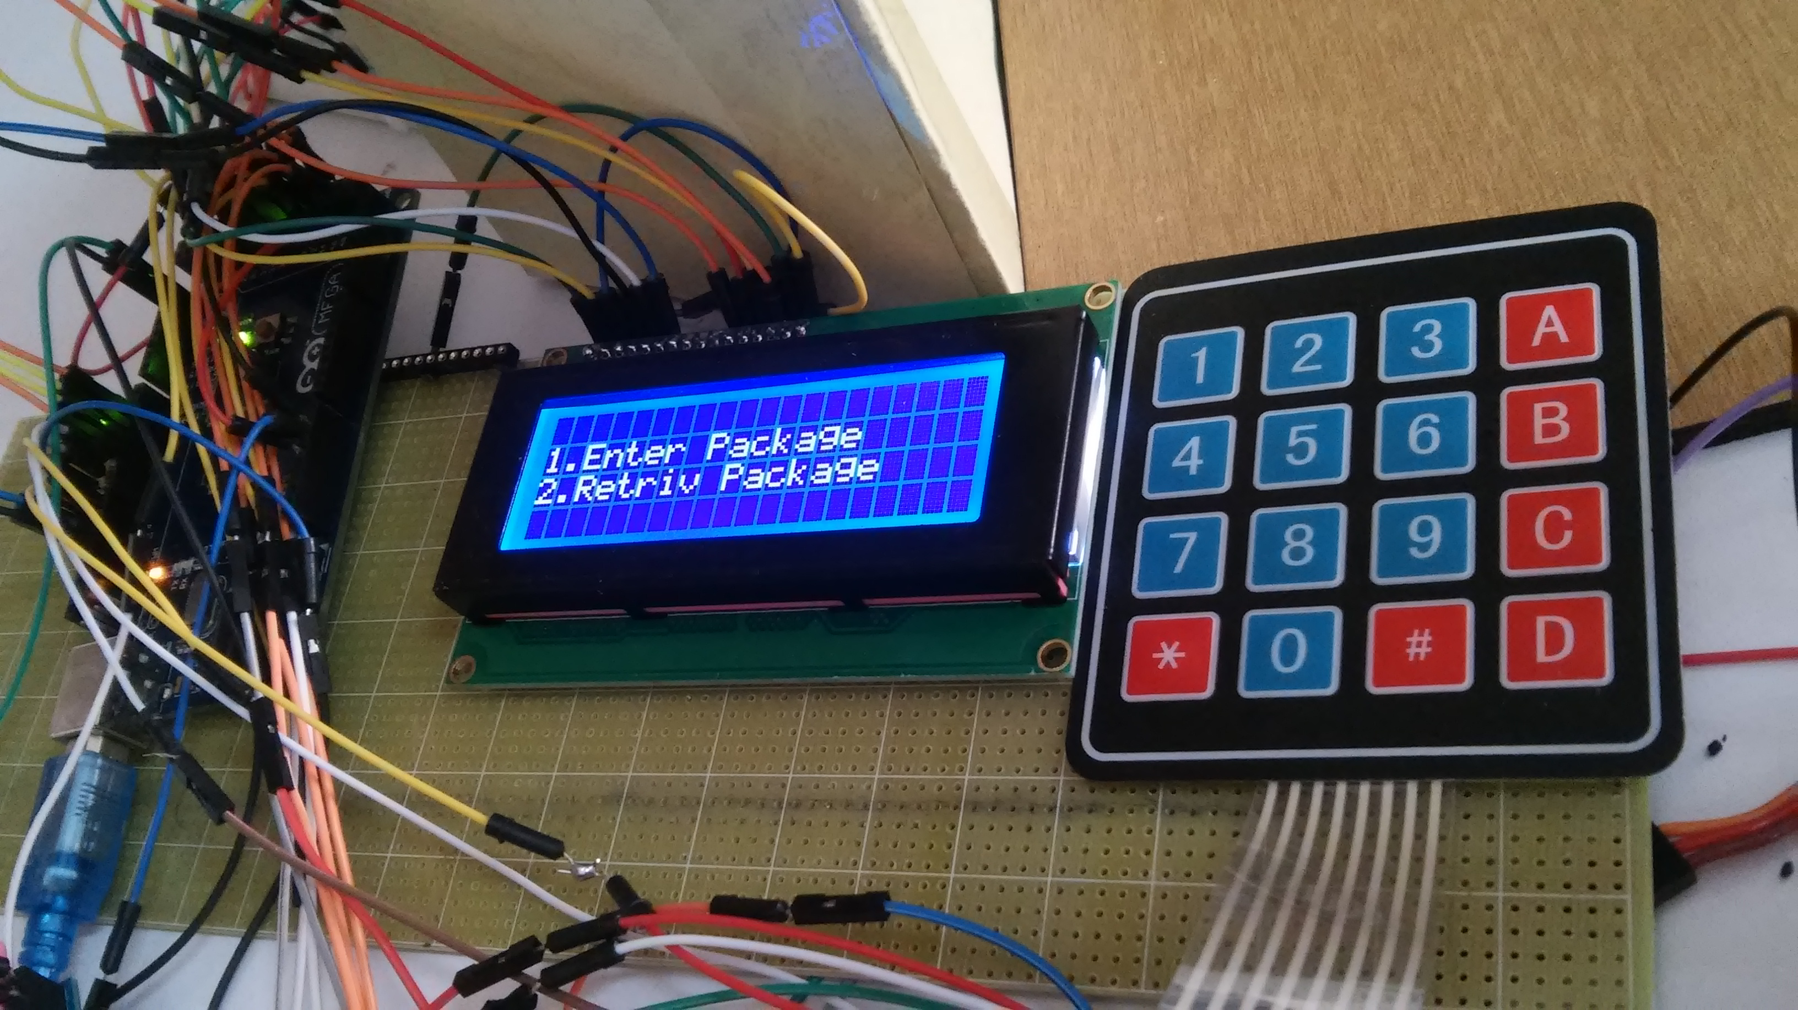
Tools and components
Control panel consist of LCD and Keypad.

Slide 13
Tools and components
Pic for lcd and keypad phone and barcode

Slide 14
Tools and components
Ultrasonic sensors.
generate high frequency sound waves and evaluate the echo which is received back by the sensor.
Sensors calculate the time interval between sending the signal and receiving the echo to determine the distance to an object.

Slide 15
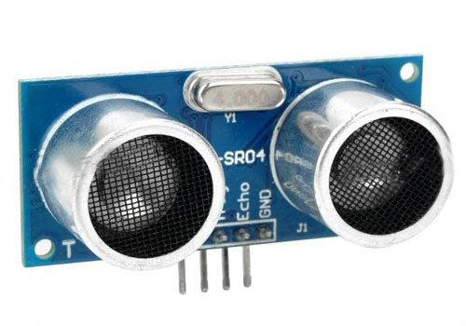
Tools and components
We used ultrasonic sensors for detections the empty slots in our model
to allow users reserve slots for their packages.

Slide 16
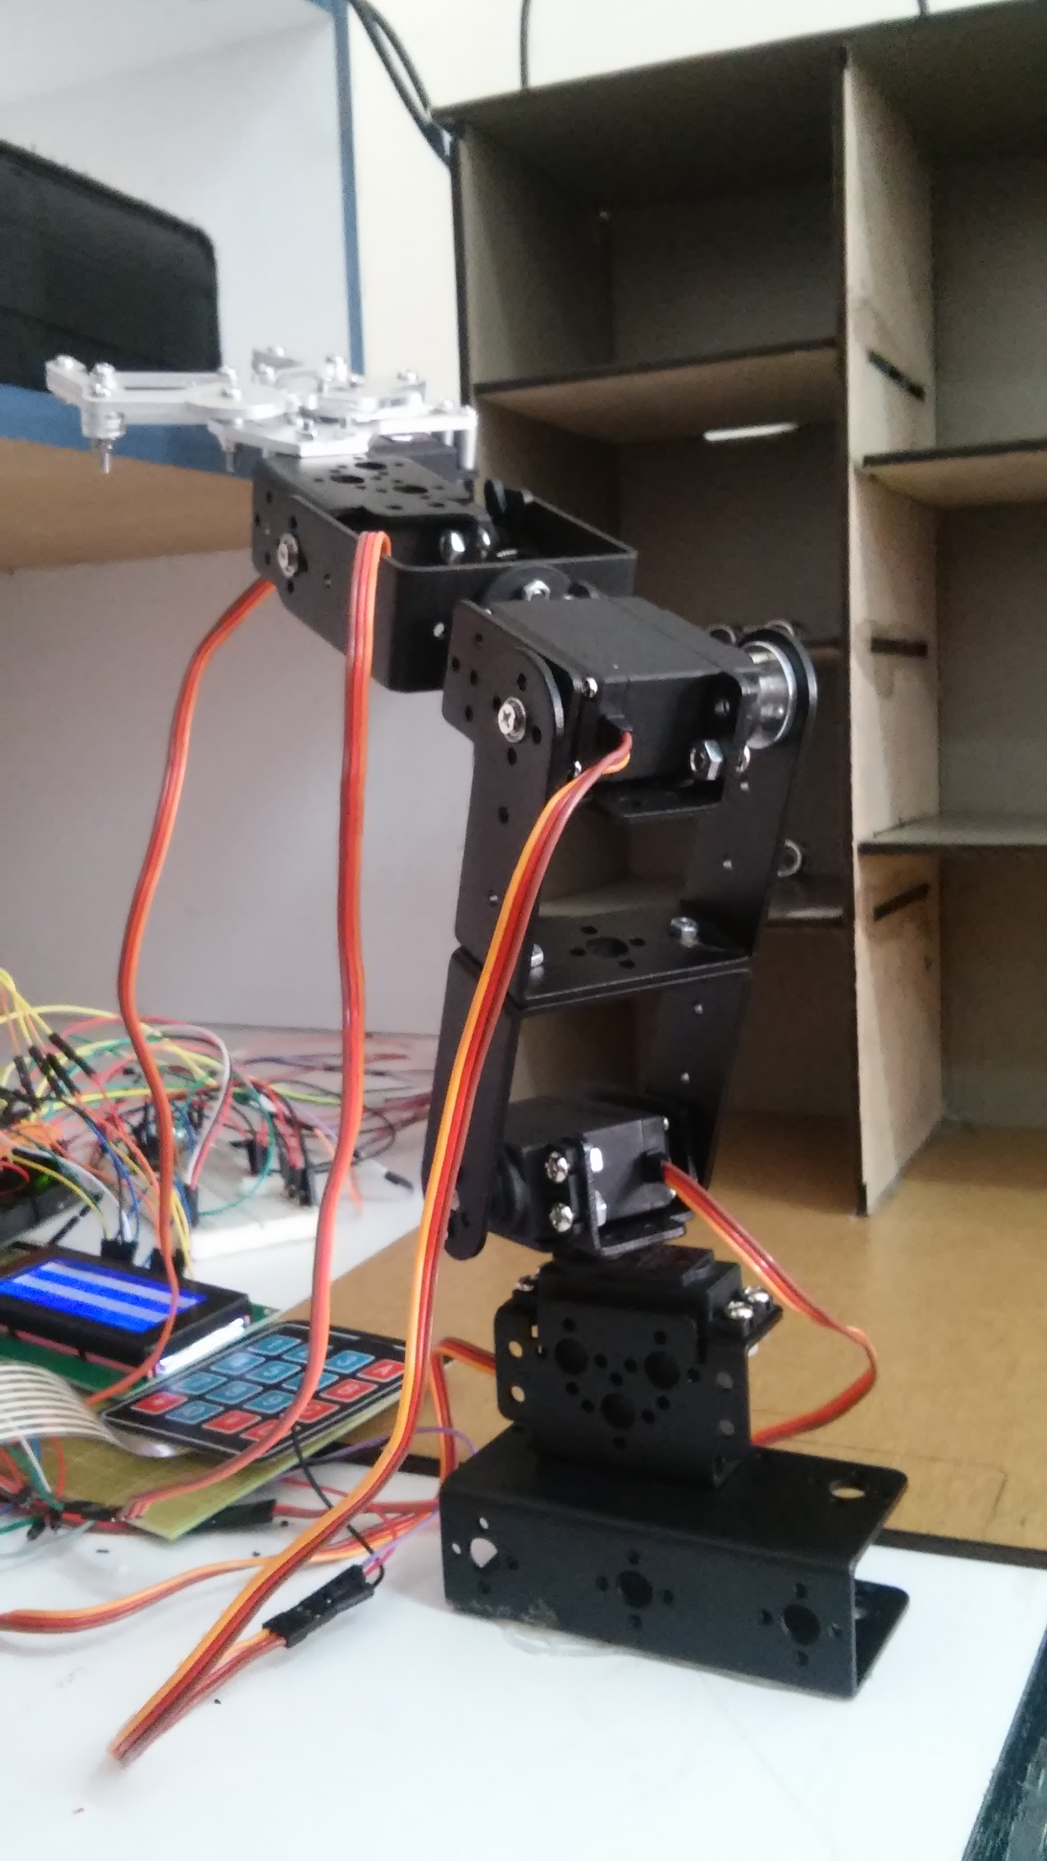
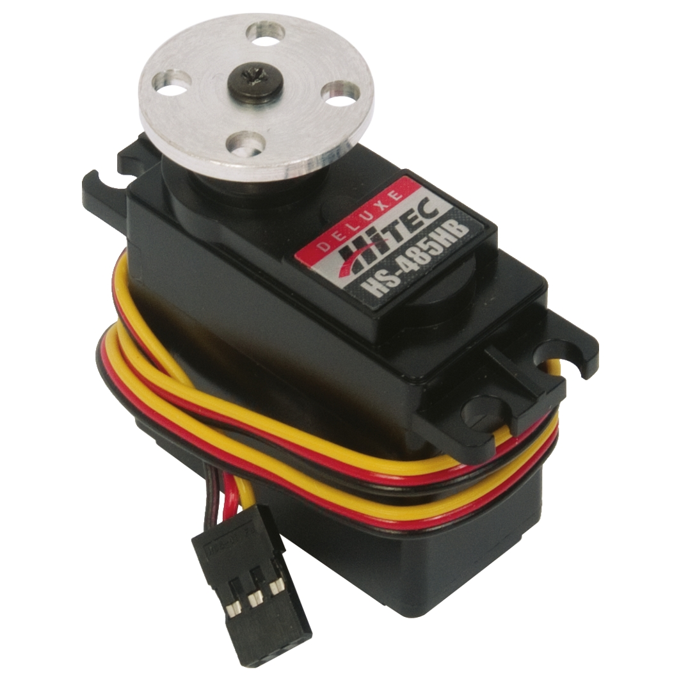
Tools and components
Servo motors.
Servos have integrated gears and a shaft that can be controlled. Servos allow the shaft to be positioned at various angles, usually between 0 and 180 degrees. We use 5 servo motor for arm to pick the package and put it inside suitable slot in wooden model and retrieve the package from it to user.

Slide 17
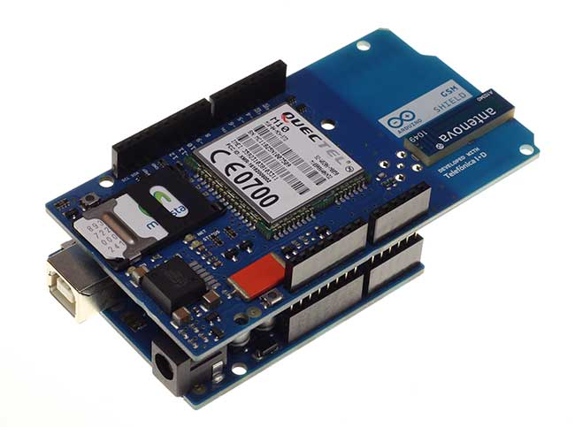
Tools and components
GSM/GPRS Shield
We use the GSM to send message when the user enter the package, he will enter his phone number to reserve empty slot, so if there is an empty slot the system will send message to user to ensure his reservation, and when the user need to retrieve his package then the system receive message to identify his package and return it to the user.

Slide 18
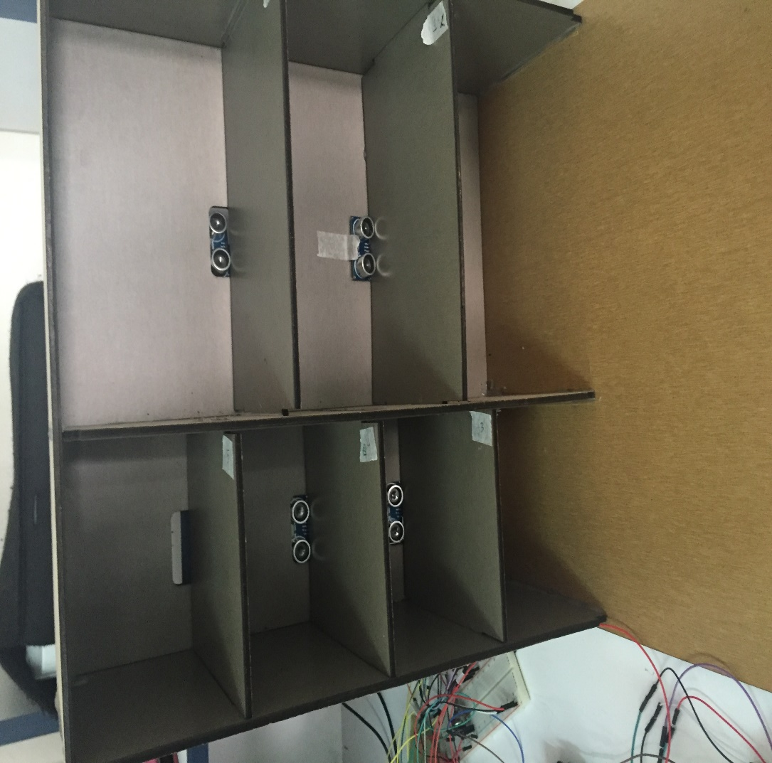
Tools and components
Wooden model
consist of two kind of sizes(small and large), the user can choose one of them to put the package according to the size of it and the reading of ultrasonic sensors that detection the empty slots in the model.

Slide 19
Features
Automation Entering and Retrieving for Packages.
Organize the packages according to their sizes(small and large).
User can reserve place using its phone number or the system give him barcode according to the place.

Slide 20
Constraints
Financial Constraints
Part | NO. Of Units | Cost/Unit NIS | Total Cost
Wooden model | 1 | 200 | 200
Arduino Uno | 1 | 69 | 69
Arduino Mega | 1 | 150 | 150
GPRS-GSM | 1 | 250 | 250
LCD | 1 | 45 | 45
Keypad | 1 | 20 | 20
Whiteboard | 1 | 10 | 10
Ultrasonic | 4 | 20 | 80
Servo motors | 5 | 62 | 310
Arm | 1 | 90 | 90
Wires | -- | 76 | 76
Total Cost |  |  | 1300

Slide 21
Constraints
Hardware Constraints
Due to the political situation in Palestine, not all hardware components available in our markets. So, sometimes, we were forced to wait for the arrival some components.

Slide 22
Constraints
Design Constraints
we made the first one which was not suitable for our project, so we changed it to another one that contains 2 kinds of shelves (small and large), we think that is more suitable.

Slide 23
Constraints
Design Constraints
we were confused with the type of sensors that we should use in order to detect the empty slots in the model and we chose Ultrasonic sensors because IR sensors don’t detect the black color.

Slide 24
Future work
Support dynamic sizes fit with any package size.
Improve the security for our system.
Remember the package’s owner to take his/her bag before the work day finish throw phone message or notification.

Slide 25
Conclusion
Our project was done step by step. Trying to achieve the best results and stable system, and solving all problem that we faced.
Finally we were able to reach a good stage in our project, but of course we need more time to do better.

