Slide 1
Analysis and Design of
Al-Quds International Airport
Main Terminal Building
By: Ahmad Abu Arra
Baker Bozeyeh
Under Supervision of :
Dr. Ibrahim Mohammad

Slide 2
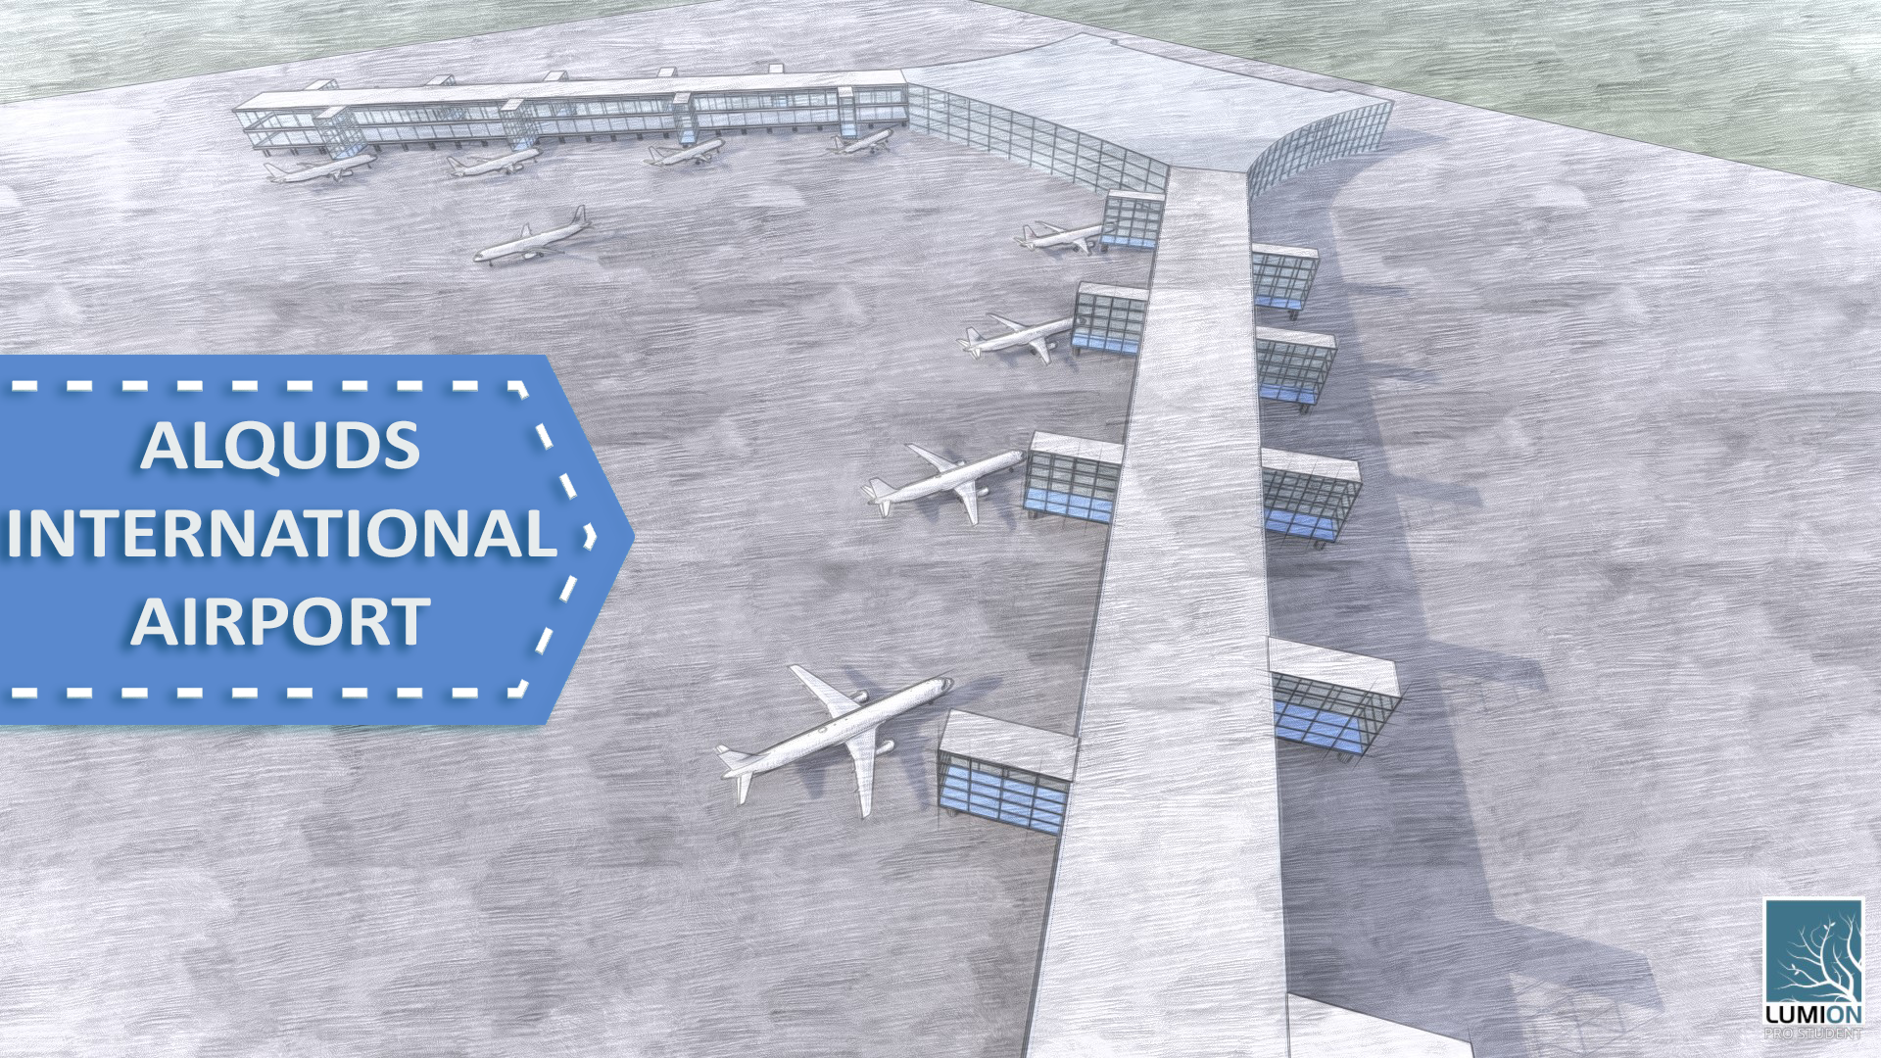

Slide 3
INTRODUCTION

Slide 4

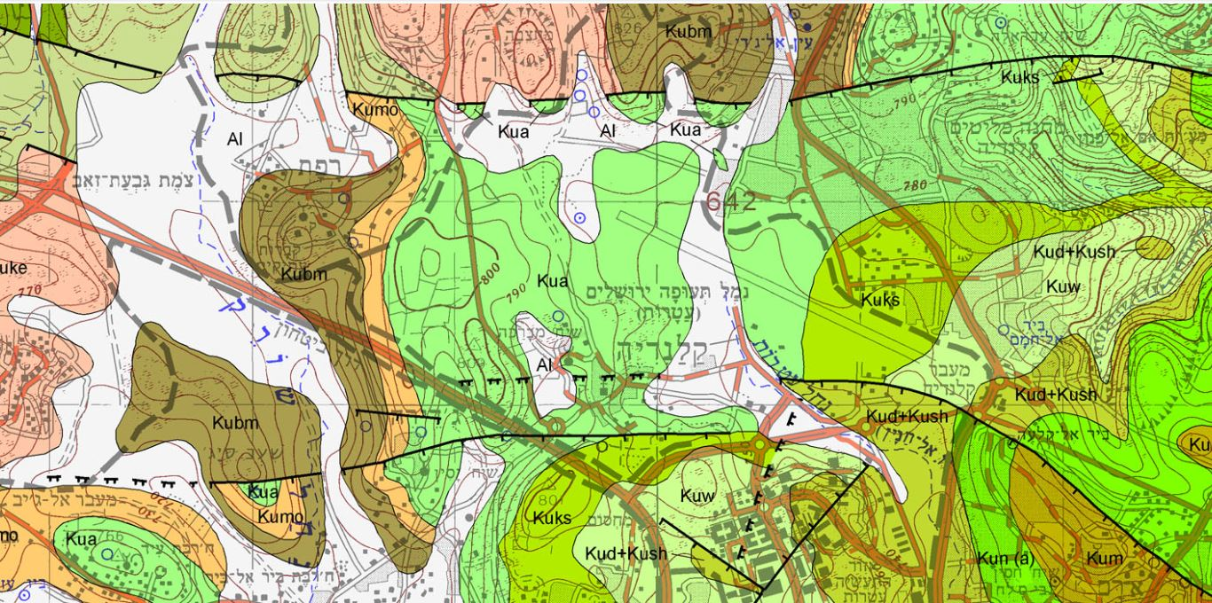
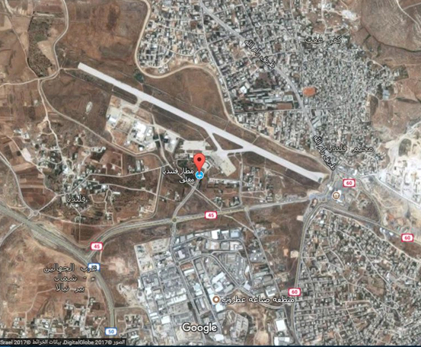
Background Info.
INTRODUCTION
Location: Qalandia, Palestine
Near Qalandia Airport Site
Site geology: Dolomite with a surface layer of Alluvium
Bearing capacity = 400 KN/m²
Figure3. Geological map of the proposed location
Figure2. Site location
Figure1. Map of Palestine

Slide 5
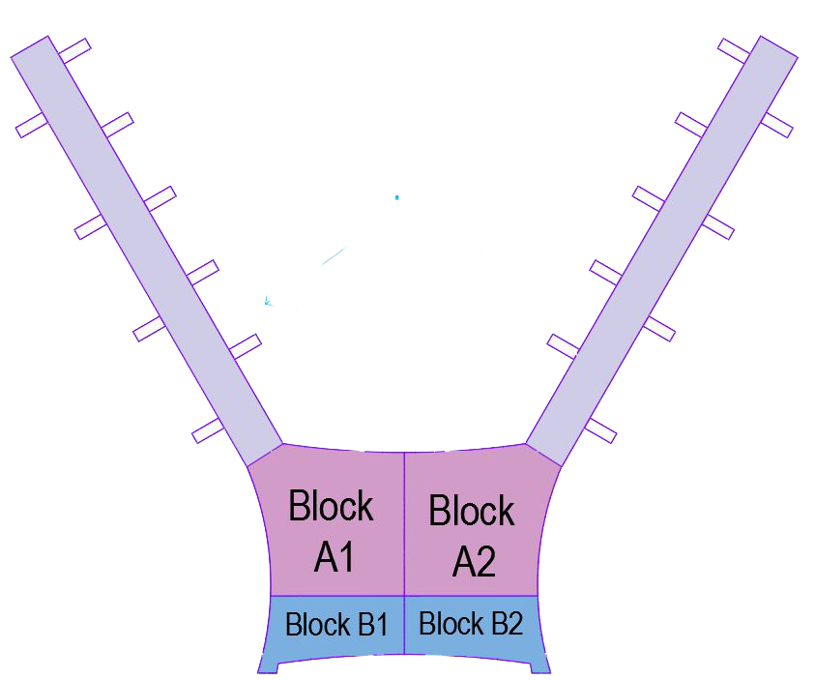


Conceptual Design
INTRODUCTION
Pier-type terminal
Based on ACRP Report 25 : Air passenger terminal planning and design
Figure4. Schematic diagram of the main terminal
Figure5. ACRP Report 25

Slide 6
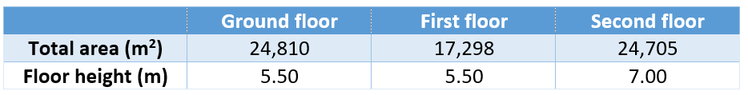
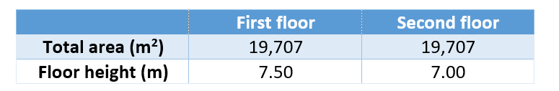
Architectural Design
INTRODUCTION
3 Stories
Total area of 64,000 m²
Total height = 18 m
Table1. Floors areas and heights
Table2. Piers areas and height

Slide 7
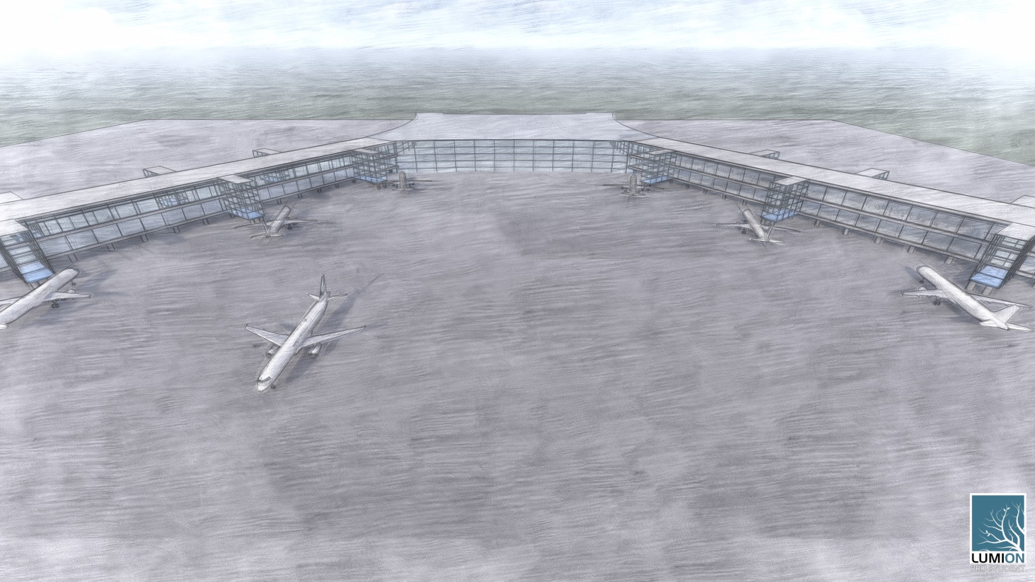

Slide 8
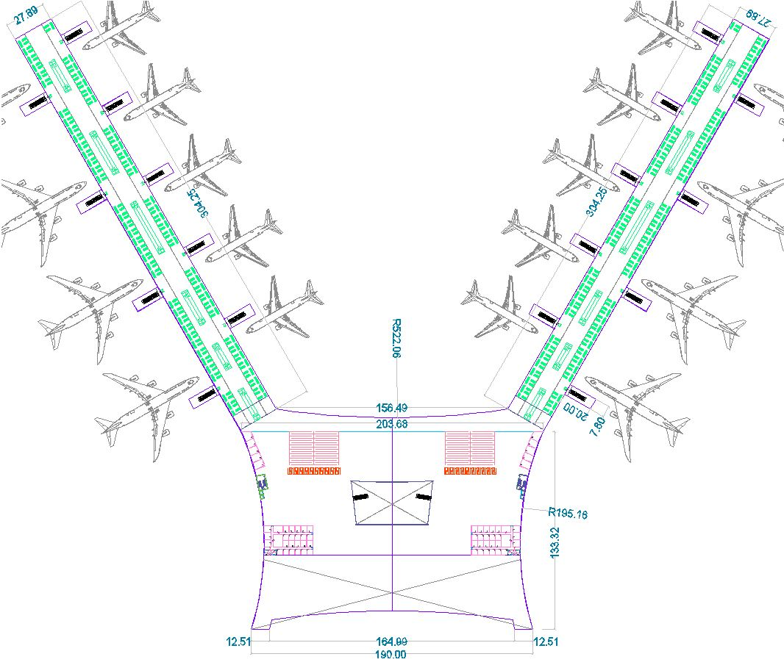
Figure7. First floor plan

Slide 9
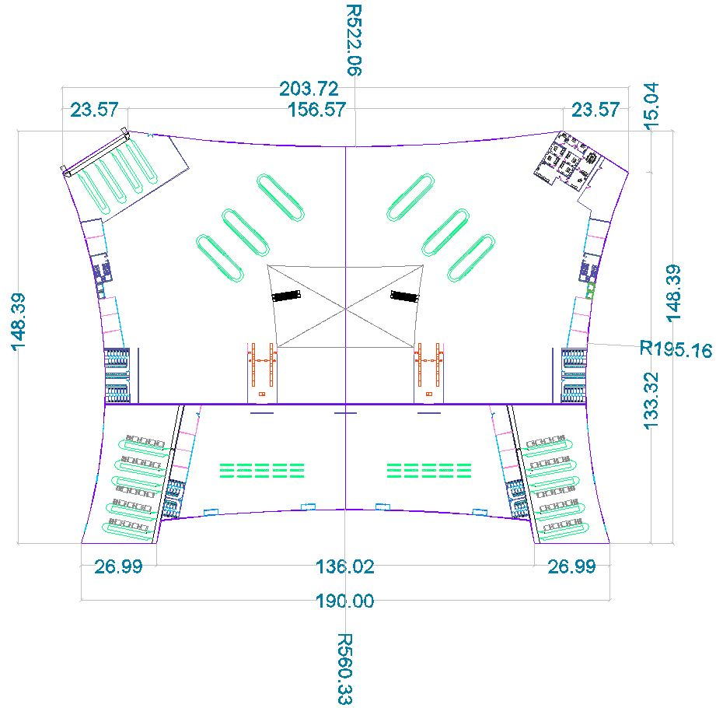
Figure6. Ground floor plan

Slide 10
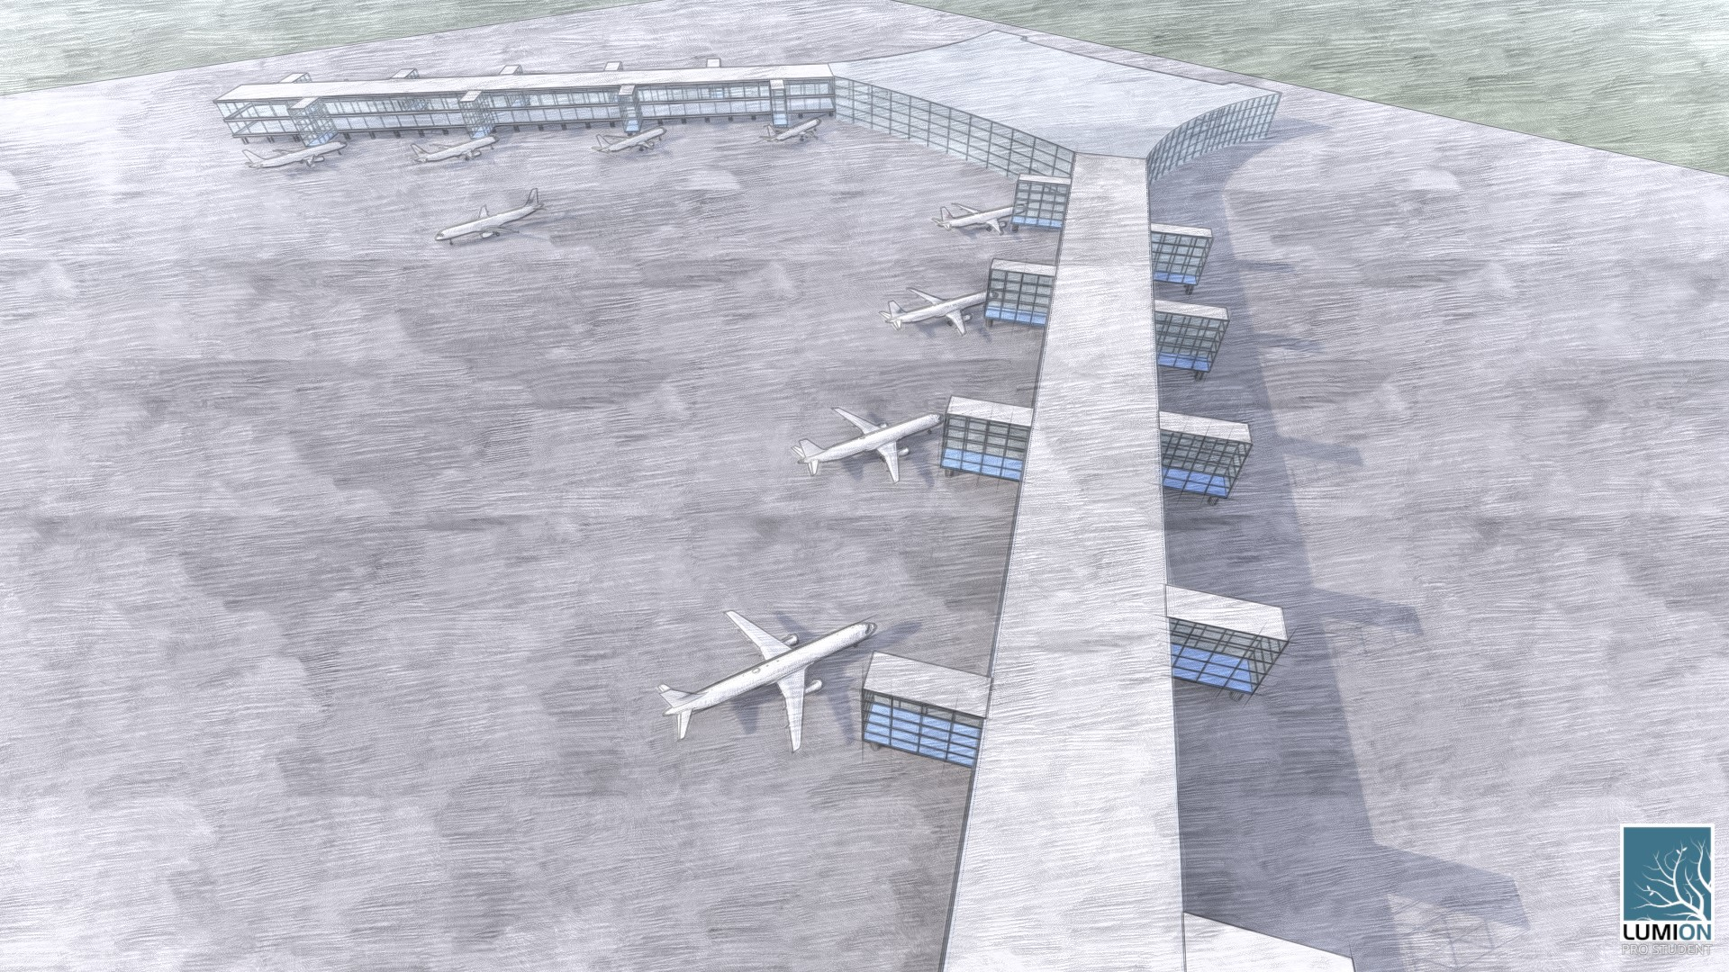

Slide 11
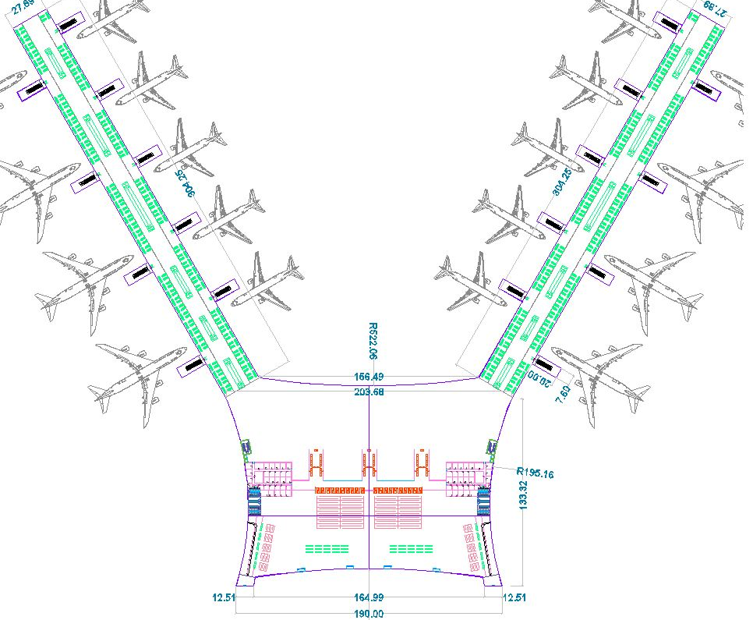
Figure8. Second floor plan

Slide 12
Structural Design
INTRODUCTION
Structural system:
Terminal: Divided into 4 blocks
Special moment resisting frames. Two way Slabs with drop beams
Piers: Composite steel and concrete structures
Figure9. Schematic diagram of the terminal building

Slide 13
INTRODUCTION
Loads
Dead Loads: Own weight
Super-imposed dead load = 3.1 KN/m²
Live load = 5 KN/m²
Snow load = 1.428 KN/m²
Self-straining loads (temperature loads)

Slide 14
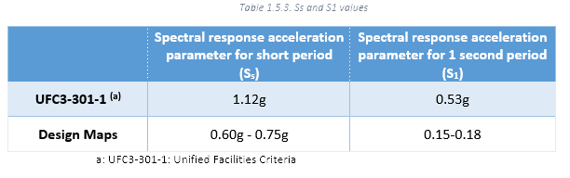
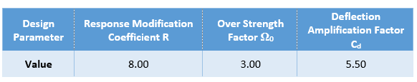
INTRODUCTION
Seismic Loads
Seismic Design Parameters:
Risk category IV
Seismic importance factor = 1.5
Site class: B
Seismic design category : D
Response spectrum
Table3. Seismic parameters
Figure10. Design response spectrum
Table4. Seismic design coefficients

Slide 15
INTRODUCTION
Load Combinations
Ultimate Load Combinations:
1.4D
1.2D + 1.6L + 0.5Lr
1.2D + 1.6L + 0.5S
1.2D + 1.6Lr + L
1.2D + 1.6S + L
1.2D + 1.0E + L + 0.2S
0.9D + 1.0E
Service Load Combinations:
D
D + L
D + Lr
D + S
D + 0.75L + 0.75Lr
D + 0.7E
D + 0.75L + 0.75(0.7E) + 0.75S
0.6D + 0.7E
Where:
D = Dead Loads
L = Live loads
Lr = Roof live load
E = Earthquake load
S = Snow load

Slide 16
Part One: Concrete Structure

Slide 17
Initial Dimensions
PRELIMINARY DESIGN
Beams: 800X400 mm
Slab thickness = 250mm
Columns: circular, D = 800mm
Materials
Concrete 32MPa.
Grade60 steel

Slide 18
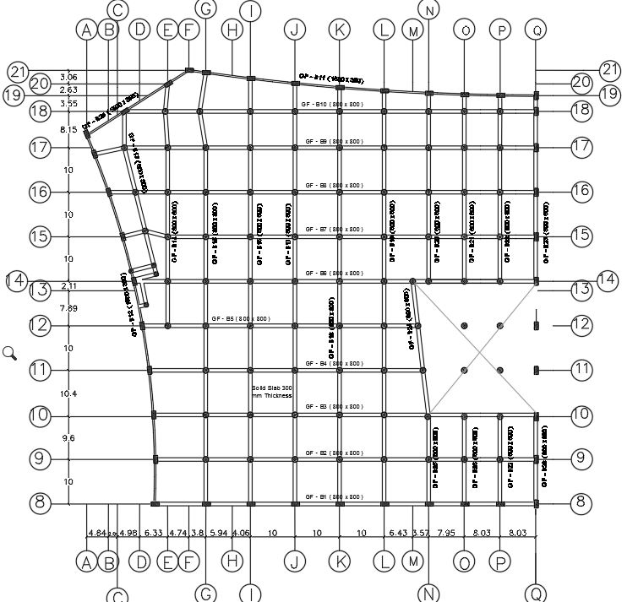
GF Beams Layout
(Block A)

Slide 19
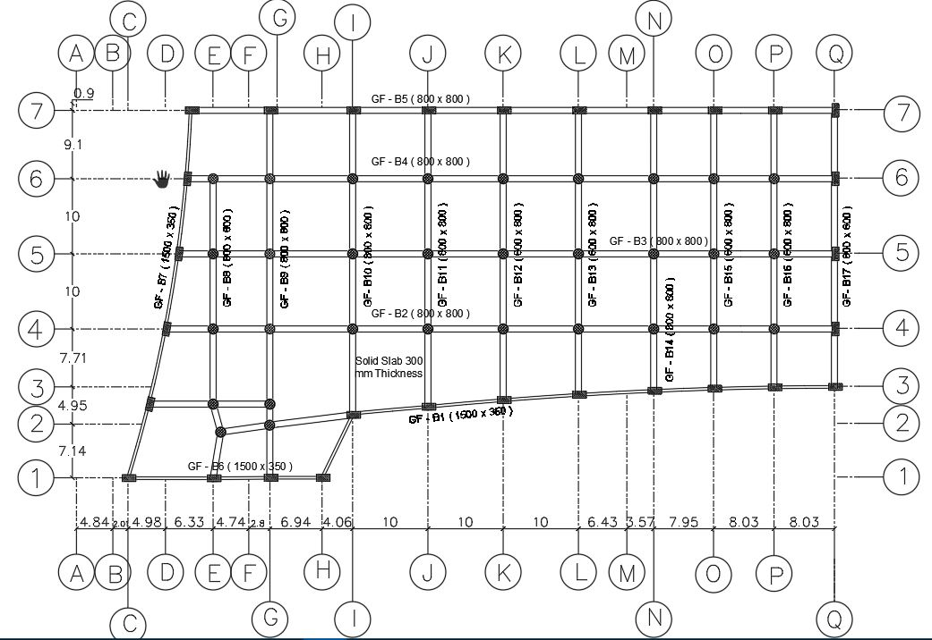
GF Beams Layout
(Block B)

Slide 20
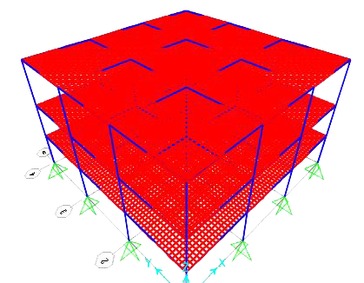
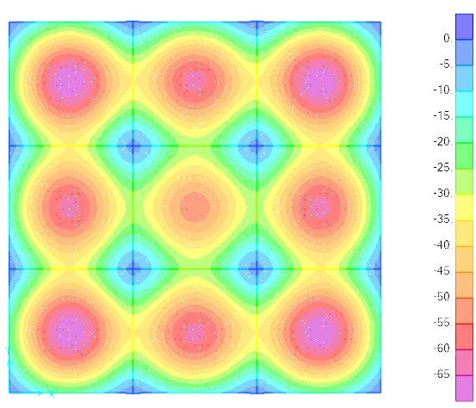
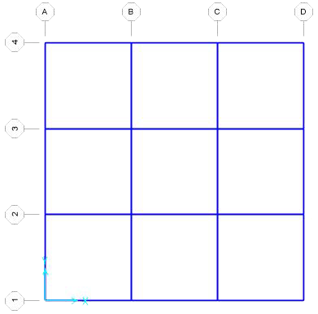
3D Model
PRELIMINARY DESIGN
Equal spans, 10m c/c
Acceptable deflections: 41.6mm for slabs, 20.8mm for spandrel beams
Slab stiffness modifier = 0.35
Combination : ∆ =2×∆𝐷+1.5×∆𝐿
Resulting deflection = 66mm > allowable
Figure11. 3D preliminary model
Figure13. Deflections in slab
Figure12. Top view of preliminary model

Slide 21
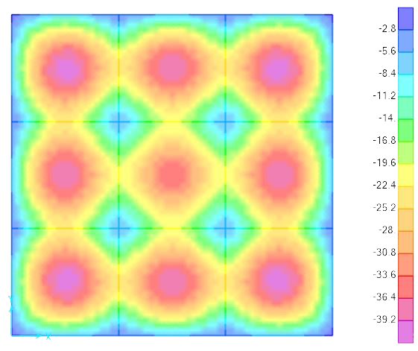
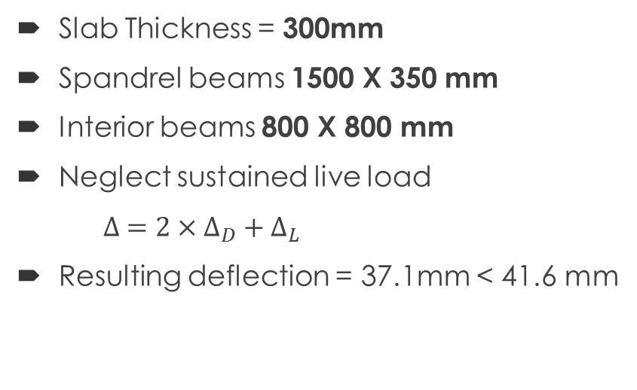
Preliminary Model Modifications
PRELIMINARY DESIGN
Slab Thickness = 300mm
Spandrel beams 1500 X 350 mm
Interior beams 800 X 800 mm
Neglect sustained live load
$∆ =2×∆_{D}+∆_{L}$
Resulting deflection = 37.1mm < 41.6 mm
Figure14. 3D preliminary model
Figure16. Deflections in slab
Figure15. Top view of preliminary model

Slide 22
3D Modeling & Analysis

Slide 23
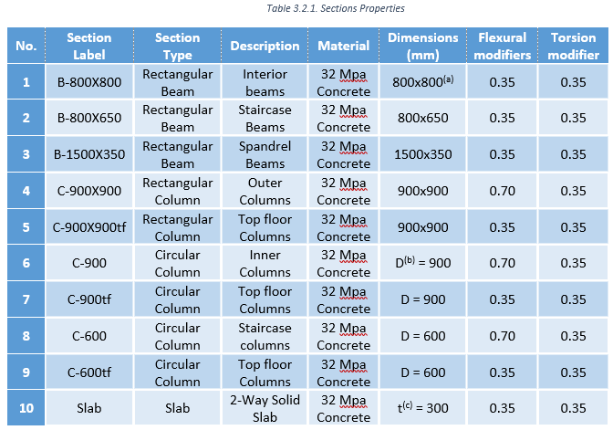
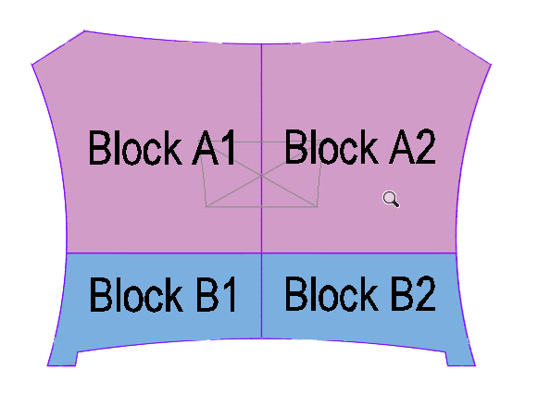
Structural Modeling
3D ANALYSIS
Table5. Section properties
Four building blocks
Section properties
Concrete 32MPa.
Grade60 steel
Figure16. Building Blocks

Slide 24
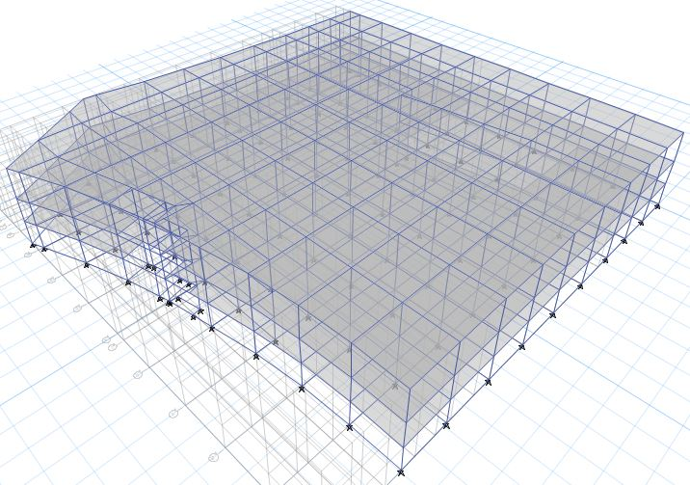
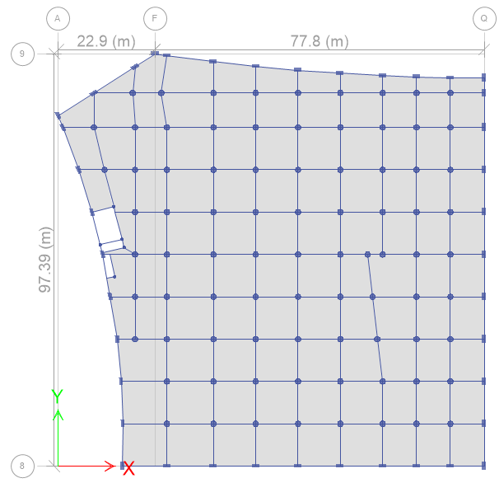
Block A
Figure18. 3D view of block A model
Figure17. Top view of block A model

Slide 25
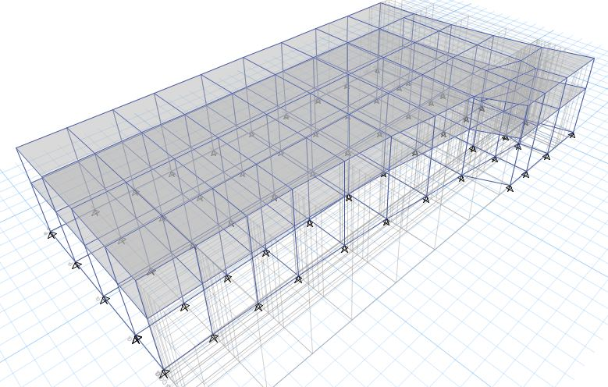
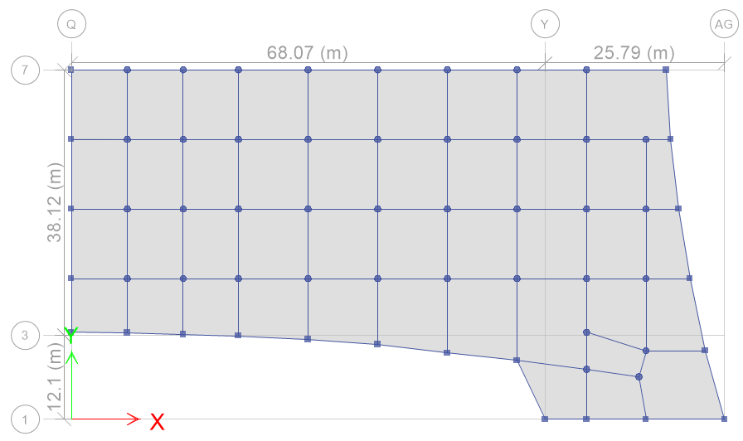
Block B
Figure20. 3D view of block B model
Figure19. Top view of block B model

Slide 26
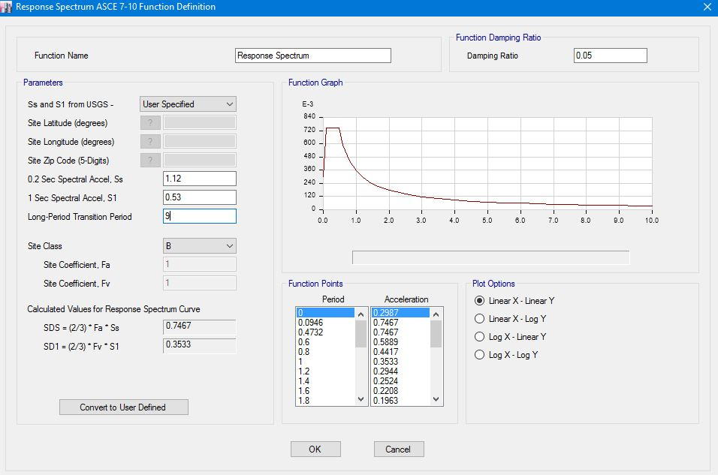
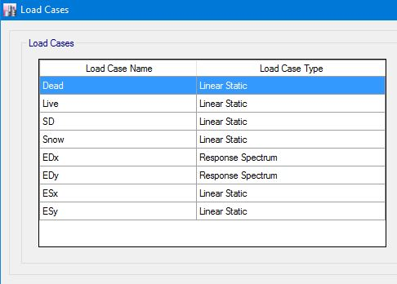
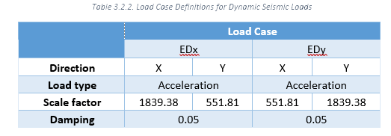
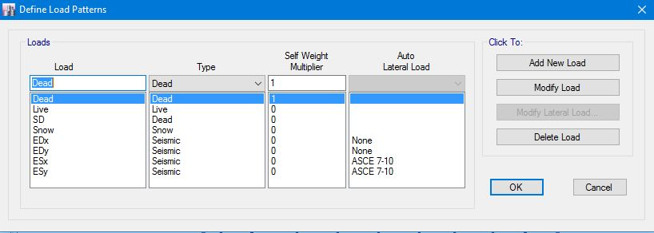
Loads Definitions
3D ANALYSIS
Load Patterns
Load Cases
Response spectrum function
Seismic load cases
EDx = Dynamic seismic load case in X- direction
EDy = Dynamic seismic load case in Y- direction
Table6. Seismic load cases
Figure21. Load patterns
Figure23. Response spectrum function definition
Figure22. Load cases

Slide 27
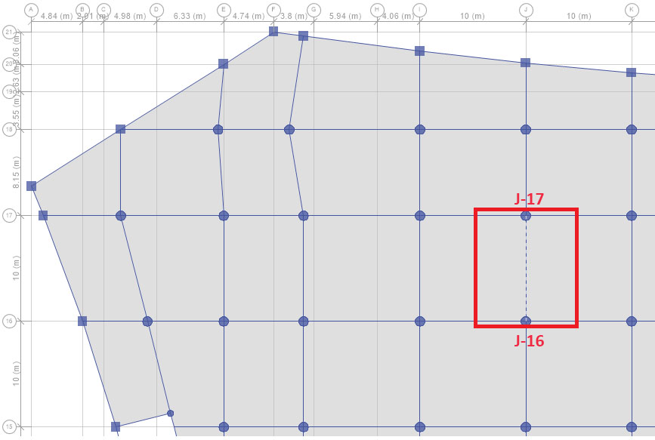
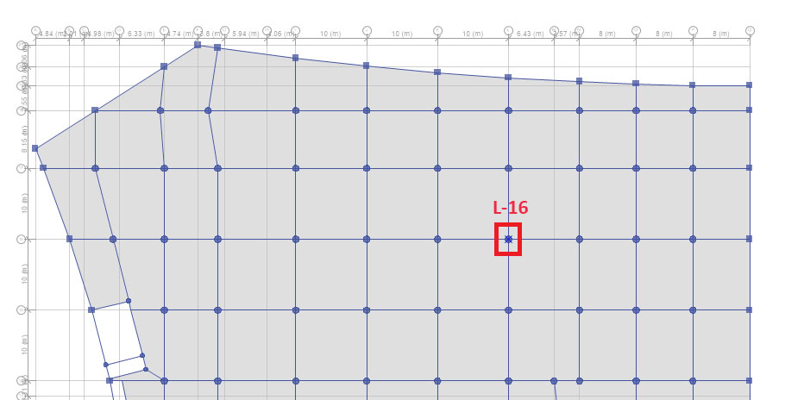
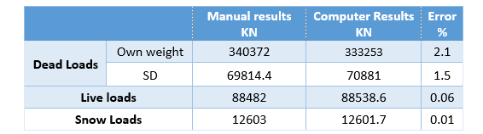
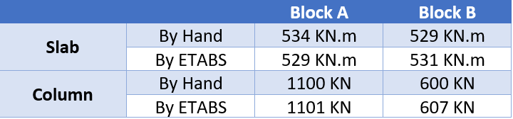
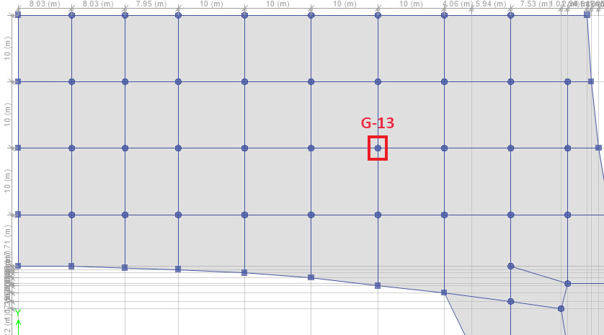
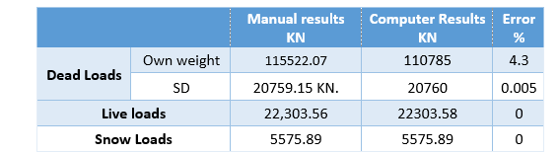
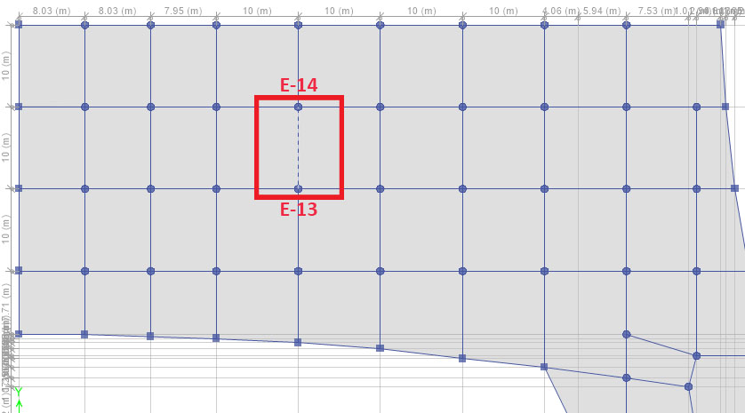
Analysis Verification
3D ANALYSIS
Table7. Equilibrium check summary for block A
Equilibrium check
Internal forces check
Slab moments
Column loads
Table9. Internal forces check summary
Figure24. Sample panel in block A
Figure26. Sample column in block A
Table8. Equilibrium check summary for block B
Figure27. Sample column in block B
Figure25. Sample panel in block B

Slide 28
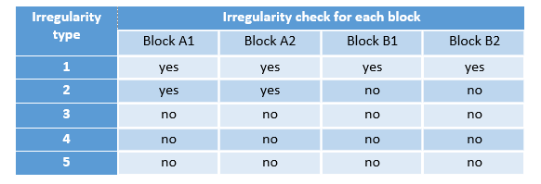
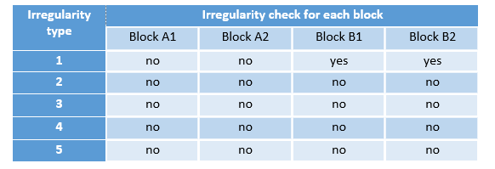
Structural Irregularities
3D ANALYSIS
Horizontal irregularities check
Torsional irregularity (1a) exists in both blocks
Reentrant corner irregularity exists in block A
Vertical irregularities check
Stiffness-extreme soft story
Irregularity exists in block B
Table10. Horizontal irregularities
Table11. Vertical irregularities

Slide 29
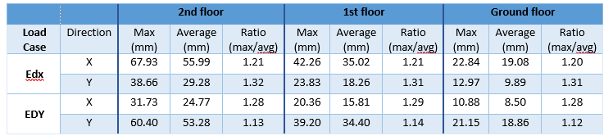
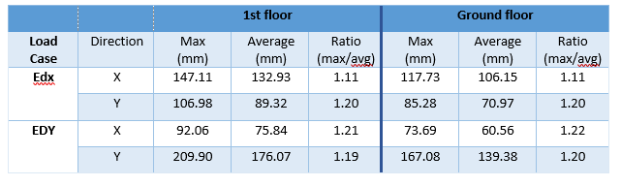
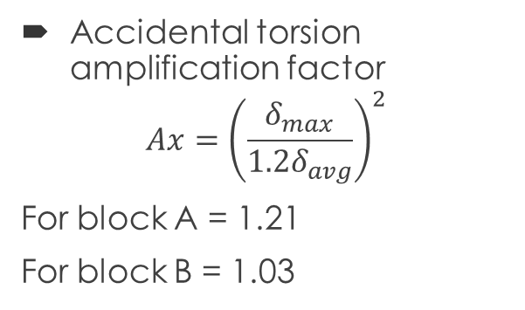
Torsional Irregularity
3D ANALYSIS
Table12. Maximum and average displacements in block A
Accidental torsion amplification factor
$$Ax={\left(\frac{δ_{max}}{1.2δ_{avg}}\right)}^{2}$$
For block A = 1.21
For block B = 1.03
Table13. Maximum and average displacements in block B

Slide 30
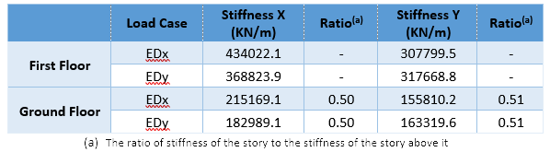
Stiffness-extreme soft story irregularity
3D ANALYSIS
Table14. Soft story check for block B

Slide 31
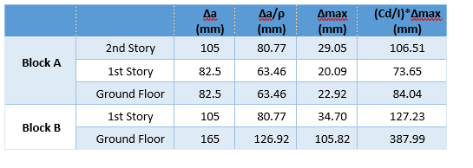
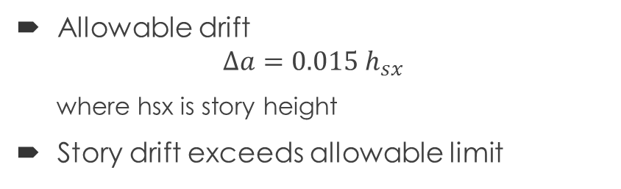
Story Drifts Check
3D ANALYSIS
Table15. Story drifts
Allowable drift
$$∆a=0.015 h_{sx}$$
where hsx is story height
Story drift exceeds allowable limit

Slide 32
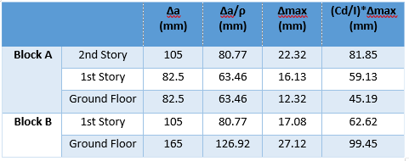
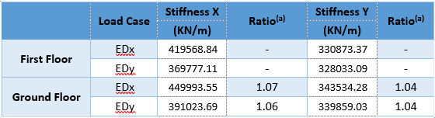
Modifications on models
3D ANALYSIS
Add tie beams in block B at height of 5.5m to increase stiffness
To decrease drifts:
- Increase diameter of circular columns to 1300 mm
- Increase dimensions of Rectangular columns to 1800X900
- Increase dimensions of Tie beams to 1500X800mm
Table17. Modified Drifts
Table16. Block B story stiffness

Slide 33
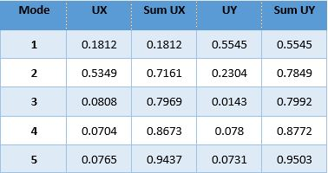
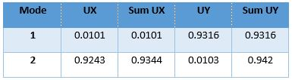


Modal Mass Participation Ratios
3D Analysis
Table18. MMPR for block A
Table19. MMPR for block B
Structural Periods
Table20. Modal Periods for block A
Table21.Model Periods for block B
- Manually calculated period = 0.88

Slide 34
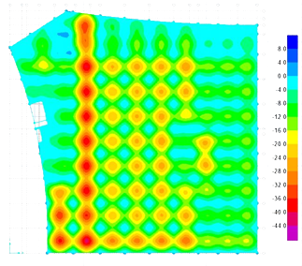



Long-Term Deflections
3D Analysis
$∆_{Long Term}=2D+2S.D+1L$
Deflections in block A
Maximum deflections = 43.2mm
$$Allowed deflection=\frac{10.5×1000}{240}=43.7 mm>43.2$$
Deflections in block B
Maximum deflections = 47.9mm
$$Allowed deflection=\frac{11.78×1000}{240}=49 mm>47.9$$
SAFE cracking section analysis results
Maximum deflection in 1st floor slab from ETABS = 42 mm
Maximum deflection in 1st floor slab from SAFE = 41.7 mm

Slide 35
Concrete Structural Details

Slide 36




Beams Detailing
Cross section in Beams:
$\text{Lap} \text{splices}$:
Continuity in bars:
$Stirrups at distance 2h:$
$≤$d/4.
$≤$ 6db.
$≤$150 mm.
spacing = 100 mm.
$Stirrups at mid of the beam:$
≤ $S=d/2.$

Slide 37



Columns Detailing
Cross Sections:
$L_{o}:$
≥ Depth of member.
≥ 1/6 of clear span of column.
≥ 450 mm.
Lap splices:
Transverse steel:
≤ ¼ minimum member dimension.
≤ 6 db.
≤ $S_{o}$

Slide 38

Slabs Detailing:
Bottom and Top steel:
Lap splices:

Slide 39

Footings Detailing:
Single footings:

Slide 40
Part Two:
Steel Structure

Slide 41

Steel Structure
Loads
Dead Loads: Own weight
Super-imposed dead load = 2.7 KN/m²
Live load = 5 KN/m²
Snow load = 1.428 KN/m²
Construction Load = 2.4 KN/m²
Wind load

Slide 42








Steel Structure
3D Model
Structural System:
Moment Frames in Y
Braced Frames in X
Composite Floor System
Steel Deck Section
Construction Load = 2.4 KN/m²
Roof structural design

Slide 43





Steel Structure
Composite Steel and Floor Design
Composite steel beams:
Non-shored construction
Partial composite action (50%), 30 shear studs per joist
Composite Floor System
Manual Design
Bending capacity and deflection
Steel Design

Slide 44





Slide 45









Steel Structure
Steel Connections
Beam-Column Flange Connection
Extended moment-end-plate
Stiffeners are used
Beam-Column Web Connection
Double Angle Connection
Beam-Girder Connection
Double Angle Connection

Slide 46
THANK YOU
☺

