Slide 1

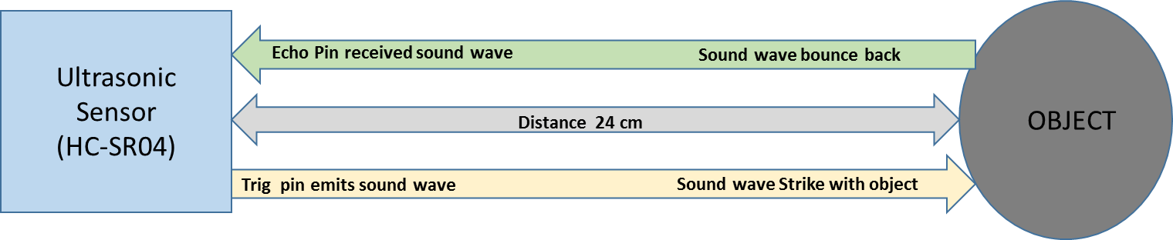
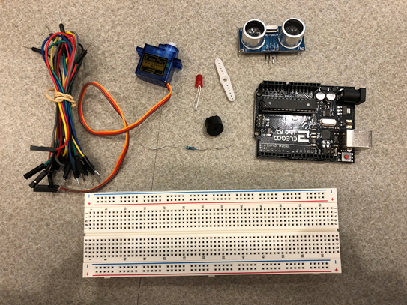
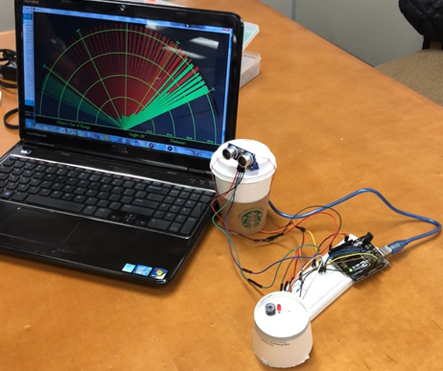
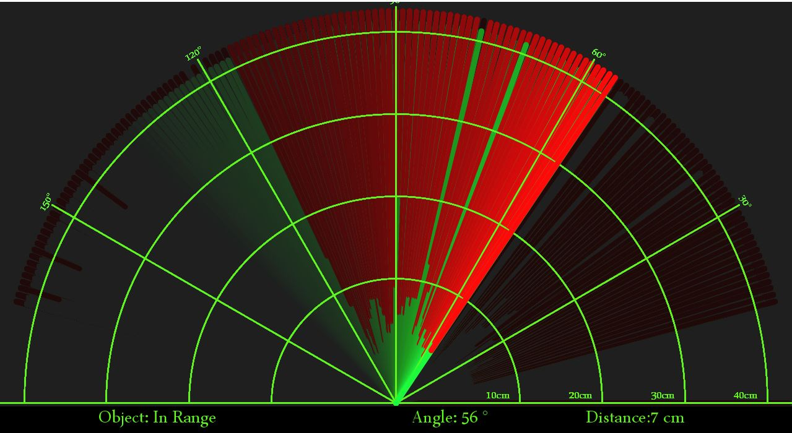
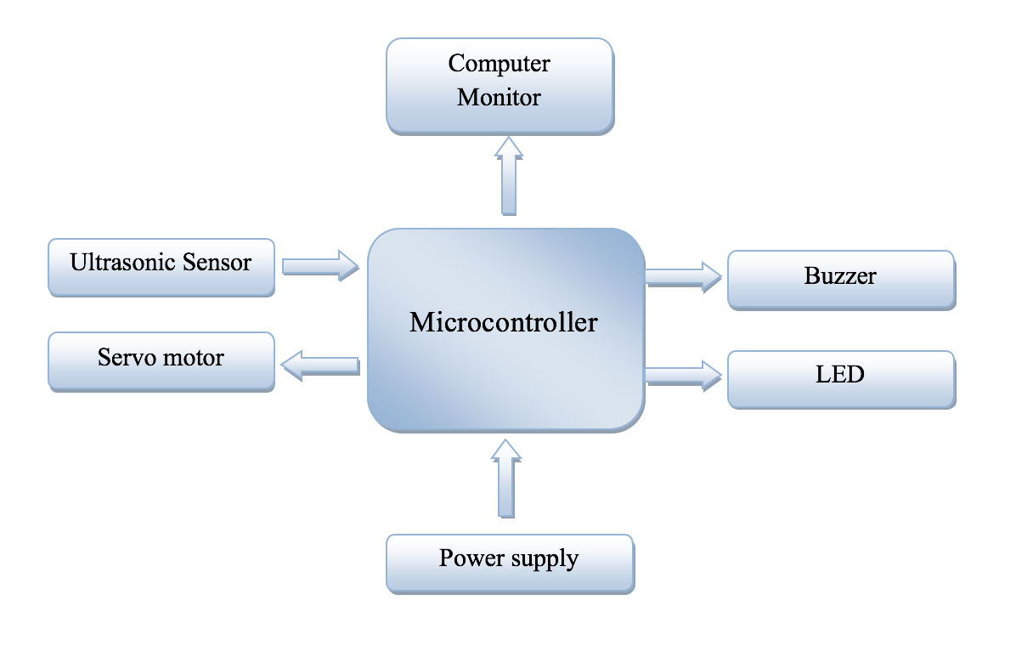
Abstract
Results & Discussion
RADAR uses radio waves to detect the range, altitude, direction, or speed of objects. Radars have been used for airport air-traffic control, highway patrol, ballistic missile guidance, military exercise and many other applications. In this poster, we developed a low-cost small ultrasonic radar system based on Arduino. It utilizes ultrasonic sensors to detect the object in the range and passes the information to Arduino microcontroller. Once the object is detected, two sets of alarm can be triggered. The graphical display utilizes the position of the detected objects on the computer to send visual alarm on LED screen. Sound alarm can also be sent via an audio buzzer. By adjusting the rotation of the servo motor, we allow the sensing to be in range from 0 degree to 150 degrees. It can detect objects up to 400 cm away from the ultrasonic sensor. The prototype of the system is implemented and coding for Arduino control is developed. Experimental results show that the system can detect objects within the range and alarm can be successfully triggered.
Using Arduino ultrasonic Sensor HC-SO4 it allows detection in a specified range of 40cm as it sends sound waves and measure the distance in that particular range giving a result of one object at a time, the measurement of more than one object a time chances could be increased depending on the speed of motor rotation. It was coded in this project of Ultrasonic Radar System that every time the sensor detect an object, the user is alarmed through visual and audio warning; using LED light and a buzzer. The sound is a longitudinal wave, This means that if the obstacle is not perfectly in front of the sensor , the waves will be deflected and they might not be reflected back to the sensor. As a result, the object is not detected.
Introduction
ULTRASONIC RADAR is an object-detection system which uses radio waves to determine the range, altitude, direction, or speed of objects. Ultrasonic Radar systems are used for air-traffic control at airports, and long range surveillance and early-warning systems. A radar system is the heart of a missile guidance system. Radar was secretly developed by several nations before and during World War II. The term RADAR itself, not the actual development, was coined in 1940 by the United States Navy as an acronym for Radio Detection and Ranging. The term radar has since entered English and other languages; as a common noun radar loses all capitalization. The use of such technology has been seen recently in the self-parking car systems launched by Audi, Ford, and even the upcoming driverless cars by Google, Tesla,Volvo and BMW. The project made by us can be used in any systems the customer may want to use like in a car, a bicycle or anything else. The use of Arduino in the project provides even more flexibility of usage of the aforementioned module according to the requirements.
Speed of Sound: V= 340 m/s V= 0.034 cm/us | Time = distance/speed t=s/v = 10/0.034 = 294us | Distance: S= t*0.034/2
Device Fabrication & Components
Ultrasonic Sensor
Ultrasonic sensors (also known as transceivers when they both send and receive, but more generally called transducers) work on a principle similar to radar or sonar which evaluate attributes of a target by interpreting the echoes from radio or sound waves respectively. Ultrasonic sensors generate high frequency sound waves and evaluate the echo which is received back by the sensor. Sensors calculate the time interval between sending the signal and receiving the echo to determine the distance to an object. This technology can be used for measuring wind speed and direction (anemometer), tank or channel level, and speed through air or water. For measuring speed or direction a device uses multiple detectors and calculates the speed from the relative distances to particulates in the air or water. To measure tank or channel level, the sensor measures the distance to the surface of the fluid. Further applications include: humidifiers, sonar, medical ultrasonography, burglar alarms and non-destructive testing. Systems typically use a transducer which generates sound waves in the ultrasonic range, above 18,000 hertz, by turning electrical energy into sound, then upon receiving the echo turn the sound waves into electrical energy which can be measured and displayed.
1. Arduino microcontroller Uno 2. Servo motor
3. Ultrasonic sensor 4. Jumper wire
5. LED. 6. Buzzer
7. USB Cable 8. Resistor (5.1m Ohm)
9. Arduino ide 10. Processing 2.1 ide
Block Diagram
Conclusions and Future Advancements
In this project using Arduino board the radar system was implemented. It succeeded in helping to be widely used to help detect objects in different environments. In the future it can be updated to be used for a larger range applications and advancements; for example, a low cost motion detection home security system, a low cost cruise-control radar system, and many more projects that could be implemented by using more powerful sensors that would have larger ranges and faster motors that would able to compute faster and provide more reliable data.
Notes:
1

