Slide 1
BrailleType
Prepared By :
Haya De’bas.
Jumanah Salhab.
Supervisor :
Dr. Raed Al Qadi

Slide 2
Outline
What is BrailleType ?
Motivation, objective and main idea .
Sub applications.
Programming techniques.
Future Work

Slide 3
What is BrailleType?
It’s an Android Application that targets visually impaired people.
It provides 6 sub applications and supports Arabic and English.
It allows users to type on touch screens using the Braille alphabet much in the same way they use it for reading.

Slide 4
Motivation
The high percentage of visually impaired people around the world and in Palestine specially.
The emergence of touch screens recently which made it much more difficult for blind people to use phones.
The experience one can gain while developing a mobile application.

Slide 5
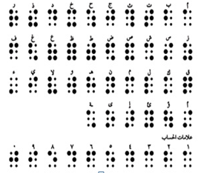
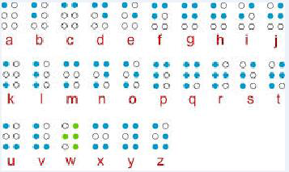
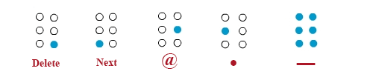
Main Idea

Slide 6
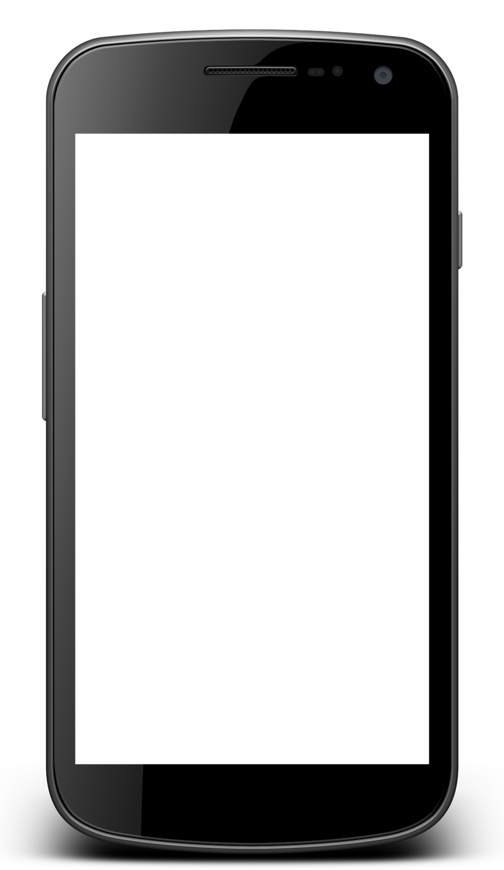
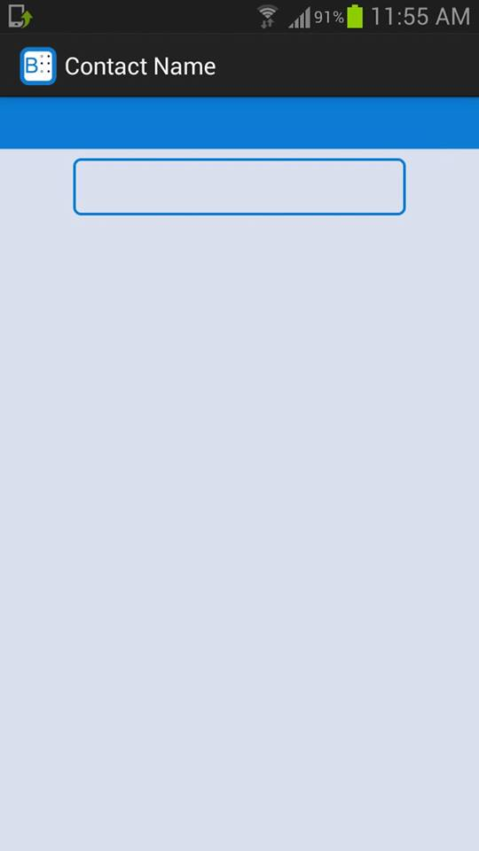
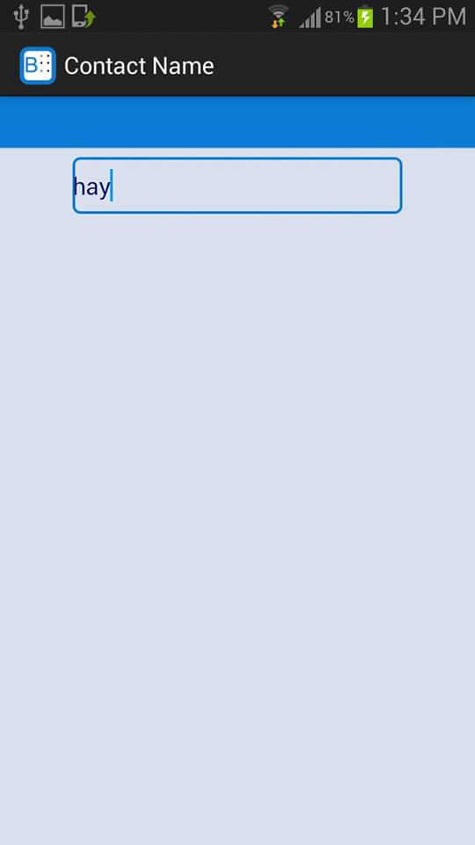
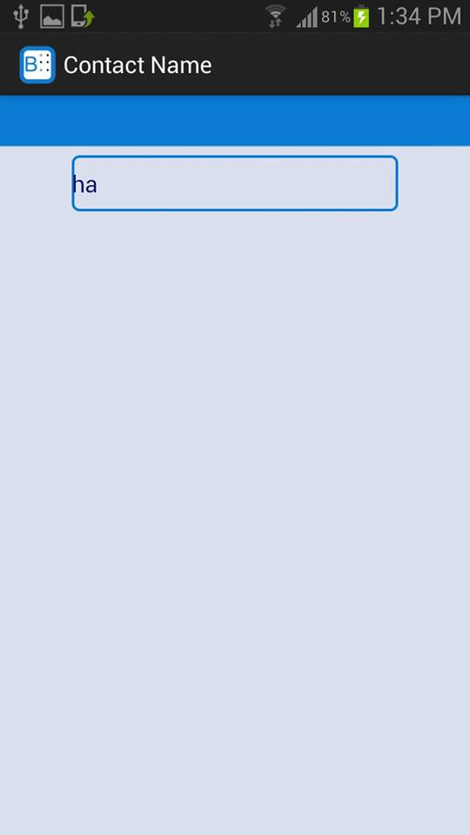

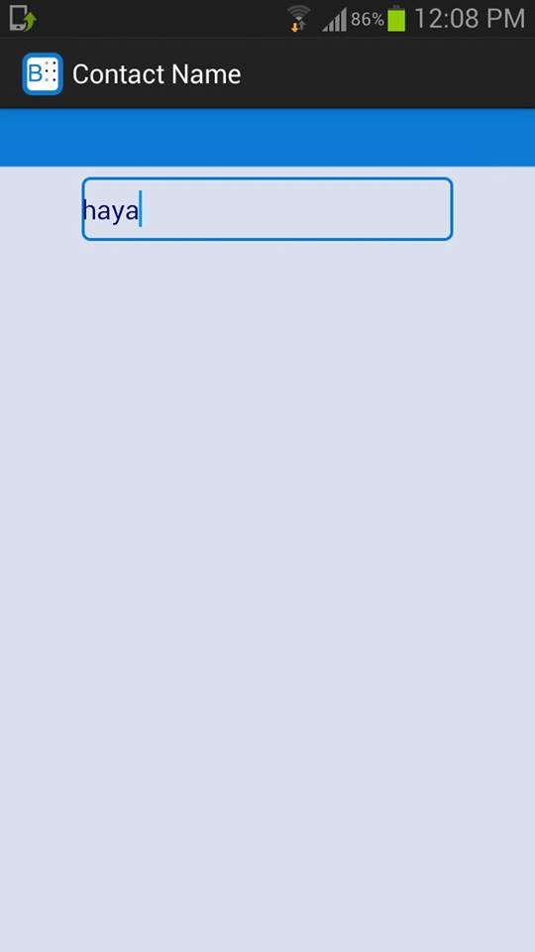
Multi touch

Slide 7
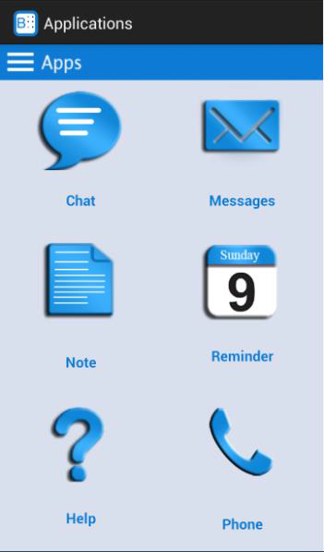
Sub Applications
Our application consists of 6 sub applications ordered in the same ordering of Braille Cells.

Slide 8
Help
First application is the Help application that provides a full description of how the whole system works.
Help is supported in Arabic and English.
It comes in two versions

Slide 9
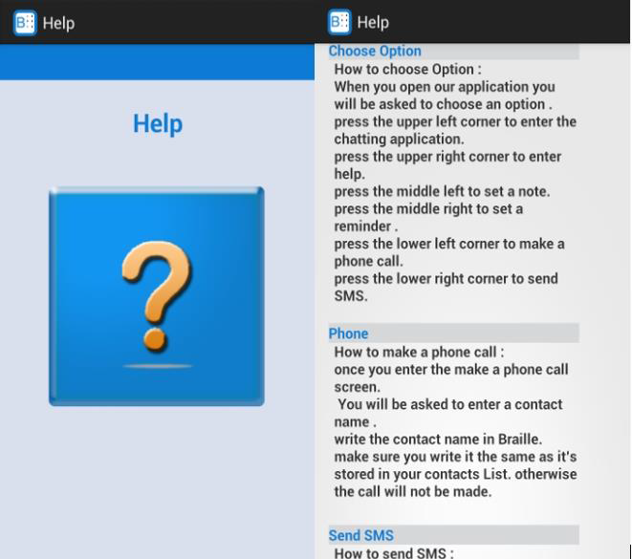
Help
Full manual version

Slide 10
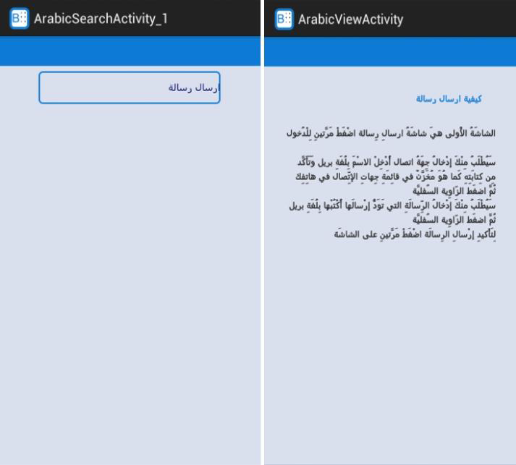
Help
The second version allows the user to search specific sections by typing keywords in Braille.

Slide 11
SMS
The second application is the SMS application and it allows the user to:

Slide 12
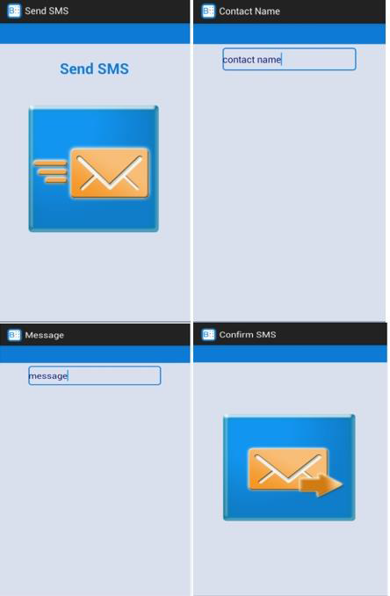
SMS
Send SMS.

Slide 13
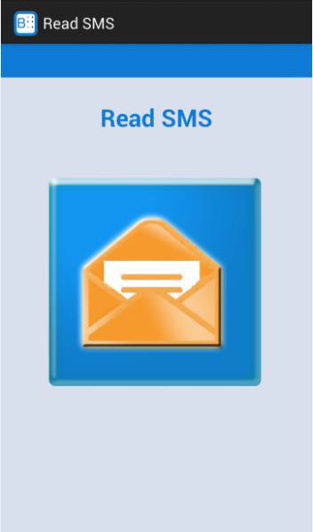
SMS
Read new unread SMSs.

Slide 14
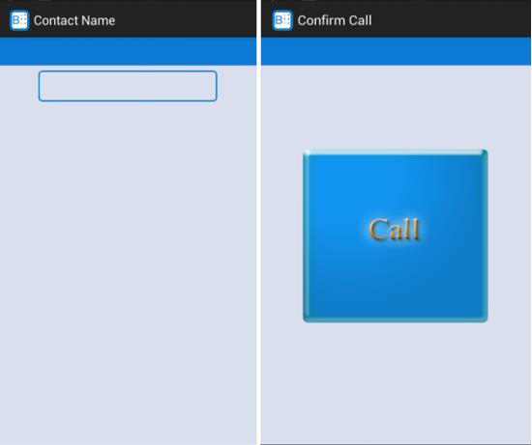
Phone Calls
This application allows the user to make a phone call with stored contact in his mobile

Slide 15
Notes
This application gives the user 3 options:

Slide 16
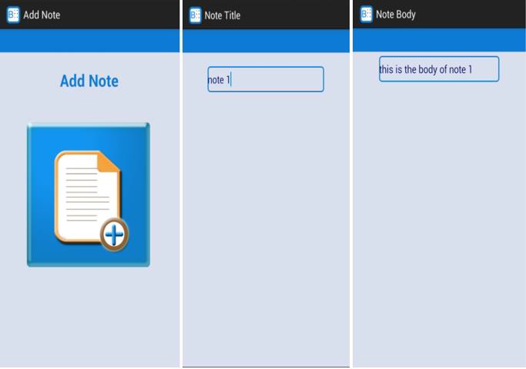
Notes
Add new note

Slide 17
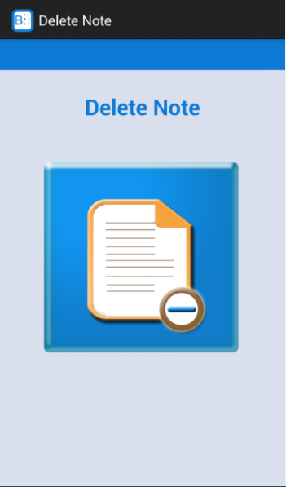
Notes
Delete note.

Slide 18
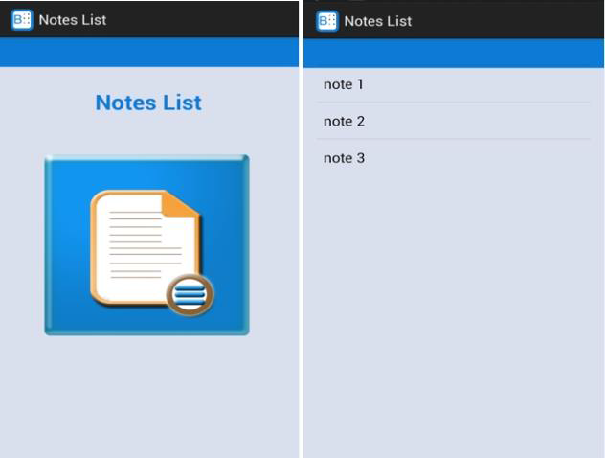
Notes
See the full list of the added notes

Slide 19
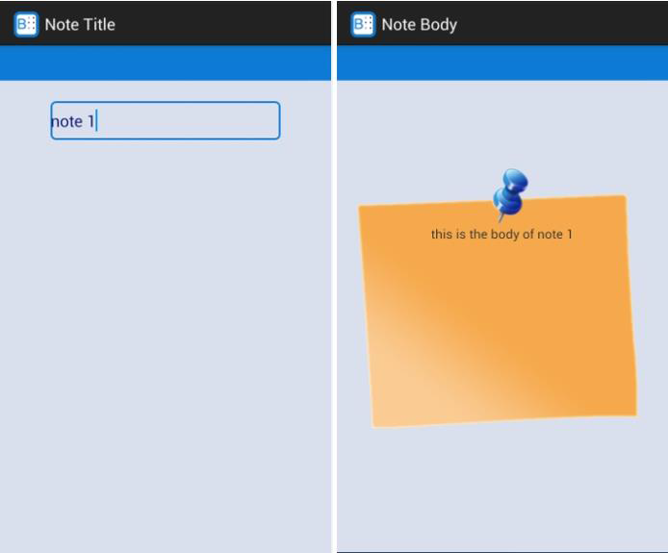
Notes
If the user wants to see the body of a specific note

Slide 20
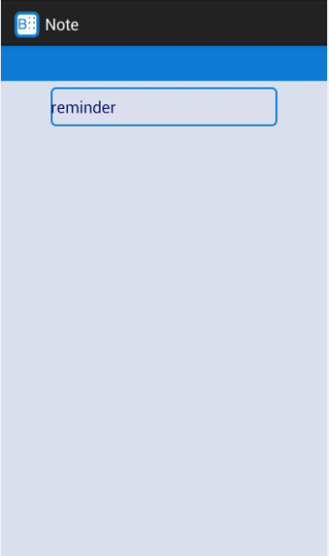
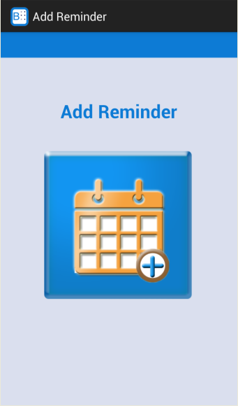
Reminder
This application allows the user to set a time date-based reminder.
First option is Add Reminder .
User enters the reminder title, year, month, day, hour and minutes.

Slide 21
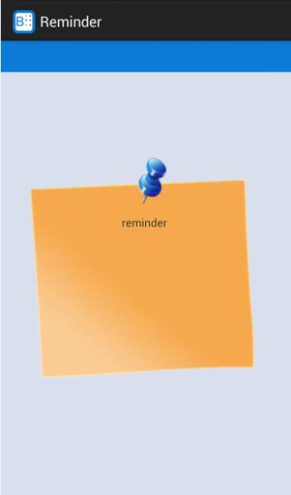
Reminder
When the selected time is reached, the user will hear a tone and the note will be spoken out and displayed on the screen.

Slide 22
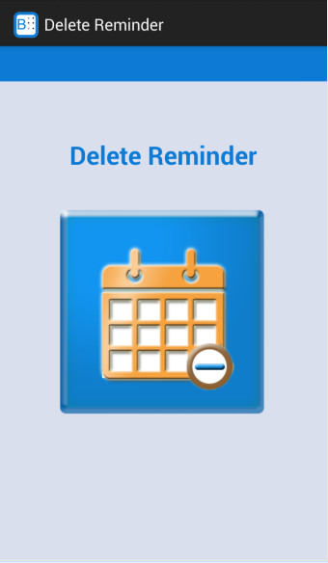
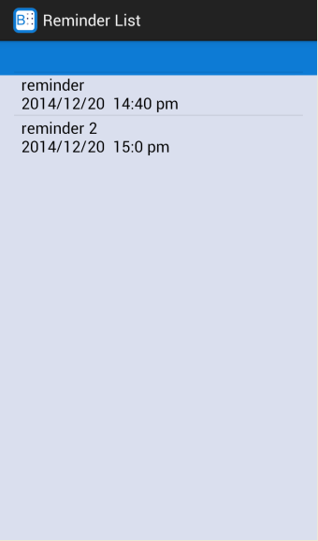
Reminder
Second option is Delete Reminder.
Third option is to see full list of all added reminders. User can select a reminder to update it’s date or time.

Slide 23
Chat
This application supports the basic functionalities of a chatting system.
These include log in, sign up, add new friend, chat with friends, accept or decline requests, show online and offline friends and get notifications when a new message is received.
This application supports 2 modes :
  Normal mode.
  Special mode.

Slide 24
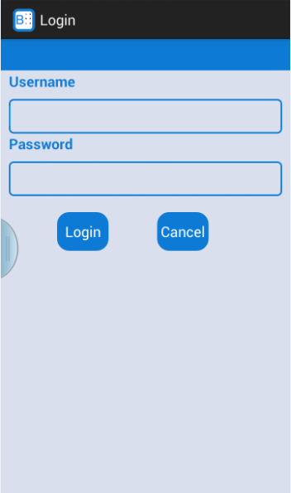
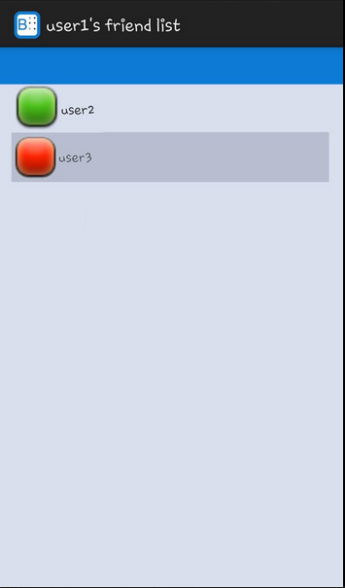
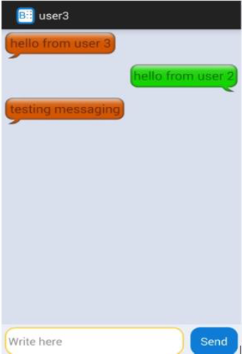
Normal Mode

Slide 25
Special Mode
If user chooses the special mode he will be asked to choose between Login or register options.
After the user logs in he will have 4 main sliding screens to choose from

Slide 26
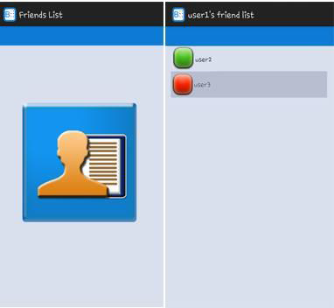
Friends List

Slide 27
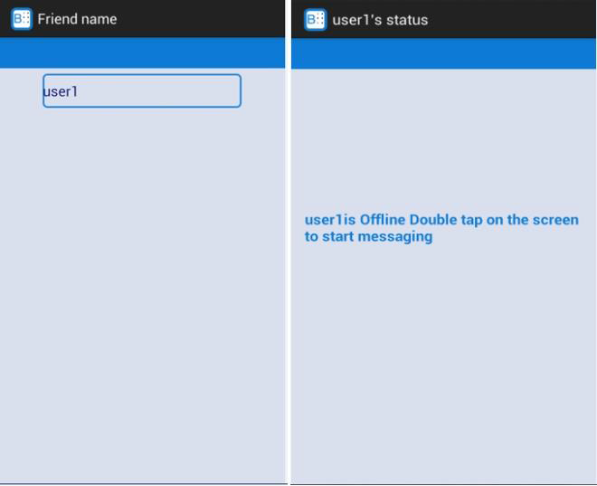
Friends List

Slide 28
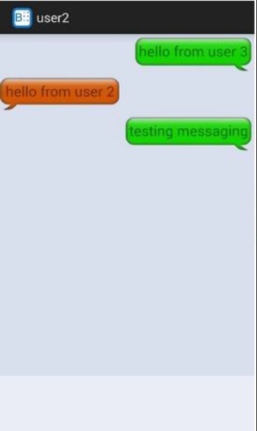
Friends List

Slide 29
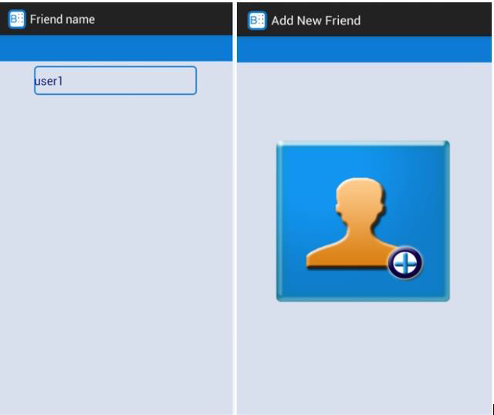
Add New Friend

Slide 30
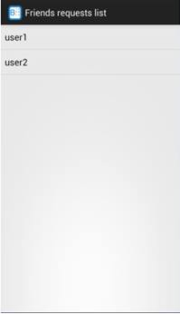
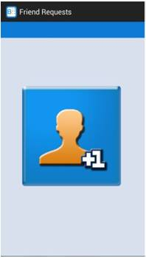
Friends Requests

Slide 31
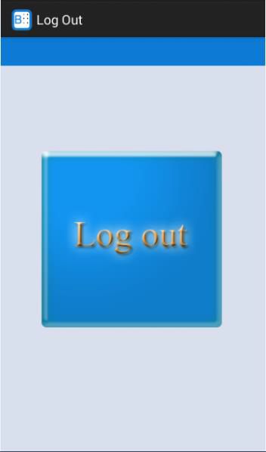
Logout

Slide 32
Programming Techniques

Slide 33
Text-To-Speech Synthesizer
The Android platform includes a Text-to-Speech (TTS) capability which enables an Android device to "speak" text in various languages.
But, Arabic is not supported so we used SVOX library (trial version).

Slide 34
Android Accelerometer
The Android platform supports three types of sensors. In our application, we use the motion sensors in 2 ways

Slide 35
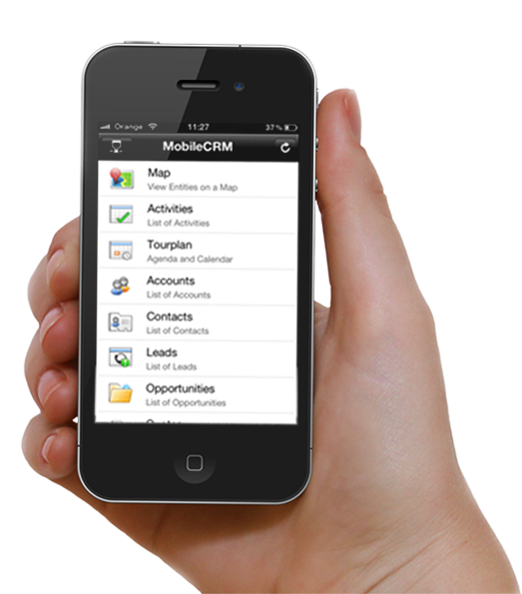
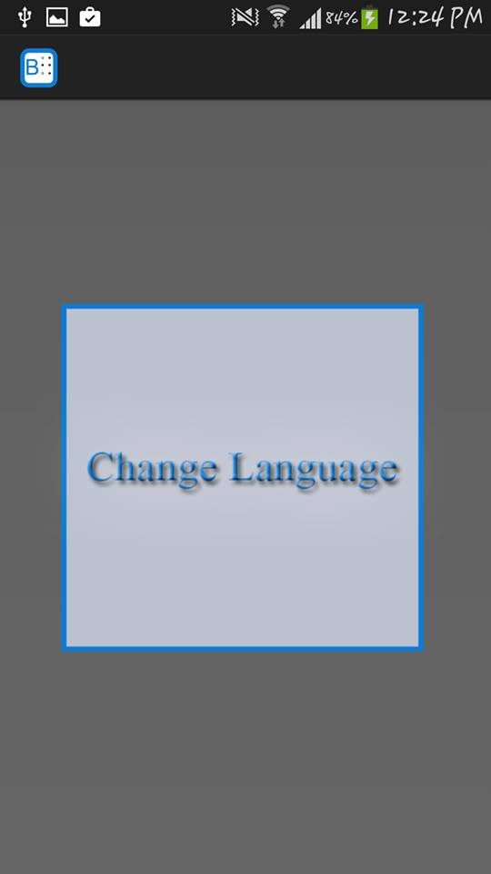
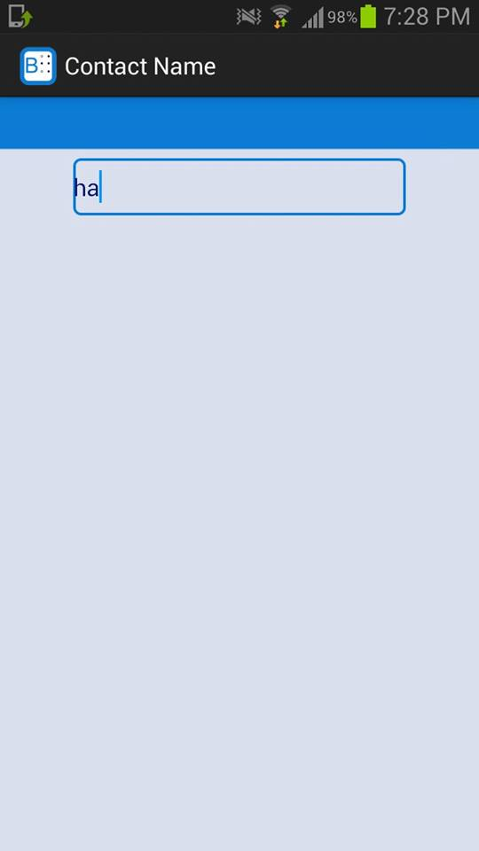
SHAKE!
  Shaking the mobile on the x-axis will allow the user to switch between Arabic and English when typing.

Slide 36
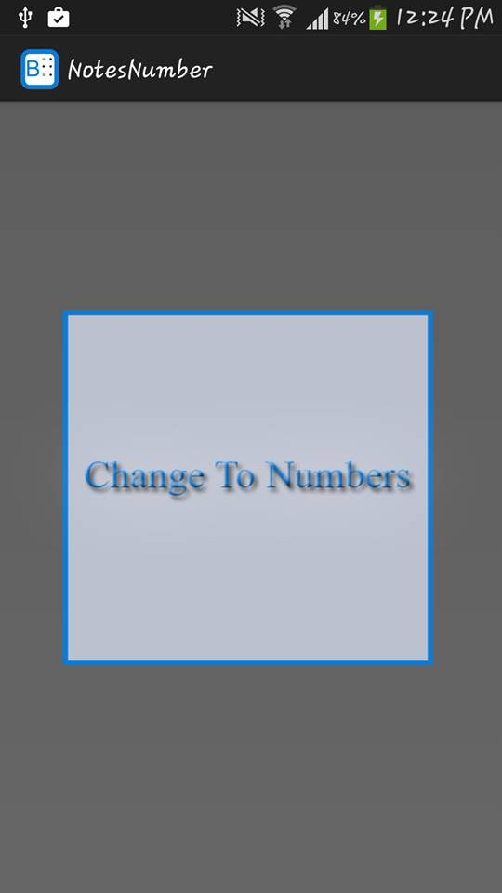
SHAKE!
Shaking the mobile on the z-axis will allow user to switch between letters and numbers.

Slide 37
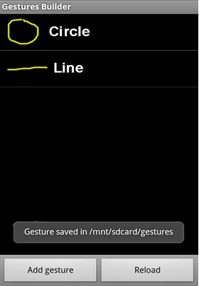
Gestures
We created these two patterns using GestureBuilder:

Slide 38
Gestures
When the user wants to choose between two options he must draw a line or a circle .

Slide 39
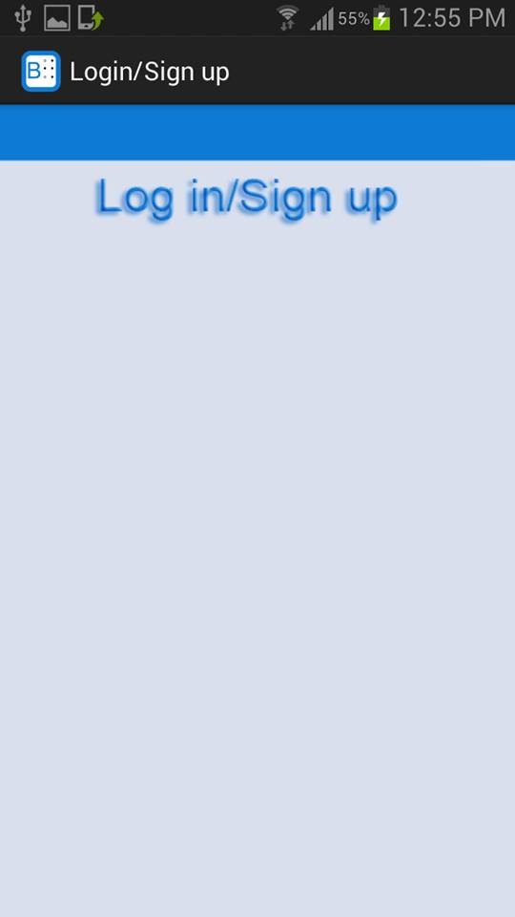
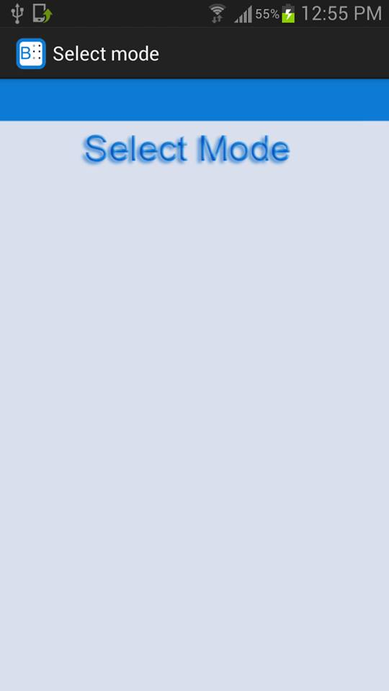


Slide 40
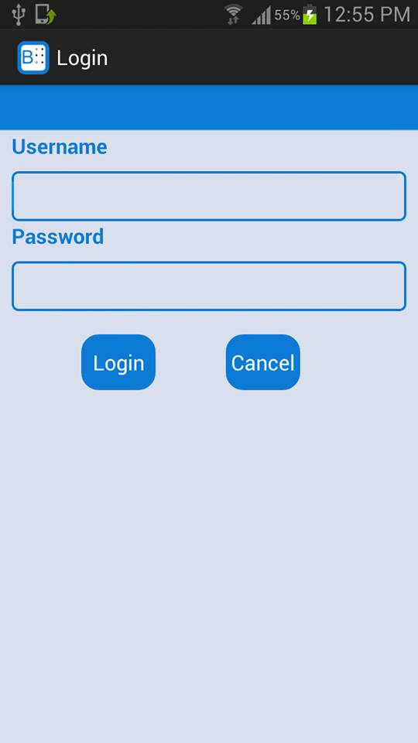

Slide 41
Gestures
When the user wants to choose between more than one option, he must slide between the options .

Slide 42

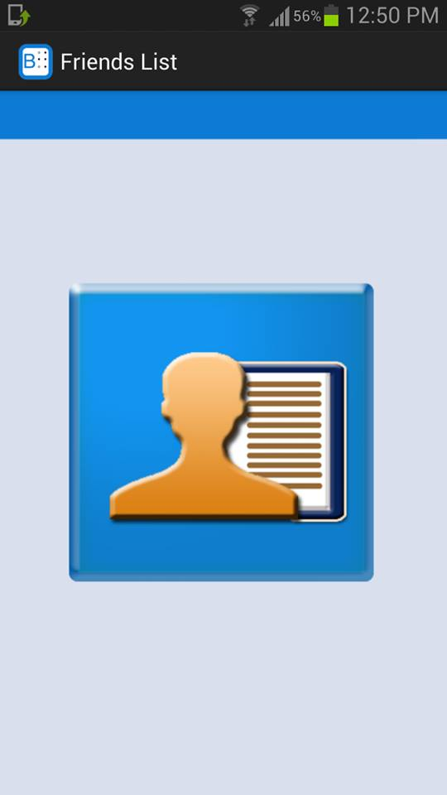
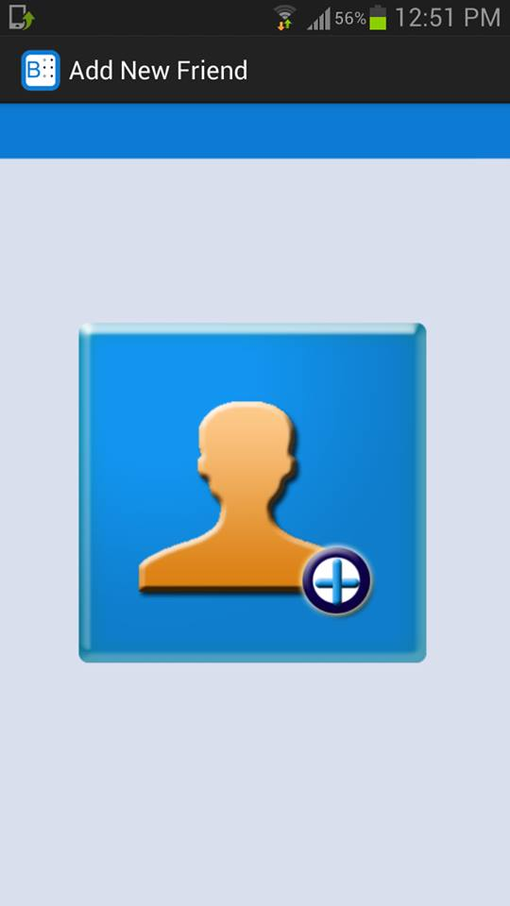

Slide 43
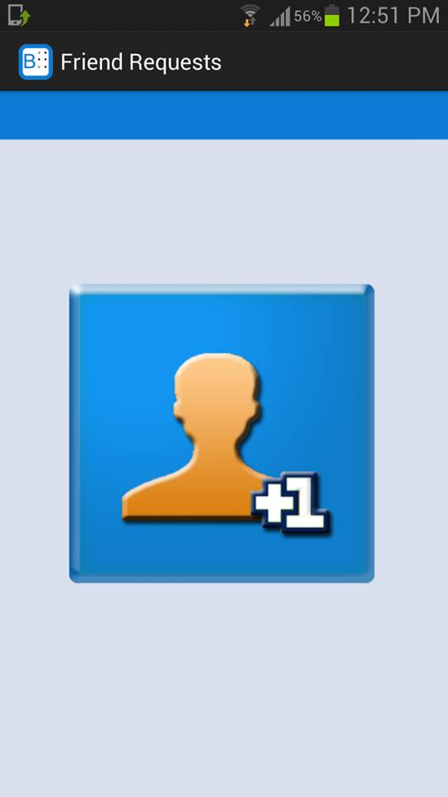

Slide 44
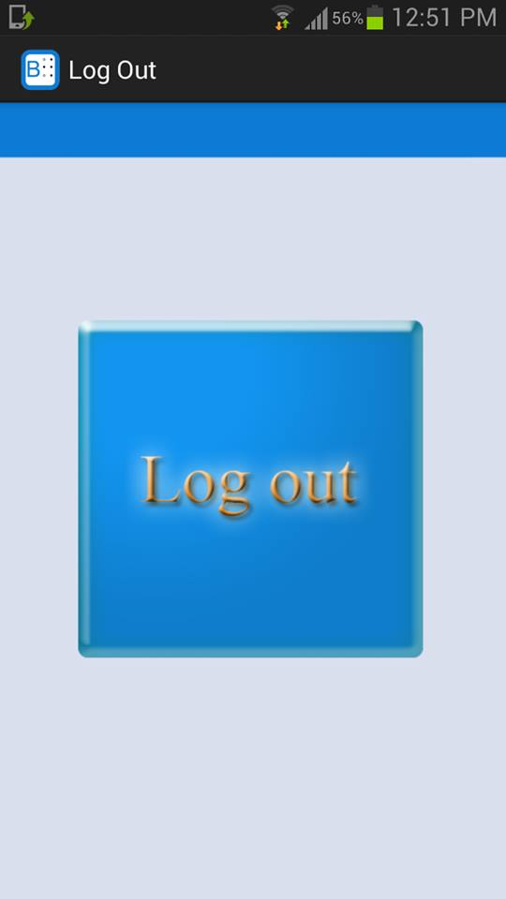

Slide 45
Gestures
When the user wants to select an element from a list he must swipe the screen from bottom to top then type the element name.

Slide 46
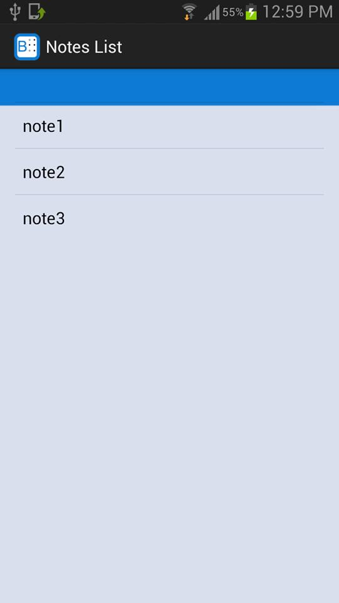
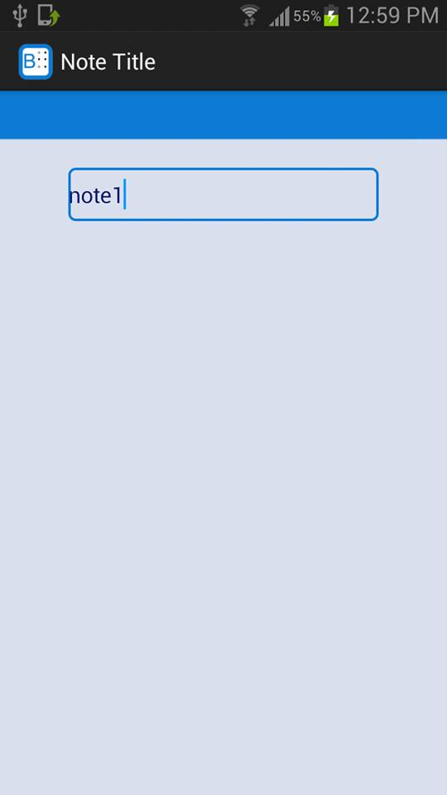

Slide 47
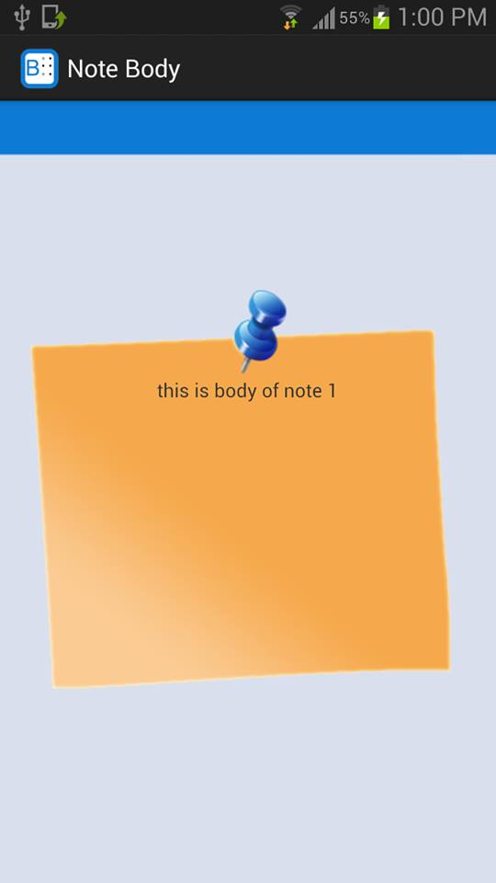

Slide 48
Overriding the volume buttons
Android gives the ability to override hardware buttons. We overrode the volume buttons so that:
Double pressing the volume-down button will cause the Text-To-Speech engine to repeat the last spoken sentence in case user didn’t hear it well.
Double pressing the volume-up button will cause the text-to-speech synthesizer to speak what is inside the input field.

Slide 49
Future Work
Our future work is to improve this project more and to carry it out into the business world.
The basic idea of our project which is typing in Braille can be extended to let blind people use different applications of smart phones regardless of their disability.

Slide 50
Demo

Slide 51
Thank You

