Slide 1

An-Najah National University
Faculty of Engineering and Information Technology
Building Engineering Department
Graduation Project – 2
Redesign of Nablus Municipality building.
Supervisor:
Dr. Luay N. Dwaikat.
Prepared By :
1.Anas Shawahni
2.Monjed Saleem
3.Muath Yameen
4.Yazan Fashafsheh

Slide 2
Contents:
Introduction.
Site Analysis.
Architectural aspects.
Environmental aspects.
Structural aspects.
Electro mechanic aspects.
Cost Estimation.

Slide 3
Introduction
Objectives:
Redesigning and development the building, all aspects and engineering systems will be included where all weaknesses and problems of the building will be taken into account during the operation process.

Slide 4
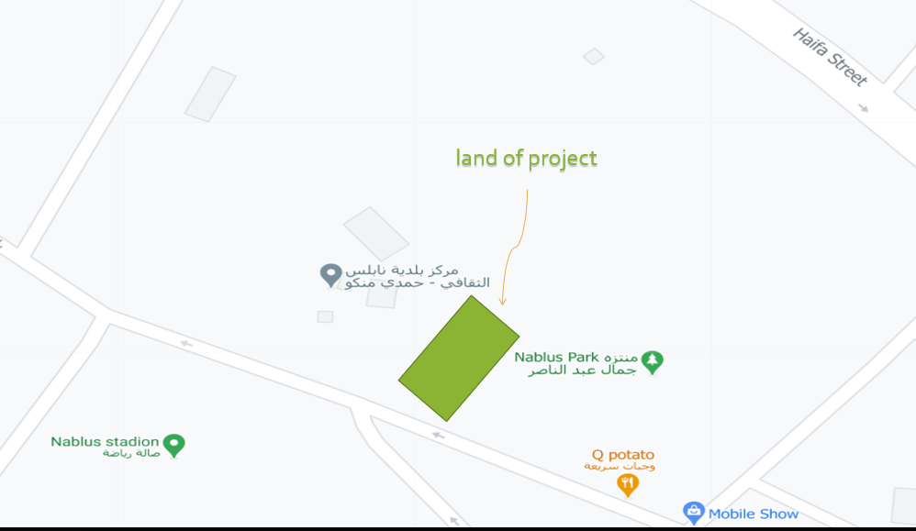
Site Analysis:
Location:
The land on which the Municipality will be built located in Yafa street near Jamal Abdul Nasser park.

Slide 5
Architectural Design.

Slide 6
Architectural Design.
General Information.
Floors.
Elevations.
Sections.

Slide 7
General Information.
The land area is about 3000 m².
The municipality contains 7 floors, two of them are basement floors.
The main entrance in East elevation.

Slide 8
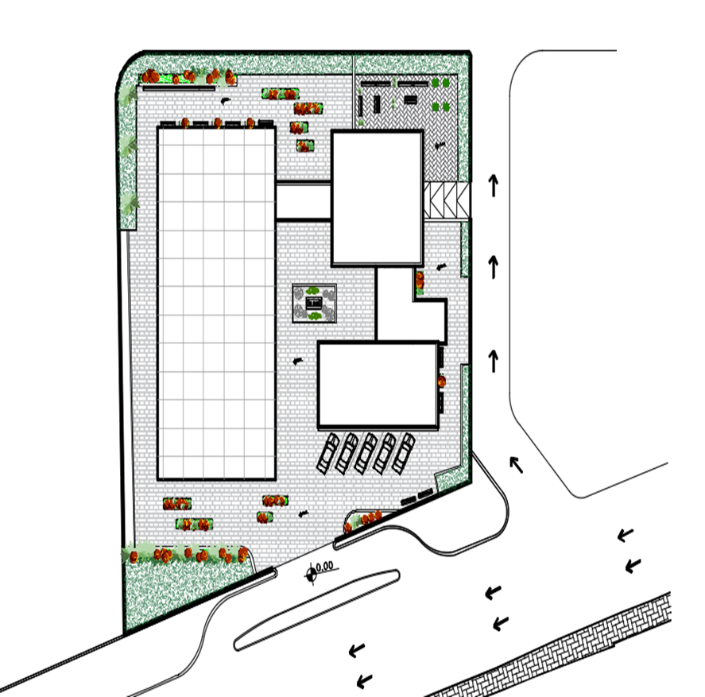
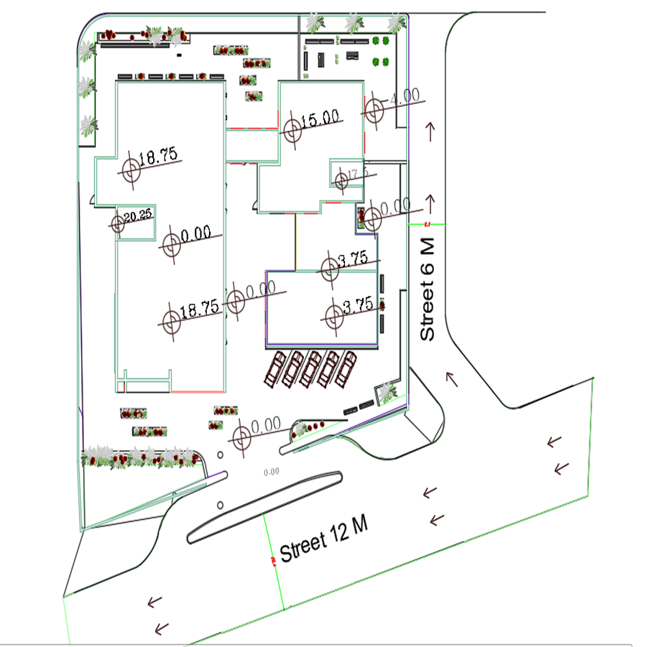

Site Plan.
before
after

Slide 9
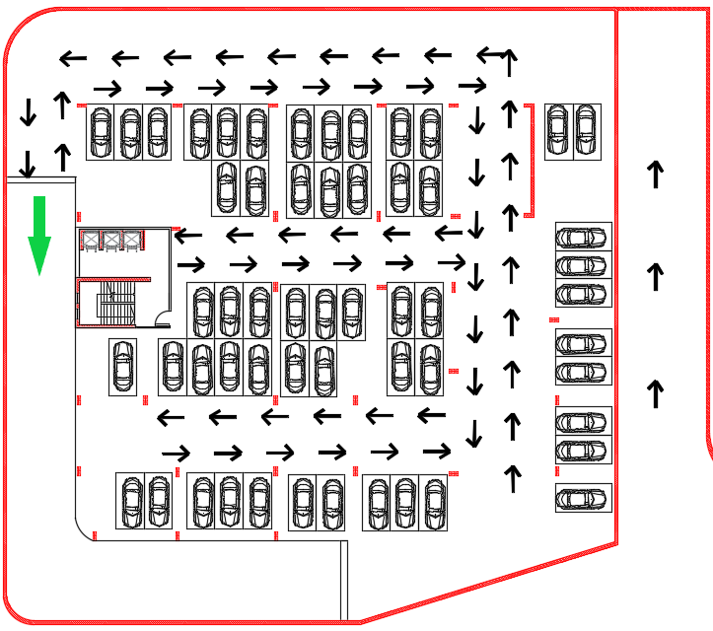

  Basement (2) floor.
  Floor height = 3.75 m.
before
after

Slide 10
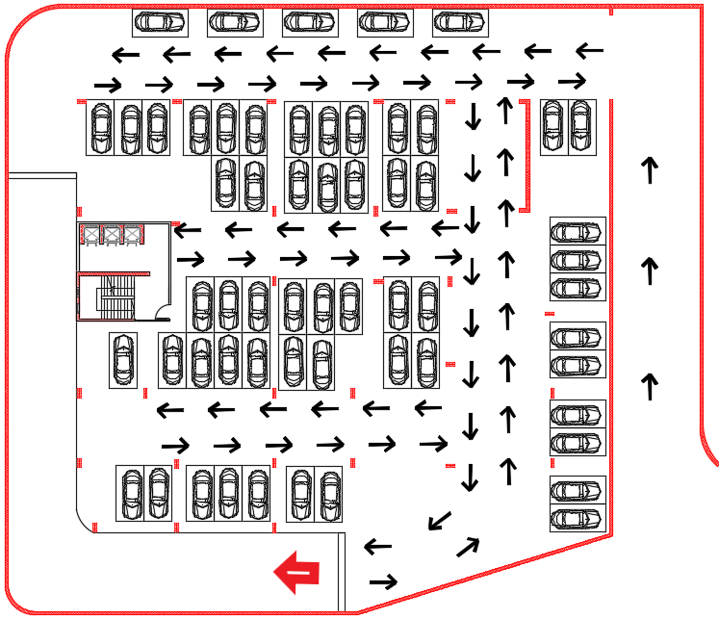
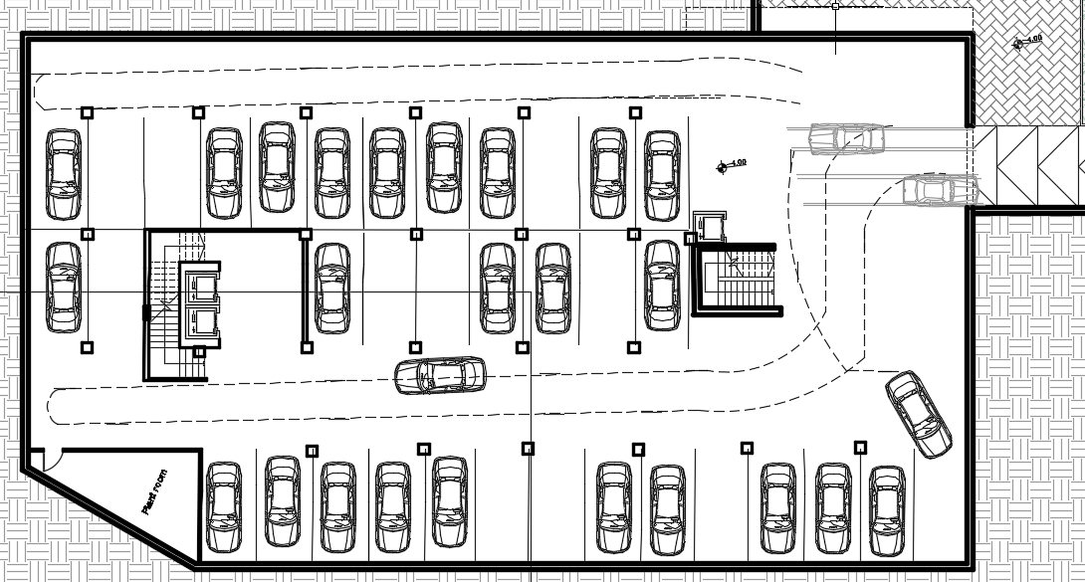
  Basement (1) floor.
  Floor height = 3.75 m.
before
after

Slide 11
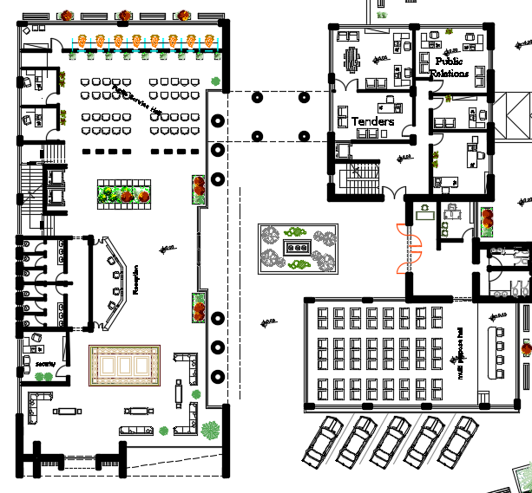
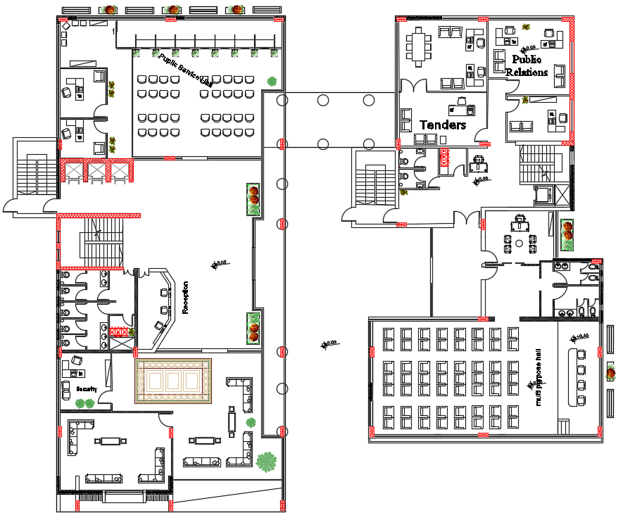
Ground floor
  Floor height = 3.75 m.
before
after

Slide 12
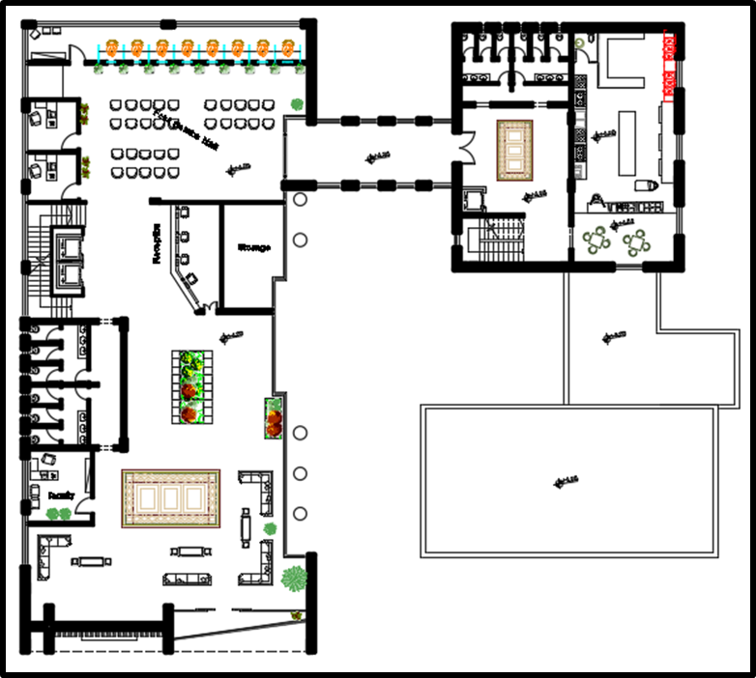
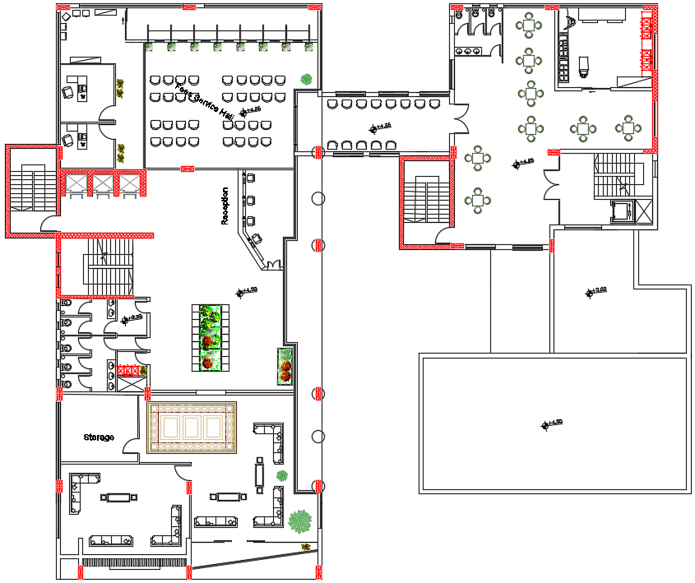
First floor.
  Floor height = 3.75 m.
before
after

Slide 13
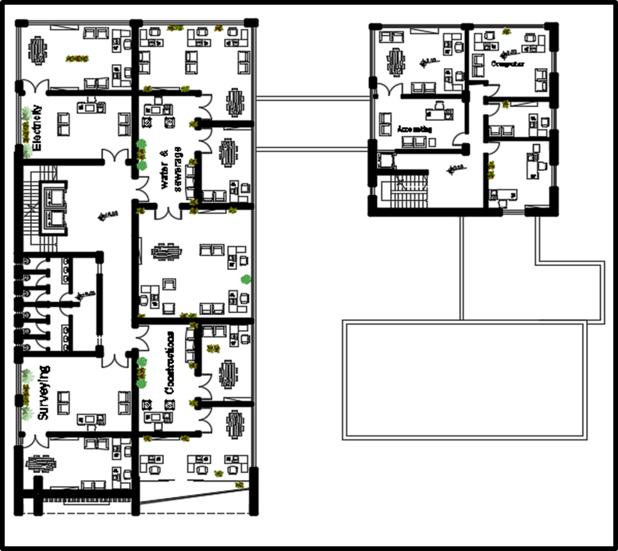
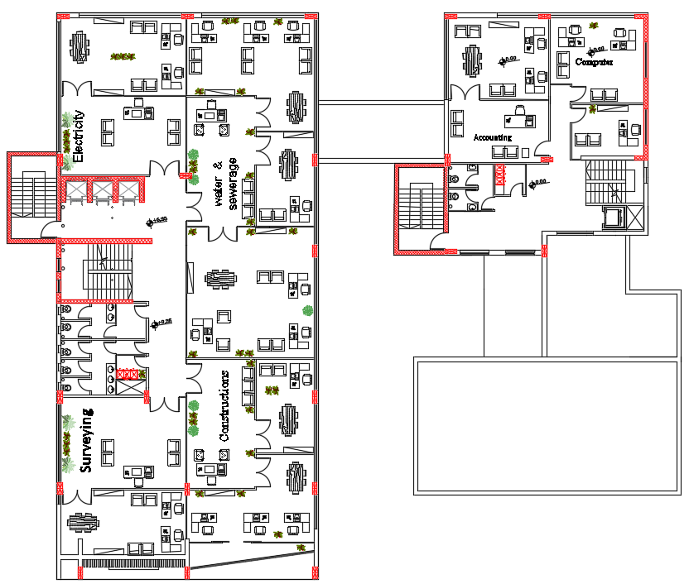
Second floor.
  Floor height = 3.75 m.
before
after

Slide 14
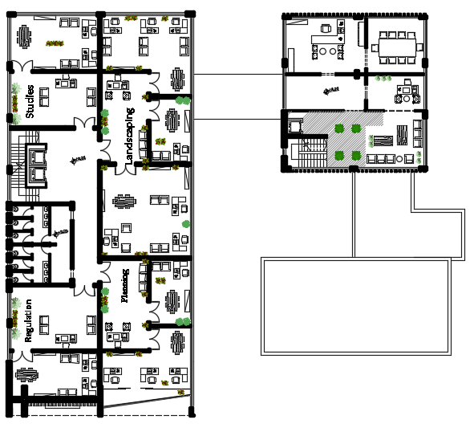
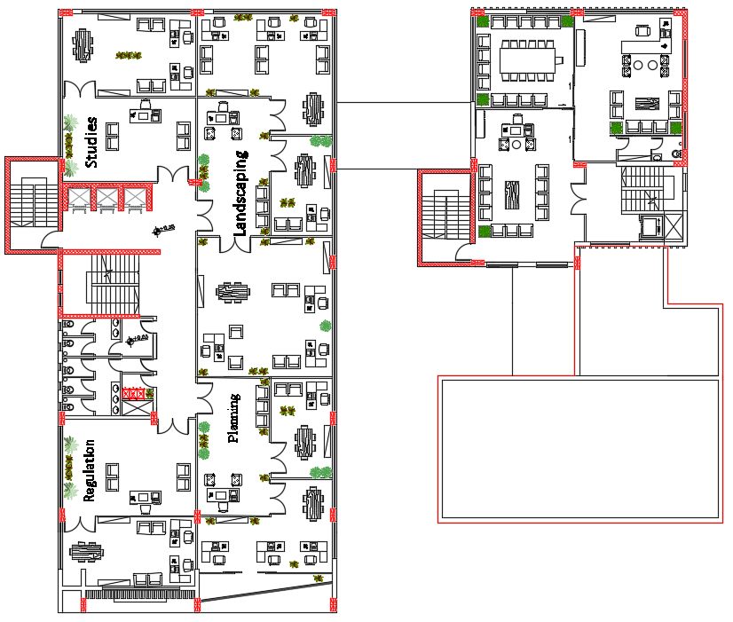
Third floor.
  Floor height = 3.75 m.
before
after

Slide 15
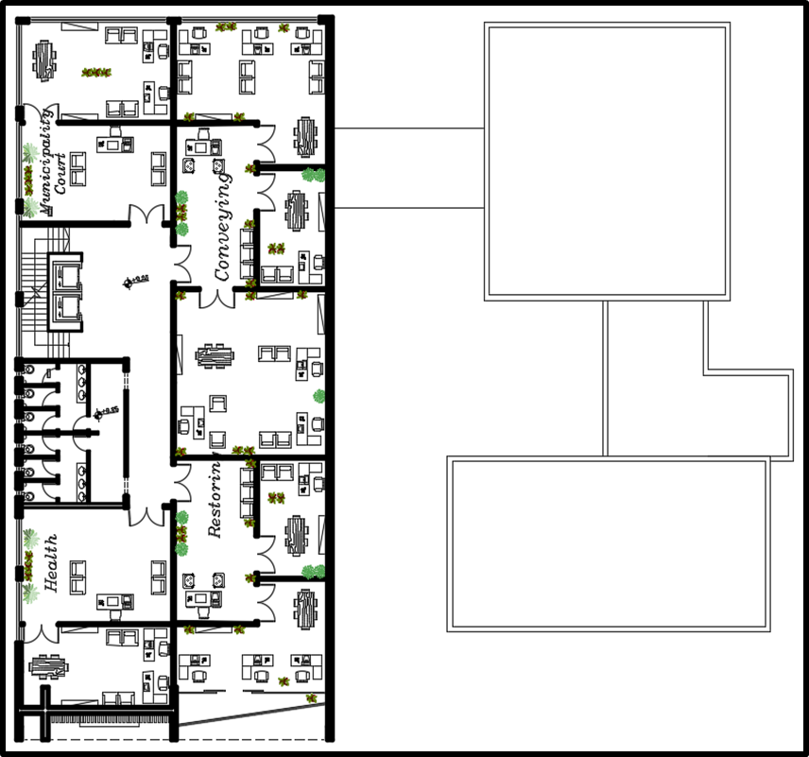
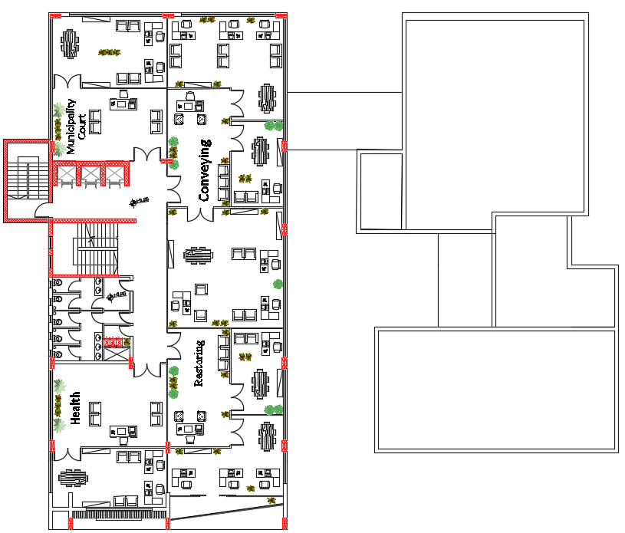
Forth floor.
  Floor height = 3.75 m.
before
after

Slide 16
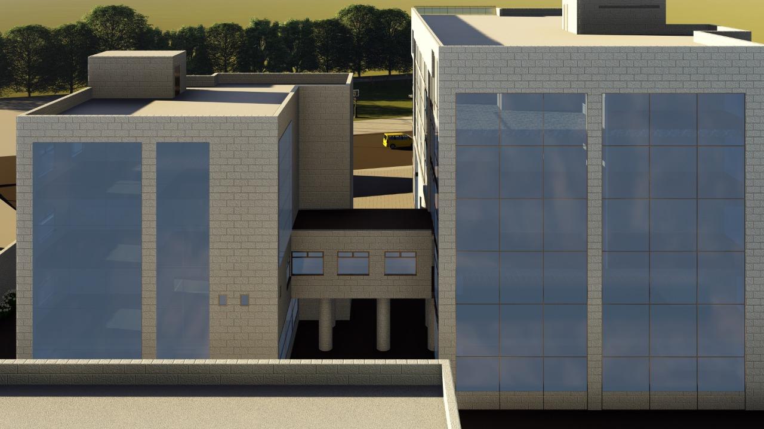
N - E

Slide 17
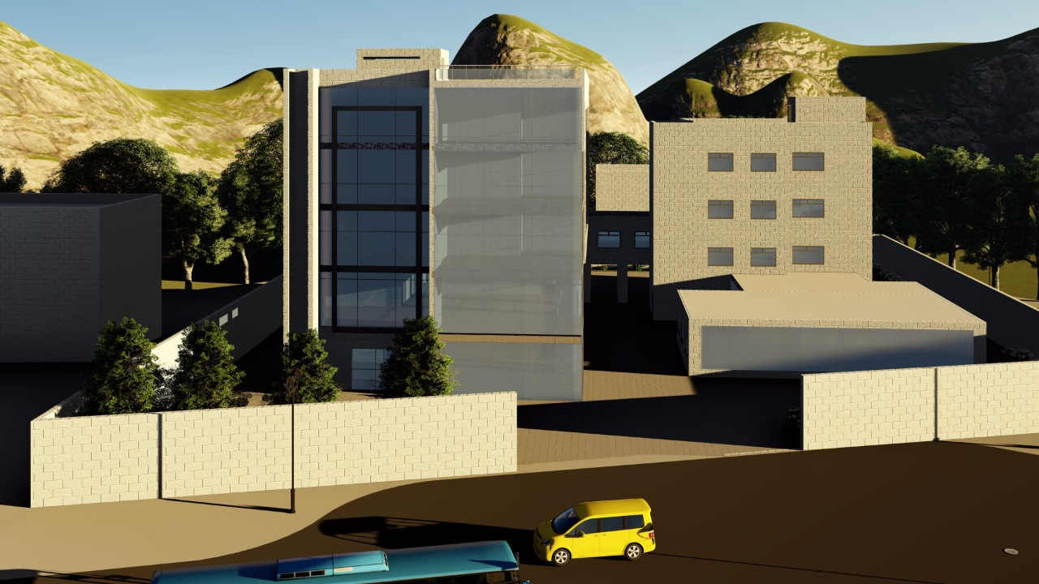
S - E

Slide 18
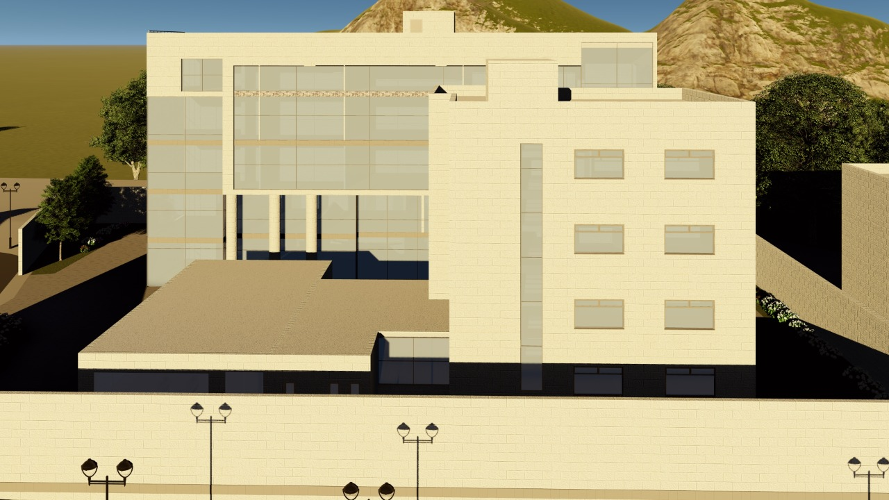
E - E

Slide 19
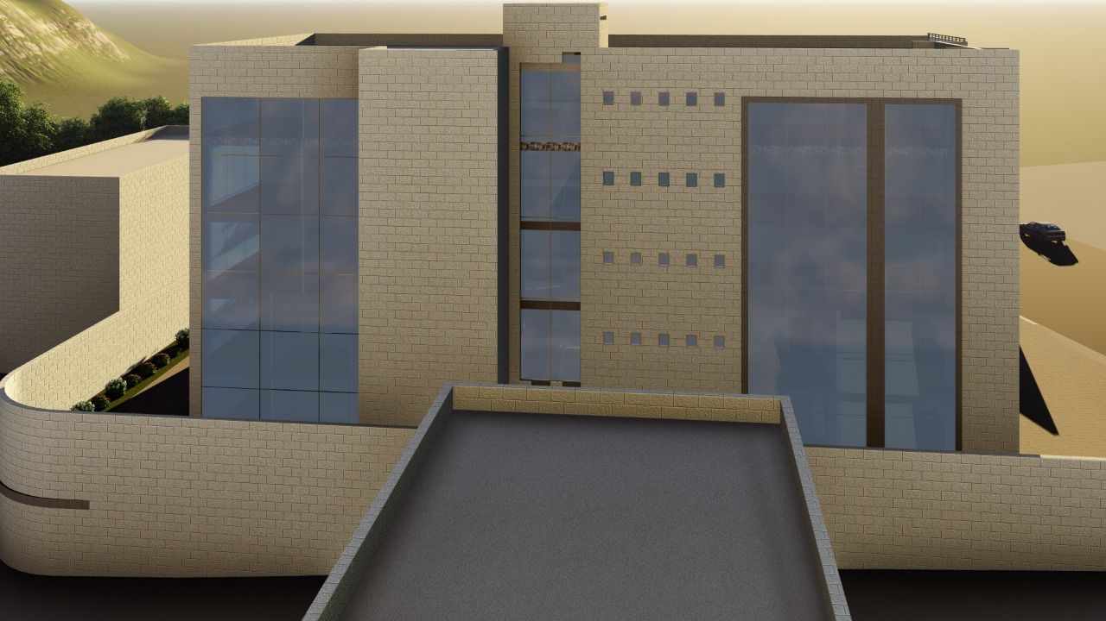
W - E

Slide 20
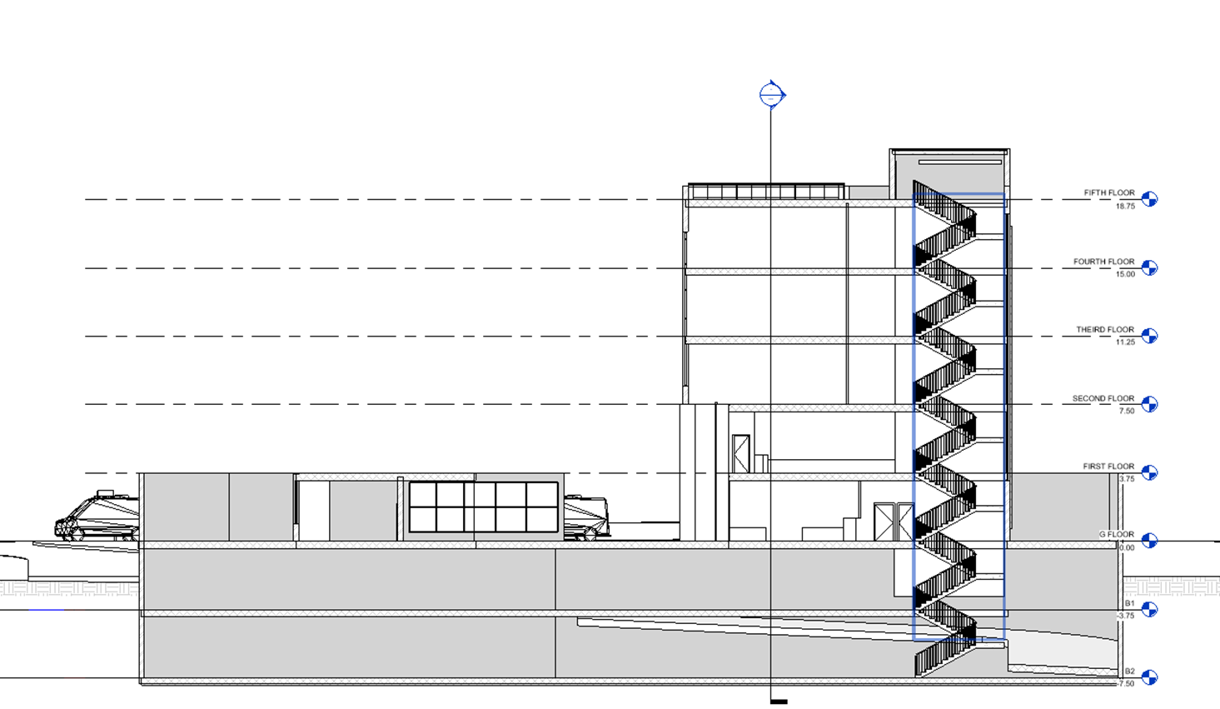
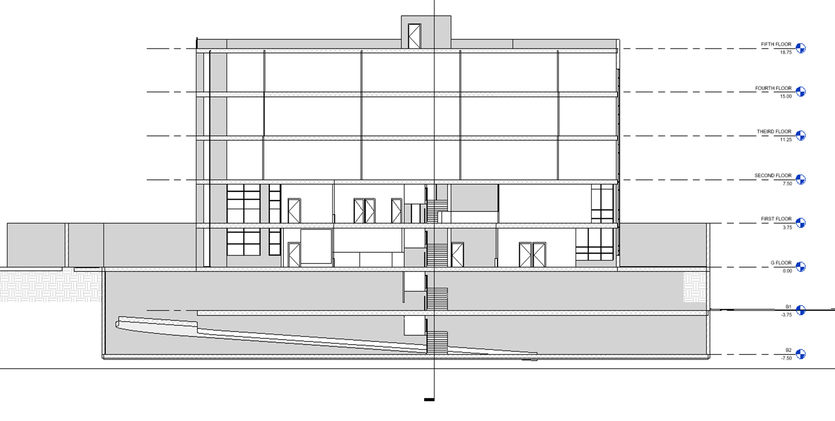

Section 2-2

Slide 21
Environmental
aspects

Slide 22
The important parameter of environmental assessment
The orientation building.
Thermal Design.
Daylight factor.

Slide 23
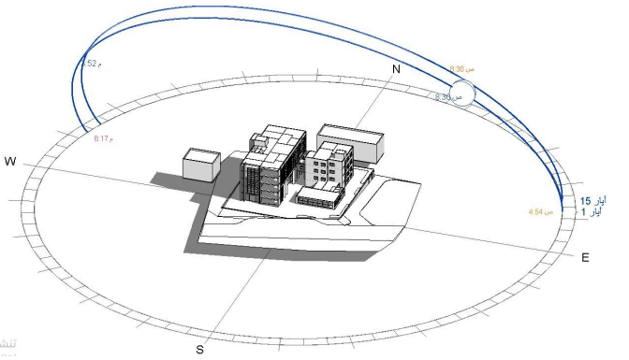
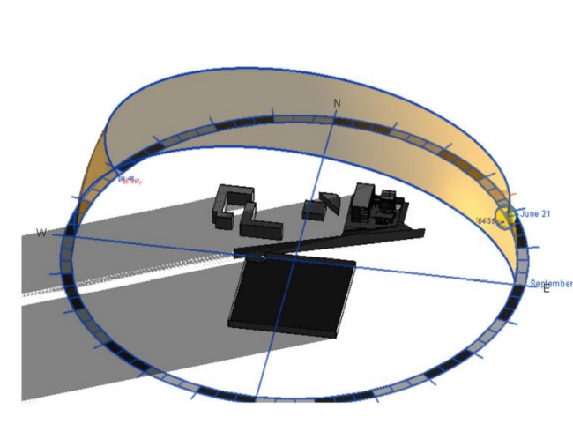
The Orientation and sun path of the building.

Slide 24
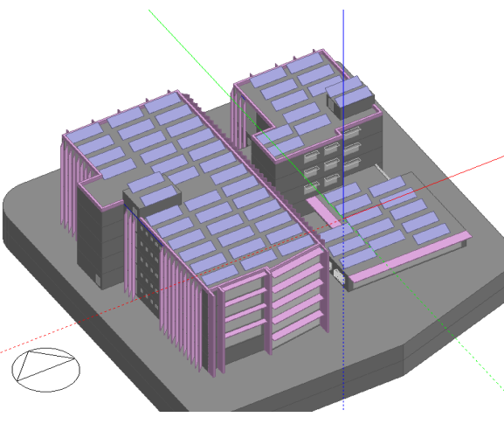
Thermal Design
Design builder model

Slide 25

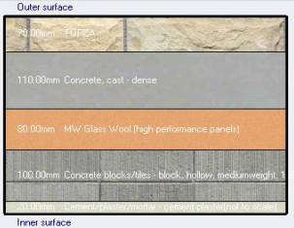
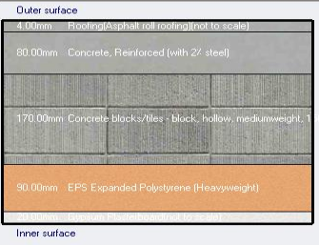
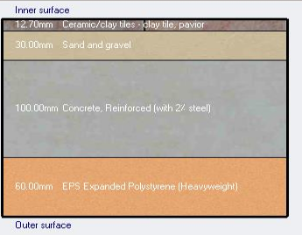
Passive design
insulation of building envelopes
External wall
Ground floor
Flat roof
U-value=0.339 W/m2. K
U-value=0.489 W/m2. K
U-value=0.32 W/m2. K
Standard U-value=0.5 W/m2. K
Standard U-value=0.8 W/m2. K
Standard U-value=0.35 W/m2. K
Notice that all U-value for envelope are less than the LEED standard values

Slide 26
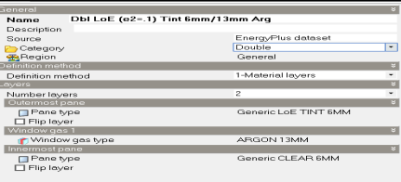
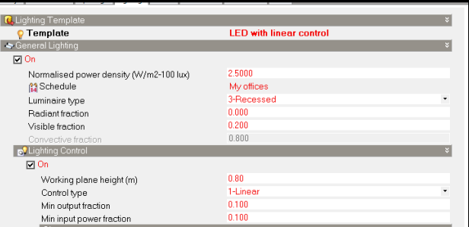
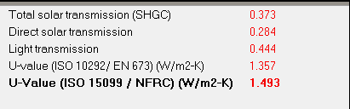
Glazing Insulation
Lighting type
U-value for window =1.49 W/m2. K
Standard U-value for window =2.1 W/m2. K

Slide 27
2-Shading systems
East and west curtain
South elevation
East elevation windows
North elevation

Slide 28
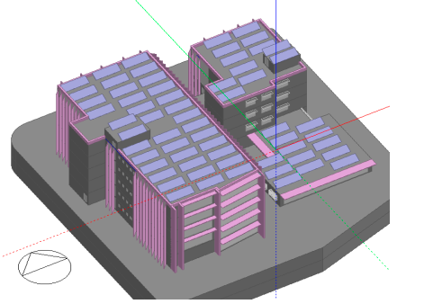
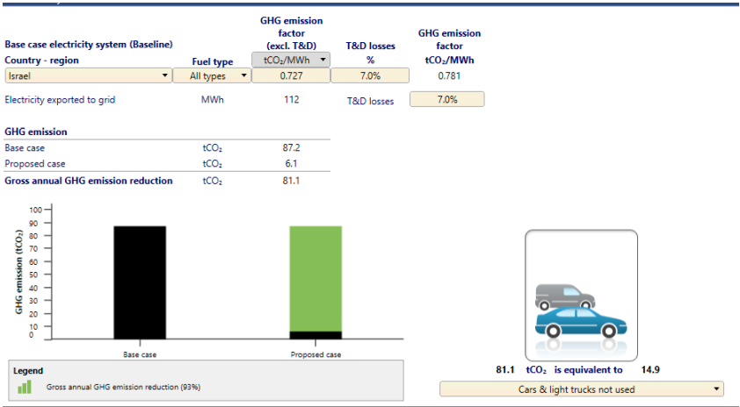
3-Photovoltaic system (PV) analysis and design:
RET screen results for PV system
The amount of annual emission reduction is 81.1-ton CO2 and its equivalent to reduce the emission of not using of 15 cars for 1 year.
Number of panels are 315 panel

Slide 29
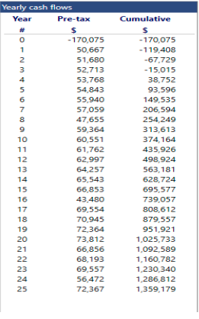
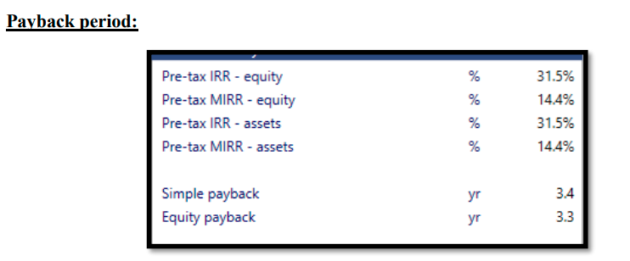
Life cycle cost and payback period analysis on RET screen program
Simple payback period =3.4 years
Equity payback period=3.3 years
Total revenue =1.36 million $ after 25 years system life

Slide 30
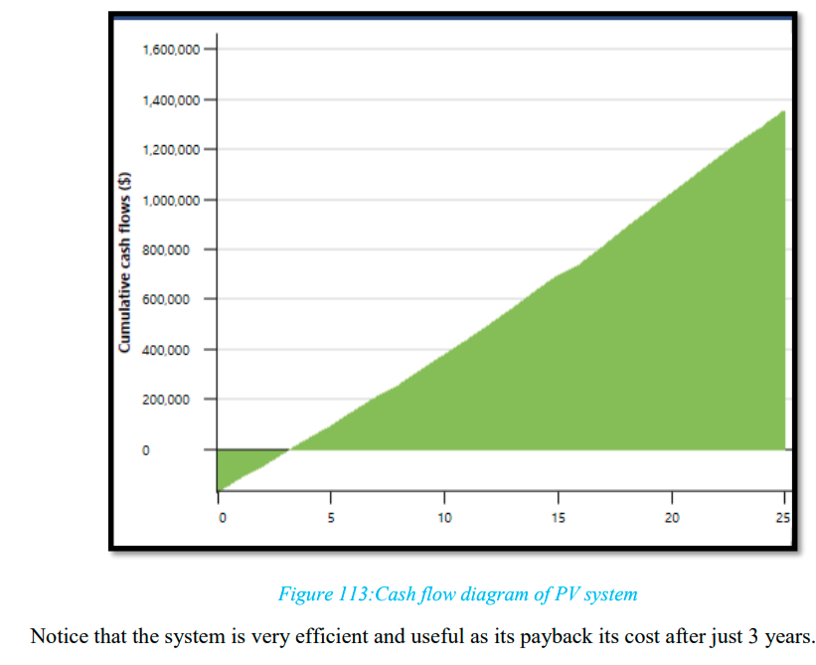
Cash flow diagram
Notice that the system is very efficient and useful as its payback its cost after just 3 years.

Slide 31
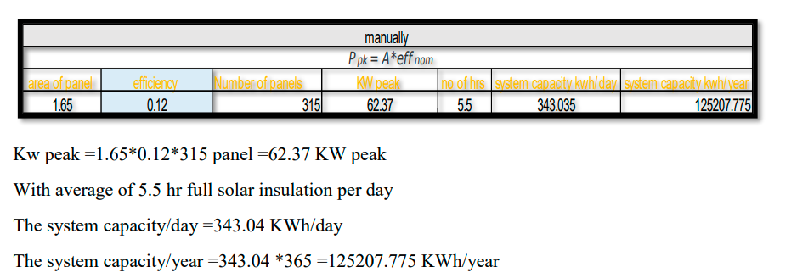
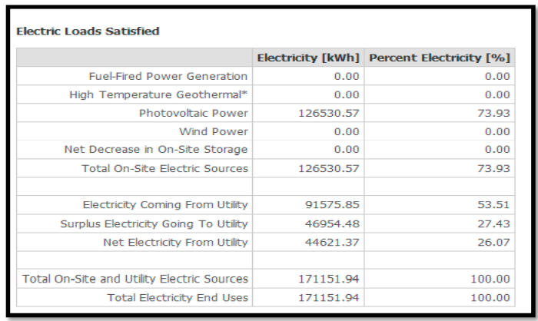
Comparison between manually and Design builder program results
Manually system capacity calculation
Design builder results for PV system
PV system saves about 74 % of total energy consumption of the building

Slide 32
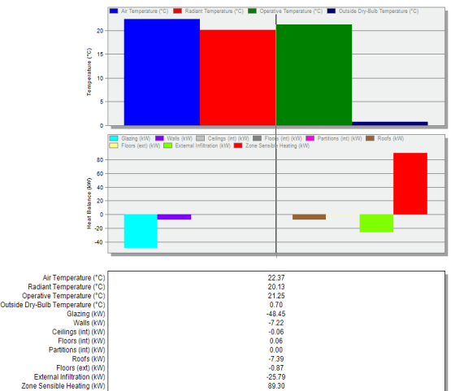
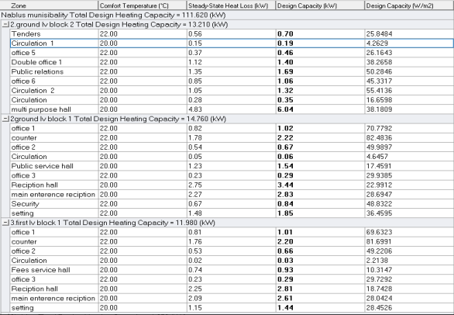
Cooling and heating design results
heating design results

Slide 33
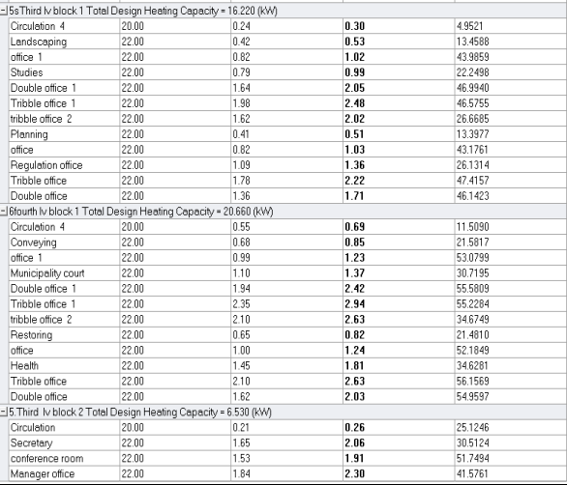
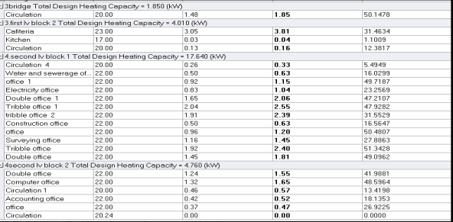
All values are less than 80 W / m2 because the improvements in the building envelope and the sealing for infiltration (0.3 ach/hr.)
Total heating design capacity is 111.62 KW

Slide 34
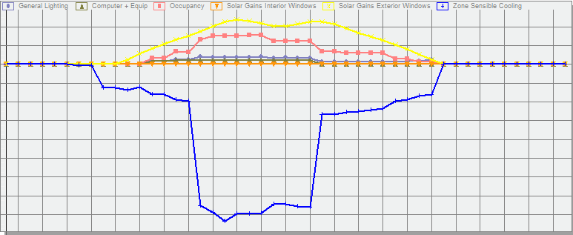
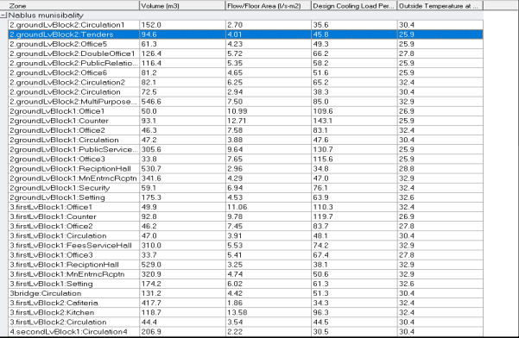
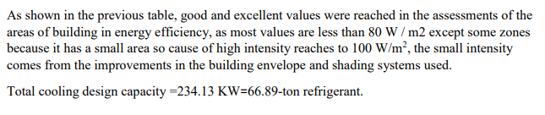
Cooling design results
Total internal gains in the building
Notice that maximum gain came from external glazing and occupant

Slide 35
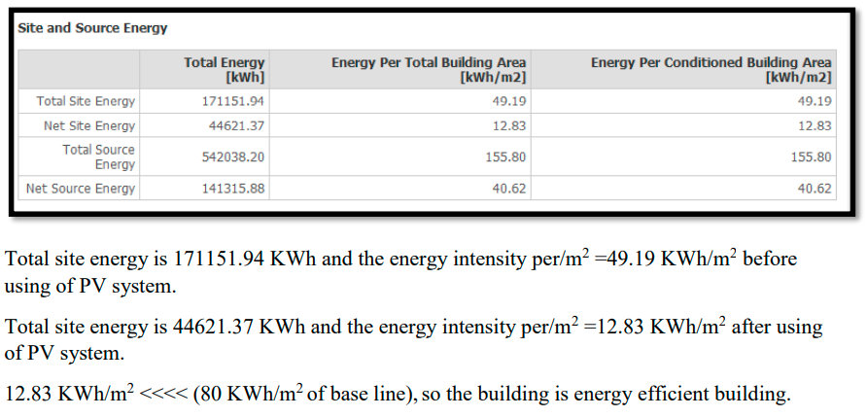
Simulation results from design builder

Slide 36
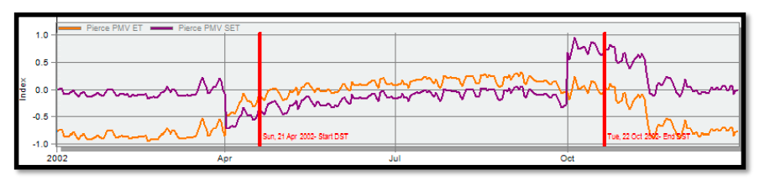
Pierce thermal comfort scale
Based on PMV set from the figure, most values are between -1 and 1, Standard comfort range of Pierce is (-1 to 1) ,the clients are comfortable in the building .

Slide 37
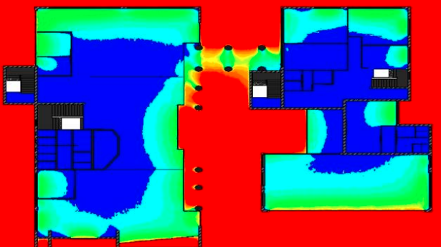
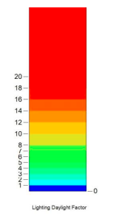
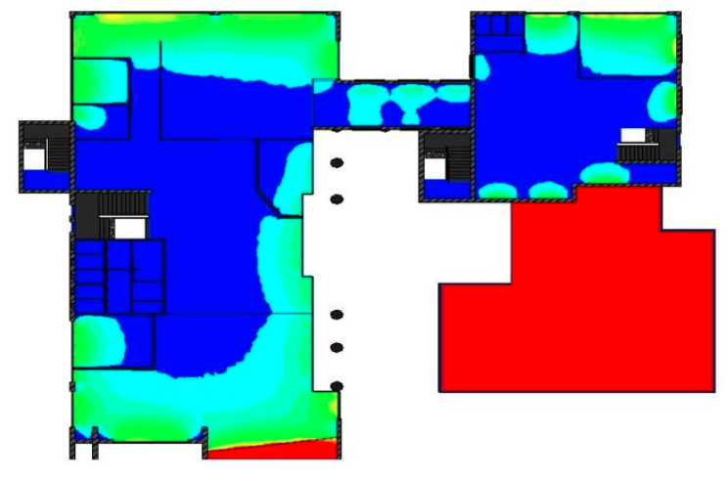

Daylight factor after modification comparison
Ground floor
First floor

Slide 38




Second floor
Third floor

Slide 39


Forth floor
Standard daylight factor threshold is (2-10)%
Most of values in floors are within standard threshold

Slide 40
Acoustical Design.
Material Choices:
• ceiling → gypsum perforated suspended ceiling
• Floor → Carpet + tile
• wall → plaster + glass

Slide 41


EASE program
Multipurpose halls
the values of RT60 in this analysis its in the avg. in the a reverberation time in the range (1.2 to 1.7 ) seconds
the most value is acceptable.

Slide 42


Direct SPL
Sound pressure level (SPL) must be 65-80dB

Slide 43


Total SPL:
This value represents the sum of the direct and indirect sound.

Slide 44


Articulation Loss :
The value of Articulation Loss must be less than 12% and her its acceptable.

Slide 45



STC for wall
we have a composite wall & STC value for wall must be more than 45dB.

Slide 46

STC value for ceiling:
STC value for ceiling must be over 60dB

Slide 47
Structural Design.

Slide 48
Structural Design
General Information
Design code :
ASCE-7 for loads and combinations.
American Concrete Institute ACI 2014 for design.
Materials:
1. Concrete.
Concrete used for slabs Columns (f'c=28 Mpa) …..(B350).
2. Steel rebar .
Steel yield strength Fy= 420 Mpa.
Loads:
Live Load for parking = 5 KN/m².
Live Load for floors = 3 KN/m².
Superimposed dead load = 4.5 KN/m².
Properties of Materials:
specific weight of Reinforced concrete = 25 KN/m³.
Specific weight of block = 12 KN/ m³.
Weight of Masonry wall = 21 KN/m.
Weight of glazing wall = 16 KN/m.

Slide 49

3D model after run .

Slide 50

Compatibility check.
All members moving together.
The check is OK.

Slide 51

Equilibrium check

Slide 52


Internal force checks.

Slide 53

Seismic checks:
Period check:
Limit =0.7924 sec
period from ETABS = 0.762
period from ETABS < Limit
Check is OK.

Slide 54

Seismic checks:
Drift Check.
All Value for Delta is less than limit
Check is OK.

Slide 55


Slab Structural System:
Two way ribbed slab.
Thickness of slab = ln\30 = 11.2 / 30 = 40 cm.

Slide 56



Slab and Beams:
Basement 2&1 Floor
GF Floor

Slide 57


Slab and Beams:
(1st), (2nd)&(3rd ) Floor
(4th ) Floor

Slide 58



Columns Design:

Slide 59


Beams Design:

Slide 60

Footing Design:
Isolated footing.
wall footing.
Mat footing.

Slide 61



Slide 62
Electrical aspect

Slide 63

Artificial Lighting Design
The modern lighting was determined on the Deluxe program, then, at that point, the structure is raised to the program and the spaces are arranged by their utilization and the capacities for which they were planned, then, at that point, the program makes the estimations after the necessary contributions from the program client are entered

Slide 64


Luminaire list
Artificial Lighting Design
Type Luminaire

Slide 65


Luminaire list
Artificial Lighting Design
Type Luminaire

Slide 66
Stander lux of rooms. office 300 lux multi purpose 500 lux reception 500 lux wc 400 lux office manger 500 lux meeting room 500 lox corridor 300 lux
Artificial Lighting Design

Slide 67


The recommended and standard for office room space
Artificial lighting Render in office room

Slide 68


The recommended and standard for multi-purpose hall
Artificial lighting Render in multi-purpose hall

Slide 69


The recommended and standard for office manager
Artificial lighting Render in office manager

Slide 70

The recommended and standard for office manager
Artificial lighting Render in meeting room

Slide 71


sockets in the zones of the building
Ground Floor
First Floor

Slide 72


second Floor
third Floor

Slide 73

fourth Floor

Slide 74


Lighting and Switch plan
Lighting distributions throughout the building's spaces in accordance with the Dialux program distribution for units
Ground Floor
First Floor

Slide 75


second Floor
Third Floor

Slide 76

Fourth Floor

Slide 77


Basement 2 Floor

Slide 78
Summary of electrical loads consumed by the building
Socket and Lighting Demand Power Calculations
Current Calculations for Socket and Lighting
3-phase fuse were used due to the relatively large loads
I=power/(power factor *voltage)
I: Current. (A) P: Power. (W)
V: Voltage = 380 Volt. P.F: Power Factor = 0.95.

Slide 79

Elevator
According to the standard and calculations, needed number of elevators =4
Passenger Capacity

Slide 80


Electrical Generator for emergency
Generator model that used.
Location for Generated in building basement 2
Generator Capacity = 40 KW

Slide 81
mechanic aspects

Slide 82


Mechanical aspect water supply distribution:
Ground floor:

Slide 83


1st Floor

Slide 84


2nd Floor

Slide 85


Water supply calculation:
# of F.U for feeder 1 in ground floor:
The diameter of pipe for feeder 1 :
Main Vertical (Gf , 1st , 2nd , 3rd , 4th )
 | FUS = 190 , Flow = 88 gpm
Diameter | 3" | 2.5" | 2"
Loss/100 | 1.5 | 3.8 | 10
Loss/100.56 | 1.51 | 3.82 | 10.06
Main Horizontal (Gf , 1st , 2nd , 3rd , 4th )
 | FUS = 38, Flow = 22 gpm
Diameter | 1.5" | 1.25" | 1"
Loss/100 | 3 | 8 | 23
Loss/14.4 | 0.43 | 1.15 | 3.31
Main Branch (Gf , 1st , 2nd , 3rd , 4th )
 | FUS = 5 , Flow = 5 gpm
Diameter | 1" | 3/4" | 1/2"
Loss/100 | 1.3 | 5.5 | 40
Loss/25.2 | 0.33 | 1.39 | 10.08
total number of F.U for feeder 1 :
So, we chose 3” for main vertical
And 1.5” for main horizontal
And 1” for branch

Slide 86


Drainage system
ground floor:

Slide 87


First Floor

Slide 88


Second Floor

Slide 89


Drainage water calculation
# of D.F.U in ground floor:
Line diagram:
Our chosen pipe diameters:
pipe function | Diameter | Slope | Pipe Type
Vent | 4" | 0% | PVC
Stack | 4" | 0% | PVC
Drainage | 4" | 1% | PVC
Sewer | 2" | 2% | PVC
Drainage between Manhole | 6" | 1% | PVC

Slide 90



Fire fighting system
Ground Floor:

Slide 91


Second floor

Slide 92


evacuation paths in the building :

Slide 93




HVAC system
Selected indoor and outdoor units
High wall indoor unit
4-way cassette unit

Slide 94




Sections from HVAC system layout for the 66.89 Ton refregirent cooling capacity

Slide 95
Quantity surveying & Cost Estimate

Slide 96




