Slide 1
Smart Home
Presented by: Ehab Afaneh
Ibraheem Bsharat
Supervisor: Dr. Hanal Abu Zant

Slide 2
Outlines
Introduction.
Features.
Technologies and Tools.
Methods and Techniques.
Constrains.
Future work.

Slide 3
Introduction
The goal of the Smart Home is to facilitate the process of managing the house, monitoring its equipment, and securing protection and control of its contents through the use of smart tools.

Slide 4
Features
Face recognition was used to control of the house’s door.
RFID was used to control of the car's parking door.
Managing the lighting system in the house based on the movement.
Managing the air conditioner according to the temperature.
Fire alarm system.

Slide 5



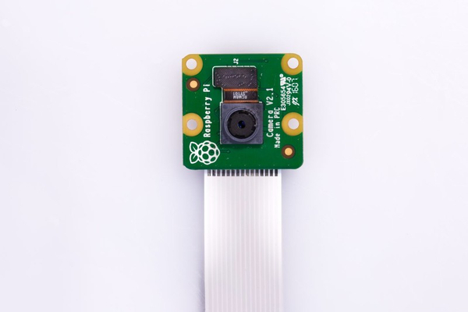

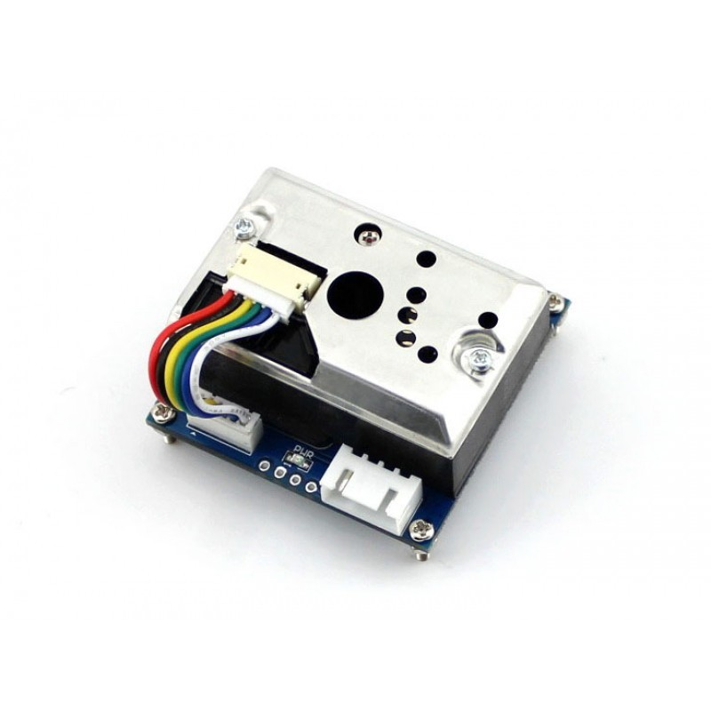


Technologies and Tools.
Main tools used

Slide 6



Technologies and Tools.
Programing technologies used

Slide 7
Methods and Techniques
Administration web page.
Face recognition.
RFID.
Lighting system.
Air condition system.
Fire alarm system.

Slide 8
Administration web page

Slide 9
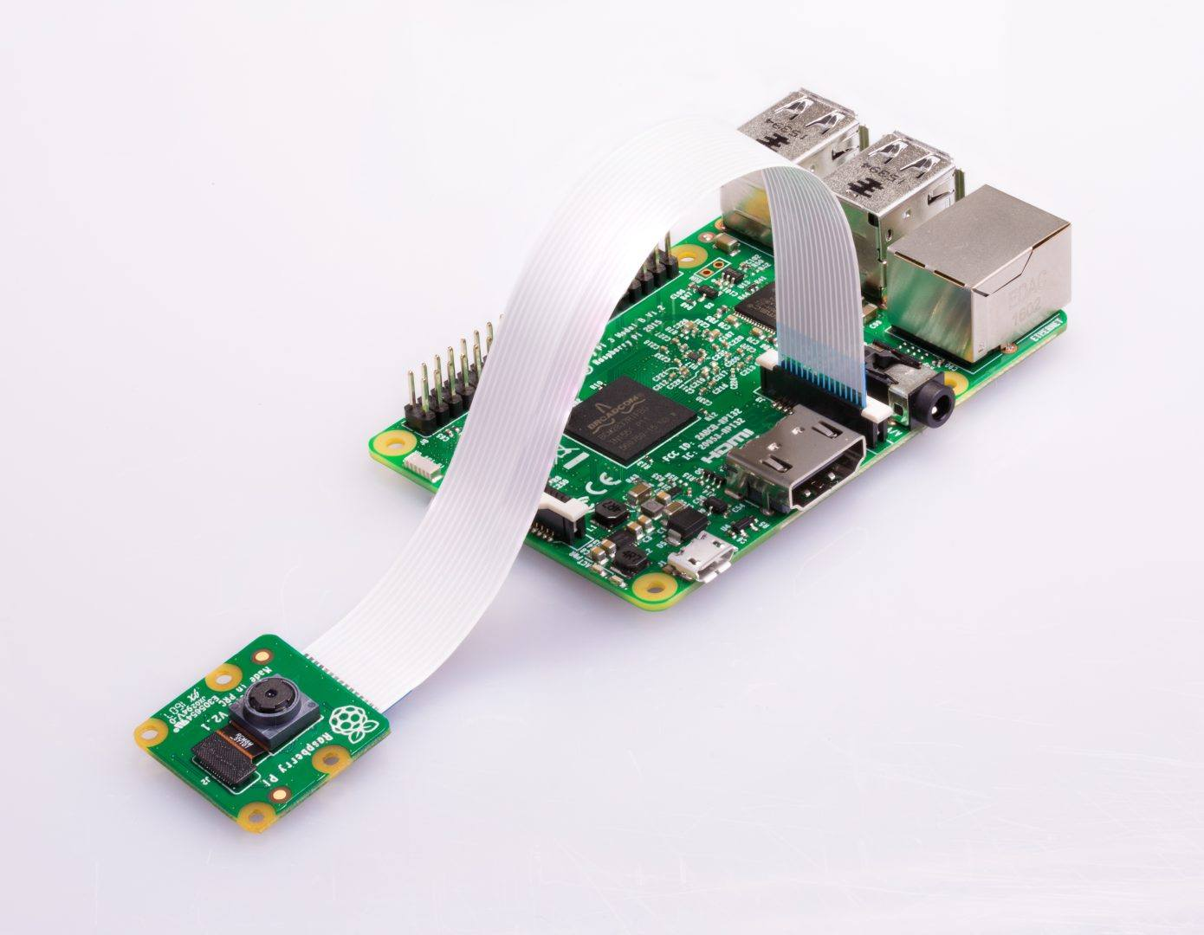
Face recognition

Slide 10
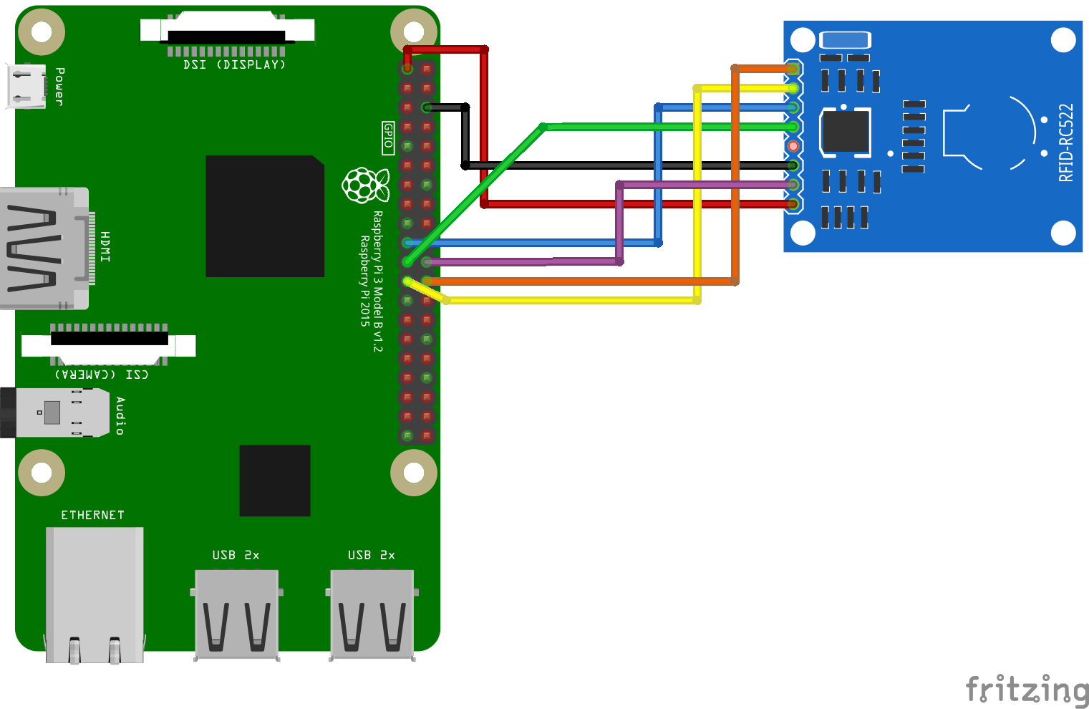

RFID

Slide 11
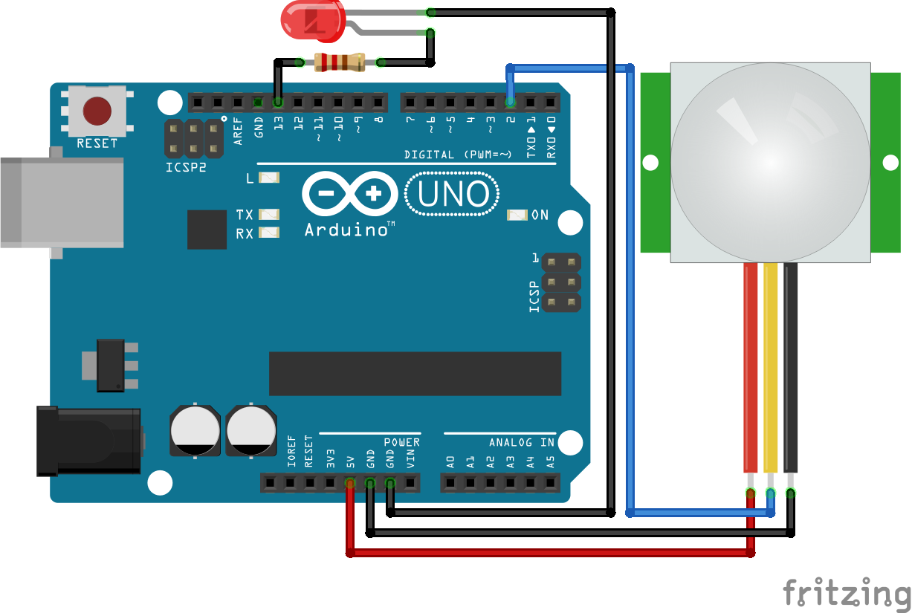
Lighting system

Slide 12
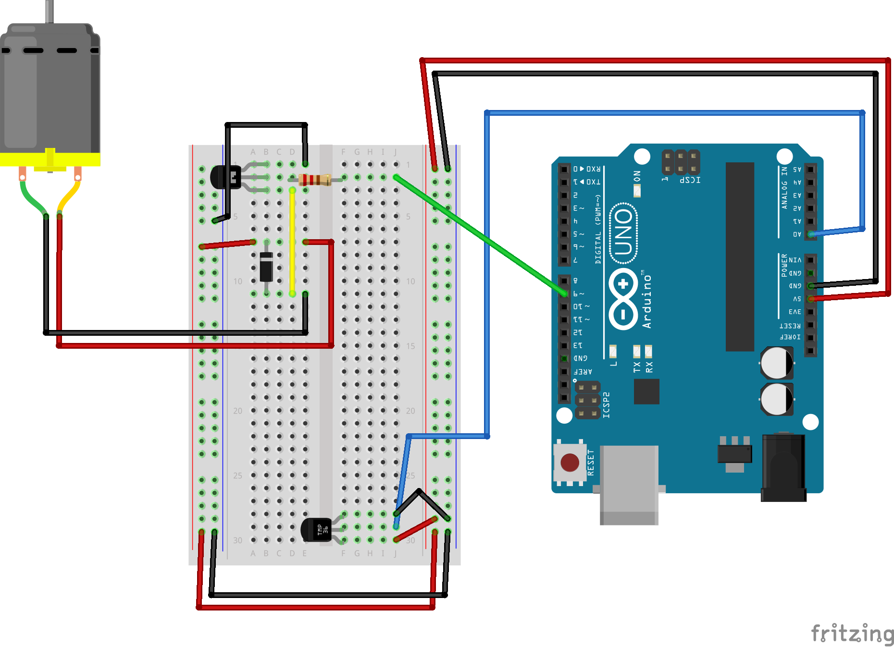
Air condition system

Slide 13
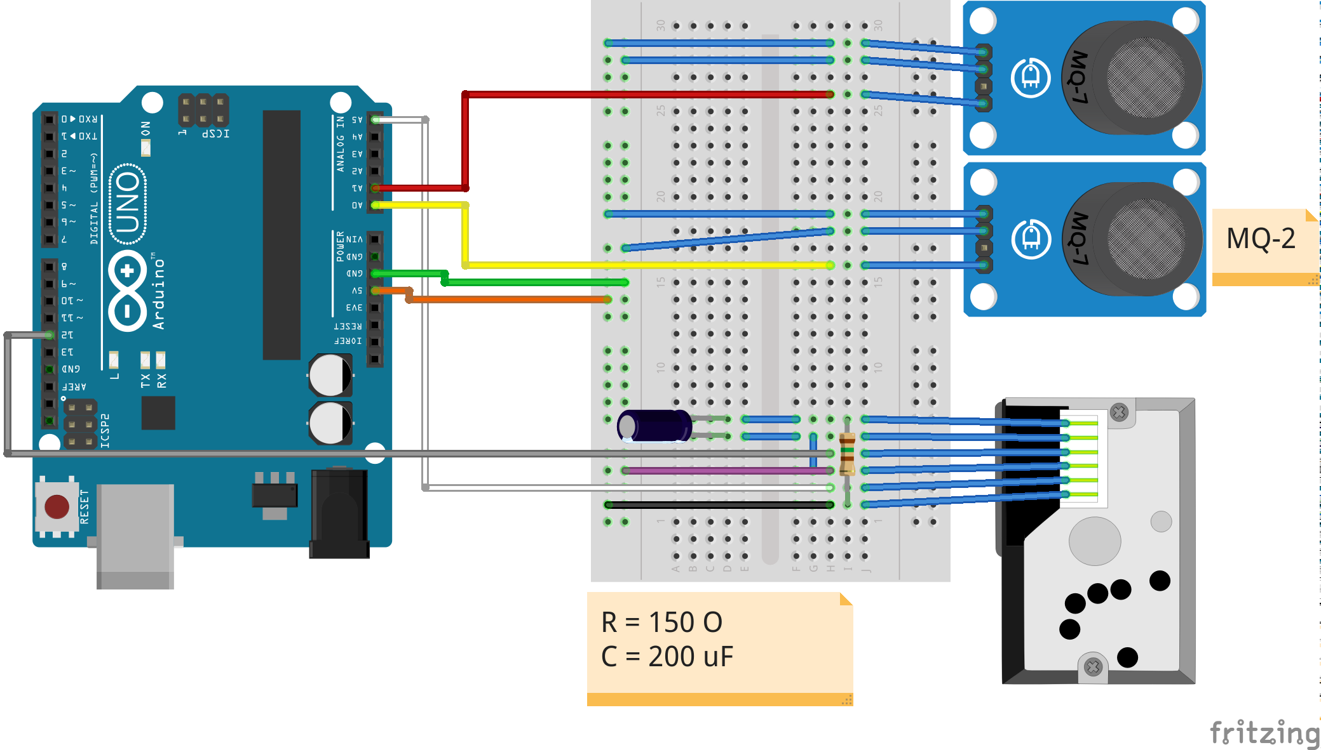
Fire alarm system

Slide 14
Constrains
Difficulty finding some electronic parts.
Learn how to use Raspberry Pi.
Learn new things like Python language and link it with OpenCV.

Slide 15
Future work
Activating the sound system to control electrical appliances in the house.
Activating the alert system via messages in the event of a strange movement in the house (a thief approaches the parking lot or the house, a fire occurs in the house).
Add a humidity system to the kitchen to maintain the normal humidity level.

Slide 16
The End
Thank You

