Slide 1

Structural Design of Al-Quds Open University in Salfit
GP - 13/5/2015
Prepared By :
Ahmed Ibrahim Saleh
Hind Fuad Tbaileh
Karim Abdulhakim Jawhari
Submitted to :
Eng. Ibrahim Arman

Slide 2

3D Architectural Model of The Project

Slide 3
Project Description
The project is located in Salfit
The project consists of three blocks separated by seismic joints.
Block 1 and Block 2 consist of 4 floors
Block 3 consists of 4 floors and a basement
Total Project Area = 4200m²
Total Building Area = 1450m²

Slide 4
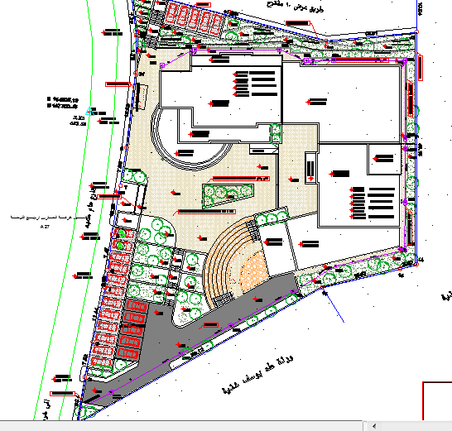
Project Description : Site Plan
Block (1)
Block (3)
Block
(2)

Slide 5
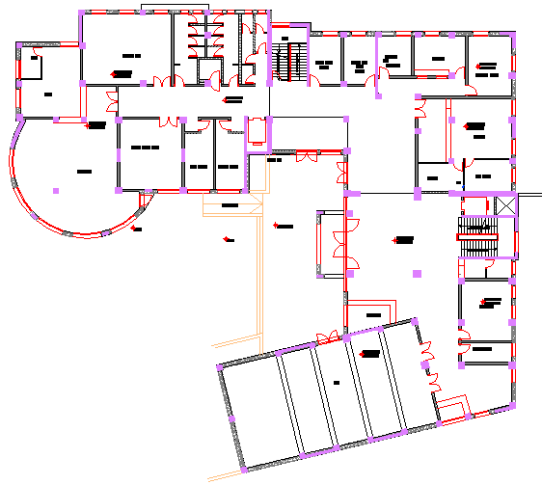
Ground Floor Architectural Plan
Block (3)
Block
(2)
Block (1)

Slide 6
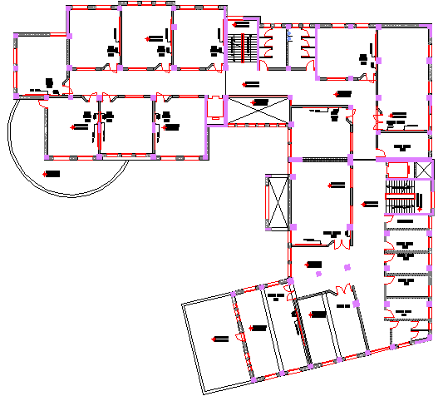
First Floor Architectural Plan
Block (3)
Block
(2)
Block (1)

Slide 7
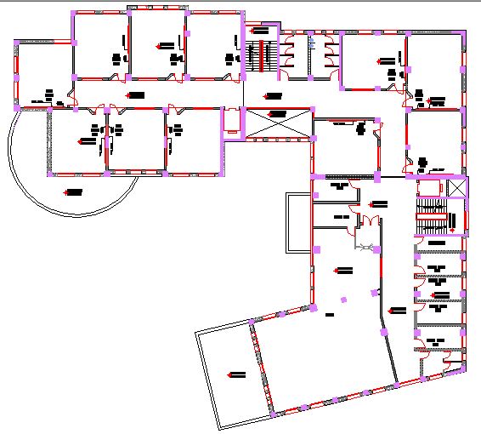
Second Floor Architectural Plan
Block (3)
Block
(2)
Block (1)

Slide 8
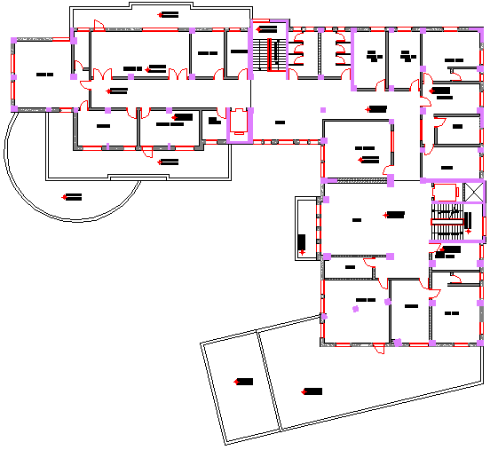
Third ( Roof ) Floor Architectural Plan
Block (3)
Block
(2)
Block (1)

Slide 9
Objectives of Graduation Project
To form a better knowledge about the different engineering codes such as UBC-97 and IBC-2012 regarding :
  Earthquake Loads
  Wind Loads
To make a preliminary design for the structural members in each block.
To analyze and design Block (1) using a 3D structural model using the provisions of UBC-97 and IBC-2012.
To do a simplified comparison between the results and design obtained from UBC-97 and IBC-2012

Slide 10
The Codes Used in This Project
The Codes used in this project are the following :
  Uniform Building Code ( UBC-97 ) for both wind and earth quake loads
  International Building Code ( IBC-2012 ) for both wind and earth quakes
  ASCE-7 (2010)
  Jordanian Code
  ACI 318-11 and ACI 318-95

Slide 11
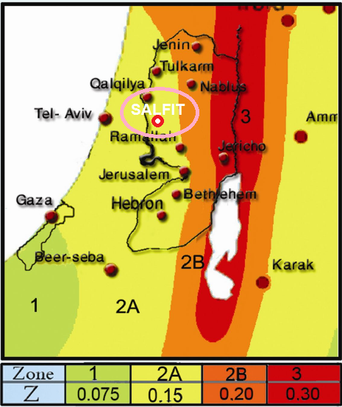
Seismic Zone Requirements (UBC-97)
Seismic Zone Factor (Z) Map Prepared By An-Najah National University is used to determine the seismic zone for Salfit
Seismic Zone for
Salfit is 2A
Factor (Z) = 0.15

Slide 12
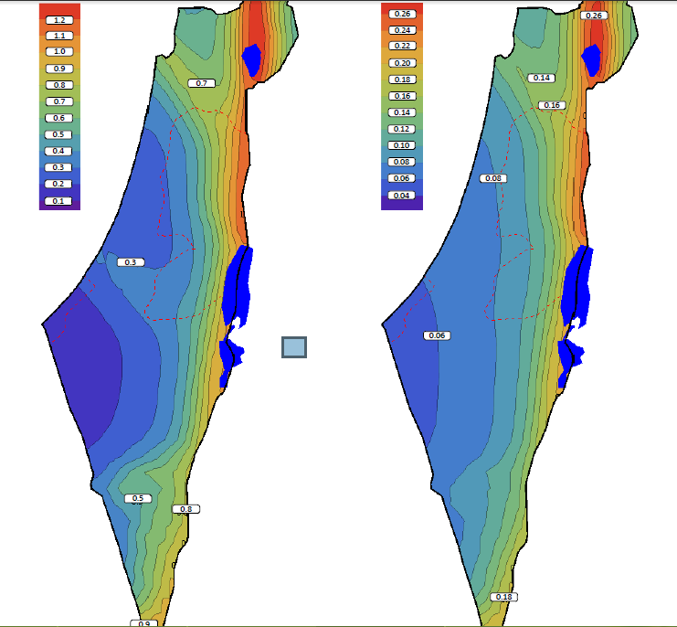
Seismic Zone Requirements (IBC-2012)
Mapped Acceleration parameters (S₁ and S_{S}) are shown below :
S_{S} = 0.6
S₁ = 0.3
S_{S} MAP (2%) S₁ MAP (2%)

Slide 13
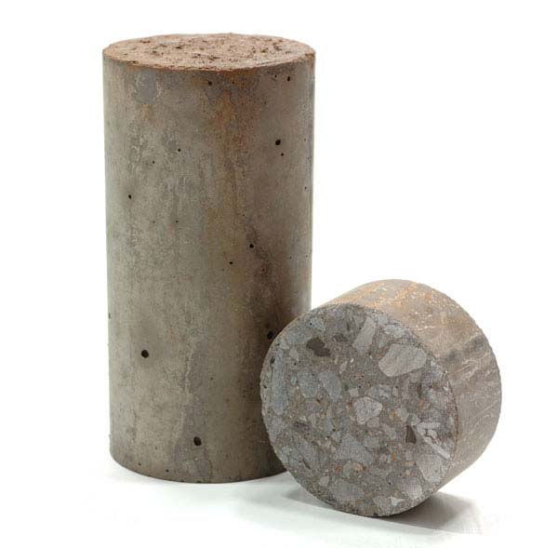
Structural Materials
Concrete
  Used Compressive Strength (f_{c}’) for Slabs, Beams, Columns and Footings is 28 MPa.
  Modulus of Elasticity = 24870 MPa
  Unit Weight for used Concrete is 25 kN/m³

Slide 14
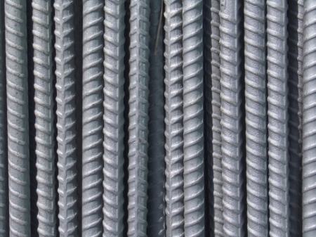
Structural Materials
Reinforcing Steel
  Yielding Stress for used Steel is 420 MPa
  Modulus of Elasticity is 200,000 MPa
  Unit Weight (ɣ) is 77kN/m³

Slide 15
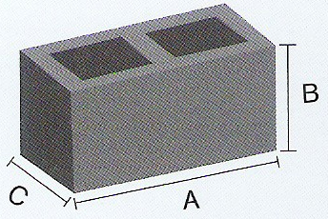
Non-Structural Materials
Concrete Blocks
  The used blocks were of 100 mm thickness, 200mm height and 400mm length in internal partitions and in external walls having a unit weight of 12kN/m³
  Internal partitions are 250mm thickness having two layers of 100mm concrete blocks with an isolation with of 50mm
  For external walls, a single layer of 100mm concrete block is used.

Slide 16

Non-Structural Materials
Building Stones:
  The average density for used building stones is 2700 kg/m³
  The Three main shapes of the used stones are:
    Tobzeh Stone
    Mufajjar Stone
    Matabbeh Stone

Slide 17
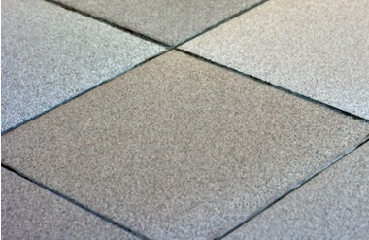
Non-Structural Materials
Plastering:
  Three layers of plastering will be used to achieve the required smoothness with an average thickness of 20mm for each layer
Tiles:
  The main two types of tiles that will be used in the building are Mosaic Tiles for internal rooms and Ceramic Tiles for kitchens and WCs with an average density of 2500 kg/m³

Slide 18
The Philosophy of Design
A 3D Model was constructed and analyzed using SAP2000 program taking into consideration the effects of dynamic Loads
Columns and Beams were represented as line elements.
Slabs and shear walls were modeled as area elements.
The connections between the footings and the column necks were represented as pin connections.
The Ultimate Design Method (LRFD) were used in the preliminary design phase.

Slide 19
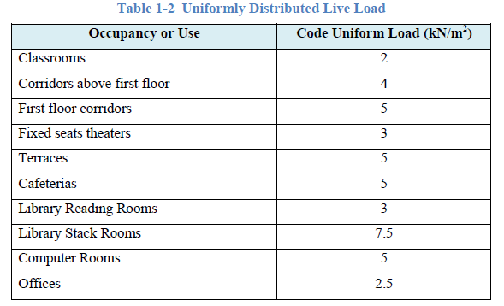
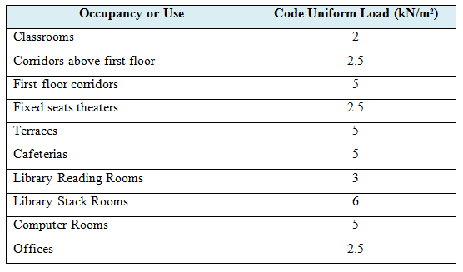
Load Types
Live Load:
Used Live Load = 4.0 kN/m²

Slide 20
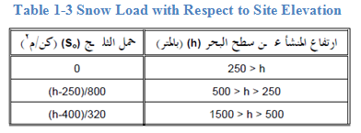
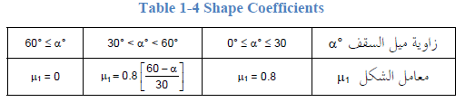
Load Types
Snow Load:
Site Snow Load (S_{o}) = (532 – 400) / 320 = 0.4125 kN/m²
Design Snow Load on Roof (S_{d}) = 0.8 X 0.4125 = 0.33 kN/m²

Slide 21
Load Types
Super Imposed Dead Load:
Filling Material: 100mm of crushed gravel mixed with sand is used having a density of 1800 kg/m³
  Filling Material Load = 0.1 X 1800 = 180 kg/m²
Mortar: 20mm were used with an assumed average density of 2300 kg/m³
  Mortar Load = 0.02 X 2300 = 46 kg/m²

Slide 22
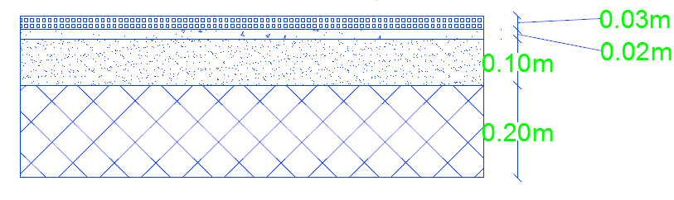
Load Types
Tiles: an average thickness of tiles were taken as 30mm with a density of 2500 kg/m³
  Tiles Load = 0.03 X 2500 = 75 kg/m²
Total superimposed dead load = 3 kN/m²

Slide 23
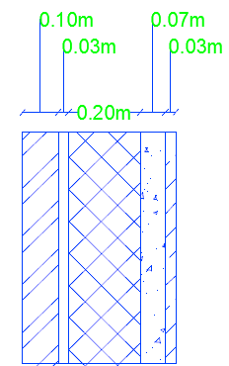
Load Types
Internal Walls: two types were used:
  Single Layer (100mm) internal wall load per meter run = 0.1 X 1200 X 3.64 = 436.8 kg/m = 4.25 kN/m
  Double Layer (250mm) internal wall load per meter run = 0.2 X 1200 X 3.64 = 873.6 kg/m = 8.5 kN/m
External Walls: which consists of:
  External wall load per meter run = ((0.03 X 2700) + (0.07 X 2500) + (0.1 X 1200)) X 3.9 = 1467 kg/m = 14.4 kN/m

Slide 24
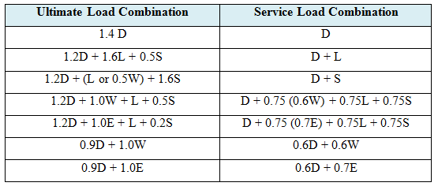
Load Combinations
Using IBC 2012:

Slide 25
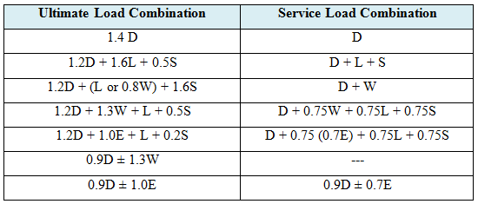
Load Combinations
Using UBC 1997:

Slide 26
Preliminary Design of The Project
To do the preliminary design for the blocks the following procedure is used :
  Determine the load assigns for the block.
  Determine the distribution of beams .
  Determine the thickness of the slab .
  Calculate the ultimate load for the slab.
  Check the shear and the reinforcement for the slab.
  Determine the dimensions of the beams.
  Determine the dimensions of the columns.

Slide 27
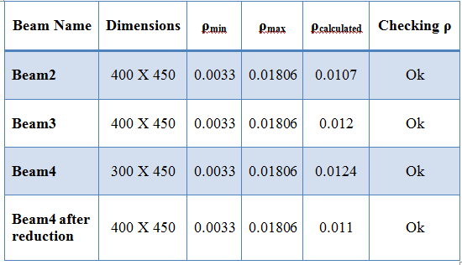
Preliminary Design of The Project
Table 2-2 shows the beam dimensions for Block (1) from the preliminary design stage:
Table 2-2 Beams Properties
Slab thickness = 150mm
Column Dimension = 500x500mm

Slide 28
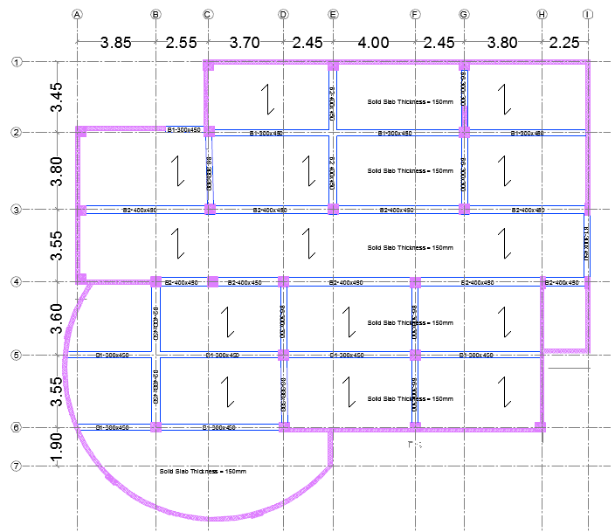
Preliminary Design of The Project

Slide 29
Equivalent Lateral Force (IBC-2012)
The Following Parameters are used in the calculations :
  Acceleration Parameter at Short Period (S_{s}) = 0.6
  Acceleration Parameter at 1-SEC Period (S₁) = 0.3
  F_{a} = 1.16 ( Table 1-14 )
  F_{v} = 1.5 ( Table 1-15 )
  S_{DS} = 2/3 x 1.16 x 0.6 = 0.464
  S_{D1} = 2/3 x 1.5 x 0.3 = 0.30
  Risk Category = (II)
  Effective Weight (W) = 25634kN

Slide 30

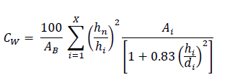
Equivalent Lateral Force (IBC-2012)
The Following factors are from Table 12.2-1 in ASCE-7 (2010)
  Response Modification Coefficient (R) = 5.5
  Overstrength Factor (Ω_{o}) = 2.5
  Deflection amplification Factor (C_{d}) = 4.5
Structural Period is approximated using the following :
  (Equation 1-41)
  (Equation 1-42)

Slide 31
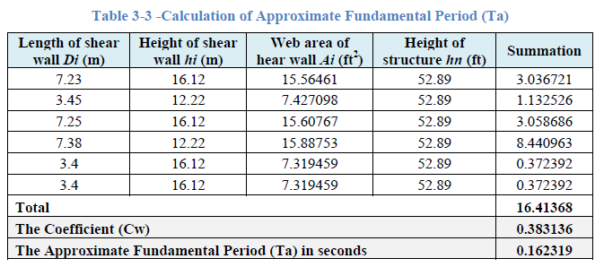
Equivalent Lateral Force (IBC-2012)
The following Table shows the calculations of structural period according to Equation 1-41 and Equation 1-42 :
Approximate Fundamental Period (Ta) = 0.1623 Seconds

Slide 32




Equivalent Lateral Force (IBC-2012)
These are the equations used for Base Shear (V) calculation :
  Base Shear (Equation 1-9)
  Seismic Coefficient (Equation 1-11)
  Maximum Coefficient (Equation 1-10)
  Minimum Coefficient Eq.(1-10)

Slide 33



Equivalent Lateral Force (IBC-2012)
Applying the previous Equations:
Select The Value of Base Shear (V) = 2163 kN

Slide 34


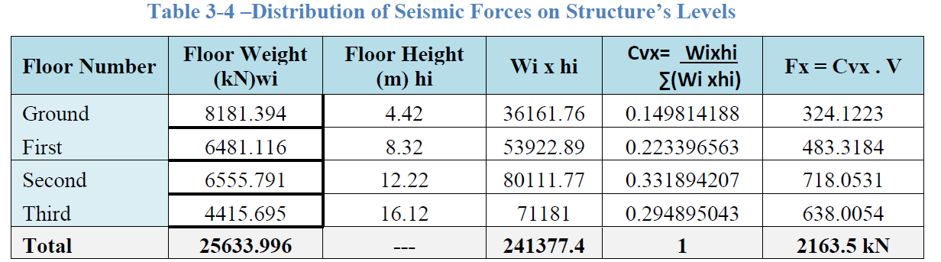
Equivalent Lateral Force (IBC-2012)
The seismic force is distributed according to this equation :
  Force Per Floor (Equation 1-43)
  Distribution Factor (Equation 1-44)

Slide 35
Equivalent Lateral Force (UBC-97)
The Following Parameters are used in the calculations :
  Seismic Zone Factor for Salfit (Zone 2A) = 0.15
  Soil Profile = S_{c}
  C_{a} = 0.18 ( Table 1-8 )
  C_{v} = 0.25 ( Table 1-9 )
  Importance Factor (I) = 1
  Reduction Factor (R) = 5.5 ( Table 1-12)
  Effective Weight (W) = 25634kN

Slide 36




Equivalent Lateral Force (UBC-97)
Due to the existence of concrete shear walls the following formula where used:
  A_{c} = 5.45 m²
For the Calculation of C_{t}:
  C_{t} = 0.0318
  The Natural Period T_{n} = 0.256 sec

Slide 37

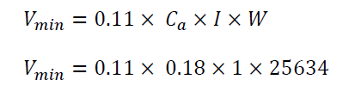

Equivalent Lateral Force (UBC-97)
These are the equations used for Base Shear (V) calculation :
  (Equation 1-9)
  (Equation 1-11)
  (Equation 1-10)

Slide 38





Equivalent Lateral Force (UBC-97)
Applying the previous Equations :
Select The Maximum Value of Base Shear (V) = 2097.32 kN

Slide 39

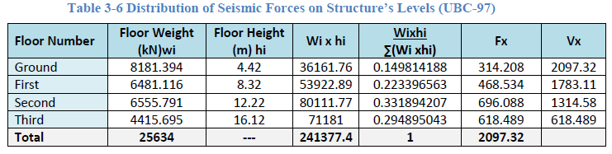
Equivalent Lateral Force (UBC-97)
The seismic Base Shear (V) is distributed according to this equation :
  Force Per Floor (Equation 1-14)

Slide 40
Calculating Wind Load (UBC-97)
The Following Parameters are used in the calculations :
  Basic Wind Speed = 120 km/hr
  Exposure = C
  Importance Factor (I_{w}) = 1 ( Table 1-26 )
  Wind Stagnation = 0.7 kN/m² ( Table 1-27 )
  Pressure Coefficient (C_{q}):
    For windward = +0.8
    For Leeward = -0.5

Slide 41
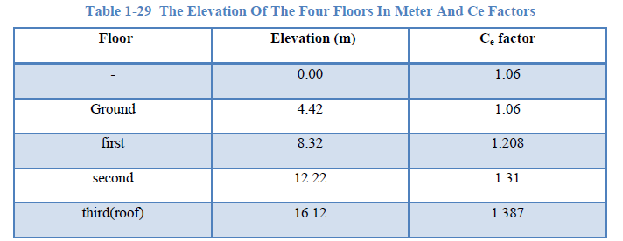
Calculating Wind Load (UBC-97)
  Combined height, importance and gust factor (C_{e}) :

Slide 42
Wind Load-Block 1 (UBC-97)
Windward Pressure = C_{e} C_{q} q_{s} I_{w}
= 1.06 X 0.8 X 0.7 X 1 = 0.6 kN/m²
Windward force = P X Tributary Area
= 0.6 X 25.42 X 2.21 = 33.34 kN

Slide 43
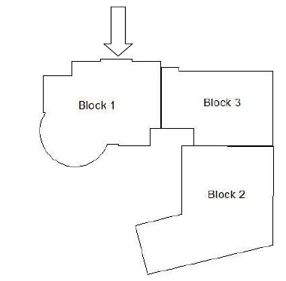
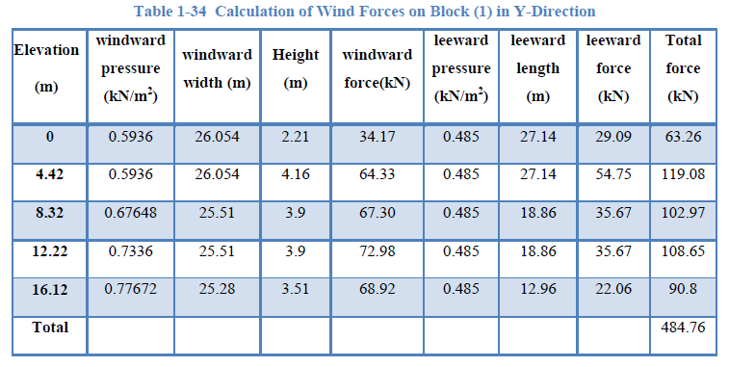
Wind Load-Block 1
(UBC-97)

Slide 44
Calculating Wind Load (IBC-2012)
The Following Parameters are used in the calculations :
  Basic Wind Speed (V)= 175km/hr = 49m/sec
  Exposure = C
  Wind Directionality Factor (K_{d}) = 0.85 (Table 1-39)
  Topographic Factor (K_{zt})= 1
  Velocity Pressure Exposure Coefficient (K_{z}) : (Table 1-41)
  Gust-effect (G) = 0.85
  External Pressure Coefficient (C_{p}):
    For windward = +0.8
    For Leeward = -0.5

Slide 45

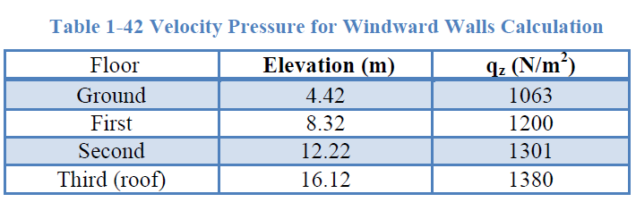
Calculating Wind Load (IBC-2012)
  Velocity Pressure (q_{z}):

Slide 46
Wind Load - Block 1 (IBC-2012)
Windward Pressure (P) = q_{z} X G X C_{p}
= 1063 X 0.85 X 0.8 / 1000 = 0.723kN/m²
Windward force = P X Tributary Area
= 0.723 X 25.42 X 2.21 = 40.26kN

Slide 47
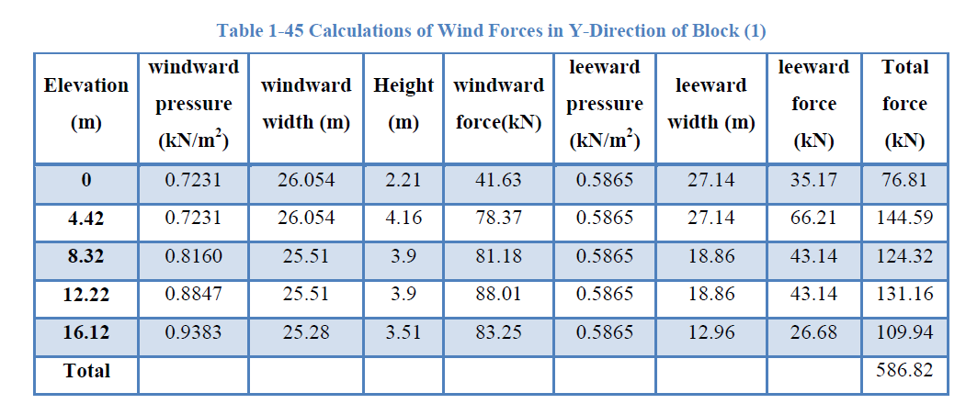
Wind Load-Block 1
(IBC-2012)

Slide 48
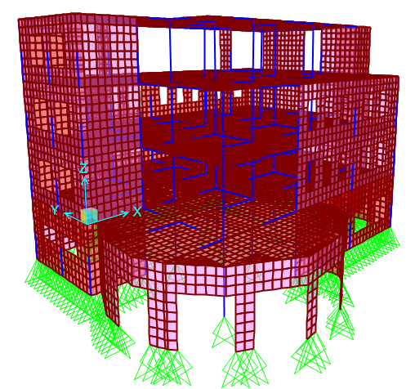
Structural 3D Modeling
The structure is modeled using SAP2000 program
All Window Openings were considered

Slide 49
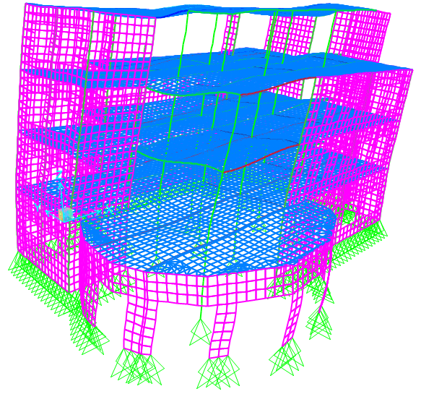
Verification of Structural Analysis
Compatibility Check :
  The following figure proves the compatibility of the model

Slide 50
Verification of Structural Analysis
Equilibrium Verification
  The Loads assigned to the model are :
  Own Weight = Calculated automatically in the SAP2000
  Super imposed dead load = 3.0 kN/m²
  Live Load = 4.0 kN/m²
  Earthquake Loads
  Wind Loads
  Snow Loads

Slide 51

Verification of Structural Analysis
Equilibrium Verification
  The following table shows the base reactions obtained from the analysis of SAP2000
Table 3-1 Base Reactions From SAP2000 Program

Slide 52
Verification of Structural Analysis
Live Load Verification
  Total Live Load from hand calculation = 5484 kN
  Total Live Load from SAP2000 program = 5320 kN
  Difference Percentage = (5848-5319)/5484 = 3%
Dead Loads Verification ( Own Weight )
  Value from SAP2000 Program for Own Weight = 14570kN
  Own Weight = 14460kN
  Difference Percentage = (14570-14460)/14570 = 0.75%

Slide 53
Verification of Structural Analysis
Superimposed Dead Load Verification
  Super Imposed Dead Loads = 10924kN
  Value from SAP2000 Program =10832kN
  Difference Percentage = (10924-10832)/10924 = 0.85%

Slide 54
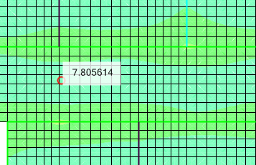
Verification of Internal Forces
Check of Slabs Internal Forces
  Ultimate Load (W_{u}) = 14.5 kN/m
  Bending Moment According to SAP2000 = 7.81 kN.m
  The clear span (l_{n}) = 3.0m
  Using the ACI Coefficient Method for analysis :
  Bending Moment = W_{u} ln²/16 = 14.5x32/16 = 8.156 kN.m
  Difference Percentage
  =(8.156-7.81)/8.156
  = 4.24 %

Slide 55
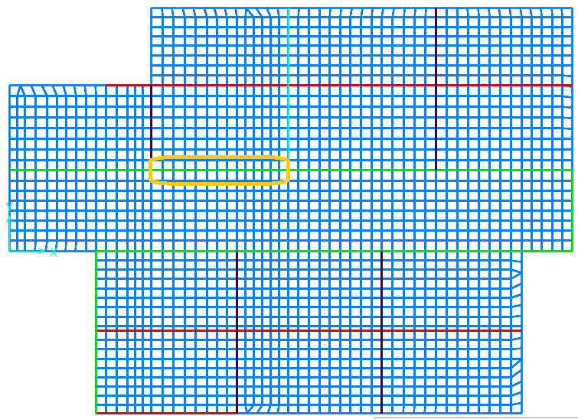
Verification of Internal Forces
Check of Beams Internal Forces
  The following figure shows the beam to be checked
Figure 3-26 The Plan of The Beam Selected for Internal Forces Check

Slide 56
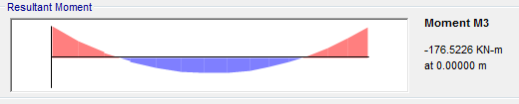
Verification of Internal Forces
Bending Moment Diagram Obtained From SAP2000 :
  Positive Bending Moment from SAP2000 = 177 kN.m
  Negative Bending Moment from SAP2000 = 86 kN.m
  Center to Center Span of the beam = 5.85 m
  Tributary Width = (3.78+3.55) / 2 = 3.665 m
  Load of Partition Wall = 8.5 kN/m
  Total Ultimate Load = 14.5 x 3.665 + 1.2 x 8.5 = 63.3 kN/m
  Calculated Moment = Wu L2/8 = 63.3x5.82/8 = 266 kN.m
  Moment from SAP2000 = 177 + 86 = 263 kN.m
  Difference Percentage = (266 - 263)/266 = 1.13%

Slide 57
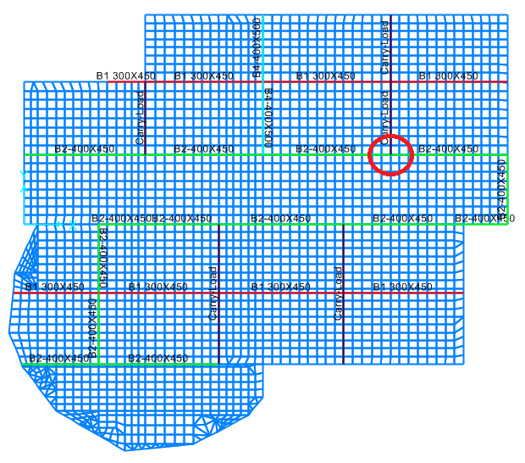
Verification of Internal Forces
Check of Columns Internal Forces
  Figure 3-28 shows the plan of ground floor where the column is to be checked
Figure 3-28 Position of the Column to be Checked in Terms of Internal Forces

Slide 58

Verification of Internal Forces
For the Live Loads
  Tributary Area = 23.30m²
  Live Load on The Floor = 4kN/m²
  The following figure shows the axial load from SAP2000
  Live Load from SAP2000 = 320 kN
  Live Load using tributary area = 23.3x( 1.5 + 4 x 3 ) = 315 kN
  Difference Percentage = (320 - 315) / 320 = 1.56%

Slide 59
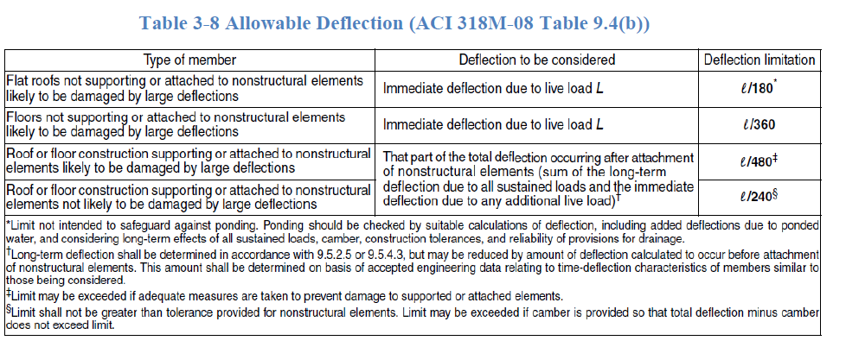
Serviceability Check
The following table shows the allowable deflection limits
  The Selected Limit to be Checked is L/240

Slide 60

Serviceability Check
The serviceability is checked in terms of long-term deflection
  Where λ is the time factor
  Δ_{LT} = Total long term deflection
  Δ_{D} = Immediate deflections due to dead loads
  Δ_{L} = Immediate deflections due to live loads
  25% of Live load is assumed to be sustained forever

Slide 61
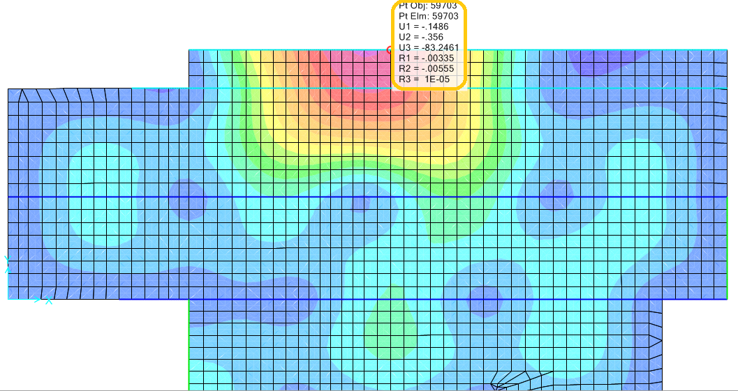
Serviceability Check
This figure shows the long term deflection in the third floor obtained from SAP2000

Slide 62
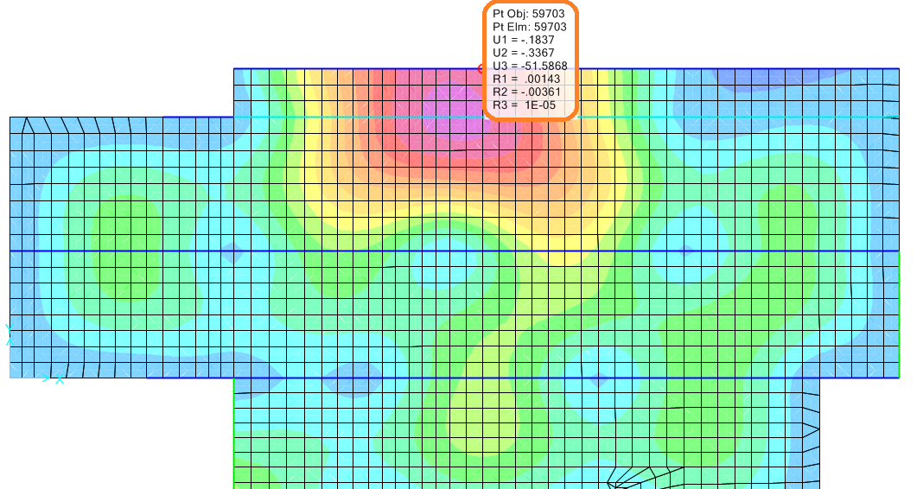
Serviceability Check
The Long term deflection = 84mm
Allowable Deflection = L/240 = 12.8/240 = 54mm
The Long term deflection exceeds the allowable limit
Beam Dimensions increased from 400x500mm to 500x700

Slide 63
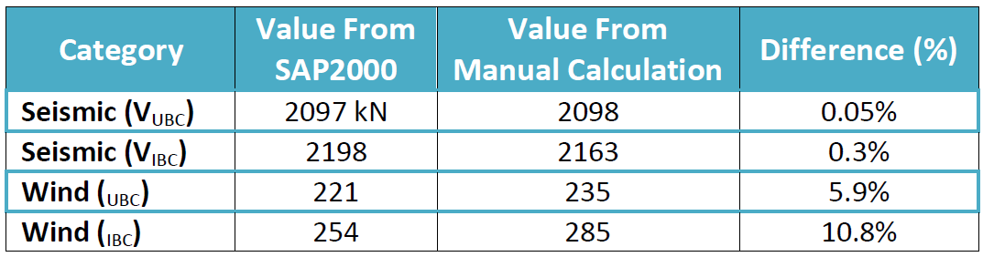
Check of Lateral Forces
The following table shows a comparison between the value of lateral forces obtained by hand calculation and by SAP2000.

Slide 64
Structural Design of Concrete Members
The code used for design and detailing is ACI 318-11 regarding seismic and gravity loads.
The structural system is Building Frame System with Special Shear Walls ( Intermediate Frames ).
Provisions were applied to all structural members including:
  Beams
  Columns
  Shear Walls
  Foundations
  Tie Beams

Slide 65
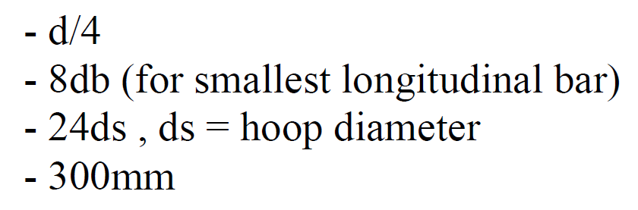
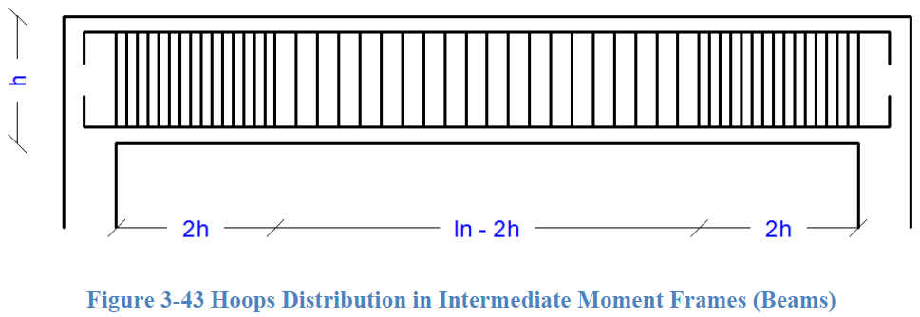
Structural Design of Concrete Members
Design and Detailing of Intermediate Beams :
Positive moment strength at joints shall be at least one third the negative moment strength.
Negative and positive moment strength at any section shall be at least one fifth the moment strength at joints.
Hoops shall be provided at a distance (2h) from the joints with a spacing equals the minimum of
Other hoops shall be spaced not more than (d/2)

Slide 66
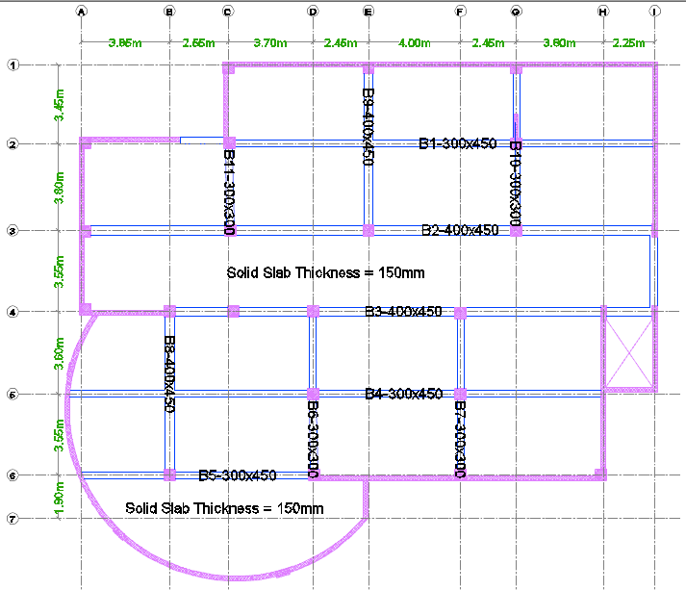
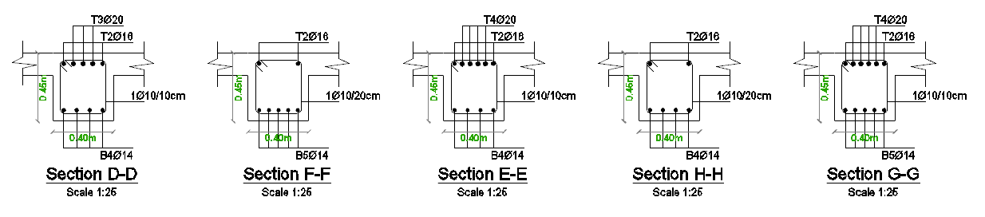
Structural Design of Concrete Members

Slide 67
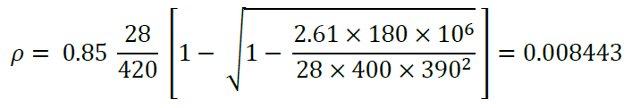
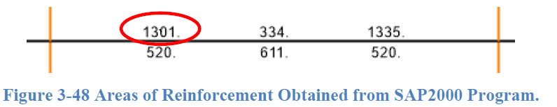
Structural Design of Concrete Members
Sample Design for Beams :
The beam to be designed is (B2) in GF between gridlines (C&E)
Dimensions : B =400mm, h =450mm, d =390mm, Span =5.53m
Ultimate Moment (M_{u})= 180 kN.m, Ultimate Shear (V_{u})= 167 kN
Reinforcement ratio
Area of steel = 0.008443 x 400 x 390 = 1317mm²
Design results obtained from SAP2000 are OK

Slide 68
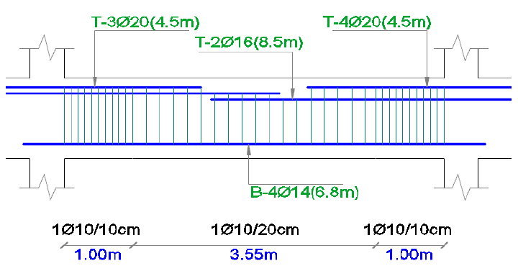
Structural Design of Concrete Members
Sample Design for Beams :
For Top Steel, 2Ø16 are provided as continuous bars A_{s}=402mm²
Cut-off bars at a distance of (l_{n}/3) = 2m are used for the remaining area A_{s}= 1301-402 = 900mm², use 3Ø20.
For Bottom Steel, A_{s}=611mm², use 4Ø14.
Spacing of Hoops = 100mm (at a distance 2h from joints faces).
Spacing of other Hoops = 200mm.

Slide 69
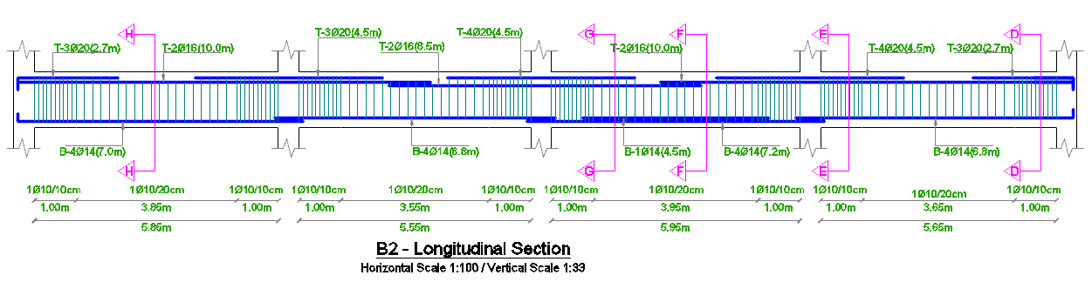
Structural Design of Concrete Members
Sample Design for Beams :
Figures below show the longitudinal section and cross sections for B2 :

Slide 70
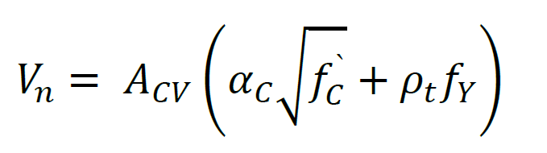

Structural Design of Concrete Members
Design and Detailing of Special Shear Walls :
Transverse and Longitudinal rebar ratio (ρ_{t} and ρ_{l}) shall be at least 0.0025
Spacing of reinforcement shall not exceed 450mm
Two diagonal bars Ø16 shall be provided at the corners of openings
Effective depth = 80% of Shear wall length (l_{w})
Nominal Shear Capacity (V_{n}) shall not exceed Equation 3-24:
Strength reduction factor (Ø) = 0.6 for seismic category (D).
Vertical segments between openings (wall piers) shall have transverse reinforcement with 150mm maximum spacing

Slide 71


Structural Design of Concrete Members
Design and Detailing of Special Shear Walls :
Special Boundary Elements shall be provided where the stress exceeds 0.2f_{c}` assuming a linearly elastic model.
Spacing of transverse reinforcement in boundary elements shall not exceed the minimum of
where S_{o} = Spacing between legs of Ties.

Slide 72

Structural Design of Concrete Members
Sample Design for Shear Walls :
The shear wall to be designed is (SW7) between gridlines (1&2)
Dimensions : L = 3250mm, b_{w} = 200mm, d = 2600mm
M_{u,major}= 1403 kN.m, M_{u,minor}= 100 kN.m, P_{u}=1700 kN, V_{u}=385kN
To account for major
moment and axial
force, minimum steel
is assumed
=0.0025 x 2750 x 200
=1375mm²

Slide 73



Structural Design of Concrete Members
Sample Design for Shear Walls :
To account for minor moment, additional steel is needed:
Total Area of Longitudinal bars = 2035 x 2 + 1375 = 5445mm²
Use 1Ø16/200mm for each layer in the shear wall.
Concrete shear capacity
Rebar capacity V_{s} = (V_{u}/Ø) - V_{c} =(381/0.6) – 388 = 247 kN > V_{s,min}
Use 1Ø12/250mm for each layer in the shear wall.
Stress σ_{max}=8.56 MPa > 0.2f_{c}` = 5.6 MPa
Special Boundary Elements are needed.

Slide 74



Structural Design of Concrete Members
Sample Design for Shear Walls :
Spacing of transverse reinforcement for special boundary elements = minimum of → use 1Ø10/100mm

Slide 75


Structural Design of Concrete Members
Design and Detailing of Special Shear Walls :
Wall piers reinforcement and Diagonal bars around openings are also provided as shown :

Slide 76



Structural Design of Concrete Members
Design and Detailing of Columns :
Spacing (S_{o}) shall be provided at both ends for length (L_{o}):
Max. vertical spacing outside (L_{o}):

Slide 77

Structural Design of Concrete Members

Slide 78


Structural Design of Concrete Members
Sample Design for Columns :
The Column to be designed is (C8)
in GF between gridlines (3&E)
Dimensions : Square (500X500)mm
Clear Length = 4.42m
Ultimate Moment (M_{u})= 12.5 kN.m
Minimum Moment = 36.4 kN.m
Ultimate Axial (P_{u})= 1214 kN
Axial Capacity (Ø P_{n,max}) = 3600 kN
Reinforcement Ratio = 1%
A_{s} = 2500 mm² (16 Ø 14)

Slide 79

Structural Design of Concrete Members
Sample Design for Columns :
Check of Column Slenderness
Moment of Inertia (I) = 5.2 X 10⁻³ m⁴
Area (A) = 0.25 m²
Radius of Gyration (r) = 0.144 m
Effective Length Factor (K) = 1.0
Unbraced Length (L_{n}) = 4.25 m
Slenderness Ratio = $\frac{K L_{n}}{r}$ = 29.5
Moment 1 = 0 Moment 2 = 12.5 kN.m
34 – 12 $\frac{ M_{1}}{M_{2}}$ = 34 > 29.5 Non-Slender Column

Slide 80




Structural Design of Concrete Members
Sample Design for Columns :
For Ø 14, Lap Splice = 800mm
Distance (L_{o}) = 700mm
Spacing (S_{o}) = 100mm
Spacing outside (L_{o}) = 200mm

Slide 81


Structural Design of Concrete Members
Design and Detailing of Slabs :
Flexural Capacity of slabs is given by:
Shear Capacity of concrete is given by:

Slide 82

Structural Design of Concrete Members
Sample Design for Slabs :
The GF Slab is going to be designed
Dimensions : Strip width = 1000mm, h = 150mm, d = 120mm
IN X-DIRECTION
Ultimate Moment (M_{u}) = 10 kN.m
Reinforcement Ratio
A_{s,required} = 216 mm²/m < A_{s,minimum} = 270 mm2/m
A_{s,used} = 392 mm²/m (5 Ø 10mm/m) (2 Layers)
Ultimate Shear (V_{u}) = 15 kN < Shear Capacity (ØV_{c}) = 79.3 kN
NO need for Shear reinforcement.

Slide 83

Structural Design of Concrete Members
Sample Design for Slabs :
The GF Slab is going to be designed
Dimensions : Strip width = 1000mm, h = 150mm, d = 120mm
IN Y-DIRECTION
Ultimate Moment (M_{u})= 10.5 kN.m
Reinforcement Ratio
A_{s,required} = 228 mm²/m < A_{s,minimum} = 270 mm2/m
A_{s,used} = 392 mm²/m (5 Ø 10mm/m) (2 Layers)
Ultimate Shear (V_{u}) = 28.2 kN < Shear Capacity (ØV_{c}) = 79.3 kN
NO need for Shear reinforcement.

Slide 84


Structural Design of Concrete Members
Sample Design for Slabs :
For Ø 10 Top Steel, Lap Splice = 1.3 X (L_{dt} ) = 500mm
For Ø 10 Bottom Steel, Lap Splice = L_{dt} = 400mm

Slide 85


Structural Design of Concrete Members
Sample Design for Slabs :
When the longitudinal bar ends
with a beam use 90º hook;
Development (L_{dh} ) = 180mm
Bent Radius = 40mm
Hook Length = 120mm
When the longitudinal bar ends
with a Shear Wall use 180º hook;
Development (L_{dh} ) = 180mm
Bent Radius = 40mm

Slide 86
Structural Design of Concrete Members
Seismic Requirements For Footings:
The development length shall be checked at both ends of the footing using standard hook depending on the bar size.
The hoops of the columns shall be continued in the footing at least 300mm from the top face of footing.
The clear cover below the footing shall be at least 70mm if there is no blinding layer, and 40mm in the case of having a blinding layer.
The longitudinal bars of the columns shall extend in the footing with a standard hook noticing that the extensions of the standard hook are pointed towards the center of the column in each direction.
Service combinations are used to determine the largest axial service load considering the earthquake effect in these combinations :
→ 0.6D + 0.7E → 1.0D + 0.75L + 0.75E → 1.0D + 0.70E

Slide 87

Structural Design of Concrete Members

Slide 88


Structural Design of Concrete Members
Sample Design for single footings:
The footing to be designed is (F1) for Column (9)
General information for column (9): cross section= 500x500mm, P_{Service}=1370KN, P_{ultimate} = 2360KN.
Calculating the required area :
Calculating the ultimate stress:

Slide 89


Structural Design of Concrete Members
Sample Design for single footings:
Determining the thickness of the footing: assuming the thickness h = 700mm and d = 620mm.
The ultimate shear on the footing :
The wide beam shear :

Slide 90

Structural Design of Concrete Members
Sample Design for single footings:
Checking the punching shear which is the minimum of the following equation:
While the ultimate shear on the footing equals to the ultimate stress multiplied by the area = 377.6 x 2.5 x 2.5 = 2360KN.

Slide 91


Structural Design of Concrete Members
Sample Design for single footings:
The ultimate moment on the footing =
Reinforcement ratio:
Which gives A_{s}= 0.0013x620x1000=813.6mm².
So use minimum steel with 1Ø18/200mm as a bottom steel and half the shrinkage as top steel 1Ø14/200mm.

Slide 92




Structural Design of Concrete Members
Sample Design for single footings:

Slide 93

Structural Design of Concrete Members
Design for Tie Beams :
Tie Beams shall have an axial design strength for a force not less than:
P_{u} = 0.1 X S_{DS} X P_{column}
where P_{column} is the largest ultimate load between the columns.
A_{s} = $\frac{P_{u}}{∅ f_{y}}$
To take into consideration the positive and negative moments that may result in the tie beam, 2 layers of minimum Area of steel where applied, one of them as a top layer and the other as a bottom one.
A_{s,minimum} = $\frac{1.4}{f_{y}} ×b ×d$

Slide 94


Structural Design of Concrete Members
Design for Tie Beams :
Assuming dimensions:
b = 350 mm, h = 700 mm, d = 640 mm
P_{u} = 0.1 X 0.46 X 2364 = 113.5 kN
A_{s} = $\frac{113.5}{0.9 ×420 }$ = 300.2 mm² use (4 Ø 12)
A_{s,minimum} = 0.00333 X 350 X 640 = 746 mm²
use (4 Ø 16)

Slide 95

Comparison between UBC-97 and IBC-2012
Comparison is done between UBC-97 and IBC-2012 codes regarding the following :
  Wind and earthquake forces
  Detailing requirements and provisions
  Design results ( required reinforcement )
Table 3-9 shows a brief comparison between the two codes

Slide 96
Comparison between UBC-97 and IBC-2012
Comparison of Detailing Requirements:
IBC-2012 uses ACI 318-11 and UBC97 uses ACI 318-95 for detailing
For Intermediate Beams, ACI 318-11 stipulates the following :
  Positive moment strength at joints shall be at least one third the negative moment strength.
  Negative and positive moment strength at any section shall be at least one fifth the moment strength at joints.
  Hoops shall be provided at a distance (2h) from the joints with a spacing equals the minimum of
  Other hoops shall be spaced not more than (d/2)

Slide 97
Comparison between UBC-97 and IBC-2012
Comparison of Detailing Requirements:
For Intermediate Columns, ACI 318-11 stipulates the following :
  Spacing (S_{o}) shall be provided at both ends for length (L_{o}) :
  Max. vertical spacing outside (L_{o}) :
  The first hoop shall not be located more than (S_{o}/2) from the joint face

Slide 98


Comparison between UBC-97 and IBC-2012
Comparison of Detailing Requirements:
These Figures are cropped literally from ACI 318-95 for Beams :

Slide 99

Comparison between UBC-97 and IBC-2012
Comparison of Detailing Requirements:
These Figures are cropped literally from ACI 318-95 for Columns :

Slide 100


Comparison between UBC-97 and IBC-2012
Comparison of Design Results :
Two models for UBC-97 and IBC-2012 are designed in order to compare the design results obtained from SAP2000 Program.
These figures show the area of longitudinal bars for Frame 3-3
IBC-2012 UBC-97

Slide 101
Comparison between UBC-97 and IBC-2012
Discussion and Conclusion:
Base shear obtained from IBC-2012 is slightly larger than Base shear obtained from UBC-97 ( V_{IBC} = 2163 kN > V_{UBC} = 2097 kN ).
The minor difference in seismic base shear (V) between both codes will not yield a considerable difference in the results of design.
Detailing requirements of seismic design for both ACI 318-11 and ACI 318-95 are the same.
Both codes are applicable and yield good design results.
For PALESTINE, UBC-97 is still good although the probability of exceedance is 10% compared to IBC-2012 (2%) when using the local maps ( Israeli Code for S_{S} and S₁, Seismic Zone Factor Map for Z )

Slide 102

The End

