Slide 1
3D Structural Dynamic Evaluation of AL-Arz Ice Cream factory
Mahde Soboh
Tahreer Sabah
Isalam Taqateq
Shaima’ Suliman

Slide 2
Outline
Ch1
Introduction
Ch2
Revision of static evaluation
Ch3
Dynamic evaluation

Slide 3
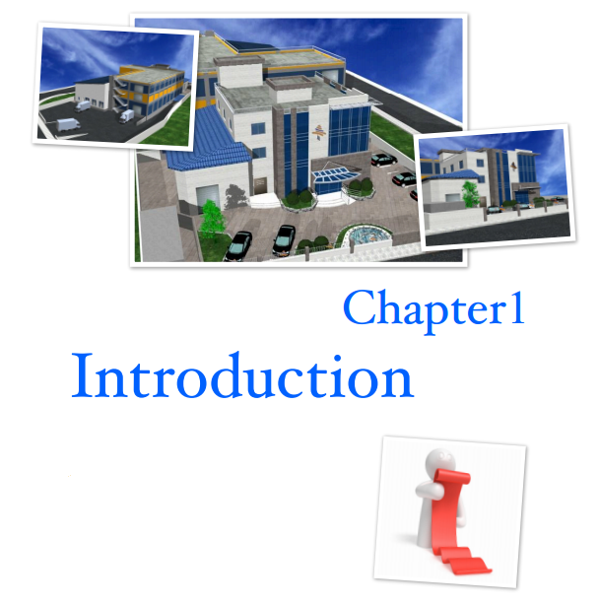

Slide 4
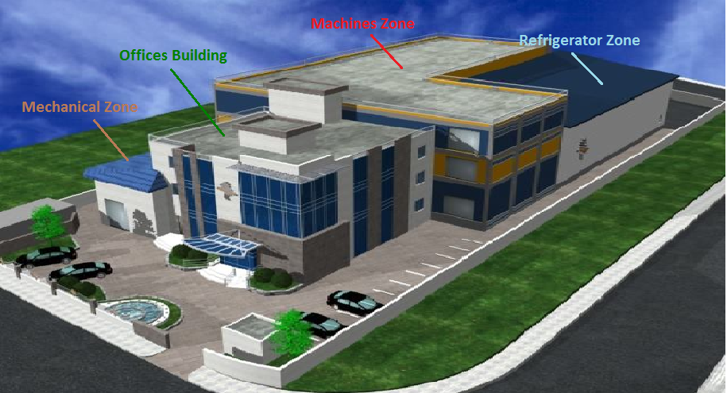
Project description
1208.50 m²
425.00 m²
644.75 m²
180.80 m²
1663.50 m²
Basement

Slide 5
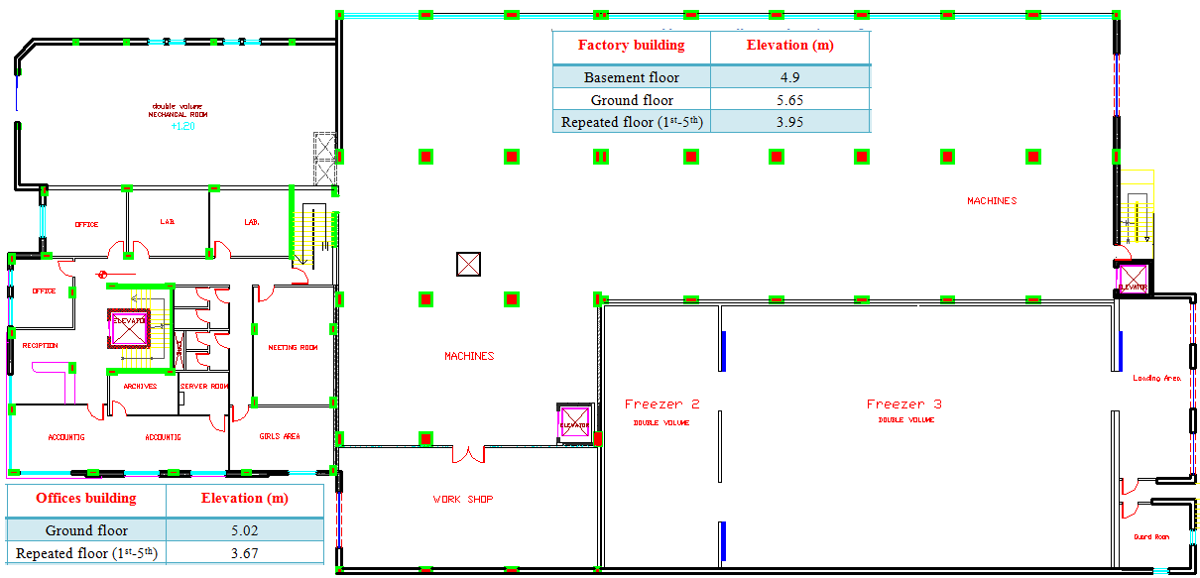
Architectural Plan

Slide 6
Site and Geology
The office area
310 kN/m²
The factory area
300 kN/m²

Slide 7
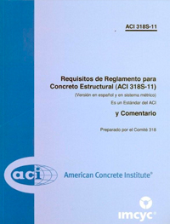


Codes and Standards
ACI 318-08: For reinforced concrete structure design.
IBC 2009: For load determination.
UBC-97: For dynamic design.

Slide 8
Material
Concrete
Reinforcement Steel
Fy=420MPa
Unit weight= 25kN/m3
fc`= 28 MPa
Es = 200GPa

Slide 9
Loads
Superimposed dead load
Building | Super imposed dead kN/m²
Factory | 2.25
Offices | 2.27 ( One-way) 1.65 (Two-way )
Live load
Zone | Live load kN/m²
Basement slab (machine zone) | 11
Basement slab (refrigerators zone ) | 13
Repeated slab | 8
Offices | 4

Slide 10
Loads combinations
According to "ACI 318-08 9.2.1", the load combinations that are used in the design are:
Wu= 1.4 D
Wu= 1.2 D + 1.6 L
Wu= 1.2D.L + 1.0L.L ± 1.0E
Wu= 0.9 D ± 1.0 E

Slide 11
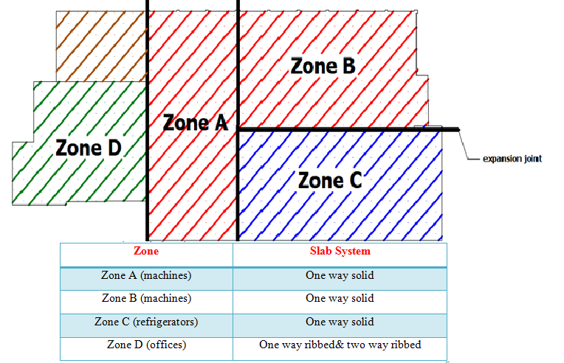
Structural system

Slide 12
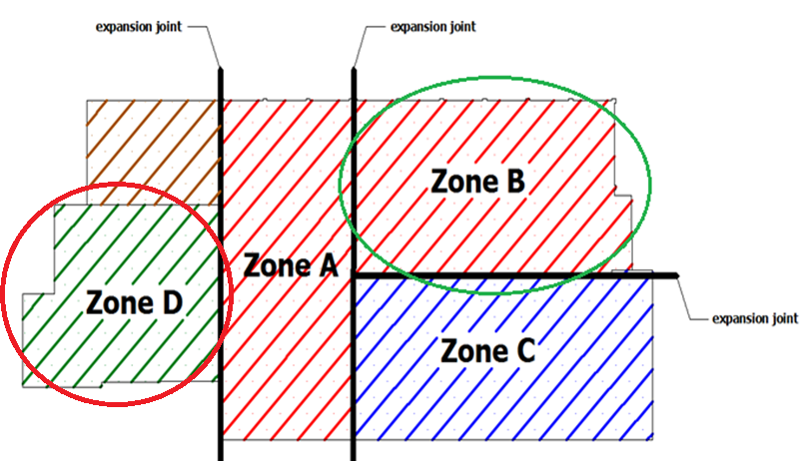
The selected zones

Slide 13
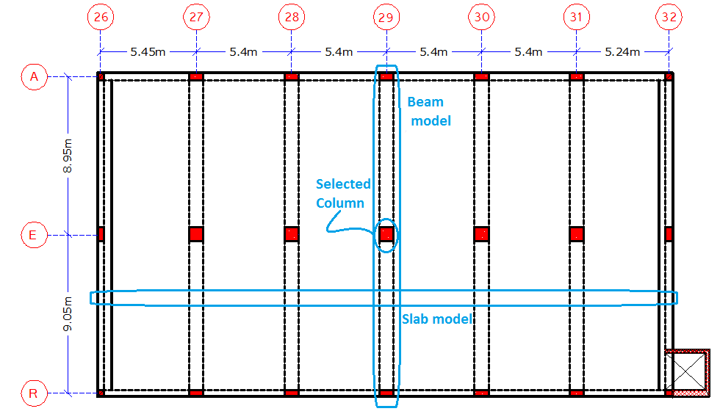
Zone B

Slide 14
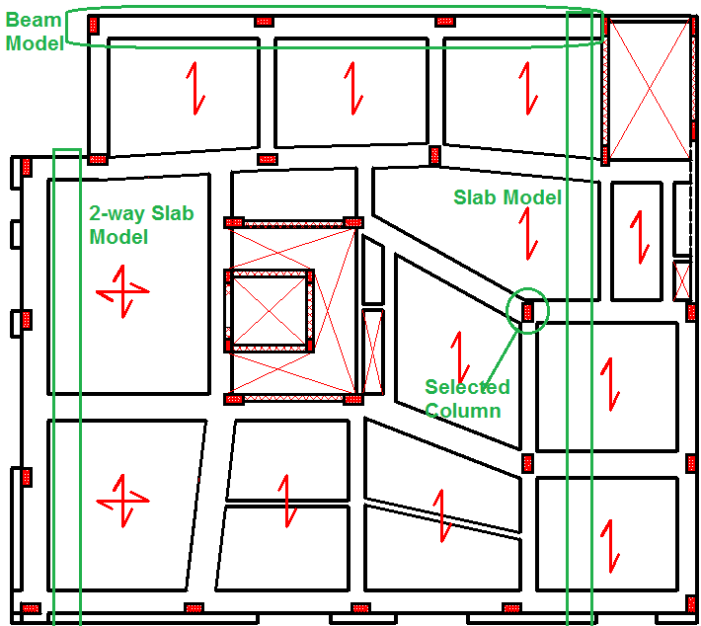
Zone D

Slide 15
Preliminary evaluation
We checked Beam, Column, and slab
Moment reinforcement
Shear reinforcement
Dimensions
OK

Slide 16
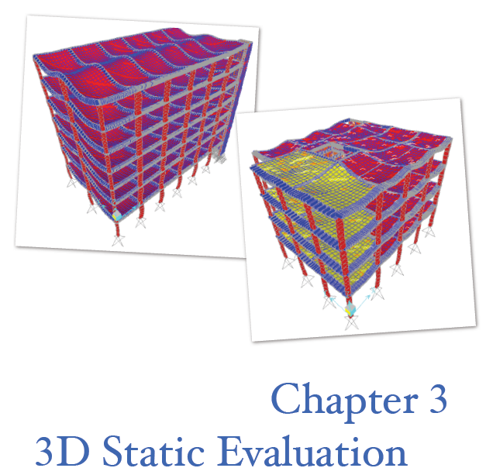

Slide 17
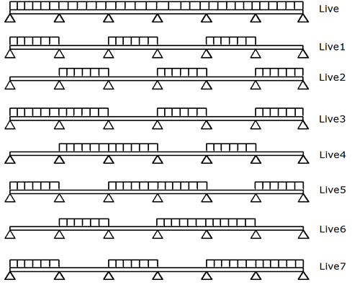
Cases of loading for Zone B

Slide 18
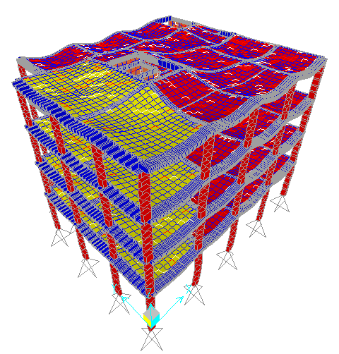
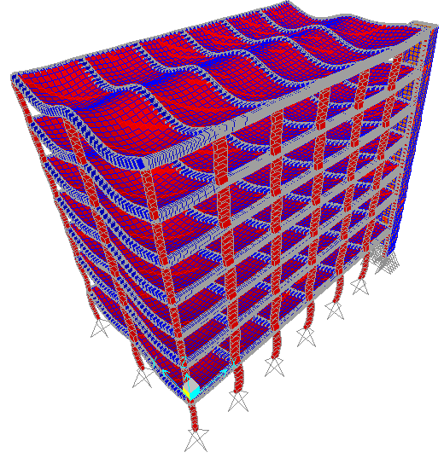
Compatibility of structural model
Zone B
Zone D

Slide 19
Equilibrium
Load type | Hand results kN | SAP results kN | Difference %
Dead | 41960.7 | 42652.7 | 1.65
S.I.D | 9135 | 9154.215 | 0.21
Live | 34220 | 34291.98 | 0.21
Zone B
Load type | Hand results kN | SAP results kN | Difference %
Dead | 17899.5 | 18634.2 | 4.1
S.I.D | 2698.12 | 2694.15 | 0.15
Live | 5028 | 5100.98 | 1.45
Zone D

Slide 20
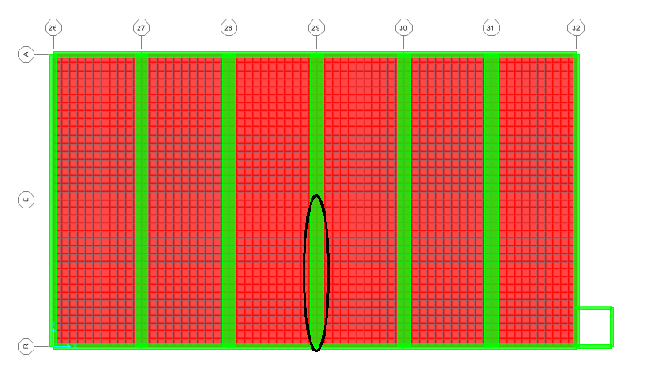
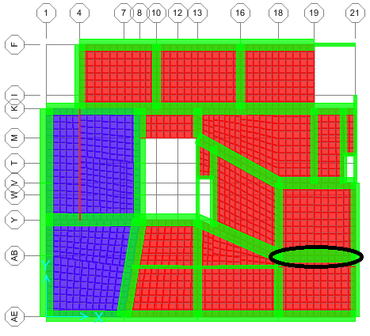
Stress Strain
Zone B
Zone D
Value from hand calculation (kN.m) | Value from SAP (kN.m) | Difference %
1369.8 | 1347.12 | 1.7
Value from hand (calculation( kN.m | Value from SAP (kN.m) | Difference %
246.50 | 244.10 | 0.93

Slide 21
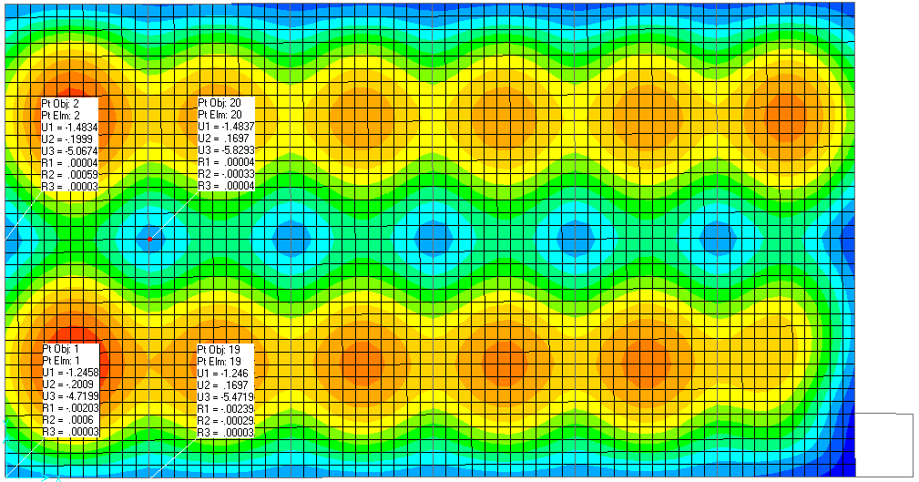
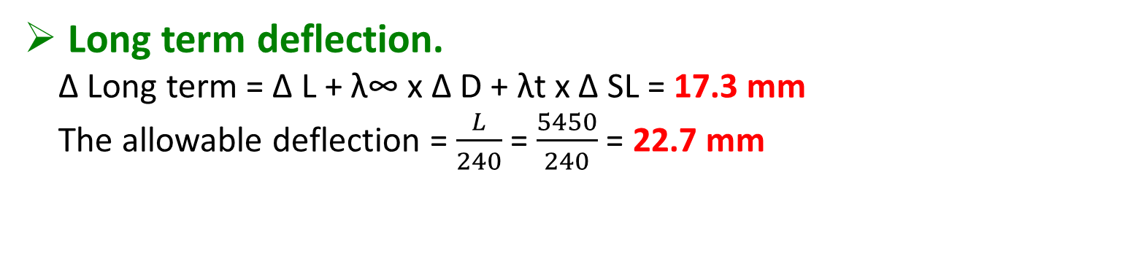
Evaluation of slabs for block B
Slab thickness for Shear. OK
Evaluation of slab for resisting bending
moment. OK
Long term deflection.
∆ Long term = ∆ L + λ∞ x ∆ D + λt x ∆ SL = 17.3 mm
The allowable deflection = $\frac{L}{240}$ = $\frac{5450}{240}$ = 22.7 mm

Slide 22
Evaluation of slabs for block D
Slab thickness for Shear. OK
Evaluation of slab for resisting bending
moment. OK
Long term deflection.
∆ Long term = 7.12 < ∆ allowable = 26.60 mm OK

Slide 23
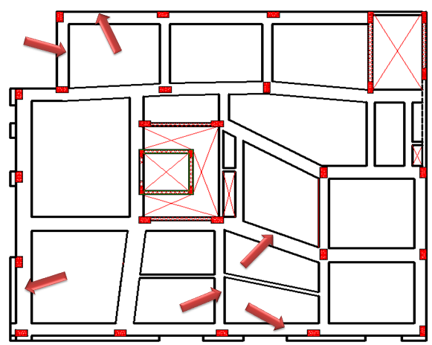
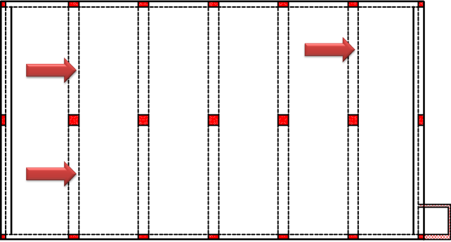
Evaluation of beams

Slide 24
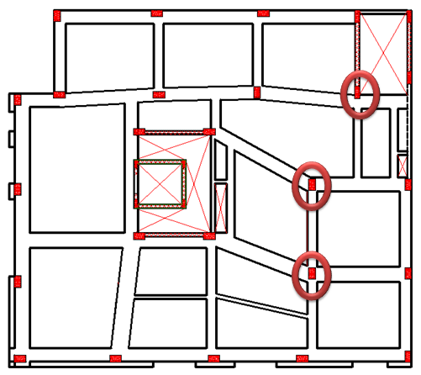
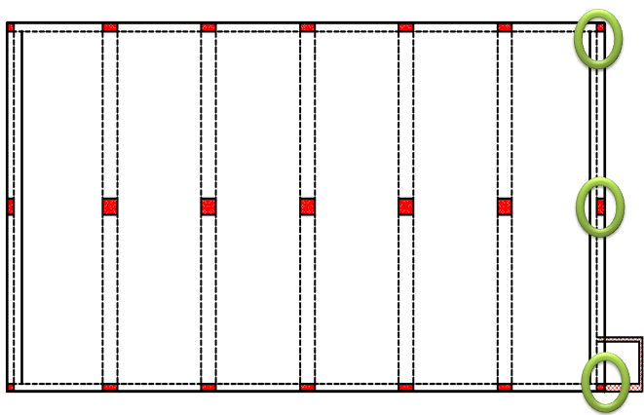
Evaluation of columns

Slide 25
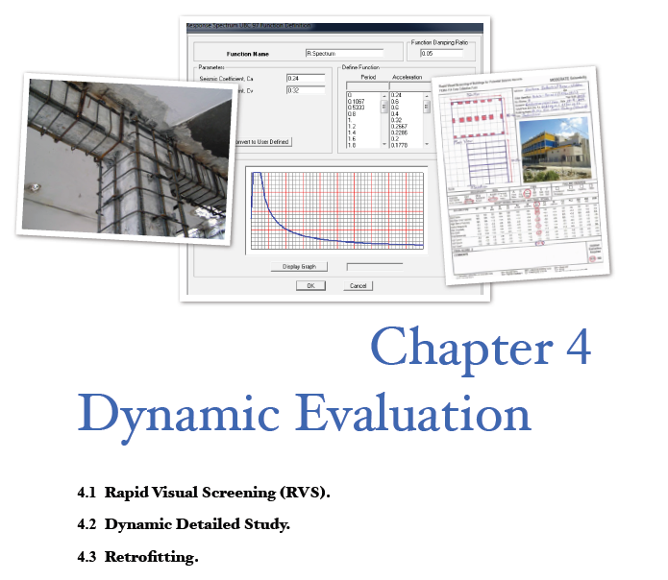

Slide 26
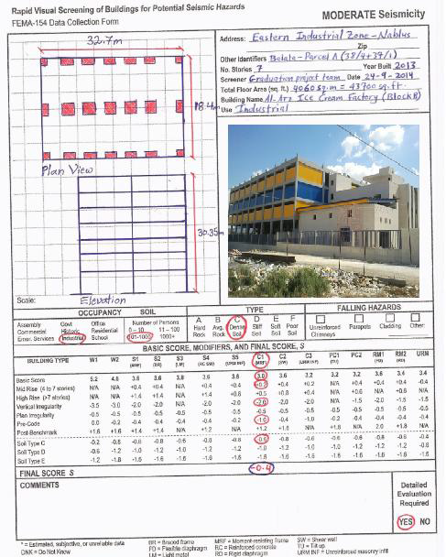
Implementation of RVS for block B

Slide 27
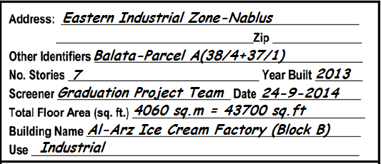
Verifying and updating the building identification information

Slide 28
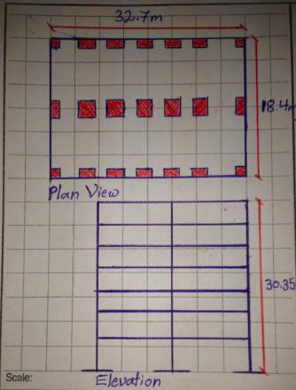
Sketching the Plan and Elevation Views

Slide 29
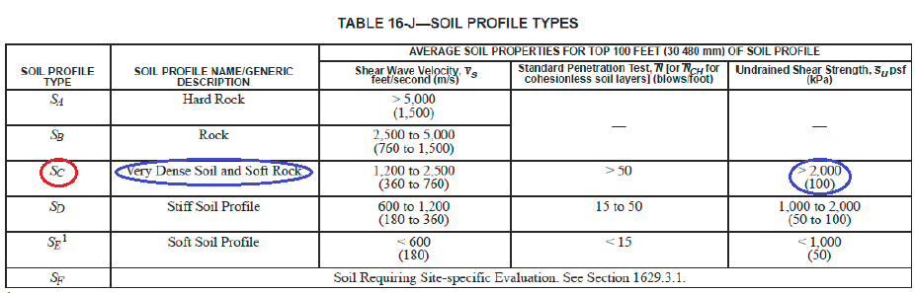
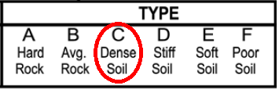
Determining soil type

Slide 30
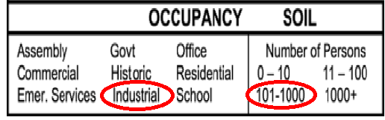

Determining and documenting occupancy

Slide 31
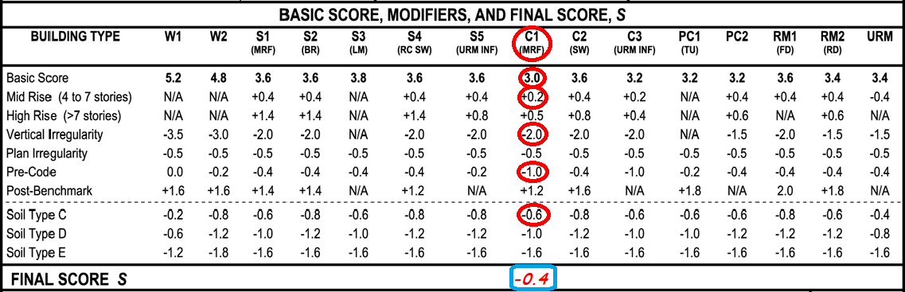
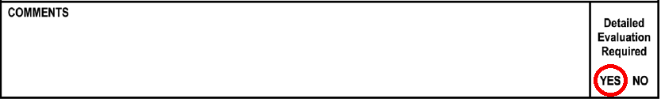
Recording Score Modifiers
-0.4 Less than 2

Slide 32
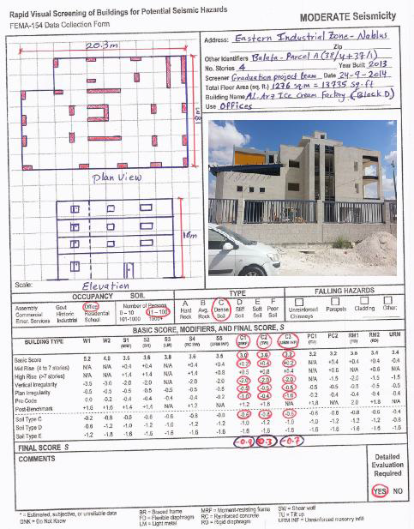
Implementation of RVS for block D
0.3
-0.9
-0.7
yes

Slide 33
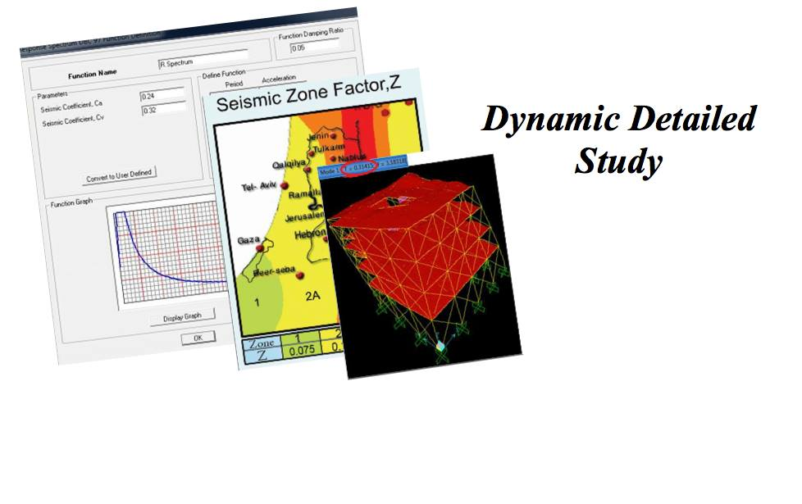

Slide 34

Seismic Design Category SDC
SDC
C
intermediate

Slide 35
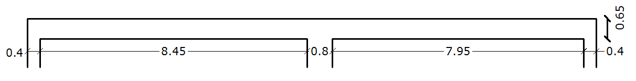
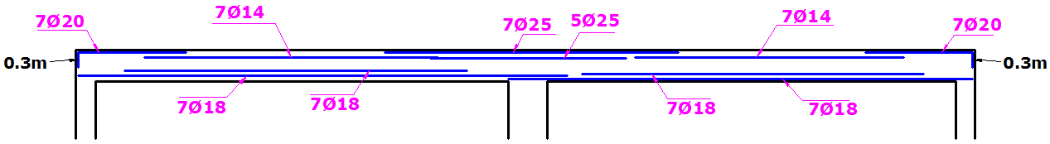
Check type of structural Detailing
Beam

Slide 36
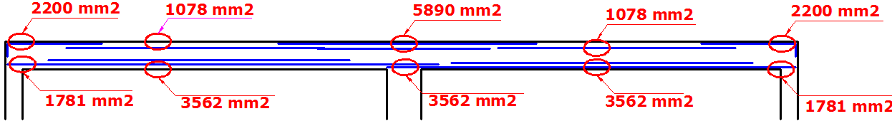
Beam
Bottom steel at face of joint ≥ 1/3 top steel at face of joint:
Left joint >>> Achieved.
Right joint >>> Not achieved.
Bottom or top steel at any section ≥ 1/5 top steel at face of joint >>> Not achieved.

Slide 37
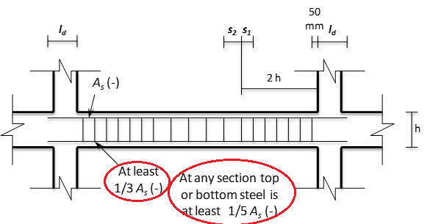
Beam
Stirrups shall be computed based on shear force Vu and shall have a maximum spacing as shown in the figure.
S1 >>> Not achieved.
S2 >>> Achieved.

Slide 38
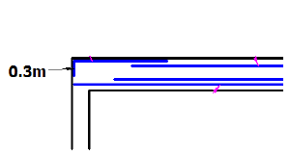
Beam
Bottom steel and top steel should be developed ld in the column.
For bottom bars >>>
Not achieved.
For top hooked bars >>> Not achieved.

Slide 39
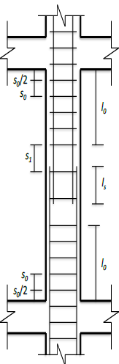
Check type of structural Detailing
Lap splice of bars shall be used at mid-height of the column with lap splice length, ls = 1.3 ld.
Not achieved

Slide 40
Check type of structural Detailing
Column
Stirrups shall be computed based on shear force Vu and shall have a maximum spacing as detailed in the figure.
So >>> Achieved
S1 >>> Achieved

Slide 41
The result of Check type of structural Detailing
Block
D
Block B
Do not meet the requirements of UBC-97 for intermediate structural detailing
&

Slide 42
Analyze the blocks under the effect of earthquake
Before get the SAP result we should check the code requirement
Mass Source
Modal Mass Participation ratio

Slide 43
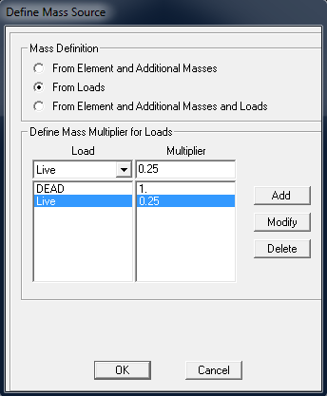
Mass Source

Slide 44
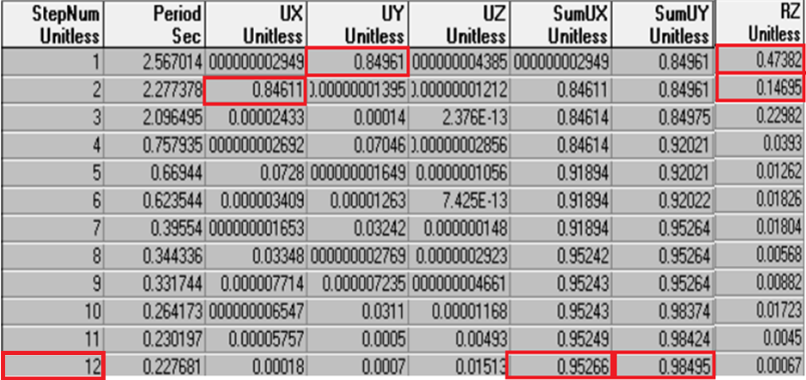
Modal mass participation ratio Block D

Slide 45
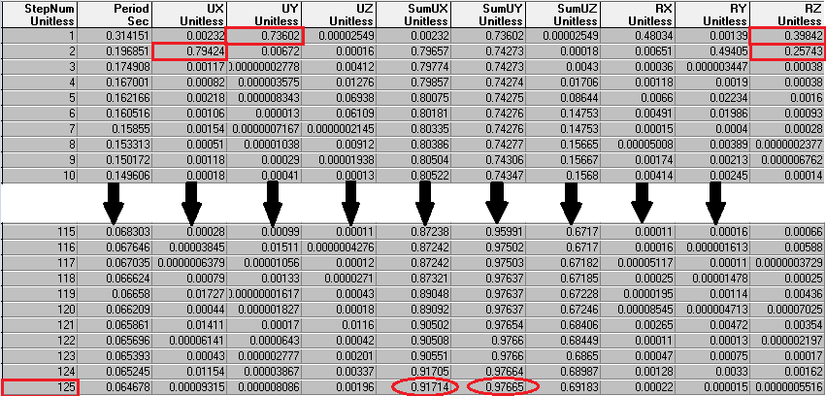
Modal mass participation ratio Block B

Slide 46
Periods
SAP
Rayleigh

Slide 47
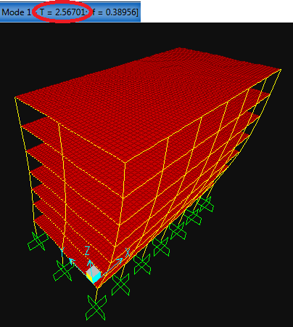
Period from SAP for Block B
In Y- direction

Slide 48
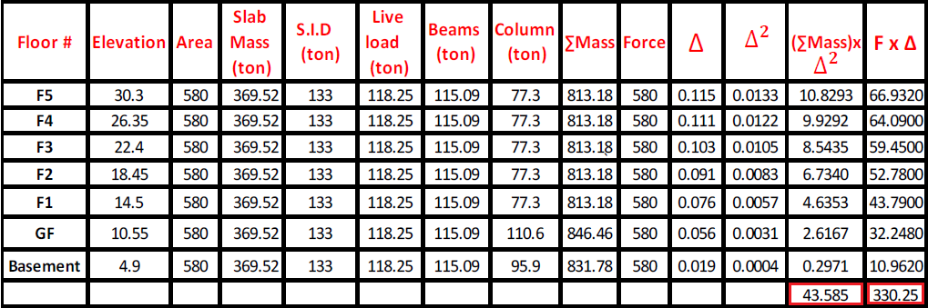
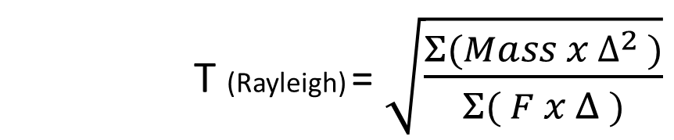
Period from manual calculations (Rayleigh method) for Block B
T (Rayleigh) = $\sqrt{\frac{Σ(Mass x ∆^{2 })}{Σ( F x Δ )}}$

Slide 49
SAP result VS Rayleigh result for Block B
SAP
2.277sec
Rayleigh
2.584 sec
2.283 sec
0.26%
Error %
2.567sec
0.66%
X -direction
Y -direction
In Y- direction

Slide 50
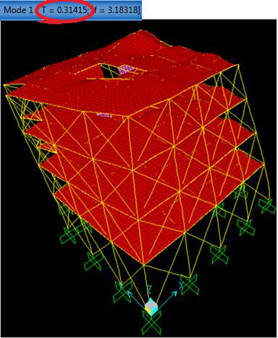
SAP result VS Rayleigh result for Block D
X-direction
Ray=0.201
SAP=0.197
ASP=0.314
Ray=0.326
Y-direction
Error % =2
Error % = 3.8
In Y- direction

Slide 51
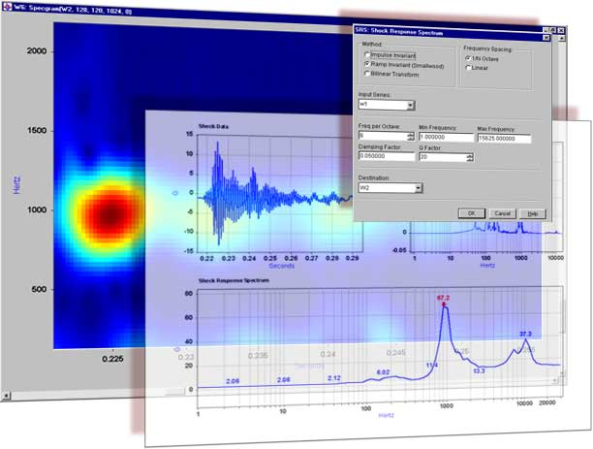
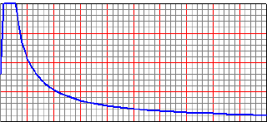
Response Spectrum Analysis
In Y- direction

Slide 52
UBC-97 Factors
value | Factors
0.2 | Zone
C | Soil Classification
0.24 | Seismic coefficient Ca
0.32 | Seismic coefficient Cv
5.5 | Determine response modification factor (R)
1 | Determine occupancy type (Importance Factor I)
In Y- direction

Slide 53
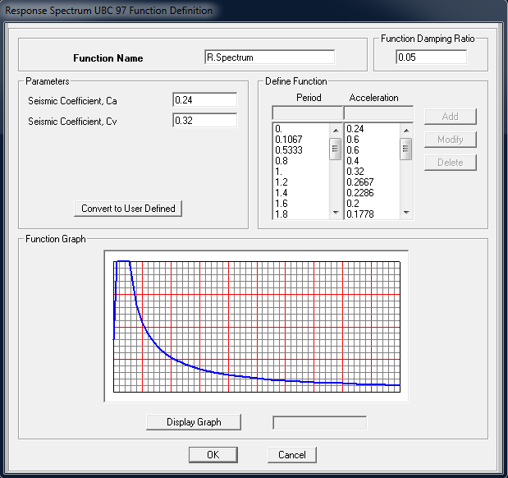
Response spectrum function definition
In Y- direction

Slide 54
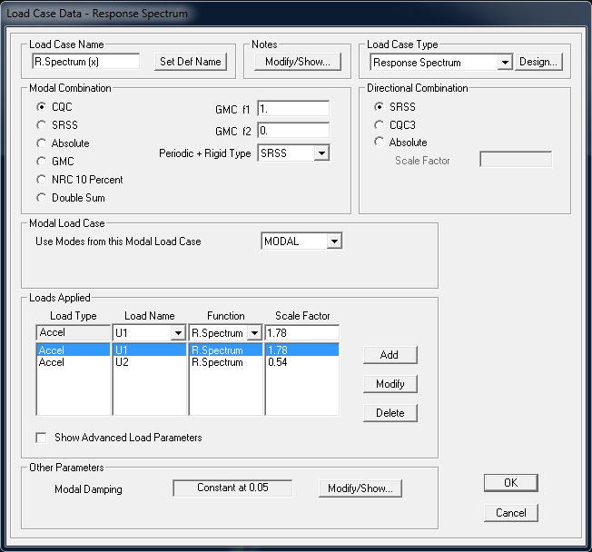
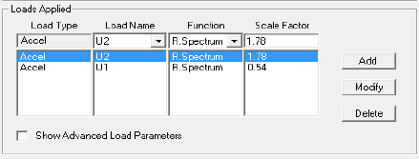
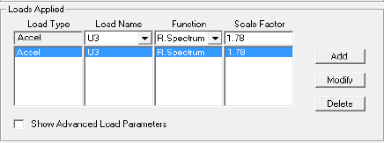
load cases
Eh1 = Ex +0.3 Ey
Eh2 = 0.3 Ex + Ey
Ev = Ez
In Y- direction

Slide 55

Base Shear (V) from response spectrum
In Y- direction

Slide 56
Equivalent Static check
$v=\frac{Cv I}{R T}$ w
𝑣=(𝐶𝑣 𝐼)/(𝑅 𝑇) w
Method B
T= T (Rayleigh)
X-direction
2.283 sec
Y-direction
2.584 sec
Method A
$$T=Cth^{(\frac{3}{4})}$$
Method A
𝑇=𝐶𝑡ℎ^((3/4))
X-direction
0.944 sec
Y-direction
0.944 sec
Note: 2.283 > 1.4x0.944 = 1.32 sec.
      2.584>1.4x0.944 = 1.32 sec.
So , use T = 1.32 sec.

Slide 57
V min
$$0.11 Ca I W=$$
1502 kN
0.11 𝐶𝑎 𝐼 𝑊=
1502 kN
V
$\frac{Cv I}{R T}$ w =
2508 kN
(𝐶𝑣 𝐼)/(𝑅 𝑇) w =
2508 kN
V max
$\frac{2.5 Ca I}{R}$ W =
6205 kN
(2.5 𝐶𝑎 𝐼)/𝑅 W =
6205 kN
The manual value of Equivalent Static
In Y- direction

Slide 58
Response spectrum base shear VS Equivalent static base shear
Equivalent Static | Response Spectrum | Direction
2507.47 | 1306.76 | X
2507.47 | 1171.23 | Y
2507.47 | 122.96 | Z
Note: in UBC97, for all regular structures, the base shear from response spectrum analysis shall be not less than 90% of the base shear determined by equivalent static method (2256.73).
In Y- direction

Slide 59

Modify the scale factor
In Y- direction

Slide 60

Final SAP Results for Block B
In Y- direction

Slide 61

Final SAP Results for Block D
In Y- direction

Slide 62
Comparison between Static and Dynamic Results Block B
Slab
Envelop Combination | Static Combination | Internal Forces
42 kN | 39.7 kN | V13
46.2 kN.m | 45.9 kN.m | M11 (+ Ve )
50.96 kN.m | 49.1 kN.m | M11 (-Ve )

Slide 63

Comparison between Static and Dynamic Results Block B
Beam

Slide 64

Comparison between Static and Dynamic Results Block B
Column

Slide 65

Comparison between Static and Dynamic Results Block D
Slab.
The static design govern.
Beam.
  That the increasing in M (-Ve), M (+Ve), shear and torsion are not considerable.
Column.
  We note that the values of Pu is increased in all columns but the values of M2, M3 and shear does not increased considerably.

Slide 66
Check Drift for Block B
ΔM = 0.7 × R × ΔS
ΔS | Floor number
4.5 | 5th floor
7.2 | 4th floor
9.8 | 3rd floor
12.3 | 2nd floor
15.3 | 1st floor
28.8 | Ground floor
14.2 | Basement floor
ΔM = 109 mm < Maximum limitation = 0.02 ×story highet= 113mm OK.

Slide 67
Check Drift for Block D
ΔM = 0.7 × R × ΔS
ΔS (mm) | Floor number
1.7 | 3rd floor
1.8 | 2nd floor
1.6 | 1st floor
1.4 | Ground floor
ΔM = 7mm < Maximum limitation = 0.02 ×story highet= 92mm OK

Slide 68

Check building separation

Slide 69
The required separation between Blocks
$$∆ΜΤ= \sqrt{{(ΔM1)}^{2 }+{(ΔM2)}^{2}}$$
∆ΜΤ= √(〖(Δ𝑀1)〗^(2 )+〖(Δ𝑀2)〗^2 )
Between Blocks A&B
50 cm
Between Blocks A&D
31 cm
The separation used = 3 cm !!!
In Y- direction

Slide 70


Slide 71


Retrofitting for seismic separation (Block A)

Slide 72


Retrofitting for seismic separation (Block B)

Slide 73
The result of retrofitting for seismic separation
The required
separation = 2 cm
The used
separation = 3 cm
But, this solution dose not work, Why ??!!

Slide 74

Retrofitting of columns
Load of column
Pu = 10036 kN.
In X-direction of column
M3 (bottom) = -956 kN.m.
M3 (top) = -311 kN.m.
In Y-direction of column
M2 (bottom) = -1260 kN.m.
M2 (top) = -108 kN.m

Slide 75

Retrofitting of columns
Check Slenderness Effect
  The Slenderness effects can be neglected in both directions X and Y.

Slide 76

Retrofitting of columns
Design column for axial and moment .
  In X-direction
  ρ = 1%>>> Use 32Ø18
  In Y-direction
  ρ = 1%>>> Use 32Ø18

Slide 77

Retrofitting of columns
Design column for shear.
Vu = max
Vu from design combination include 3.0 E
l

Slide 78


Retrofitting of columns
Design hoops and check spacing.
  Use 3Ø10 hoops (6 legs)
  Max spacing.
  S1 =288 mm
  So =144 mm

Slide 79

Retrofitting of columns
Final dimensions
Column | Before retrofitting |  | After retrofitting
 | Dimensions | Steel | Dimensions | Steel
C1 | $$80cm×80cm$$ | 24Ø18 | $$90cm×90cm$$ | 32Ø18
C2 | $$80cm×40cm$$ | 18Ø16 | $$80cm×60cm$$ | 24Ø16
C3 | $$40cm×40cm$$ | 16Ø16 | $$60cm×60cm$$ | 18Ø16

Slide 80

Retrofitting of columns
Check Splice length and location.
  Ls required = 860 mm
  Lo required = 900 mm

Slide 81

Retrofitting of columns
How to execute C1 in reality

Slide 82

Retrofitting of Beam
Load of Beam
Mu-ve (Right) = 1112 kN.m
Mu-ve (Left) = 1025 kN.m
Mu+ve = 502 kN.

Slide 83
Retrofitting of Beam
Design beam for moment .
Steel Reinforcement | The value of the moment
12Ø25 | Mu-ve (Right) = 1112 kN.m
16Ø20 | Mu-ve (Left) = 1025 kN.m
10Ø18 | Mu+ve = 502 kN.m

Slide 84


Retrofitting of Beam
Reinforcement for moment.

Slide 85
Retrofitting of Beam
Verify minimum intermediate detailing requirements.
As+ at face of joint ≥ 1/3 As- at face of that joint. OK
Bottom or top steel at any section ≥ 1/5 max steel at face of either joint. OK

Slide 86

Retrofitting of Beam
Design beam for shear.
Vu = max
2 Vu from design combination include E
l

Slide 87

Retrofitting of Beam
Design of hoops and check spacing.
  Use 2Ø10 hoops (4 legs)
  Max spacing.
  S1 =112 mm >>> (use 2Ø10@10cm)
  S2 =295 mm >>> (use 2Ø10@20cm)

Slide 88

Retrofitting of Beam
Check Ld.
  For top hooked bars = 290 mm.
  For bottom hooked bars = 260 mm.
  For straight top bars = 1200 mm.
  For straight bottom bars = 660 mm.
Available length = 540 mm OK

Slide 89


Retrofitting of Beam
How to execute B1 in reality.

Slide 90


Evaluation of Foundations of Block B
Check if we really need mat foundation.

Slide 91

Evaluation of Foundations of Block B
Checks of mat foundation for.
  Compatibility , OK.
  Deflection
  Δ allowable > max deflection, OK.
  Stress,
  The applied stress <qu, OK.
  Punching shear, OK.
  Reinforcement in both direction, OK.

Slide 92


Evaluation of Foundations of Block D
  Checks of single footing.
  Check the area of the footing based on the
  allowable bearing capacity of the soil, Not OK.
  Check footing depth for wide beam shear, OK.
  Check footing depth for punching shear, OK.
  Reinforcement, OK.

Slide 93

Retrofitting of Foundations of Block D

Slide 94


Design of shear wall

Slide 95

Design of shear wall
Internal forces and moment.
  M1 (Muy) = 20 kN.m.
  M2 (Mux) = 1600 kN.m.
  F1 (Vuy) = 680 kN.
  F2 (Vux) = 10 kN

Slide 96

Design of shear wall
Check shear in X- direction.
ΦVc = 0.75(1/6)$(\sqrt{28}$)(200-40)(4200)/1000 = 444 kN > 10kN ,, OK.
Design for shear in Y- direction.
  Use 2Φ12 mm @ 250 mm C/C.
Design for moment around Y- axis.

Slide 97


Design of shear wall
Design for axial force and moment around X- axis.

Slide 98


Design of shear wall
Use 11Φ14 mm/m on each face.

