Slide 1
ANLP text analyzer
Noor Zreaq
Omar Dweikat
Supervisor: Dr.Aladdin Masri

Slide 2
Outline
Introduction
  Problem
  Solution
Implementation
  Dataset
  Models
Results & Discussion
Service
Constraints
Future work
Conclusion

Slide 3
Introduction
Since the creation of the first computer, humans have struggled with Human-Machine interaction
Natural Language Processing(NLP), the new way to interact with machines
Examples include: Siri, Cortana, Alexa, Google Assistant

Slide 4
The problem
  Though NLP has been a prominent part of the Artificial Intelligence(AI) industry, Arabic NLP(ANLP) still lags behind
  Business text analysis in Arabic is one severely lacking topic in present ANLP applications

Slide 5
CRM applications
Customer Relationships Management(CRM) is one of the most important fields of business management
CRM programs are one of the most effective and efficient ways to implement CRM concepts
Using ANLP to help analyze messages received from customers, would help support CRM programs, and help business managers make more informed decisions

Slide 6
First step
Using Deep Learning and AI methods, we create an ANLP service, capable of analyzing texts(preferably business related), and returning the sentiment behind these texts, whether they are urgent or not, and what the main topics being discussed in the texts are

Slide 7
Implementation
Dataset(collection and classification)
Models(Convolutional Neural Network(CNN))
Flask API Service
React Web Page

Slide 8
Dataset
Original dataset collection from Isra Software & Computer Company(Iscosoft) emails
Collecting over 14000 emails from 4 different email addresses
Classifying said emails into a dozen categories across 3 different types of text analyzation.
Urgency Detection
Sentiment Analysis
Topic Classification(for department redirection purposes)

Slide 9
Data processing
After collecting the data, we had to process the emails, to get rid of any unwanted texts, and separate email threads which contained many replies into individual emails.
This process included getting rid of any non-Arabic emails, getting rid of any non-Arabic characters, removing any white spaces to make the email more readable, removing the sender’s name and fixing any spelling mistakes

Slide 10
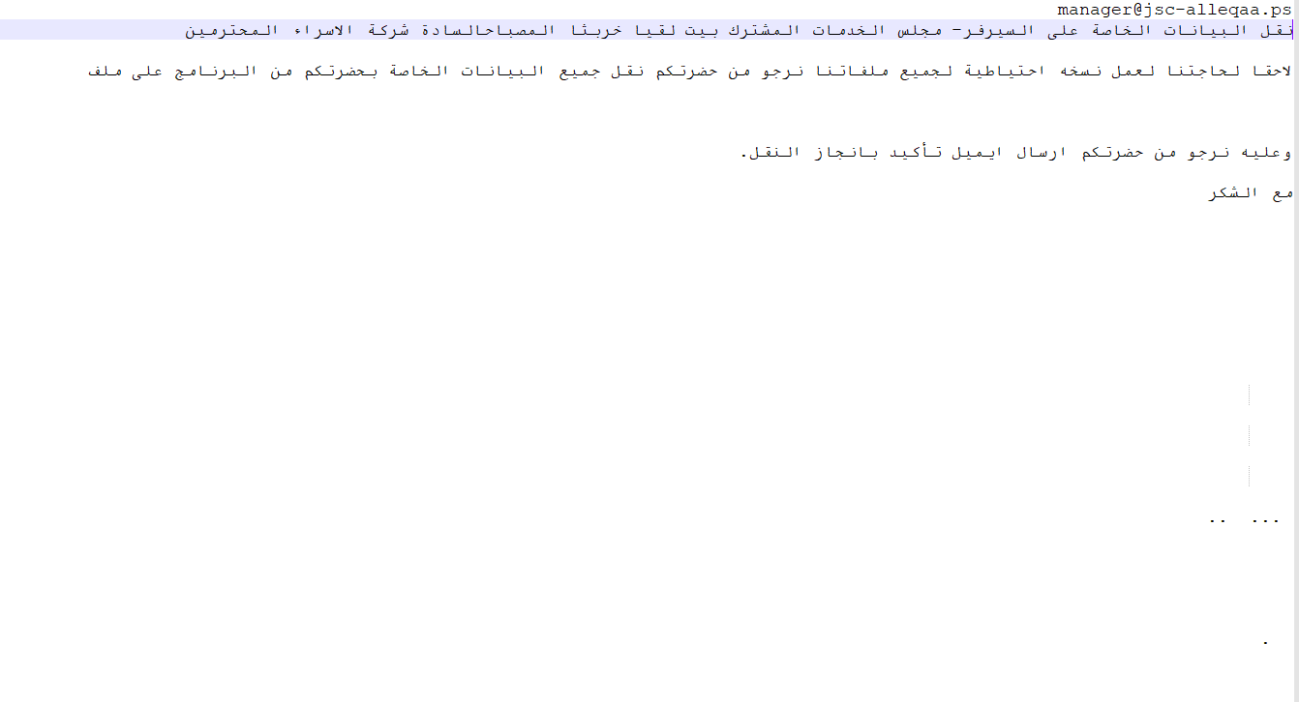
Data processing(email before)

Slide 11
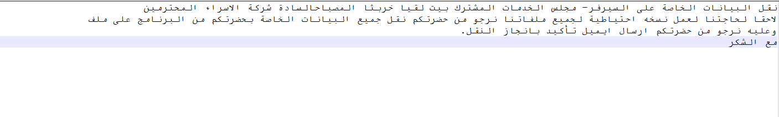
Data processing(email after)

Slide 12
Data Classification
The previous process yielded 14099 Arabic only emails
Which were then classified into 3 separate main folders, each containing many subfolders
  Urgency
  Sentiment
  Topic
During this classification, many emails were removed due to repetition, irrelevance to the dataset, as well as other reasons. Giving a final total of roughly 5000 emails

Slide 13
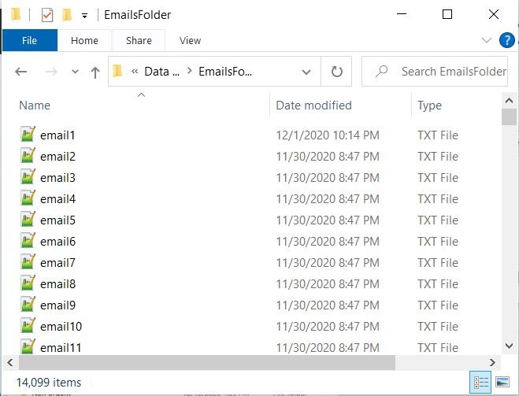
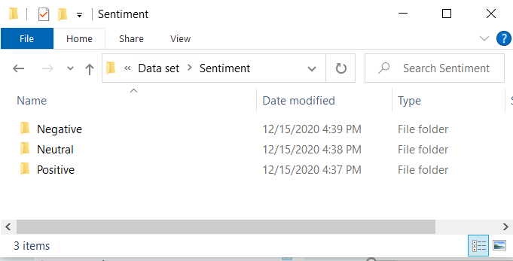
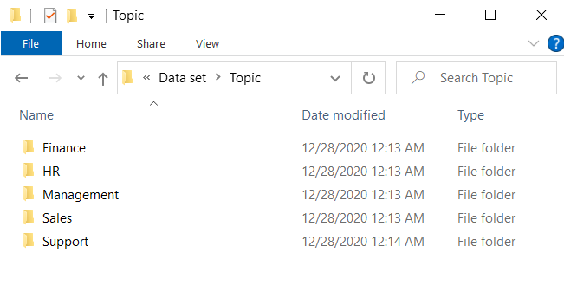
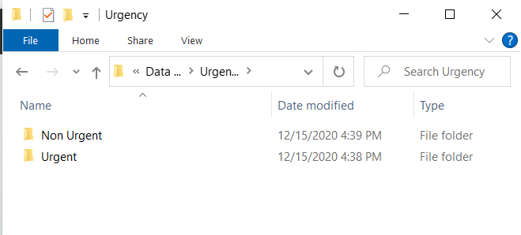
Dataset classification

Slide 14
Data representation
We used Word Embedding to numerically represent our data, since it is one of the major breakthroughs in solving complex NLP problems
Word Embedding was used as a layer in our models, and passed the documents as a vector of encoded values using the one hot encoding from the Tokenizer API in Keras
And since Word Embedding requires specific types of data preprocessing, we will now show how that was achieved

Slide 15
Data preprocessing
From the data, we removed punctuation(e.g !,؟…), letter modification(الحَرَكاتْ)
We also removed stop words(ليس، لا، الذي…), but not for all models
Finally, we removed any non alphabetical words

Slide 16
Models
Each dataset was divided into two sub-datasets, one for training the model, and one for testing it
The Urgency and Sentiment models were divided with an 85:15 scale, while the Topic Model was divided with a 90:10 scale
Our models
  Urgency Detection model
  Sentiment Analysis model
  Topic Classification model

Slide 17
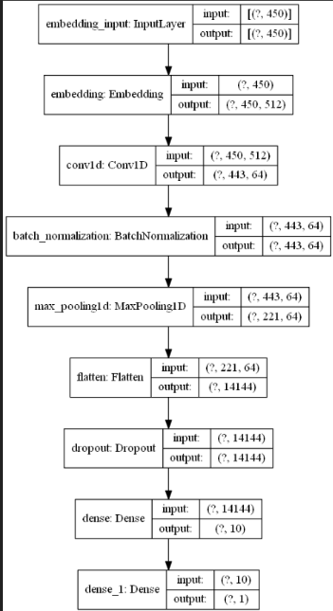
Urgency Detection Model
The embedding layer mentioned before is the input layer with input length=450 and output length=512
Connected to it’s output is a 1D Convolutional Neural Network(CNN) with 64 filters and a kernel size of 8

Slide 18
Urgency Detection Model
A dropout layer and a batch normalization layer were added to help reduce the effects of overfitting
And finally, the output layer, which is a keras.dense layer with 1 neuron output, which represents how urgent the text is.

Slide 19
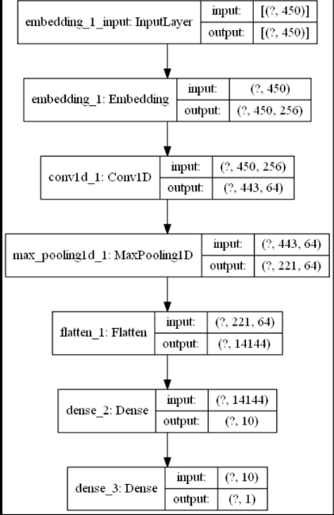
Sentiment Analysis Model
Same as in the Urgency model, the first two layers did not change, with the exception of the output length of the Embedding layer being 256 instead of 512
The output layers are also the same as they were in the Urgency model
We note that the representation of neutral data, was done using the value 0.5

Slide 20
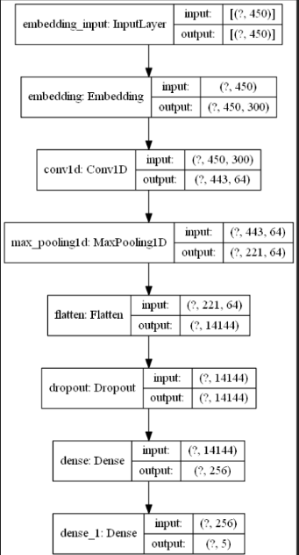
Topic Classification Model
As for the Topic Classification Model, it was built using roughly the same layers as the Urgency Detection Model.
The Embedding layer’s output was adjusted to 300 rather than 512
The BatchNormalization layer was dropped, since the dataset for Topic Classification was already diverse enough and so MaxPooling was enough

Slide 21
Topic Classification Model
Dropout layer is still necessary here to reduce the effects of overfitting
And the first keras.dense layer has an output of 256 instead of 10
The final output layer has 5 classes, one for each topic, each of these is an independent value, which makes it a multi-label classification problem

Slide 22
Optimizer
In all our models, we used the Adam Optimizer, provided as a class in keras
The Optimizer is needed to update the network weights iterative based in the training process

Slide 23
Activation, Loss Function
We used the Relu Activation Function in every CNN layer and the hidden keras.dense layer, this was used across all models
We also used the Sigmoid Activation Function in the output layer of the all of our models
Furthermore, we used the Binary Crossentropy Loss Function in each of these models as well

Slide 24
Results & Discussion
Since we used a result driven model modification method, we kept tweaking the models and changing the numbers until we got some desirable results
These will be shown in the following slides, with the training results(accuracy and loss of each epoch), the test results(final accuracy across each subfolder as well as the main one) and the discussion for these results on each model

Slide 25
Urgency(Training Results)

Slide 26
Urgency(Testing Results)
When using the Urgency model on the testing dataset(15% of the original dataset), we got the following results
87% accuracy on all the test dataset(this includes both urgent and non_urgent test emails)
88% accuracy on the non urgent emails alone
85% accuracy on the urgent emails alone

Slide 27
Sentiment(Training Results)

Slide 28
Sentiment(Testing Results)
When using the Sentiment model on the testing dataset(15% of the original dataset), we got the following results
78.75% accuracy on all the test dataset(this includes both positive and negative test emails)
79% accuracy on the positive emails alone
78.5% accuracy on the negative emails alone

Slide 29
Topic(Training Results)

Slide 30
Topic(Testing Results)
When using the Topic model on the testing dataset(10% of the original dataset), we got the following results
62.183% accuracy on all the test dataset(this includes all 5 topics)
The accuracies of each topic test datasets are as follows
  80% for the Finance topic
  60% for the HR topic
  76% for the Sales topic
  36% for the Support topic
  40% for the Management topic

Slide 31
Urgency(Discussion)
In the training results, we notice how the loss decreases with each epoch, while the accuracy increases
This is due to the repetitive training of the model(the model works), which causes the prediction accuracy to increase while the loss decreases
In the Test results, we notice how the overall accuracy of the model is about 87%, while the non_urgent test accuracy was slightly higher, this is due to the fact that the non_urgent dataset is larger than the urgent dataset, which tilts the model slightly toward non_urgent predictions

Slide 32
Sentiment(Discussion)
In the training results, we notice how the loss decreases with each epoch, while the accuracy increases
It is also worth noting that the accuracy is much lower than it was in the Urgency training, we suspect this to be caused by the nature of sentiment vs urgent in the Arabic language itself
The test dataset accuracies are also reasonable, though a little on the low end, this is probably due to the fact that the Arabic language is peculiar with it’s use of sentiment, since some words can mean both positive and negative emotion, and it’s left for interpretation

Slide 33
Topic(Discussion)
As for the previous models, the training accuracy increases as more epochs are trained, we note that the final accuracy is also much lower than that of the Urgency model
The more interesting results though, are the test dataset results, which show very low accuracies in two specific topics
  Management
  Support

Slide 34
Service
Web service which receives text, and delivers the analysis in a json object consisting of percentage points for each classification
We used Flask to create the API, along with Flask_CORS to solve the CORS_Policy issue, and Flask_sqldb to interact with the database
We also created a MySql database, this database was created to hold the API security & authorization metrics(user info and keys)

Slide 35
Web page
Finally, we created a web page, which we used for testing the API service
This web page was created using ReactJS, along with Primereact for template and design purposes, and the axios library to handle http requests
The web page, as shown below, allows the user to input any text, and on the click of a button, returns the analysis of the text in a presentable and understandable manner.

Slide 36
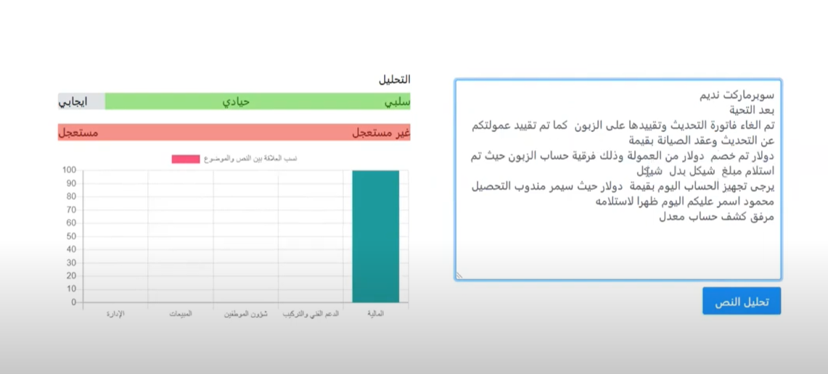
Web page

Slide 37
Constraints and problems
Collecting the dataset was a big problem, especially with the COVID pandemic related lockdowns, which delayed the data collection by about two weeks
Classifying the dataset, since the dataset ended up being around 14000 emails, which we manually classified and put into each of the three main folders, this was a tedious and time consuming process, and with the delays from the previous step, we ended having some time issues
Dataset size, although the dataset consisted of about 14000 emails at the beginning, processing these emails and eliminating the useless ones reduced them down to about 5000, which is somewhat of a small dataset for model training

Slide 38
Future work
Increase the dataset size, we need to collect more emails, classify them and add them to the model training process
Publish as research paper with our process, findings and discussions.
Include more text analysis models and methods, and expand the service to be more widely accessible

Slide 39
Conclusion
There is a huge gap between ANLP and NLP, one which ought to be bridged. After all, Arabic is the 5th most spoken language in the world, and it’s speakers are spread across all continents
We try to reduce this gap by creating a text analysis service, used for business text analysis, this is merely a first step towards the betterment of the ANLP field in particular, and the NLP & AI fields in general

Slide 40
Thanks for watching!

