Slide 1


Slide 2
Topics that will be talked about:
The aim of project
Contact stress.
Some application of contact stress.
Hertzian contact
Contact between two cylinders.
Contact between two spheres.
Model of contact stress.
Interference (shrink and press) fit .
deference between shrink fit and press fit .
Some application of Interference (shrink and press) fit .
Interference (shrink and press) fit equations.
Model of Interference fit.

Slide 3
The aim of project
The aim of this project is to investigate the stresses for both contact stress, press and shrink fit.

Slide 4
Contact stress:
Contact Stresses occur in the transfer of forces between two bodies or two parts when they touch and may be contact between two spherical bodies where the contact area is in the form of a circular. and contact between two cylinder bodies where the contact area is in the form of a rectangle.

Slide 5
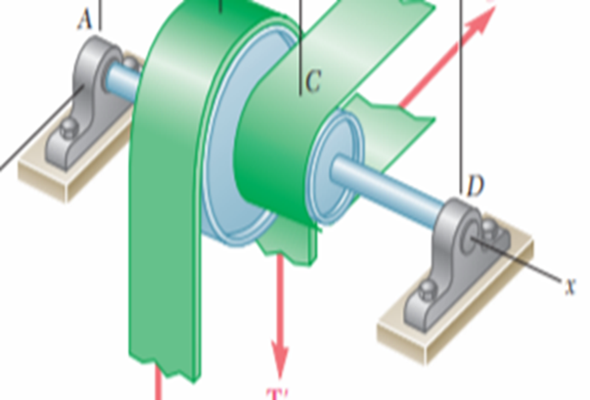
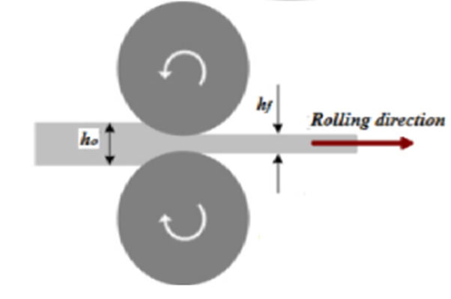
Some application of contact stress
Contact between conveyor and pulley
Contact between Roll and Workpiece

Slide 6
Hertzian contact:
Assumptions:
The contact between the bodies is smooth.
The body is homogeneous.
The contact area resulting from touching the two bodies is small.
The material is isotropic elastic.

Slide 7
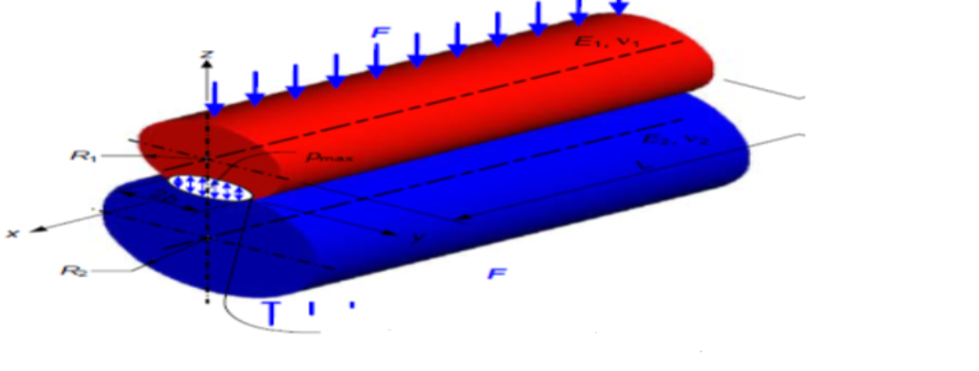

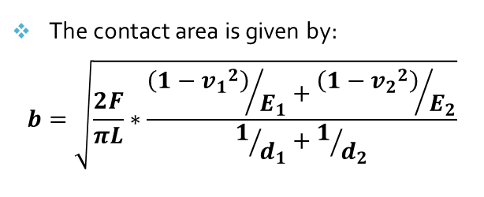
Contact between two cylinders
The contact area is given by:
$$b=\sqrt{\frac{2F}{πL}∗\frac{{\left(1−{v_{1}}^{2}\right)}/{E_{1}}+{\left(1−{v_{2}}^{2}\right)}/{E_{2}}}{1/{d_{1}}+1/{d_{2}}}}$$
The maximum pressure is given by:
Pmax =$\frac{2F}{πbl}$

Slide 8
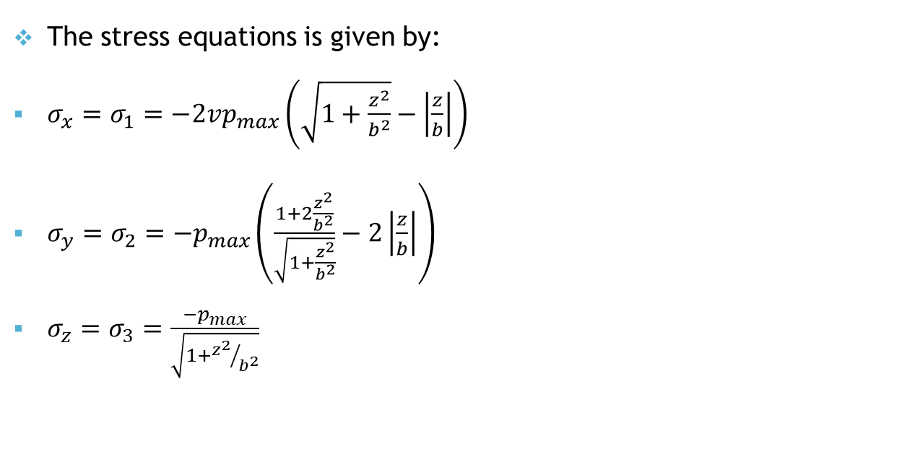
Contact between two cylinders
The stress equations is given by:
$σ_{x}=σ_{1}=−2vp_{max}\left(\sqrt{1+\frac{z^{2}}{b^{2}}}−\left|\frac{z}{b}\right|\right)$
$σ_{y}=σ_{2}=−p_{max}\left(\frac{1+2\frac{z^{2}}{b^{2}}}{\sqrt{1+\frac{z^{2}}{b^{2}}}}−2\left|\frac{z}{b}\right|\right)$
$σ_{z}=σ_{3}=\frac{−p_{max}}{\sqrt{1+{z^{2}}/{b^{2}}}}$

Slide 9
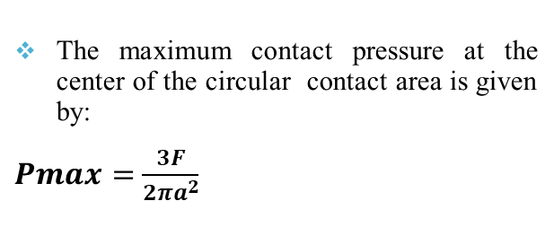
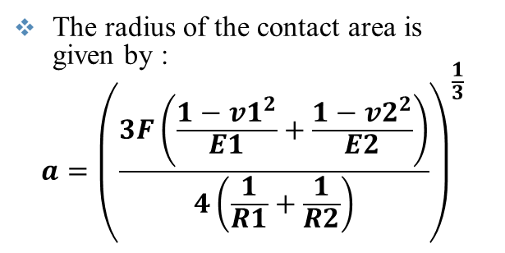
Contact between two spheres
The radius of the contact area is given by :
$$a={\left(\frac{3F\left(\frac{1−v1^{2}}{E1}+\frac{1−v2^{2}}{E2}\right)}{4\left(\frac{1}{R1}+\frac{1}{R2}\right)}\right)}^{\frac{1}{3}}$$
The maximum contact pressure at the center of the circular contact area is given by:
$Pmax=$ $\frac{3F}{2πa^{2}}$

Slide 10

Contact between two spheres
The stress equations is given by:
$σ_{x}=σ_{y}=σ_{1} =−p_{max}\left[\left(1−\left|\frac{z}{a}\right|\tan^{−1}{\frac{1}{\left|z/a\right|}}\right) \left(1+v\right)−\frac{1}{2\left(1+\frac{z^{2}}{a^{2}}\right)}\right]$
$σ_{z}=σ_{2}$=$\frac{−P_{max}}{1+\frac{z^{2}}{a^{2}}}$

Slide 11
Finite Element Analysis
Create parts.
Define material.
Define section .
Assign the define material to the deformable part.
Create assembly.
Define step .
Define interactions.
Define load and BC (Boundary condition).
Define Mesh.
define job and submitted.
The visualization.

Slide 12
Model of contact stress

Slide 13
Description of the model 1 (Contact between an internal sphere and an external sphere )

Slide 14
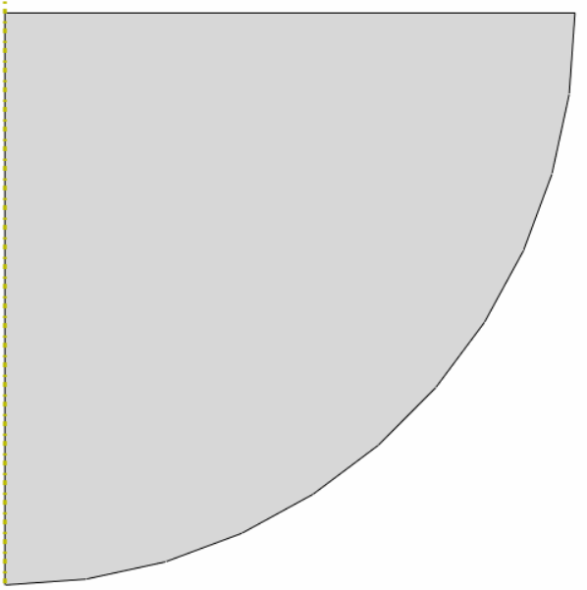
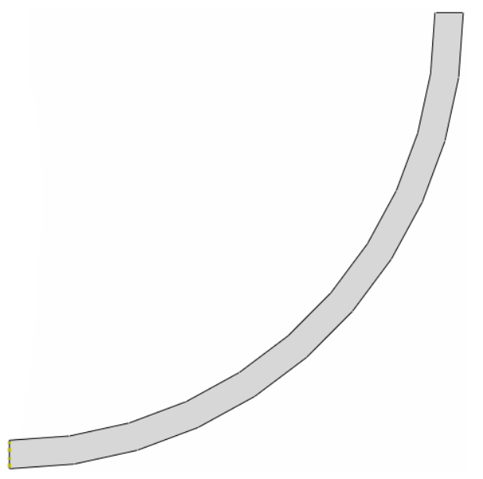
Create parts
External sphere
Axisymmetric →Deformable→shell
Internal sphere
Axisymmetric →Deformable→shell

Slide 15
Define section
Define material
Homogeneous.
Poisson’s ratio | Young’s Modulus (GPa) | Elastic
0.326 | 119

Slide 16
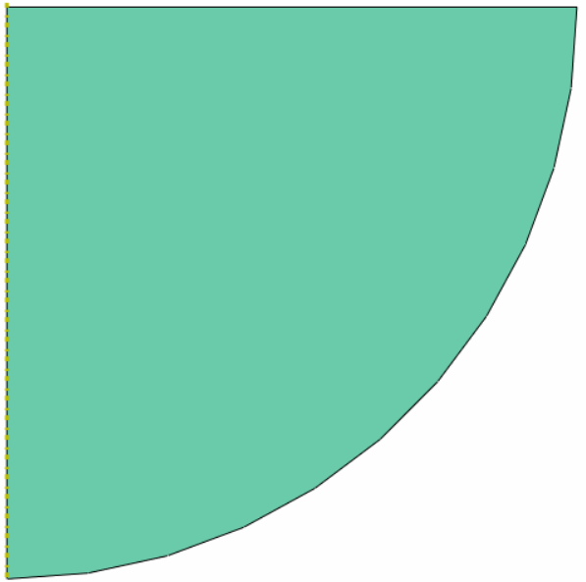
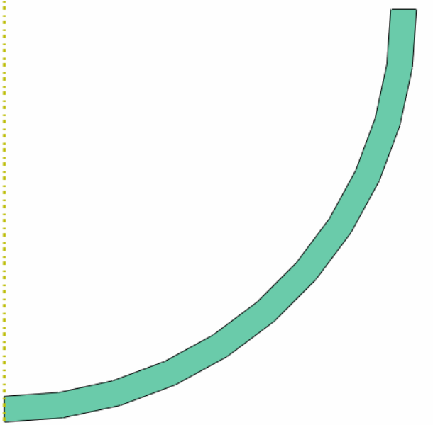
Assign the define material to the deformable part
Internal sphere
External sphere

Slide 17
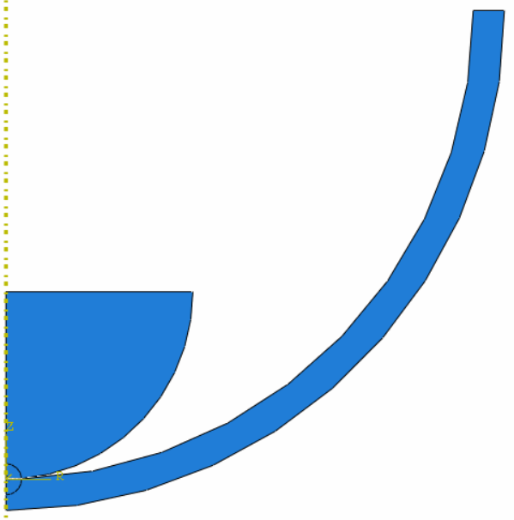
Create Assembly
Define step
Initial →Static, General
Time period was 1 second.

Slide 18
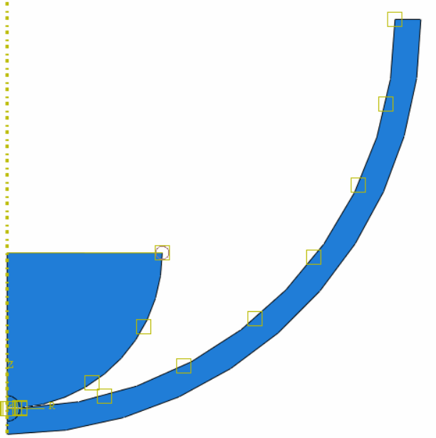
Interaction Model

Slide 19
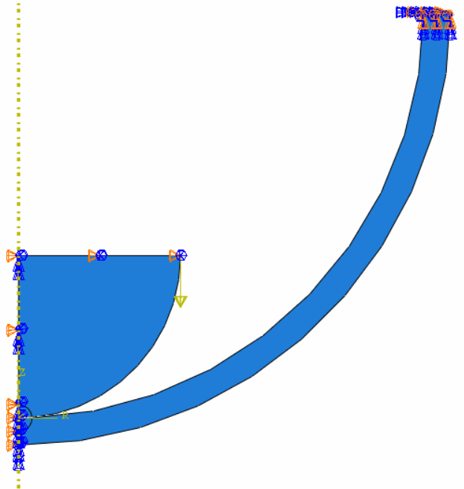
Load and Boundary condition
External sphere (ENCASTRE , XSYMM ).
Internal sphere →(CF2=-500N , XSYMM,U1=0 mm and UR3=0 mm )

Slide 20
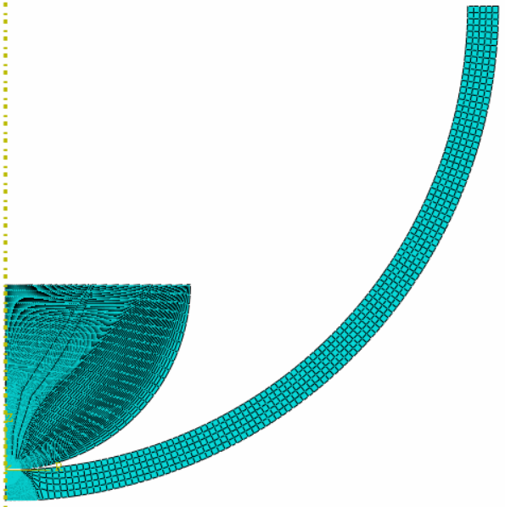
Mesh

Slide 21
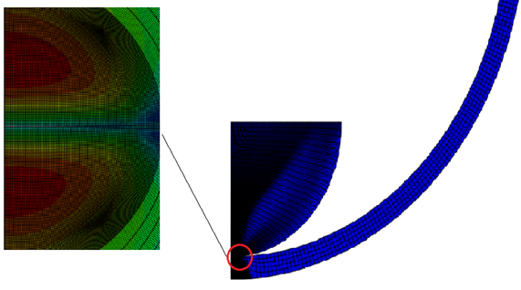
Define job
The Visualization
Job-1 was created and submitted.

Slide 22
Results

Slide 23
Description of the model 2 (Contact between two spheres )

Slide 24
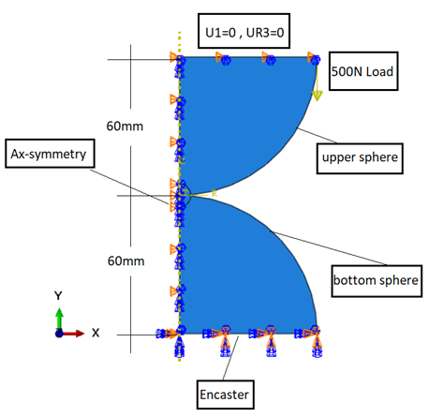
Model 2 (Contact between two spheres )

Slide 25
Results

Slide 26
Description of the model 3 (Contact between two cylinders )

Slide 27
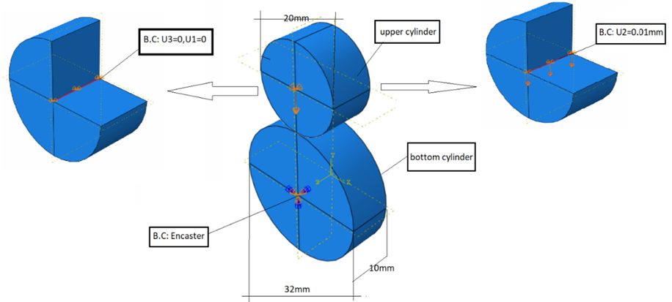
Model 3 (Contact between two cylinders )

Slide 28
Results

Slide 29
Interference (shrink and press) fit
Are a semi-permanent assembly system that can resist the relative motion or transmission of torque between two components, and the overlap fit is produced by heating one component while keeping the other components cool for easy assembly or vice versa. Or the assembly process takes place with a large amount of forces and forcing the column to rotate at room temperature.

Slide 30
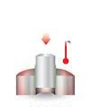


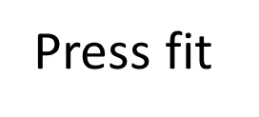
Deference between shrink and press fit .

Slide 31
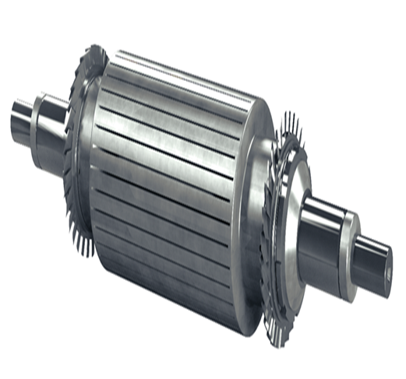
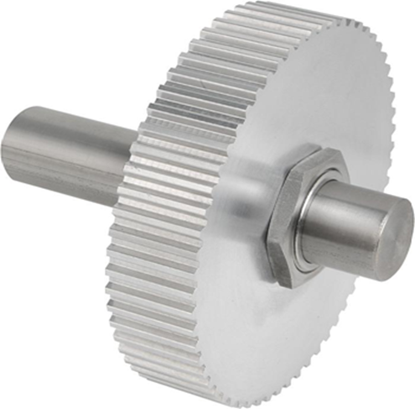
Some application of Interference (shrink and press) fit
turbine rotor
shaft and hub connection

Slide 32
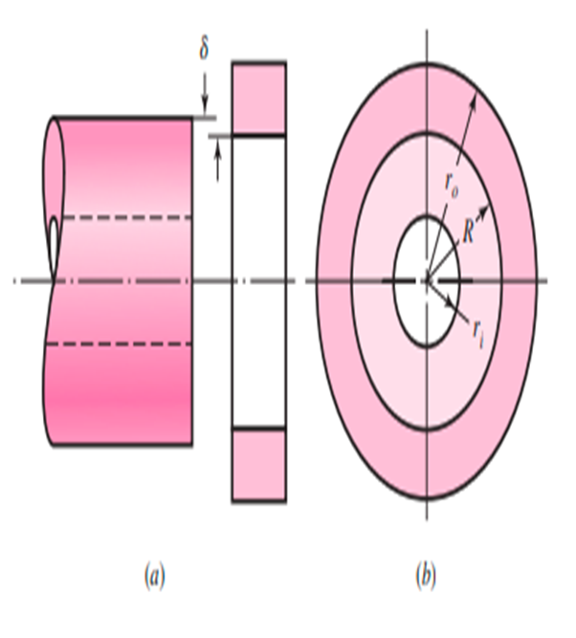

Interference (shrink and press) fit equations
This pressure is given by :
$$p=\frac{δ}{R[\frac{1}{E_{o}}\left(\frac{r_{0}^{2}+R^{2}}{r_{o}^{2}−R^{2}}+ν_{o}\right)+\frac{1}{E_{i}}\left(\frac{R^{2}+r_{i}^{2}}{R^{2}−r_{i}^{2}}−ν_{i}\right)]}$$

Slide 33
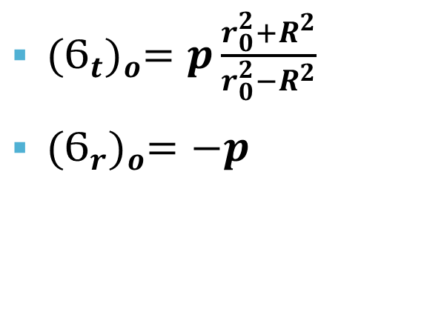
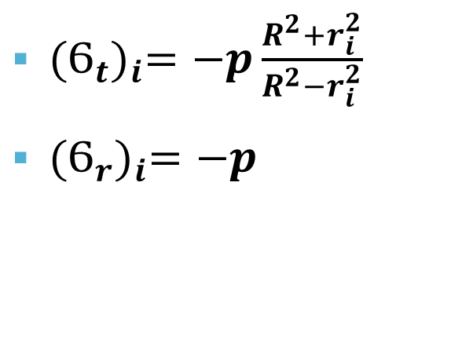
Interference(shrink and press) fit equation
Tangential and radial stresses at the inner member
Tangential and radial stresses at the outer member
${(Ϭ_{t})}_{i}=−p\frac{R^{2}+r_{i}^{2}}{R^{2}−r_{i}^{2}}$
${(Ϭ_{r})}_{i}=−p$
${(Ϭ_{t})}_{o}=p\frac{r_{0}^{2}+R^{2}}{r_{0}^{2}−R^{2}}$
${(Ϭ_{r})}_{o}=−p$

Slide 34

Interference (shrink and press) fit equations
The deflection between two member :
$δ$= $r_{o inner}−r_{i outer}$

Slide 35
Model of Interference fit

Slide 36
Description of the model 4 (shaft –bearing)

Slide 37
Model 4 (shaft –bearing)

Slide 38
Results

Slide 39
Thank you

