Slide 1

The Prime Robot: vision-guided robotic assistant
Yanal Oudeh & Younis Masri
Supervisor: Dr. Anas Toma
An-Najah National University – September 2025

Slide 2

What is The Prime Robot?
The Prime Robot is a vision-guided assistant that reads hand gestures in
real time, moves accordingly, and uses a robotic arm to pick up and hold
objects.

Slide 3
Why The Prime Robot?
Too many controls
Confusing behavior
Old robots need many small commands, Prime uses simple hand gestures, so driving would be easier.
Mixed inputs can cause mistakes.Prime shows clear status and uses steady gestures, so actions are predictable.
Safety in shared spaces
Portable setup
Robots can start or keep moving when it is not safe, Prime blocks unsafe starts and stops right away near obstacles.
Not fixed in one place, easy to move between rooms, labs, and events, and quick to set up anywhere.

Slide 4
What is The Prime Robot?
Gesture-controlled,
easy to use
Follow Mode (hands-free)
One gesture starts Follow. The robot moves forward, auto-stops near obstacles, then auto-resumes. A Stop gesture exits anytime.
Reads hand gestures in real time to drive(forward/left/right/back/stop) and to trigger a simple arm pick.
Multimodal & portable
Bluetooth and voice as backups, quick setup, standard parts. Easy to move and use.

Slide 5
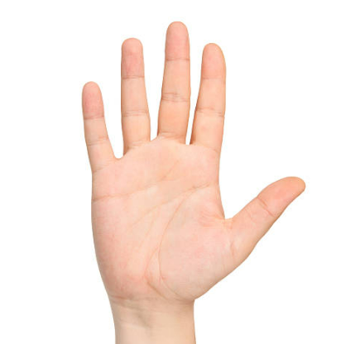

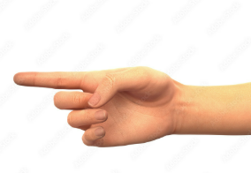
Hand gestures
Open → Stop
Fist → Move
Forward
Point Left → Move Left

Slide 6
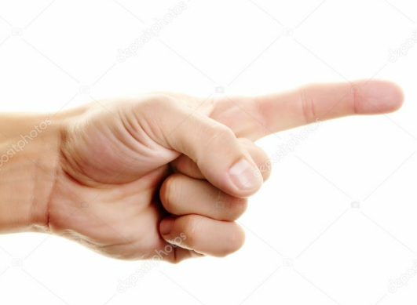
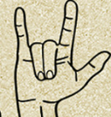
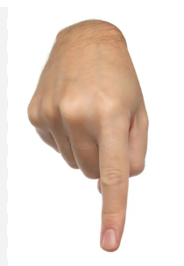
Hand gestures
Point Right → Move right
Spider → Move backward
Point Down → Arm
pinch

Slide 7
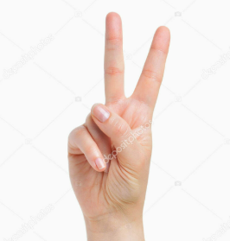
Hand gestures
Two Finger → Follow mode

Slide 8





Key Features
Gesture Control
Follow Mode
Arm Pinch
Reads hand gestures in real time to drive: forward, left, right, back, and stop.
One gesture starts Follow. The robot moves forward, auto-stops near obstacles, then auto-resumes.
A pinch gesture triggers a quick arm routine to grab and hold an object, then return to home.
Audio Control
Bluetooth Control
Say short keywords to move the robot; handy when your hands are busy.
Drive from a phone with simple commands (forward, back, left, right, stop) and optional speed change.

Slide 9
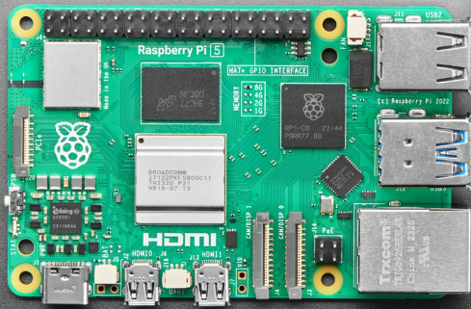
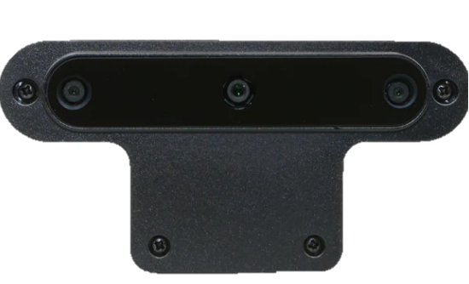
Control & Processing Set
This is the brain of the robot: Raspberry Pi 5 runs the control code (gestures, Follow, safety) and drives the motors/servos, while OAK-D handles vision and hand tracking.
Raspberry pi 5
OAK-D Camera

Slide 10
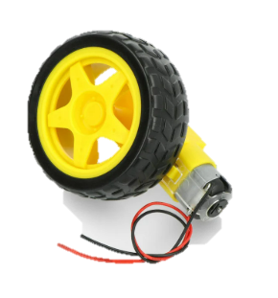
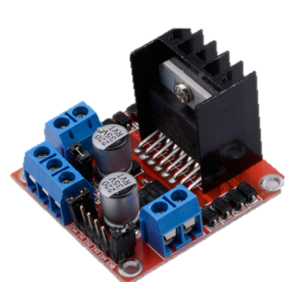
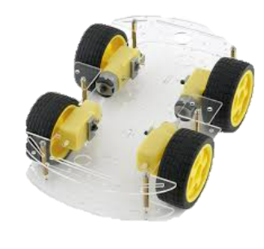
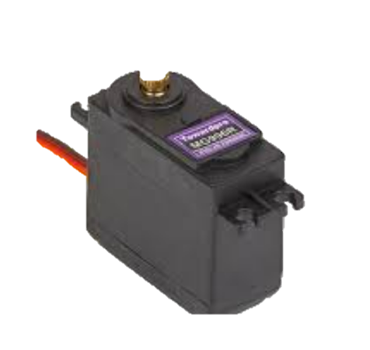
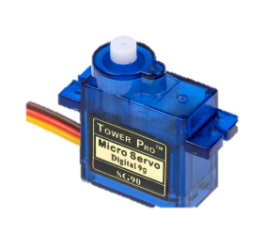
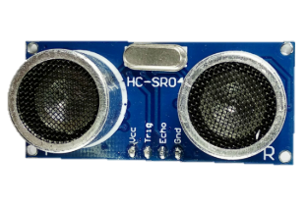
Motion Set
This set moves the robot base and positions the arm smoothly and safely.
DC Gear Motors (wheels)
Dual H-Bridge Drivers (L298N ×2)
Wheels & Chassis
Front Ultrasonic Safety (HC-SR04)
Servo Kit (3× MG996R)
SG90 9g Micro Servo SG90

Slide 11
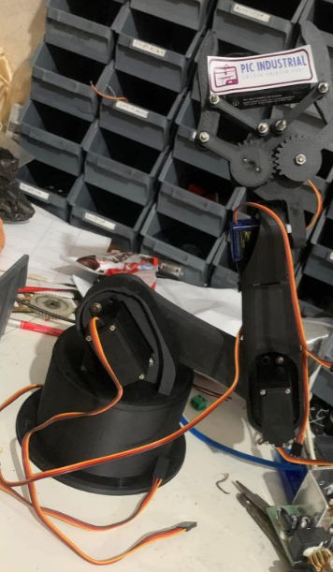
Robotic Arm
This set is a 6-joint robotic arm—base, shoulder, elbow, wrist pitch, wrist roll, and a two-finger gripper. It follows hand gestures and moves smoothly and safely.
Robotic Arm

Slide 12
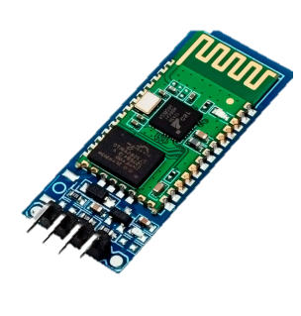
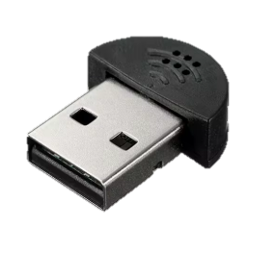
Audio & Bluetooth Set
This set ensures audio and Bluetooth guidance.
HC-06 Bluetooth Module
Super Mini USB 2.0 Microphone

Slide 13
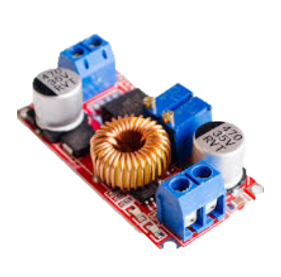
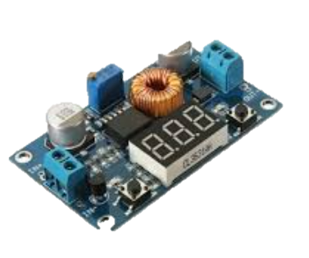
Power Regulation & Monitoring
This set gives safe, stable power to the robot.
XL4015 Adjustable Step Down Buck Converter with
screen
XL4015 Adjustable Step Down Buck Converter

Slide 14
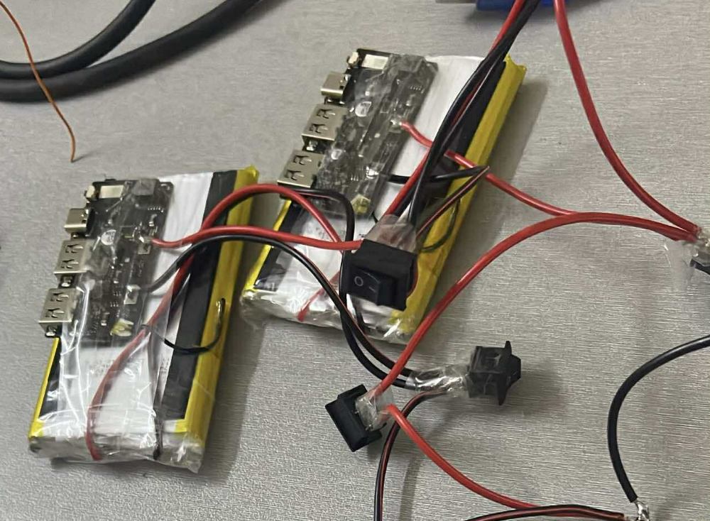
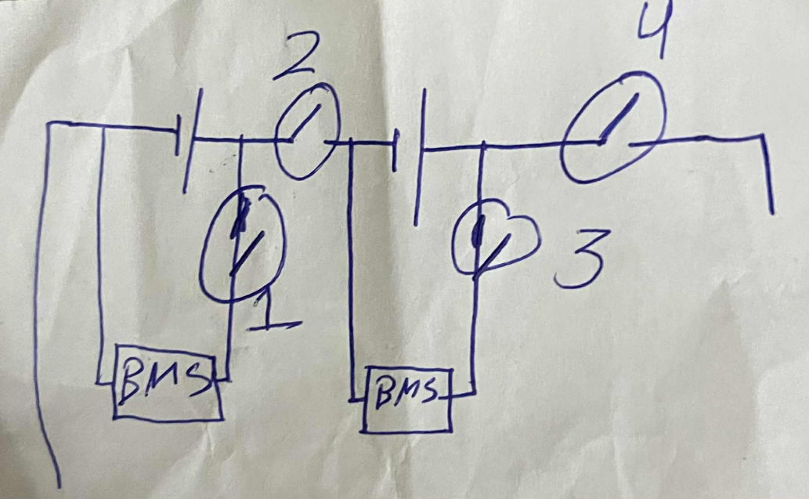
Power Set
This set supplies and organizes the energy distribution.
Batteries
Batteries Manual

Slide 15








Software & Technology
Raspberry Pi 5 + Python
OAK-D + DepthAI
Real-time control loop for motion, 6-servo arm, and safety. Uses GPIO/PWM, threads, and JSON configs for modes and thresholds
Hand landmarks → 42-D normalized feature. Templates with short history for. Triggers Follow, turn, stop, and arm actions.
Open-source libraries
Multimodal control: Bluetooth & Voice
DepthAI, OpenCV, NumPy, RPi.GPIO/Pigpio, threading & logging
HC-06 Bluetooth for simple serial commands and a USB mic for basic voice control (e.g., follow, left/right, stop, pinch).

Slide 16



Workflow
1. Input: gestures / Bluetooth / voice
2. Camera + Distance
The user gives a command by hand gesture, Bluetooth message, or simple voice phrase.
The OAK-D camera reads the hand landmarks and the ultrasonic sensor checks distance to obstacles.
3. Actuation: drive + arm
The drive motors move forward/left/right/backward. The 6-joint arm runs a pinch routine to pick or place objects.

Slide 17


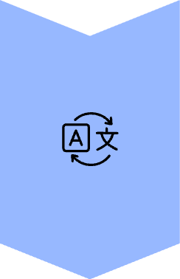

Future Work
One moving camera for everything
Use a single camera on a small pan-tilt mount to track hands, people, and targets. The camera keeps the subject centered.
Face & object recognition
Run light models to detect faces and common objects. Greet known users and let the robot find/approach or pick items.
Smoother, high-quality arm
Use smarter servos with feedback, smooth start/stop, smoother paths, and a gentle, better gripper.
More hand gestures, more actions
Add new gestures and map them to actions

Slide 18



Conclusion
Simple, modular, and portable
Vision-guided, gesture-first control
From demo to daily use
The Prime Robot uses standard parts and clean software. It sets up fast, travels easily, and fits many places like labs, classrooms, and demos
A camera reads hand gestures and tracks people. Bluetooth and voice are backups, A safety layer is also added
by sensors
Prime is easy to run, easy to learn, and safe to share. It follows, stops, and resumes on its own, with an arm ready for simple pick-and-place.

Slide 19

Thank You

