Slide 1
Ahl - Al Quran “ أهل القرآن “
Supervisors:
Dr.Manar Qamhieh
Dr.Muhannad Al-Jabi
Done by:
Haroon Dweikat
Baker Dweikat

Slide 2
The Problem
How can we organize Dor Al Quran ?
How does Quran memorization continue in disasters (Covid-19) ?
How do we make the memorization process easier and more efficient ?

Slide 3
The solution

Slide 4
The Solution cont.
An application enables us to :
Organizing Dor Al Quran
Continuing to memorize the Qur’an in times of disaster

Slide 5
The Main Functionality

Slide 6
The main Functionality cont.
Add tasks by teacher
Notify students
Tracking the tasks are completed successfully
Holding online meetings by teachers when needed

Slide 7
The Architecture

Slide 8
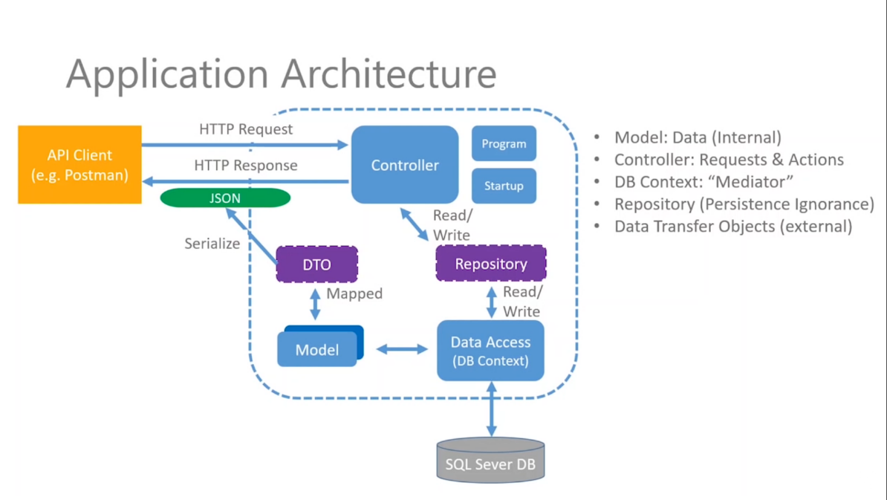
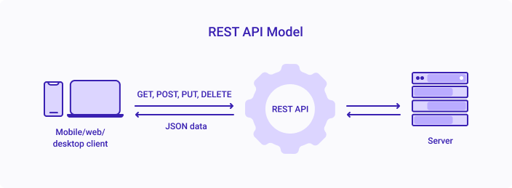
We Used Web API RESTFul Service :

Slide 9
Architecture Cont.
The communication between Client and services done using Rest verbs.
The service build using MVC.

Slide 10
The Technology Used

Slide 11








Technology Used Cont.

Slide 12
The Challenges

Slide 13
Challenges Cont.
lack of project building experience.
Learn new Framework in short time.
Find good tutorial and community of technologies that we used.

Slide 14
Future Work

Slide 15
Future Work cont.
Add more features to app .
Improve UI

