Slide 1
Design of Pedestrian Bridge at Al-Academia Street-Nablus
Prepared by:
Dina Aqra
Shatha Bast
Supervised by:
Dr. Munther Diab

Slide 2
Contents
Problem Definition
Design Criteria (Codes and materials)
Gravity Loads
Lateral Loads
Analysis and Design of Steel Bridge
Analysis and Design of Concrete Bridges

Slide 3
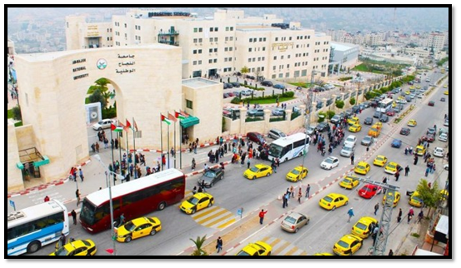
Problem Definition

Slide 4
Design Criteria
Codes
(ASCE 7-10).
Jordanian Code for Loads-2006.
(AASHTO).
(AISC 360-10).
(IBC 2012).
(ACI 318-14).

Slide 5
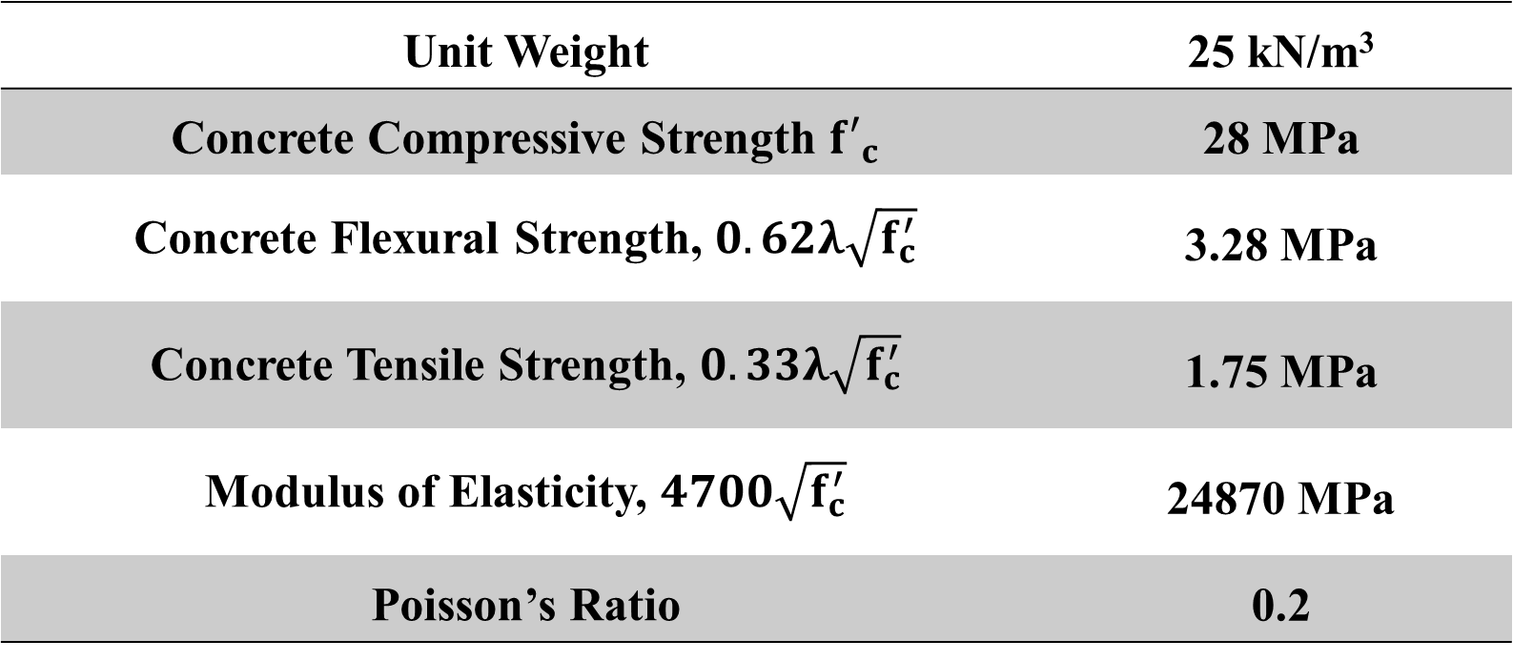
Design Criteria
Materials:
Concrete
Unit Weight | 25 kN/m³
Concrete Compressive Strength ${f′}_{c}$ | 28 MPa
Concrete Flexural Strength, $0.62λ\sqrt{f_{c}^{′}}$ | 3.28 MPa
Concrete Tensile Strength, $0.33λ\sqrt{f_{c}^{′}}$ | 1.75 MPa
Modulus of Elasticity, $4700\sqrt{f_{c}^{′}}$ | 24870 MPa
Poisson’s Ratio | 0.2

Slide 6
Design Criteria
Materials:
Steel:
Reinforcing steel
76.97 kN/m³ | Unit weight,
200 Gpa | Modulus of elasticity, E
620 MPa | tensile strength, fu
420 MPa | yielding strength, fy

Slide 7
Design Criteria
Materials:
Steel:
ASTM-Gr 50 (A572)
76.97 kN/m³ | Unit weight,
200 Gpa | Modulus of elasticity, E
455MPa | tensile strength, fu
350MPa | yielding strength, fy

Slide 8
Design Criteria
Materials:
Steel:
A36
76.97 kN/m³ | Unit weight,
200 Gpa | Modulus of elasticity, E
400MPa | tensile strength, fu
250MPa | yielding strength, fy

Slide 9
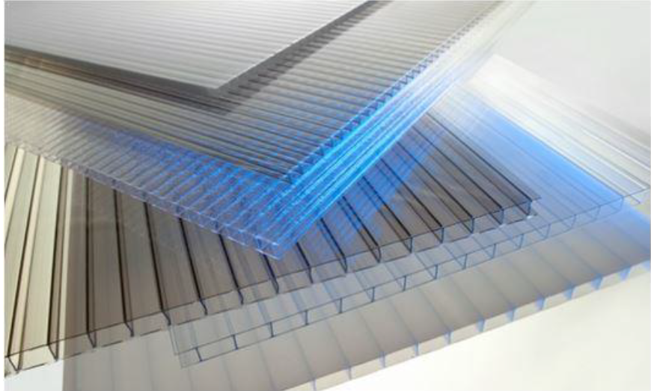
Design Criteria
Materials:
Polygal Standard
It is a covering material for roof, sides of the bridge, and sides of the stairs. It has a specific unit weight of 1.67KN/m³, and the modulus of elasticity, E is 2400MPa.

Slide 10
Gravity Loads
Dead Load : own weight of the structure
Live Load: 5KN/ m²
Roof Live Load: 5KN/ m²
Super Imposed Dead Load: 1KN/m or 0.5KN/ m²
Snow Load: 0.75 KN/m²

Slide 11
Lateral Loads
Wind Loads
Velocity pressure: q_{z} = 0.613 K_{d} K_{zt} K_{z} V²
V: basic wind load speed = 51m/s.
Kd: wind directionality factor = 0.85.
Exposure: C open terrain.
Kzt: topography =1 (flat).
Kz or Kh: velocity pressure exposure

Slide 13
Lateral Loads
Seismic Loads: 3 procedures to analyze seismic loads:
Equivalent lateral force analysis (equivalent static).
Modal response spectrum analysis.
Seismic response history procedure (time history).

Slide 14
Lateral Loads
Seismic loads:
Site class is D.
Risk category ш , importance factor=1.25.
The design parameters:
SDS = 0.7 and SD1 = 0.475.
Seismic design category D.

Slide 15
Lateral Loads
Seismic Loads
Response modification factor: R = 2
Deflection Amplification Factor (Cd) = 2
System Over Strength Factor (Ω0) = 2

Slide 16
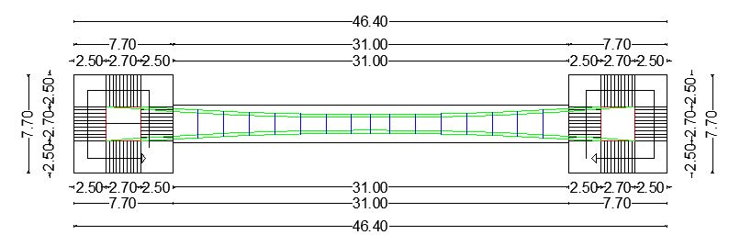
Pedestrian Bridge layout

Slide 17
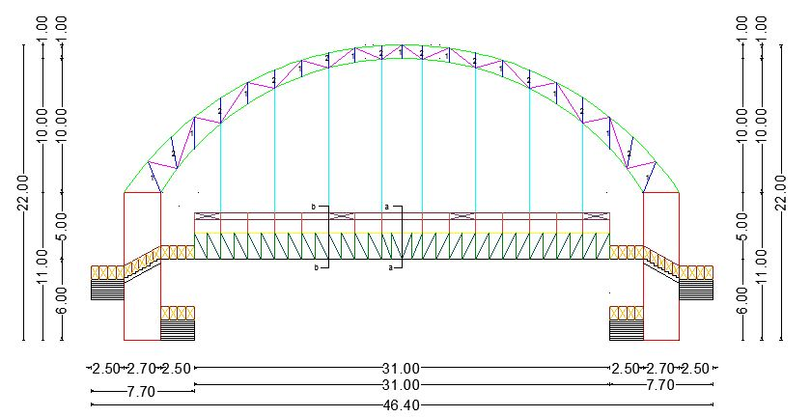
Pedestrian Bridge layout

Slide 18
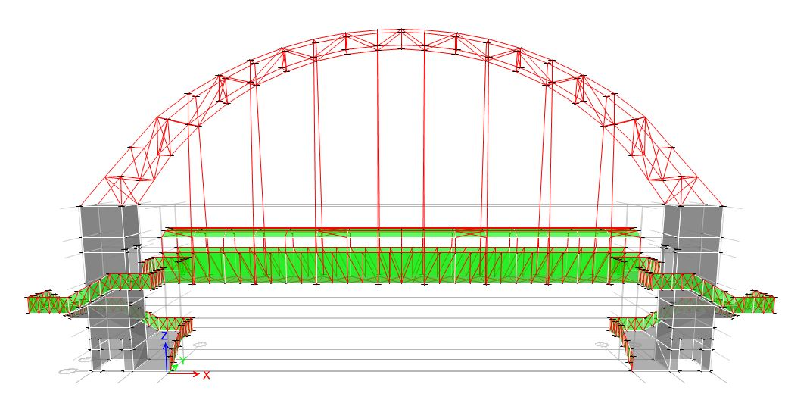
3D modeling:

Slide 19
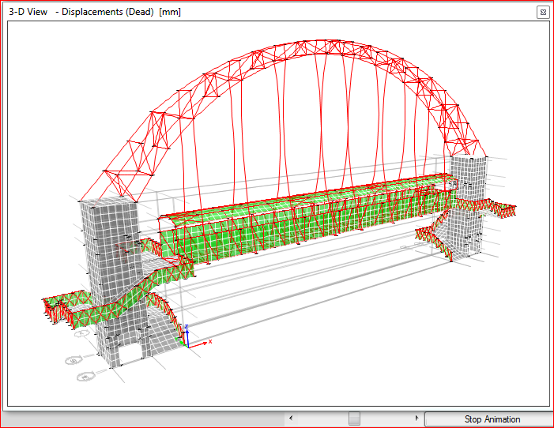
Analysis and design
Checks
Compatibility

Slide 20
Analysis and design
Equilibrium
Error% | Manual | ETABS
1.14 | 3795.47 | 3839.26 | Dead
0.01 | 1154.00 | 1153.87 | Live
0.02 | 56.89 | 56.90 | Roof Live
0.00 | 258.43 | 258.43 | Snow
2.54 | 438.70 | 427.85 | wx
0.33 | 683.60 | 685.89 | wy
2.47 | -438.70 | -427.85 | (-wx)
0.39 | -683.60 | -686.29 | (-wy)

Slide 21
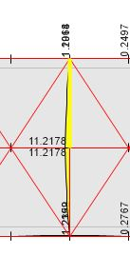
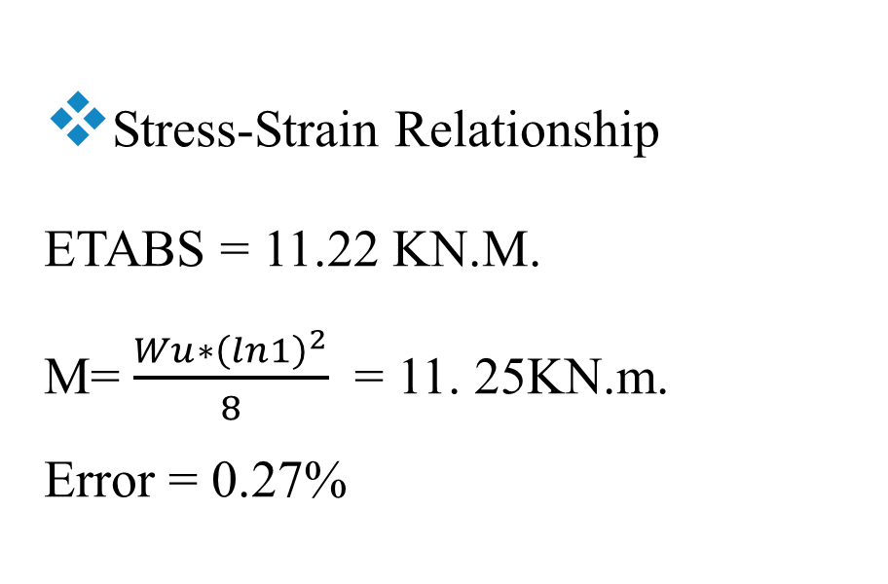
Analysis and design
Stress-Strain Relationship
ETABS = 11.22 KN.M.
M= $\frac{Wu∗{\left(ln1\right)}^{2}}{8}$ = 11. 25KN.m.
Error = 0.27%

Slide 22
Analysis and design
3D without separating
High ductility
Low ductility
Separate steel and concrete
High ductility
Low ductility

Slide 23
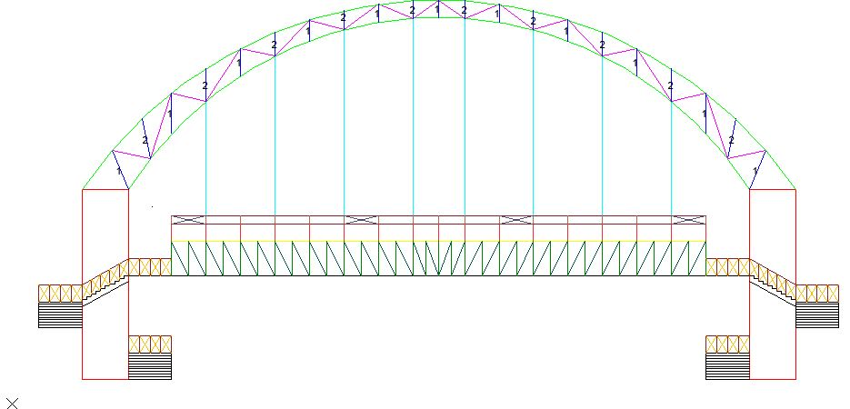
Analysis and design
Front view of the bridge

Slide 24
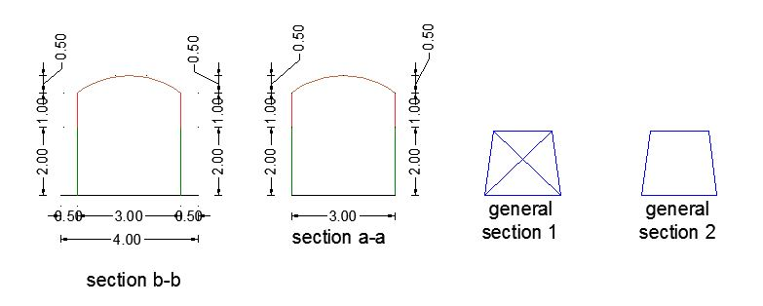
Pedestrian Bridge layout

Slide 25
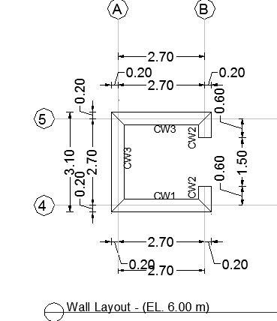
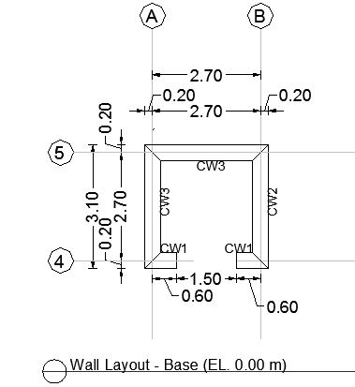
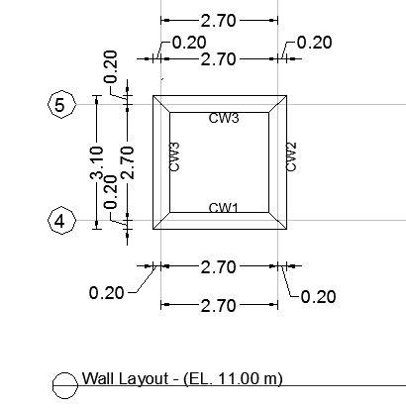
Analysis and design
Layout of walls

Slide 26
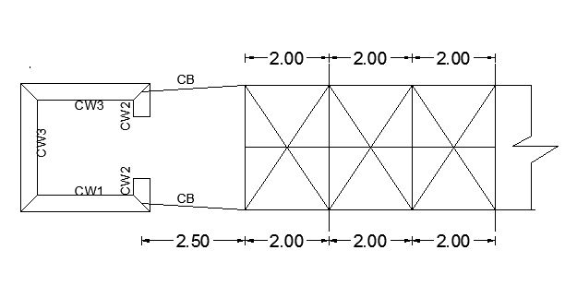
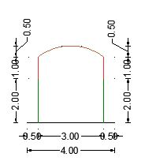
Analysis and design
Part of plan at elevation 6m
Section in the beam

Slide 27
Analysis and design
Low ductility (separated) | High ductility (separated) | 3D Low ductility | 3D High ductility | Group name
C 30 | C 30 | C 30 | C 30 | Cables
TUPO 140*140*8 | TUPO 140*140*8 | TUPO 140*140*8 | TUPO 180*180*12.5 | Arch
TUPO 60*60*3.6 | TUPO 60*60*3.6 | TUPO 80*80*5 | TUPO 140*140*10 | Main truss
TUPO 70*70*4.5 | TUPO 70*70*4.5 | TUPO 90*90*5.4 | TUPO 180*180*12.5 | Sec. truss
TUPO 80*80*5 | TUPO 80*80*5 | TUPO 80*80*5.4 | TUPO 120*120*8 | Roof arch
L60*4 | L60*4 | L60*4 | L60*4 | Roof bracing
TUPO 80*80*5.9 | TUPO 100*100*7.1 | TUPO 80*80*5.9 | TUPO 100*100*10 | Bridge sides members
L 60*4 | L 60*4 | L 75*5 | L 80*8 | Bridge sides bracing
HI 140B | HI 140B | HI 140B | HI 160B | Main beams
HI 100B | HI 100B | HI 100B | HI 120B | Main beams 2
HI 100A | HI 100A | HI 100A | HI 160B | Sec. beams
L80*6 | L80*6 | L100*7 | L100*7 | Deck bracing
TUPO 60*60*6.3 | TUPO 60*60*6.3 | TUPO 60*60*3.6 | TUPO 60*60*3.6 | roof members
TUPO 60*60*4 | TUPO 60*60*4 | TUPO 60*60*4 | TUPO 60*60*4 | Bridge sides top

Slide 28
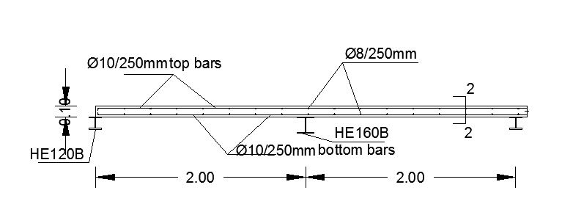
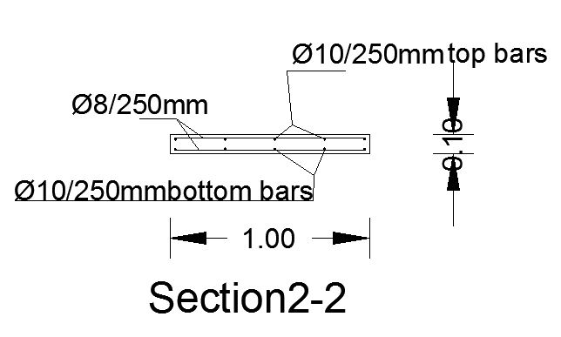
Analysis and design
Design of the bridge deck (slab)
Depth = 100mm.

Slide 29
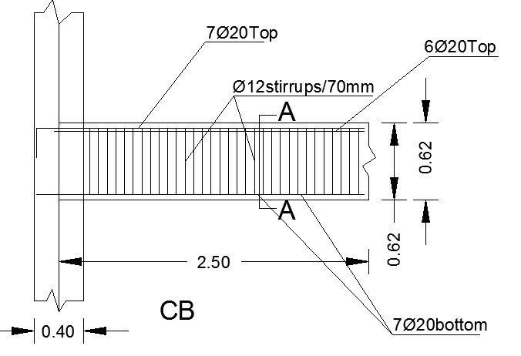
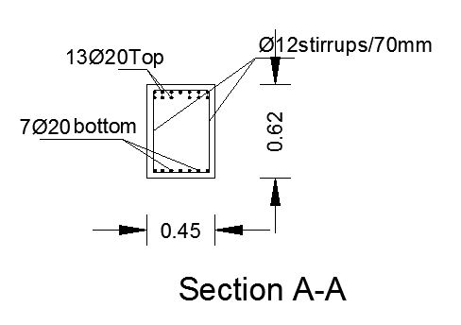
Analysis and design
Design of concrete beams
Width = 450mm, depth = 620mm.

Slide 30
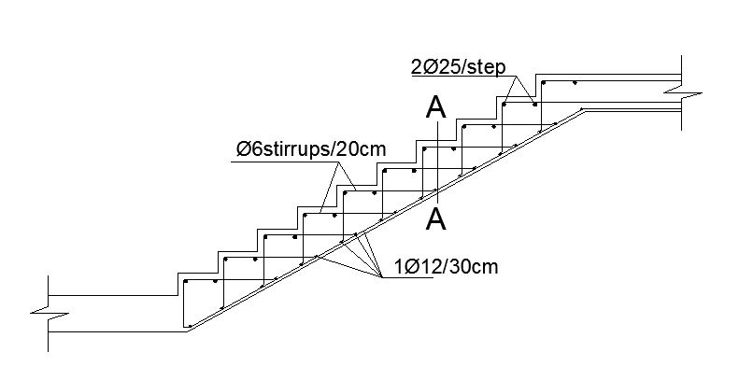
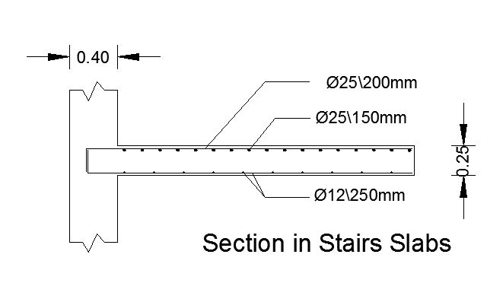
Analysis and design
Design of stair’s slabs and flights
Width = 2.5m, rise height = 15cm and 10 steps at each flight.
Stair’s flights

Slide 31
Analysis and design
Design of stair’s slabs and flights
Depth = 250mm.

