Slide 1
Equestrian Club
Supervisor :
Dr.Manar Qamhieh
Participants :
Hasan Abu Thiab
Mohammad Mousa

Slide 2
Table of contents
01
03
05
02
04
06
Problem
Main Functionalities
Technology
The problem our project is aiming to solve
The main features our application provides
Technologies used to implement the application
Solution
The Architecture
Challenges
The solution we committed to
Architecture used to implement the application
What we will do to update and enhance the application

Slide 3
01
The problem

Slide 4
Problem cont.
Difficulty of managing the club and the students.
Lack of the ability to view courses of Trainers
Missing out on changes to courses or tournaments
Having to manually write down your own schedule or remember it.

Slide 5
02
The solutions

Slide 6
Solutions cont.
A website which can do:
Simplify managing the club for the Admin
Notify the User of any changes
Enable the User to communicate with their Trainer
The ability to enroll and pay for courses through online means
Provide the User with a schedule

Slide 7
03
Main Functionalities

Slide 8
Main functionalities cont.
Manage the Club through a Dashboard.
Reserve a session and pay online.
An Automatic Scheduling system.
Register for Tournaments online.
Communicate with the Trainer
A notification system that keeps the User updated.

Slide 9
04
The Architecture

Slide 10
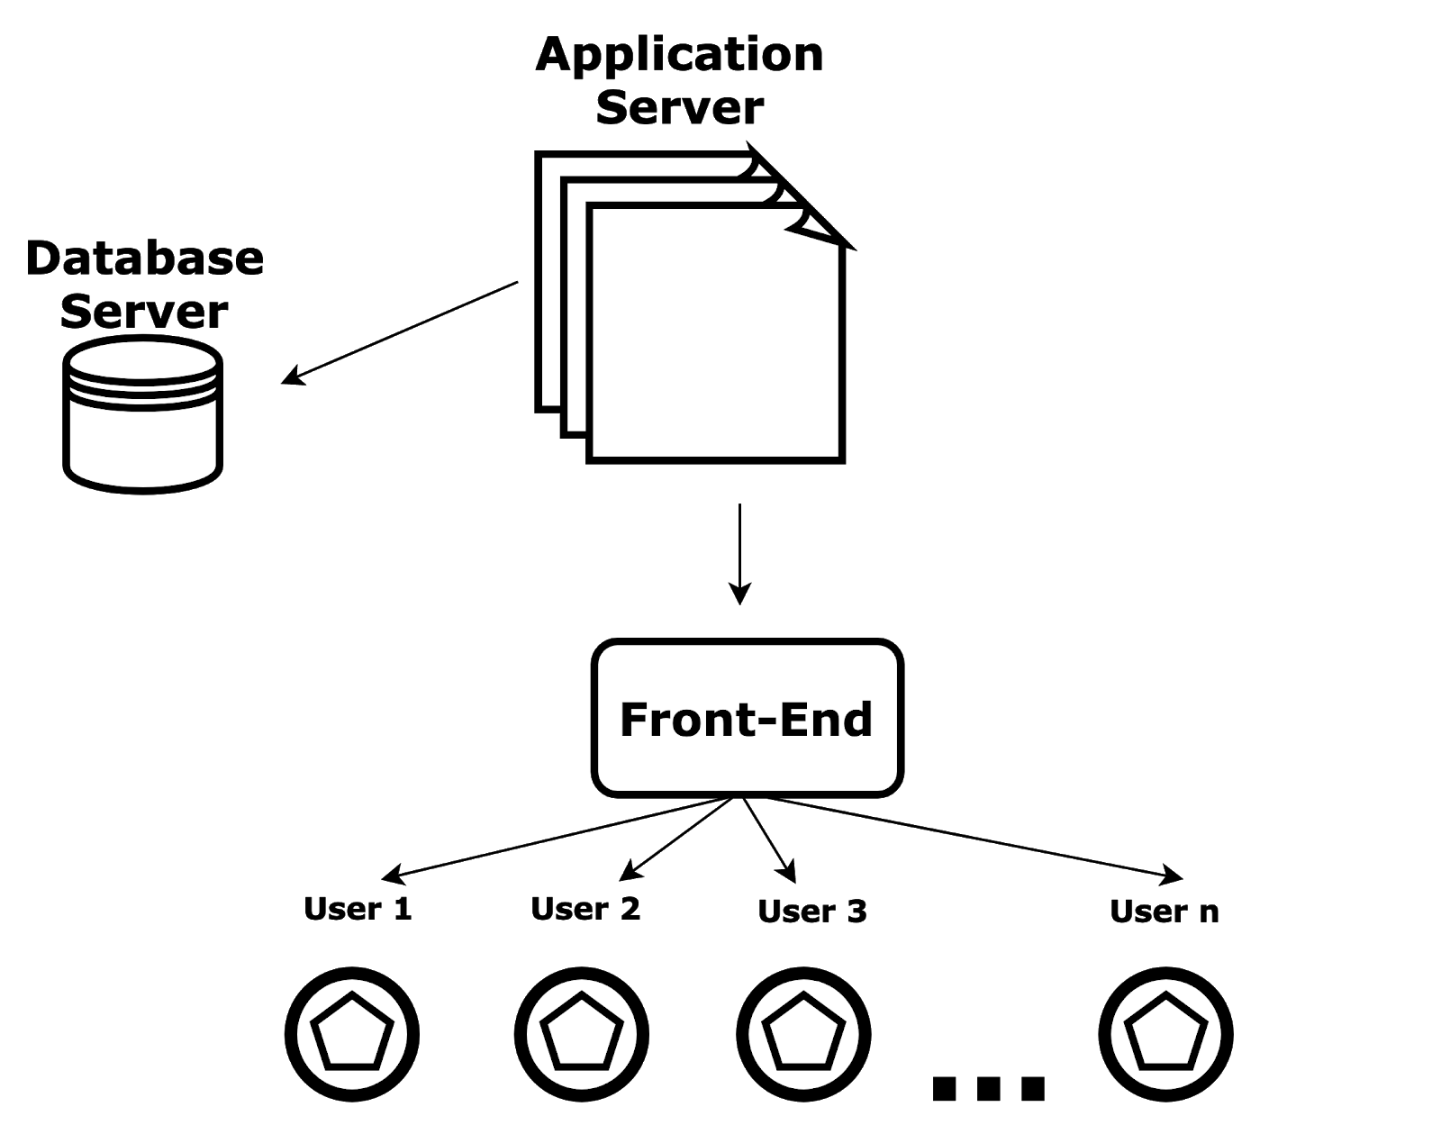
The Architecture cont.
Client -Server
Architecture

Slide 11
The Architecture cont.
The communication between the frontend (the clients) and the backend (the server) done by REST style
The backend built by Model-View-Controller (MVC) pattern

Slide 12
05
Technology

Slide 13






Technology cont.
Back-end
Notification API
Front-end
Payment SDK
Database
Database container

Slide 14
06
Challenges

Slide 15
Challenges cont.
Lack of modern means to run Equestrian club without them
Build a project with a languages we were unfamiliar with in a short period of time
Lack of experience

Slide 16
07
Future work

Slide 17
Future work cont.
Integrate a small shop to provide the User with tools.
Subscription Systems that enables more luxury features.
Build up more on the feedback to include reviews and more features.
Integrate AI for Horse health.
Enhance UI/UX

Slide 18
Thanks!
Thanks for listening!
Equestrian club
Supervisor :
Dr.Manar Qamhieh
Participants :
Hasan Abu Thiab
Mohammad Mousa

