Slide 1
Graduation project
High Tech Robotic System for Off-Site Shelving
Presented in Partial fulfilment of the requirements for Bachelor degree in ‘’Electrical Engineering ‘’.
By :Sami habash,Ibrahim hamdan,muhannad Azmi
Supervisor
Dr. Omar Tamimi

Slide 2
Introduction
Automated storage and retrieval systems (also it’s called ASRS systems) are a computer-controlled system and robotic system which are for the purposes of storing and transporting loads to pre-defined places as well as retrieving them or moving them to other places, with precision, accuracy and speed.
The purpose of delivering or sorting items directly to a person by an automated storage and retrieval system as opposed to the employee walking to retrieve or store items. The ASRS system reduces labour requirements as walking and searching time for the employee
Typically, automated storage and retrieval systems are used in manufacturing, distribution facilities, warehouses, shipping places, and libraries, where they help them in, shelving, sorting and retrieving loads.

Slide 3
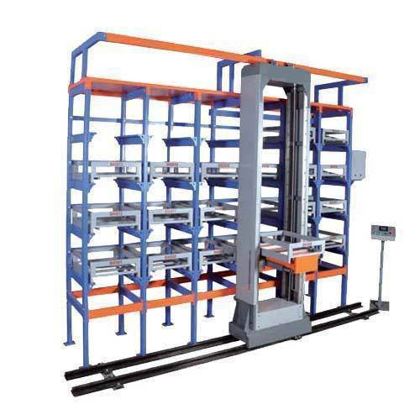
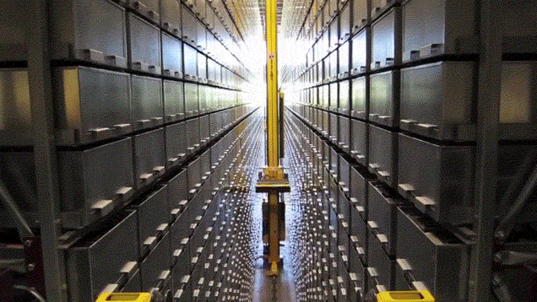
The Automated Storage and Retrieval system

Slide 4
The main aims and objectives of our project are
1. In Our project is to design a prototype for an automated retrieval and storage system (ASRS) that can be developed to be commercial ASRS system.
2.To introduce robots which are developed with basic technologies that can be adapted with minimum efforts to support human beings in a wide array of applications.
3.This robot (ASRS system) will be capable of carrying out a complex series of actions automatically. (In our project the robot will be controlled using computer).
4. In our project the robot’s main task is shelving which can be very efficient in industrial companies which saves so much time, money and hand workers.

Slide 5
Benefits of robots over manpower
This automated system AS/RS is designed to decrease the errors and increased operational and organizational flexibility, while savings tasks time, labour costs and increase storage space.
storage and retrieve can be performed manually by Labour but the automated system AS/RS for storing and retrieving packages are more efficient, accurate and Fast response.
while the conventional system, need a lot of labour and the tools which can lead to many errors and it needs a long time since automated system is more accurate and Fast- acting.
therefore, storage costs will be reduced in warehouse for example and we can increase the storage capacity Through this design. otherwise, the possibilities of errors occur during storing and retrieving of the packages at original location and find the items in shelving can sometimes be difficult and it need longer time.

Slide 6
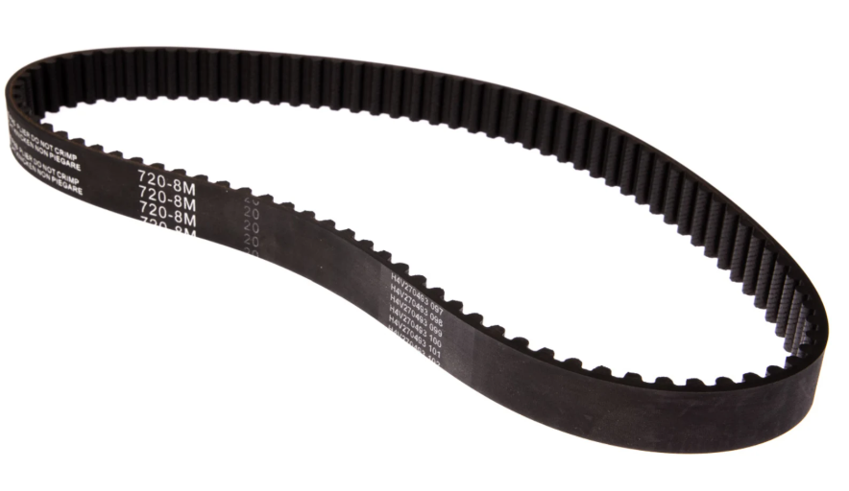
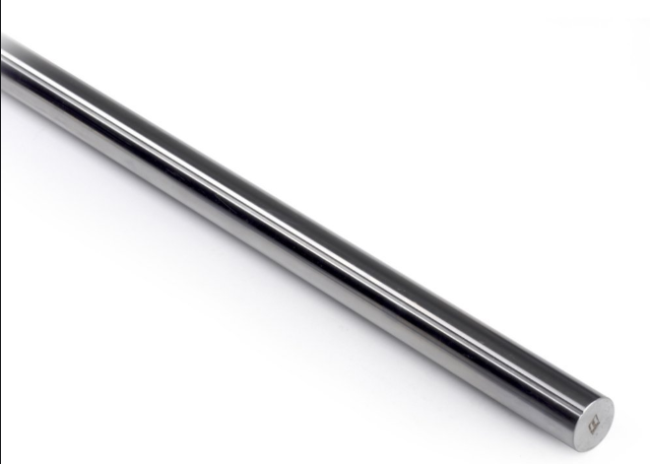
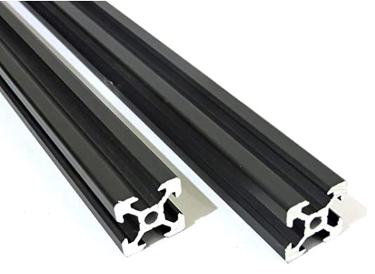
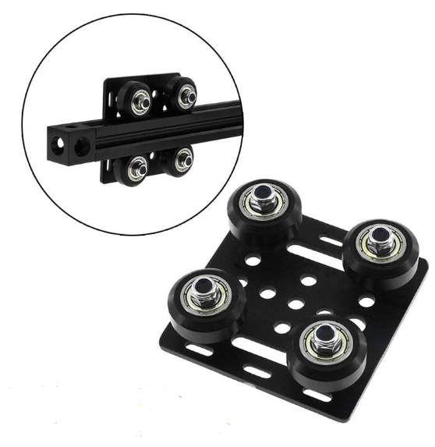
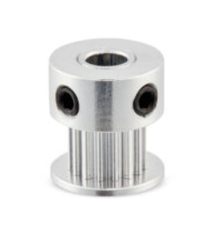
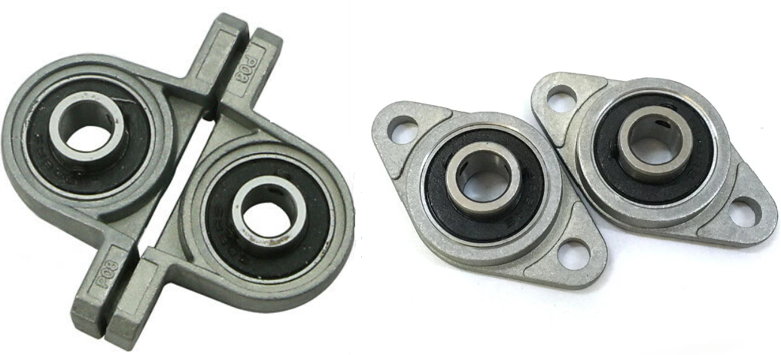
The mechanical part
The following parts were used to achieve linear stable motion
Transmission timing belt.
Stainless Steel Shaft.
V-Slot aluminium profile.
V-slot gantry plate.
2GT pulley
Ball bearing pillow block

Slide 7
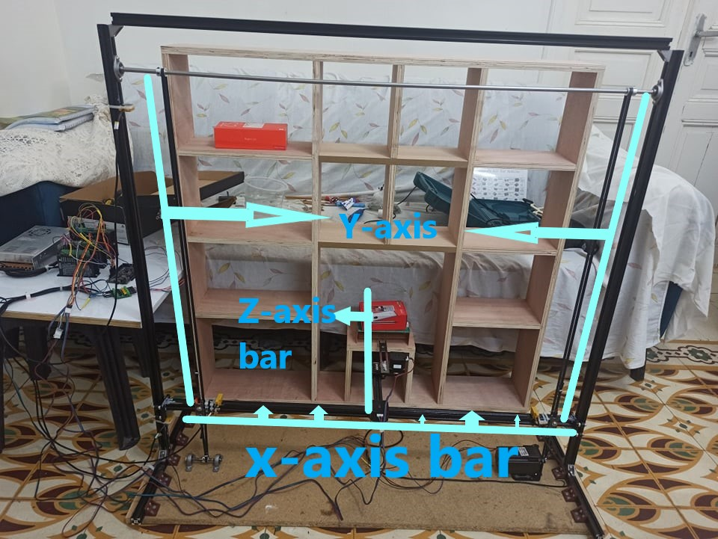
The mechanical part
After combining the parts shown in past slide ,the following structure was built

Slide 8
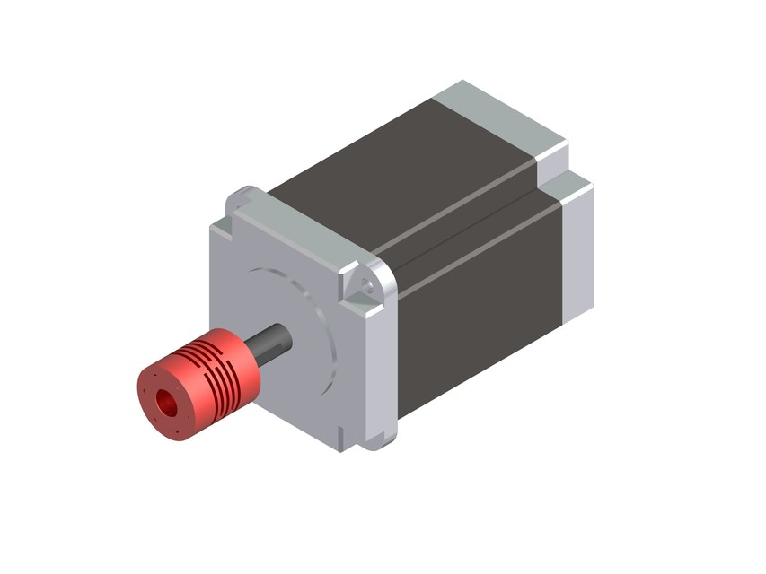
Electrical part
Stepper motor
A stepping motor is a brushless dc motor, the input given to this motor is in the form of electrical pulses, for every input pulse the motor shaft turns through a definite number of degrees ''step''.
Therefore, a stepping motor is a motor whose shaft moves through one angular step for each input pulse, the range of step scope is changing from 0.72 to 90 degrees.
Actually, a stepping motor can be observed as a digital electro-mechanical device.

Slide 9
Stepper motor type selection
There are three types of stepper motors (permanent magnet, variable reluctance, Hybrid)
In our project, we decided to choose a hybrid stepper motor due to several advantages of hybrid Stepper motors have over the other two types.
Hybrid stepper motor affords high torque the same as permanent magnet motors but with even higher resolution with step angles as small as 0.72 degrees (500 steps per revolution) in full-step mode.
Hybrid stepper motor can also afford high speed the same as the variable reluctance motor as well as the advantages we mentioned before.
Finally, a Hybrid stepper motor combines the best features of both variable reluctance and permanent magnet stepper motors.

Slide 10
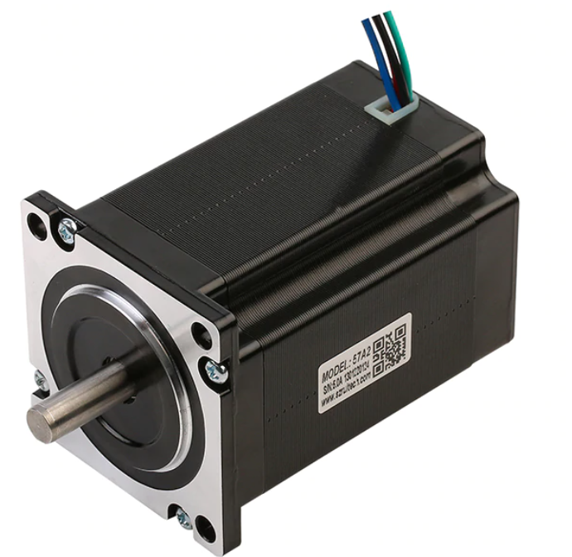
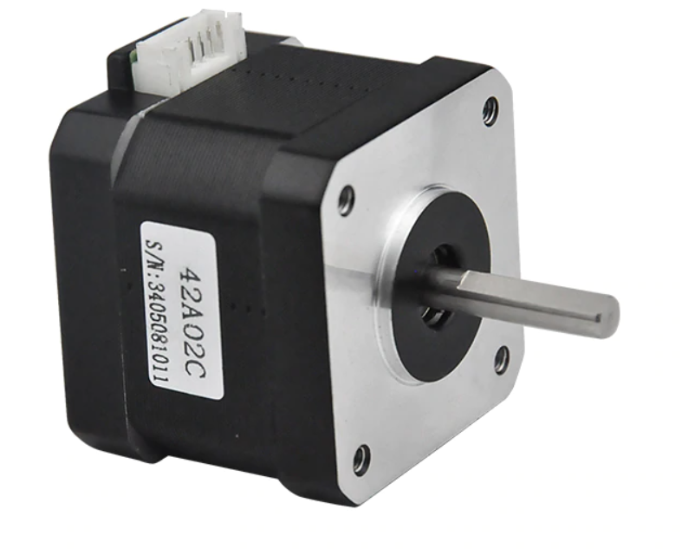
Stepper motors
In this project the following stepper motors was used
Nema 23 57A3
Nema 17 42A02C

Slide 11
stepper driver
TB660 stepper driver
DM556 stepper driver

Slide 12
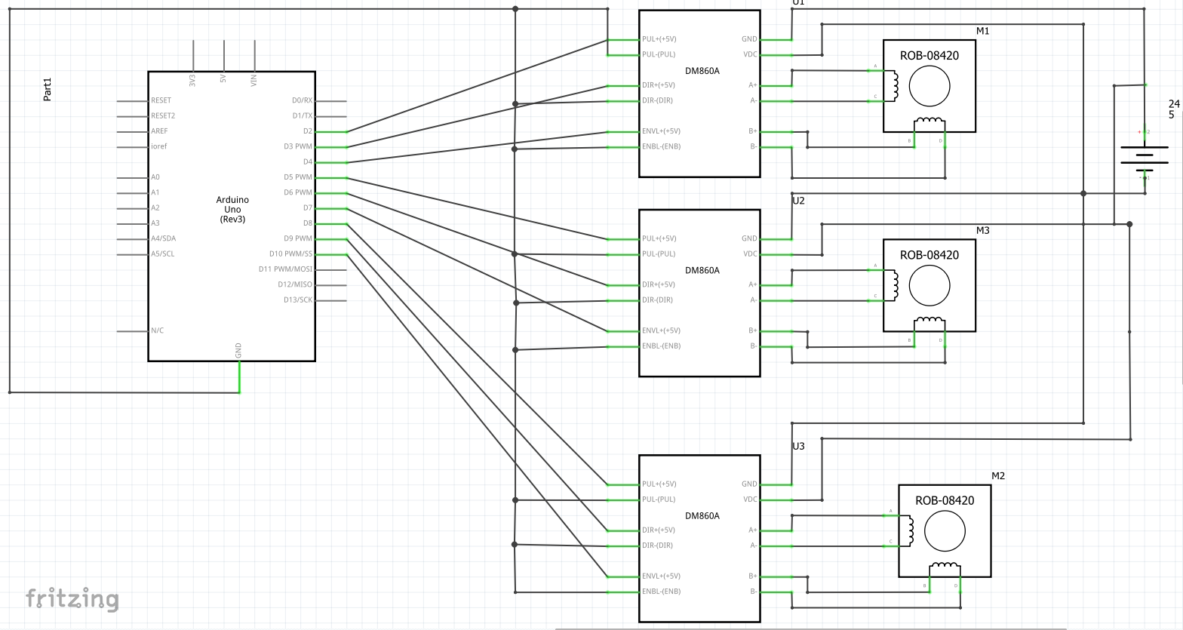
Micro controller with stepper motor and stepper driver schematic diagram

Slide 13
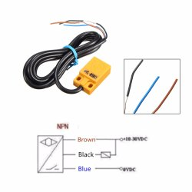
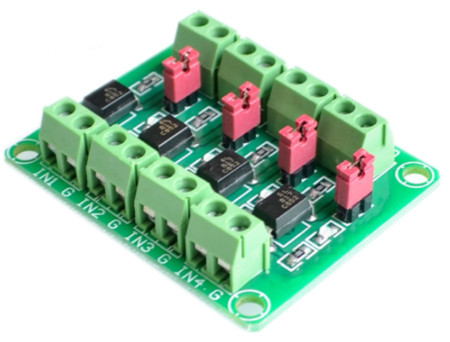
Feedback system.
A reference point ( Home position) was created for the storage and retrieval process by using inductive proximity sensors.
The inductive proximity sensors was matched to the microcontroller ( Arduino) through an optocoupler isolation board.
Inductive proximity sensor
optocoupler isolation board

Slide 14
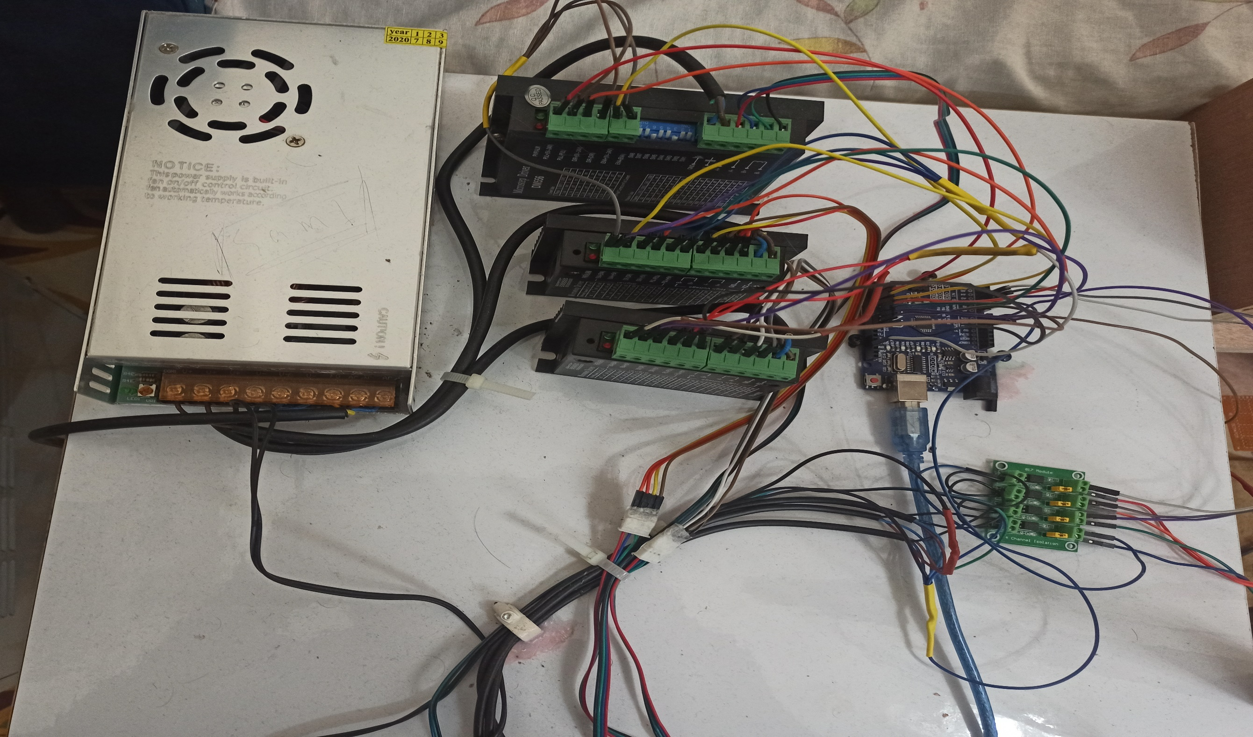
Electrical control wiring & Converter

Slide 15
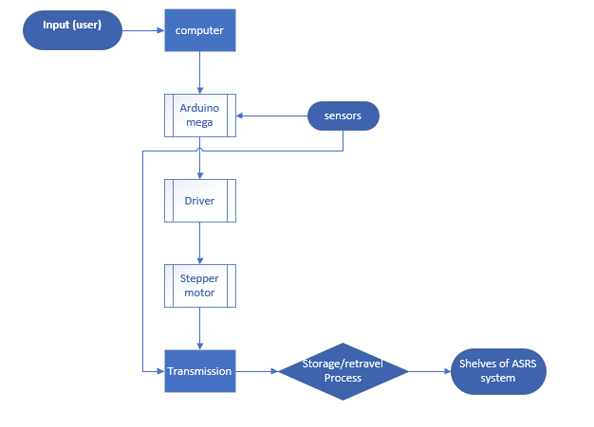
Functional Block diagram of ASRS

Slide 16
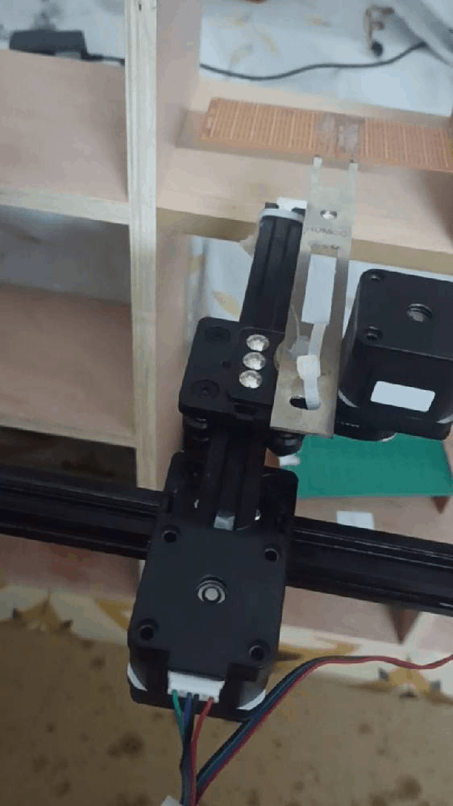
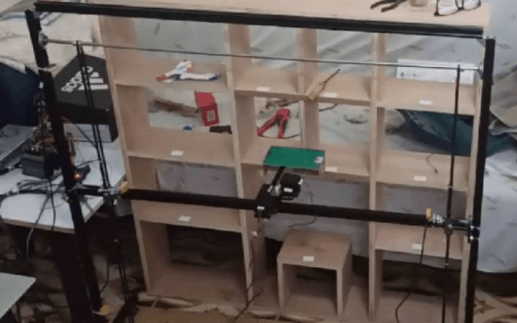
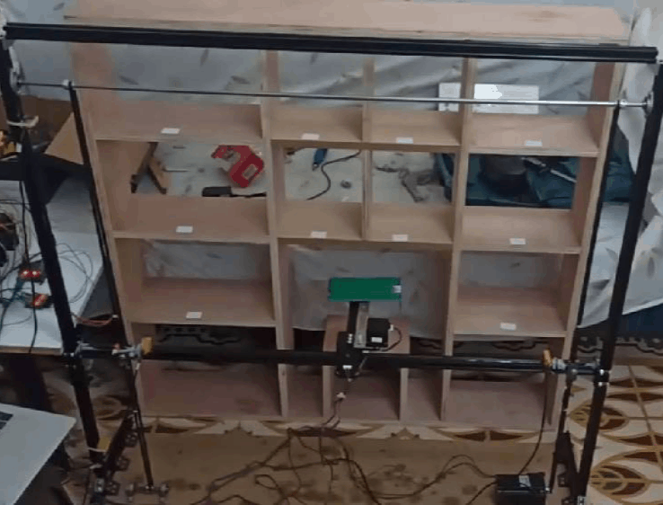
The overall system
Z-axis linear motion
X-axis linear motion
Y-axis linear motion

Slide 17
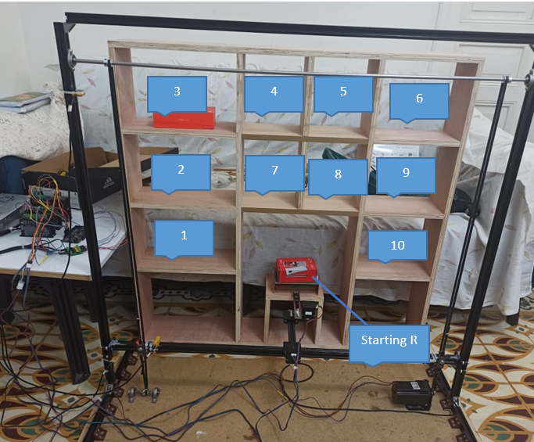
The shelves ,Reference point and starting point

Slide 18
conclusion
In the context of this project we have studied research in the automated storage and retrieval systems, we have studied the parts that we want to use in a project and the principle of their work and in Project 2 we applied them in practice
In conclusion, the automated AS/RS system should be able to be improved to be used in warehouses, factories, and libraries, performing its job smartly, effectively by saving time and hand workers, making dealing with sorting and retrieving items much easier.
We have merely learned a concerned lot about automated ASRS systems. We saw how automated systems could be allegedly used in smart ways to merely make life much easier.

Slide 19
Future work
This project is just a prototype that can be improved in many several ways such as
* Arduino can be replaced with PLC or another type of microcontroller.
* Encoders can be used to make the system more accurate and easier to control.
* Bar code reader can be used to recognize the object and store it automatically.
* Many more features can be added to the system depending on the user requirements.

