Slide 1
Mojito Maker Pro
Prepared By:
Malak Jawabreh
Aya Awwad
Supervisor:
Dr. Haya Sammana

Slide 2
Agenda
1. Main Idea 2. Features 3. Motivations
4. Hardware Modules 5. Constraints 6. Future Work

Slide 3
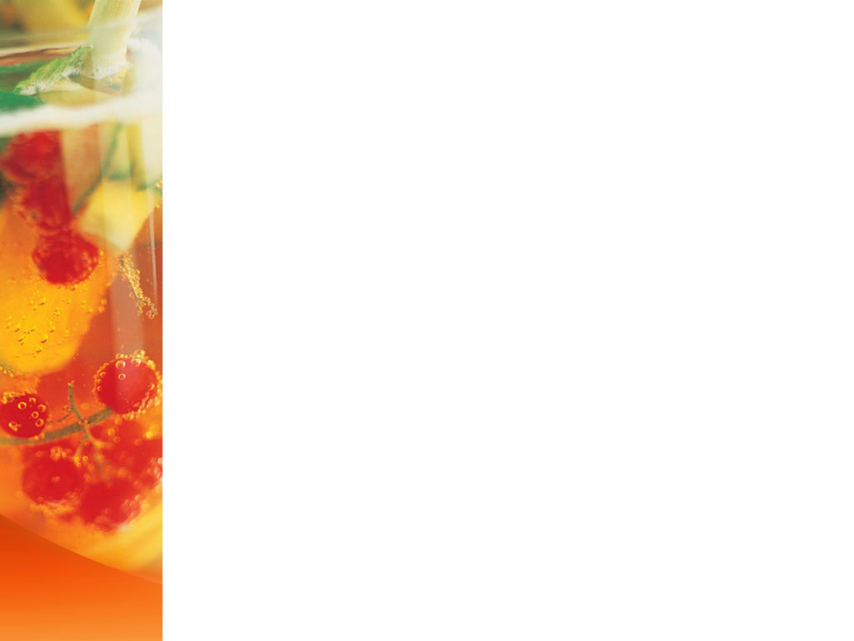
Main idea
A highly efficient Mojito production line, designed to deliver a refreshing drink with a variety of flavors tailored to different tastes. The line is distinguished by the unique addition of fresh lemon slices, enhancing the flavor and adding a delightful natural touch. Furthermore, ice cubes are carefully integrated to maintain the drink’s coolness, making it the perfect choice for hot summer days.

Slide 4
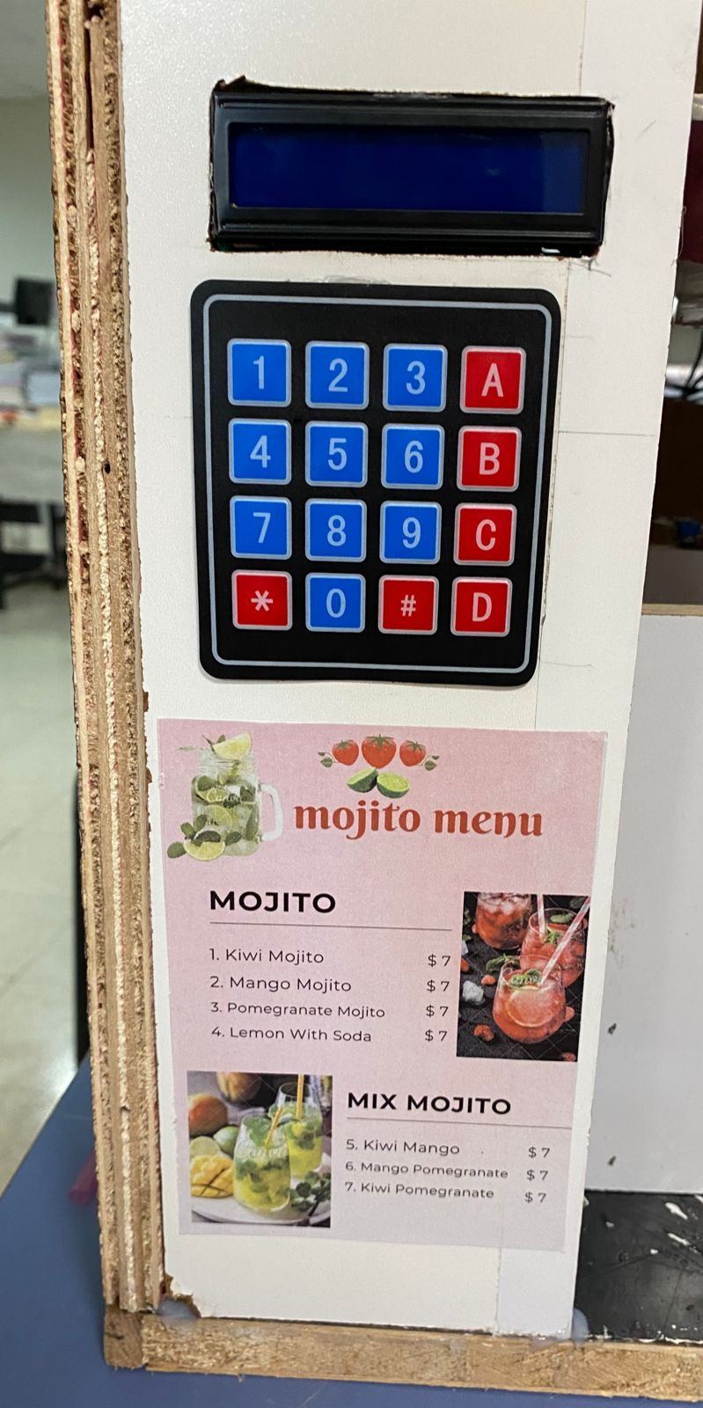
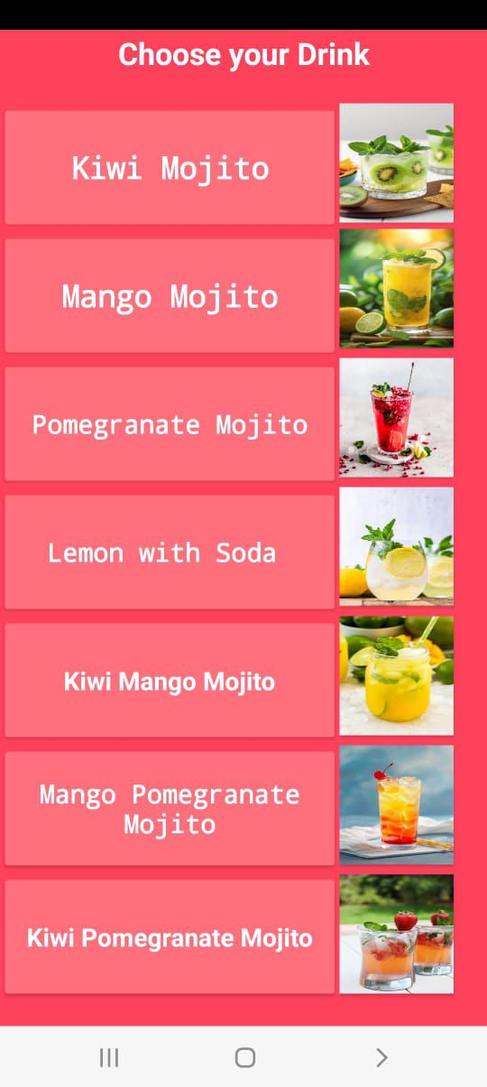
Features
Stage 1 :
Make Your Order:
From Keypad
From Mobile App

Slide 5
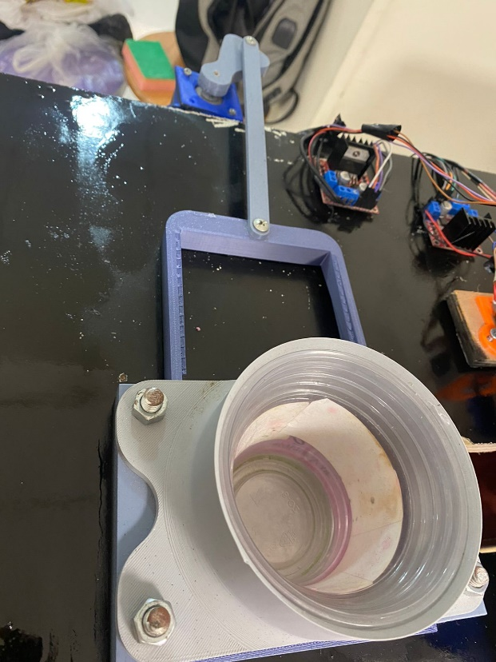
Features
Stage 2 :
Cup will be dropped after confirming the order and flavour.

Slide 6
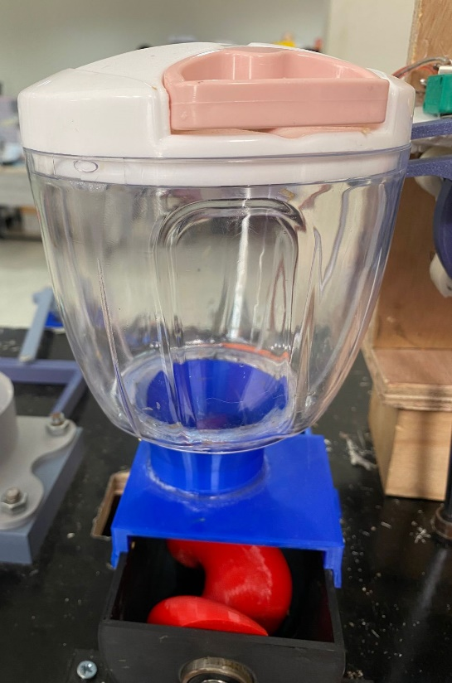
Features
Stage 3 :
The lemon slices are transported through the spiral motion of the screw mechanism.

Slide 7
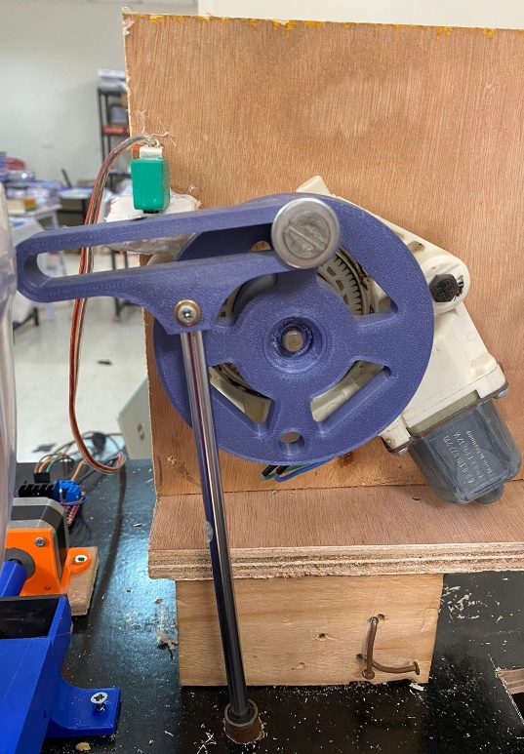
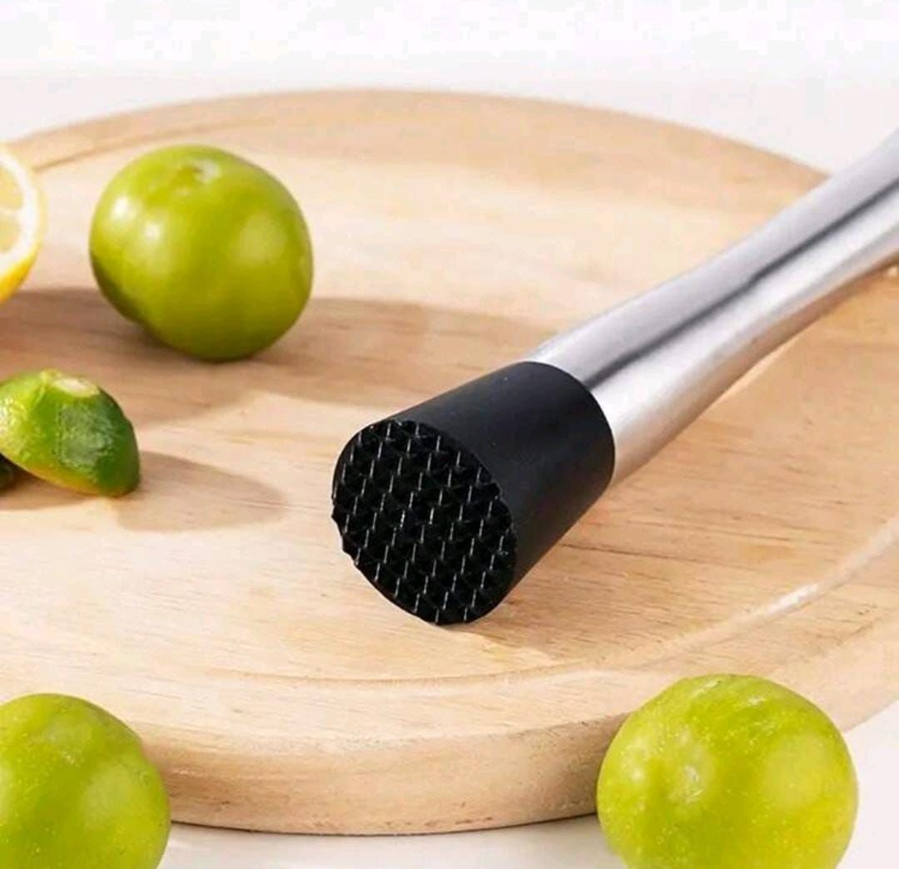
Features
Stage 4 :
The hand blender moves downward to finely blend the lemon pieces.

Slide 8
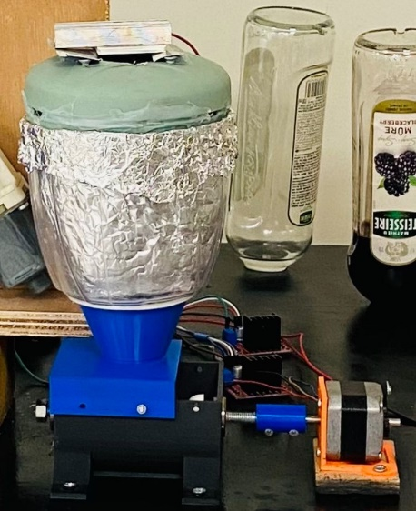
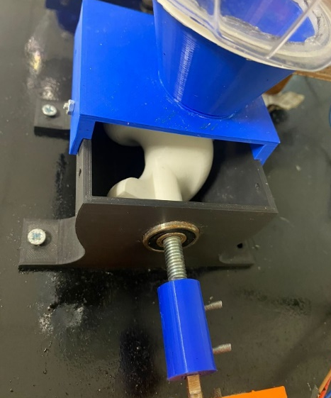
Features
Stage 5 :
The same principle applies to lemons, and ice cubes fall.

Slide 9
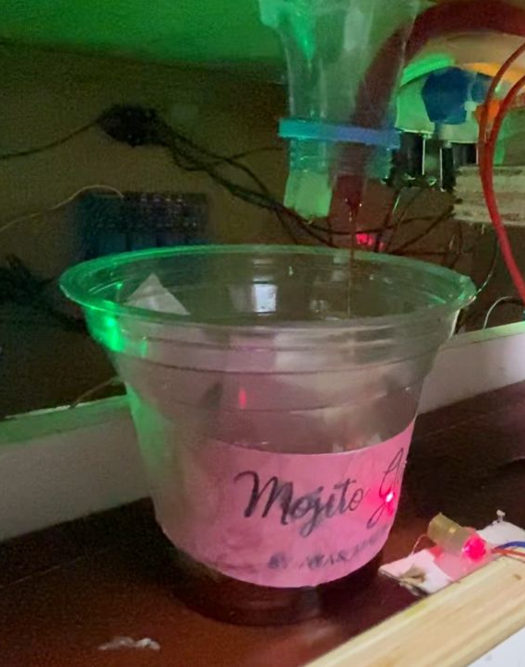
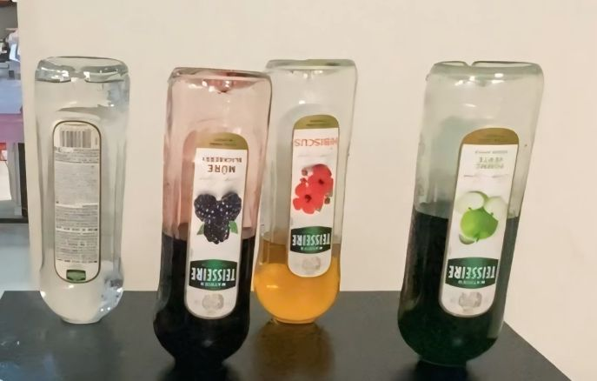
Features
Stage 6 :
Filling Flavors and Soda.

Slide 10
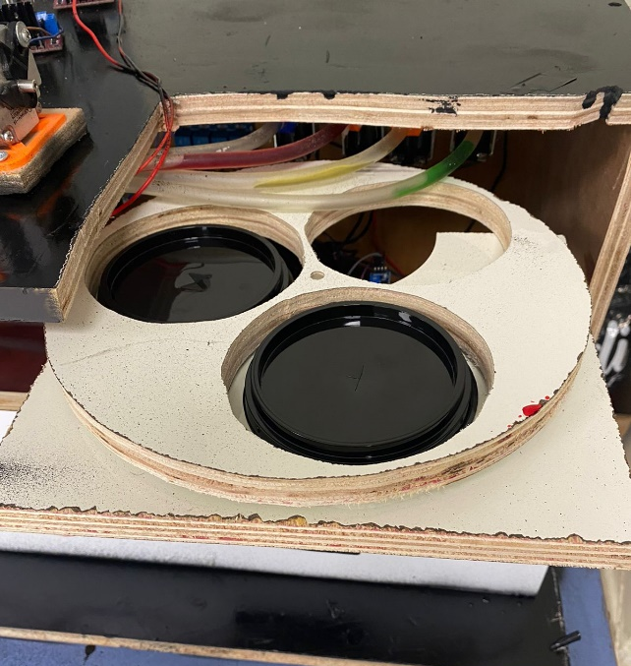
Features
Stage 7 :
Dropping cup's cover.

Slide 11
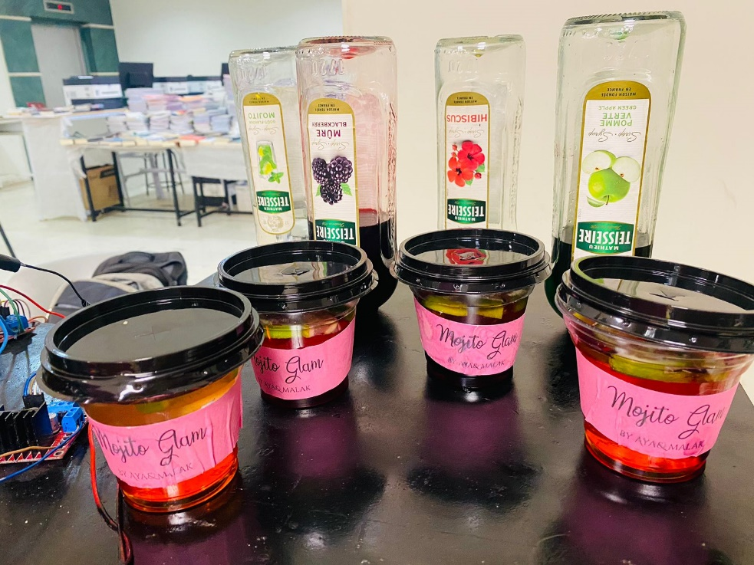
Features
Finally, Enjoy Your Mojito !

Slide 12





Motivations
Speed
cleanliness
Business
Freshness
Customization

Slide 13
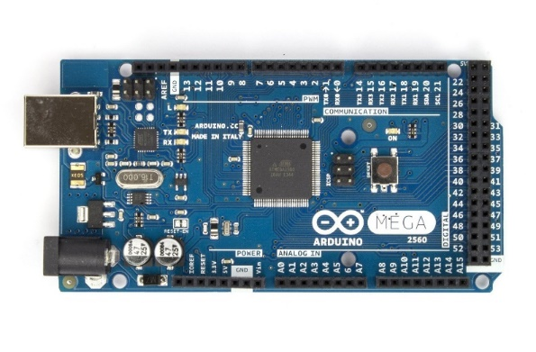
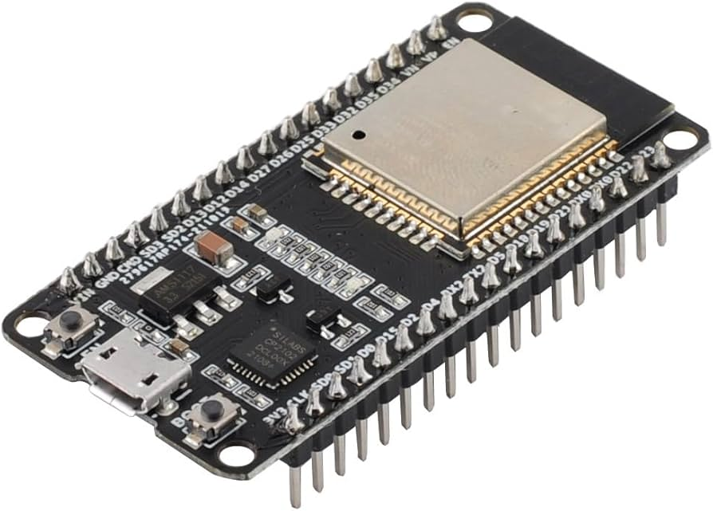
Hardware Module
Control Unit
Arduino Mega 2560
ESP32

Slide 14
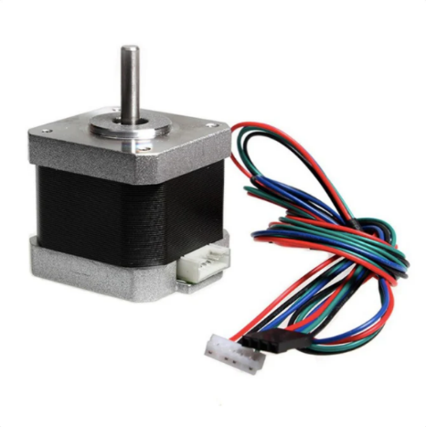
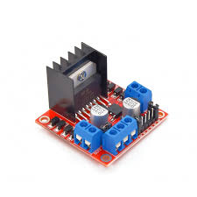
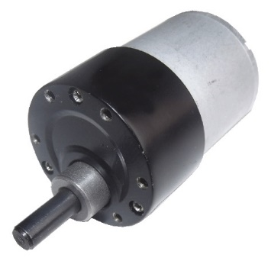
Input/Output Unit
DC gear motor
Stepper Motor
H Bridge driver

Slide 15
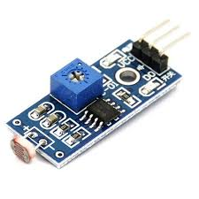
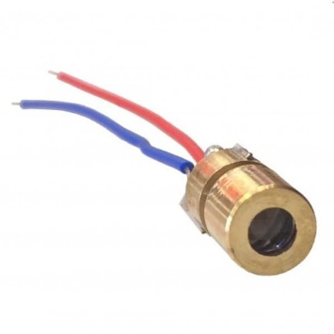
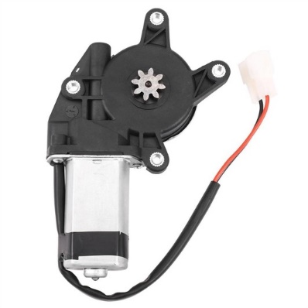
Input/Output Unit
Laser
DC Power Window Motor for Car
LDR sensor

Slide 16
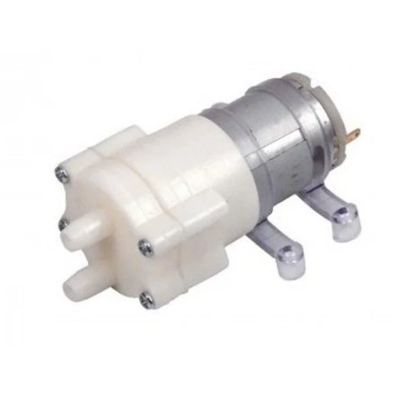
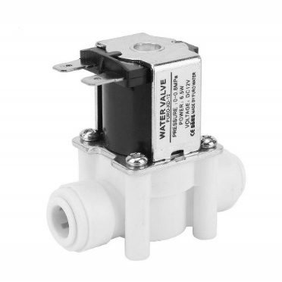
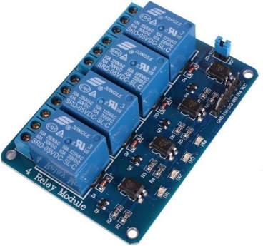
Input/Output Unit
Relay Module
12V pump Water
Solenoid Valves

Slide 17
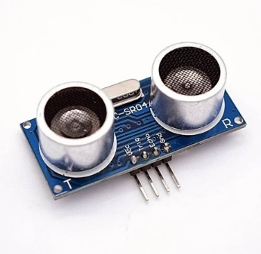
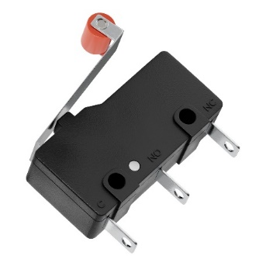
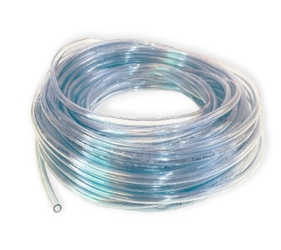
Input/Output Unit
Limit Switch
water pipe tube
ultrasonic sensor

Slide 18
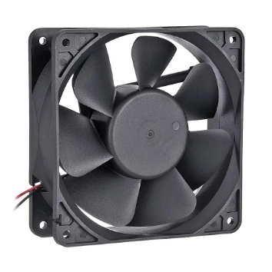
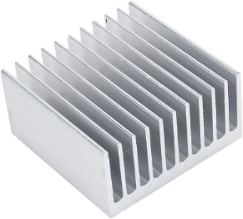
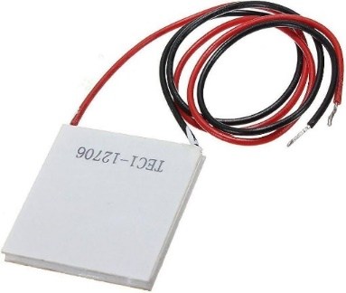
Input/Output Unit
Fan
Peltier cooler
heat sink

Slide 19
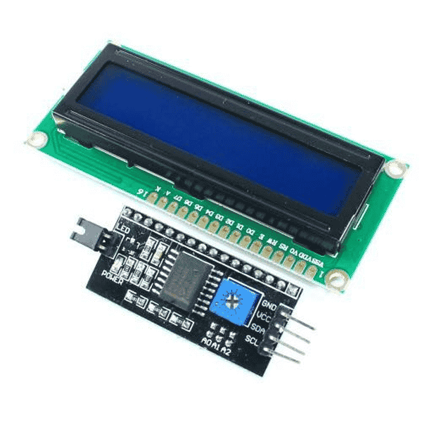
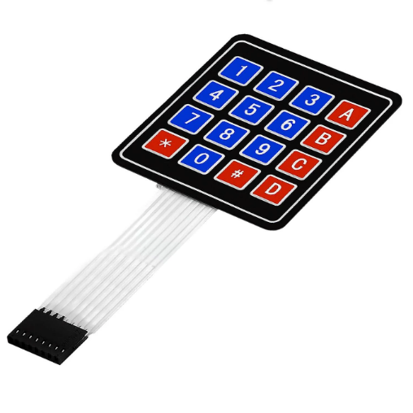
Input/Output Unit
Keypad
LCD 16x2 with I2c

Slide 20
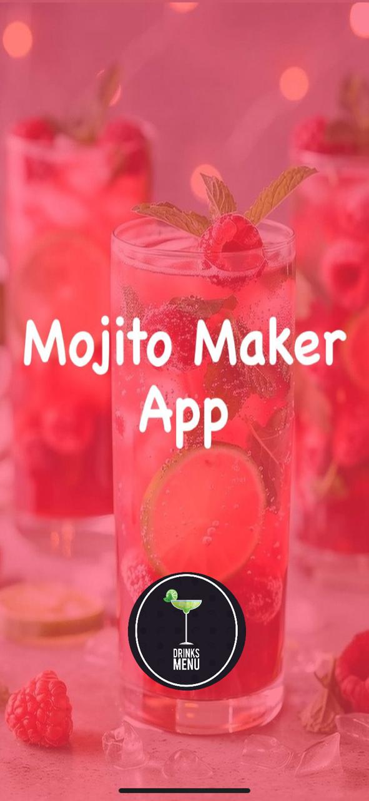
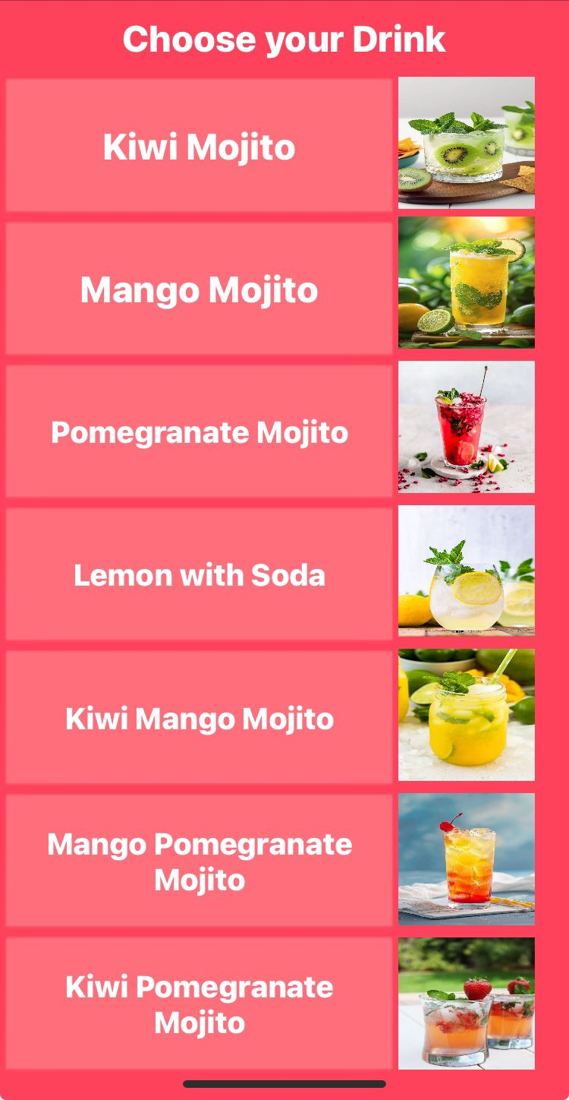
Mobile Application
Page 1
Page 2

Slide 21
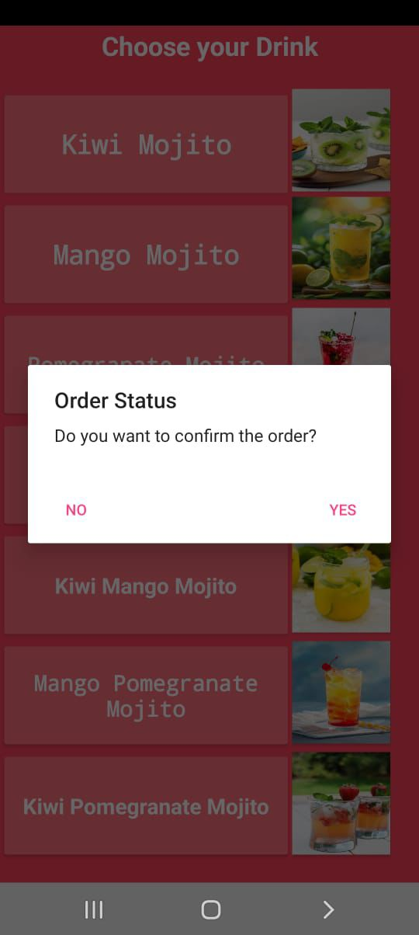

Mobile Application
Confirm order
Notifications

Slide 22
Constraints
Limited time available.
Difficulty in keeping ice cold.
Lack of experience with electronic parts.
High budget constraints.

Slide 23
Future Work
Offering cups in different sizes.
Adding various flavors and a selection of different fruits.
Enhancing the machine with a special mechanism for freshly cutting lemons.
Equipping the machine with efficient cooling coils to keep the ice preserved.

Slide 24
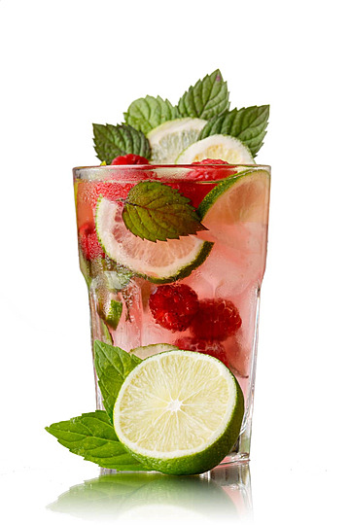
Q&A
Thanks for Listening.
Any Questions ?

