Slide 1
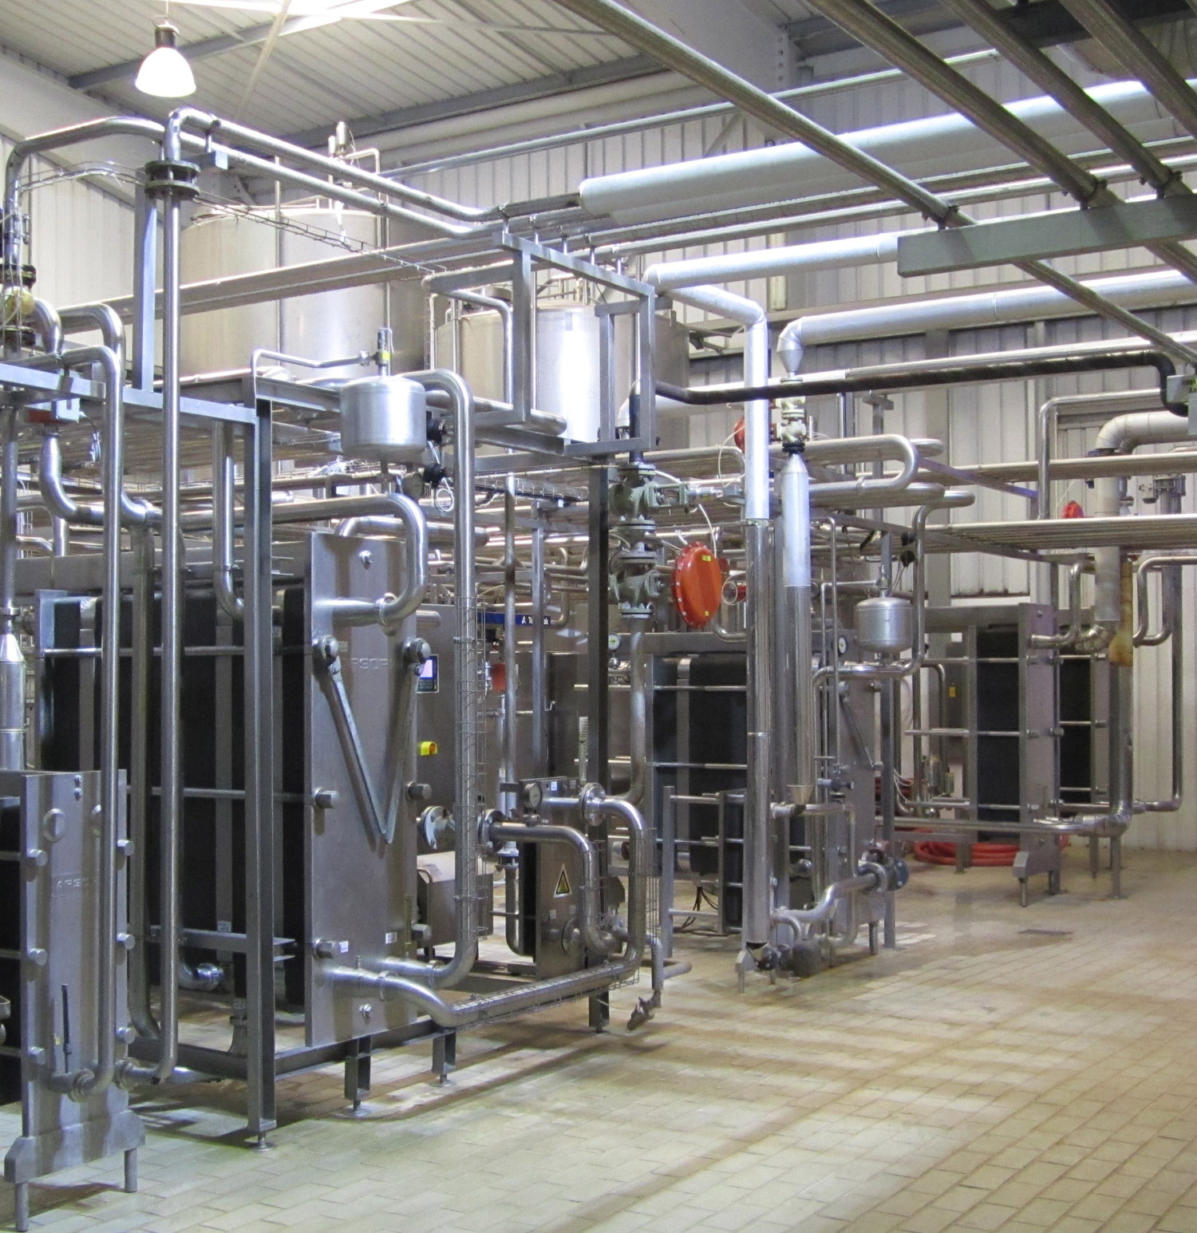
An-Najah National University
Faculty of Engineering & Information Technology
Industrial Engineering Department
Assessment of the Implementation of Lean Manufacturing Concepts in the Palestinian Dairy Industry
Supervisor: Dr. Ahmad Al- Ramahi

Slide 2
Our Team
Asem Judeh
Majd Tbaileh
Baraa Ali
Motaz Hindi

Slide 3
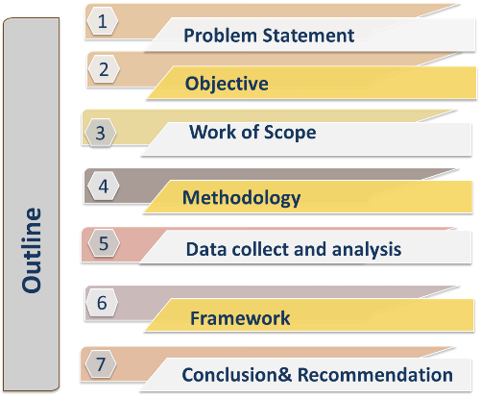

Slide 4
Problem Statement
Lack of a clear understanding of lean performance and its measurement .
Companies should understand the implementation of lean manufacturing concepts.
Assessment is essential to identify both the and progress of lean concepts with deficiencies in firms.

Slide 5
Objectives
This project is to assess level of implementation of lean manufacturing concepts in the Palestinian dairy industry, the project aims to satisfy the following two main:
Framework for enhancing implementation of lean concepts
Achieve clear gap analysis

Slide 6
Work of scope
1- Design assessment tool including measuring indicators fit dairy industry
3- Development of a framework to enhance the implementation of lean concepts in dairy industry
2- Assessment of Lean manufacturing practice in dairy industry

Slide 7
Lean definition and philosophy
Def: Provide clients and customers the products or services they want, at which time they wish, by using the most effective ways and fewer resources available.
Philosophy
There is waste in any production system.
Lean manufacturing is a dynamic and continuous improvement of the system of production process.
Training and education for all employees on the concept of lean manufacturing.

Slide 8
Lean manufacturing tools
Lean Tools
TPM
JIT
5S
V.S.M
Poka Yoke
Jidoka
K.P.I
SMED
Kaizen
Heijunka

Slide 9
Methodology
Reviewing lean concept
Understand lean industry
Primary field visit
Selection of lean tools that fit local diary industry
Design the assessment tools (Questionnaire)
Data collect and analysis
Finalize a framework to enhance the implementation of lean concepts

Slide 10
Results & Analysis

Slide 11
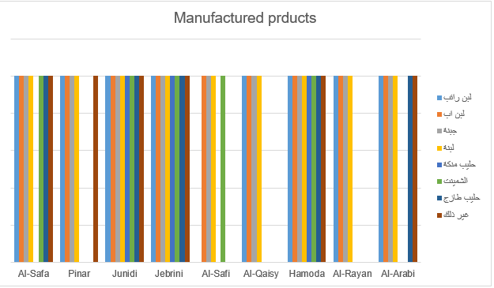
Analysis product Variety

Slide 12
Preceding knowledge of the concept of lean manufacturing

Slide 13
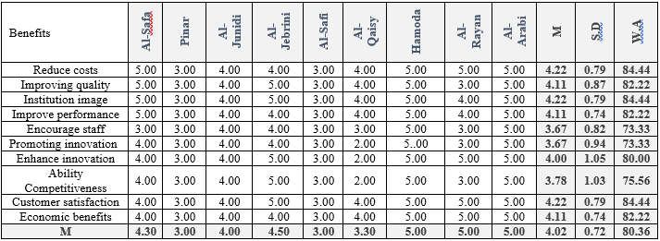
Perception about benefits of lean manufacturing

Slide 14
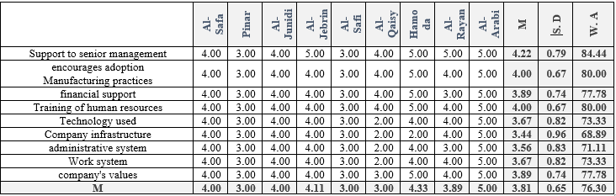
Perception of facilities about factors helping to implement concepts of lean manufacturing

Slide 15
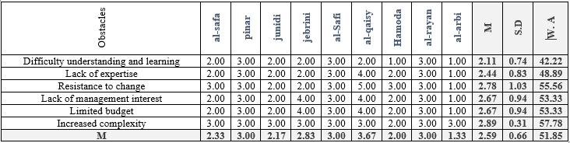
Perception about obstacles in implementing lean manufacturing

Slide 16
The structure of the Roadmap for manufacturing the assessment of level of implementation of lean in the dairy sector

Slide 17
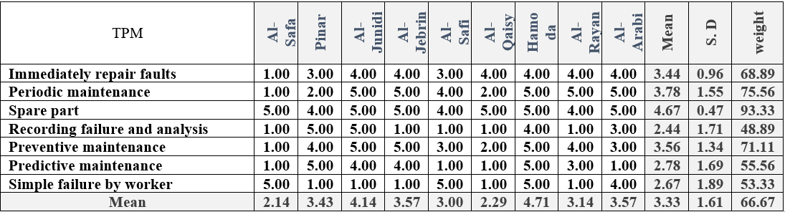
Total productive maintenance

Slide 18
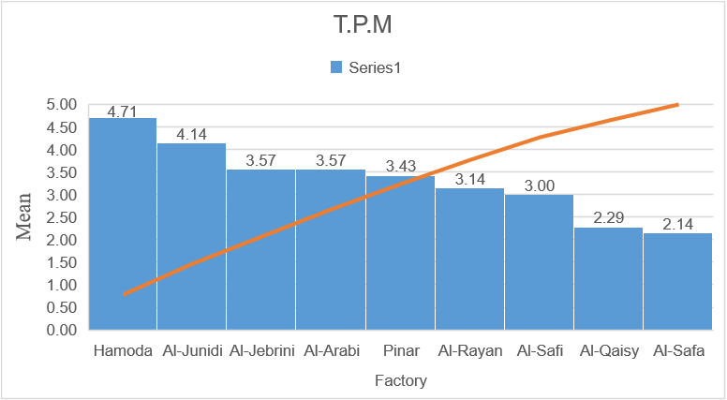
The level of facilities in term of implementing Total Productive Maintenance

Slide 19
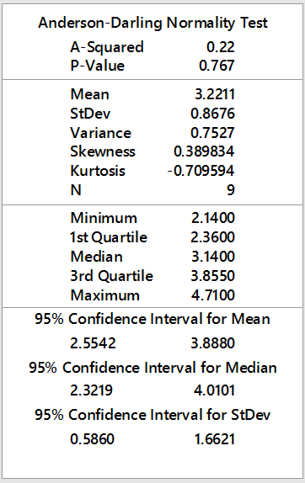
Normal distribution test for T.P.M
1- level 1(low level) <μ-σ
level 1 <2.35
2- μ-σ≤level 2 (mid level)≤ μ+σ
2.35≤level 2≤4.087
3- level 3 (high level) ≥μ+σ
level 3 >4.087

Slide 20
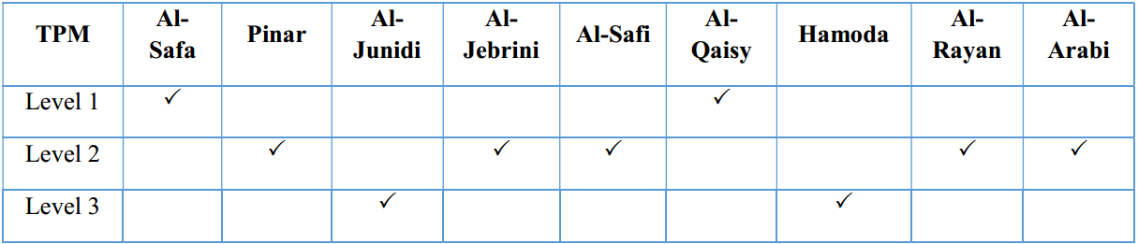
The level of each plant in implement TPM

Slide 21
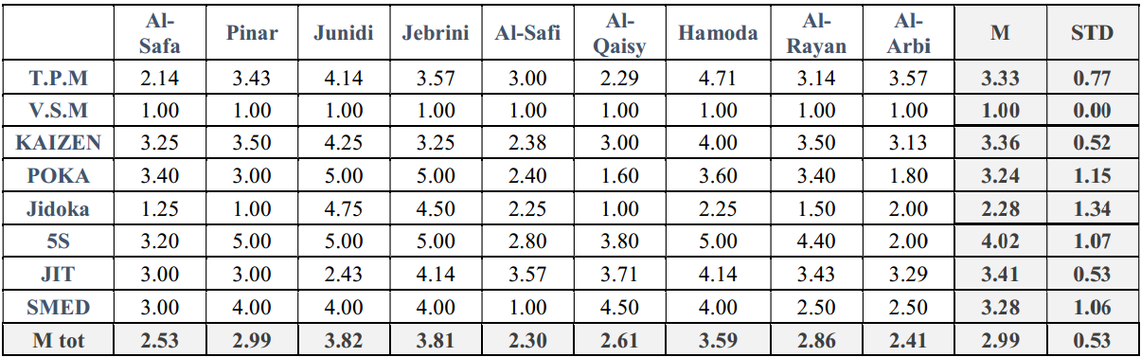
Analysis of implementing lean manufacturing practices

Slide 22
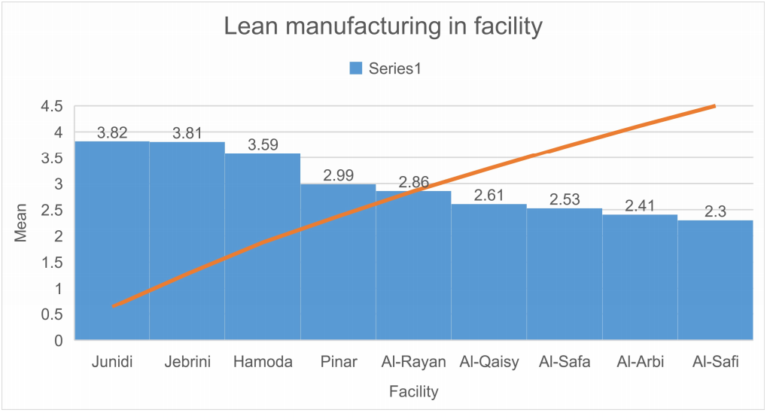
The level of facilities in term of implementing lean manufacturing tools

Slide 23
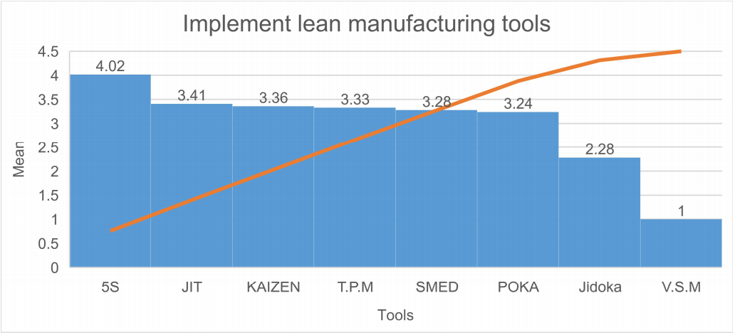
The level of lean manufacturing tools

Slide 24
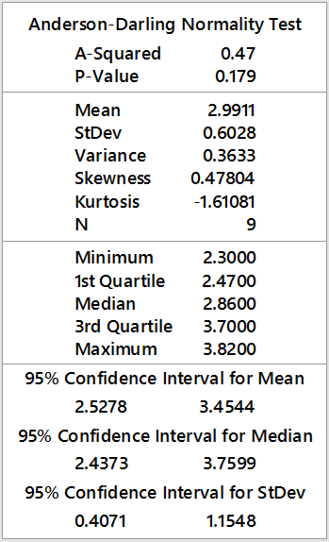
Normal distribution test for Lean manufacturing tools
1- level 1(high level) <μ-σ
level 1 <2.39
2- μ-σ≤level 2(mid level)≤ μ+σ
2.39≤level 2≤3.59
3- level 3 (low level) ≥ μ+σ
level 3 >3.59

Slide 25
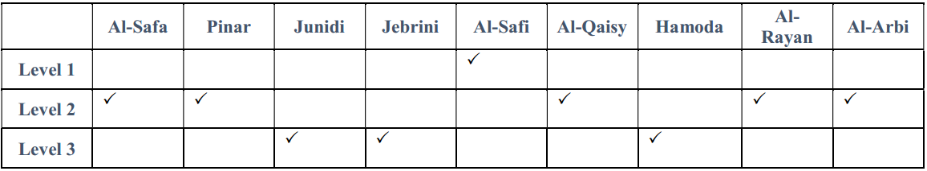
The level of each plant implementing Lean Manufacturing tools

Slide 26
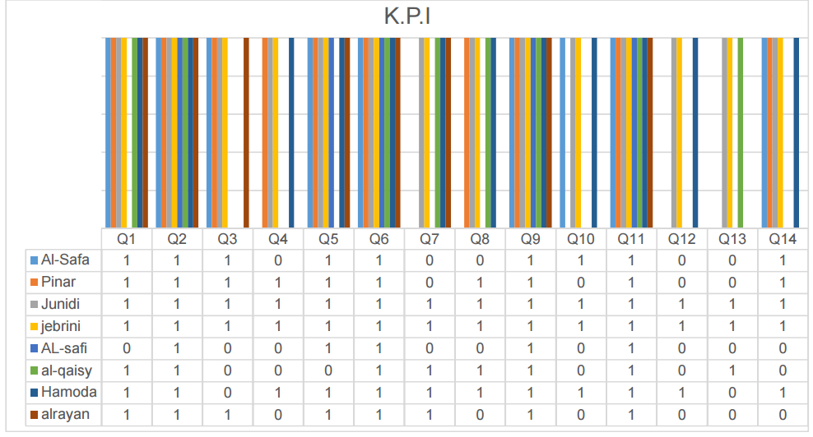
Key performance indicator

Slide 27
Framework to implement lean manufacturing tools
Identifying vulnerable indicators in each tool.
Improve vulnerable indicators in each tool.
Sustain improvement to maintain each tool at the highest possible level.

Slide 28
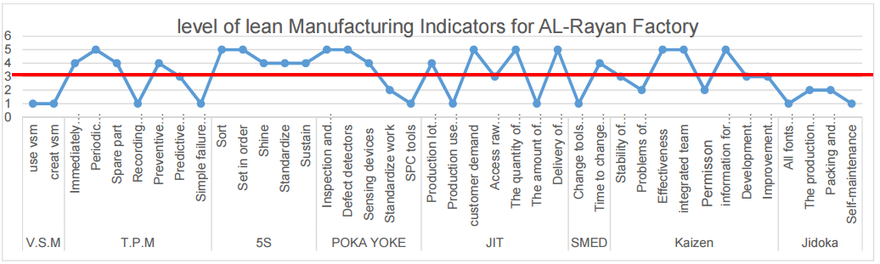
Lean manufacturing indicators for AL-Rayan Factory

Slide 29
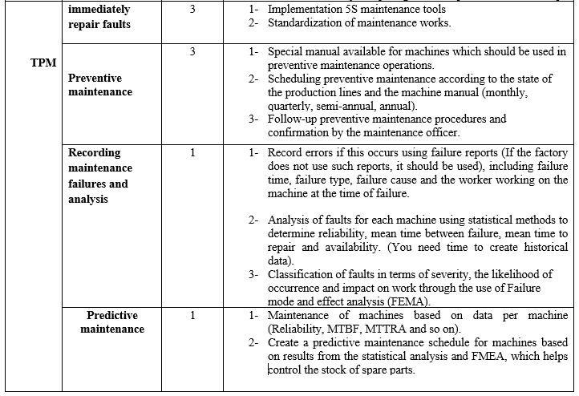
Improving vulnerable indicators in each tool

Slide 30
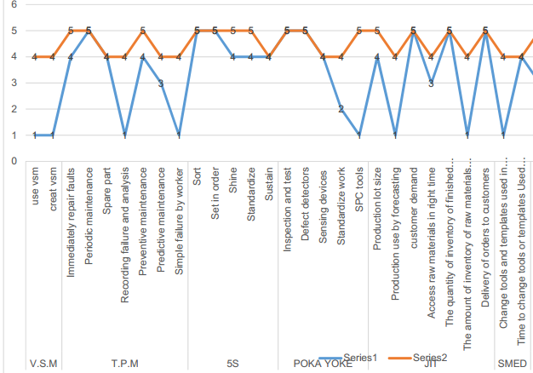
Sustainability to maintain each tool at the highest level

Slide 31
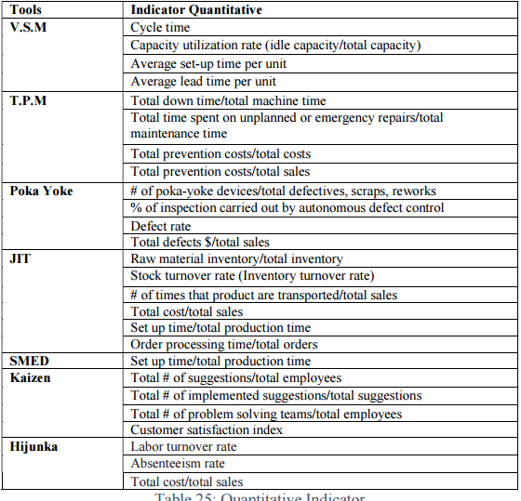
Quantitative indicators

Slide 32
Conclusion
Develop a questionnaire for the assessment of the level of implementation of lean manufacturing concept.
55% of the facilities have prior knowledge about lean manufacturing,
66% has a positive perception about the benefits .
66% confident that they have factors help in implementing lean.
11% don't have serious obstacles that prevents the implementation.

Slide 33
Continue
For the level of implementing lean manufacturing practices (tools), we conclude the following
Approximately 44% of the studied sample have a weakness in implementing TPM
100% of the studied sample have a weakness in implementing VSM
55 % of the studied sample have a weakness in implementing Kaizen.
33 % of the studied sample have a weakness in implementing 5S
44 % of the studied sample have a weakness in implementing Poka-Yoke
44 % of the studied sample have a weakness in implementing JIT
44 % of the studied sample have a weakness in implementing SMED.
77 % of the studied sample have a weakness in implementing JIDOKA.
66 % of the studied sample have a weakness in implementing Hijunka.

Slide 34
Continue
There is a weakness in implementing “VSM”, and strong implementation of “5S” tool in the local dairy sector.
Framework was introduced:
(1) Assessment of level of implementation.
(2) Improve level of implementation of vulnerable tools.
(3) Sustain improvements.

Slide 35
Recommendation
1- It is recommended that the Palestine federation of industries should conduct awareness campaign about the concepts of lean manufacturing and its importance to the local industries in general and dairy industries in particular.
2- Dairy industries are recommended to train their staff on how to implement the different lean manufacturing tools in their factories.
3- Dairy industries are recommended to appoint industrial engineers to help in transferring the knowledge and practices of lean manufacturing local dairy sector.
4- Dairy industries are recommended to be more open in providing real data needed for quantitative analysis; this is really necessary for the step of sustaining development in the facility.
5- As future work. it is recommended to improve the check list (questionnaire) and make it relay more on quantitative indicators in addition to qualitative indicators.

Slide 36


