Slide 1
بسم الله الرحمن الرحيم
(وقل ربي زدني علما)

Slide 2

An Najah National University
Faculty of Engineering
Civil Engineering Department
Design and rehabilitation of storm water network in Qalqilia city
Submitted to Dr. Hafiz Shaheen
Prepared by :
Belal Al sous
Jber Maialeh
Tariq Shreem
Yousef Sarsour

Slide 3
Outline:
Introduction.
Damages occurs by flood.
Study area.
Objectives .
Methodology .
Data collected .
Design.
Results.
Comparison.
Discussion.
Conclusion.
Recommendations.

Slide 4
Introduction
Qalqilia suffering from many problems in draining system, these problems as a result of:
Insufficient in the existing draining system.
Some areas do not have draining system.
Israelian separation wall.
Clogging Calvert in the wall quickly, due to the accumulation of waste.

Slide 5
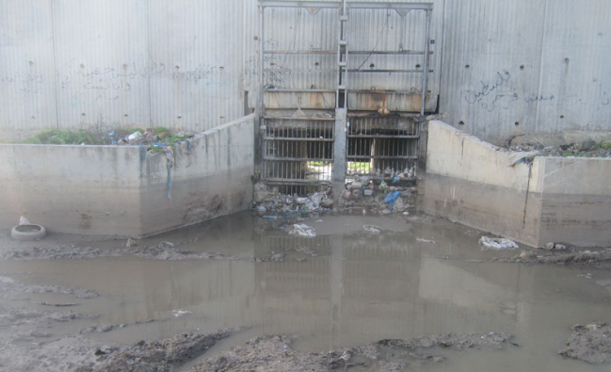

Slide 6
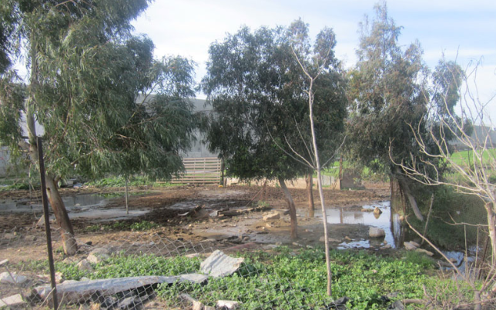
Damages occurs by flood
1- Agriculture damages.

Slide 7
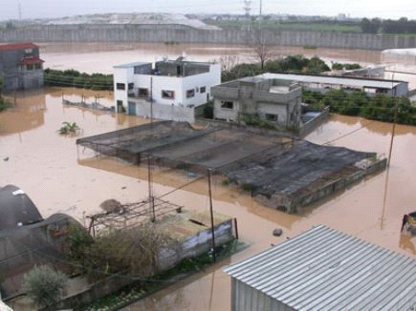
2- Damage in residential building

Slide 8
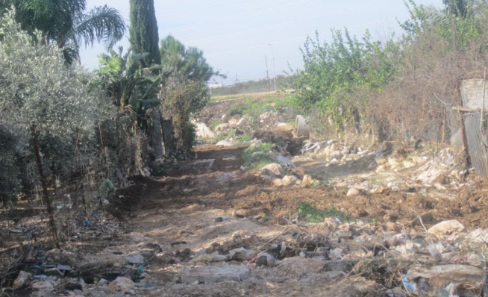
3- Broken down the streets

Slide 9
Study area
Our project serve four blocks:
Al Wady block.
Western area.
Al Nuqar block.
Al Khala block.

Slide 10
Objectives
Our project aims to reduce floods as possible as we can by:
Design storm water network for Western area and Al Khala.
Rehabilitation of existing storm water network for Al Wady and Al Nuqar blocks.
Try to solve problems related to separation wall.

Slide 11
Methodology
Site investigation and collect data
Draw catchment areas
And path flows
Data needed
For storm
cad
Draw lay out
Check
results
design

Slide 12
Data collected
Master plane report contain:
Contour map shows buildings, streets and elevation.
Information about existing network.
Percent of land covers.
IDF Curves.
Rainfall information's.

Slide 13
Design
Design criteria:
Using Manning equation to find size of pipe.
Assume steady state condition.
Clogging factor 30%.
Returned period = 20 years.
Concrete pipes with diameters more than 10 in.
Using FAA to find time of concentration.
Using runoff coefficient between (0.4-0.7).
Partially fall (75%).

Slide 14
Design Constraints
Cover between (1 – 4m)
Velocity between (0.6 – 3m/s)
Slope (1-12%)
Length of conduits 400 ft for 8in, 10in, 12in and 600 ft for more than 15in.

Slide 15
Programs Used
Civil 3D used to draw catchments area and path flow.
Storm CAD: this program produced by Bentley company, it used Manning equation to determine size of conduits.

Slide 16
Design Steps
Draw layout.
Identify conduits and catch basins.
Draw sub catchments area for each catch basins.
Interring data needed.
Run the models.
Check results.

Slide 17
Design
Rational Method
Q = CIA
Q : The peak runoff rate (m³/hr).
C : The runoff coefficient (dimensionless).
I : The average rainfall intensity ( mm/hr).
A : The size of the drainage area (hectares).

Slide 18
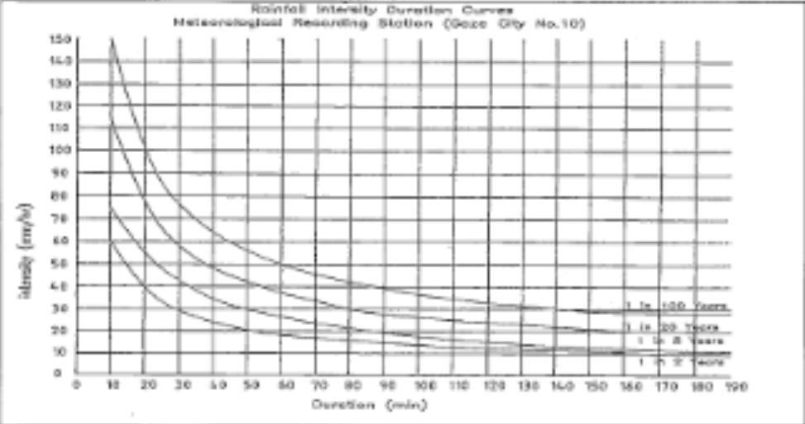
Data Needed for Design
IDF curves

Slide 19
Runoff Coefficient(C)
Runoff coefficient | Surface Description
0.35 | Mixed Residential ( all type buildings)
0.30 | Average Villas
0.70 | Economic Residential / Commercial
0.60 | Residential Communities
0.65 | Modern Residential/ Mixed
0.20 | Sport and Green areas/ Irrigation areas
0.90 | Roads and Parking

Slide 20
Percent of Land Cover
% of land covers | Surface Description
25 | Mixed Residential ( all type buildings)
10 | Average Villas
20 | Economic Residential / Commercial
10 | Residential Communities
10 | Modern Residential/ Mixed
5 | Sport and Green areas/ Irrigation areas
20 | Roads and Parking

Slide 21
Returned Period
Based on analysis of rainfall data 20 years was chosen .

Slide 22

Time of concentration
Time of concentration calculated automatically by storm CAD depend on C coefficient, slope and longest path flow
FAA (Federal Aviation Administration) used to estimate Tc.
Tc=

Slide 23
Results

Slide 24
We get the result of the four blocks ( Al-Nqare, Al- Khaleh, Al-Wade and west area blocks) from the storm Cad program. The result of each block include number of catch basin and manhole, length and size of conducts, minimum and maximum velocity, and minimum and maximum cover for each block and we summarized the result in the following tables.

Slide 25
Result of Al-Nqare block
Number of Manhole | 9
Number of catch basins | 25
Conduit length (m) | 3230
Maximum velocity (m/s) | 6.61
Minimum velocity (m/s) | 2.2
Maximum cover (m) | 3.98
Minimum cover (m) | 1

Slide 26
Result of Al- Khaleh block
Number of Manhole | 7
Number of catch basins | 25
Conduit length (m) | 3070
Maximum velocity (m/s) | 6.74
Minimum velocity (m/s) | 1.11
Maximum cover (m) | 6.80
Minimum cover (m) | 1.00

Slide 27
Result of Al-Wade block
Number of Manhole | 13
Number of catch basins | 25
Conduit length (m) | 3190
Maximum velocity (m/s) | 6.14
Minimum velocity (m/s) | 1.81
Maximum cover (m) | 6.14
Minimum cover (m) | 0.50

Slide 28
Result of West area block
Number of Manhole | 6
Number of catch basins | 24
Conduit length (m) | 3070
Maximum velocity (m/s) | 5.94
Minimum velocity (m/s) | 1.53
Maximum cover (m) | 5.02
Minimum cover (m) | 1.00

Slide 29
Total Result of Excavation
Block name | Volume of excavation ( m³ )
Al-Nqare | 10956
Al-Khaleh | 11327
Al-Wade | 8852
West area | 7876
Total excavation | 39011

Slide 30
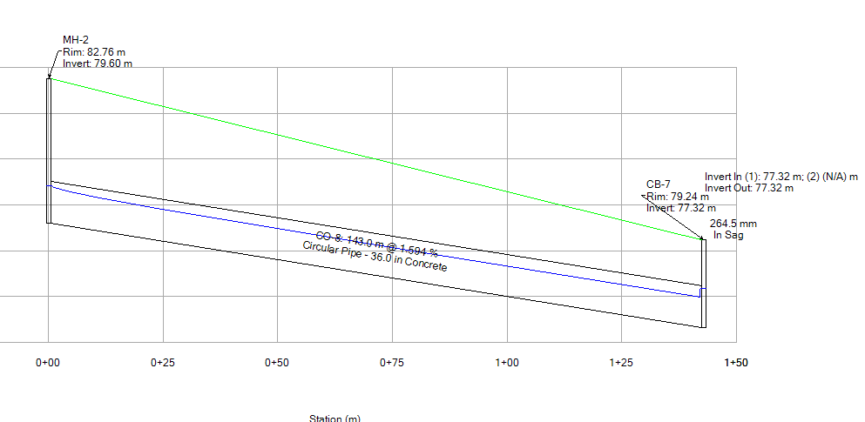
Profile

Slide 31
Comparison between the existing network and our design

Slide 32
Pipes diameters in Al-Nuqar and Al-Wade
Old
mm | 150 | 200 | 250 | 500 | 700 | 1000
Al-Nuqar | 110 | 150 | 120 | 1762 | 0 | 0
Al-Wadi | 113 | 18 | 4 | 2279 | 40 | 0
Designed
mm | 150 | 200 | 250 | 500 | 700 | 1000
Al-Nuqar | 0 | 0 | 190 | 110 | 430 | 750
Al-Wadi | 0 | 0 | 0 | 670 | 170 | 250

Slide 33
Discussion and Conclusion
1- We try to minimize the cover depth by reducing the minimum velocity for the network to be less than 1.2 m/s but the cover depth still high so that we have a cover depth of 6.4m in some conduit as a maximum cover depth in the network and we can’t avoid this situation, because the slope in the most area are high.

Slide 34
2- In some conduits the velocity is more than constrains, that because we design the network to be in the road and this road have many intercepted and tern in the direction at short distance . Therefore, we need to put catch basin or manhole on this intersection and that make the distance between catch basins or manholes are very small, but the change in the elevation is high.

Slide 35
3- The IDF curves for Qalqilia are not available; therefore the IDF curves from two other Palestinian cities are used to estimate the IDF curve for Qalqilia, so we use the IDF curves for Nablus and Gaza.
4- We design the conduit to have a partly flow
with 75% of the full flow.
5- We used clogging factor in catch basins equal to 30% to consider the efficacy.

Slide 36
Recommendations
1- Design new system and rehabilitation of existing storm water system.
2- Maintenance and cleaning of channels and outlet before and during winter seasons.
3- Increase the number of culvert in separation wall and clean it.

Slide 37
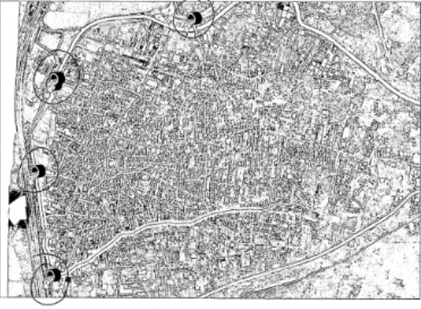

Slide 38
4- Concrete pipes used because its available in large dimension in markets.
5- Consider the main constraint of design in storm water system (velocity, cover and slope).

Slide 39
Thank You

