Slide 1

An-Najah National University
Faculty of Engineering
Conveyor-Dryer Handling Machine
Prepared by :
Saad Sami Halaweh
Omar Husni Odeh
Omar Taher Tuffaha
Yahya Hisham Abu-Bieh
Supervised by:
Dr. Osayd Abdel Fattah

Slide 2
Outline:
What is it all about ?
Conveyor design
Frame Design
Bolts Design
Welding Design
Torque Calculations
Bearing Design and Selection
Motor Selection
Sprockets Design and Selection
Chain Selection
Drying System Design
dryer cover
Heat exchanger
Fan Selection
Drying experiments

Slide 3
What is it all about ?
- Problem definition
- Why to use such a machine ?
- How does it contribute to the company ?

Slide 4
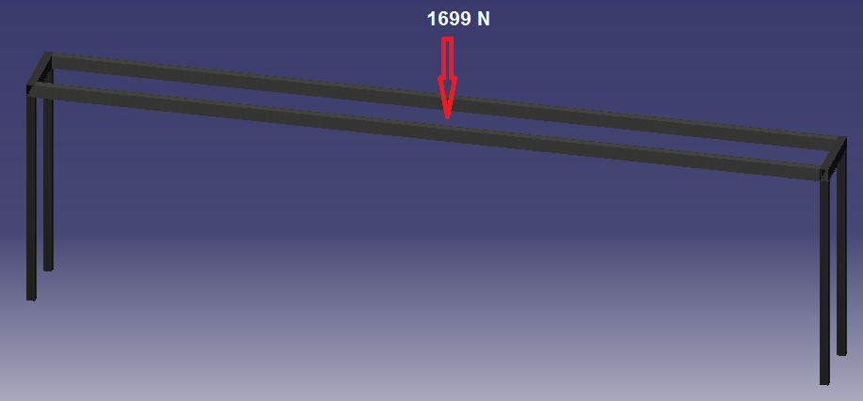
Conveyor design
1- Frame Design
for the leg we assumed b=h ,but in horizontal beams h=1.5*b and yield strength(Sy)=180Mpa,
Modules of Elasticity (E) =207Gpa
and the safety factor (n) is1.8

Slide 5
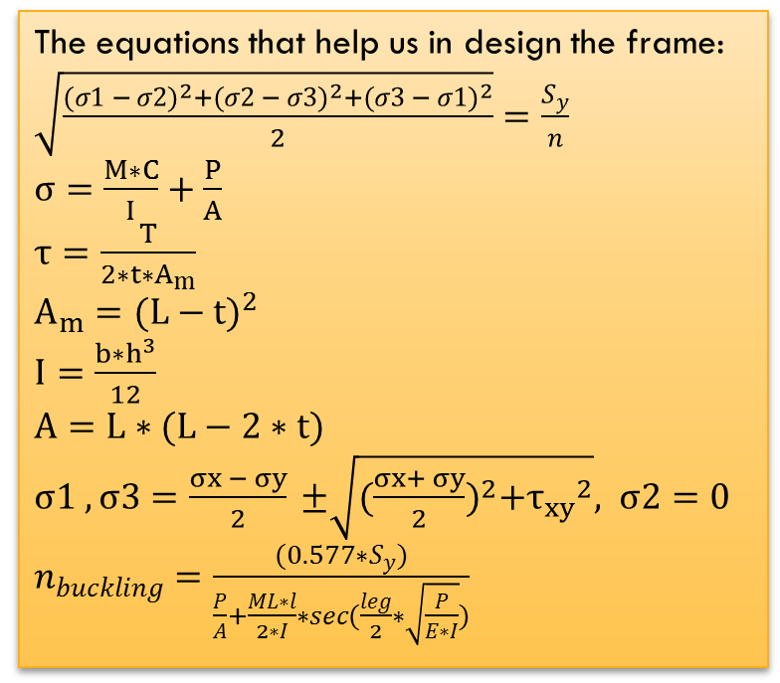
The equations that help us in design the frame:
$\sqrt{\frac{{(σ1 − σ2)}^{2}+{(σ2 − σ3)}^{2}+{(σ3 − σ1)}^{2}}{2}}=\frac{S_{y}}{n}$
$σ=\frac{M∗C}{I}+\frac{P}{A}$
$τ=\frac{T}{2∗t∗A_{m}}$
$A_{m}={(L−t)}^{2}$
$I=\frac{b∗h^{3}}{12}$
$A=L∗(L−2∗t)$
$σ1 , σ3=\frac{σx − σy}{2} ±\sqrt{{(\frac{σx+ σy}{2})}^{2}+{τ_{xy}}^{2}}, σ2=0$
$n_{buckling}=\frac{(0.577∗S_{y})}{\frac{P}{A}+\frac{ML∗l}{2∗I}∗sec(\frac{leg}{2}∗\sqrt{\frac{P}{E∗I}})}$
 | Mx (N.m) | My (N.m) | Mz (N.m) | T (N.m) | Length (mm) | assumption | Normal force(P)(N) | Shear force(v)(N)
Small beam | 148.5 | 0 | 0 | 1517.3 | 350 | h=1.5*b | 0 | 424.3
long beam | 0 | 0 | 1577.3 | 148.5 | 3570 | h=1.5*b | 0 | 424.3
Each leg | 148.5 | 0 | 1577.3 | 0 | 1000 | h=b | 424.3 | 0
summary for forces analysis

Slide 6
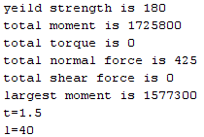
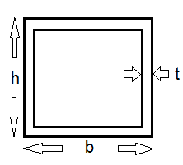
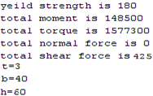
this results for identical four legs which L=b=h=40mm
Cross section
this results for identical four beams which b=40mm, h=60

Slide 7
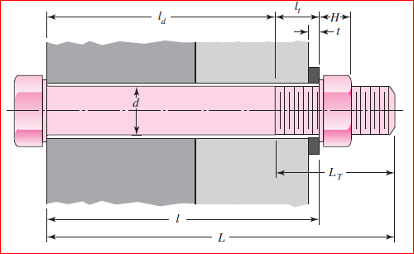





2- Bolts Design
Some eqn. may help us
K_{m} = E *d * A *exp(B*d/l)
F_{m} = (1-C)*F –F_{i}
K_{b} = $\frac{Ad∗At∗E}{Ad∗lt+At∗ld}$
Ϭ_{servise} = Ϭ_{i} + $\frac{C∗P}{At}$
N_{l} = $\frac{Sp∗At−Fi}{c∗F}$
Recommendations and needed
Carbon steel : E = 207 GPa
Grid length (ℓ) = 19 mm
L = 30 mm
L_{t} = 26 mm
L_{d} = L – L_{t} = 4 mm
L_{t} = l – l_{d} = 15 mm
F = 100 KN
F_{i} = 13.4 N
S_{p} = 830 MPa
A = 0.78715
B = 0.62873
N=1.5
N = sp/Ϭ
M 5 *0.8 class 9.8
C = $\frac{Kb}{Kb+Km}$
A_{t} = 14.2 mm²
Ϭ_{i} = $\frac{Fi}{At}$
F_{b} = F_{i} +CF

Slide 8
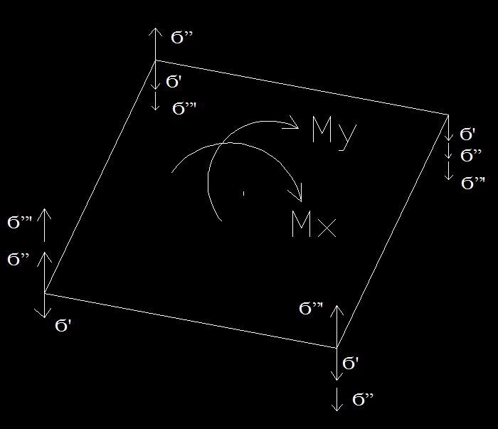

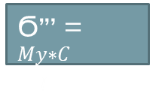

3- Welding Design
N=1.5
Sy=100Mpa
Ϭ” = $\frac{Mx∗C}{I}$
Ϭ”’ = $\frac{My∗C}{I}$
That gives us the area which equals
6.74*10⁻⁴ m²
And the inertia is
2.666*10⁻⁵ m³
So the thickness of weld is
6mm
Ϭ’ = $\frac{F}{A}$
Ϭ= Ϭ’ + Ϭ” + Ϭ”’
N=Sy/ Ϭ

Slide 9
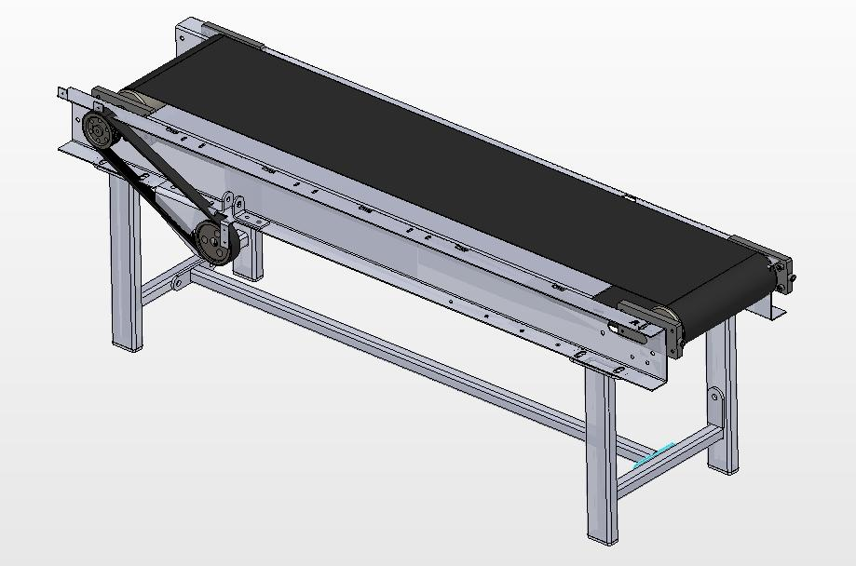
CAD Design

Slide 10
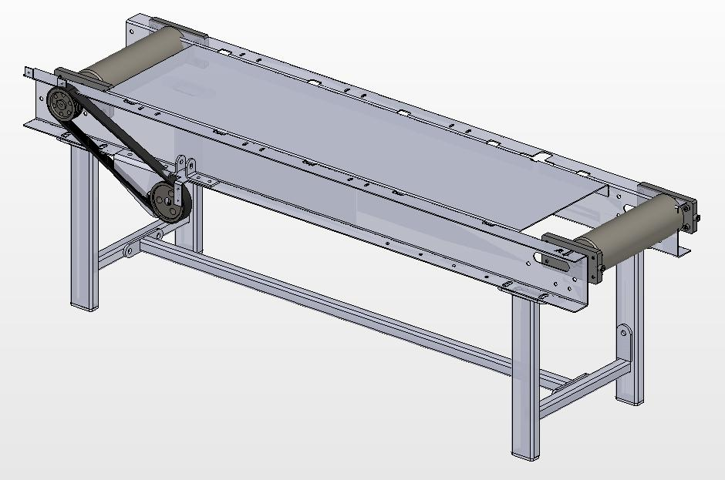

Slide 11
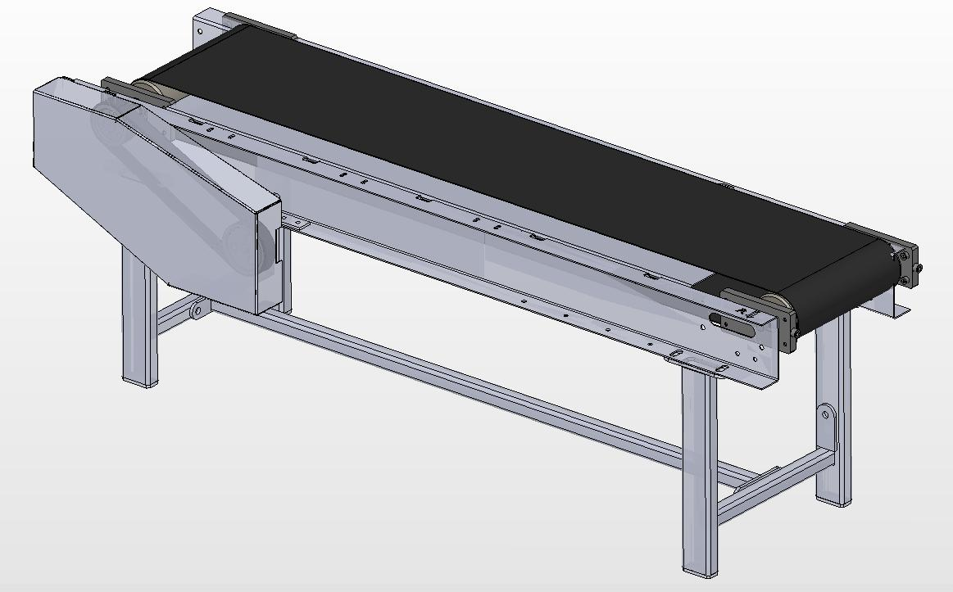

Slide 12
Actual Design

Slide 13
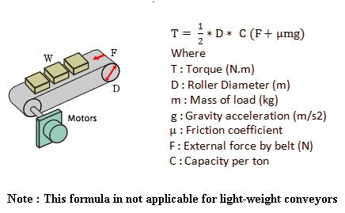
4- Torque Calculations
- This machine is considered as light-weight belt conveyor.
- One of the most common formulas to calculate the torque for
heavy-weight belt conveyors :
- Alternatively, the torque was
calculated By using the following
procedure :

Slide 14
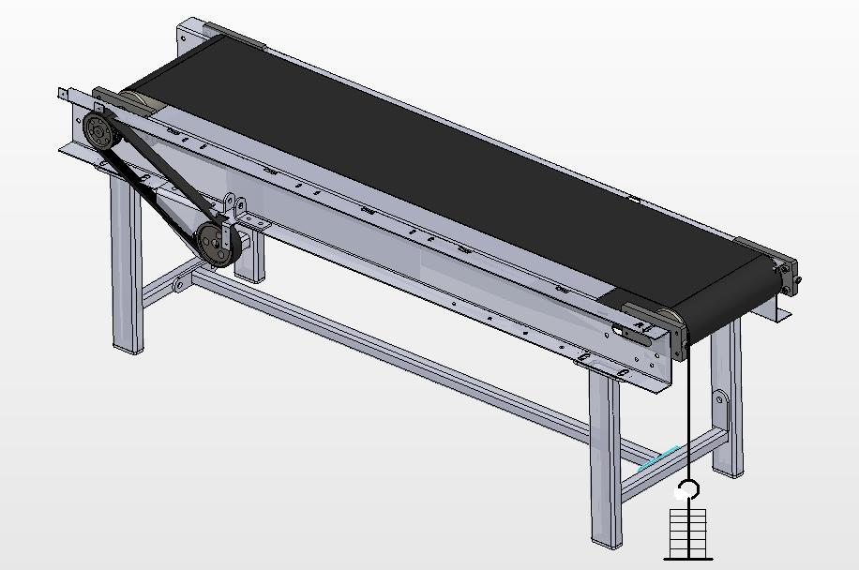
Experimental Procedure to calculate the torque

Slide 15
- It was found that the added mass required to drive the system equals 45 kg (441 N) – inserted to the pulley
which has a diameter of 12 cm.
- So the torque induced on the drive shaft is :
T = Force*distance = (P) (Pulley diameter / 2) = 441 * 0.06 =
26.46 N.m
- The force is moved to act on the sprocket which has a
diameter of 14 cm.
26.46 = T * 0.075
T = 353 N
Where T is the radial force on the drive sprocket – 14 cm in diameter.

Slide 16
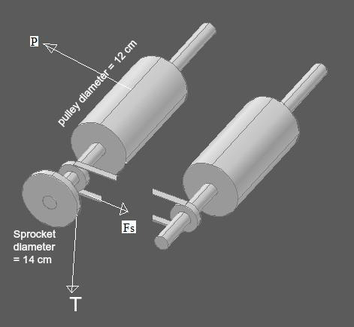

Slide 17
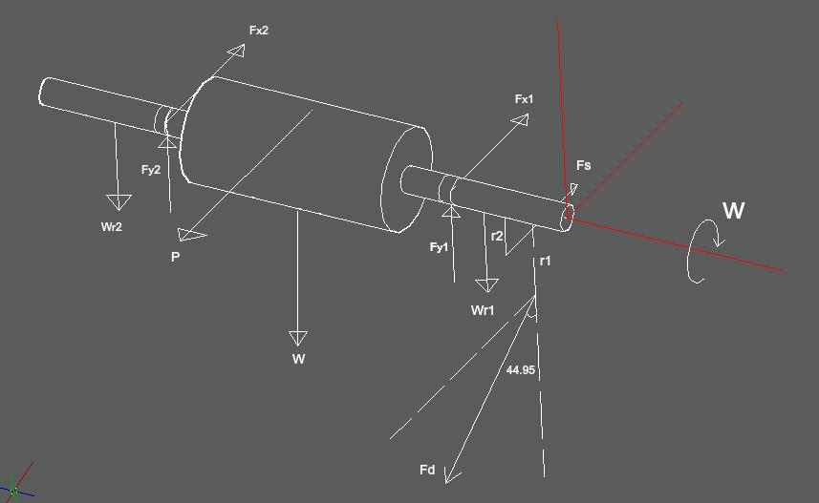
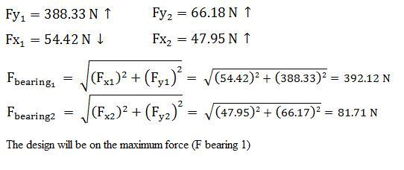


5- Bearing
Design and Selection
Xo = 0.02
($θ−x_{o}$) = 4.439
b = 1.483
$X_{D}= \frac{L_{D}n_{D}60}{L_{R}n_{R}60}$
$a_{f}$ = 1.3 (Machinery with light impact)
$$C_{10}=a_{f} Fr {\left[\frac{X_{D}}{x_{o}+\left(θ−x_{o}\right){\left(\ln{\frac{1}{R_{D}}}\right)}^{\frac{1}{b}}}\right]}^{\frac{1}{a}}$$

Slide 18
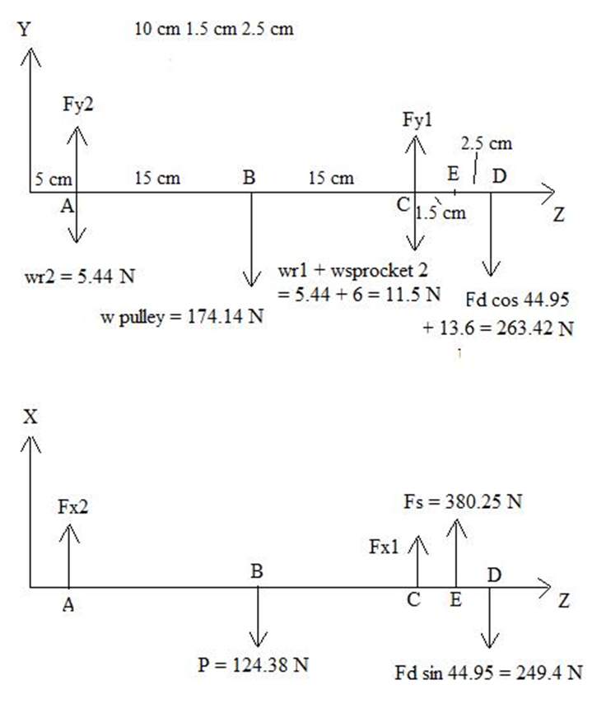
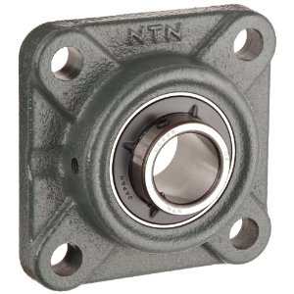
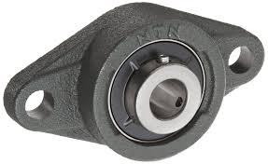
From angular contact select the bearing
which has the following dimensions:
- UCF201
- Bore = 10 mm
- Outer diameter (OD) = 30 mm
- Width (A1) = 11 mm.
- Fillet radius = 0.6 mm.
- Shoulder diameters
N = 11.5 mm, S = 11.5 mm
- C10 = 4.94 KN.
- Co = 2.12 KN.

Slide 19
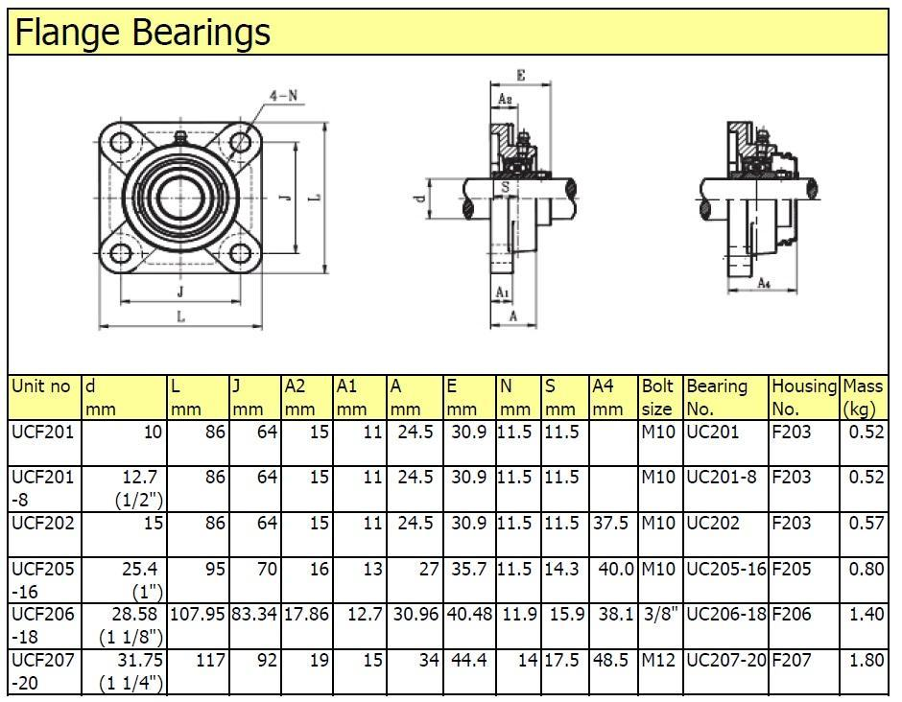

Slide 20
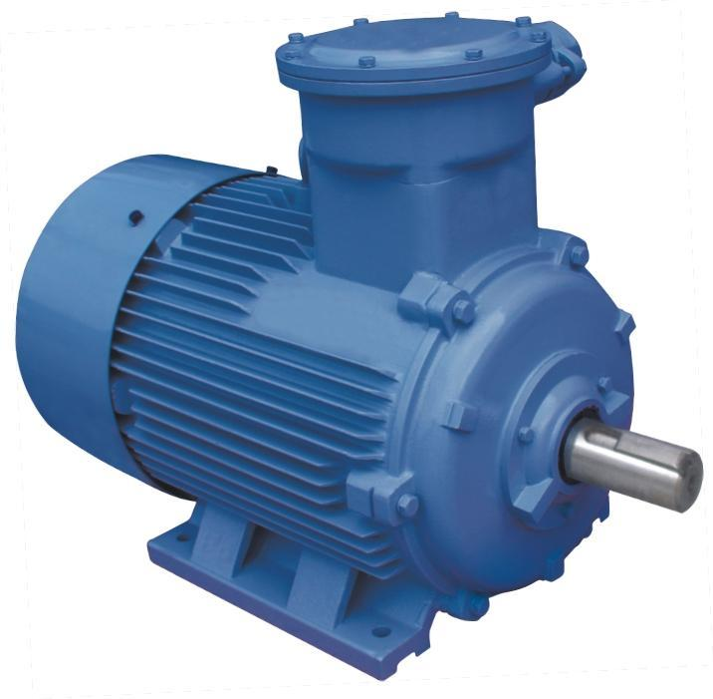
6- Motor Selection
Why not to use
3-phase synchronous motor ?
The required Power transmission by the motor equals 2 * 133 = 266 watt
(For two identical conveyors)
Three-phase Squirrel-cage Induction Motor
Rated torque = 0.5 N.m
Rated speed=1473 rpm
Rated power= 300 watt
= 0.40Hp
Efficiency = 0.8
Three-phase Squirrel-cage Induction Motor
torque = 102 N.m
speed=28 rpm
Rated power= 300 watt
= 0.40Hp
Efficiency = 0.8
Built-in
Speed reducer

Slide 21
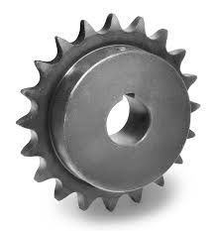
7- Sprockets Design and Selection
- Two Identical Belt Conveyors
- The torque required to drive the system
without “ belt slipping “ is : 26.5 N.m
- Motor Parameters :
Induced Torque = 102 N.m
Rated Speed = 28 rpm
- The motor - sprockets - chain system acts as a speed reducer.

Slide 22
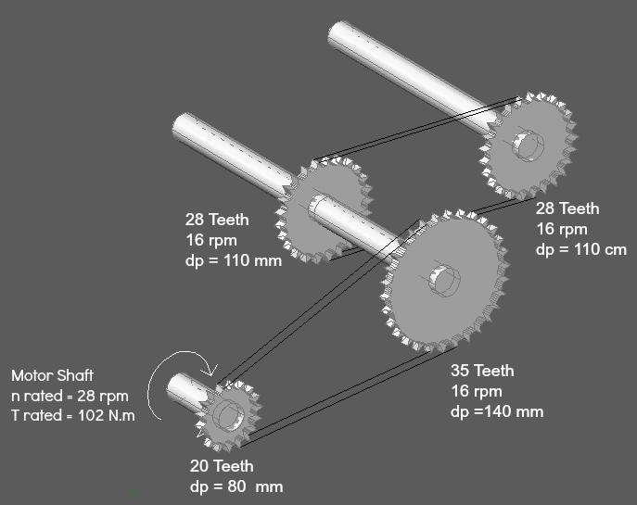

Slide 23



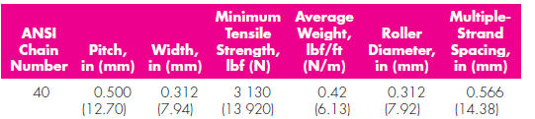
8- Chain Selection
The total horse power needed to drive the conveyor is
266 watt
We chose chain number 40
P=0.5 in
Max power can withstand is 0.37Hp=276 watt

Slide 24
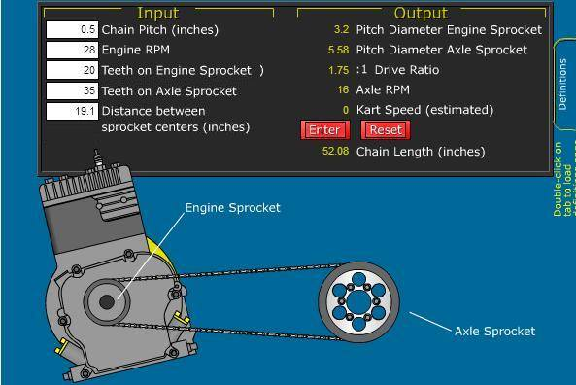

Slide 25
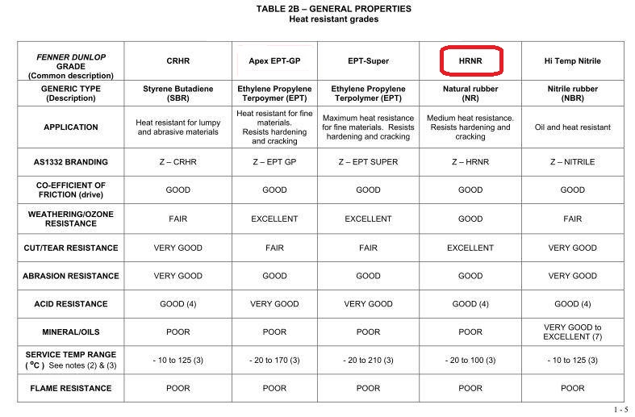
9- Belt Selection

Slide 26
Drying System:
10- Drying System Design
What is drying?
Drying means removal of relatively small amounts of solvent from solid materials.
What is our task?
Our task is to design a process to remove solvent from adhesive material taking into account the above constrains to minimize the time of drying as short as possible.

Slide 27
Drying time depends on
the temperature of drying air
air flow rate (amount of air)
drying surface area
Humidity of drying air (solvent content)

Slide 28
Investigations of drying rate parameters
Experimentally, It was found that the optimal parameters of drying rate after carrying out few experiments :
Air temperature is 70C
Drying air flow rate is 90-100 L/min
Amount of adhesive to dry : as the same used on tin plate in the factory (about 5g/tin)
The drying time of the adhesive sample (50-52s).

Slide 29
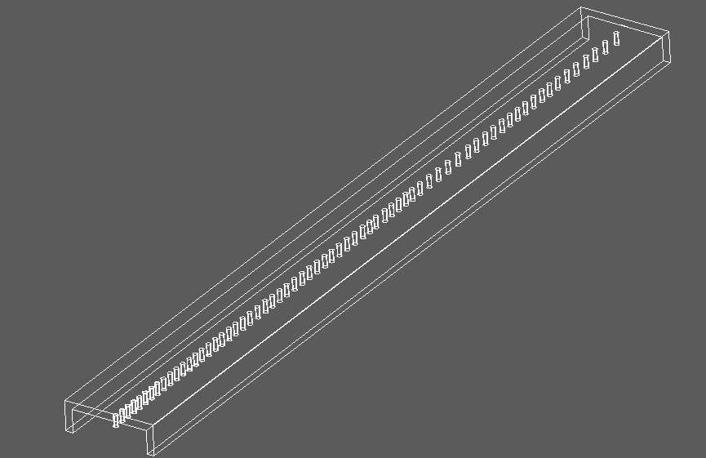
Dryer with pipe manifold air distribution :
Previously Heated air in heat exchanger is distributed ensuring enough drying capacity to solvent on adhesive material

Slide 30
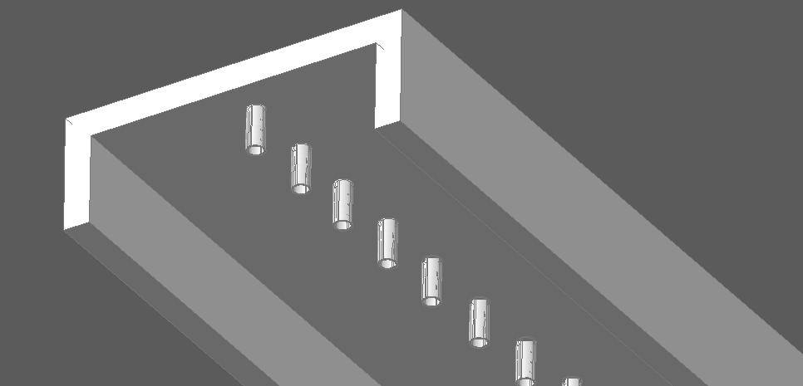
Cover of dryer parameters:
X=2.5mm k=54 for carbon steel
X=10mm k=0.045 for Rockwool
Q Losses)cover)= 318.18 W
Q Losses (conveyer) = 150 W
Q (overall)=468.18*3=1404 W Factor =3

Slide 31
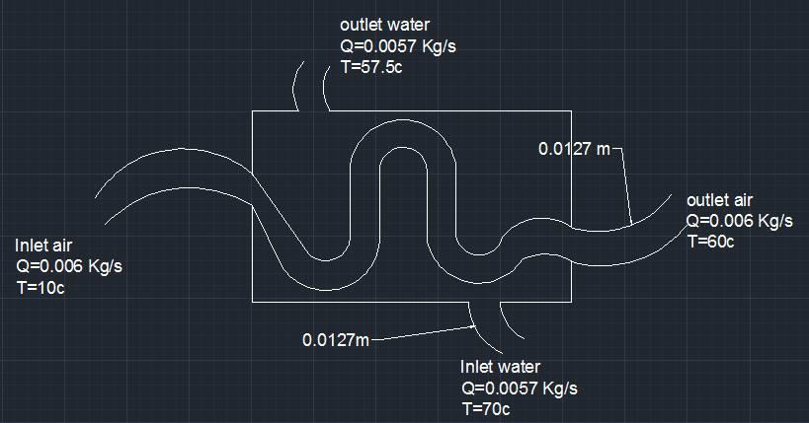

Heat exchanger :
Length of tube ($L$)=4.2 m
Q initial=4000 watt
Q for keeping the temperature constant =3000watt

Slide 32
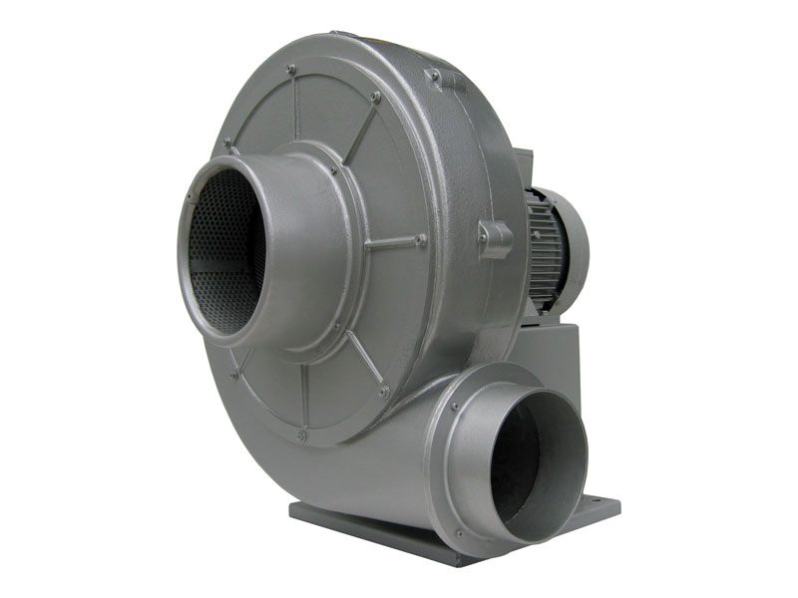
Ventilator (Fan Selection):
Type : Centrifugal Fan
Power Supply : Electric
Model NO. : DF Series
Power:0.5kw
Type of drive :AC single speed

Slide 33
experiments

Slide 34
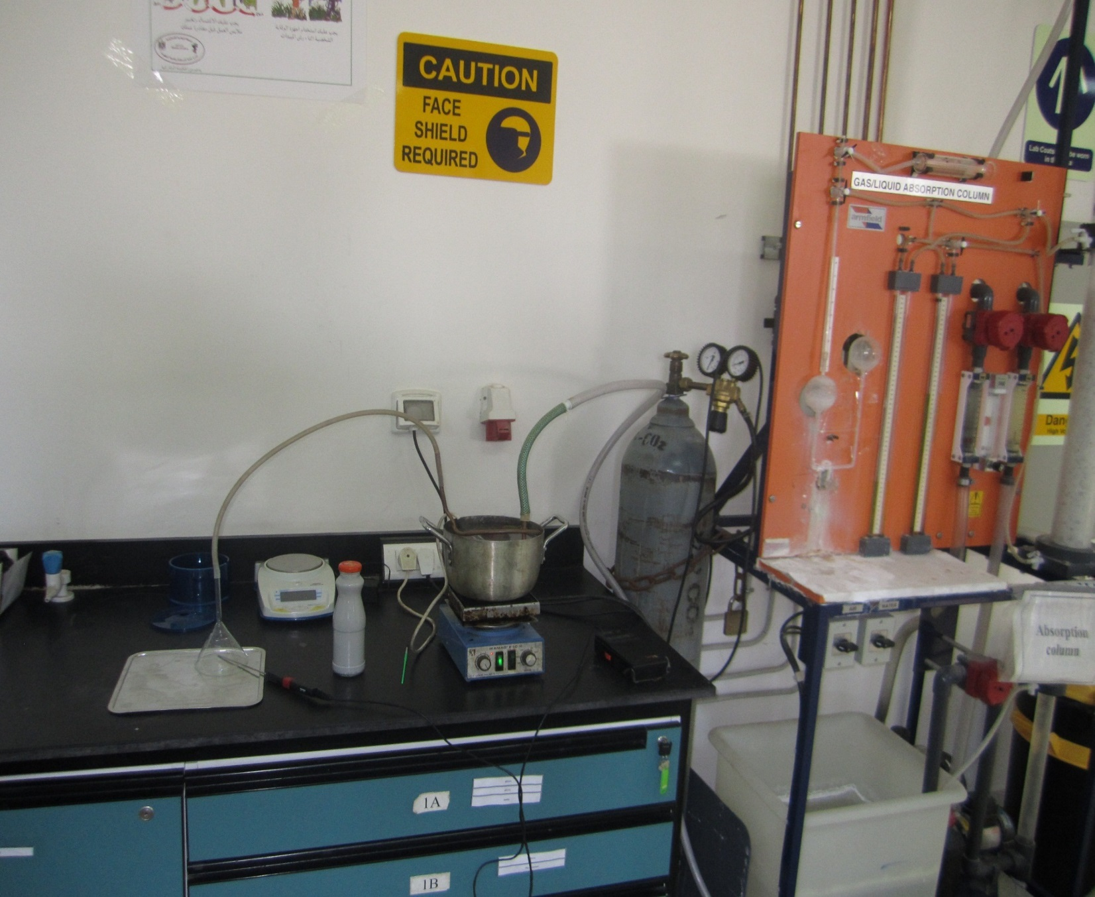
Drying experiments

Slide 35
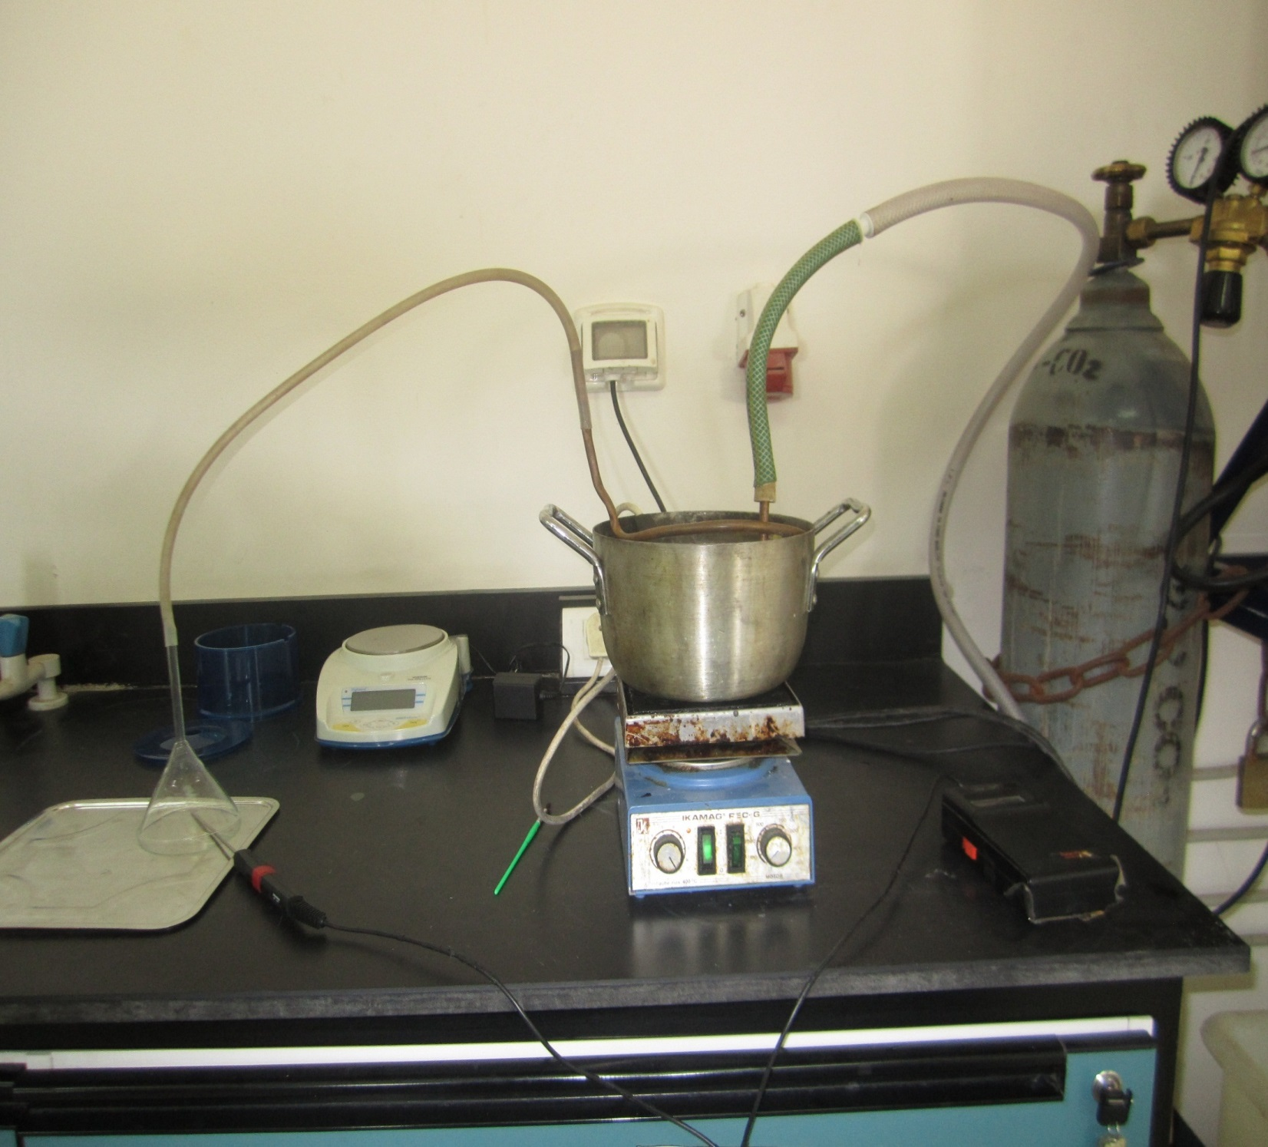

Slide 36
Its flow rate is determined by rotameter (20-180) l/min. The air is heated through copper coil fitted in hot water. The heating rate is controlled by controllable hot plate. The hot air temperature is measured by digital industrial thermometer (-199-+199) T = 50 c
The drying steps:
•Switch on the power of air compressor
•Heating the water bath that contain the copper coil and heating the air flow, see the
•Portioning the proper amount of adhesive on the bottom metal sheet
•Drying the adhesive by hot air measuring the time of drying and air temperature.
•Drying means that the adhesive material does not stick your finger if you touch it.
•The experiment is repeated many times fixing the drying temperature and changing the air flow rate. This results different drying times.

Slide 37
Experimental design :
we have conducted many experiments to obtain an equation relates air flow rate, temperature and time
110 | 100 | 90 | 80 | Air flow rate (l/min)
50 | 50 | 50 | 50 | Temperature ©
46 | 52 | 67 | 78 | Time (s)

Slide 38
- According to this equation, we have determined the fundamental specifications of the overall system such as the length and the width of the conveyor, heat exchanger design, the required speed to drive the conveyor .
relationship between air flow rate and time
Q =961.3*t ^{-0.568} Q: air flow rate t : time

Slide 39
Total cost
Motor
Q=266 watt
Cost per hour =0.7 NIS
Operating time=8 hr
Running Cost per day=0.266*8*0.7=1.5 NIS

Slide 40
Heat exchanger
Q Initial =4000 watt
Q for keep heat constant =3000 watt
Operating time=8 hr
Running Cost per day (initial)=4*0.7*1=2.8 NIS
Running Cost per day(keep heat constant )=3*0.7*8=16.8 NIS
Running Cost per day )Heat exchanger)=2.8+16.8=19.6 NIS

Slide 41
Ventilator
Q=0.5 Kw
Operating time=8 hr
Running Cost per day=8*0.5*0.7=2.8 NIS
Total cost=2.8+19.6+1.5=23.7 NIS

Slide 42
Conclusion
We can conclude :
1- Conveyor-Dryer handling machine contributes to the mitigating of the workforce and reducing the monthly costs.
2- No more time-consuming activities in the drying of the coated plates.
3- The efficiency of the tin production line is greatly increased.

Slide 43
Thank You
Any Question ?

